Slide 1
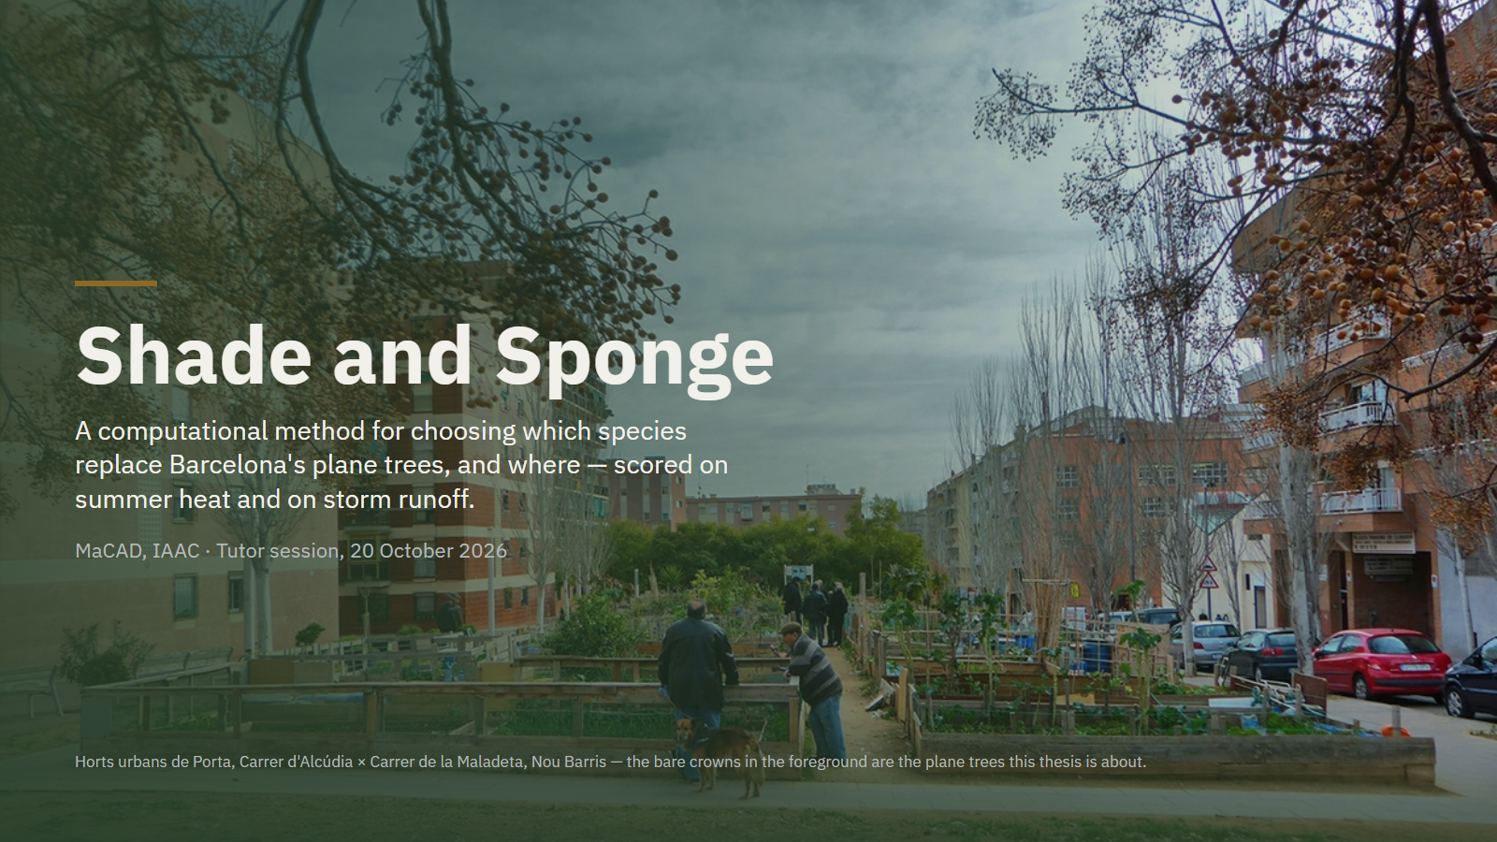
Notes:
This is Porta, in Nou Barris, and those are plane trees. Barcelona will remove more than half of its planes in ten years. My thesis is about what goes back in their place, and what that does to heat and storm water.

Slide 2
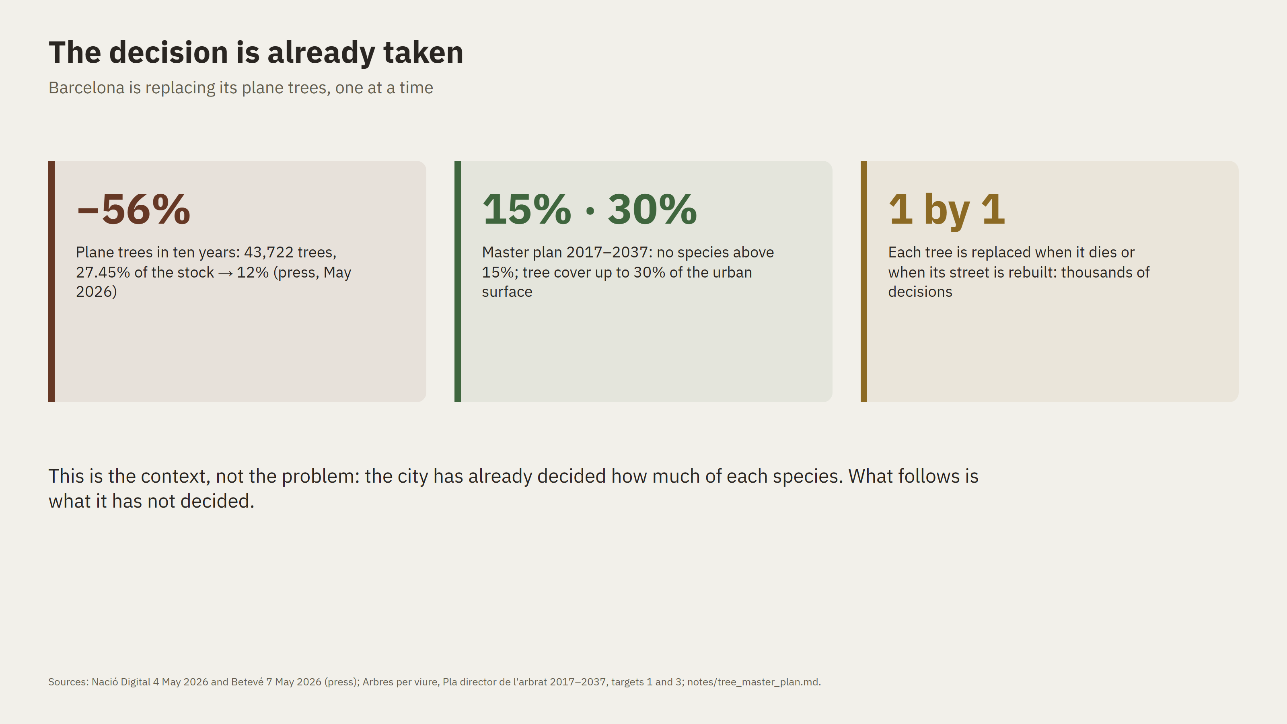
Notes:
First, the context, which is not my problem but the frame of it. The city has decided to cut its planes by more than half. No species may exceed fifteen percent. And replacement happens one tree at a time: when a tree dies, or when a street is rebuilt. So over the next decade there will be thousands of small decisions. Each one fixes a street's canopy for decades.

Slide 3
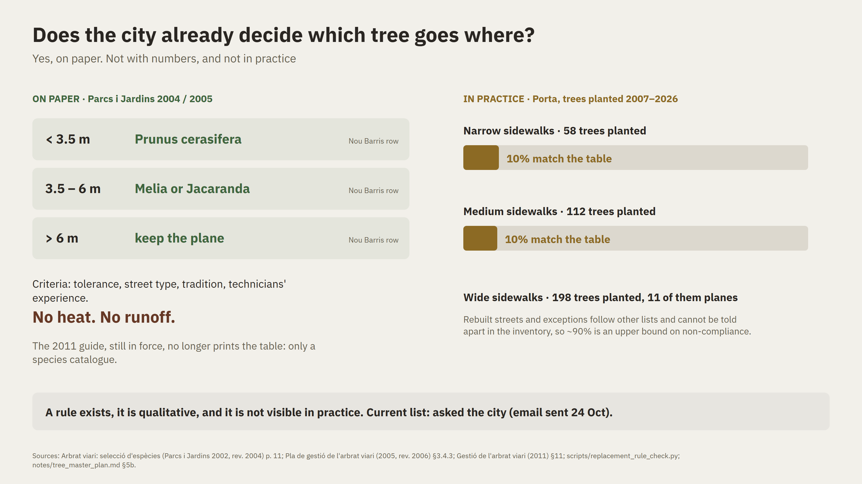
Notes:
You asked me to check whether Barcelona already has a structured plan for which tree goes where. It does, on paper. Parcs i Jardins published a table in 2004 and 2005: for each district and sidewalk width, which species replaces a dead tree. In Nou Barris that is Prunus on narrow sidewalks, Melia or Jacaranda on medium ones, and the plane is kept on wide ones. The criteria are tolerance, street type and tradition. Heat and runoff are not among them. The current guide no longer prints the table. And in Porta, only about one in ten trees planted since 2007 matches it. I also asked the city for the current list; I'm waiting for the reply.

Slide 4
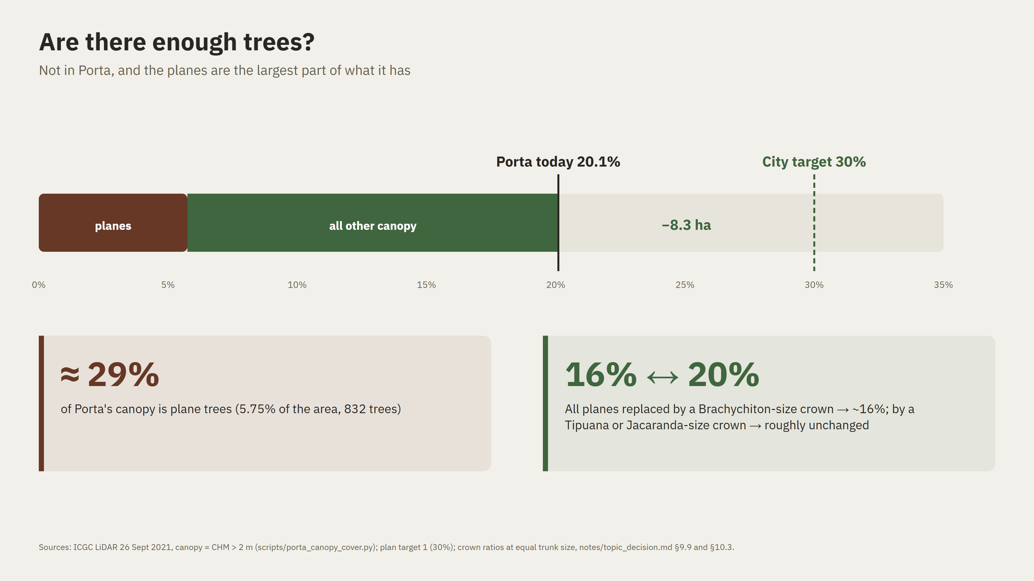
Notes:
Your second question: are there enough trees? Not in Porta. The plan targets thirty percent tree cover. I measured Porta from the 2021 laser scan: twenty point one percent, about ten points short. And almost a third of that canopy is plane trees. So the replacement is not a detail next to 'plant more'. If every plane became a small-crowned species, Porta would drop to about sixteen percent. With large-crowned ones it holds. In a neighbourhood that already lacks trees, this choice decides whether it moves towards the target or away from it.

Slide 5
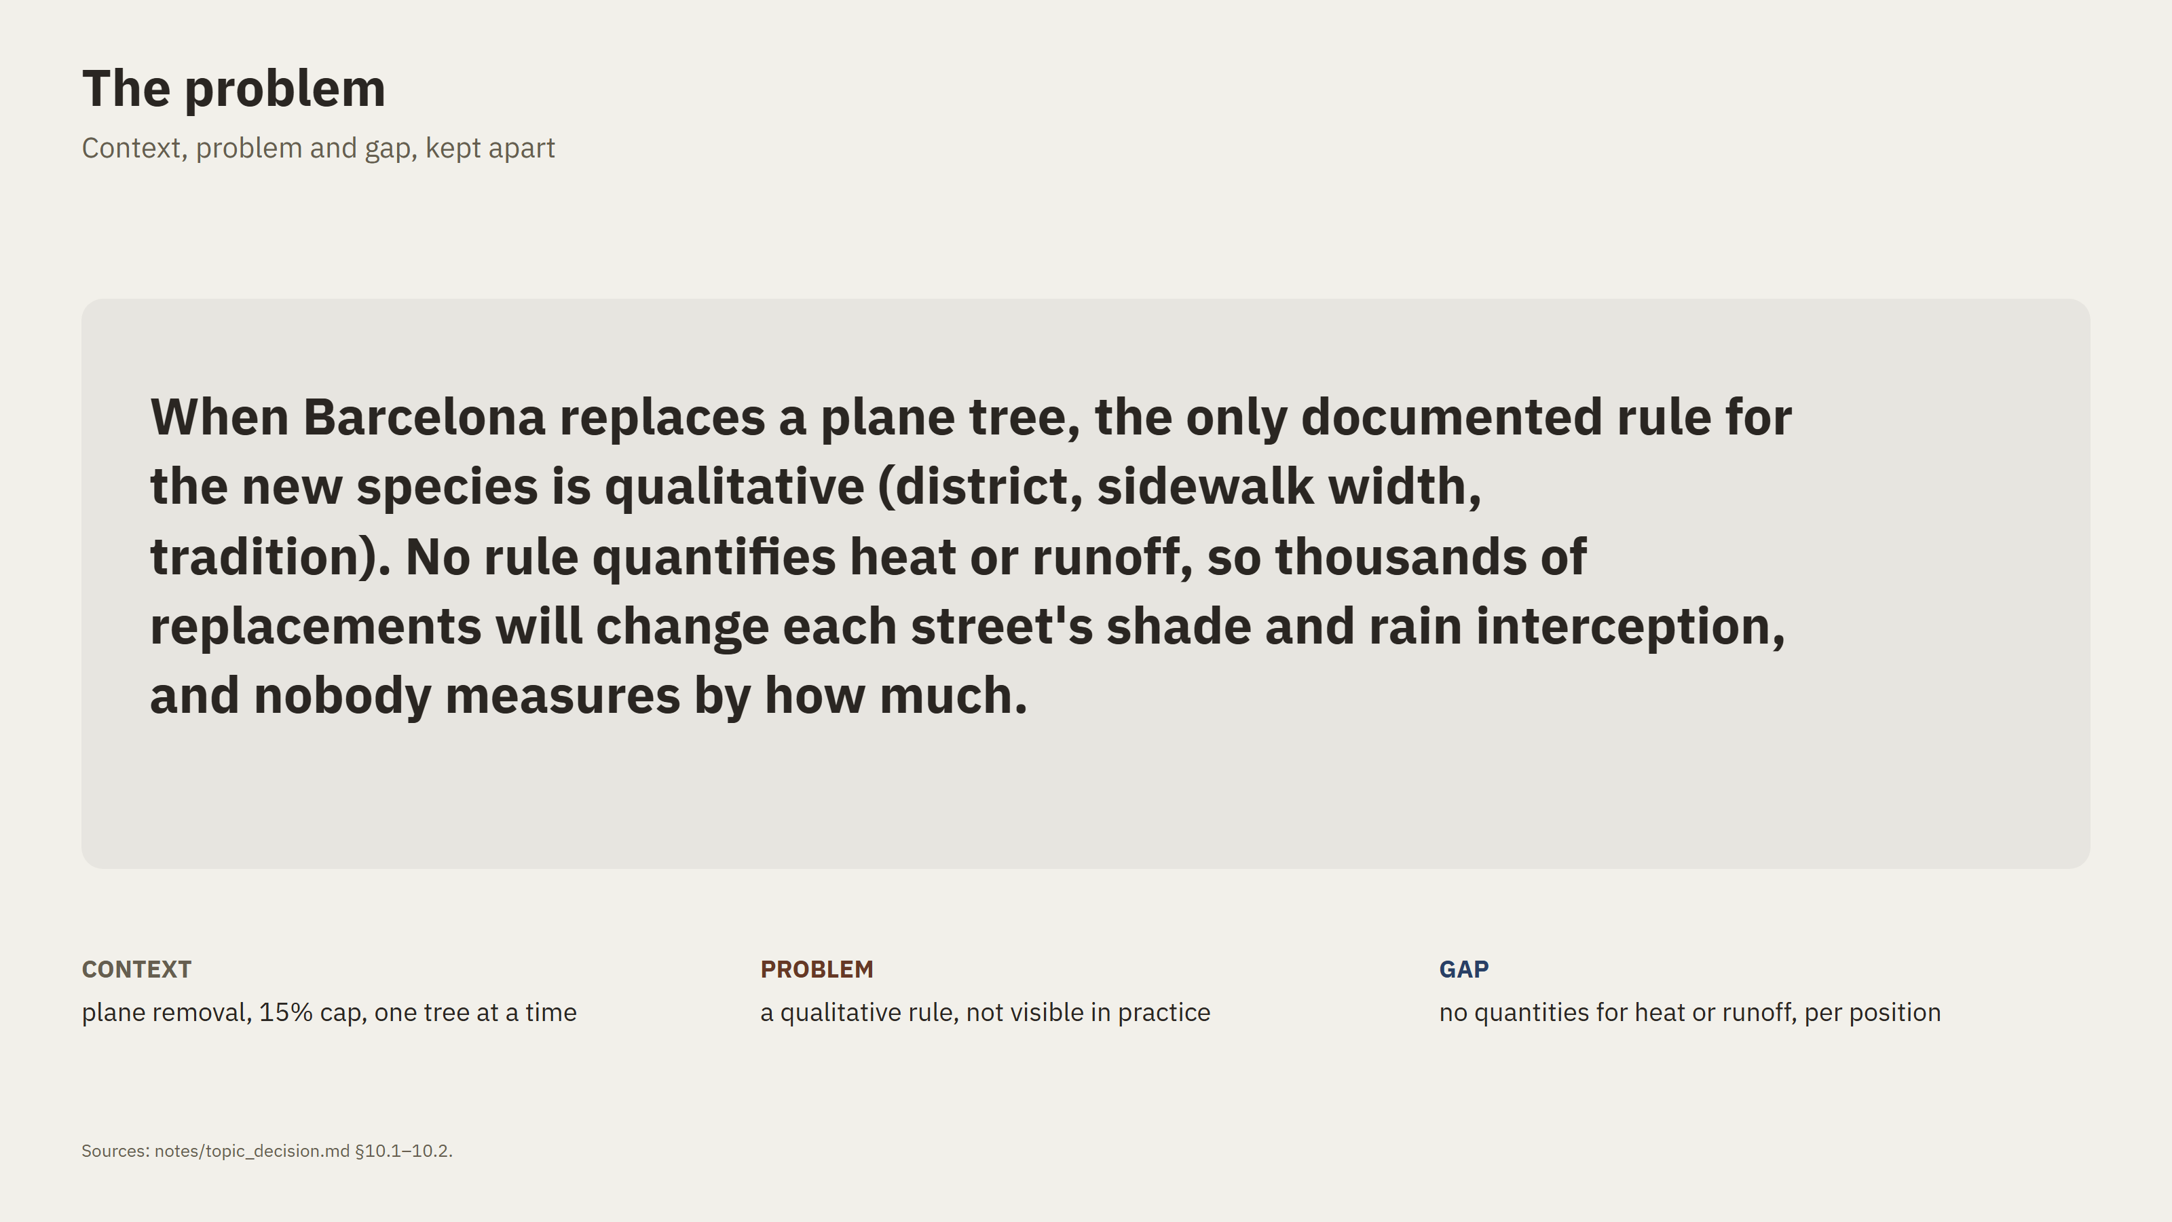
Notes:
So this is the problem. The rule that exists is qualitative, practice doesn't follow it, and nothing measures the consequences. Context, problem and gap are now three separate things. The rest of the talk is about measuring those consequences.

Slide 6
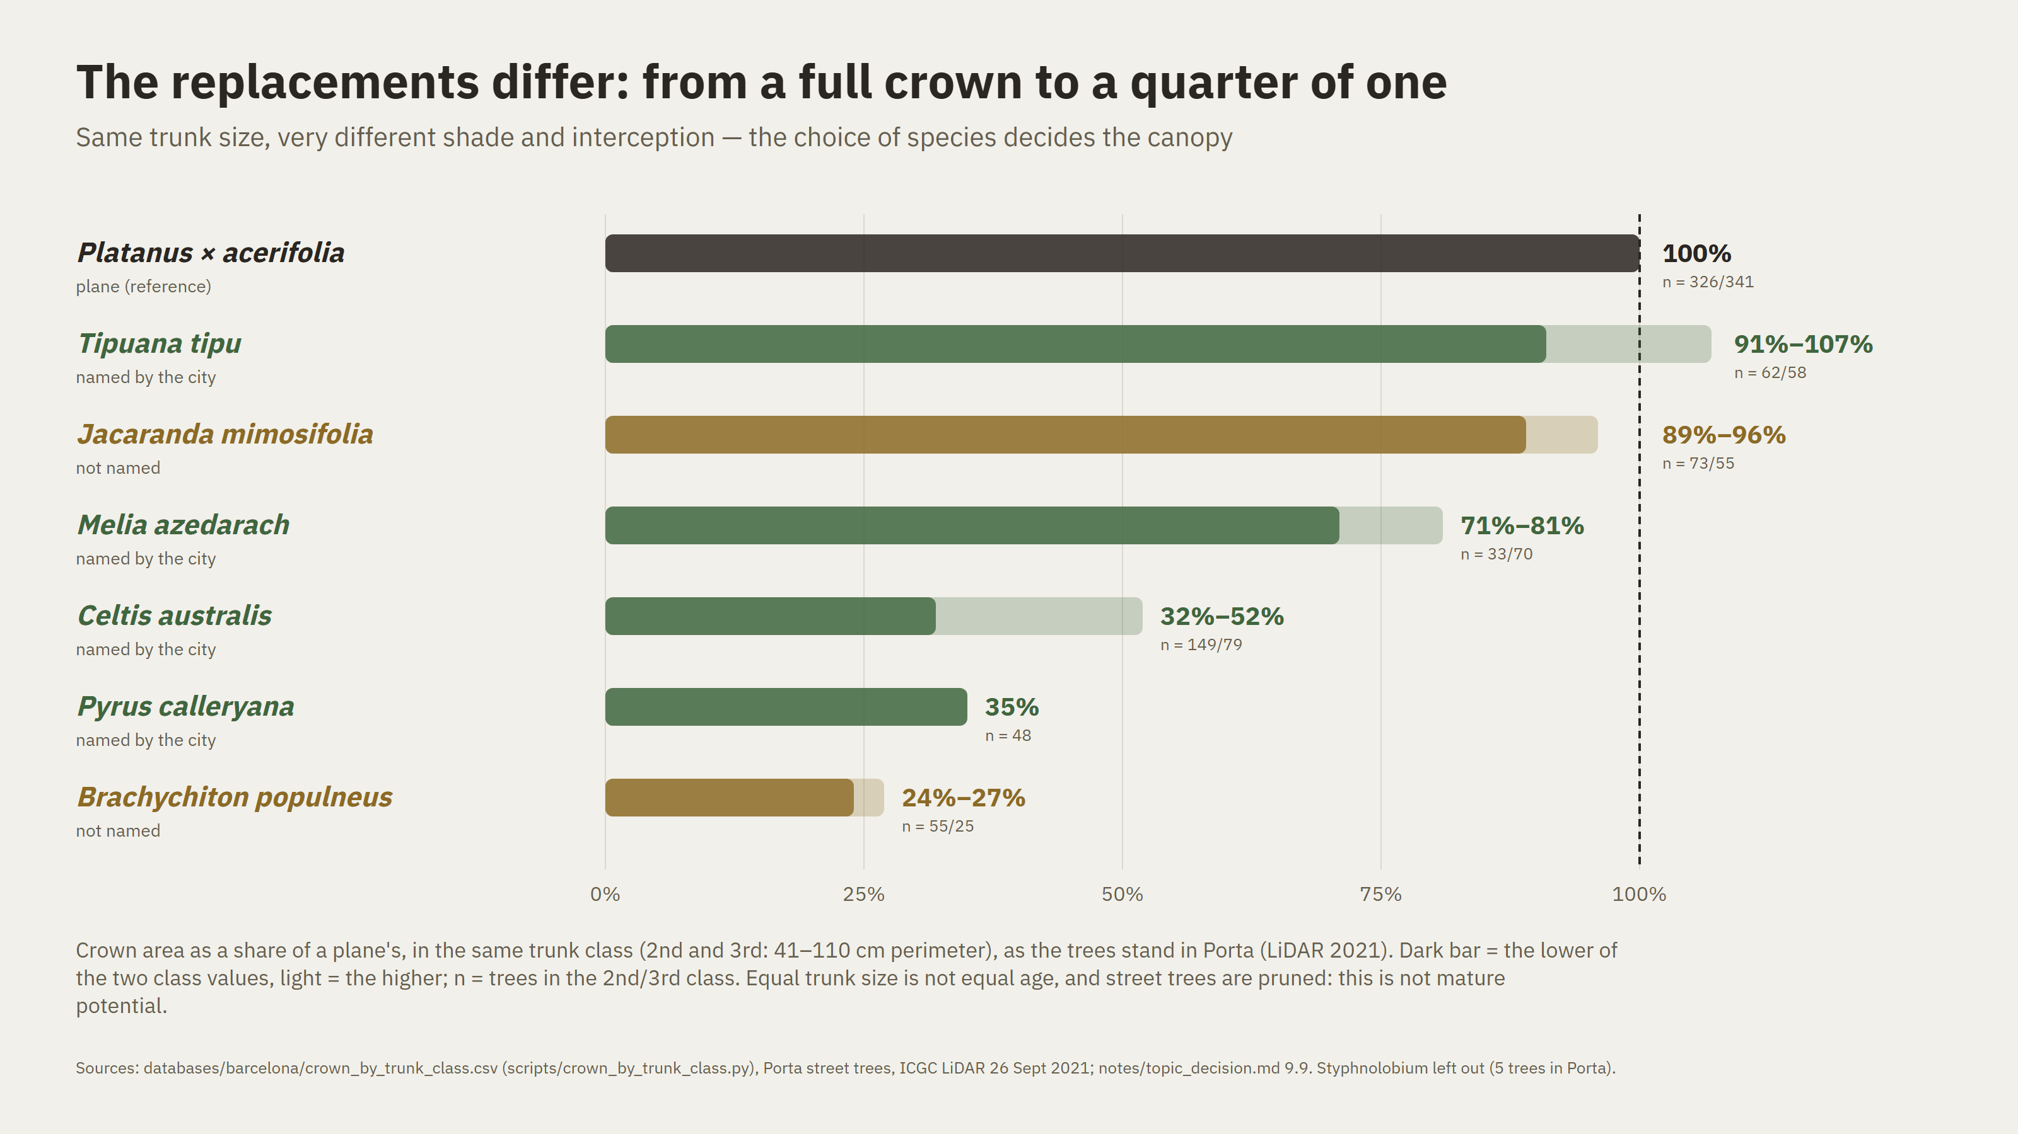
Notes:
Why measuring matters: at the same trunk size, the candidates carry very different crowns. Tipuana and Jacaranda are close to a plane. Melia is three quarters. Celtis, Pyrus and Brachychiton carry between a quarter and a half. All of them follow the city's rules. The shade and rain interception left on the street can differ three- to fourfold.

Slide 7
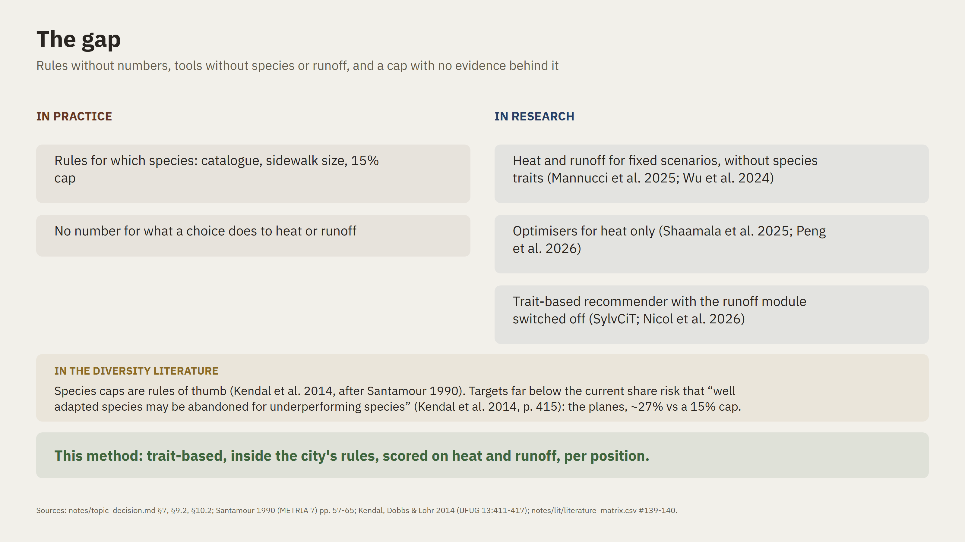
Notes:
In practice there are rules but no numbers. In research, the tools either assess heat and runoff without species, or optimise heat alone. The most advanced trait-based recommender, SylvCiT, has its runoff module switched off. And the diversity literature itself warns about Barcelona's case. The fifteen percent cap is a rule of thumb. Kendal and colleagues, looking at 108 cities, warn that a target far below a species' current share risks replacing well-adapted trees with weaker ones and changing what they provide. The planes are at twenty-seven percent. That is where this method sits.

Slide 8
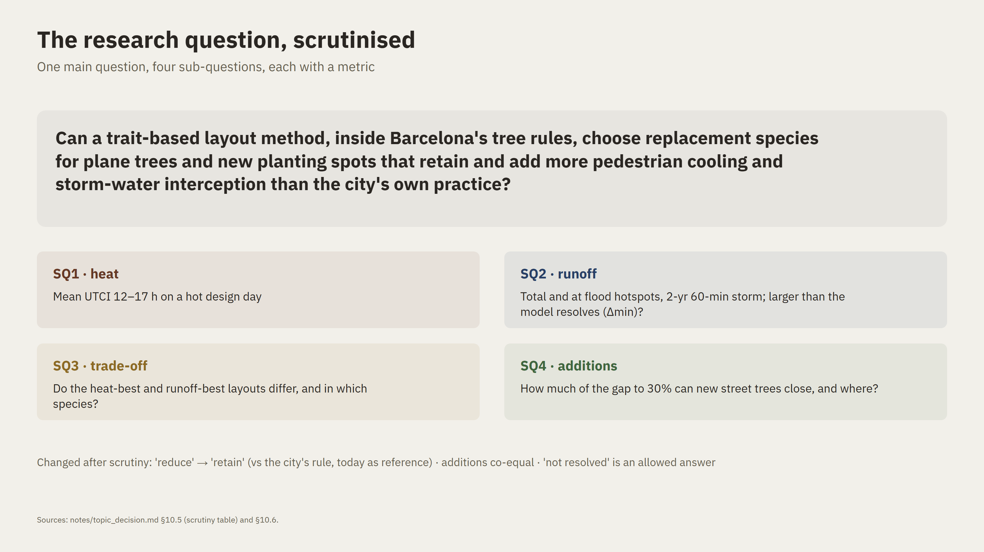
Notes:
I scrutinised the question part by part; the table is in my notes. Three changes matter. First, 'reduce' became 'retain'. Replacing a plane almost always loses shade compared with today. So the fair test is my method against the city's own rule, with today as the reference. Second, additions are now an equal part: replace, add, or both. Third, every sub-question has a metric and a threshold. For runoff, 'not resolved by the model' is an allowed answer, because the differences are close to what the model can tell apart. The baseline is the city's 2026 mix, placed by its sidewalk rule; the 2004 table is cited, not run.

Slide 9
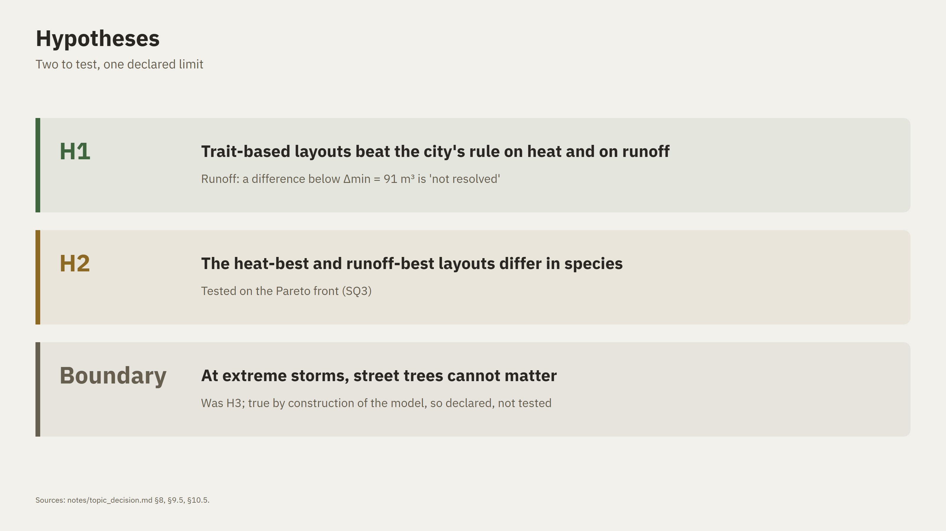
Notes:
Two hypotheses. H1: the method beats the city's rule on both heat and runoff. H2: the best layout for heat and the best for runoff differ. And one declared boundary: at extreme storms trees don't matter. It used to be a hypothesis, but the model makes it true by construction.

Slide 10
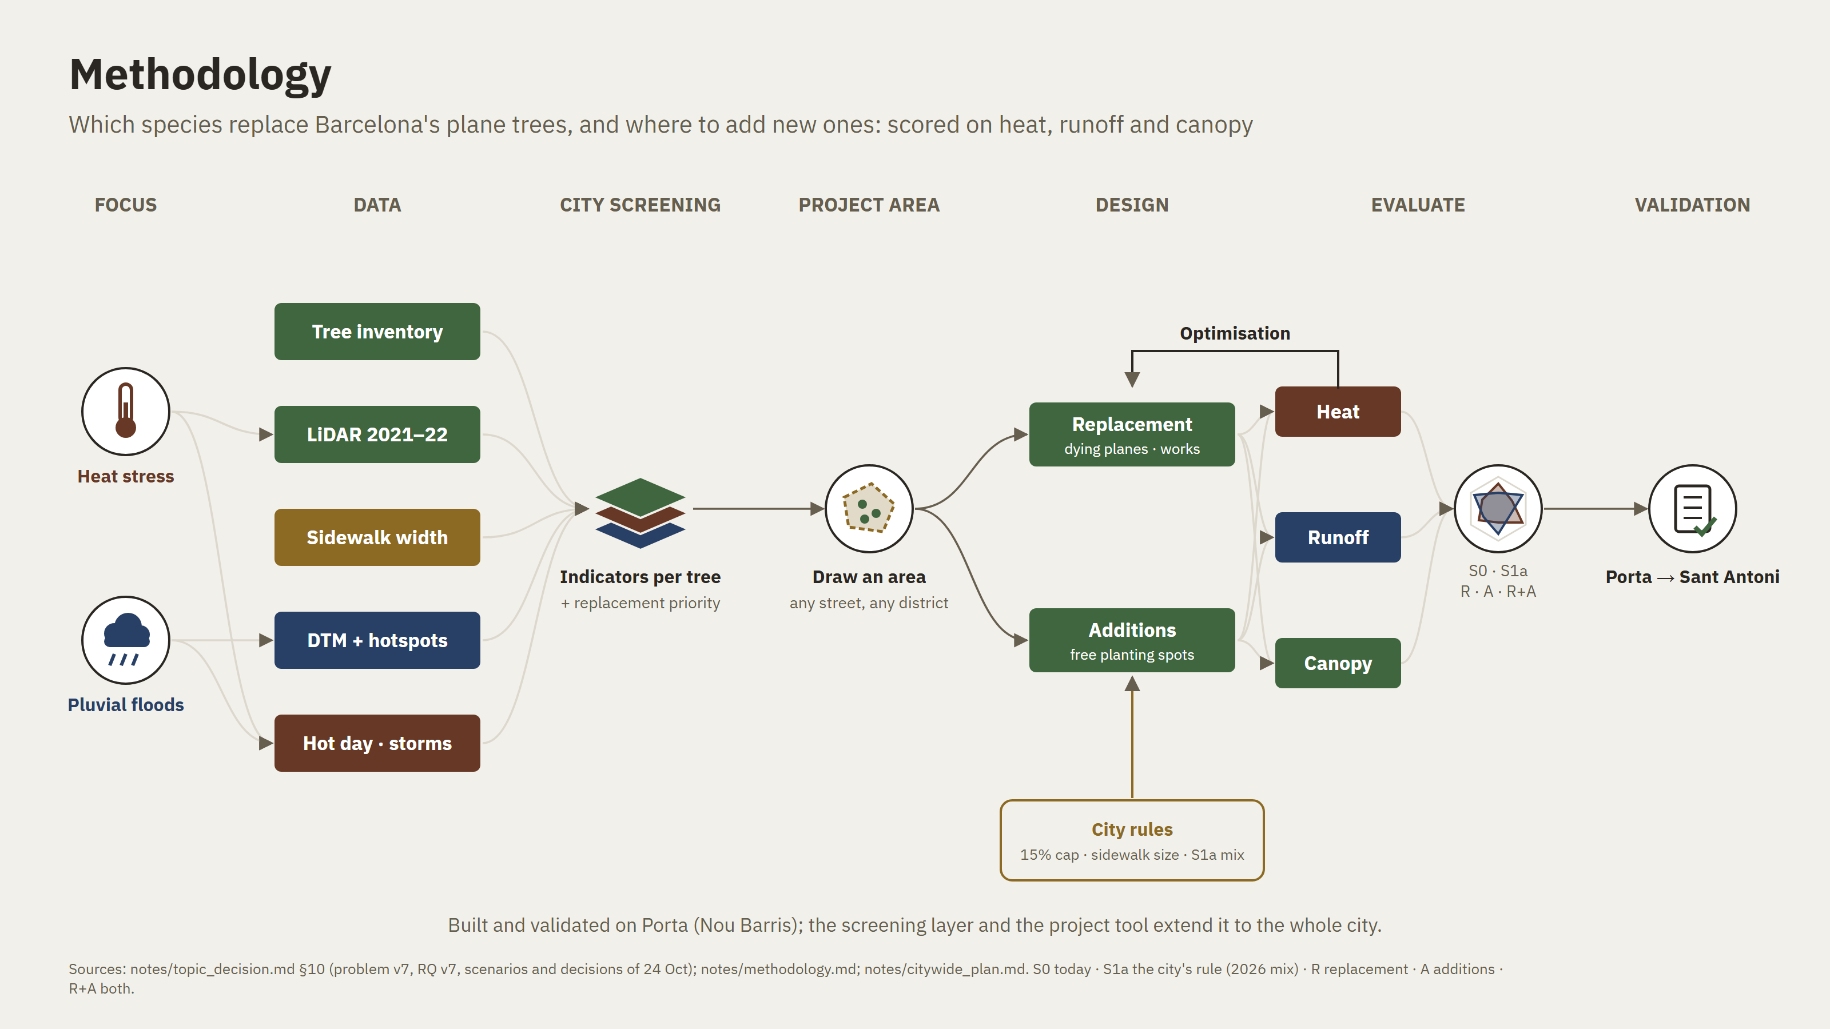
Notes:
Here is the method on one page. Two hazards, heat and pluvial flooding. Open data: the tree inventory, LiDAR, sidewalk widths, terrain and flood hotspots, the hot day and the design storms. First a screening layer: indicators for every tree. Then a designer draws a project area. Inside it, two branches: replacing the planes, and adding trees in free spots. The city's rules are a hard input: the fifteen percent cap, the sidewalk size, the city's mix. Every layout is scored on heat, runoff and canopy and compared on one chart. Then validation.

Slide 11
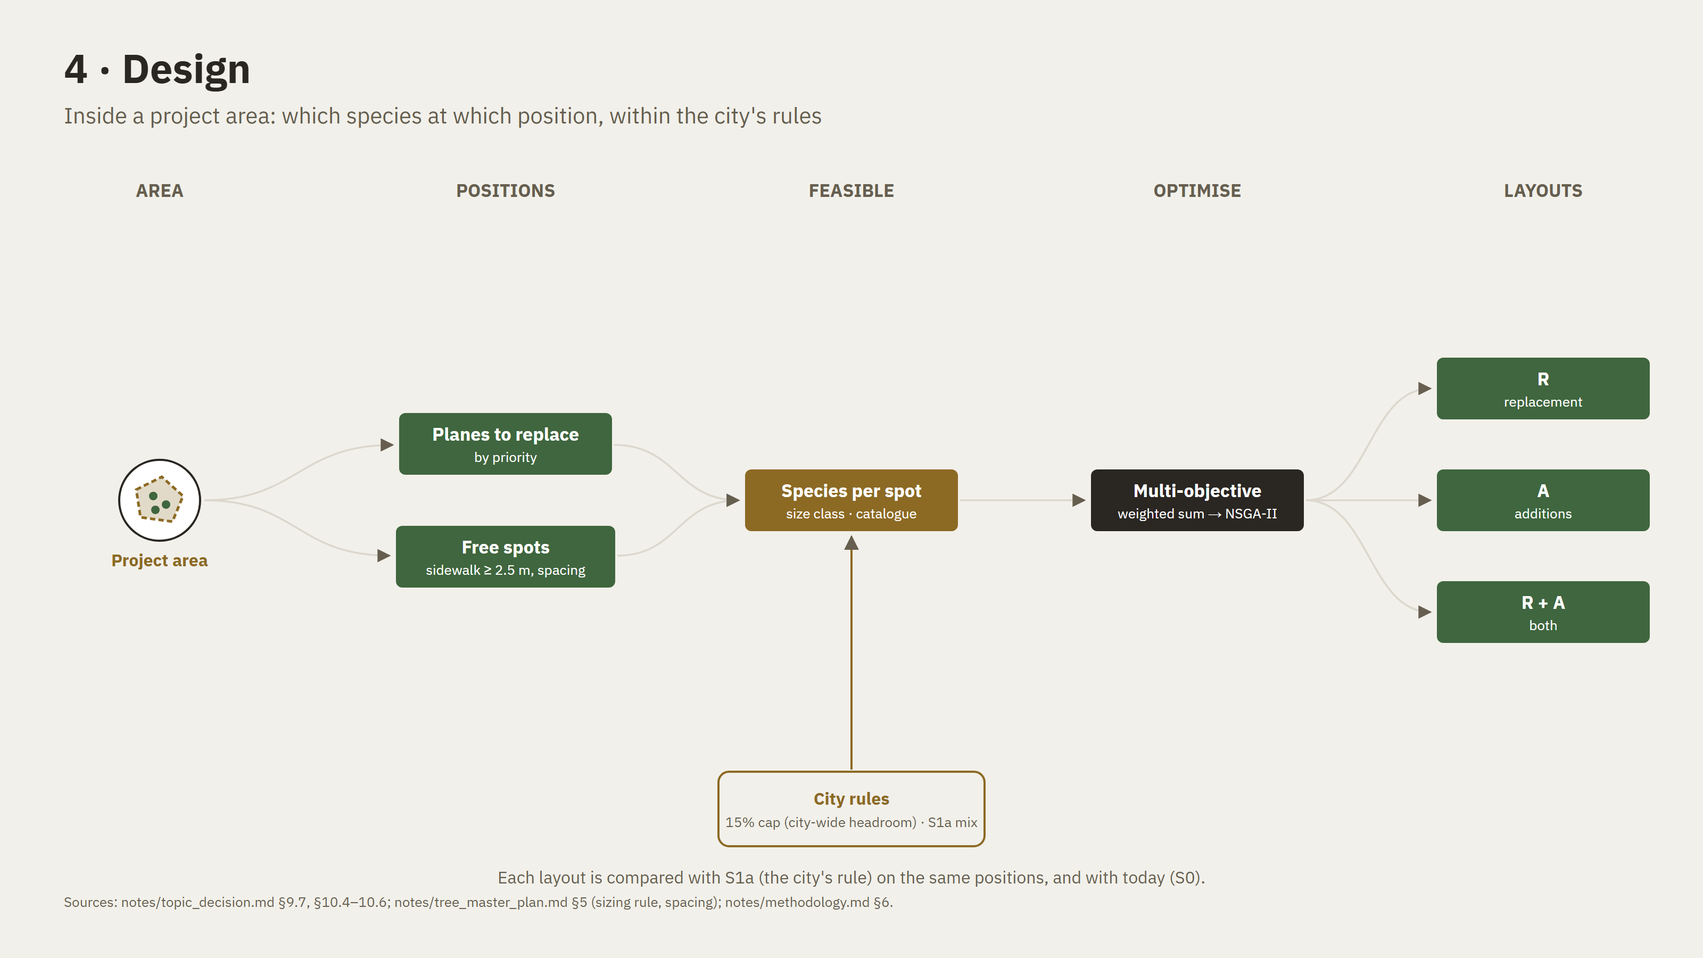
Notes:
Inside the project area: planes to replace, ranked by priority, and free spots. Each spot gets the species that fit its sidewalk and the catalogue, and the optimiser picks the combination. Every layout is compared with the city's rule on the same positions. This is what makes it concrete: it works for one street rebuild, not only for a whole district.

Slide 12
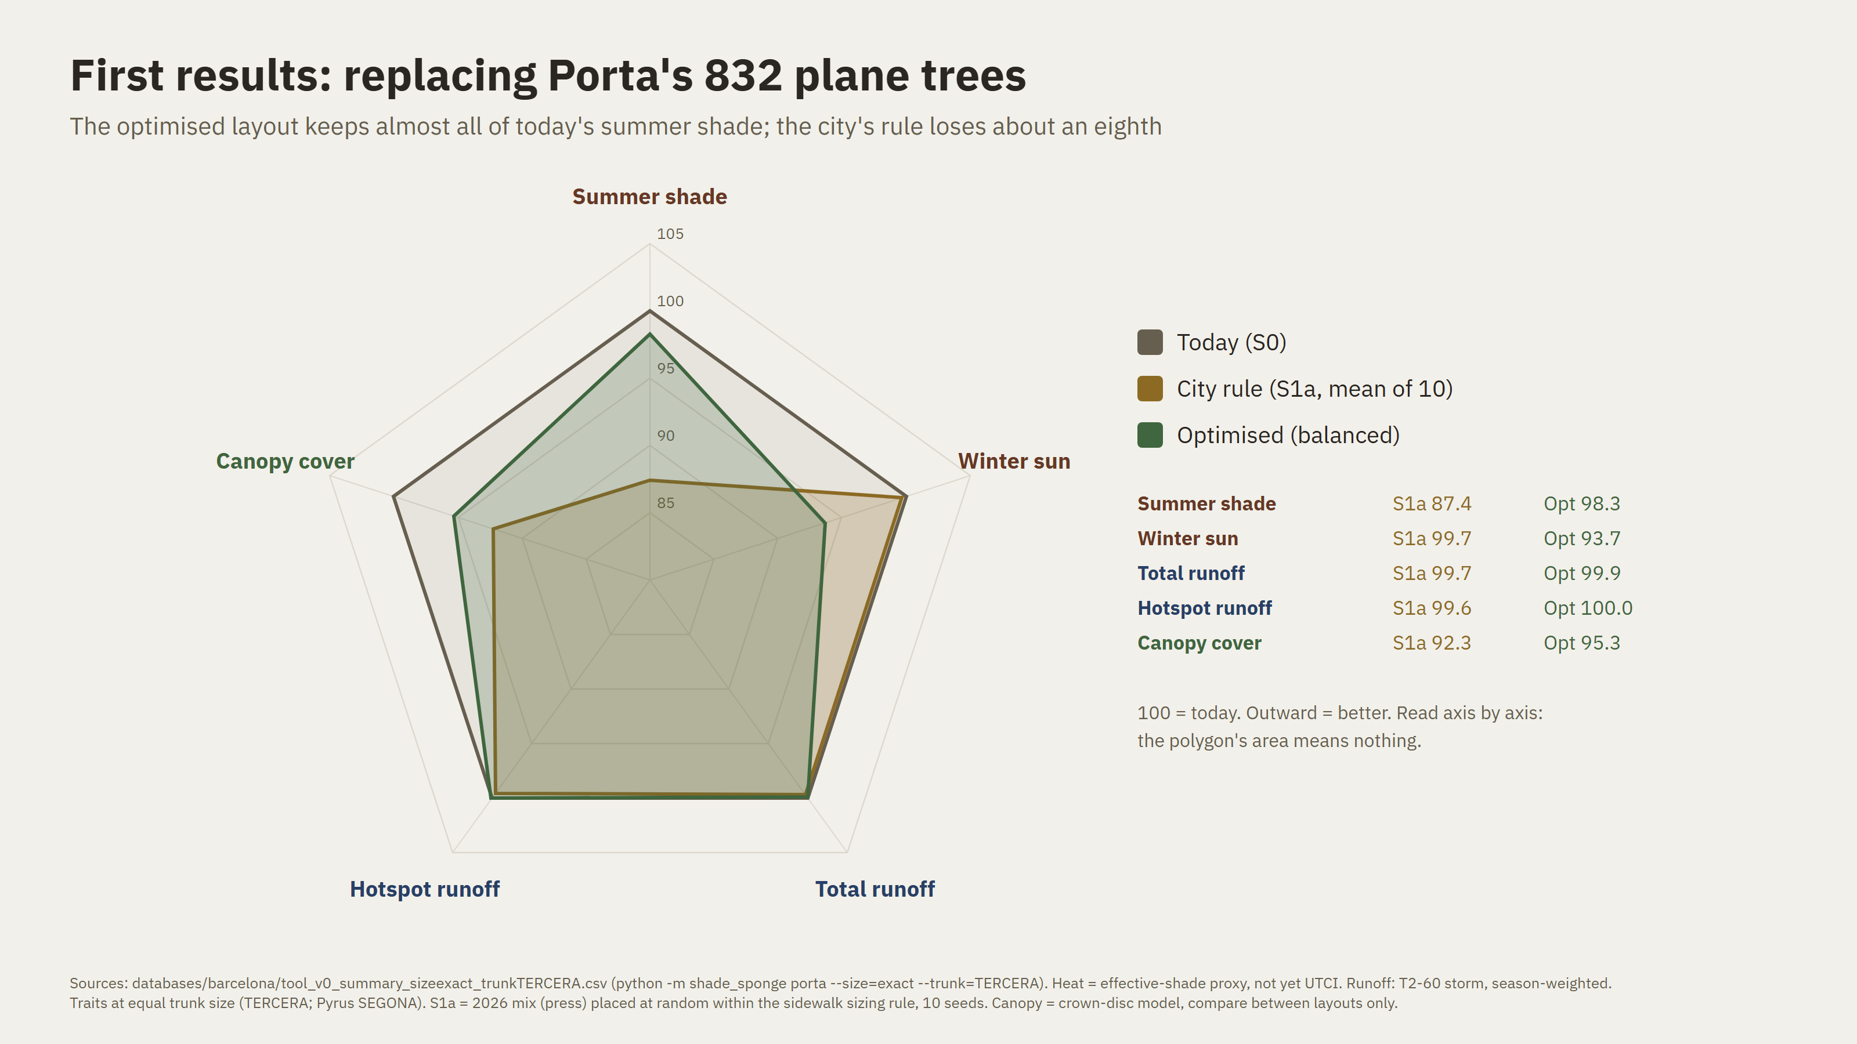
Notes:
First results, for all 832 planes in Porta. Heat here is effective shade, not yet UTCI. Each axis is normalised to today, a hundred. The city's rule keeps eighty-seven percent of today's summer shade. Choosing species by traits, under the same rules, keeps ninety-eight. The price is more shade in winter, about six percent, which is a real trade-off. On runoff, the difference is thirty-four cubic metres. That is below what the model can resolve, so for runoff the answer today is 'not resolved'. That is a result too, and an honest one.

Slide 13
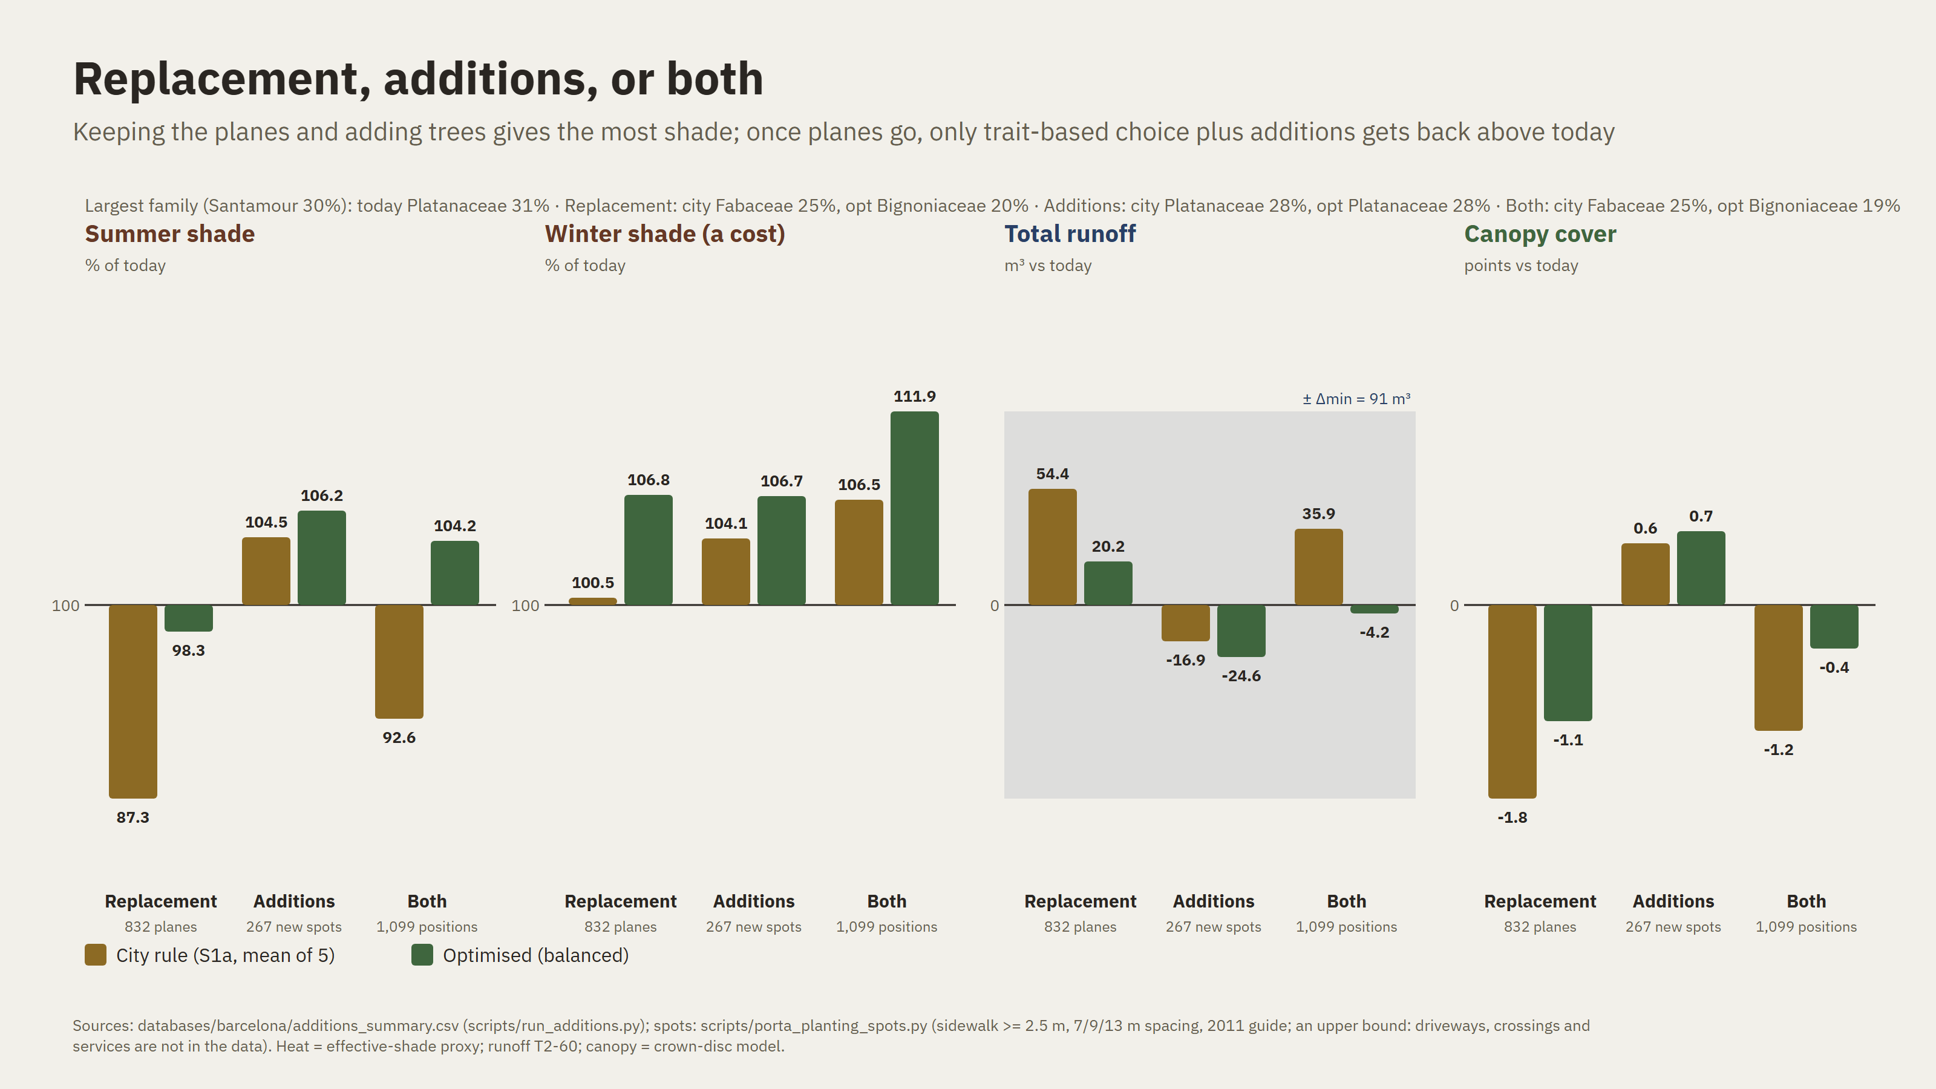
Notes:
Then I added trees. In Porta there are 267 free spots on sidewalks wide enough under the city's rules. That's an upper bound, because driveways and services aren't in the data. Keeping the planes and adding trees gives the most shade, but the planes are going. Once they go, the city's rule plus the same new trees still ends below today, at ninety-three percent. Trait-based replacement plus additions ends above today, at a hundred and four. So the combination of the two levers, chosen with numbers, is the only path that does better than today.

Slide 14
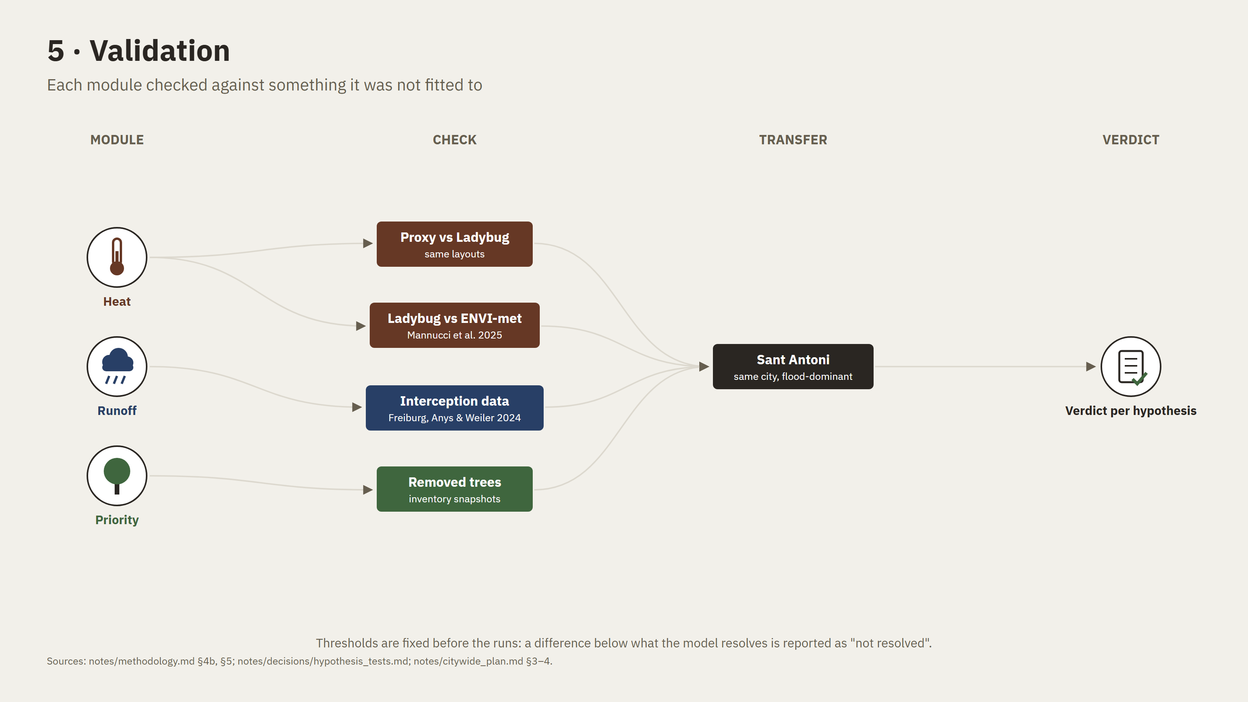
Notes:
Each module is checked against something it was not fitted to. Heat: my proxy against Ladybug on the same layouts, and Ladybug against ENVI-met from the literature. Runoff: interception against field data from Freiburg. The priority score: against trees the city actually removed between inventory snapshots. Then the whole method moves to Sant Antoni, same city and data, flood-dominant. Next: UTCI on the final layouts, the health proxy, and a screening layer for the whole city, so a designer can draw a project area anywhere. Two questions for you: Infrared City access, and whether Sant Antoni is a sufficient transfer test.

Slide 15
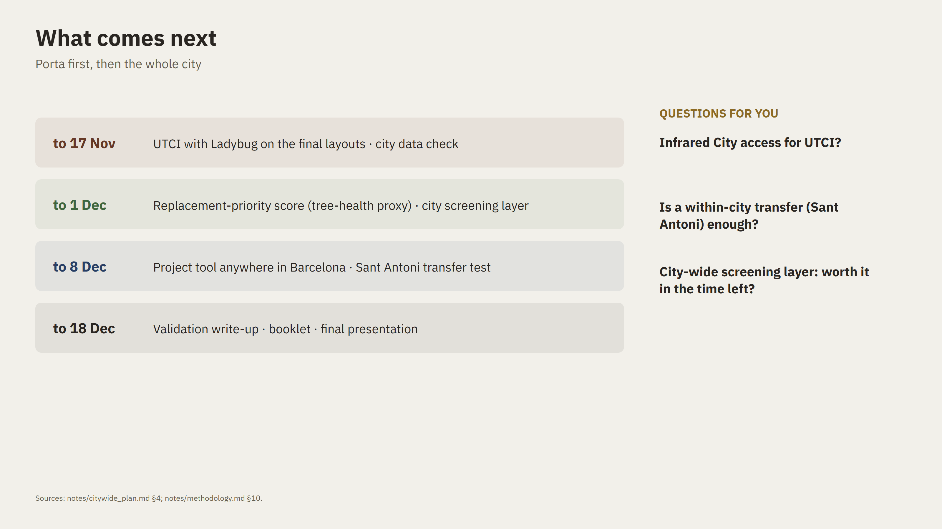

Slide 16
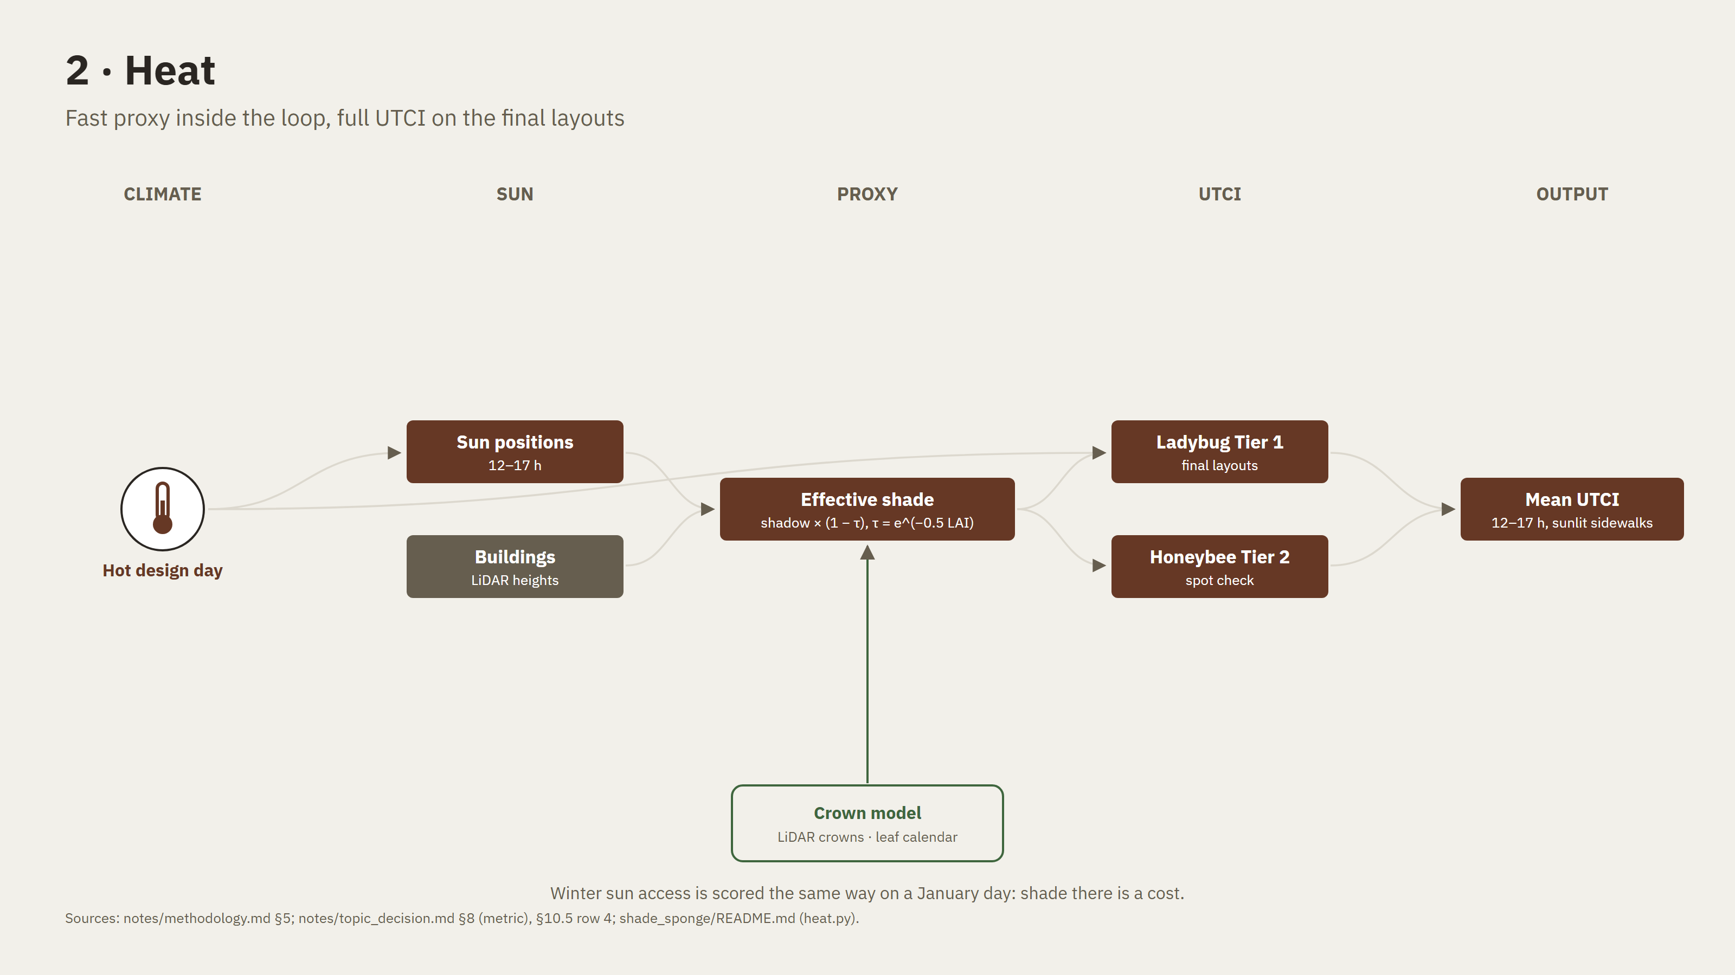
Notes:
Backup.

Slide 17
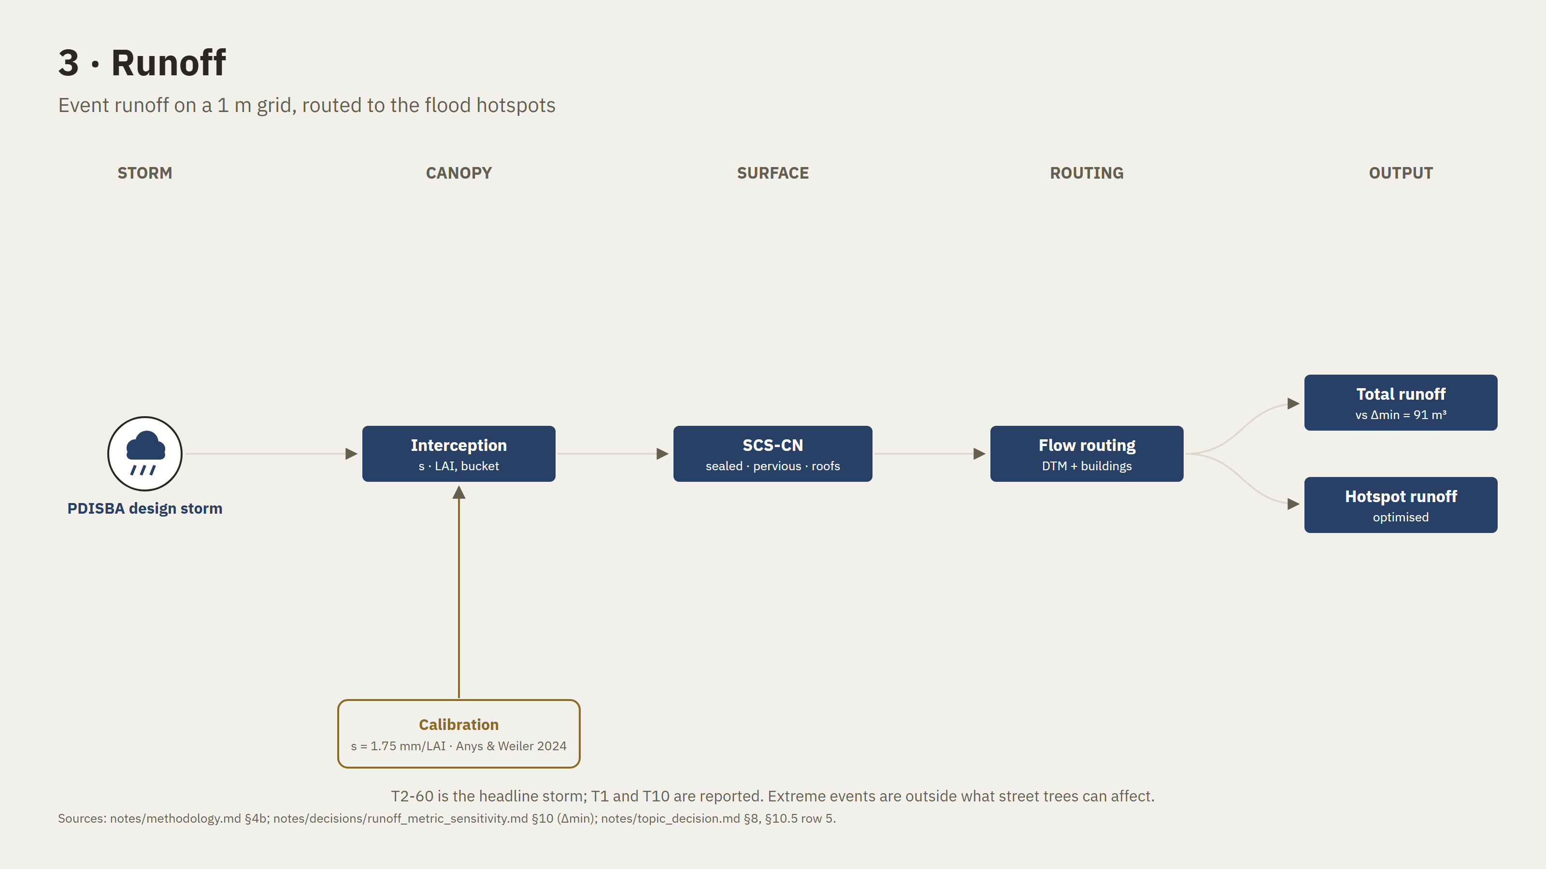
Notes:
Backup.

Slide 18
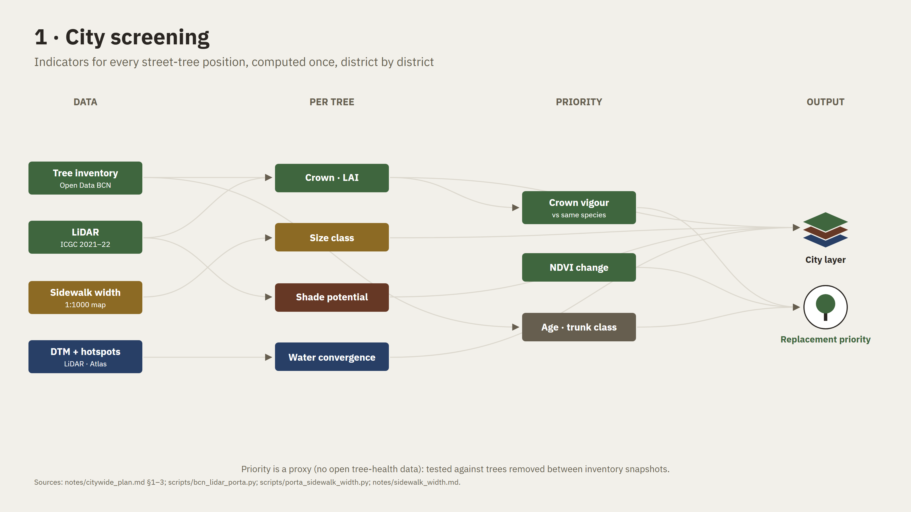
Notes:
Backup.

Slide 19
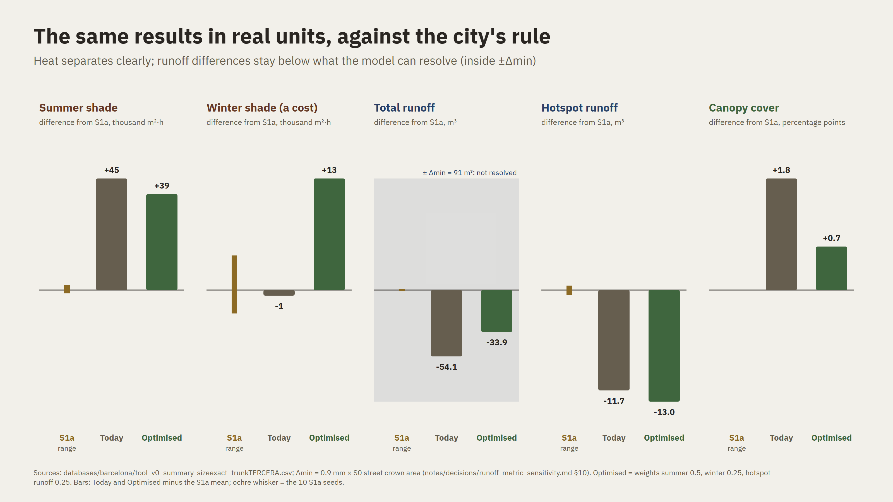
Notes:
Backup.

Slide 20
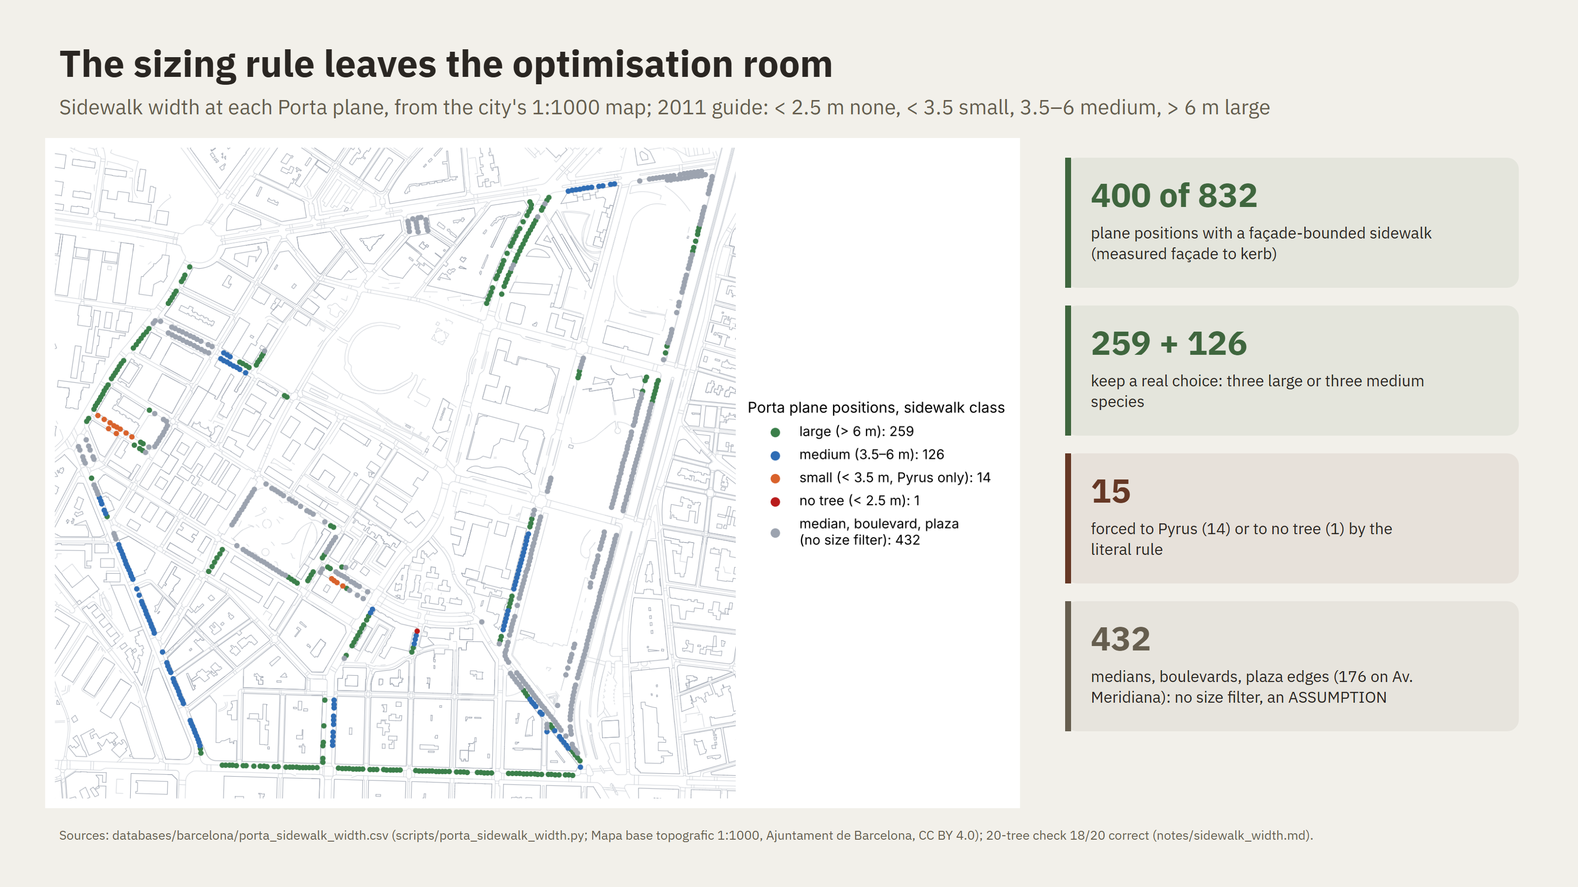
Notes:
Backup.

