Slide 1
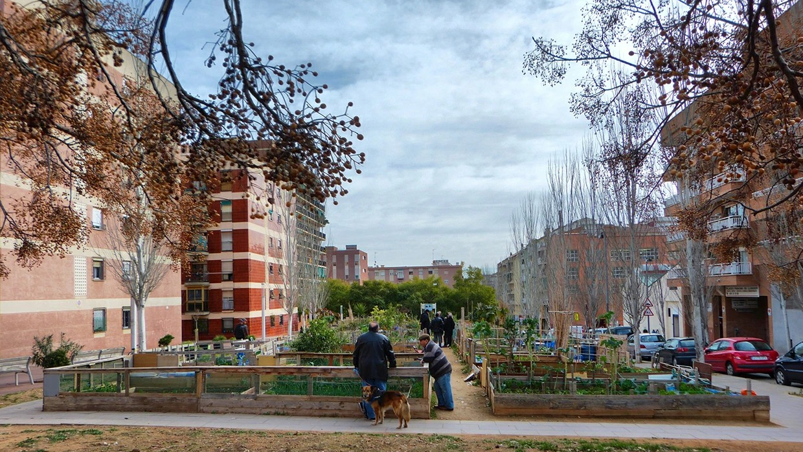
Shade and Sponge
When a project must cut street trees, what is the best way to replace them? First case: Barcelona's plane trees, in Porta.
MaCAD, IAAC · Research & Technologies, Pecha Kucha, 11 November 2026
Notes:
This is Porta, in Barcelona. When a project has to cut street trees, what is the best way to replace them? My thesis is a method that chooses the new species and positions so that heat and storm water get better, or at least not worse. Plane trees are my first case.

Slide 2
The decision is already taken
Barcelona replaces street trees one at a time; the planes are the largest case
−56%
15% · 30%
10,976
Plane trees in ten years: 27% → 12% of the stock
Master plan: max 15% per species; 30% tree cover
Trees replaced with another species, 2018–2026
This is the context, not the problem: the city has already decided how much of each species. What follows is what it has not decided.
Sources: Nació Digital, 4 May 2026; Betevé, 7 May 2026; Ajuntament de Barcelona, Pla director de l'arbrat 2017–2037; Open Data BCN, arbrat viari, quarterly inventories 2018–2026.
Notes:
Barcelona replaces street trees one at a time, when a tree dies or a street is rebuilt. Since 2018 almost eleven thousand trees got a new species. Now the planes must drop from twenty-seven to twelve percent, and no species may exceed fifteen.

Slide 3
The problem
Thousands of small decisions, unmeasured
When a project must replace street trees, the only rule for the new species is qualitative.
Nobody measures whether the street ends up hotter or wetter.
Sources: Parcs i Jardins, Arbrat viari: selecció d'espècies (rev. 2004); Ajuntament de Barcelona, Pla director de l'arbrat 2017–2037.
Notes:
Here is the problem. A designer who must replace trees has only a qualitative rule, which practice mostly does not follow, and nothing that says whether the street ends up hotter or wetter. Thousands of small decisions, unmeasured.

Slide 4
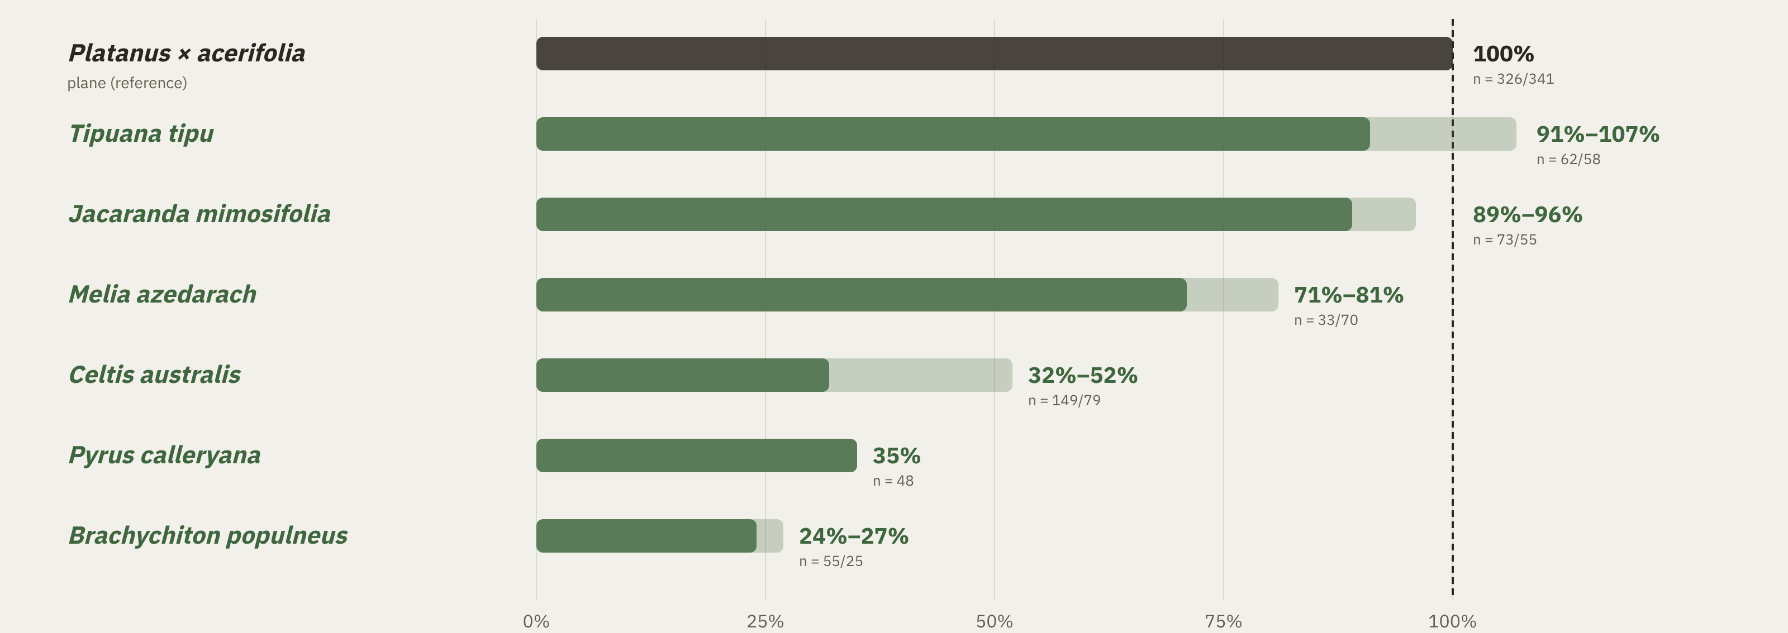
Same rules, very different crowns
Crown area as a share of a plane's, same trunk size, Porta's own trees
Of 18 tools that place or assess urban trees, none chooses species tree by tree inside a city's rules.
Sources: ICGC, LiDAR flight of 26 Sept 2021; Ajuntament de Barcelona, arbrat viari; Mannucci et al. 2025; Nicol et al. 2026; Shaamala et al. 2025; Peng et al. 2026; Dong et al. 2026.
Notes:
And the choice matters. At the same trunk size, the allowed species carry crowns from a full plane down to a quarter of one. Of eighteen tools that place or assess urban trees, none chooses species tree by tree inside a city's rules.

Slide 5
The research question
When a project must replace street trees, can a trait-based method, inside the city's rules, choose the new species and positions so that cooling and storm-water interception improve, or at least do not get worse, compared with the city's own practice?
Notes:
So my question: when a project must replace trees, can a trait-based method, inside the city's rules, choose species and positions so that cooling and rain interception improve, or at least do not get worse, compared with what the city actually plants?

Slide 6
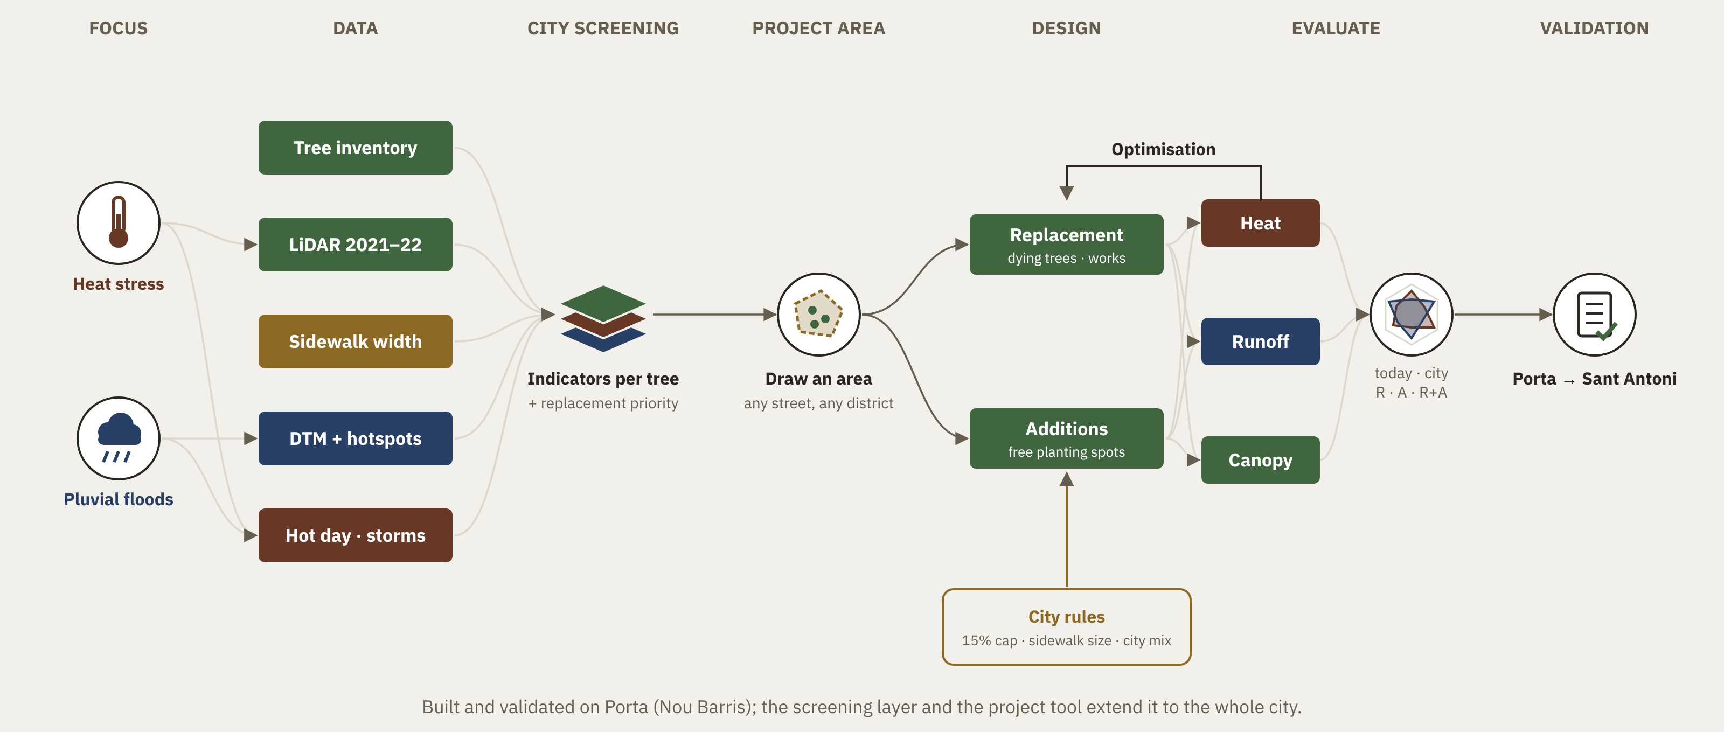
Shade and Sponge: how it works
Open data in, a species and a position for every tree out
Notes:
So I built Shade and Sponge. It reads open data: the tree inventory, LiDAR crowns, terrain, a design storm and a hot day. For every tree to replace, it proposes a species and a position, scored on shade and runoff together, inside the city's rules.

Slide 7
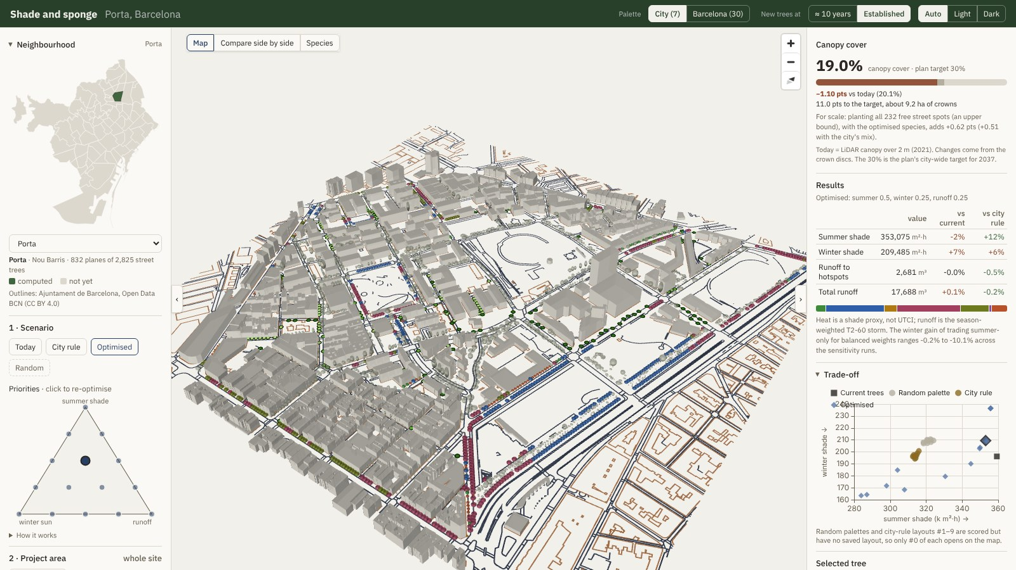
A tool for designers
Pick an area, set priorities, compare today, the city's rule and the optimised layout
giofox96.github.io/shade-and-sponge · open source
Notes:
This is the web app. A designer picks a neighbourhood, sets priorities between summer shade, winter sun and runoff, and compares today, the city's rule and the optimised layout, tree by tree, in 3D. It is online and open source.

Slide 8
Innovation
The city's rules are inside the tool, not checked afterwards
Two services, one choice
Species and position for every tree, scored on summer shade / UTCI and runoff together.
Rules inside, not after
15% species cap, sidewalk width → tree size, the city's own species list.
Real baseline, any tree
Compared with what the city actually plants (its inventory, 2018–2026). Any tree a project replaces; one data adapter per city.
Notes:
Three things make it new. The city's rules are inside the optimiser, not checked afterwards: the fifteen percent cap, sidewalk width and the city's species list. The baseline is what the city really plants, from its own inventory. And it works for any tree, any city.

Slide 9
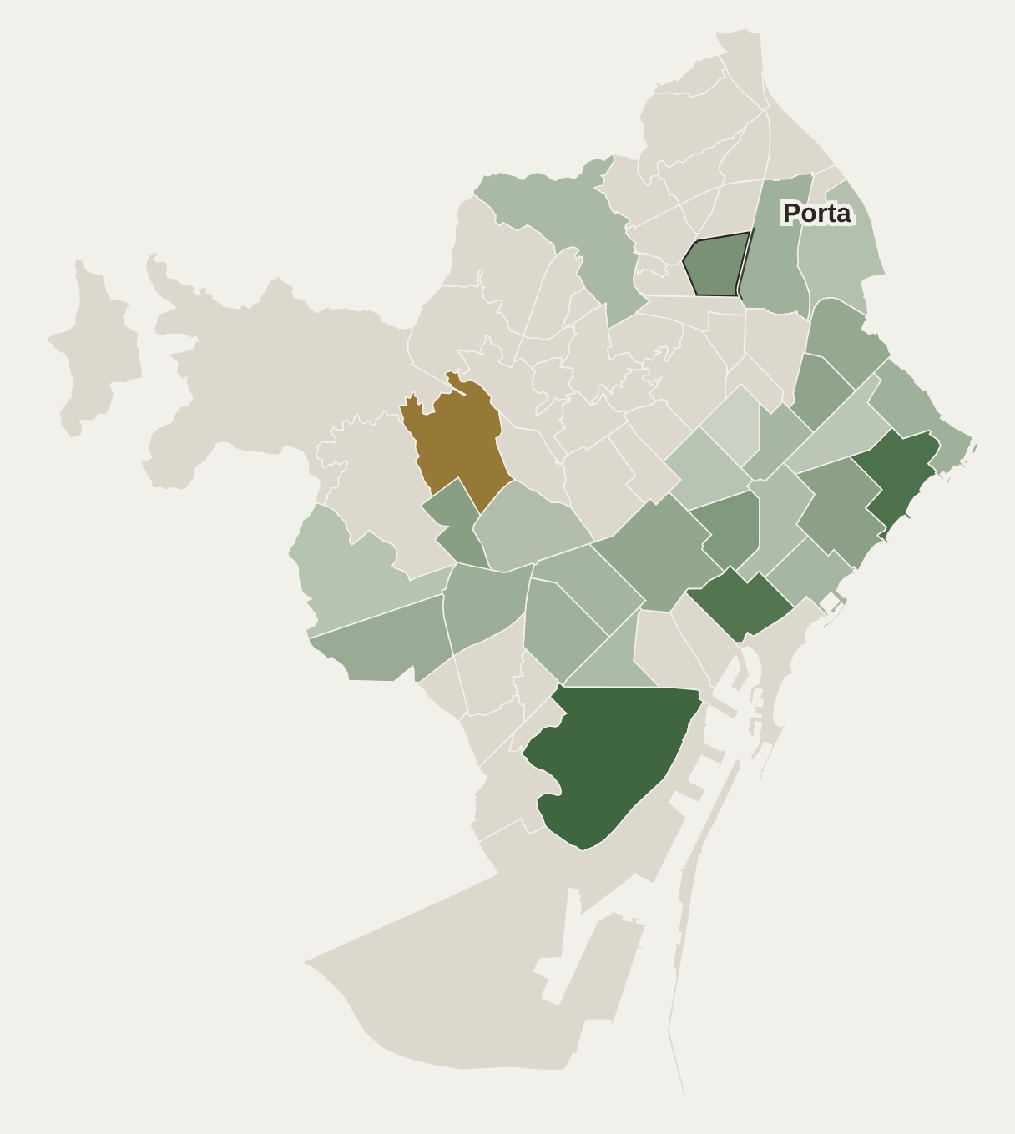
First evidence
28 barris, one layout under the city's 15% cap, against the city's announced mix
+9.2 pts
median summer-shade gain over the city's announced mix
27 of 28
barris gain; against what the city actually plants, none of 33 loses
≤ 0.2 °C
change in pedestrian heat (UTCI) vs today's planes, Ladybug / Honeybee
Green = gain over the city's mix · ochre = loss · grey = not computed
Sources: Outlines: Open Data BCN (CC BY 4.0). Cap: Pla director de l'arbrat 2017–2037. City mix: Betevé, 7 May 2026. Ladybug Tools. Heat on the map = shade proxy.
Notes:
First evidence. Across twenty-eight neighbourhoods, under the city-wide cap, the tool keeps more summer shade than the city's announced mix in twenty-seven, by a median of nine points. Against what the city actually plants, none of thirty-three neighbourhoods loses. And pedestrian heat stays within two tenths of a degree of today's planes.

Slide 10
Limits, said upfront
Simulated, not measured no field data yet
Heat gain is small its sign depends on how porous the crowns are
Runoff is a check differences stay below what the model can resolve
Benefits take time they arrive only when the new trees mature
Notes:
And the limits, said upfront. Everything is simulated, not measured. The heat difference is small, and its sign depends on how porous the crowns are. Runoff is a check: the differences stay below what the model can resolve. And the benefits arrive only when the new trees mature.

Slide 11
Actors
Decide
Parcs i Jardins, Ajuntament de Barcelona (tree master plan, 15% cap)
Use
Landscape architects, computational designers, urban planners
Data & testing
ICGC (LiDAR) · BCASA (drainage) · Ladybug / Honeybee · Infrared City (in contact) · Comune di Firenze (LiDAR, transfer)
Benefit
Residents and pedestrians in streets that are both hot and flood-prone
Notes:
Who is involved? The city's parks department decides. Designers use the tool. Data comes from the Catalan mapping institute, the city and its water-cycle company. I test the heat side with Ladybug and am in contact with Infrared City. Florence's municipality has offered LiDAR for a transfer test.

Slide 12
Exploitation
What, how, for whom
What | How | For whom
Method: trait-based layout under city rules | Thesis, paper | Researchers, city technicians
Python core + web app | Open source (MIT), online | Designers, other cities
Per-tree crown and trait dataset | Open data (own data only) | City, researchers
Transfer guide | Florence / Mataró test | Cities replacing a monoculture
Notes:
What can be exploited? The method, through the thesis and a paper. The code and a public web app, open source, for designers and cities. A per-tree dataset of crowns and traits. And a transfer guide for any city that has to replace a monoculture.

Slide 13
Impact over time
Short term · now
Open, reproducible method · simulated gains in 28 barris · checked in Ladybug / Honeybee
Medium term · 1–3 yrs
Pilot streets with Parcs i Jardins · transfer test: Florence, Mataró
Long term · 2037
Canopy toward 30%, no species above 15% · no more runoff where streets flood · a method for cities replacing monocultures
Notes:
Impact over time. Short term: an open, reproducible method with simulated gains across the city. Medium term: pilot streets with the parks department, and a transfer test in Florence and Mataro. Long term: canopy moving toward thirty percent, no species above fifteen, and no street left hotter or wetter by a replacement.

Slide 14
Impact dimensions · technology readiness
Environmental
Social
Technological
Economic
Policy
It turns a quota plan into a spatial one.
TRL 1
TRL 2
TRL 3
TRL 4
TRL 5
TRL 6
TRL 7
TRL 8
TRL 9
TRL 3 now → 4 by December
validated in simulation, on real city data
TRL 5
a test with a real designer
TRL 6+
a pilot street, after the thesis
Notes:
It touches five dimensions, from comfort to policy: it turns a quota plan into a spatial one. Today it is at TRL three; by December, TRL four: validated in simulation, on real city data. A test with a real designer would bring it to five. A pilot street is the step after the thesis.

Slide 15
MY ASK
Test it on one real street rebuild, with a designer or Parcs i Jardins.
Least loss, inside the city's rules.
giofox96.github.io/shade-and-sponge
Notes:
So here is my ask. The city will replace trees anyway, street by street. I want to test this on one real street rebuild, with a designer or the parks department. That is the step from simulation to TRL five. Least loss, inside the city's rules. Thank you.

