Slide 1
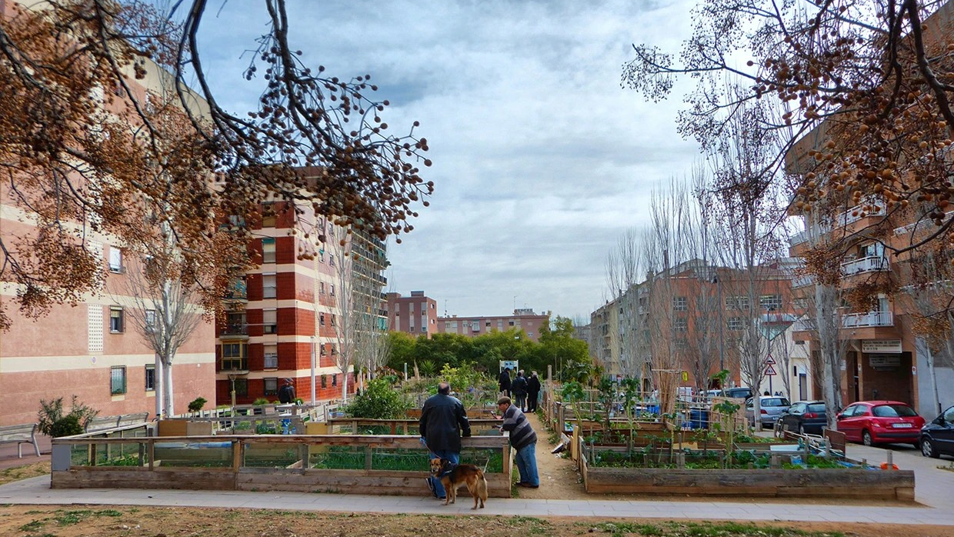
Shade and Sponge
A computational method for replacing the street trees a project must cut, so that summer heat and storm runoff improve, or at least do not get worse. First case: Barcelona's plane trees (Platanus).
MaCAD, IAAC · Tutor session with A. Chronis, 10 November 2026
Horts urbans de Porta, Carrer d'Alcúdia × Carrer de la Maladeta, Nou Barris: the bare crowns in the foreground are the plane trees this thesis is about.
Notes:
This is Porta, in Nou Barris, and those are plane trees, Platanus. When a project has to cut street trees, what is the best way to replace them? My thesis is a method that chooses the new species and positions so that heat and storm water get better, or at least not worse. The plane trees are my first case.

Slide 2
The decision is already taken
Barcelona replaces street trees one at a time; the planes are the largest case
−56%
15% · 30%
10,976
Plane trees in ten years: 27% → 12% of the stock
Master plan: max 15% per species; 30% tree cover
Trees replaced with another species, 2018–2026
This is the context, not the problem: the city has already decided how much of each species. What follows is what it has not decided.
Sources: Nació Digital, 4 May 2026; Betevé, 7 May 2026; Ajuntament de Barcelona, Pla director de l'arbrat 2017–2037; Open Data BCN, arbrat viari, quarterly inventories 2018–2026.
Notes:
First, the context, which is not my problem but the frame of it. The city has decided to cut its planes by more than half. No species may exceed fifteen percent. And replacement happens one tree at a time: when a tree dies, or when a street is rebuilt. In the city's own inventory I counted almost eleven thousand replacements since 2018, and the planes are only thirteen percent of them. So the planes are the biggest case, not the only one. Each replacement fixes a street's canopy for decades.

Slide 3
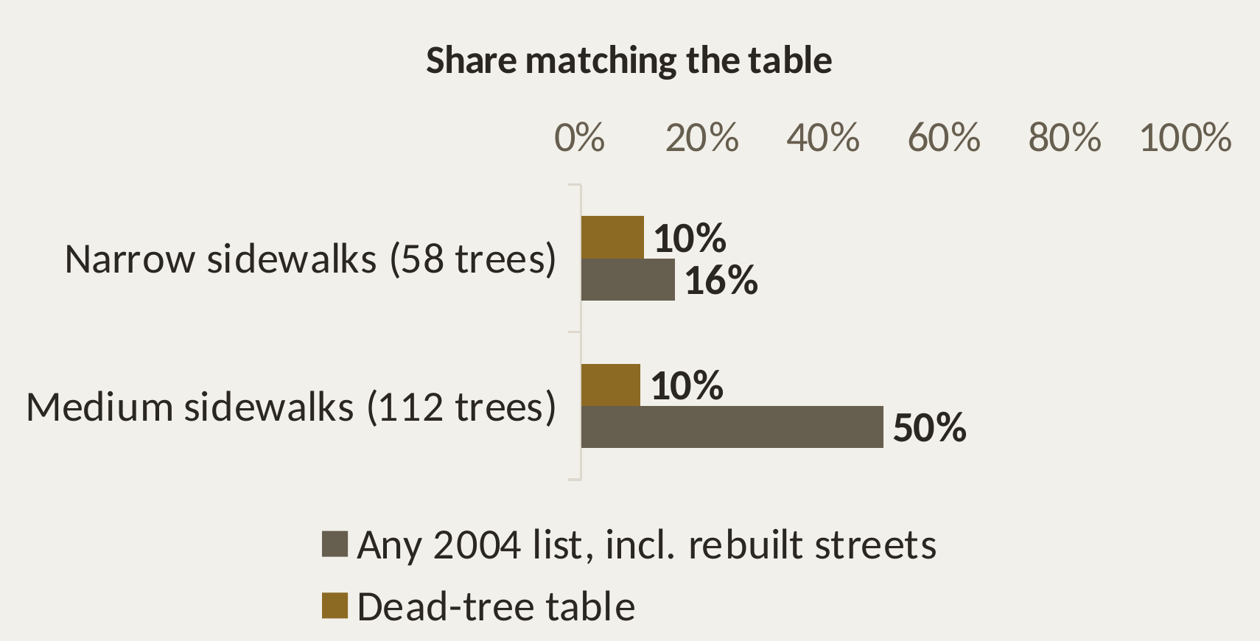
Does the city already decide which tree goes where?
Yes, on paper. Not with numbers, and not in practice
ON PAPER · Parcs i Jardins 2004 / 2005, Nou Barris row
IN PRACTICE · Porta, trees planted 2007–2026
Sidewalk width | Replacement species
< 3.5 m | Prunus cerasifera
3.5 – 6 m | Melia or Jacaranda
> 6 m | keep the plane
Criteria: tolerance, street type, tradition, experience.
No heat. No runoff.
Most plantings match none of the 2004 lists.
Rebuilt streets: a longer list per sidewalk class (p. 13).
A rule exists, it is qualitative, and practice mostly does not follow it.
Sources: Parcs i Jardins, Arbrat viari: selecció d'espècies (rev. 2004) pp. 11–14; Gestió de l'arbrat viari de Barcelona (2011) p. 28; Open Data BCN, arbrat viari (planting dates 2007–2026).
Notes:
You asked me to check whether Barcelona already has a structured plan for which tree goes where. It does, on paper. Parcs i Jardins published a table in 2004 and 2005: for each district and sidewalk width, which species replaces a dead tree. In Nou Barris that is Prunus on narrow sidewalks, Melia or Jacaranda on medium ones, and the plane is kept on wide ones. The criteria are tolerance, street type and tradition. Heat and runoff are not among them. The current guide no longer prints the table. Rebuilt streets get a longer list. And in Porta, most trees planted since 2007 on narrow and medium sidewalks match none of these lists. I also asked the city for the current list; I'm waiting for the reply.

Slide 4
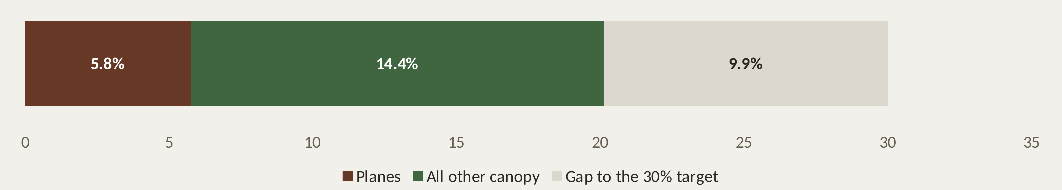
Are there enough trees?
Not in Porta, and the planes are the largest part of what it has
Porta today 20.1% · city target 30% by 2037
≈ 29%
16% ↔ 20%
of Porta's canopy is plane trees (5.75% of the area, 832 trees)
Small-crowned replacements → ~16%; large-crowned → unchanged
Sources: ICGC, LiDAR flight of 26 Sept 2021; Ajuntament de Barcelona, Pla director de l'arbrat 2017–2037 (target 1); Pla Clima 2024 p. 33.
Notes:
Your second question: are there enough trees? Not in Porta. The plan targets thirty percent tree cover. I measured Porta from the 2021 laser scan: twenty point one percent, about ten points short. And almost a third of that canopy is plane trees. So the replacement is not a detail next to 'plant more'. If every plane became a small-crowned species, Porta would drop to about sixteen percent. With large-crowned ones it holds. In a neighbourhood that already lacks trees, this choice decides whether it moves towards the target or away from it.

Slide 5
The problem
Context, problem and gap, kept apart
When a project in Barcelona must replace street trees, at least ~1,300 a year, the only documented rule for the new species is qualitative. No rule checks whether a replacement keeps, loses or improves the street's shade and rain interception, so a project can leave its street hotter or wetter, and nobody measures by how much.
CONTEXT
planes going, 15% cap, trees replaced one at a time
PROBLEM
a qualitative rule; a project can make its street worse
GAP
no quantities for heat or runoff, per position
Notes:
So this is the problem, seen from the project. A designer who has to replace trees has a qualitative rule, which practice doesn't follow, and nothing that tells them whether the street ends up better or worse. The rest of the talk is about measuring that, and choosing so that nothing gets worse.

Slide 6
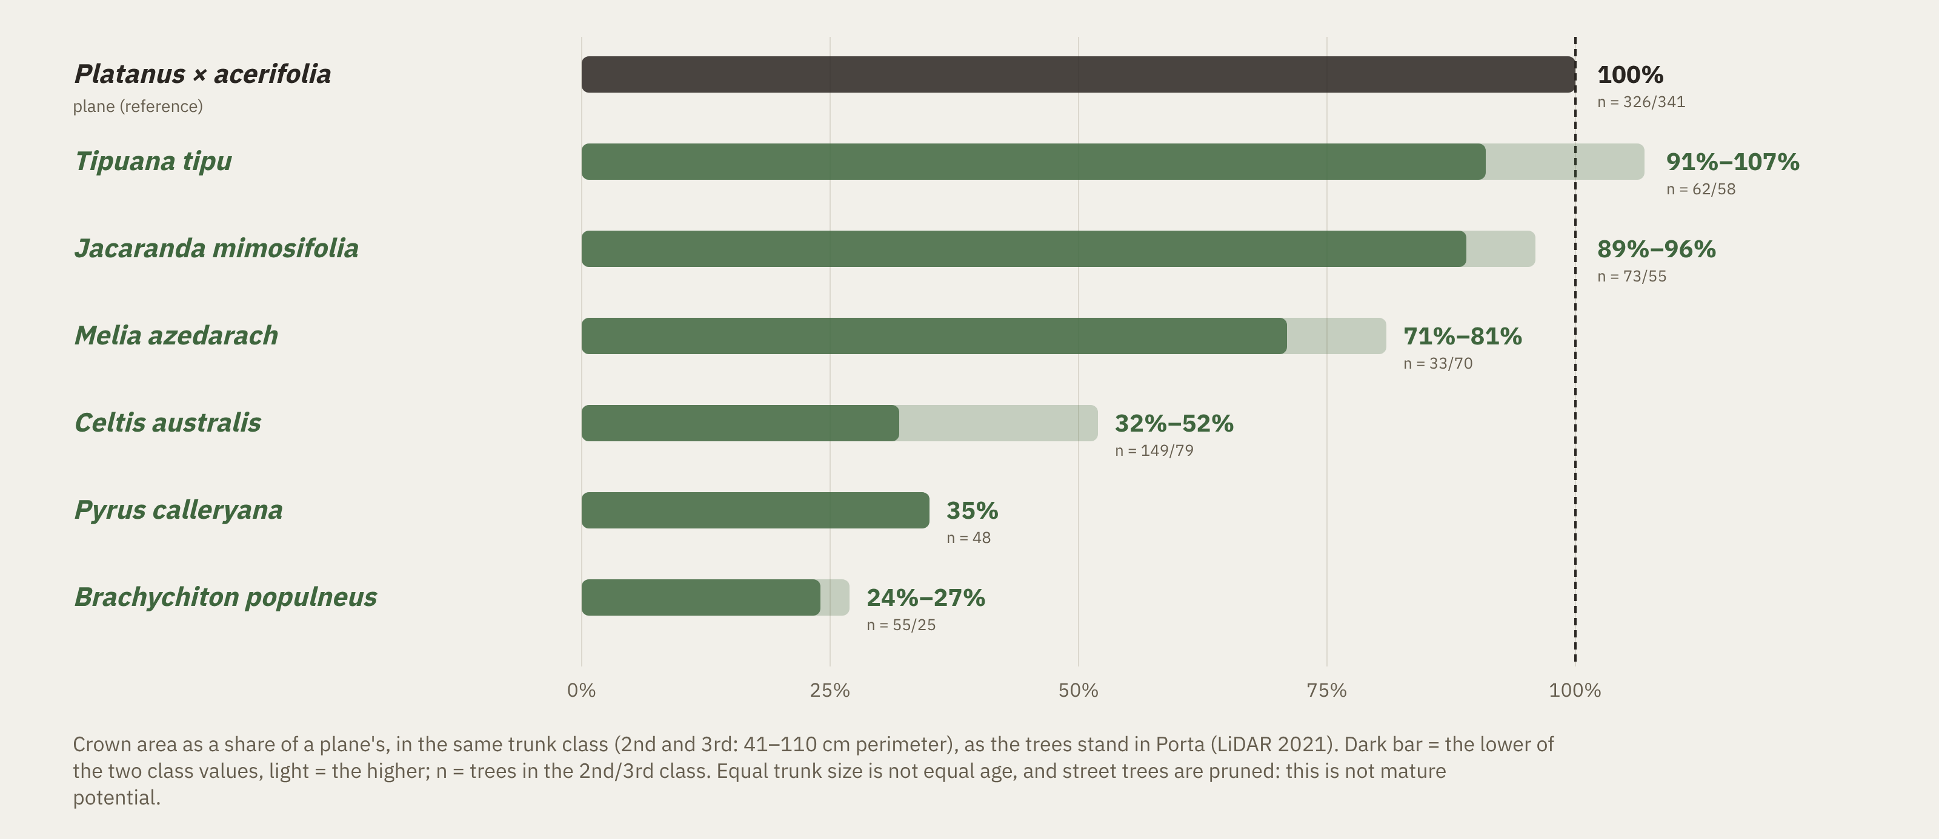
Why it matters: the crowns differ
Crown area as a share of a plane's, same trunk size, Porta's own trees
Sources: ICGC, LiDAR flight of 26 Sept 2021; Ajuntament de Barcelona, arbrat viari (trunk class).
Notes:
Why measuring matters: at the same trunk size, the candidates carry very different crowns. Tipuana and Jacaranda are close to a plane. Melia is three quarters. Celtis, Pyrus and Brachychiton carry between a quarter and a half. All of them follow the city's rules. The shade and rain interception left on the street can differ three- to fourfold.

Slide 7
The gap
Rules without numbers, tools without species or runoff, and a cap with no evidence behind it
IN PRACTICE
IN RESEARCH
Rules for which species: catalogue, sidewalk size, 15% cap
Heat and runoff for fixed scenarios, no species (Mannucci et al. 2025)
No number for what a choice does to heat or runoff
Optimisers: heat only (Shaamala 2025; Peng 2026), or a species mix with no positions (Dong 2026)
Nature Plan: "which species for shade, where" still to study
Trait-based recommender, runoff switched off (SylvCiT; Nicol et al. 2026)
IN THE DIVERSITY LITERATURE
Species caps are rules of thumb; far below the current share, “well adapted species may be abandoned” (Kendal et al. 2014, p. 415). Planes: ~27% vs a 15% cap.
This method: trait-based, inside the city's rules, scored on heat and runoff, per position.
Sources: Mannucci et al. 2025; Shaamala et al. 2025; Peng et al. 2026; Dong et al. 2026; Nicol et al. 2026 (PLoS One); Santamour 1990 (METRIA 7); Kendal, Dobbs & Lohr 2014 (UFUG 13); Ajuntament de Barcelona, Pla Natura 2021–2030 p. 114.
Notes:
In practice there are rules but no numbers. In research, the tools either assess heat and runoff without species, or optimise heat alone. The most advanced trait-based recommender, SylvCiT, has its runoff module switched off. And the diversity literature itself warns about Barcelona's case. The fifteen percent cap is a rule of thumb. Kendal and colleagues, looking at 108 cities, warn that a target far below a species' current share risks replacing well-adapted trees with weaker ones and changing what they provide. The planes are at twenty-seven percent. That is where this method sits.

Slide 8
The research question, scrutinised
One main question, four sub-questions, each with a metric
When a street project in Barcelona must replace trees, can a trait-based layout method, inside the city's tree rules, choose the new species and positions, and new planting spots, so that pedestrian cooling and storm-water interception improve, or at least do not get worse, compared with the city's own practice and with today?
SQ1 · heat
Mean UTCI 12–17 h on a hot design day
SQ2 · runoff
Total and at flood hotspots, 2-yr 60-min storm; larger than the model resolves (Δmin)?
SQ3 · trade-off
Do the heat-best and runoff-best layouts differ, and in which species?
SQ4 · additions
How much of the gap to 30% can new street trees close, and where?
Changed after scrutiny: 'reduce' → 'improve, or at least do no harm' (city's practice first, then today) · any tree a project replaces, planes as the validated case · additions co-equal · 'not resolved' is an allowed answer · baseline = the city's observed replacement mix (S1b), with the announced mix (S1a) beside it
Notes:
I scrutinised the question part by part; the table is in my notes. Four changes matter. First, the question starts from the project: any tree that has to be replaced, with the planes as the first, validated case. Second, 'reduce' became 'improve, or at least do no harm'. Replacing a plane almost always loses some shade compared with today, so the first test is against the city's own practice, and today is the target, reached with new trees. Third, additions are an equal part: replace, add, or both. Fourth, every sub-question has a metric and a threshold. For runoff, 'not resolved by the model' is an allowed answer, because the differences are close to what the model can tell apart. The baseline is what the city actually plants where a plane goes, from its own inventory since 2018, next to its announced 2026 mix, both placed by its sidewalk rule; the 2004 table is cited, not run.

Slide 9
Hypotheses
Do no harm, improve where possible: two to test, one declared limit
H1
No worse than the city's practice on heat or runoff, better on summer heat
For any tree a project replaces. Runoff is a check: below Δmin = 91 m³ it is 'not resolved'; pits and grouping matter more than species
H2
The heat-best and runoff-best layouts differ in species
Tested on the Pareto front (SQ3)
Boundary
At extreme storms, street trees cannot matter
Was H3; true by construction of the model, so declared, not tested
Notes:
Two hypotheses. H1 is 'do no harm': the method is never worse than the city's practice on heat or runoff, and better on summer heat. For runoff this is a check: species matter little, the tree pit and grouping matter more. H2: the best layout for heat and the best for runoff differ. And one declared boundary: at extreme storms trees don't matter. It used to be a hypothesis, but the model makes it true by construction.

Slide 10
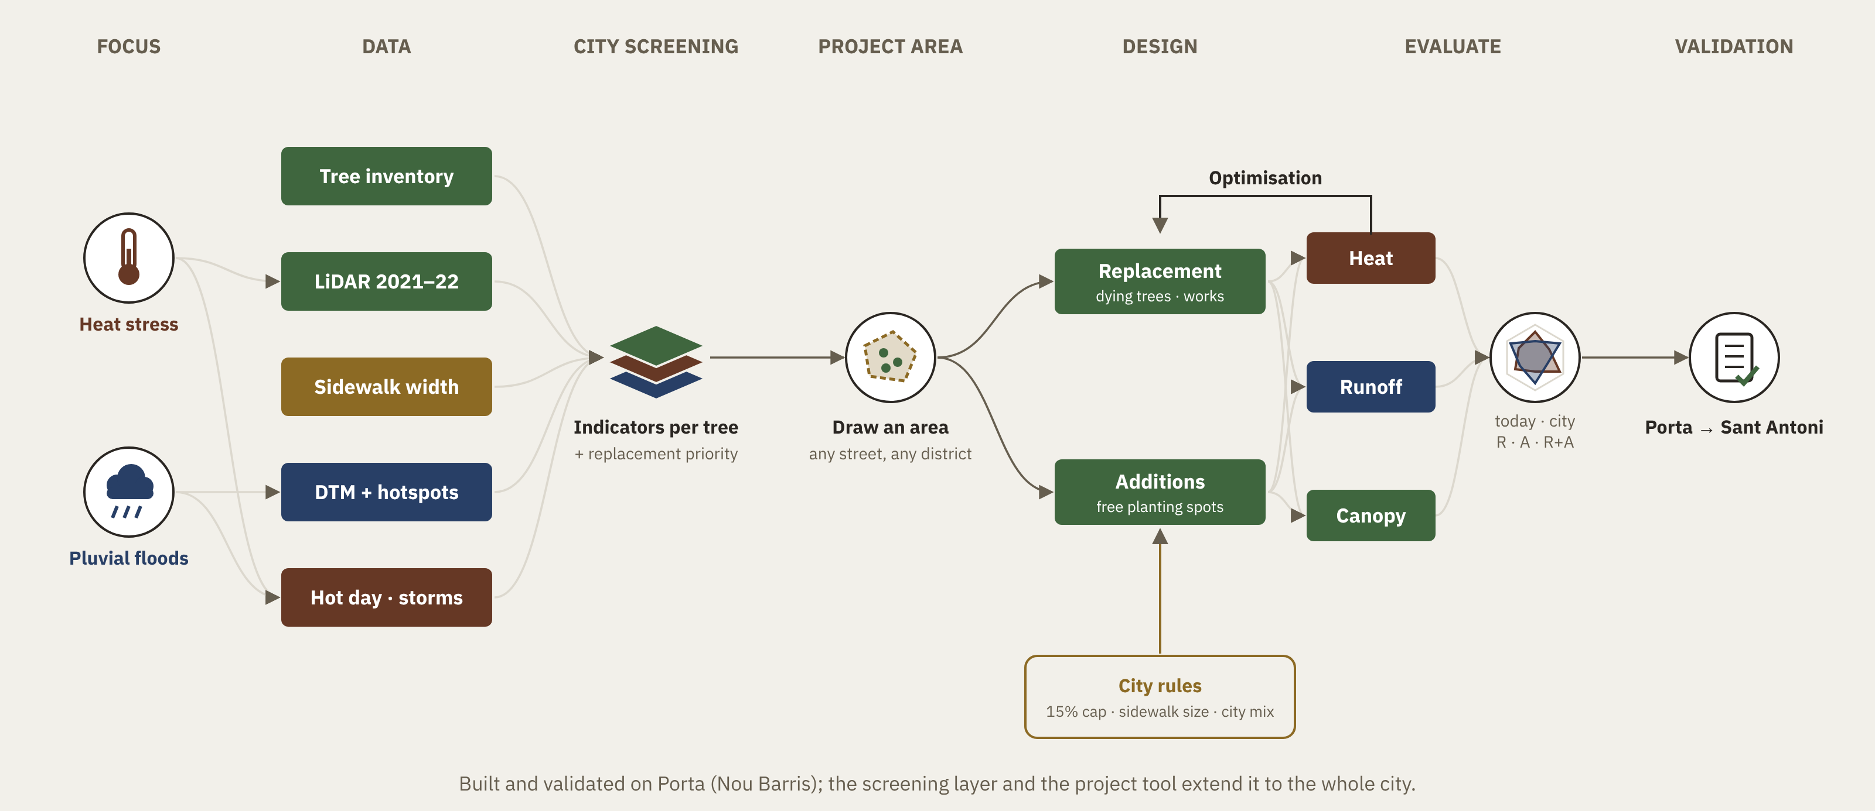
Methodology
Which species replace the trees a project must cut, and where to add new ones
Notes:
Here is the method on one page. Two hazards, heat and pluvial flooding. Open data: the tree inventory, LiDAR, sidewalk widths, terrain and flood hotspots, the hot day and the design storms. First a screening layer: indicators for every tree. Then a designer draws a project area. Inside it, two branches: replacing the planes, and adding trees in free spots. The city's rules are a hard input: the fifteen percent cap, the sidewalk size, the city's mix. Every layout is scored on heat, runoff and canopy and compared on one chart. Then validation.

Slide 11
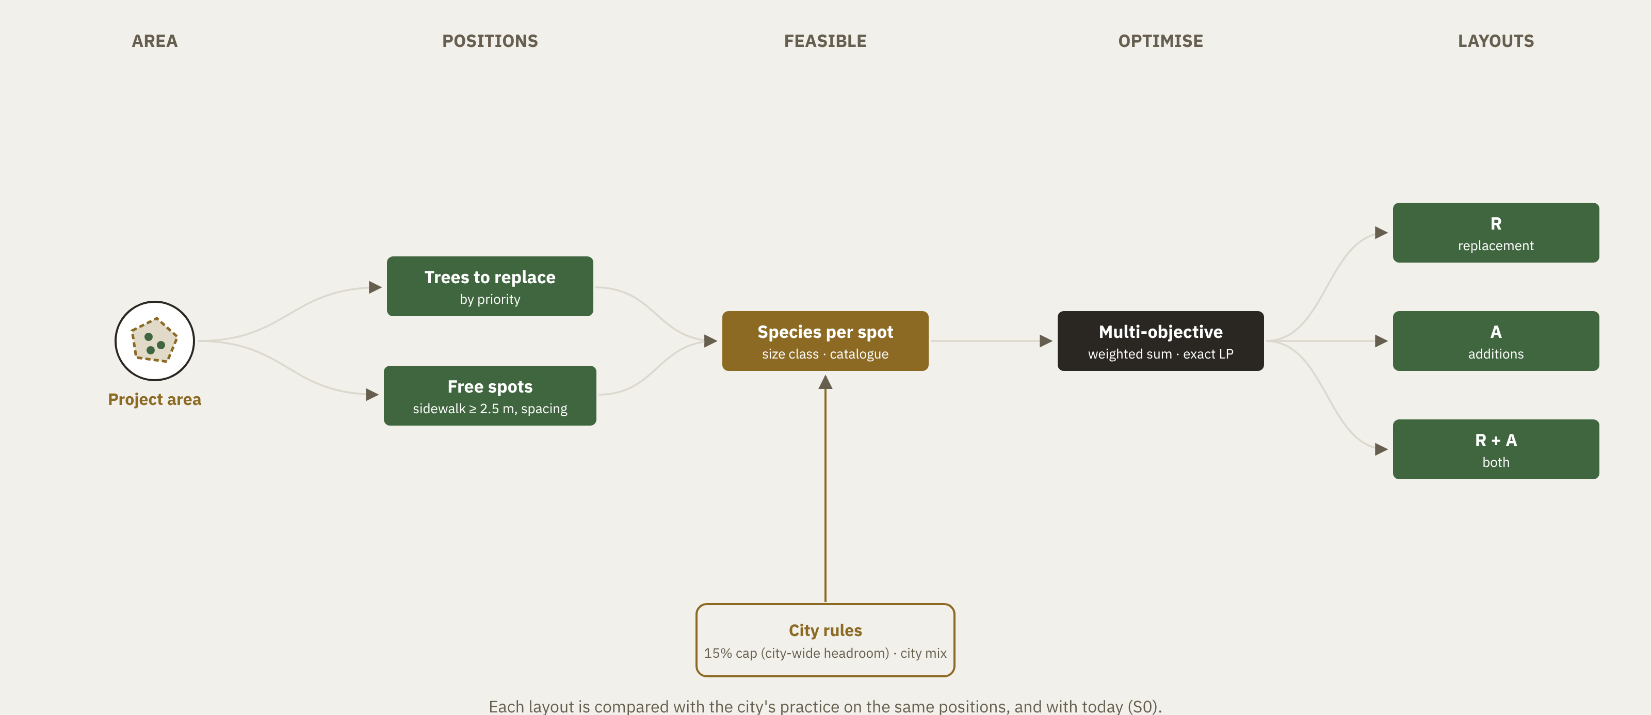
Design module
Inside the project area the designer draws
Notes:
Inside the project area: planes to replace, ranked by priority, and free spots. Each spot gets the species that fit its sidewalk and the catalogue, and the optimiser picks the combination. Every layout is compared with the city's rule on the same positions. This is what makes it concrete: it works for one street rebuild, not only for a whole district.

Slide 12
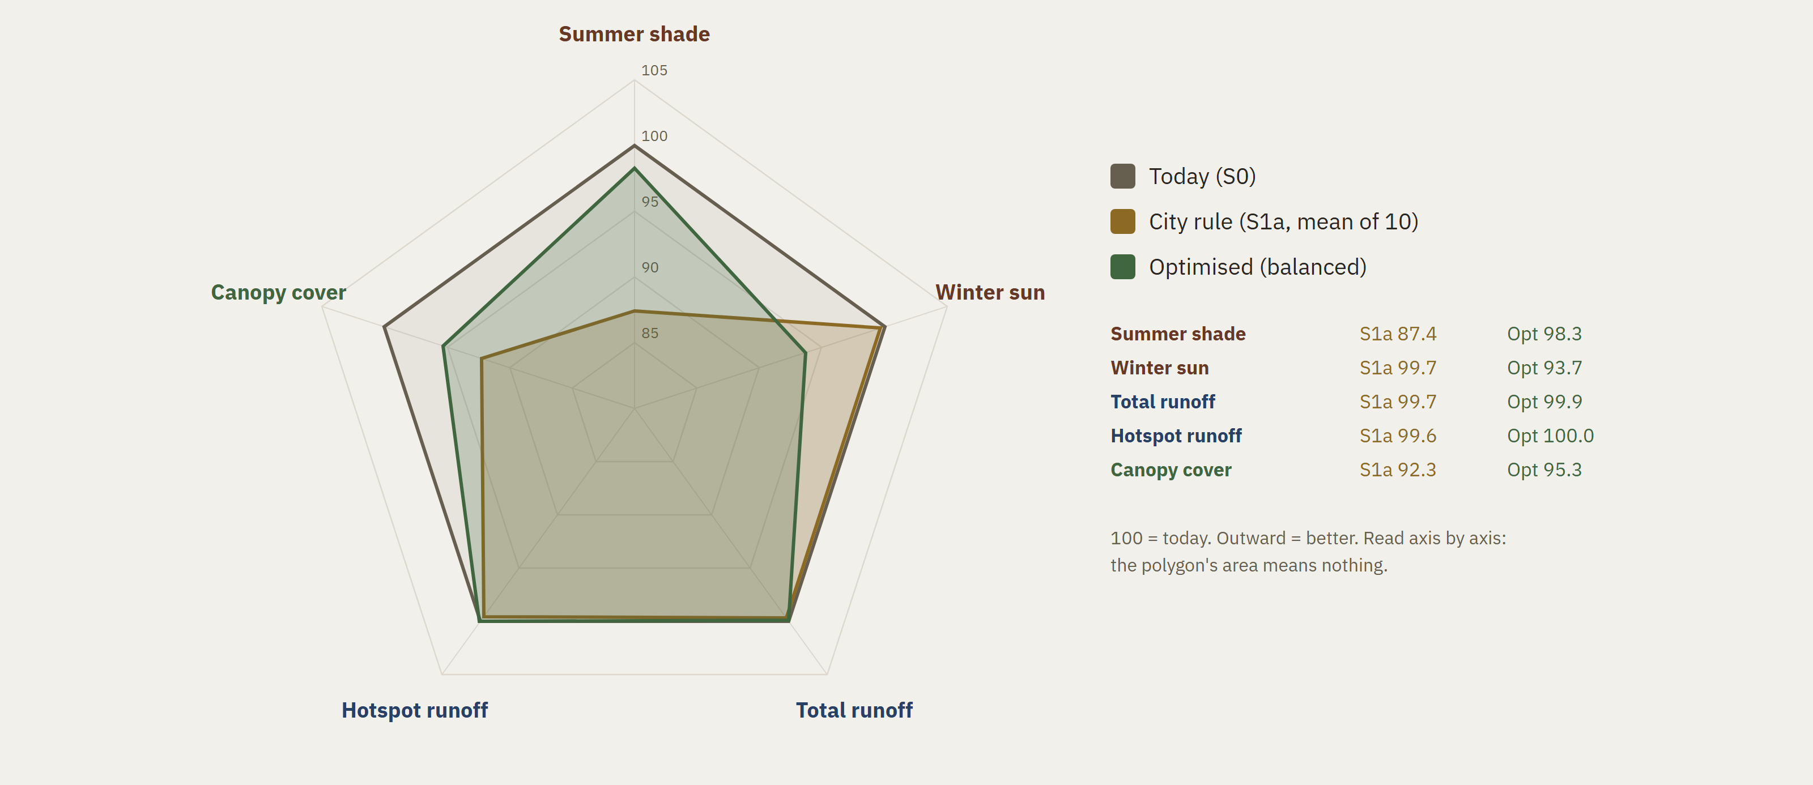
First results: replacing Porta's 832 plane trees
The optimised layout keeps almost all of today's summer shade; the city's announced mix loses about an eighth
Sources: City mix: Betevé, 7 May 2026. Storm: PDISBA, 2-year 60-min. Heat = shade proxy, not yet UTCI.
Notes:
First results, for all 832 planes in Porta. Heat here is effective shade, not yet UTCI. Each axis is normalised to today, a hundred. The city's announced mix keeps eighty-seven percent of today's summer shade, and what it has actually planted since 2018 about ninety. Choosing species by traits, under the same rules, keeps ninety-eight. The price is more shade in winter, about six percent, which is a real trade-off. On runoff, the difference is thirty-four cubic metres. That is below what the model can resolve, so for runoff the answer today is 'not resolved'. That is a result too, and an honest one.

Slide 13
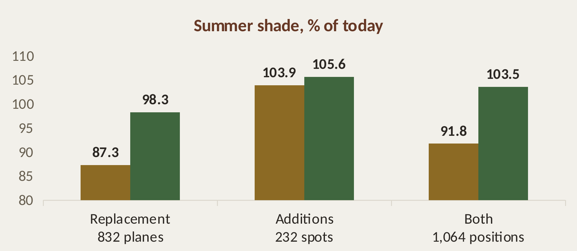
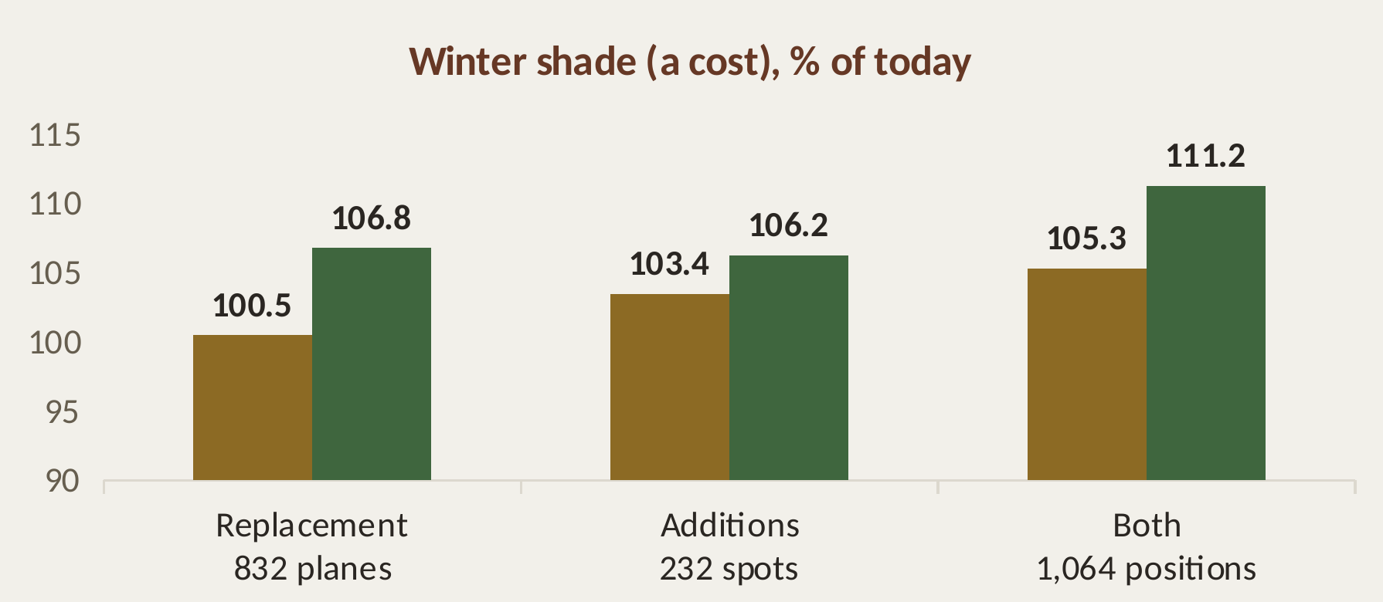
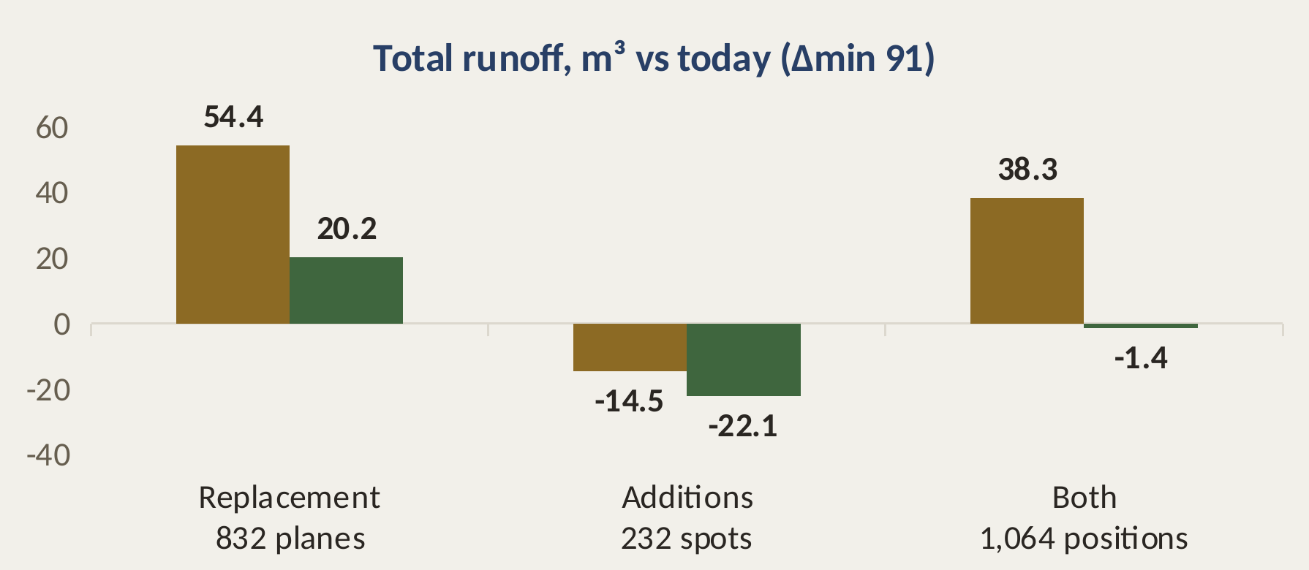
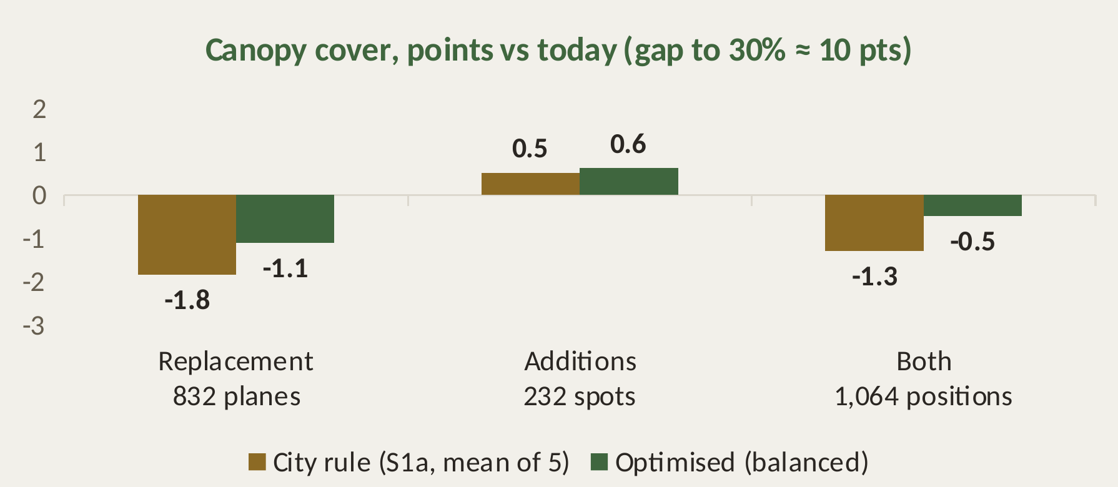
Replacement, additions, or both
Once the planes go, only trait-based choice plus additions gets back above today
Sources: Free spots by the spacing rules of Gestió de l'arbrat viari de Barcelona (2011); an upper bound. Heat = shade proxy.
Notes:
Then I added trees. In Porta there are 232 free spots on sidewalks wide enough under the city's rules, away from crossings and bus stops. That's still an upper bound, because driveways and services aren't in the data. Keeping the planes and adding trees gives the most shade, but the planes are going. Once they go, the city's rule plus the same new trees still ends below today, at ninety-two percent. Trait-based replacement plus additions ends above today, at a hundred and three and a half. So the combination of the two levers, chosen with numbers, is the only path that does better than today. But the additions do not bring Porta to thirty percent: all 232 trees add about 0.6 points of cover, about six percent of the gap. On these streets new trees make up for the summer shade that replacement loses, not even for the crown cover: both levers together still end half a point below today. The rest of the target has to come from squares, parks and courtyards.

Slide 14
City-wide: 28 barris, one layout
Summer shade gained over the city's mix, one optimisation under the 15% city cap
+9.2 pts
median gain of summer shade over the city's mix
27 of 28
barris gain (31,580 planes)
Bonanova
loses a little: with one city cap the capped species go where they add most
small gain
large gain
loss
not computed
Porta
Sources: Outlines: Open Data BCN (CC BY 4.0). Cap: Pla director de l'arbrat 2017–2037. City mix: Betevé, 7 May 2026. Heat = shade proxy, not UTCI.
Notes:
Then I ran the same method on every barri with at least five hundred planes: twenty-eight barris, thirty-one and a half thousand planes, in one optimisation under the city's fifteen percent cap. Against the city's own mix, the median gain is nine points of today's summer shade, and twenty-seven of twenty-eight barris gain. One, la Bonanova, loses a little: with one cap for the whole city, the capped species go where they add most. Three barris, Porta among them, end above today.

Slide 15
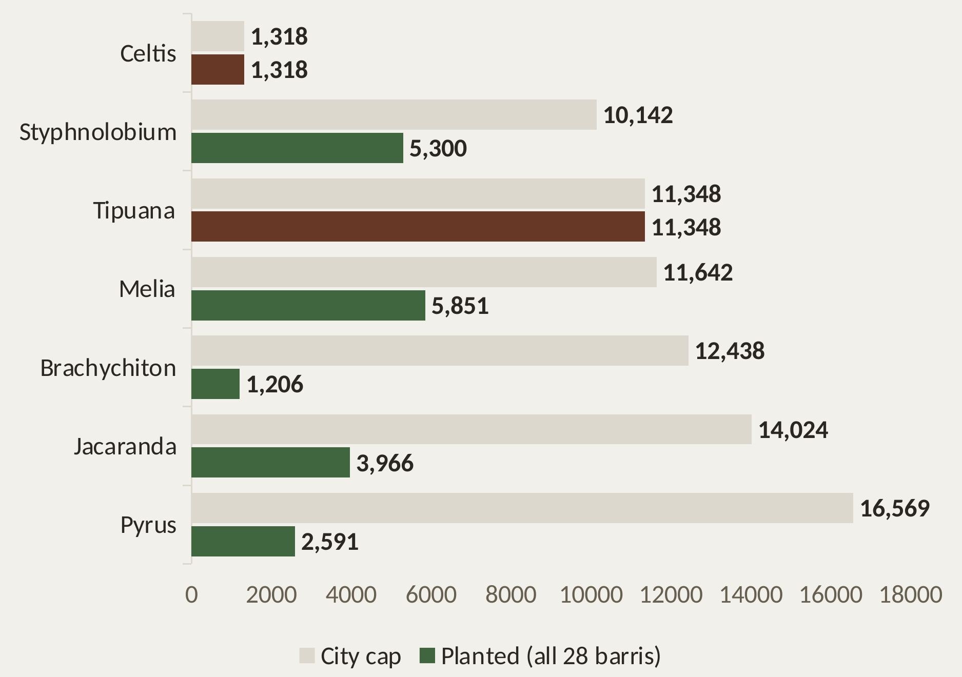
Two rules: a city cap and a local ceiling
The city's 15% fixes how much of each species; the local ceiling stops any barri ending more concentrated than today
1. CITY CAP: how much of each species
No species above 15% of the city's street trees (master plan).
2. LOCAL CEILING: no barri more concentrated than today
No species ends with more trees in a barri than it has planes today. Diagonal Mar: Tipuana 48.5% → 37.2%. Costs little shade.
Limit: barris with few planes (Baró de Viver, 15) need a different ceiling.
Dark red = at the cap: Celtis and Tipuana.
Sources: Outlines: Open Data BCN (CC BY 4.0). Cap: Pla director de l'arbrat 2017–2037. City mix: Betevé, 7 May 2026. Heat = shade proxy, not UTCI.
Notes:
Two rules make this work. The city's cap fixes how much of each species. A local ceiling, my addition, stops any barri from ending more concentrated than today: without it, one barri got almost half Tipuana. Celtis and Tipuana end at the cap. The ceiling has a limit: where very few planes are replaced, it can leave no species that fits a spot, so small barris need a different rule.

Slide 16
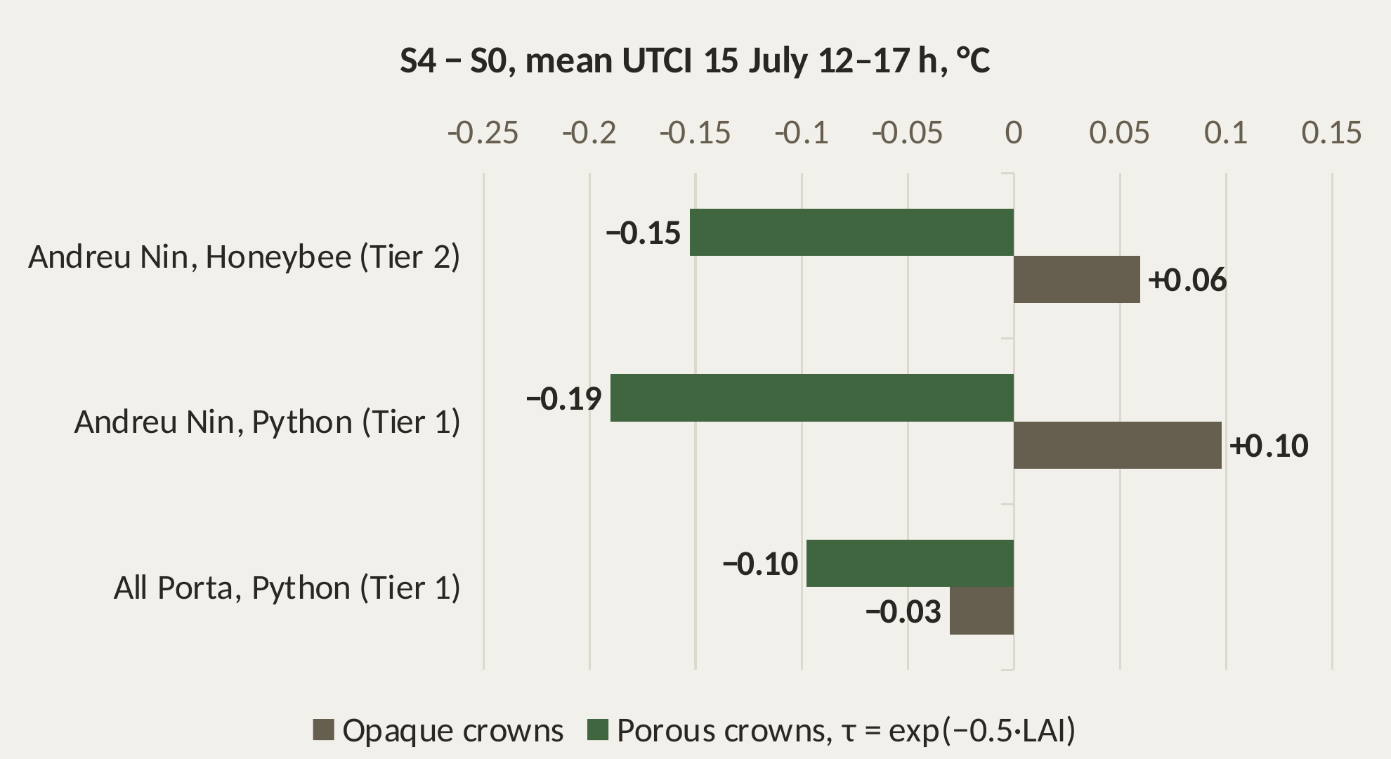
Validation: a first heat check
UTCI from Ladybug and Honeybee, today's planes (S0) vs the tool's layout (S4)
r = −0.73
shade proxy vs Ladybug UTCI across 1,974 points
r = −0.82
on the S4 − S0 change per point
Claim: for heat, no worse than today's planes within model uncertainty.
Python chain = Ladybug in Grasshopper within 0.02 °C. 15 July is an ordinary day, not yet the hot design day.
Sources: Ladybug Tools (Ladybug, Honeybee/Radiance); weather: El Prat TMYx 2011–2025 (climate.onebuilding.org); porous crowns after Peng et al. 2026.
Notes:
First independent check of the heat proxy: UTCI, today's planes against the tool's species. The proxy ranks points as Ladybug does, so it is fit for choosing positions. I rebuilt the Ladybug chain in Python; it matches Grasshopper to two hundredths of a degree and lets light through the crowns by their leaf area. Honeybee with Radiance agrees. The two layouts differ by about a tenth of a degree, on one street and over all of Porta, and the sign depends on whether crowns are opaque or porous. So my claim for heat is modest: no worse than today's planes. The gain over the city's practice is the summer shade kept, under the cap; runoff is a check, and winter sun is a cost. Four questions: may I extend the method to every tree a project replaces, keeping the planes as the validated case? Does Infrared model porous crowns, is Sant Antoni enough as a transfer test, and may one barri lose while the city gains?

Slide 17
What comes next
Five weeks to the final delivery, one theme a week
11–15 Nov
16–22 Nov
23–29 Nov
30 Nov–6 Dec
7–18 Dec
Every tree
Heat
Transfer
Tool
Deliver
Any tree a project replaces, not only planes
City layout against S1b
Demo: Santapau · Emili Roca · Desfar works
UTCI of the final layouts
Infrared City, ENVI-met check
Hot design day · priority score
Sant Antoni: repeat the checks (tool already run)
Mataró: Catalan city, ICGC LiDAR
Florence: city LiDAR + 1,459 measured trees
City screening layer
GeoPackage + QGIS style · web app
Co-benefits per layout
Booklet
Final presentation
Defence 10–23 Dec
Writing, every week: update chapters 3 and 5 → write 6 and 7 → then 1, 8, 9 and the abstract
Florence LiDAR waits on the Comune's delivery agreement; Mataró's per-tree species table is not yet confirmed.
Notes:
Backup.

Slide 18
Co-benefits not optimised (yet)
Reported after 10 Nov, not objectives of the tool
Pollen
Plane pollen gets the top allergen score (4 of 4) in a Spanish species index
Species index exists (IUGZA, Cariñanos et al. 2014). Replacing planes likely gains here; to compute per layout
Carbon
Storage grows steeply with trunk size, and the planes are large
The tool's mix may lose here at first. Urban allometry (McPherson et al. 2016); reported even if it loses
Diversity
The 15% cap and the local ceiling already act on it
Already computed (effective species, as in SylvCiT): to report per barri, before and after
Ozone · VOC
Some species emit isoprene; ozone also depends on local NOx
Not modelled: a declared limit
The master plan already lists allergies and VOC among the disservices to avoid, with no number per species.
Sources: Cariñanos, Casares-Porcel & Quesada-Rubio 2014 (Landsc. Urban Plan. 123:134-144); McPherson, van Doorn & Peper 2016 (PSW-GTR-253); Pla director de l'arbrat 2017–2037 §1.3.4, p. 14.
Notes:
Backup.

Slide 19
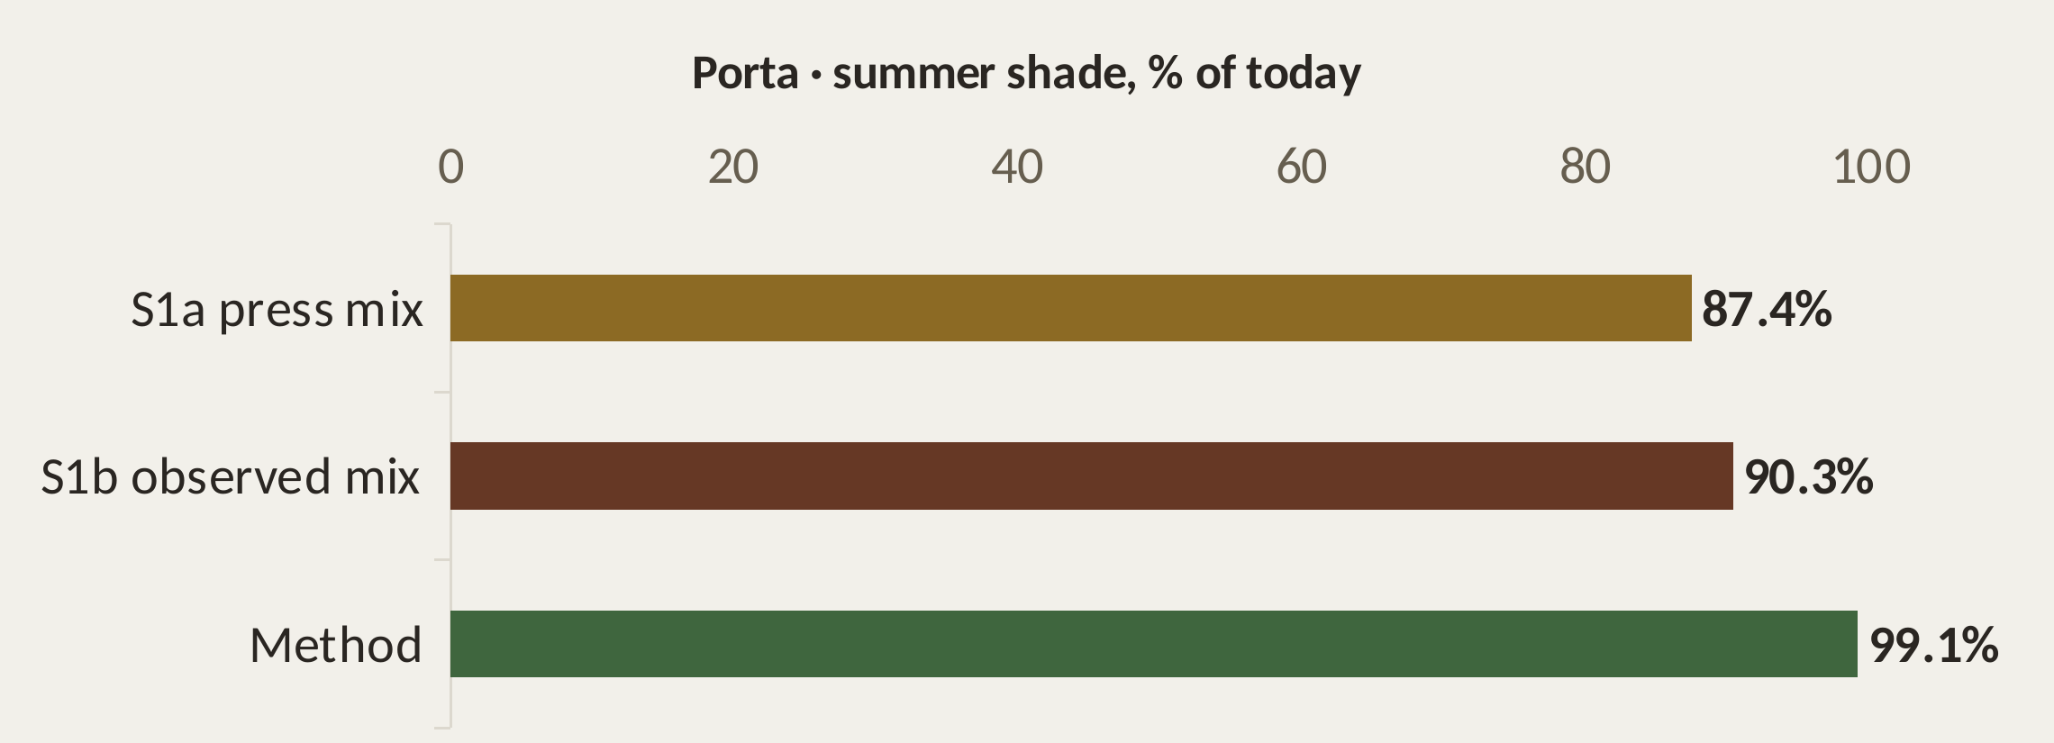
The city's baseline: from press to practice
The method beats both the announced and the observed mix
S1-2004
S1a
S1b
Parcs i Jardins table (district × sidewalk): documented, qualitative. Cited, not run
The 2026 target mix (press, May 2026), drawn within the sidewalk sizing rule
What the city actually planted where planes were replaced, 2018–2026: 1,444 cases
+5.7 · +7.2
Median margin of the method over 33 barris (points): vs S1a · vs S1b. No barri ≤ 0
Sources: Open Data BCN, arbrat viari, 35 quarterly inventories 2018–2026; Betevé, 7 May 2026; Parcs i Jardins, Arbrat viari: selecció d'espècies (rev. 2004).
Notes:
Backup.

Slide 20
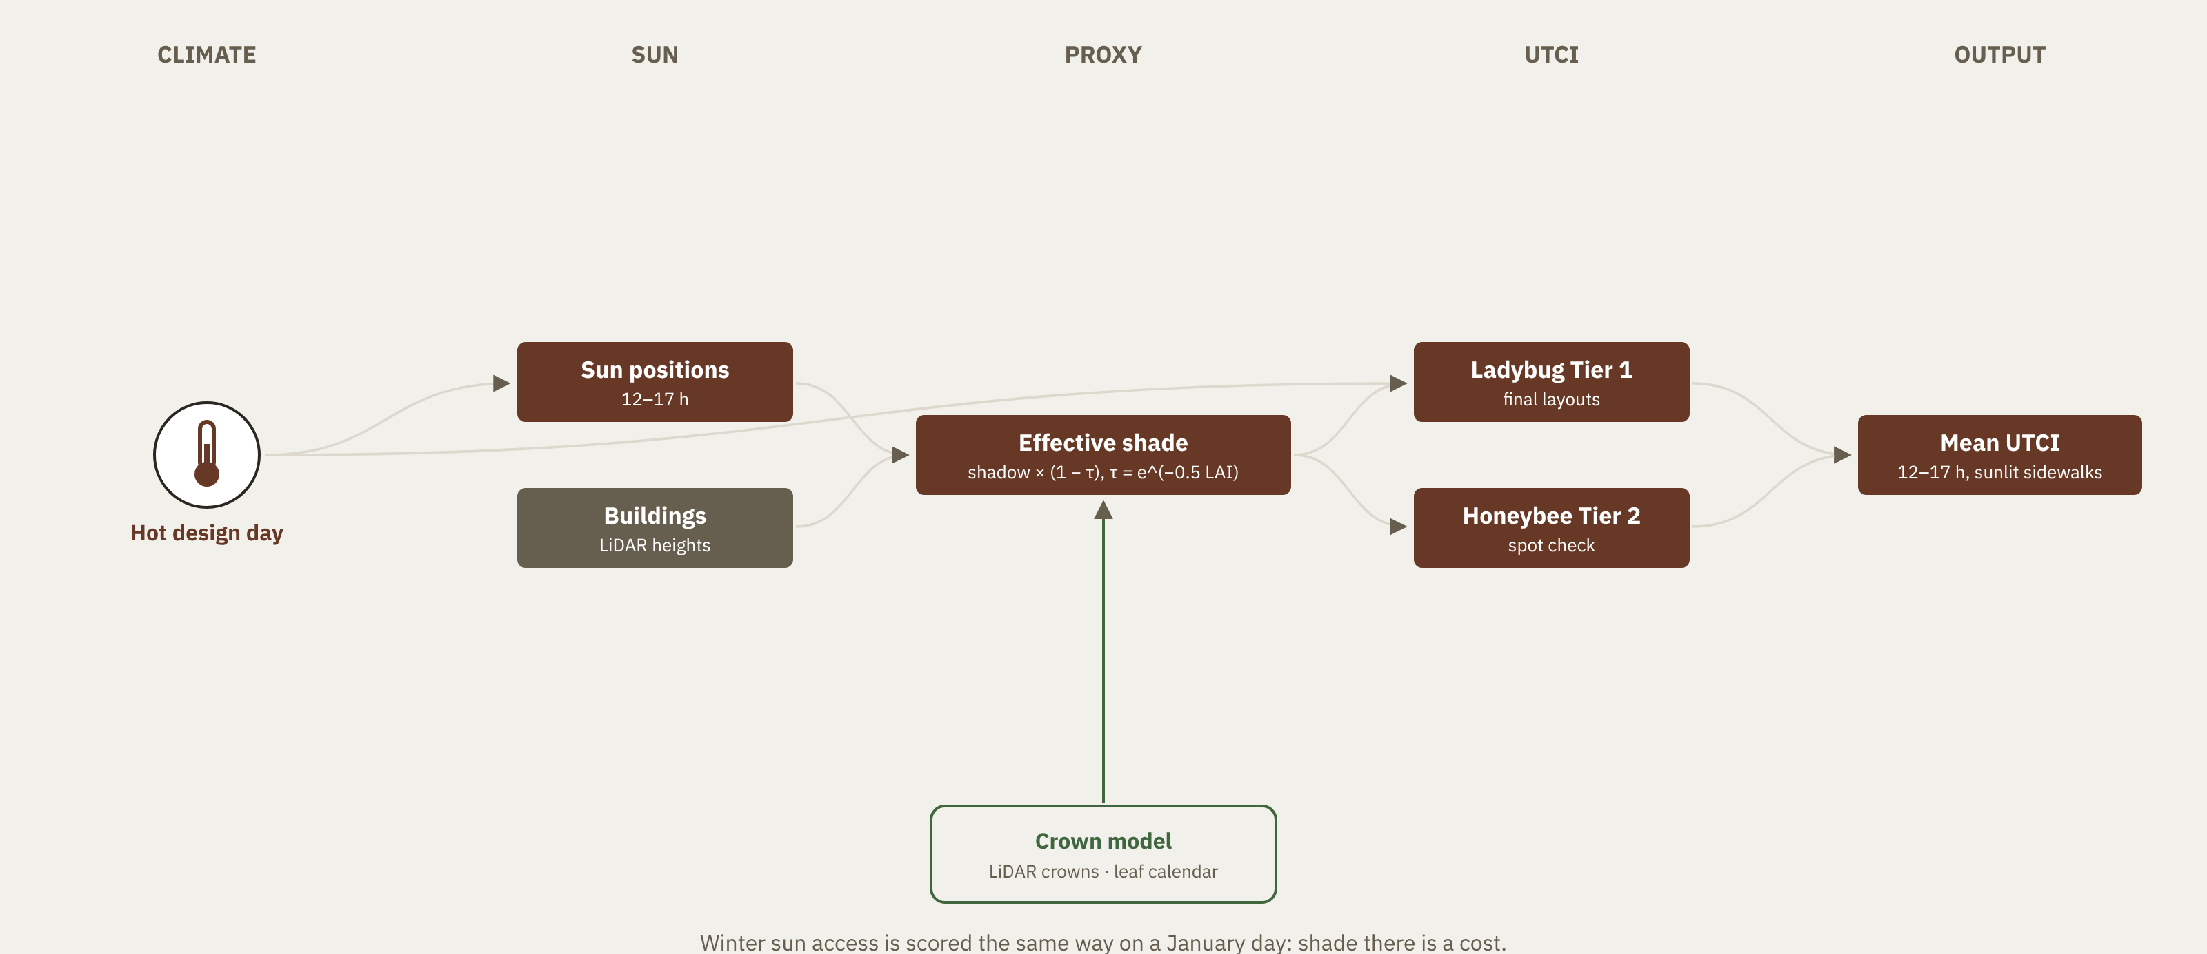
Backup B1 · Heat module
Fast proxy inside the loop, full UTCI on the final layouts
Notes:
Backup.

Slide 21
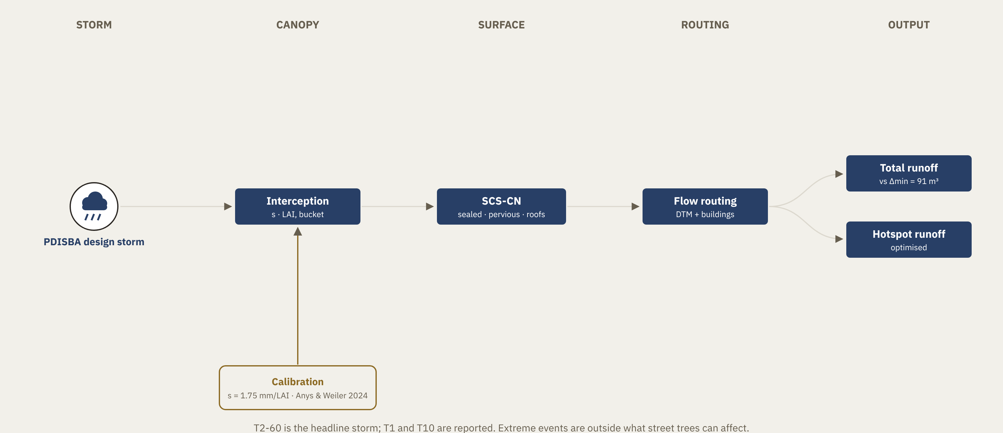
Backup B2 · Runoff module
Event runoff on a 1 m grid, routed to the flood hotspots
Notes:
Backup.

Slide 22
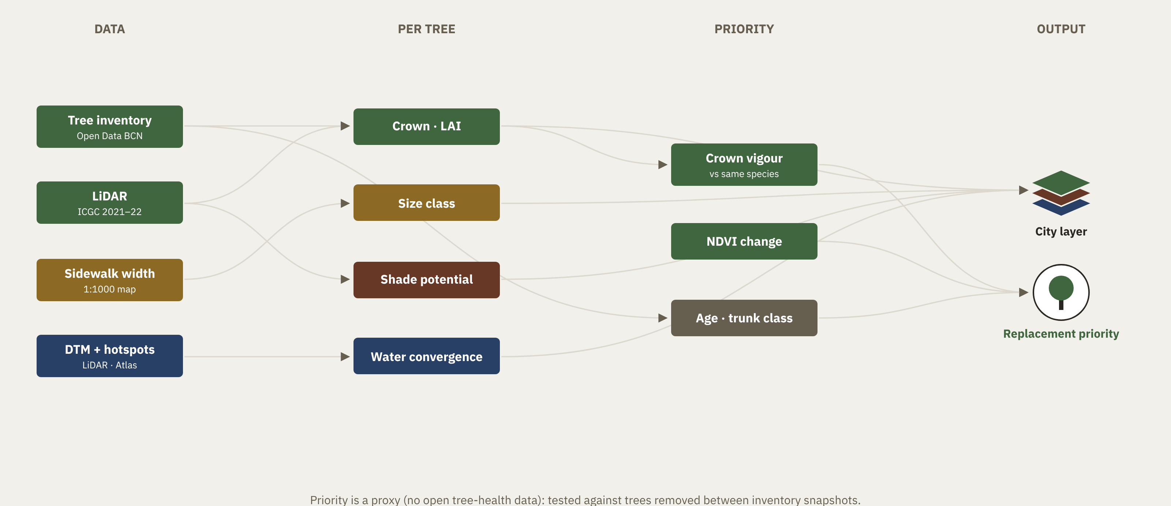
Backup B3 · City screening
Indicators for every street-tree position
Notes:
Backup.

Slide 23
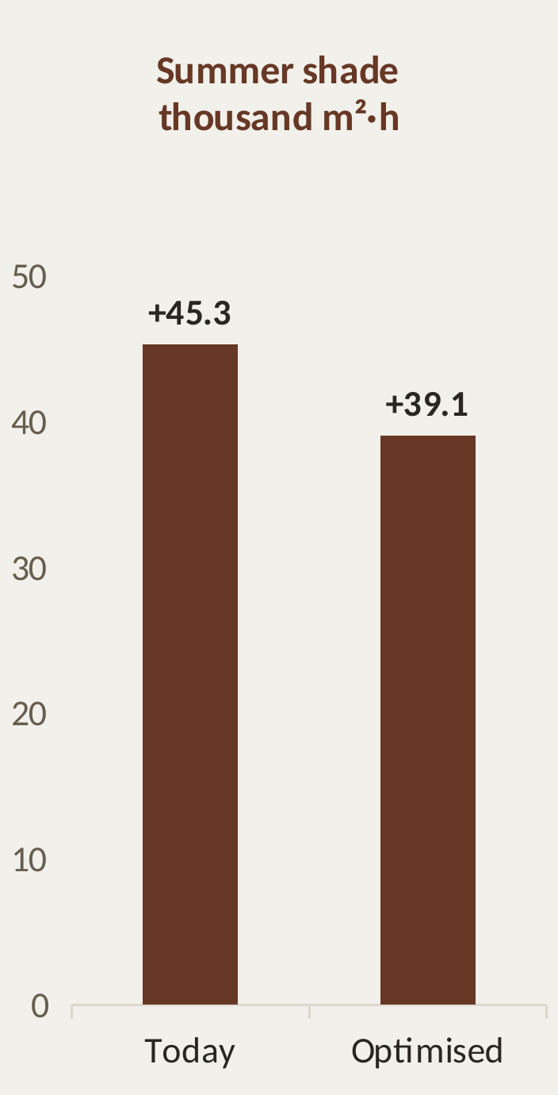
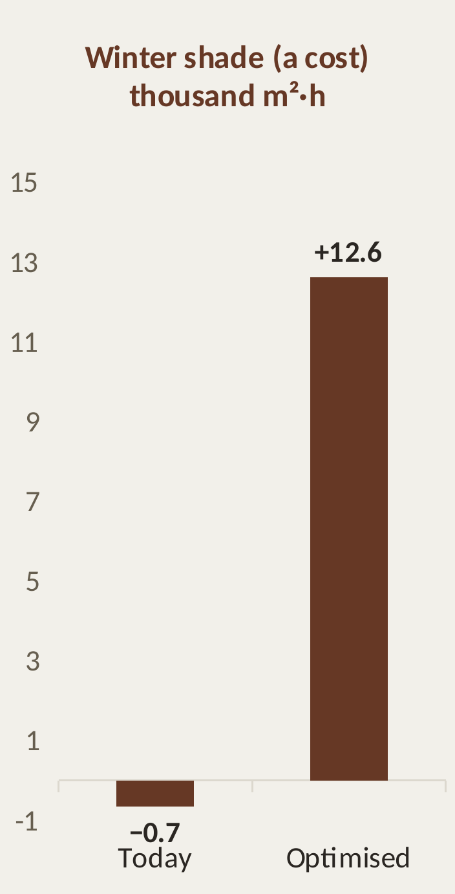
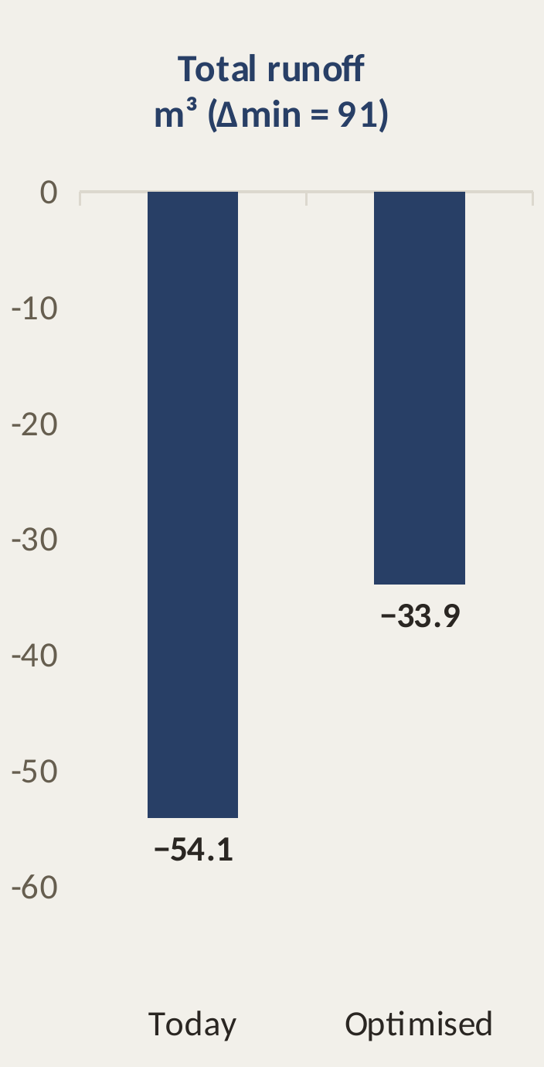
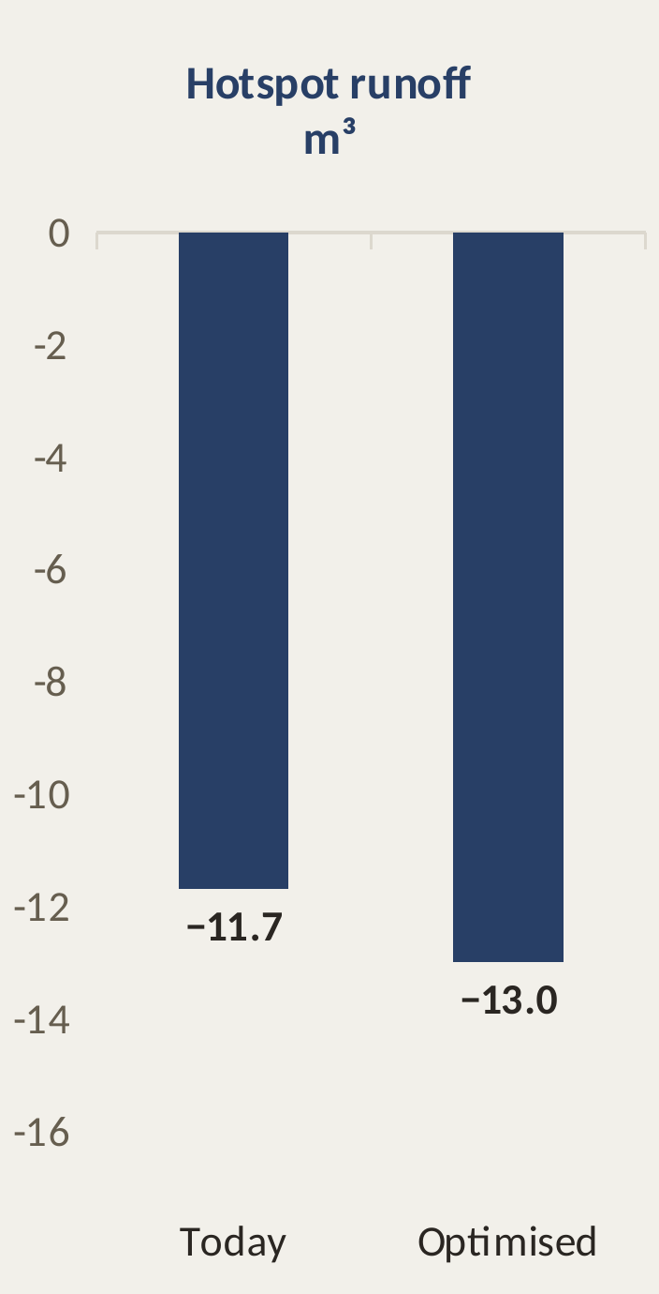
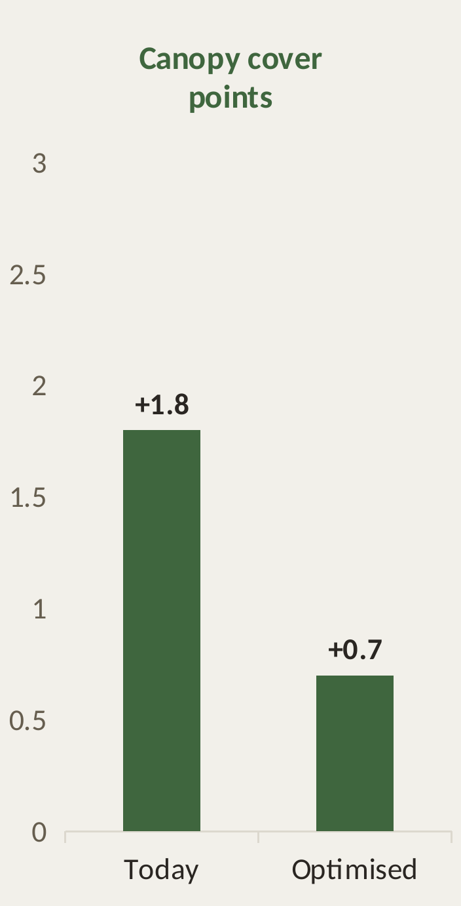
Backup B4 · Results in real units
Difference from the city's mix (S1a), Porta; runoff stays inside ±Δmin
Bars = layout minus the S1a mean (10 seeds). Heat = shade proxy. Storm: PDISBA 2-year 60-min.
Notes:
Backup.

Slide 24
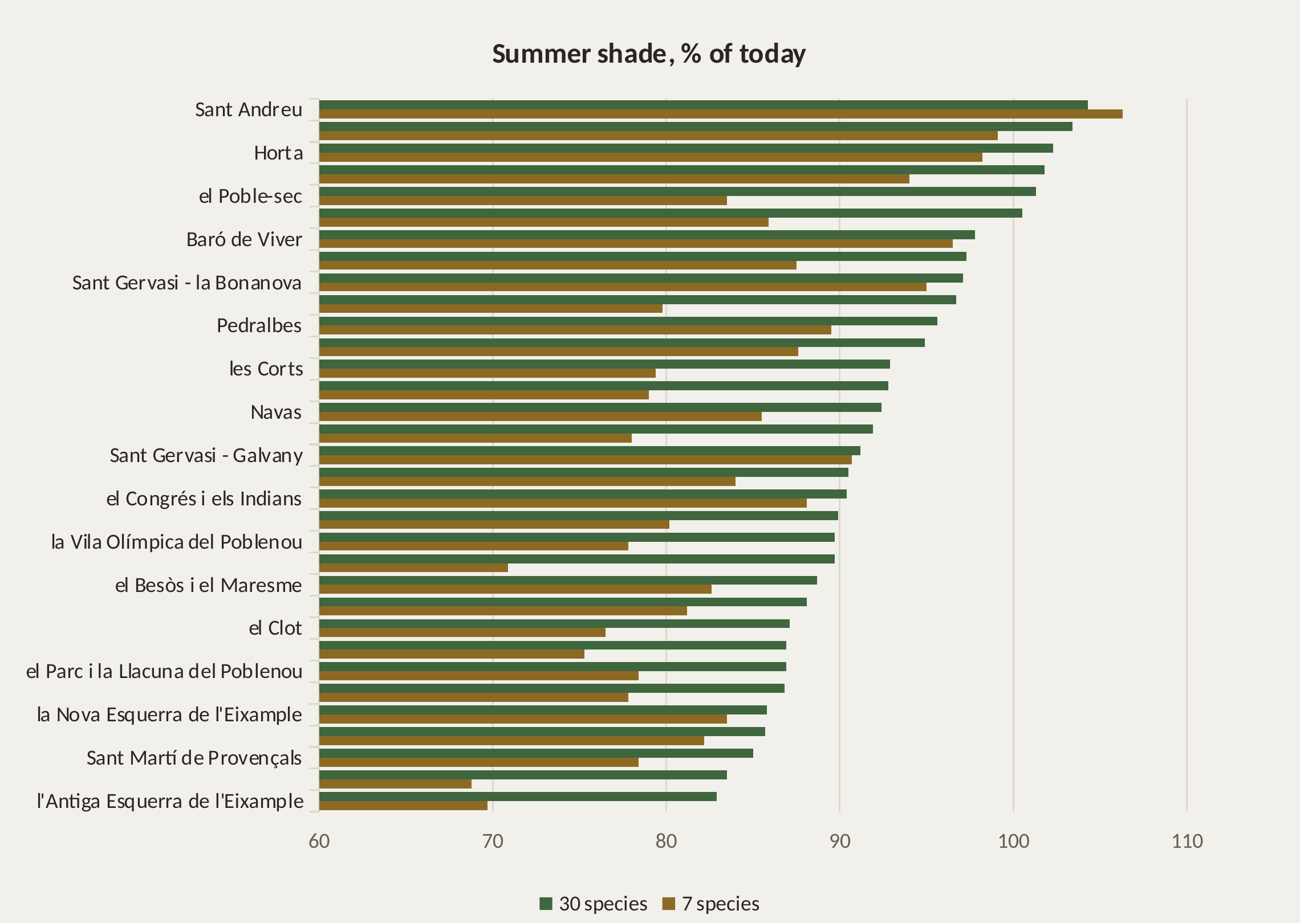
Backup B4b · Wider palette (30 species)
Same rules, the city's catalogue instead of 7 species: Porta and 32 barris, each optimised alone
+8.2 pts
median summer-shade gain over 7 species (31 of 32 barris gain)
96–128%
of today's winter shade: the price (more evergreens)
30 species = the 2011 guide catalogue minus its 4 'avoid' species. The city-wide LP still uses 7.
Sources: Ajuntament de Barcelona, Gestió de l'arbrat viari de Barcelona (2011), species catalogue.
Notes:
Backup.

Slide 25
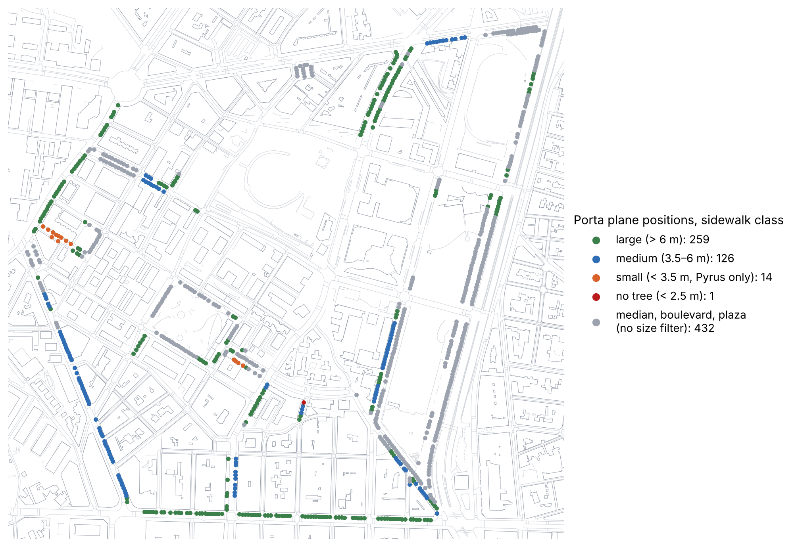
Backup B5 · The sizing rule leaves real choice
Sidewalk width at each Porta plane (2011 guide: < 2.5 m none, < 3.5 small, 3.5–6 medium, > 6 large)
259 + 126
planes keep a real choice: several large or medium species
15
forced to a small tree or to none by the literal rule
432
medians and plaza edges: no size filter (ASSUMPTION)
Sources: Ajuntament de Barcelona, Mapa base topogràfic 1:1000 (CC BY 4.0); Gestió de l'arbrat viari de Barcelona (2011) pp. 22–23.
Notes:
Backup.

Slide 26
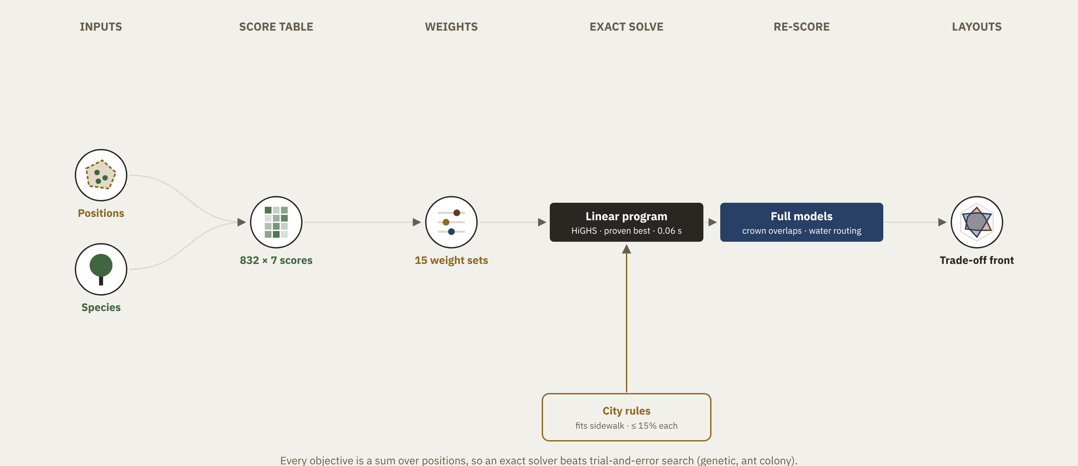
Backup B6 · How the optimiser finds the layout
No trial and error: a score table, then one exact solve per weight set
Sources: HiGHS open-source linear optimisation solver (highs.dev), called through SciPy.
Notes:
Backup.

Slide 27
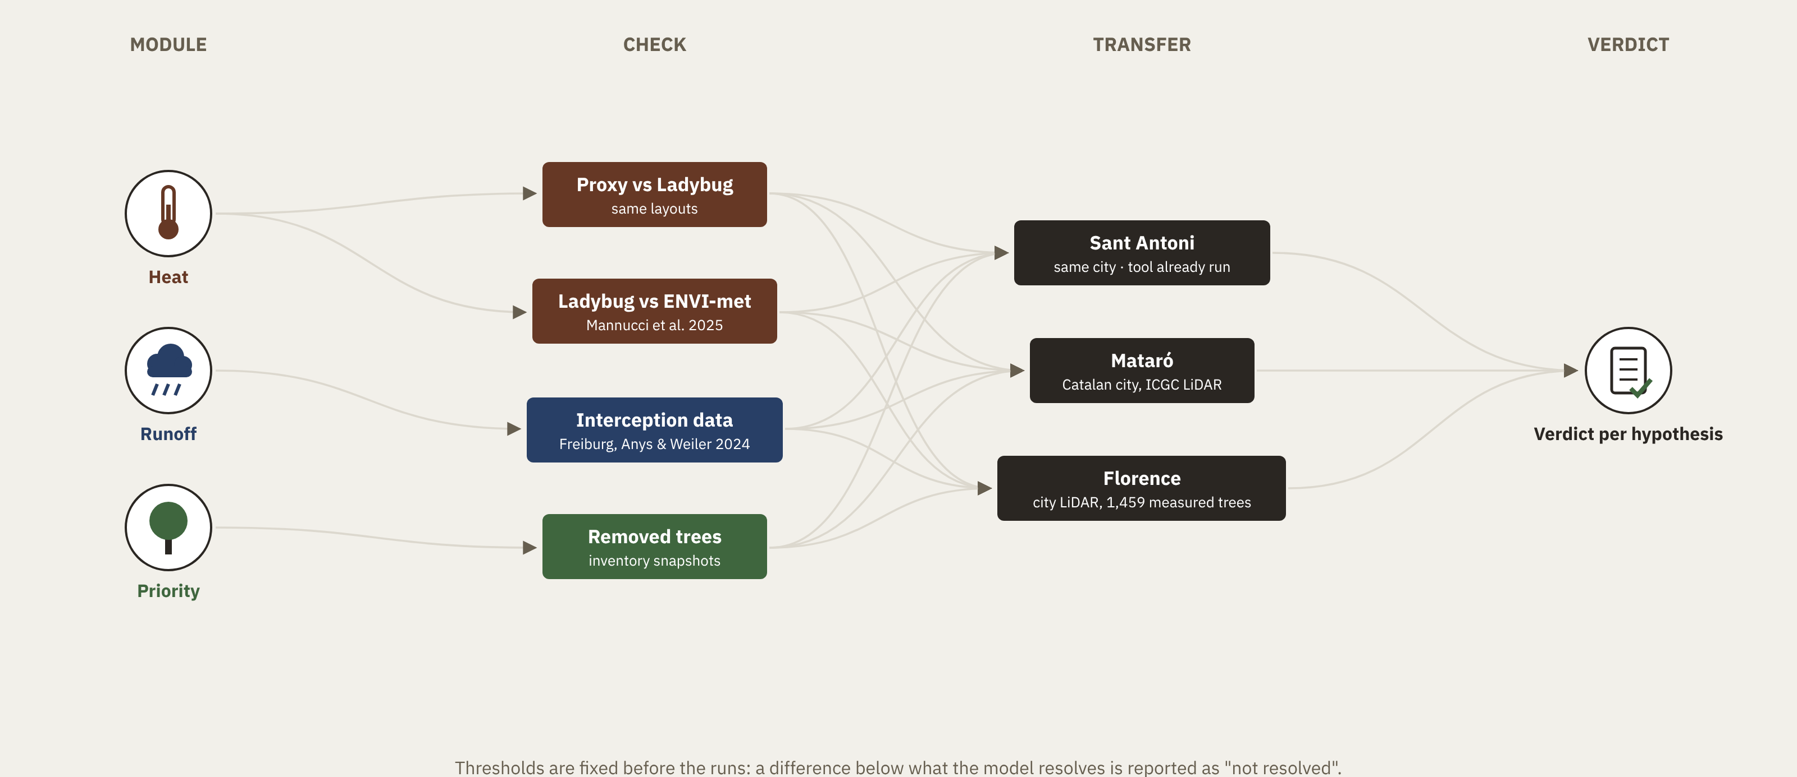
Backup B7 · Validation plan
Each module checked against something it was not fitted to
Notes:
Backup.

Slide 28
Backup B10 · Simplifications and their risks
How the model was made tractable, and what each choice can hide
Simplification | Risk | How it is handled
Same tree pit for every species; no roots, no infiltration under the tree | Runoff depends more on pit size and grouping than on species | Runoff is a check, not the main gain; pit grouping is future work
Canopy bucket, event volume only; no sewer, ponding or peak flow | Where the water goes is not modelled | Δmin fixed before the runs; ranking stable for s = 0.83–1.75 mm per LAI
One storage s for all species; LAI from a LiDAR proxy (probably low) | Species differences in storage misstated | Sensitivity on s; allometric LAI (Nowak 1996) as an upper bound
Heat = shade proxy; Ladybug has no transpiration | Vegetation cooling underestimated; small UTCI differences uncertain | Porous crowns, Honeybee cross-check; claim is 'no worse'
Airport weather (El Prat), afternoon of one day; no night | Urban heat and night-time trapping missed | Urban offset 0 to +1.5 °C as sensitivity; stated limit
Crowns compared at equal trunk size | Benefits arrive only when the new trees mature | Stated; young-tree variant later
15% cap counted on street trees only | Different base from the plan's ~201,600 trees | Revisit before the final results
Free spots without driveways or services | Additions overstated | Reported as an upper bound
UTCI = one average person | Vulnerable people and night excluded | Declared, shared limit of the RM cluster
Sources: Anys & Weiler 2024; Xiao & McPherson 2016; Nowak 1996; RM seminar L04 (5 Nov 2026).
Notes:
Backup.

