Slide 1
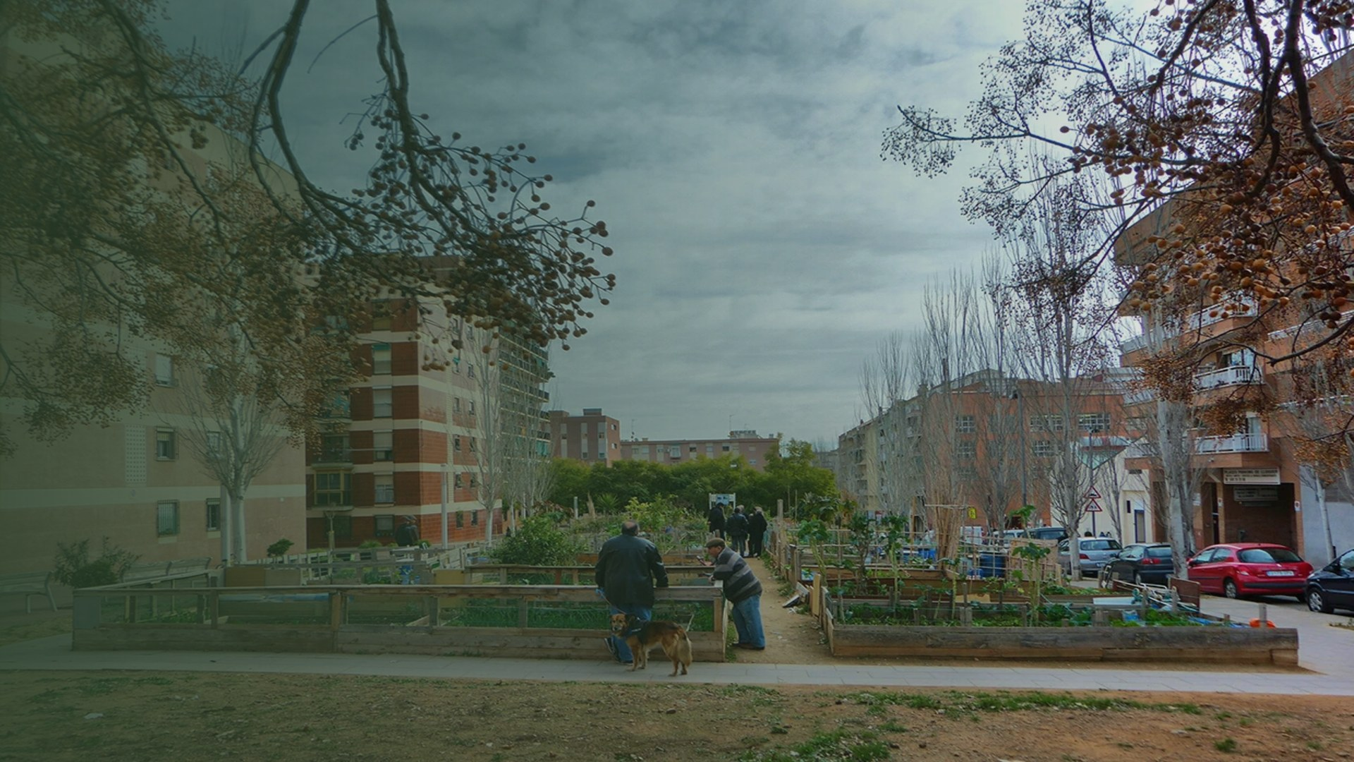
Shade and Sponge
A computational method for choosing which species replace Barcelona's plane trees, and where, scored on summer heat and on storm runoff.
MaCAD, IAAC · Tutor session, v6 draft
Horts urbans de Porta, Carrer d'Alcúdia × Carrer de la Maladeta, Nou Barris: the bare crowns in the foreground are the plane trees this thesis is about.
Notes:
This is Porta, and those bare crowns are plane trees. Barcelona has decided to remove more than half of them in ten years. My thesis is about one decision the city has not taken: which species goes back, where, and what that does to heat and to storm water.

Slide 2
The decision is already taken
Barcelona's tree master plan 2017–2037 and the 2026 plane target
27.45% → 12%
≤ 15%
one at a time
43,722 plane trees, cut to 12% of the city stock within ten years (press, May 2026)
no species above 15% of the urban fabric (tree master plan 2017–2037)
each tree is replaced when it dies or when its street is rebuilt
Thousands of small decisions over the next decade. Which species goes back, and where, is still open.
Notes:
The starting point is not a proposal, it is a decision. Barcelona's plane is more than a quarter of the city's trees, and the master plan says no species may exceed fifteen percent. The city has announced it will cut the planes by more than half, to twelve percent, within ten years. Nobody plants them all at once. Each one is replaced when it dies or when its street is rebuilt. That makes thousands of small decisions over the next decade.

Slide 3
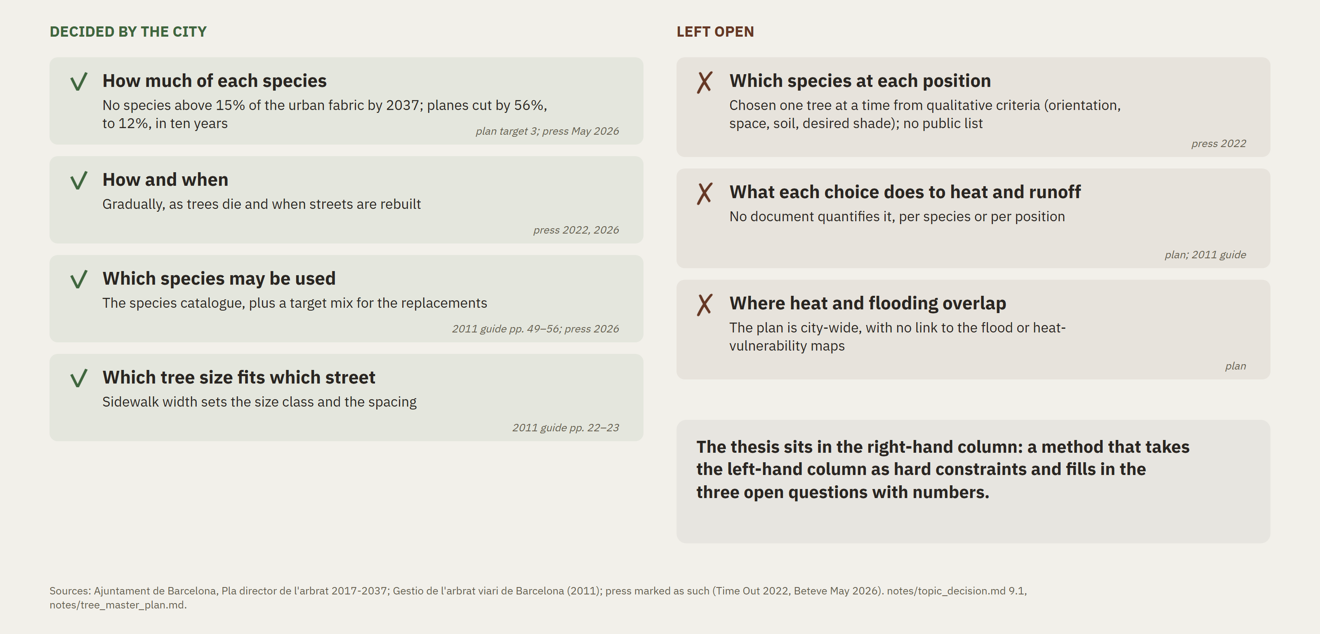
The city decided how much, not which species where
Barcelona's tree master plan (2017–2037) and street-tree guide (2011), read 20 Oct
Notes:
So I read the plan and the city's 2011 street-tree guide. On the left is what the city has decided: how much of each species, how and when to replace, which species may be used, and which tree size fits which sidewalk. On the right is what it has not decided. First, which species goes at each position. The city says it chooses from criteria such as orientation, space, soil and desired shade, but that list is not public, and nothing puts a number on the choice. Second, what each choice does to heat and to runoff. Third, where heat and flooding overlap, because the plan is city-wide. My thesis is the right-hand column. It takes the left-hand column as hard constraints.

Slide 4
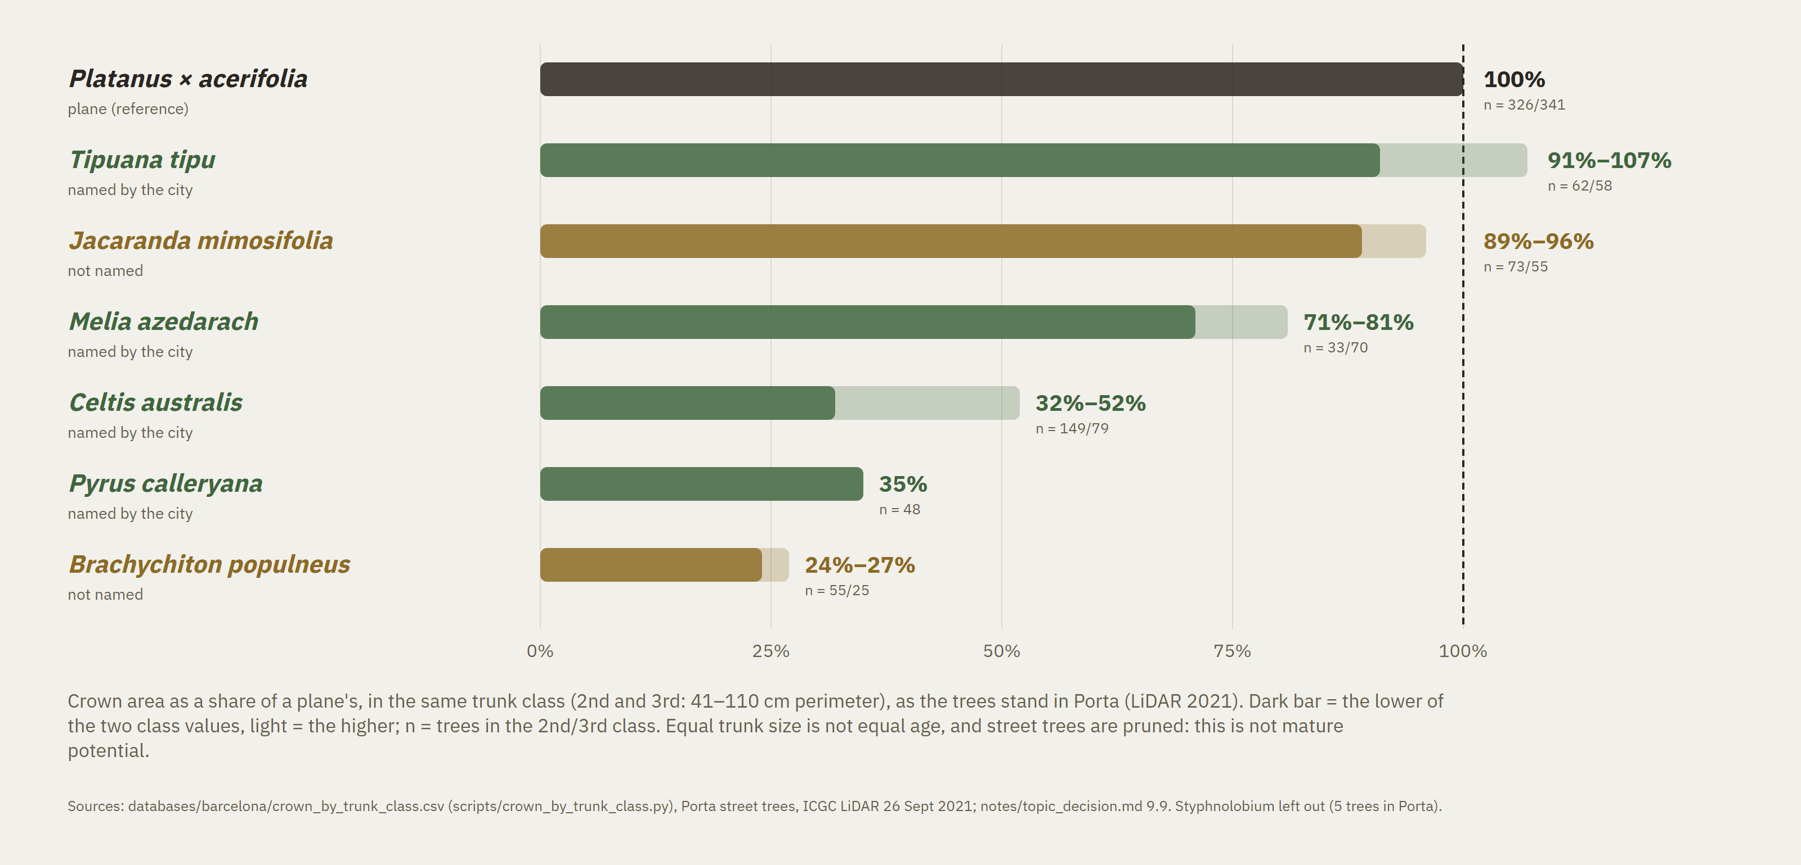
The replacements differ: from a full crown to a quarter of one
Same trunk size, very different shade and interception — the choice of species decides the canopy
Notes:
Why does it matter which species? Because the replacements are very different trees. Here is crown area as a share of a plane's crown, at the same trunk size, for the trees standing in Porta today, from the 2021 laser scan. Tipuana and Jacaranda carry about the same crown as a plane. Melia carries three quarters. Celtis, Pyrus and Brachychiton carry between a quarter and a half. Every one of these choices follows the city's rules, and yet the shade and rain interception left on the street can differ by a factor of three to four. This also sets two of the plan's own targets against each other: diversity on one side, canopy cover on the other.

Slide 5
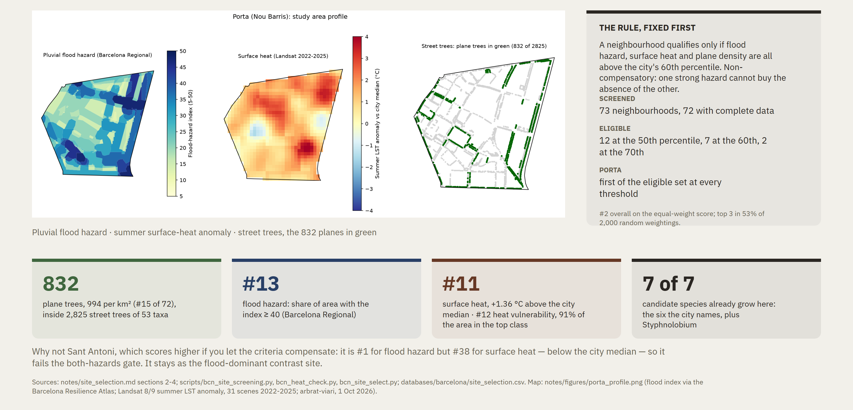
Porta, Nou Barris: both hazards, and the planes to replace
0.84 km² · chosen by a rule written before the data was ranked
Notes:
The losses would matter most where heat and flooding overlap. I screened all seventy-three neighbourhoods with open data. To qualify, a neighbourhood had to be above the city's sixtieth percentile for flood hazard, for surface heat and for plane density at the same time. Porta comes first at every threshold I tried. It has eight hundred and thirty-two plane trees. And every replacement species the city names already grows there, so I can measure them rather than assume them.

Slide 6
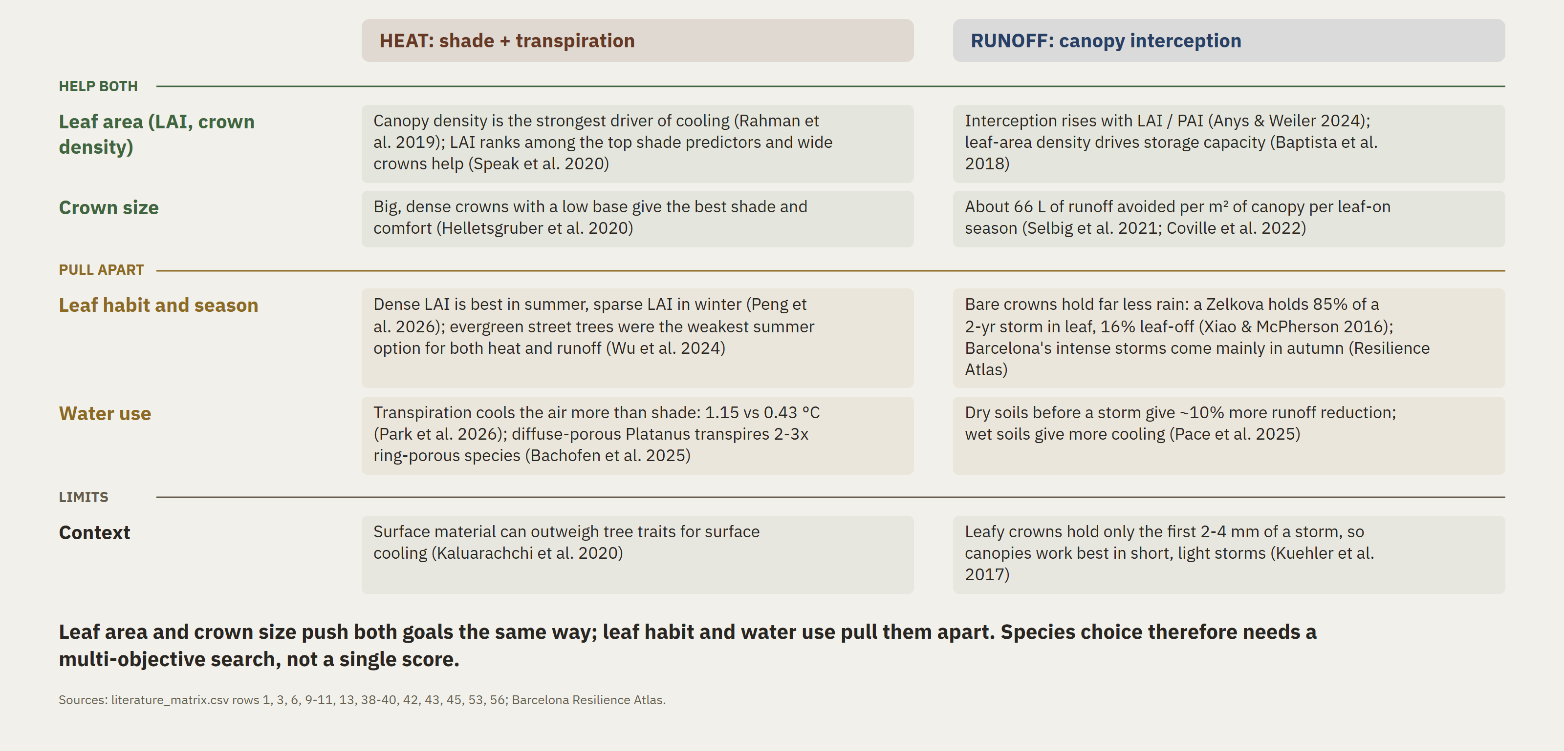
Same tree, two jobs: which traits help both, and where they conflict
Heat and runoff evidence side by side (buckets B1, B7, B8)
Notes:
The literature gives the mechanism. The same crown traits drive both services: crown size and leaf area set how much shade a tree casts and how much rain it holds back. But some traits pull apart. An evergreen crown intercepts winter rain and also blocks winter sun. So I expect gains on both goals together, and a real trade-off at the margin.

Slide 7
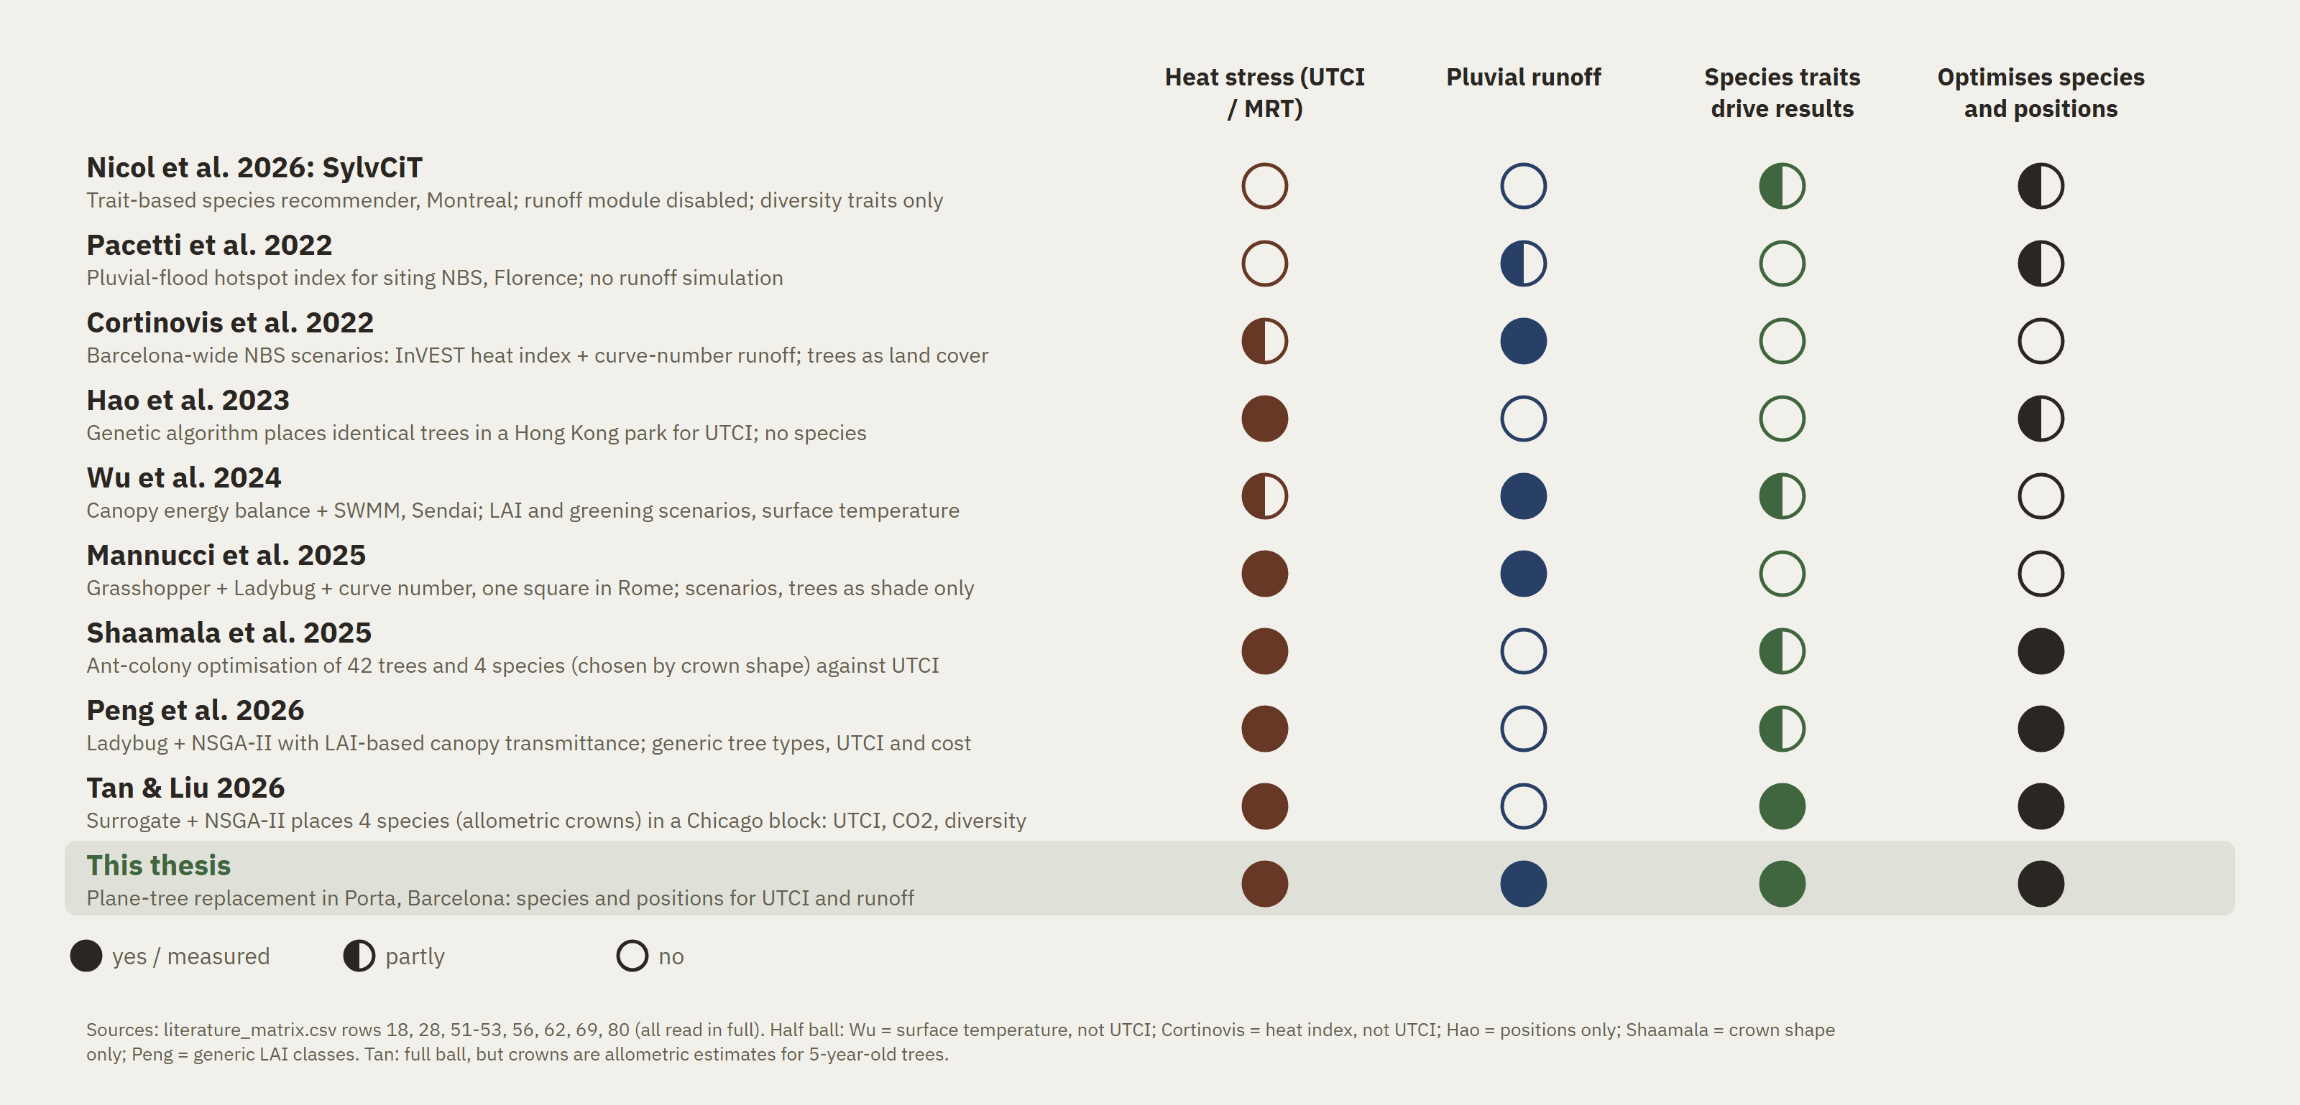
No method yet chooses species and positions for heat and runoff together
Closest precedents from the review vs this thesis
Notes:
The gap is the same in practice and in research. The city has rules and qualitative criteria, but no quantities. Studies assess heat and runoff for fixed scenarios without species traits, or optimise trees for heat only. The most advanced trait-based recommender, SylvCiT, has its runoff module switched off. Nobody gives, position by position, the rule-compliant species that keeps the most cooling and the most rain interception.

Slide 8
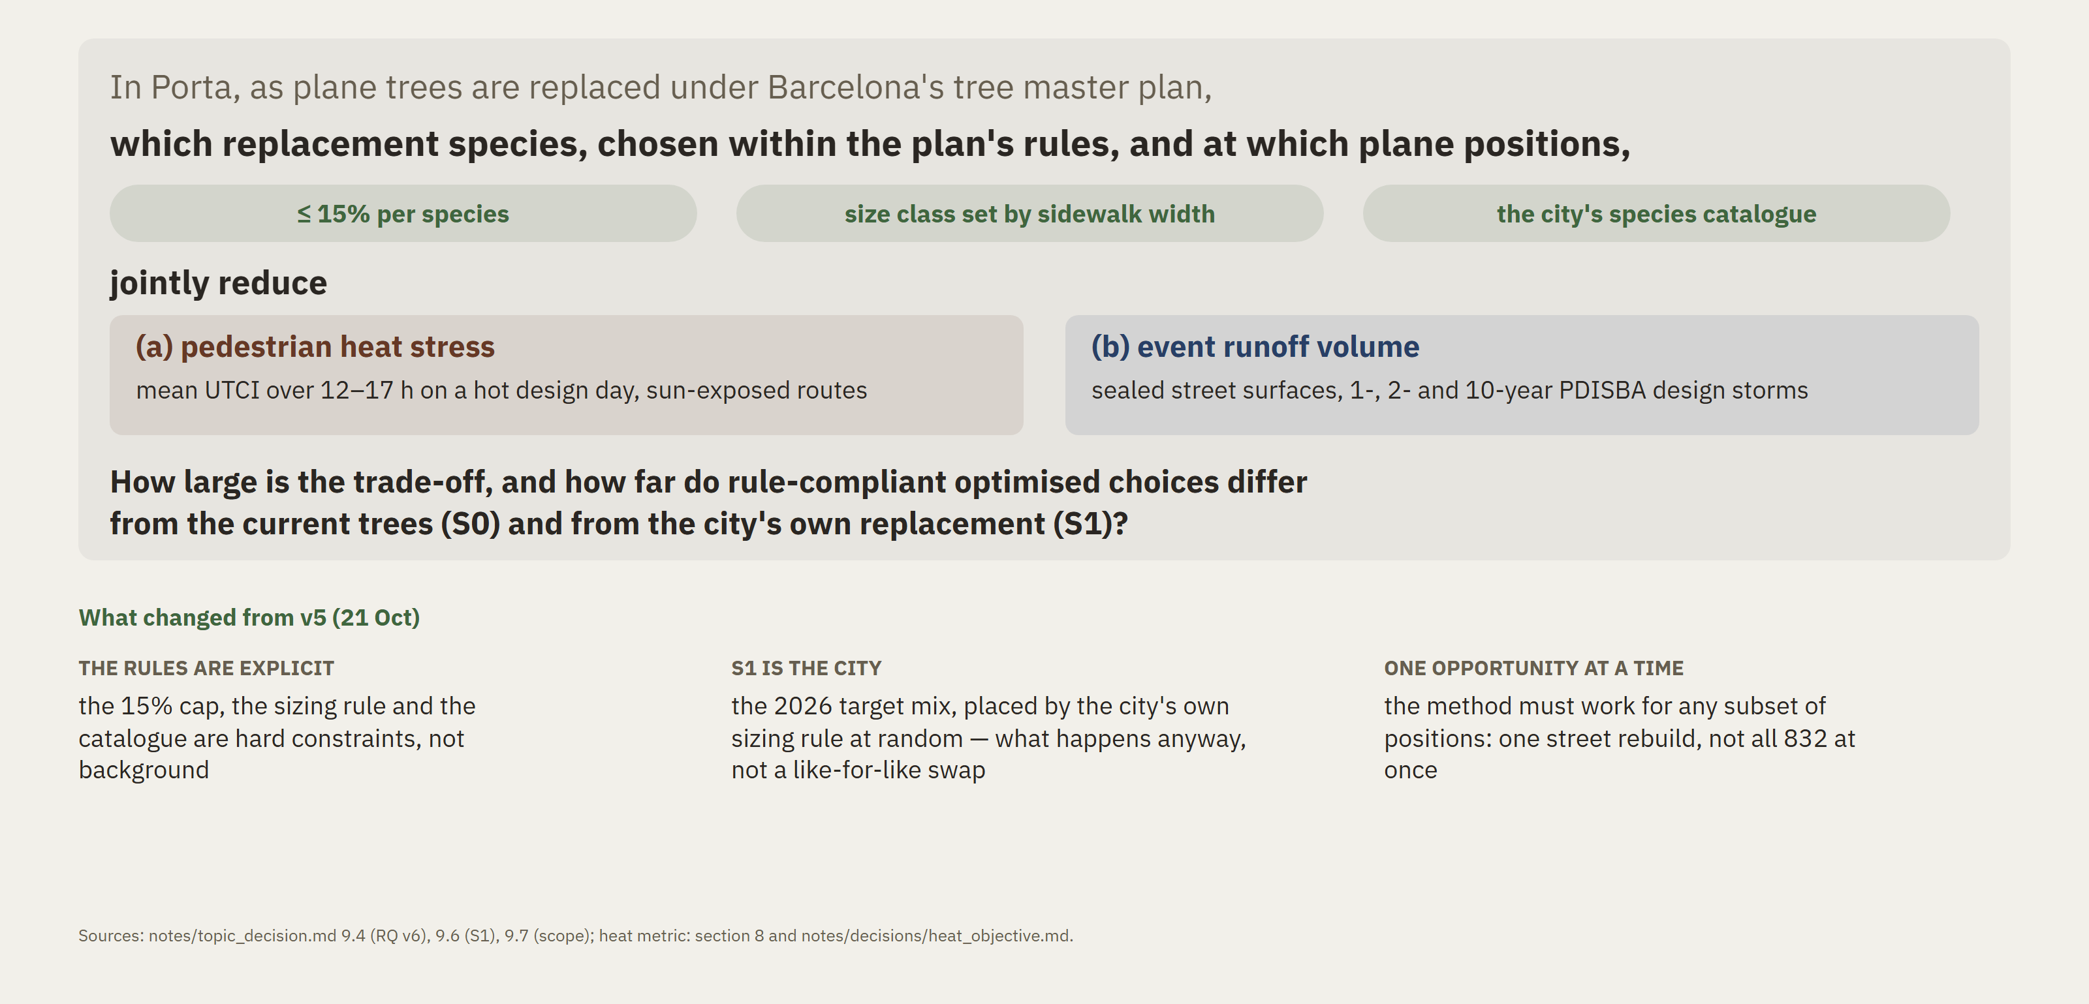
The research question (v6)
Rebuilt on the tree master plan, 21 Oct
Notes:
So the question. In Porta, as the planes are replaced under the master plan, which species, chosen within the plan's rules, and at which positions, jointly reduce pedestrian heat stress and event runoff? I measure heat stress as mean felt temperature over the afternoon of a hot day, and runoff for one-, two- and ten-year design storms. And how large is the trade-off between the two? The comparison is new. It is not against a random palette but against the city's own replacement: its announced species mix, placed by its own sizing rule. That is what happens anyway if this method does not exist.

Slide 9
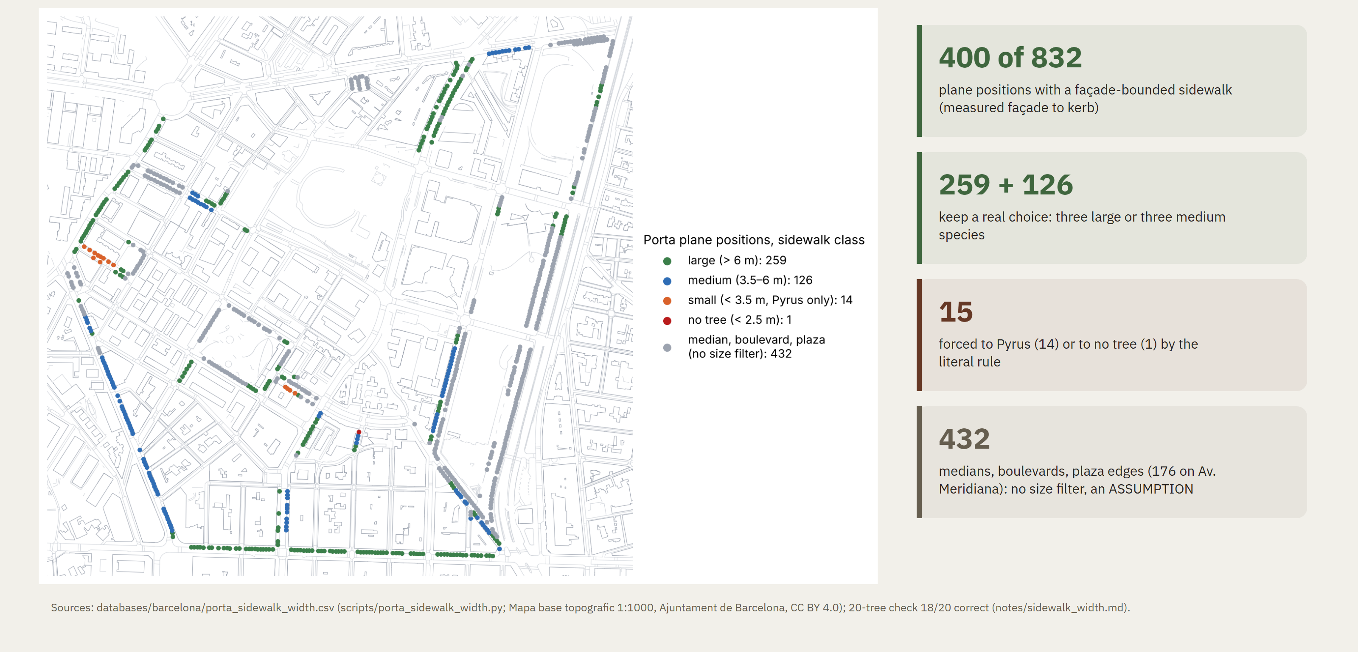
The sizing rule leaves the optimisation room
Sidewalk width at each Porta plane, from the city's 1:1000 map; 2011 guide: < 2.5 m none, < 3.5 small, 3.5–6 medium, > 6 m large
Notes:
One risk could have killed the optimisation. The 2011 guide sets the tree size by sidewalk width. If most sidewalks were narrow, only one species would fit and there would be nothing to choose. So I measured the sidewalk at every plane, from façade to kerb, on the city's 1:1000 map, and checked twenty trees by eye. Four hundred positions have a proper sidewalk, and only fifteen of them are forced to Pyrus or to no tree. The rest keep three species each. The other four hundred and thirty-two are medians, boulevards and plaza edges. There the rule does not apply as written, and I state that as an assumption.

Slide 10
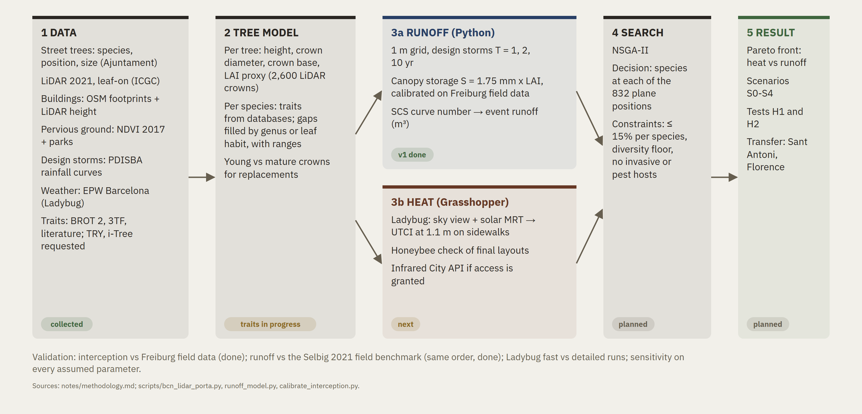
Hypotheses and method
Two testable hypotheses, one declared boundary; the pipeline is unchanged from 20 Oct
H1, synergy: at the same positions, with the size class each sidewalk takes, trait-based choices beat the city's own replacement (S1) on both heat and runoff. Runoff differences below Δmin = 91 m³ are reported as "not resolved".
H2, trade-off: the heat optimum and the runoff optimum differ mainly in species, so the front is not a point.
Declared boundary: the runoff benefit shrinks as storms grow. True by construction of the model, so not tested.
Constraints: ≤ 15% per species · size class by sidewalk width · the city's catalogue · diversity floor.
Notes:
Two hypotheses. One, synergy: under the same rules, trait-based choices beat the city's own replacement on both goals, because crown size and leaf area drive both. Two, trade-off: the heat optimum and the runoff optimum differ in species. The method is unchanged from last time. A laser scan gives each tree's crown. A runoff module and a heat module score each layout. An optimiser picks a species per position, now under the plan's rules as hard constraints. Because trees are replaced one street at a time, it also works on any subset of positions.

Slide 11
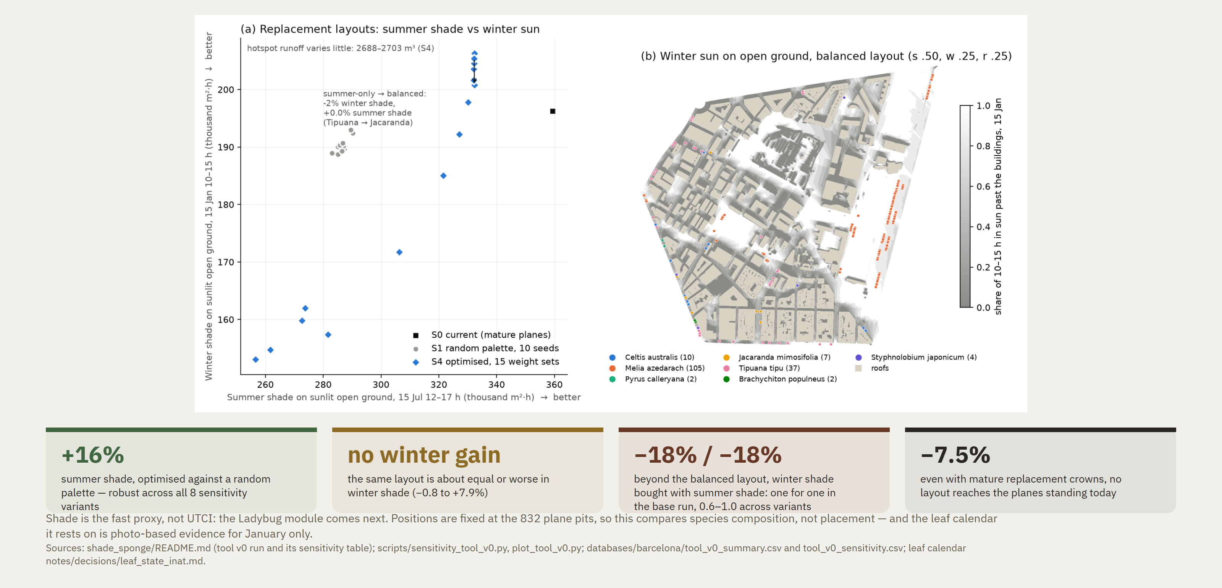
Where the tool stands
20 Oct run, before v6: random-palette baseline, no sizing rule. Re-run against S1 before quoting.
Notes:
The tool already runs end to end. In the version before v6, an optimised layout gave sixteen percent more summer shade than a random one, and that held across eight sensitivity variants. But those runs were against a random palette and without the sizing rule. The next run uses the city's replacement as the baseline and the sidewalk constraint. That comparison is the result the thesis is built on.

Slide 12
Open questions, and what I asked the city
Email to Parcs i Jardins, 21 Oct
Five questions to the city:
– Is there an internal replacement list?
– Which streets keep their planes (is Av. Meridiana one of them)?
– Is the 15% applied per neighbourhood?
– Is there an official source for the 2026 target mix?
– Is there an official sidewalk width, and how are trees on medians sized?
If the city has a list, it becomes S1, and the contribution narrows to the quantities.
Assumptions to defend
– the Porta-local 15% cap
– no size filter on medians
– Av. Meridiana included by default
My question to you: is the city's own replacement the right baseline for the main result?
Notes:
Three things are still open, and I have asked the city about each. If there is an internal replacement list, it becomes my baseline, and my contribution narrows to the numbers. That is fine. I also asked which avenues keep their planes, because Meridiana alone holds a hundred and ninety-four of Porta's. Until they answer, I state my assumptions. My question to you: is the city's own replacement the right baseline for the main result?

Slide 13
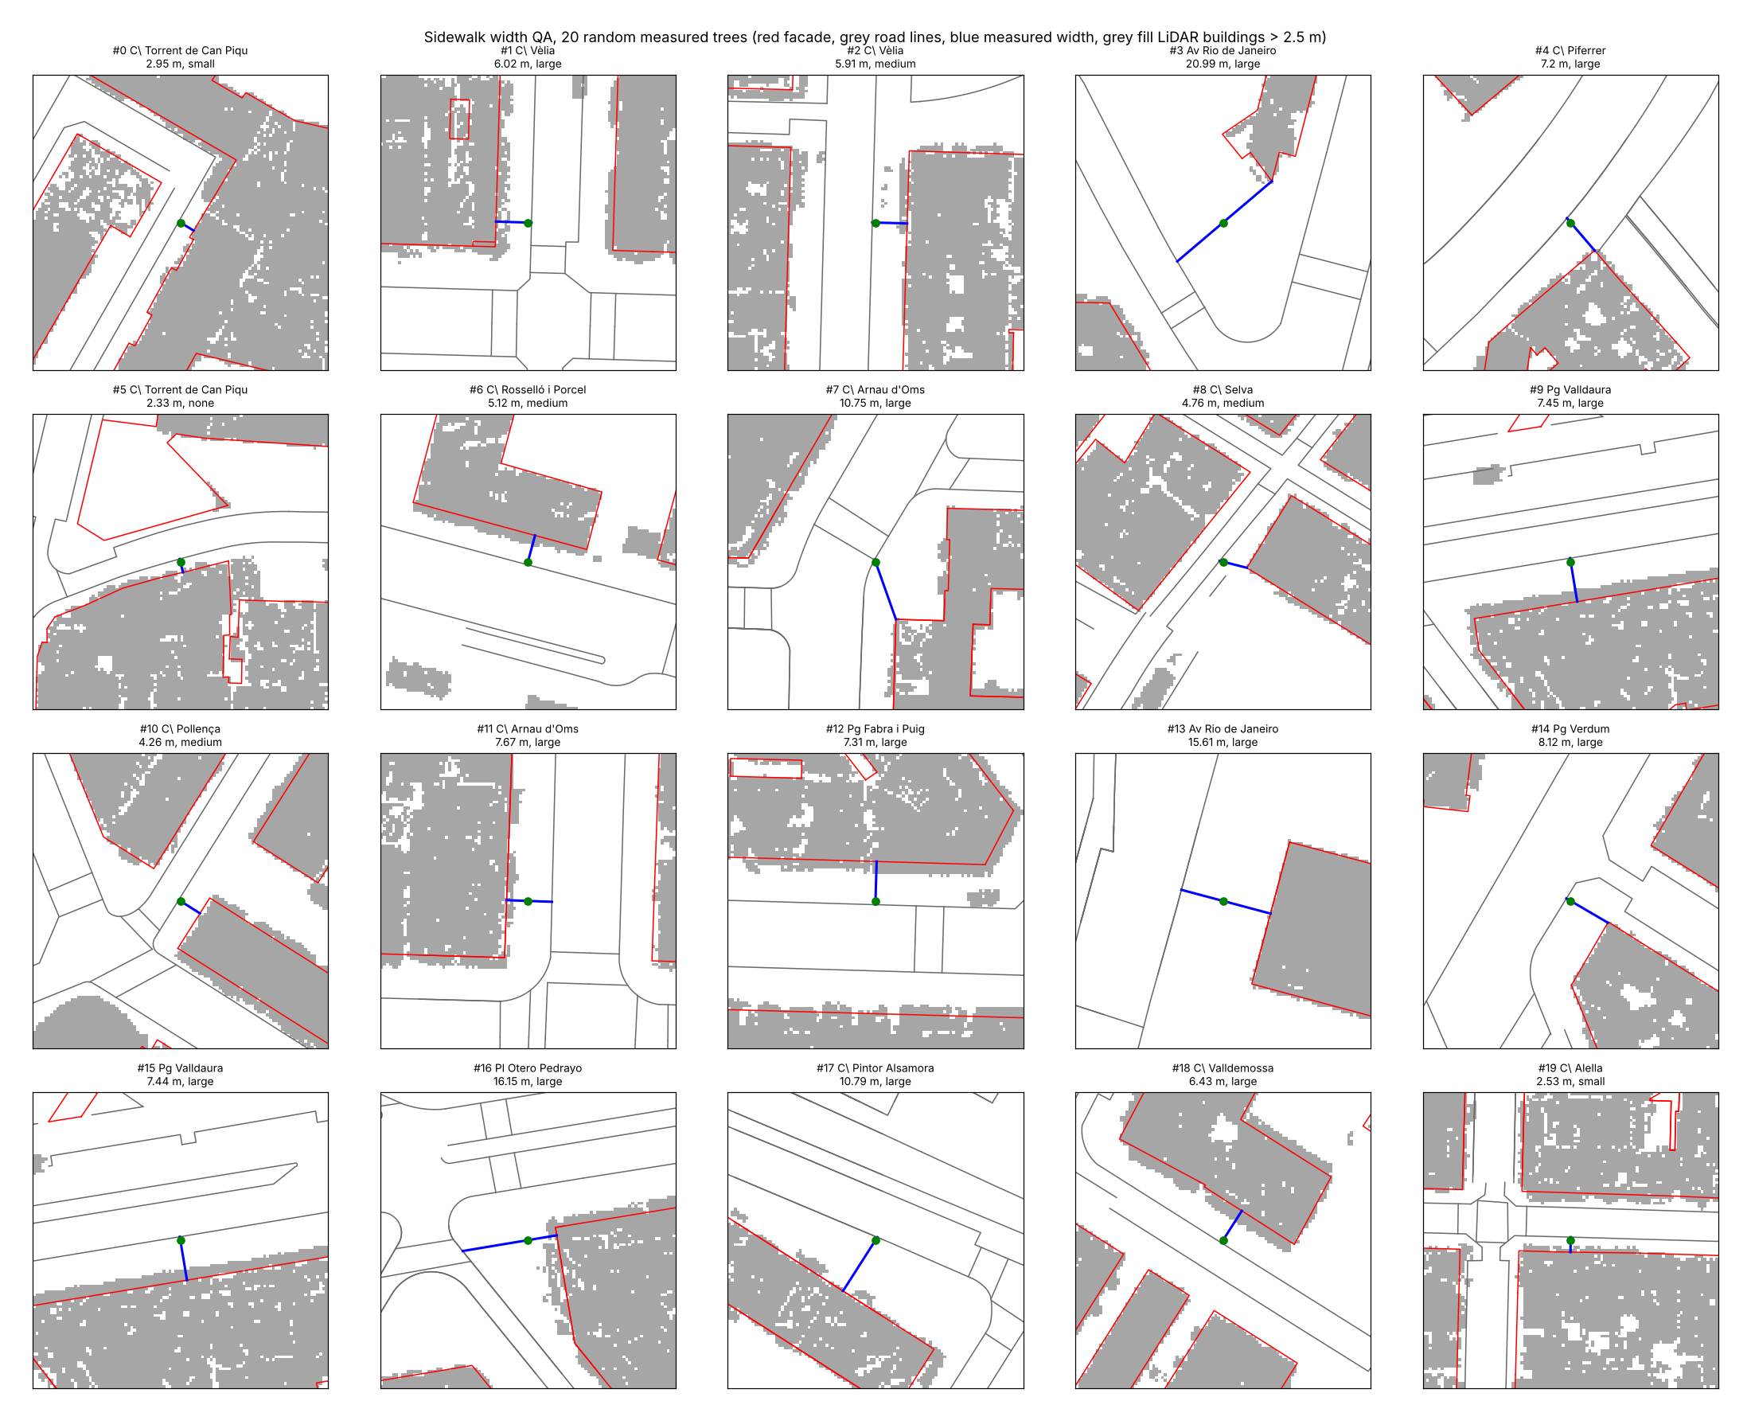
Backup: how the sidewalk was measured
20 random Porta planes checked by eye on the 1:1000 map
A ray runs from the nearest façade, through the tree, to the first kerb line.
18 of 20 are correct; the other 2 are corner trees measured diagonally, and both stay "large".
LiDAR at 0.5 m cannot check ±0.3 m: roofs overhang façades by a median 0.6 m, and kerbs are smoothed out of the ground model.
32 of the 400 measured planes lie within 0.3 m of a class threshold.

Slide 14
Backup: the crown comparison, raw vs equal trunk size
Why slide 4 compares crowns inside the same trunk class
Raw medians mislead: Melia looks as big as a plane because 30% of the Melias in the table are in the largest trunk class, against 16% of the planes.
They also overstate the Pyrus loss: 63% of the Pyrus trees are in the smallest class.
Source: notes/topic_decision.md §9.9.

