Slide 1
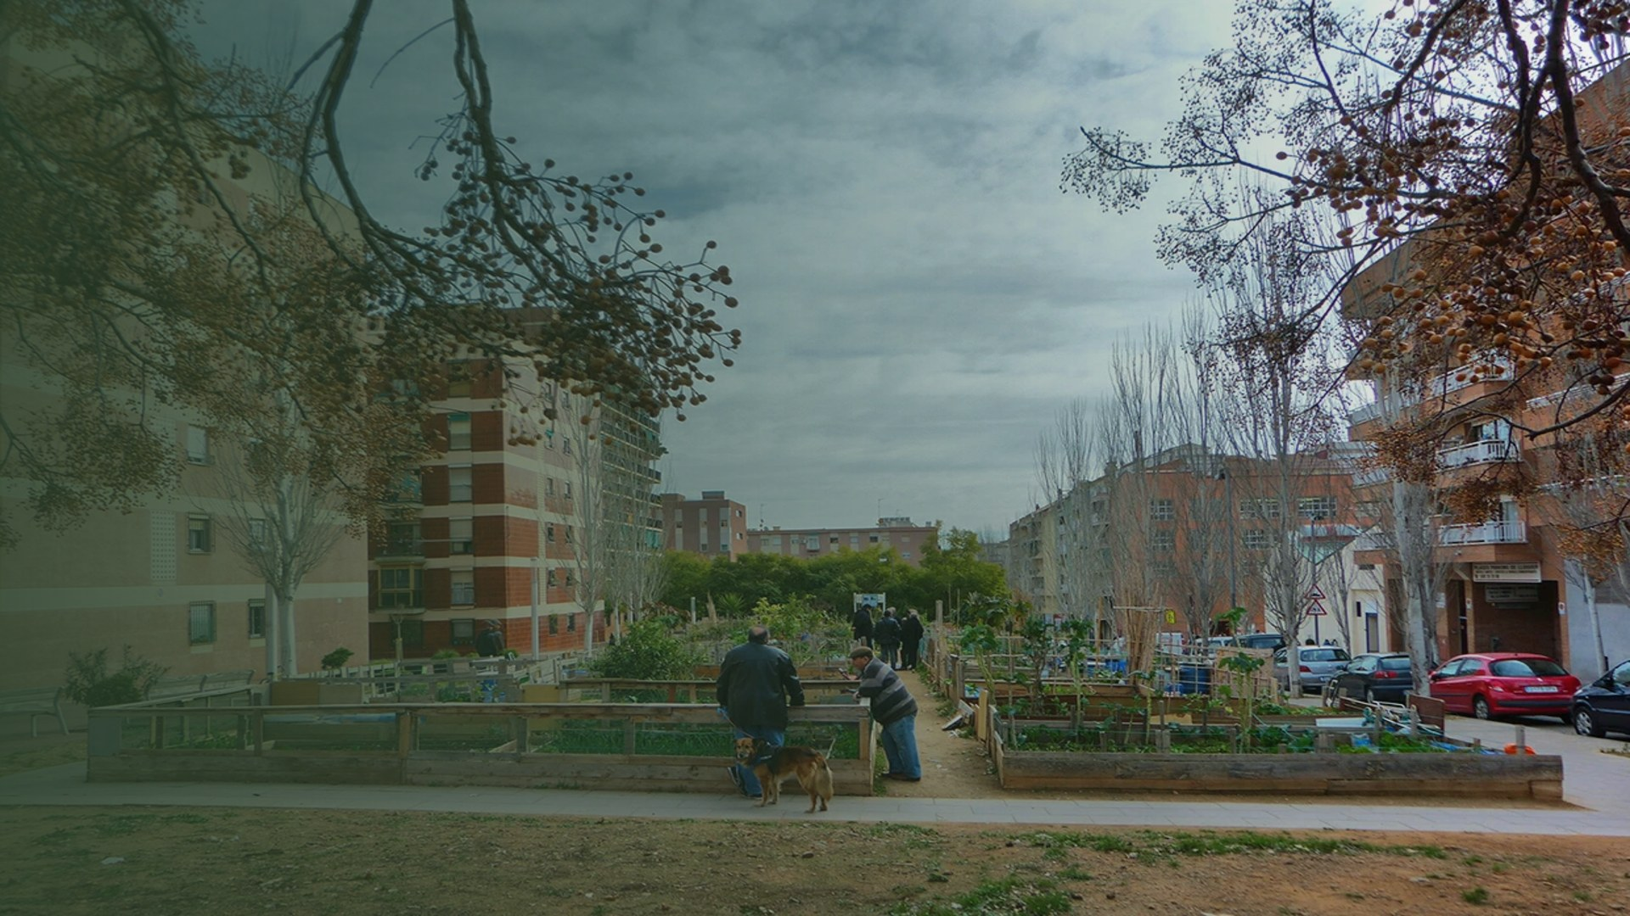
Shade and Sponge
A computational method for choosing which species replace Barcelona's plane trees, and where, scored on summer heat and on storm runoff.
MaCAD, IAAC · Tutor session, 20 October 2026
Horts urbans de Porta, Carrer d'Alcúdia × Carrer de la Maladeta, Nou Barris: the bare crowns in the foreground are the plane trees this thesis is about.
Notes:
This is Porta, at the corner of Alcúdia and Maladeta, and those bare crowns are plane trees. Barcelona has to replace a large share of its street trees, because one species — the plane — is twenty-eight percent of the city stock, and twenty-nine percent in the neighbourhood I work in, while the tree plan caps every species at fifteen. My thesis is how to decide what goes back.

Slide 2
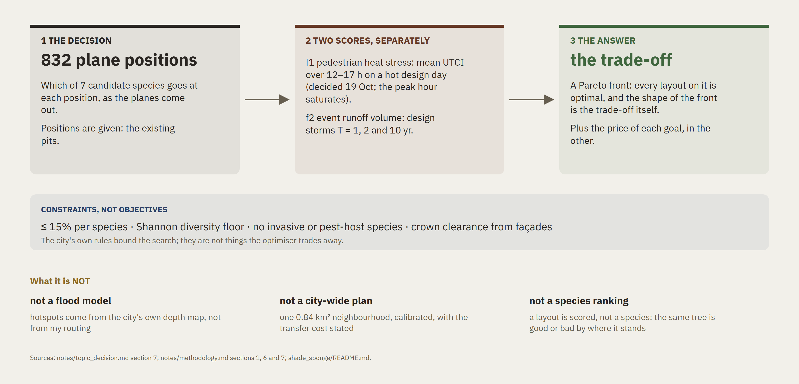
species × position → heat + runoff → trade-off
The whole thesis in one line, and its boundaries
Notes:
In one line: species times position, scored on heat and on runoff, and what I report is the trade-off between them. Three things it is not. It is not a flood model — the hotspots come from the city's map. It is not a city-wide plan. And it is not a ranking of species: the same tree is good or bad depending on where it stands.

Slide 3
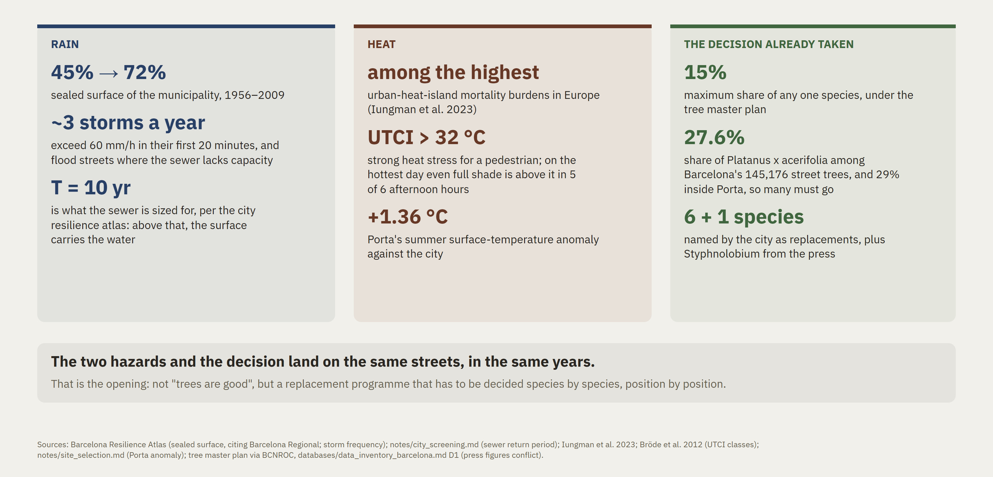
Two hazards, one street, one decision
Why this is a design decision and not a slogan
Notes:
Two hazards arrive on the same streets. Barcelona's sealed surface went from forty-five to seventy-two percent between 1956 and 2009. About three storms a year exceed sixty millimetres an hour in their first twenty minutes, and the sewer is only sized for a ten-year storm — above that, the surface carries the water. In summer the city has one of the highest heat-island mortality burdens in Europe. And the decision is already taken: the plane trees are coming out. Nobody has to be convinced that something should be planted. The question is what, and where.

Slide 4
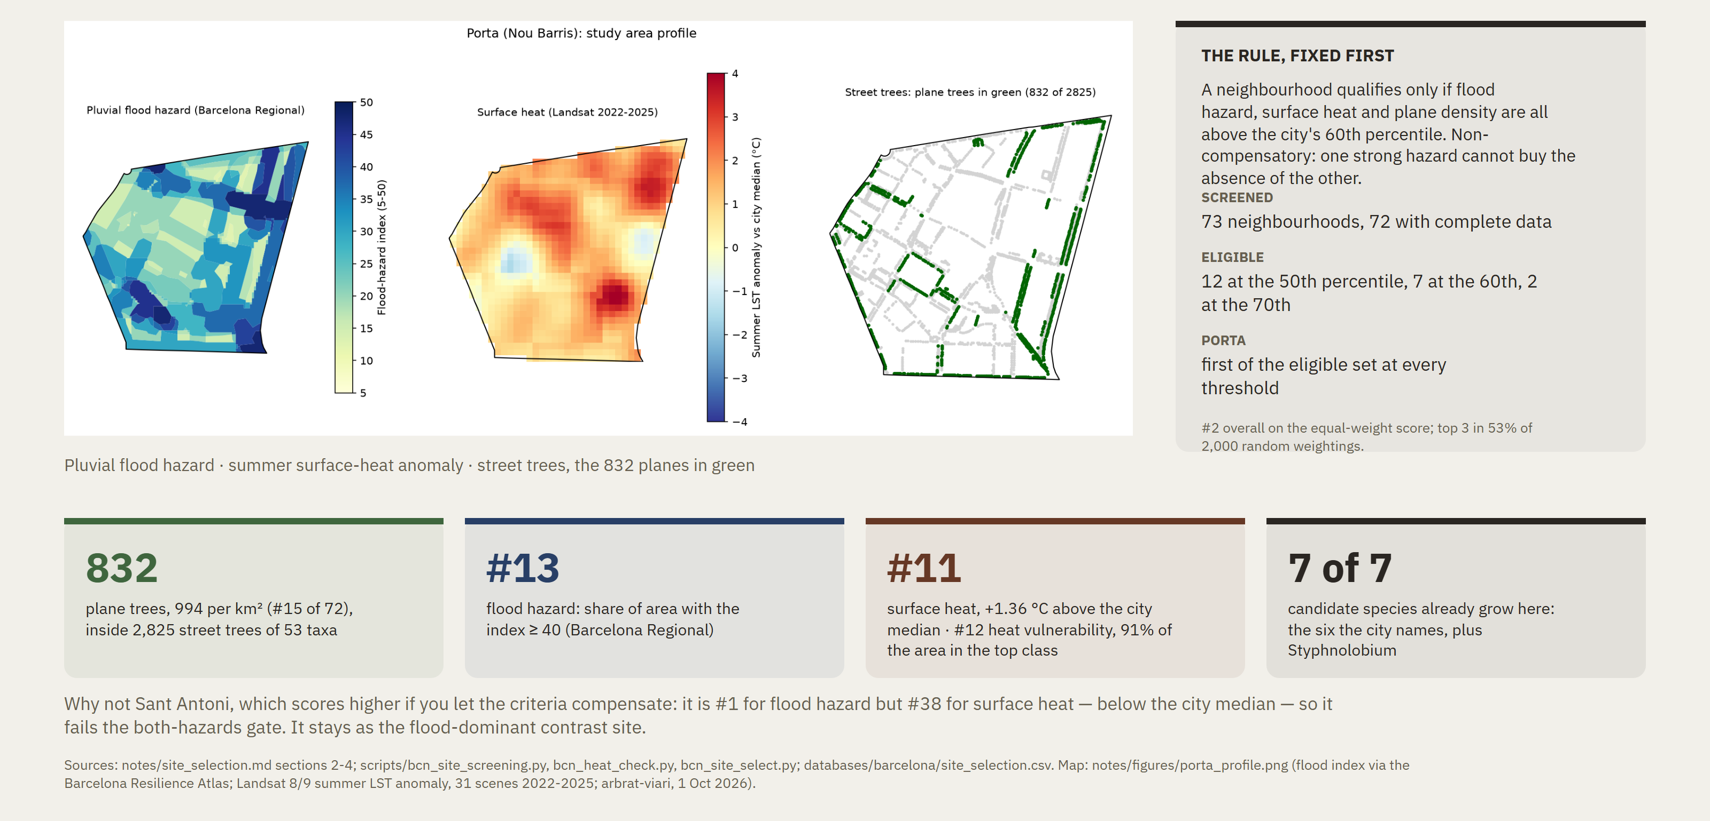
Porta, Nou Barris: both hazards, and the planes to replace
0.84 km² · chosen by a rule written before the data was ranked
Notes:
I needed one neighbourhood where both hazards and the replacement problem are real at the same time. I screened all seventy-three with open data: to qualify, a neighbourhood had to be above the city's sixtieth percentile for flood hazard, for surface heat and for plane density, simultaneously. Porta comes first at every threshold I tried. On the equal-weight score across the whole city it is second, and it stays in the top three in just over half of two thousand random weightings. It has eight hundred and thirty-two plane trees. Sant Antoni floods more but its heat is average, so it becomes my contrast site.

Slide 5
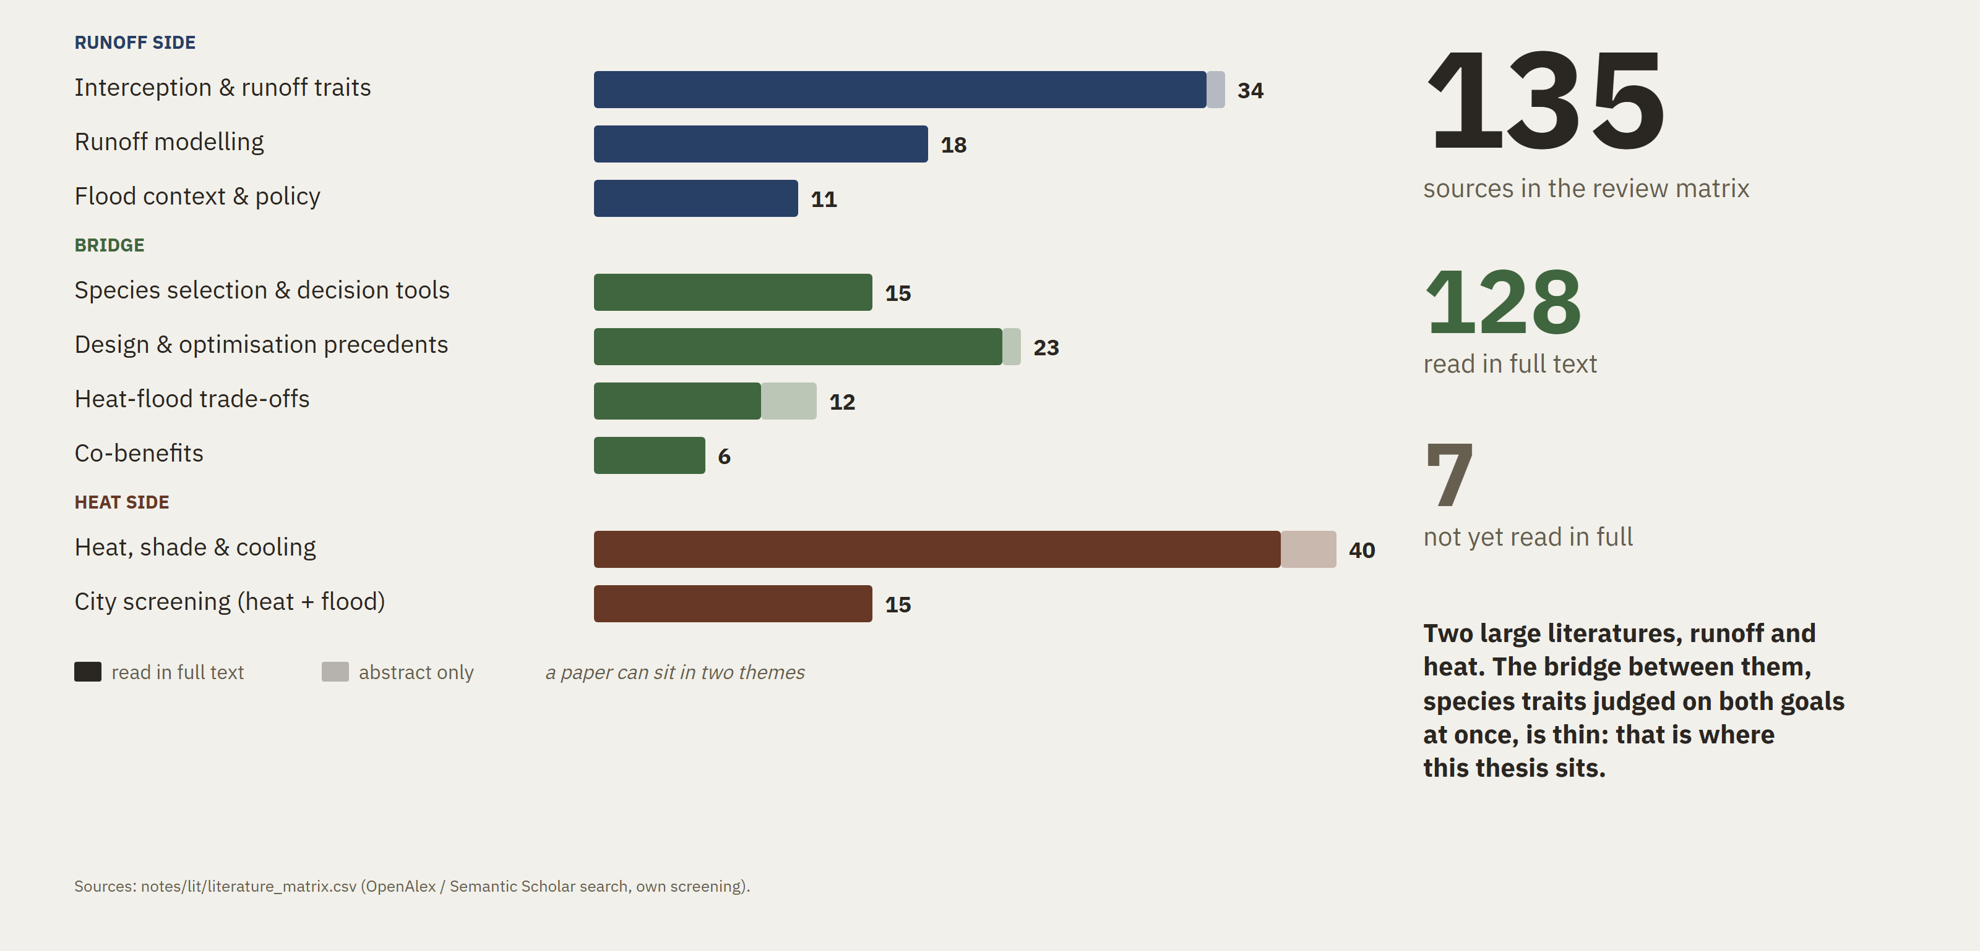
What the literature review covers
135 sources screened in 9 themes (7-12 Oct 2026)
Notes:
The review is a hundred and thirty-five sources on topic, and a hundred and twenty-eight of them I have read in full rather than from the abstract. I will take two findings from the runoff side and two from the heat side, because those four decide the method.

Slide 6
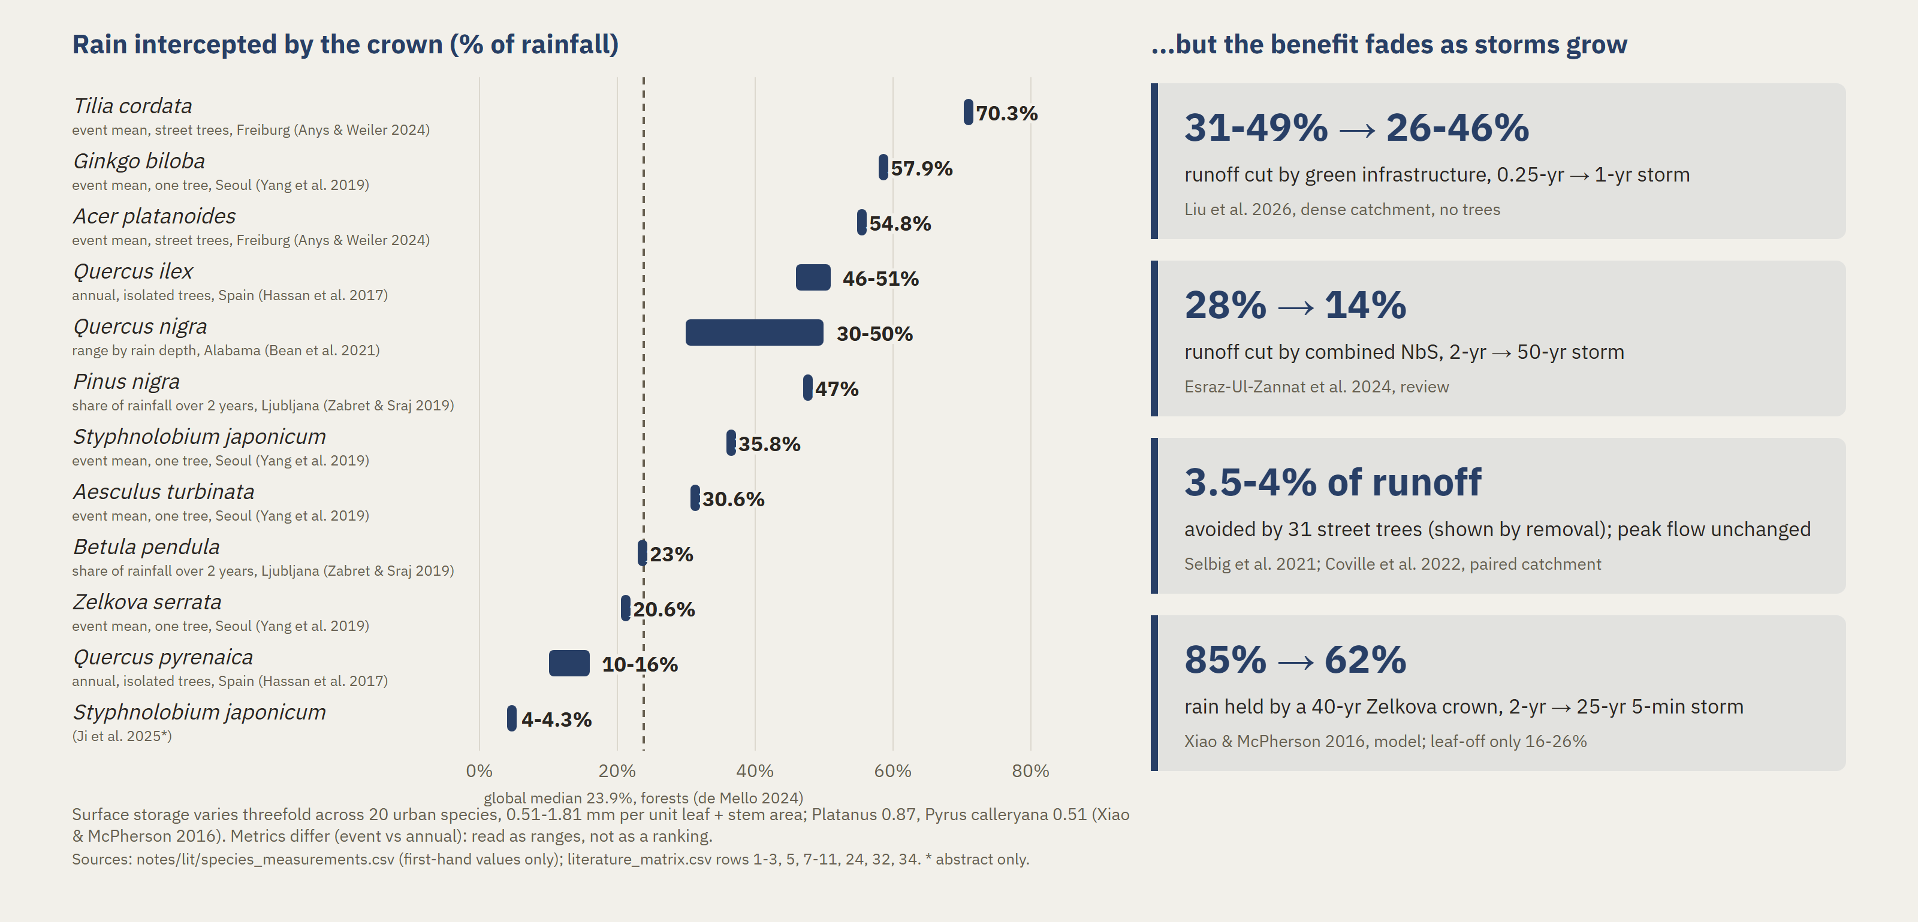
Trees intercept rain: species differ, and the effect fades with storm size
Runoff side of the review (bucket B1-B2)
Notes:
Two findings. First, species differ: a crown intercepts somewhere between four and seventy percent of rainfall across the field studies, and the main driver is leaf area — which is a measurable trait, not a preference. Second, the size of the prize is small and it has a boundary: a paired-catchment study measured four percent of runoff volume from street trees — three and a half in the calibrated re-analysis — and no effect at all on peak flow. So trees are a tool for frequent storms, not for extreme ones.

Slide 7
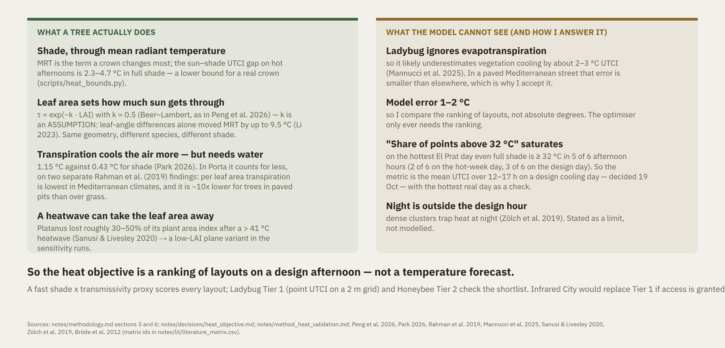
Heat: what a tree can do, and what my model cannot see
The evidence behind f1, and the honest boundary around it
Notes:
On the heat side the honest version is two-sided. A crown works mostly through radiation — the sun-to-shade gap on a hot afternoon is between two and nearly five degrees of felt temperature, and that is a lower bound, and leaf area decides how much sun gets through. Transpiration cools the air more, but it needs water — and per leaf area it is lowest in Mediterranean climates, and separately about ten times lower for a tree in a paved pit than over grass. My engine ignores transpiration altogether. That is why the heat objective is a ranking of layouts, not a temperature forecast.

Slide 8
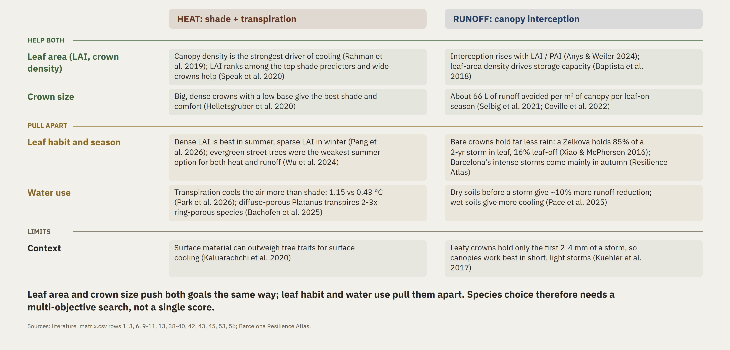
Same tree, two jobs: which traits help both, and where they conflict
Heat and runoff evidence side by side (buckets B1, B7, B8)
Notes:
Here is why one score is not enough. The two goals share their drivers — crown size and leaf area feed both shade and interception — so part of the benefit is free. But they pull apart on timing: leaf habit decides whether the crown is there for the August heat or for the October storm, and in winter the same crown becomes a cost, not a benefit. Shared drivers, different calendars. That is a multi-objective problem.

Slide 9
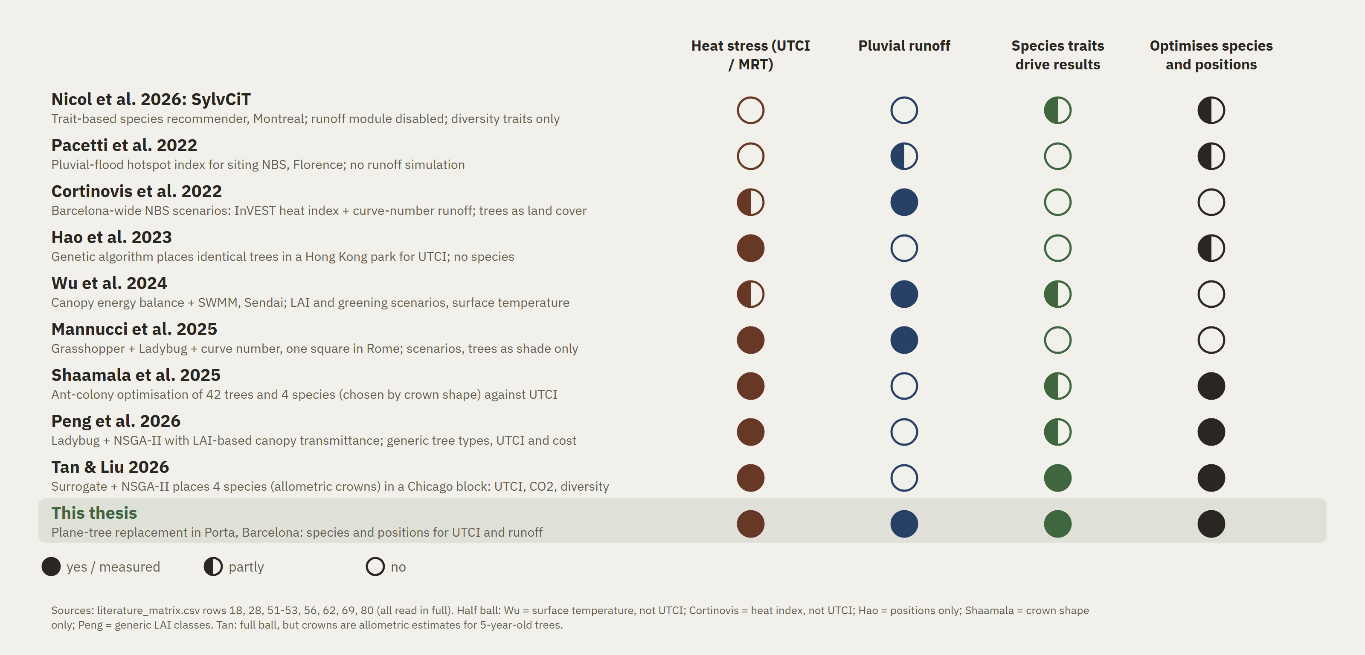
No method yet chooses species and positions for heat and runoff together
Closest precedents from the review vs this thesis
Notes:
The gap is narrow and I want to state it narrowly. The closest work either assesses heat and runoff for fixed planting scenarios, without species traits, or optimises species and positions for heat alone. The most advanced trait-based recommender, SylvCiT, has its runoff module written in the paper as disabled. Nobody chooses street-tree species and positions against pedestrian-level heat stress and event runoff together. That sentence is the gap, and every word in it is load-bearing; the contribution I would claim from it is the method.

Slide 10
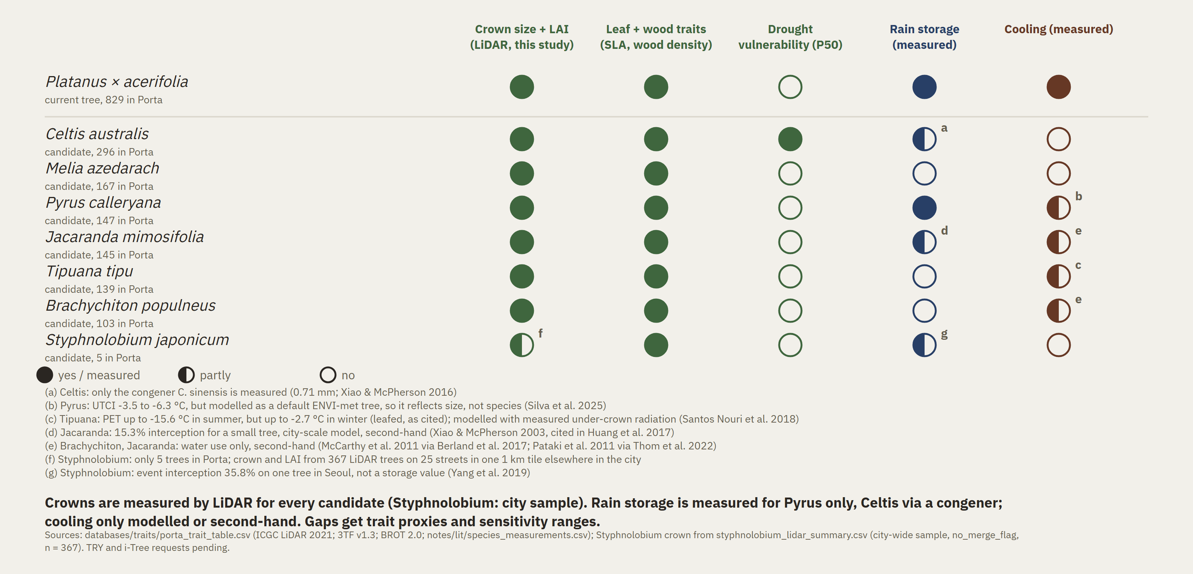
The replacement palette: crowns we can measure, rain and cooling mostly not
Plane tree vs the six replacement species the city names, plus Styphnolobium (named in the press); all grow in Porta
Notes:
There is a second gap, and it is in the data. For the city's own replacement species I can measure the crown on site from the laser scan. But canopy storage has been measured for one of them, and none has a measured cooling value. That gap is not a weakness of the thesis, it is one of its results.

Slide 11
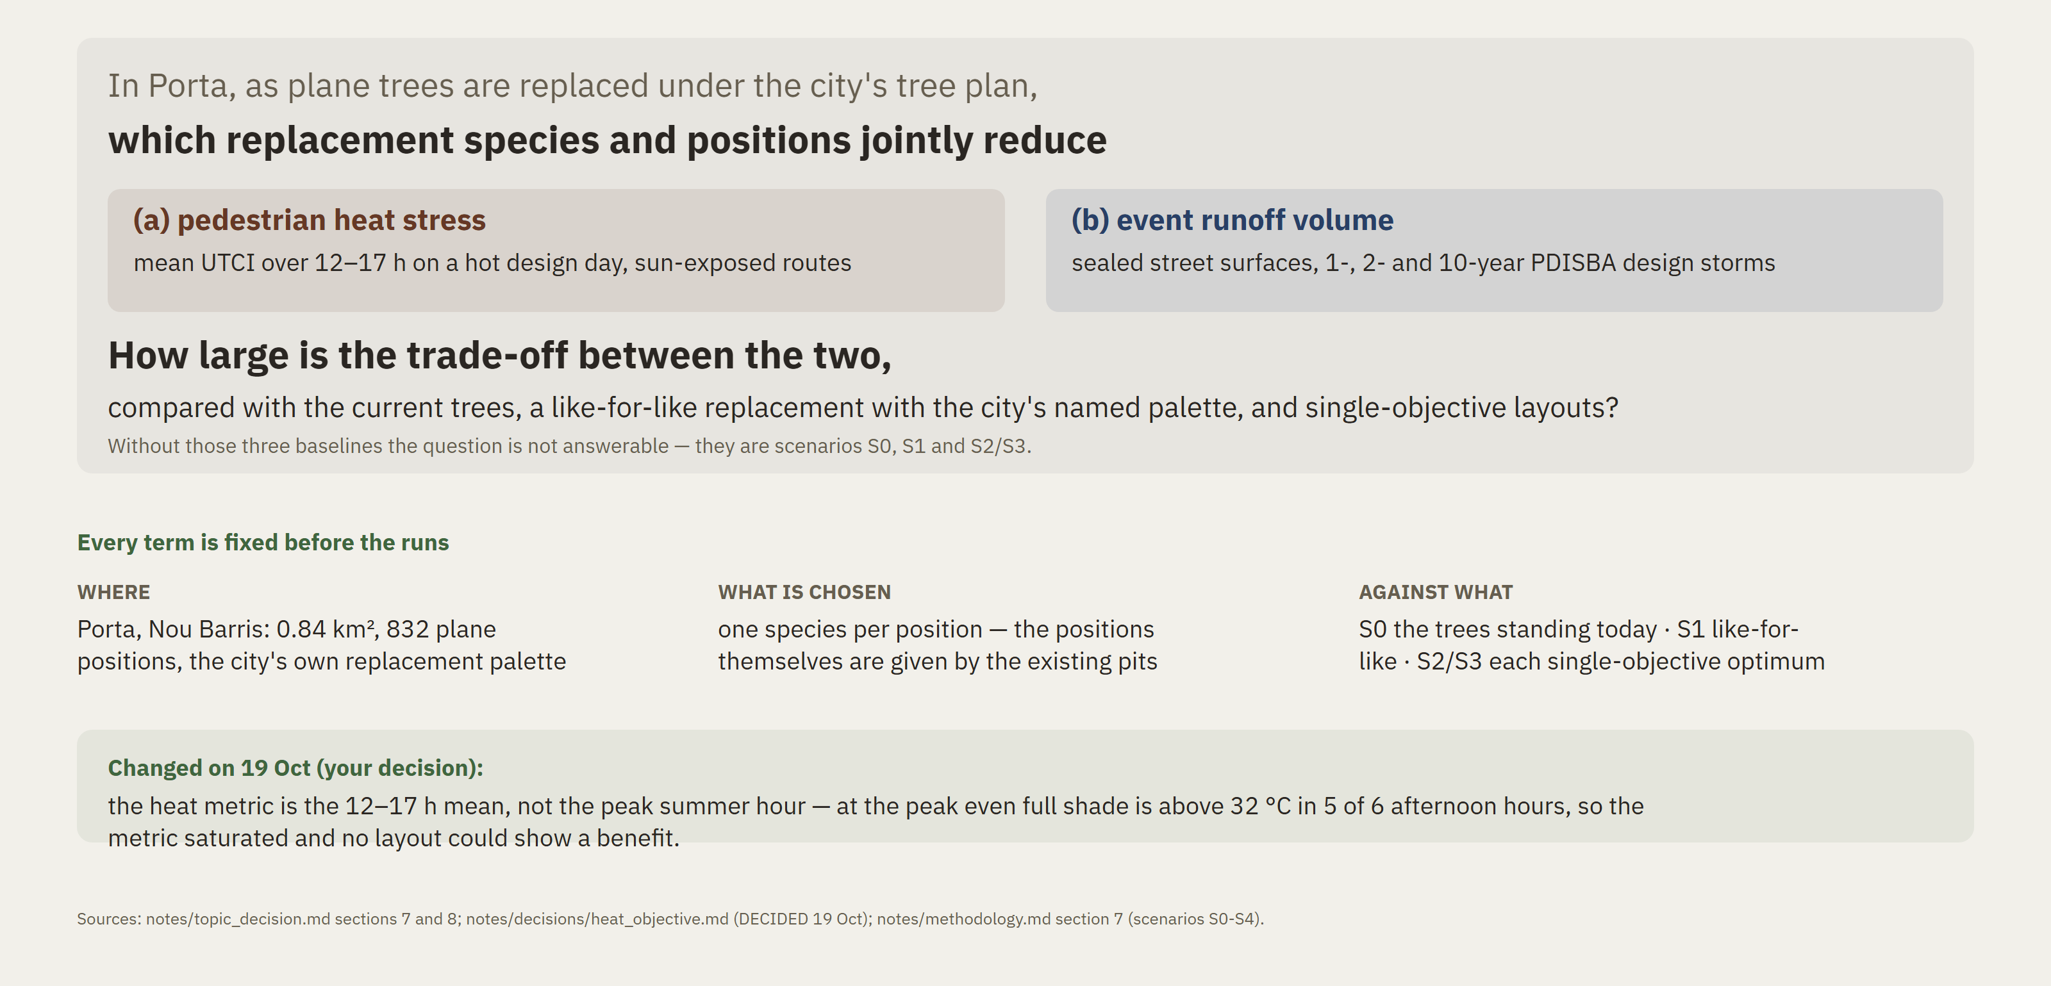
The research question, part by part
v5, 19 Oct — what is chosen, against what, measured how
Notes:
So, the question. In Porta, as the plane trees are replaced, which species and which positions jointly reduce pedestrian heat stress and event runoff volume for one-, two- and ten-year design storms — and how large is the trade-off, measured against three baselines: the trees that are there today, a like-for-like replacement, and each single-objective optimum. One thing I changed yesterday: I measure heat as an average over the afternoon, twelve to five, not at the single peak hour — at the peak even full shade is above the stress threshold, so the metric saturated and no layout could show a benefit.

Slide 12
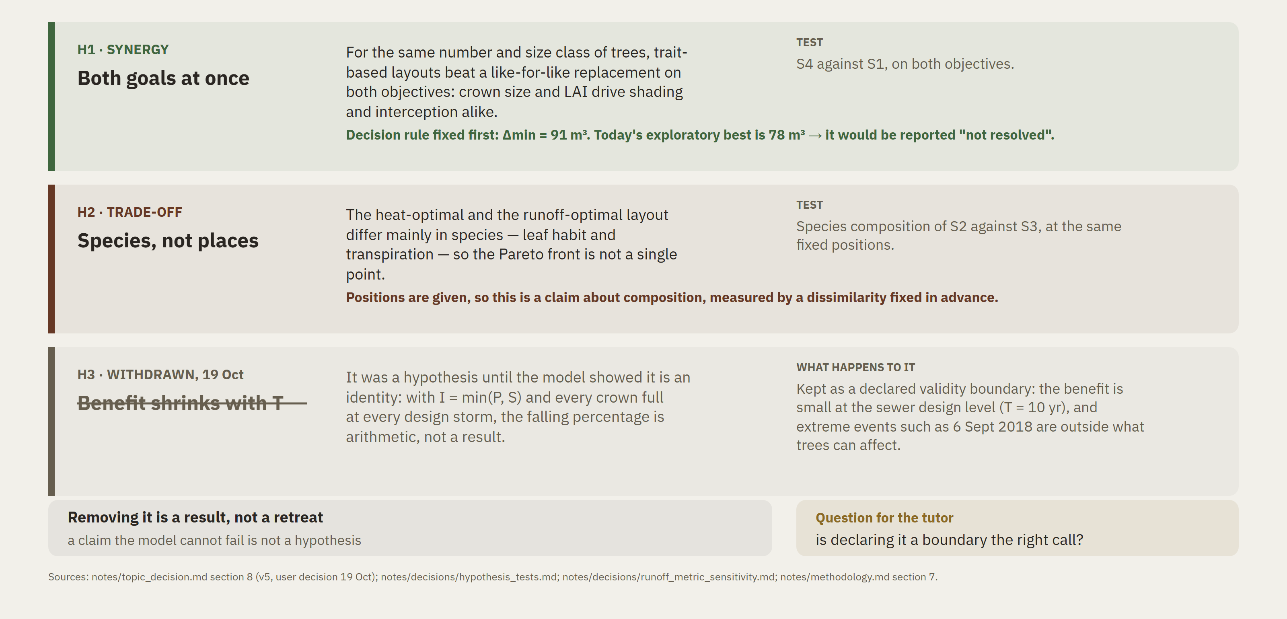
Two hypotheses — and the one I took out
H1 and H2 are testable; H3 was withdrawn on 19 Oct because the model cannot fail it
Notes:
Two hypotheses, and one I removed. One, synergy: at the same number and size of trees, a trait-based layout beats a like-for-like replacement on both goals. Two, trade-off: the heat optimum and the runoff optimum differ mainly in species, not in positions. I fixed a minimum meaningful difference before running anything — ninety-one cubic metres — and on today's exploratory numbers the best layout does not clear it, which I would report as not resolved. The third one I took out yesterday. It said the runoff benefit shrinks as storms grow, and the model cannot fail it: with a full crown at every storm that is arithmetic, not a test. So it is now a declared boundary of the method. My question to you is whether that is the right call.

Slide 13
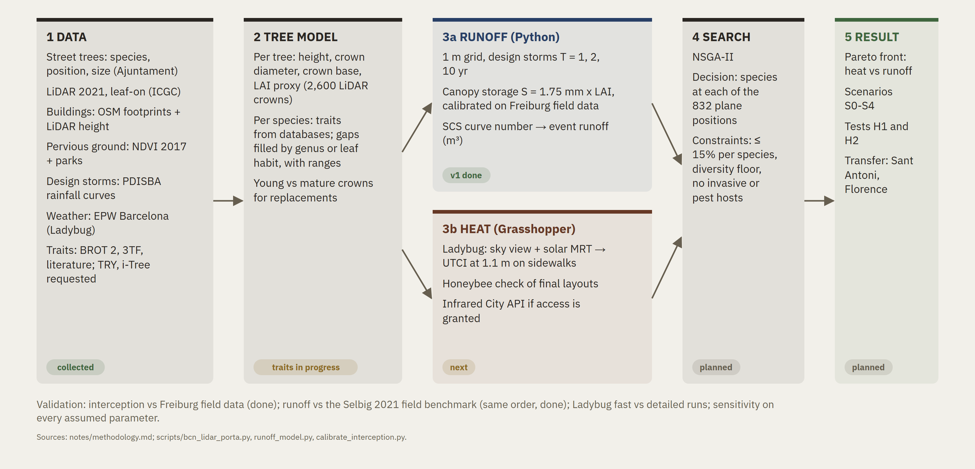
Method: from LiDAR trees to a heat-runoff trade-off
Python modules + Grasshopper; status on 8 Oct 2026
Notes:
The method has five steps. From the 2021 laser scan — flown in September, with the leaves on, which matters — I get every tree's height, crown and a leaf-area proxy. A Python module scores runoff for a design storm; a Ladybug module in Grasshopper scores felt temperature on a design afternoon. A genetic search then chooses the species at each of the eight hundred and thirty-two plane positions, under the city's fifteen-percent rule and a diversity floor. The output is a Pareto front, and then the same machine is pointed at a second site.

Slide 14
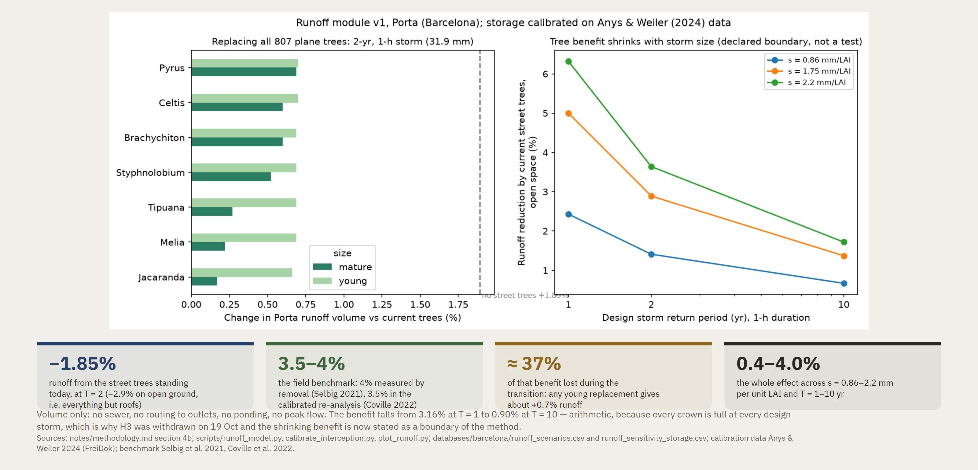
First result: the runoff module runs
Porta, 2-year 1-hour design storm (31.9 mm); canopy storage calibrated on 16 trees and 51 storms in Freiburg
Notes:
The runoff module already runs. I calibrated canopy storage on open field data — sixteen trees, fifty-one storms. Porta's street trees as they stand today cut runoff in a two-year storm by one point eight five percent, or about three percent counting open ground only, everything but the roofs. That is the same order as the three and a half to four percent measured in the field, which is the check I wanted. Replace the mature planes with young trees and more than a third of that benefit disappears during the transition. That number is for the city, not for me.

Slide 15
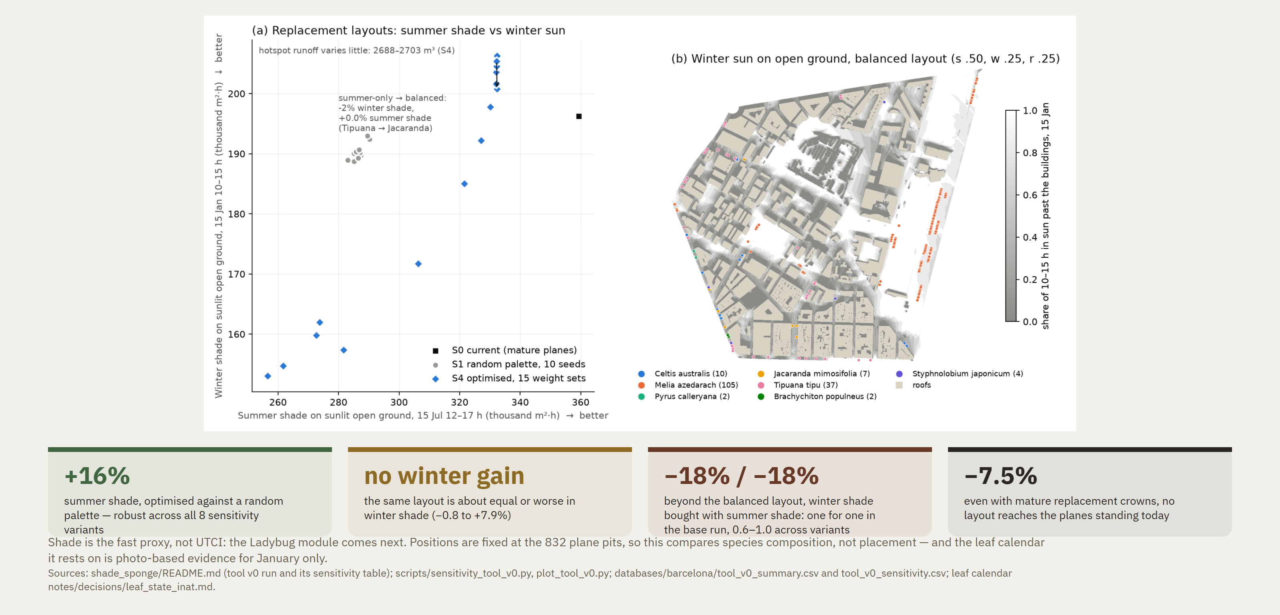
First result: the shade trade-off is real
Tool v0 over the seven candidate species, with the photo-based leaf calendar (re-run 15 Oct)
Notes:
The first version of the optimiser also runs, on the shade side. Against a random palette, an optimised one gives sixteen percent more summer shade, and that holds across eight sensitivity variants — but it buys no winter sun at all: about equal, or slightly worse. Push it further and the trade-off becomes real: you buy winter sun with summer shade, one for one in the base run and two-thirds to one across the variants. And this is with mature replacement crowns — even then, no layout reaches the planes that are standing today. That is the honest shape of the problem.

Slide 16
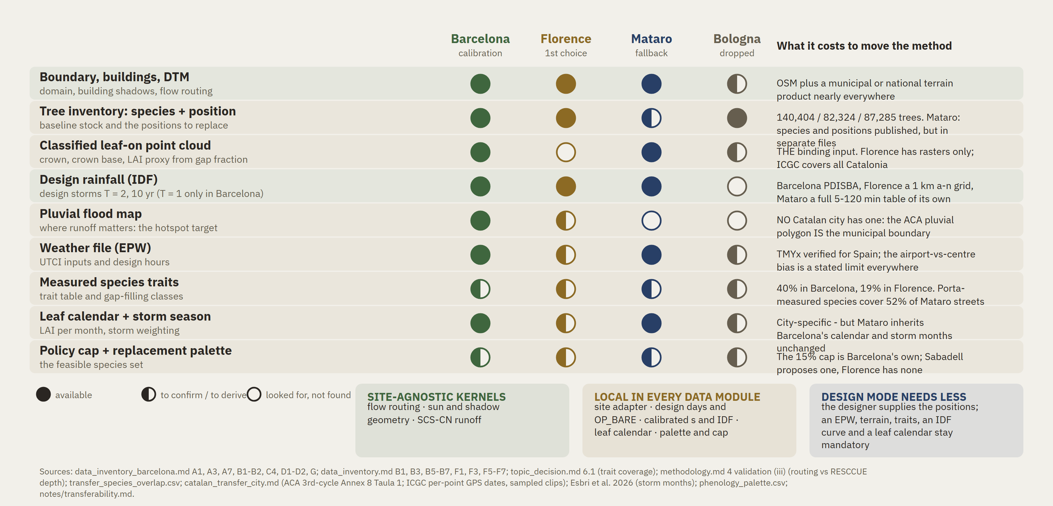
The code travels, the evidence does not
What the method needs at a new site: Porta (calibration) vs three transfer options, verified 19 Oct
Notes:
Last piece: how far this travels. The code is site-agnostic by construction — the routing, the shadow geometry and the runoff kernel carry no local constant. What does not travel is the evidence, and in particular one input: a laser scan taken with the leaves on, dense enough to see inside a crown. Florence has the trees and the rainfall but only rasters, so I have to ask for the cloud. My fallback is Mataró, which has the scan and, unlike Badalona, its own design storm — borrowing Barcelona's would have made the test circular. And the thing I did not expect: no Catalan city publishes a city-wide pluvial map. Barcelona's is the only one I found. That is why I calibrated here.

Slide 17
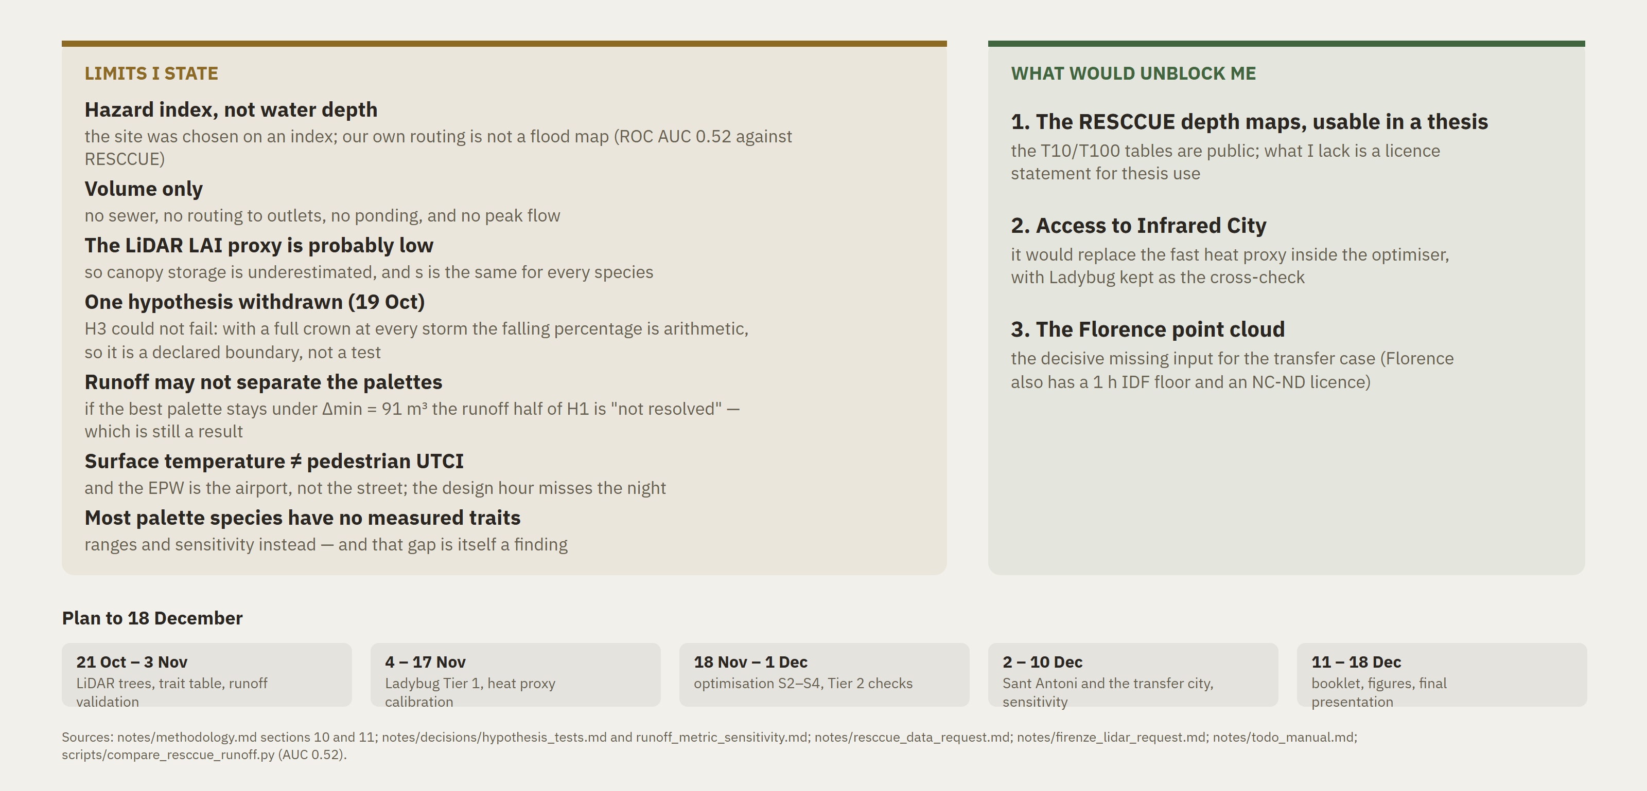
What I cannot do yet, and what would unblock me
Limits first, then three asks and the plan to 18 December
Notes:
I would rather say the limits myself. It is volume, not peak flow. It is a hazard index, not water depth — my own routing is not a flood map and I tested that. The leaf-area proxy is probably low. And the third hypothesis is true by construction of my model, so I declare it as a boundary rather than claim it as a result. Three things would unblock me: the licence to use the city's flood-depth maps, access to Infrared City, and the Florence point cloud.

Slide 18
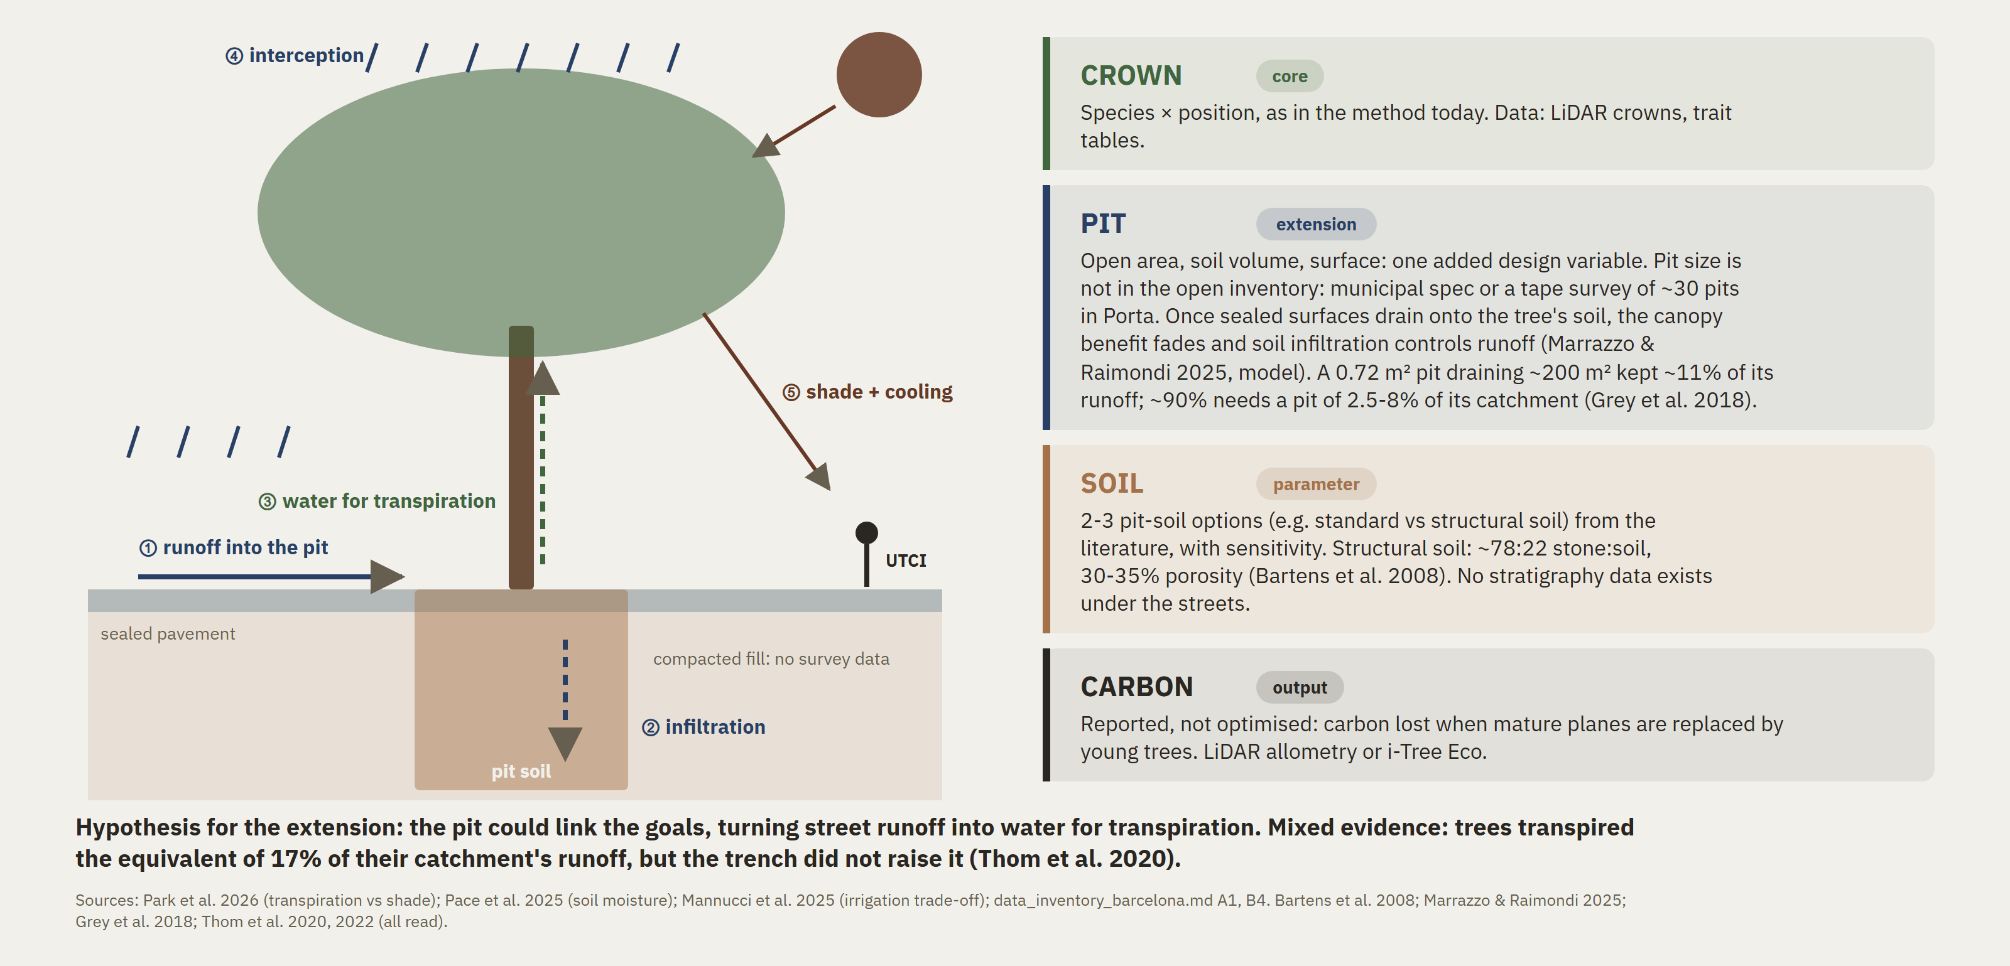
If broader: from the crown to the tree as a system
Backup slide: one added design variable (the pit), soil as a parameter, carbon as an output
Notes:
If the scope needs to be wider, I would not add parallel themes. I would widen the tree into a system. The pit is the one design variable I'd add, because it links the two goals: it takes runoff from the pavement and stores it as water for transpiration, which cools the air more than shade does. Soil would enter as two or three literature options with sensitivity, since there is no survey under the streets. Carbon would be reported, not optimised.

Slide 19
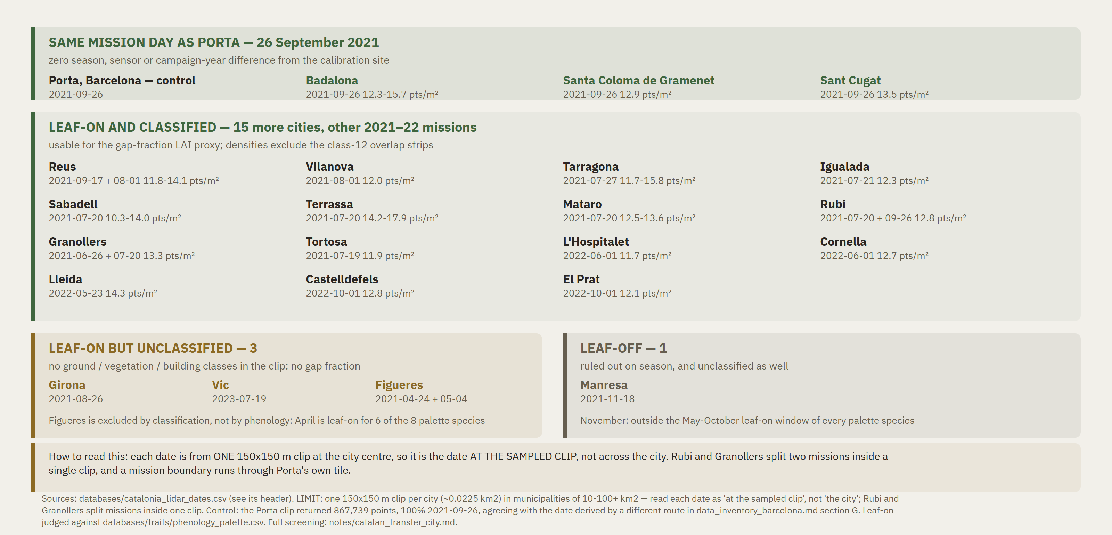
22 Catalan cities, screened on the one input that decides a transfer
ICGC Territorial LiDAR v3: the per-sheet metadata gives only the flight year, so each date was read from per-point GPS time in the cloud itself
Notes:
I screened twenty-two Catalan cities on the one input that decides a transfer. ICGC publishes only the flight year, so I read the date from the per-point GPS time in the cloud itself, and checked it against Porta, where it reproduces the date I already had. Eighteen are leaf-on and classified. Three are flown but unclassified, and one is flown in November.

