Slide 1
AGENTCONF · HANDS-ON WORKSHOP
AI
Build an AI
software factory
FACTORY
A practical introduction using Pocket Cinema as the shared product
PLAN
BUILD
VERIFY
REVIEW
AI SOFTWARE FACTORY WORKSHOP
01
Notes:
Welcome participants and frame the session as a workshop about engineering systems, not prompt tricks.
The running example is Pocket Cinema, which we will safely transform into TableStory.
Set the expectation: we will plan, build, verify, and review one bounded change end to end.
[Sources]
- /Users/glaquidara/Projects/agentconf/factory/WORKSHOP_OUTLINE.md
- /Users/glaquidara/Projects/agentconf/factory/README.md
[/Sources]

Slide 2
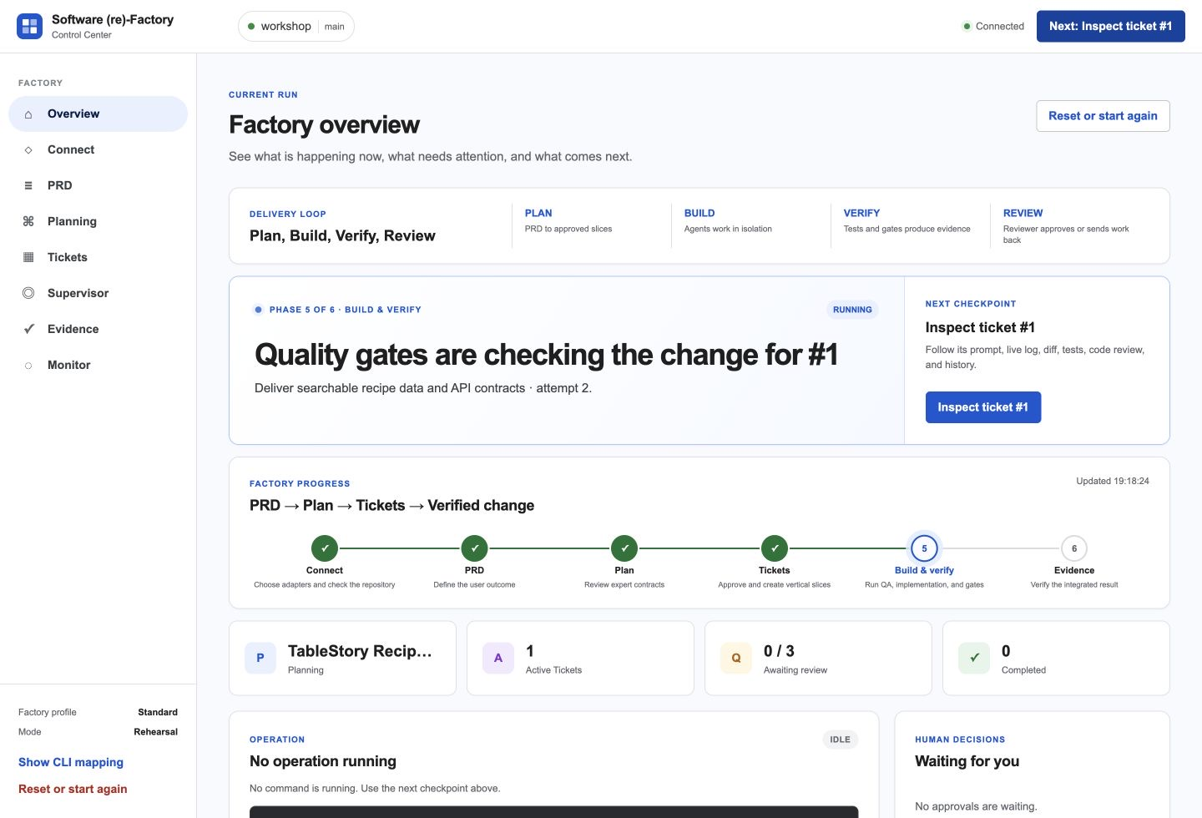
01 · THE IDEA
An agent executes. A factory governs the change.
An AI software factory surrounds coding agents with the system they need to deliver trustworthy software:
Context
Isolation
Quality gates
Traceability
Human decisions
The factory makes state, gates, and human checkpoints visible.
AI SOFTWARE FACTORY WORKSHOP
02
Notes:
Use the distinction literally: an agent can execute work; the factory governs what work is allowed and how it becomes trusted.
Point out the visible Plan, Build, Verify, Review loop in the Control Center.
Emphasize that people still own intent approval and the merge decision.
[Sources]
- /Users/glaquidara/Projects/agentconf/factory/WORKSHOP_OUTLINE.md
- /Users/glaquidara/Projects/agentconf/factory/README.md
- /Users/glaquidara/Projects/agentconf/workshop-guide/public/screenshots/control-center-overview.jpg
[/Sources]

Slide 3
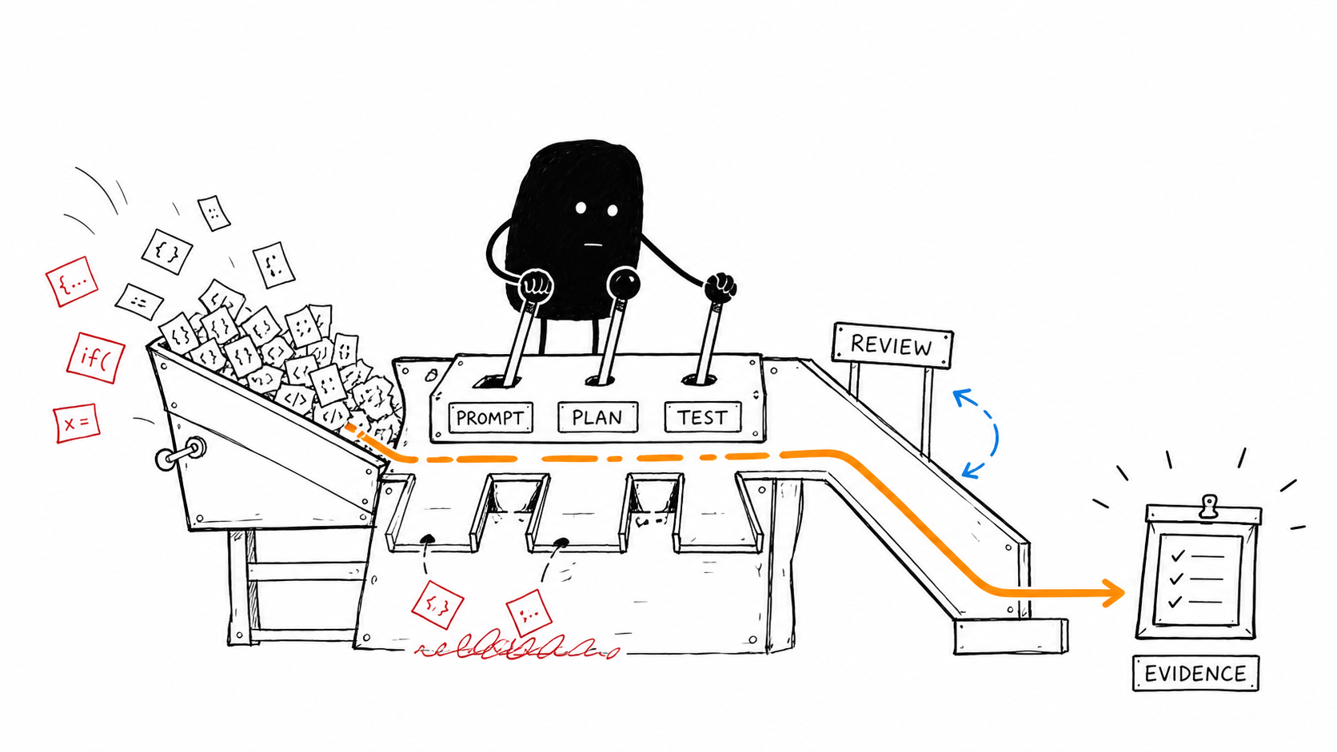
02 · THE LOOP
Start with the minimum responsible loop
Clear intent → one bounded slice → a real test → reviewable evidence → a human merge
Goal · Do · Check · Decide
AI SOFTWARE FACTORY WORKSHOP
03
Notes:
This is deliberately smaller than a grand autonomous system.
The factory begins with a bounded issue and ends only when a person can inspect causal evidence and make a merge decision.
Repeat the cadence: Goal, Do, Check, Decide.
[Sources]
- /Users/glaquidara/Projects/agentconf/factory/WORKSHOP_OUTLINE.md
- /Users/glaquidara/Projects/agentconf/workshop-guide/public/illustrations/01-from-prompt-to-evidence.png
[/Sources]

Slide 4
03 · THE CONTROLS
Every control answers a visible failure mode
01
Ambiguous intent
02
Conflicting assumptions
Product review turns a request into an approved problem, behavior, and boundary.
Architecture, program design, and alignment converge on one PRD and coherent slices.
03
Colliding workers
04
Weak evidence
Dependencies, claims, and isolated worktrees keep concurrent work bounded and reversible.
Protected acceptance tests, required gates, code review, and human merge make completion inspectable.
The goal is not more process. It is less ambiguity at the moments where ambiguity is expensive.
AI SOFTWARE FACTORY WORKSHOP
04
Notes:
Walk clockwise through the four failures and ask participants which one they have seen most often.
Frame controls as specific responses to real engineering failures, not ceremony for its own sake.
Mention handoff receipts and post-merge monitoring if the audience asks about traceability after completion.
[Sources]
- /Users/glaquidara/Projects/agentconf/factory/WORKSHOP_OUTLINE.md
[/Sources]

Slide 5
04 · TODAY’S ROUTE
How we will proceed in 100 minutes
One shared product. One visible factory loop. Three acts.
0–53
53–85
85–100
ALIGN
EXECUTE
PROVE
Agree the work
Run the factory
Decide with evidence
Inspect Pocket Cinema
Read the PRD
Approve intent and tickets
Approve acceptance tests
Launch isolated work
Observe the delivery loop
Review RED → GREEN
Inspect the candidate
Merge and monitor
Rehearsal mode
deterministic workshop run
Live mode
same workflow with real integrations
AI SOFTWARE FACTORY WORKSHOP
05
Notes:
Keep the workshop moving as three acts rather than reciting every step.
Align covers setup, product inspection, PRD review, planning, and ticket creation.
Execute covers protected tests and factory execution; Prove covers evidence, merge, and monitoring.
Participants can follow Rehearsal mode for determinism or Live mode when integrations are ready.
[Sources]
- /Users/glaquidara/Projects/agentconf/factory/WORKSHOP_OUTLINE.md
- /Users/glaquidara/Projects/agentconf/factory/FACILITATOR.md
- /Users/glaquidara/Projects/agentconf/factory/README.md
[/Sources]

Slide 6
05 · THE SHARED USE CASE
Pocket Cinema is our starting system
A working streaming UI
The challenge is not to generate a greenfield demo. It is to change a real, already-working product without losing what matters.
Browse and search
Reusable data contracts
Responsive behavior
Existing tests and navigation
AI SOFTWARE FACTORY WORKSHOP
06
Notes:
Invite participants to notice that Pocket Cinema already has product behavior, data, navigation, and responsive constraints.
This makes it a useful factory test: we must preserve reliable behavior while changing the product model.
The work is a controlled transformation, not a visual reskin.
[Sources]
- /Users/glaquidara/Projects/agentconf/factory/WORKSHOP_OUTLINE.md
- /Users/glaquidara/Projects/agentconf/factory/README.md
- /Users/glaquidara/Projects/agentconf/workshop-guide/public/screenshots/pocket-cinema-before.webp
[/Sources]

Slide 7
06 · THE TARGET
Pocket Cinema becomes TableStory
A recipe discovery experience designed for desktop, mobile, and TV input.
The product promise
Browse
Search
Open details
Save recipes
Use arrows + Enter on TV
Same intent.
Different surfaces.
TV MODE
← ↑ ↓ → ENTER
remote-first
POCKET CINEMA → TABLESTORY
07
Notes:
Describe the target as a coherent product transformation: recipes replace films across the data model, interaction model, and brand.
The acceptance surface spans desktop, mobile, and TV. TV navigation uses arrow keys, Enter, and Escape or Backspace.
Core user journeys are browsing, searching, reading details, and saving recipes to a cookbook.
[Sources]
- /Users/glaquidara/Projects/agentconf/factory/README.md
- /Users/glaquidara/Projects/agentconf/factory/scenarios/recipe-rebrand/steps/5/demo-app/README.md
- /Users/glaquidara/Projects/agentconf/workshop-guide/public/screenshots/tablestory-desktop.webp
- /Users/glaquidara/Projects/agentconf/workshop-guide/public/screenshots/tablestory-mobile.webp
[/Sources]

Slide 8
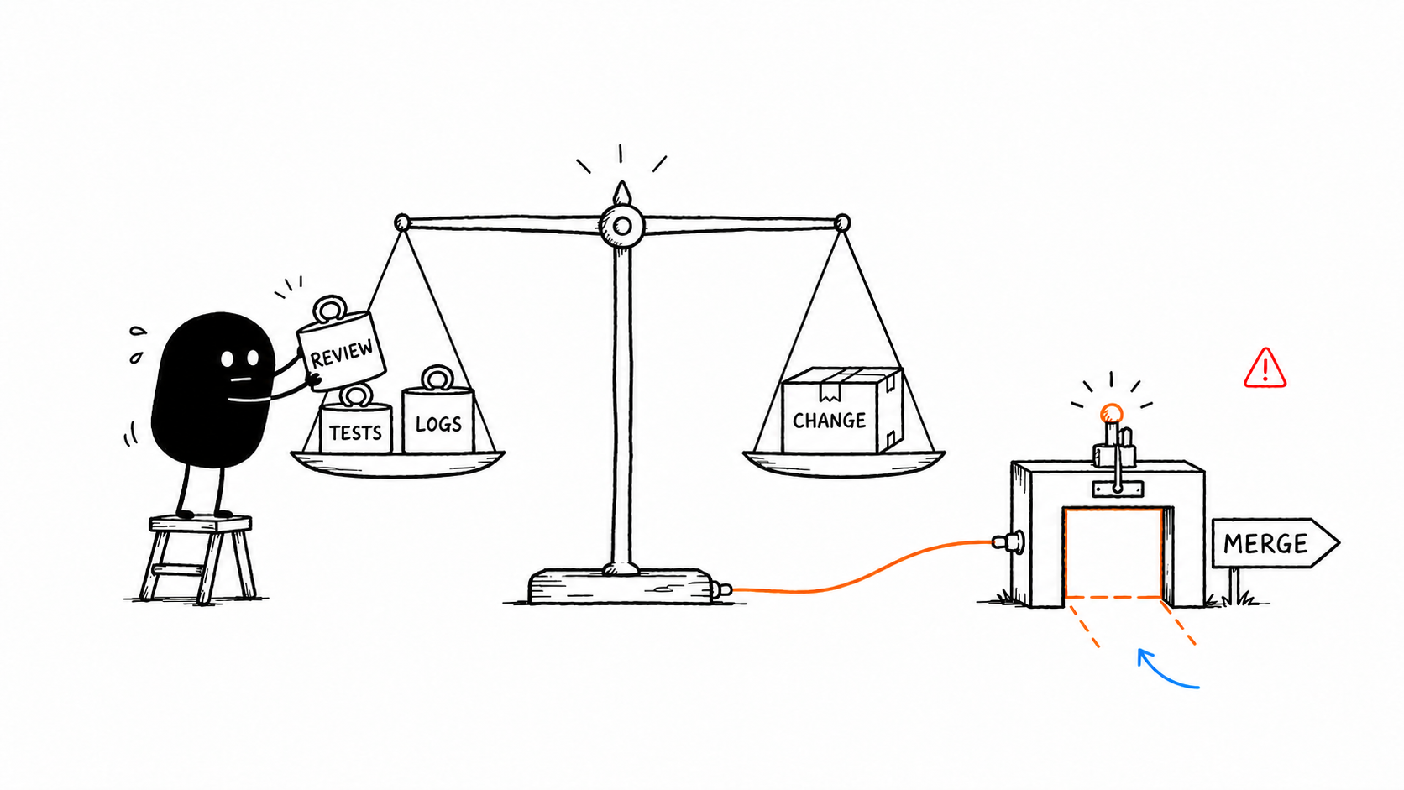
07 · THE PROOF
Completion is a claim until evidence makes it reviewable
The factory does not ask the reviewer to trust the agent’s confidence.
01
Causal test
The same focused check fails before the change and passes after it.
02
Required gates
Tests, lint, type checks, and review rules produce a visible result.
03
Human decision
A person inspects the exact candidate revision before merge.
04
Post-merge health
The integrated result remains observable after delivery.
AI SOFTWARE FACTORY WORKSHOP
08
Notes:
Explain causal evidence: the same focused command must detect the missing behavior and then pass after implementation.
A reviewer should receive the candidate revision, diff, tests, logs, code review, and history in one causal chain.
The final decision remains human, and monitoring extends responsibility beyond the merge event.
[Sources]
- /Users/glaquidara/Projects/agentconf/factory/WORKSHOP_OUTLINE.md
- /Users/glaquidara/Projects/agentconf/factory/README.md
- /Users/glaquidara/Projects/agentconf/workshop-guide/public/illustrations/03-evidence-controls-merge.png
[/Sources]

Slide 9
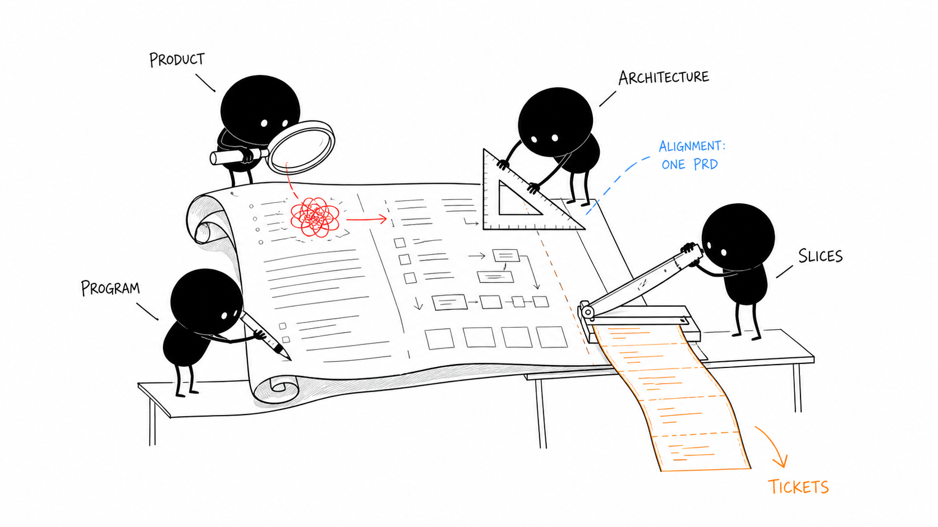
08 · FIRST MOVE
Before we automate,
we learn the system.
Inspect Pocket Cinema and answer three questions:
01
What already works?
02
What must change?
03
What must never regress?
OPEN POCKET CINEMA →
Alignment comes before acceleration.
AI SOFTWARE FACTORY WORKSHOP
09
Notes:
Transition directly into the exercise. Ask participants to open the baseline app and inspect it before reading the target PRD.
The three questions establish the current behavior, intended change, and non-regression boundary.
Then move to product review and alignment before any agent starts coding.
[Sources]
- /Users/glaquidara/Projects/agentconf/factory/WORKSHOP_OUTLINE.md
- /Users/glaquidara/Projects/agentconf/workshop-guide/public/illustrations/02-four-planning-perspectives.png
[/Sources]

