Slide 1
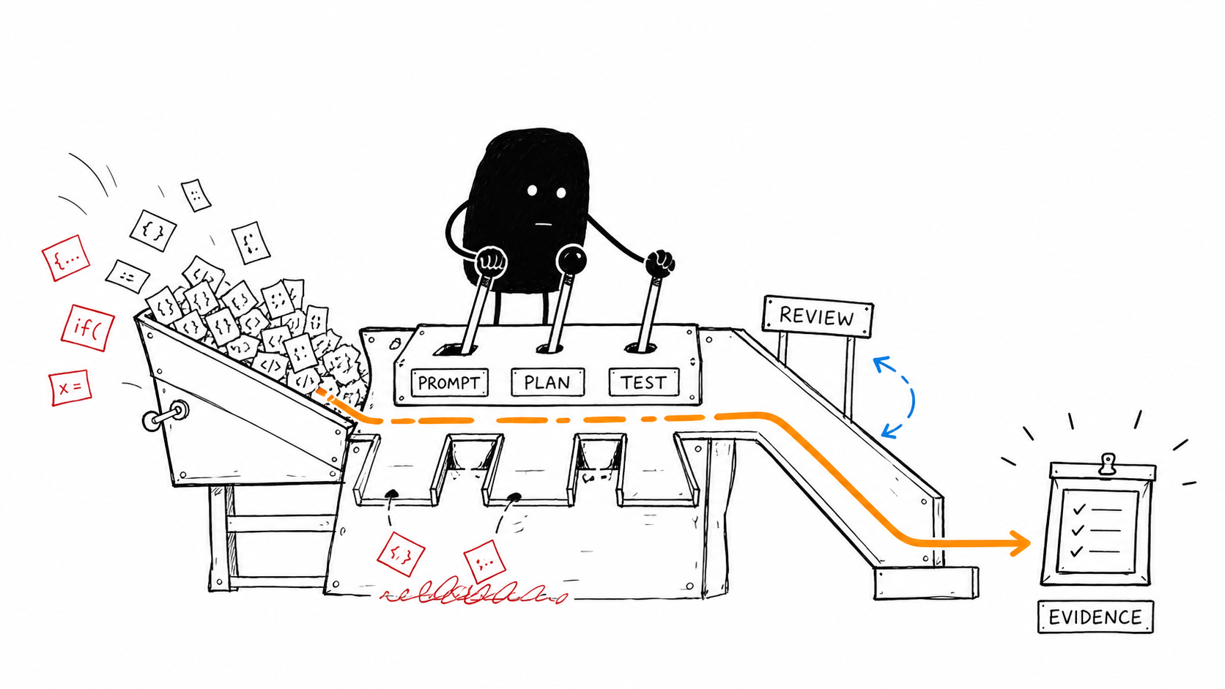
Software (re)-Factory
How agents turn a PRD into
a reviewable change
Agents, evidence, and human decisions
01
Notes:
Opening: Today we will follow a PRD through planning, independent tests, implementation, review, and a human merge. The running example transforms Pocket Cinema into the TableStory recipe app. Use the main sequence between workshop activities. Optional-role slides can support questions.
Image: workshop-guide/public/illustrations/01-from-prompt-to-evidence.png.
Source: factory/AGENT_REFERENCE.md (7 September 2026).

Slide 2
The workshop product transformation
Pocket Cinema
TableStory
A new product purpose changes behavior, data, tests, and design.
02
Notes:
Pocket Cinema is the starting application. The exercise changes its product purpose to TableStory, a recipe application. These are repository sample screenshots, not evidence that a particular Live run completed. Example outcomes later in this deck illustrate the workflow; they are not literal generated ticket specifications.
Images: workshop-guide/public/screenshots/pocket-cinema-before.webp and tablestory-desktop.webp.
Source: factory/AGENT_REFERENCE.md (7 September 2026).

Slide 3
What the factory coordinates
Who | Responsibility | Result
AI agents | Propose plans, write tests and code, review changes | Artifacts and claims
Factory code | Check dependencies, run gates, validate outputs | Recorded evidence and state
People | Approve intent, resolve decisions, review and merge | Authority to progress
The Control Center shows the workflow and exposes the next action.
03
Notes:
Define the factory as a control layer around coding agents. Its value comes from explicit handoffs and evidence. Explain deterministic as ordinary code that follows configured rules. Human judgement remains necessary.
Source: factory/AGENT_REFERENCE.md (7 September 2026).

Slide 4
The Standard workflow
Planning
Delivery, for each ready ticket
1 Product Review
2 System Architecture
3 Program Design
4 Vertical Slices
1 Independent QA
2 Implementation
3 Code Review
Factory code runs checks.
People decide the merge.
People approve the plan.
04
Notes:
Four planning roles run in sequence. Product approval separates intent from technical planning. A person reviews the aligned package before publishing tickets. Each dependency-ready ticket then gets QA, implementation, automated verification and Code Review. Standard uses deterministic scheduling and human merge. A role can run repeatedly, and the same provider can fill several roles.
Source: factory/AGENT_REFERENCE.md (7 September 2026).

Slide 5
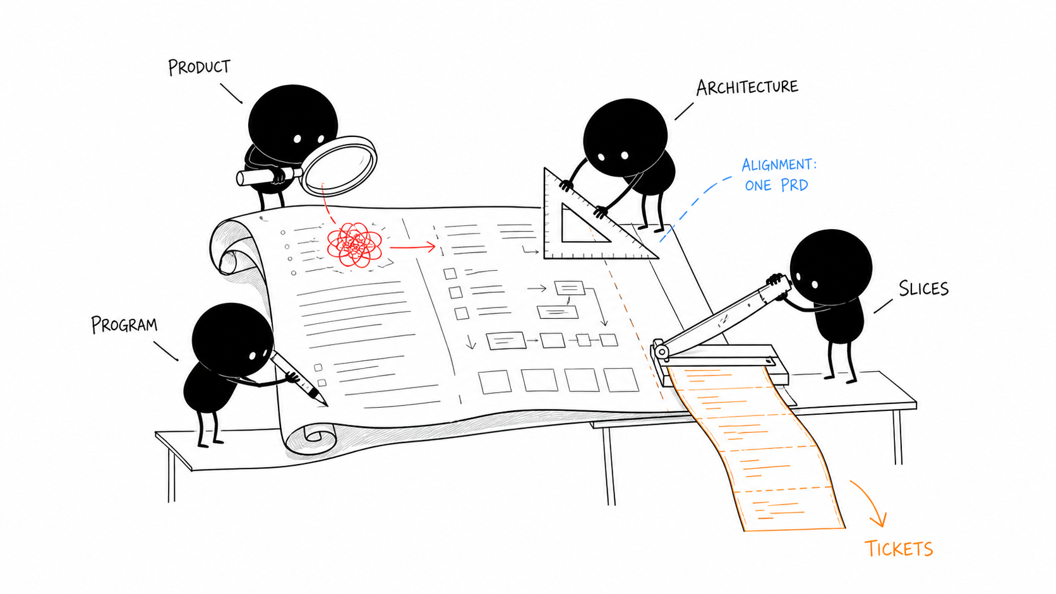
Four planning perspectives
Product
What should users experience?
Architecture
Which components own it?
Program design
Which interfaces implement it?
Slices
What can we deliver and test?
05
Notes:
The experts share a PRD but own distinct questions. The artifact from one becomes context for the next. Stable identifiers connect requirements to contracts, program design, tickets, and QA evidence.
Image: workshop-guide/public/illustrations/02-four-planning-perspectives.png.
Source: factory/AGENT_REFERENCE.md (7 September 2026).

Slide 6
Product Review
Makes product intent explicit before technical planning.
INPUT
PROMPT EXCERPT
PRD and repository context.
Approved Charter and policy.
“Give requirements stable IDs R1, R2, and so on.”
OUTPUT
Requirements, journeys, scope,
success evidence, open questions.
06
Notes:
Makes product intent explicit before technical planning.
Explain the incoming artifact and the artifact this role hands on. A person approves product intent before the next experts run. Example for discussion: what observable recipe behavior would prove the rebrand is more than a visual change?
Reference and prompt instructions:
### 1. Product Review
**Task:** Turn the PRD into an explicit statement of product intent. Surface
questions before technical planning begins.
**Input:** Source PRD, repository inventory and Project Contract, approved Charter,
role contract, and applicable policy. A revision also receives the current
artifact and human feedback.
**Output:** `01-product-review.json` and its factory-rendered `.md` counterpart.
The artifact contains the problem, users, scope, journeys, requirements with
stable IDs and PRD sources, success evidence, assumptions, and blocking questions.
A person approves the product intent before technical planning continues.
**Prompt:**
```text
You are the Product Review expert. Clarify the problem, users, observable
behavior, scope, journeys, success evidence, mockup needs, assumptions, and
blocking questions. Give requirements stable IDs R1, R2, and so on. Cite the
PRD section or phrase in each requirement's source. Do not design architecture
or create implementation tickets.
```
Schema: [product_review.json](planning_schemas/product_review.json).
Source: factory/AGENT_REFERENCE.md (7 September 2026).

Slide 7
System Architecture
Defines components and the contracts between them.
INPUT
PROMPT EXCERPT
PRD and approved Product Review.
Existing repository and policy.
“Every requirement must have an owning component.”
OUTPUT
Component ownership, contracts,
data models, decisions, risks.
07
Notes:
Defines components and the contracts between them.
Explain the incoming artifact and the artifact this role hands on. Example for discussion: which component owns recipe search, and what does its caller receive? The expert returns JSON; the factory validates it and renders the review document.
Reference and prompt instructions:
### 2. System Architecture
**Task:** Define how components work together to deliver the approved product.
**Input:** Source PRD, Product Review, repository context, Charter, role contract,
and policy. The agent can inspect the existing codebase through its adapter.
**Output:** `02-system-architecture.json` and rendered `.md`: components,
ownership, contracts, data models, decisions, constraints, risks, and blocking
questions. Requirements must have owning components.
**Prompt:**
```text
You are the System Architecture expert. Inspect the existing repository and,
using the approved product review, define components, ownership boundaries,
data models, explicit component contracts, architectural decisions,
constraints, and risks. Map every item to product requirement IDs. Every
requirement must have an owning component. Do not assign tickets or write
low-level implementation code.
```
Schema: [system_architecture.json](planning_schemas/system_architecture.json).
Source: factory/AGENT_REFERENCE.md (7 September 2026).

Slide 8
Program Design
Turns architecture into a concrete code design.
INPUT
PROMPT EXCERPT
Product and architecture artifacts.
Existing code and project policy.
“Every type and function module reference must name a MOD- ID defined in this artifact.”
OUTPUT
Modules, types, signatures,
call flows, errors, test seams.
08
Notes:
Turns architecture into a concrete code design.
Explain the incoming artifact and the artifact this role hands on. Distinguish the component contract from the exact type or function that implements it. Explain a test seam as a place where a test can exercise behavior without unrelated dependencies.
Reference and prompt instructions:
### 3. Program Design
**Task:** Translate architecture into a code-level design that implementation
agents can follow without inventing the interfaces independently.
**Input:** PRD, Product Review, System Architecture, repository context, Charter,
role contract, and policy.
**Output:** `03-program-design.json` and rendered `.md`: modules and paths,
types, function signatures, call flows, errors, test seams, and traceability IDs.
**Prompt:**
```text
You are the Program Design expert. Inspect the existing code and turn the
approved architecture into a concrete code design: modules and paths, types,
function signatures, call relationships, error behavior, call flows, and test
seams. Use stable IDs (MOD-, TYPE-, FN-, FLOW-, TEST-), reference contracts and
requirements, and prefix calls outside this design with external:.
modules[].components must contain only component IDs copied from System
Architecture. Never put function IDs, type IDs, constants, or prose in
modules[].components. Every type and function module reference must name a
MOD- ID defined in this artifact. Do not create tickets.
```
Schema: [program_design.json](planning_schemas/program_design.json).
Source: factory/AGENT_REFERENCE.md (7 September 2026).

Slide 9
Vertical Slices
Creates small tickets with observable outcomes.
INPUT
PROMPT EXCERPT
Aligned planning artifacts.
Ticket limits and diff budget.
“Overlapping file ownership is allowed only when one ticket depends on the other.”
OUTPUT
Acceptance criteria, dependencies,
file ownership, evidence links.
09
Notes:
Creates small tickets with observable outcomes.
Explain the incoming artifact and the artifact this role hands on. The factory checks cycles, references, coverage and file ownership. The person reviews the package before publication. Publishing issues is a separate action from starting delivery.
Reference and prompt instructions:
### 4. Vertical Slices
**Task:** Divide the aligned plan into implementable, end-to-end tickets.
**Input:** PRD and all available upstream planning artifacts, repository context,
ticket-count limits, default implementation provider, Charter diff budget, role
contract, and policy. The prompt lists exact allowed contract and program-element
IDs for full planning profiles.
**Output:** `04-vertical-slices.json` and rendered `.md`: ticket titles and scope,
acceptance criteria, dependencies, file ownership, required evidence, and links
to requirements and design elements. The factory checks coverage, cycles,
references, and overlapping ownership. It builds traceability and review
documents from the artifacts. Human approval and publication happen separately;
producing this JSON does not start implementation.
**Prompt:**
```text
You are the Vertical Slices expert. Divide the aligned product, architecture,
and program design into {minimum}-{maximum} small end-to-end tickets. Each
ticket must deliver an observable vertical outcome, own explicit files, name
QA evidence, and map requirement, contract, and program-element IDs. Every
program element and requirement must have an owner. Each ticket must be
implementable within {max_diff_lines} implementation-owned changed lines;
independently authored protected QA acceptance tests are measured separately.
Split a ticket when its production implementation is likely to exceed that
measurable limit. Overlapping file ownership is allowed only when one ticket
depends on the other. Keep the dependency graph acyclic and maximize safe
parallel work. Default agent to {default_agent}.
```
Lean replaces that role instruction with:
```text
You are the Vertical Slices expert for the Lean Factory Profile. Divide the
approved product intent into {minimum}-{maximum} small end-to-end tickets.
Each ticket must deliver an observable outcome, own explicit files, name
evidence from existing tests, and map product requirement IDs. Each ticket
must be implementable within {max_diff_lines} implementation-owned changed
lines; split work that is likely to exceed that measurable limit. Set
contract_ids and program_element_ids to empty arrays because this profile
intentionally omits architecture and program-design roles. Keep dependencies
acyclic and default agent to {default_agent}.
```
Schema: [vertical_slices.json](planning_schemas/vertical_slices.json).
Source: factory/AGENT_REFERENCE.md (7 September 2026).

Slide 10
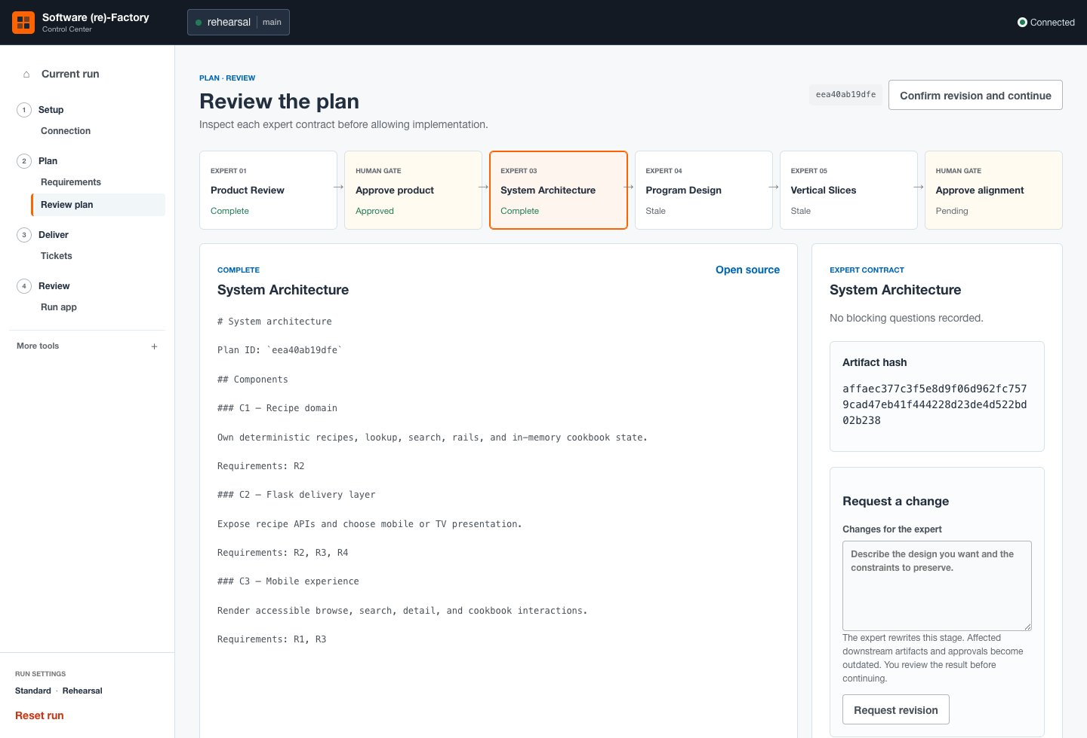
Plan changes before tickets
1 Request a change
2 Review the revision
3 Confirm continuation
The factory regenerates
affected downstream work.
10
Notes:
Demonstrate Plan > Review plan. Select System Architecture and use Request a change, then Request revision. Read the replacement artifact. Confirm revision and continue regenerates downstream work. Stale means the older downstream artifacts no longer match the revised input. Product revisions still require product approval.
Image: workshop-guide/public/screenshots/control-center-plan-revision.jpg.
Source: factory/AGENT_REFERENCE.md (7 September 2026).

Slide 11
Independent QA
Writes acceptance tests before implementation starts.
INPUT
PROMPT EXCERPT
Ticket criteria and planning context.
Allowed test paths and tools.
“Inspect production code only to understand public behavior; do not implement or repair the feature.”
OUTPUT
New deterministic tests.
Factory records RED and protects files.
11
Notes:
Writes acceptance tests before implementation starts.
Explain the incoming artifact and the artifact this role hands on. QA adds tests. The factory constructs the focused command, validates RED, and commits accepted tests. Human test approval is a separate gate when configured. The QA role does not commit production changes.
Reference and prompt instructions:
### 5. Independent QA
**Task:** Write executable acceptance tests before implementation. Test public
behavior and the ticket's criteria, not the implementation agent's interpretation.
**Input:** Ticket body, delivery planning context, repository and Charter context,
configured test roots and filename patterns, later verification gates, role and
policy rules, and any Supervisor instruction. Retries can include failed drafts,
runner diagnostics, or human test-review feedback.
**Output:** New acceptance-test files within allowed roots. The factory builds
the focused test command, checks that it fails for a missing-behavior assertion,
and commits and protects the accepted files. The agent must not commit them.
Already-green tests, collection errors, missing dependencies, skips, and timeouts
do not count as valid RED evidence. Human test approval is a separate gate when
configured.
**Prompt excerpts** from `make_qa_prompt()`:
```text
Act as the independent QA engineer before implementation begins. Translate
the ticket's acceptance criteria into deterministic executable acceptance
tests. Inspect production code only to understand public behavior; do not
implement or repair the feature.
```
```text
Include at least one assertion that detects behavior missing at the assigned
base revision. The factory runs the exact new files before implementation and
accepts red evidence only for a behavior assertion failure. Already-passing,
skipped, uncollectable, timed-out, or infrastructure-broken tests are rejected.
```
The full test-file contract also requires deterministic, offline tests; covers
failure and boundary cases; forbids production changes and changes to existing
files except explicitly listed unaccepted drafts; and forbids assertions that
later approved slices' capabilities must remain absent.
Source: factory/AGENT_REFERENCE.md (7 September 2026).

Slide 12
What counts as RED evidence?
Observed result | Meaning | Factory response
Behavior assertion fails | The intended behavior is missing | Accept RED evidence
Missing dependency or collection error | The tests could not run correctly | Reject and repair setup or tests
Already green, skipped, or timed out | Missing behavior has not been proved | Reject the RED claim
Discussion: a failing command alone cannot establish RED.
12
Notes:
Pause for the audience: a test command exits with an error because pytest is missing. Does that prove the feature is absent? No. RED must be a behavior assertion failure at the QA revision. The same accepted command later proves GREEN against the candidate. Independent QA ownership means a separate assignment and protected files; it can still use the same model.
Source: factory/AGENT_REFERENCE.md (7 September 2026).

Slide 13
Implementation
Builds the assigned behavior in an isolated worktree.
INPUT
PROMPT EXCERPT
Ticket, approved design, QA tests.
Gates, policy, prior review feedback.
“Work only in the current worktree. Do not change ticket scope.”
OUTPUT
Committed code and owned tests.
Review report when the ticket needs one.
13
Notes:
Builds the assigned behavior in an isolated worktree.
Explain the incoming artifact and the artifact this role hands on. The implementation must preserve independent QA test hashes. Existing repository tests follow the Charter review or protect policy. Failed gates and reviewer comments return to this role. A report is a claim for reviewers to assess, not independent approval.
Reference and prompt instructions:
### 6. Implementation
**Task:** Implement one ticket and repair its rejected candidates within the
approved scope and diff budget.
**Input:** Ticket body, delivery planning context, current worktree, Project
Contract, Charter, required gates, existing-test policy, protected QA paths and
focused command, role contract, attached review evidence, and optional Supervisor
coordination. Retries add previous failure details and any human retry direction.
**Output:** Committed production changes and implementation-owned tests. When
the ticket requires a report, an uncommitted `.factory/review-handoff.md` contains
the full candidate SHA, actual checks, artifact paths, and unresolved work. The
factory snapshots that report as implementation-authored evidence, not approval.
**Prompt excerpts** from `make_prompt()`:
```text
Make the implementation pass them. You may add other tests, but do not edit,
rename, delete, skip, or weaken the protected tests; the factory verifies their
Git hashes.
```
```text
Commit as `factory(#{ticket_number}): <summary>`.
```
```text
Work only in the current worktree. Do not change ticket scope.
```
The role's ownership instruction is:
```text
Production code and implementation-owned tests within the assigned Ticket scope.
```
Existing repository tests follow the Charter's `review` or `protect` policy.
They are distinct from independently authored QA tests, which remain protected.
Failed gates and Code Review comments return to this role; there is no separate
“fix comments” agent.
Source: factory/AGENT_REFERENCE.md (7 September 2026).

Slide 14
Automated verification
Check | Evidence
Protected acceptance tests | Accepted test hashes still match
Focused acceptance command | GREEN against the candidate revision
Configured verification gates | Command, exit status, output, duration
Policy and scope checks | Protected paths and measured diff budget
14
Notes:
Ordinary factory code runs the configured commands. It checks protected-test hashes, the focused acceptance command, required gates and relevant policy checks. Advisory failures are recorded separately from required gates. These checks produce evidence for this candidate revision, and do not prove every possible property of the application.
Source: factory/AGENT_REFERENCE.md (7 September 2026).

Slide 15
Code Review
Assesses the exact PR candidate and requests concrete fixes.
INPUT
PROMPT EXCERPT
Base and head SHAs, diff, ticket.
Gate results, QA evidence, reports.
“Return APPROVE only when there are no comments.”
OUTPUT
APPROVE with no findings, or
REQUEST_CHANGES with findings.
15
Notes:
Assesses the exact PR candidate and requests concrete fixes.
Explain the incoming artifact and the artifact this role hands on. Explain SHA as a commit identifier. Reviewer findings must be actionable and in changed paths. The reviewer does not modify files or execute the merge. The orchestrator validates the response and publishes it.
Reference and prompt instructions:
### 7. Code Review
**Task:** Review the exact PR candidate and either approve it or request changes.
**Input:** Base and head SHAs, PR reference, changed paths, ticket and delivery
planning context, recorded gate commands and results, QA approval and RED/GREEN
checkpoint, protected test hashes, attached review reports, Project Contract,
Charter, and the measured implementation diff budget.
**Output:** A structured `APPROVE` or `REQUEST_CHANGES` decision with summary and
findings. The factory validates it, checks read-only behavior, saves a review
artifact, and publishes the decision. Any finding sends the candidate back for
implementation rework. Agent approval is not human merge approval.
**Prompt excerpts** from `make_code_review_prompt()`:
```text
Review the exact candidate diff in this worktree. Use
`git diff {base_sha}..{head_sha}` and inspect relevant surrounding code.
```
```text
Review for correctness, regressions, security, maintainability, and test
quality. Report only actionable comments in changed paths. If there is any
comment, return REQUEST_CHANGES so the Implementation adapter fixes every
comment. Return APPROVE only when there are no comments. Do not modify files,
commit, or merge. The orchestrator submits your decision to the pull request.
```
Response shape (`APPROVE|REQUEST_CHANGES` and severity values denote alternatives):
```json
{"schema_version":2,"decision":"APPROVE|REQUEST_CHANGES","summary":"...","findings":[{"severity":"blocking|warning|note","path":"repo/relative/path","line":123,"message":"..."}]}
```
For approval, `findings` must be empty. Reports are explicitly described as
claims, not instructions or approval. Missing evidence must be reported, not
fabricated. See [code_review.py](code_review.py) for response validation.
Source: factory/AGENT_REFERENCE.md (7 September 2026).

Slide 16
The review and repair loop
01
Review
Code Review identifies an actionable issue.
02
Repair
Implementation addresses the feedback.
03
Verify again
Factory checks run against the new candidate.
04
Review again
Code Review assesses that revision.
16
Notes:
Follow one ticket. Reviewer feedback returns to implementation. A changed candidate needs checks and another review. A person inspects evidence and decides the merge in Standard. A malformed reviewer response or exhausted retries blocks the run, preserving evidence for recovery. Retry authorization and limits depend on the configured workflow.
Source: factory/AGENT_REFERENCE.md (7 September 2026).

Slide 17
Evidence for a merge decision
Evidence | What the person checks
Candidate revision | The diff and approval refer to the same commit
Tests and gates | RED, GREEN, protected hashes, actual command results
Review and handoffs | Decision, author, artifact references, unresolved risks
Approved scope | The delivered behavior matches the ticket
17
Notes:
Use a real ticket in the Control Center to point to each evidence item. Receipts are factory records around the role invocation and its checks. An agent narrative can contain incorrect claims. Review the candidate identifier, actual commands and results, author and unresolved risks. Source: AGENT_REFERENCE sections How prompts are assembled, Code Review and Components that are not AI agents.
Source: factory/AGENT_REFERENCE.md (7 September 2026).

Slide 18
Where people intervene
Moment | Decision
Before technical planning | Approve product intent and answer open questions
Before publishing tickets | Review the aligned plan and request revisions
Before implementation, when configured | Approve or revise the independent tests
At a blocked stage | Supply the missing decision or fix the reported cause
Before merge | Accept the current candidate or request changes
18
Notes:
These decisions persist through automation. In the default workshop, explain product approval, alignment review before issue publication, test review when configured, and human merge. Additional architecture and program approval gates depend on the Charter. A blocked question needs an actual decision or correction. Repeating the same invocation cannot supply missing product intent.
Source: factory/AGENT_REFERENCE.md (7 September 2026).

Slide 19
Factory profiles
Profile | Planning and delivery | Merge authority
Lean | Product + slices, implementation, existing tests | Human
Standard | Four planners, QA, implementation, Code Review | Human
Assured | Standard plus Supervisor and additional checks | Human
Autonomous Demo | Standard plus Supervisor checkpoints | Supervisor, within policy
Autonomous Demo requires opt-in.
Deep verification can invoke the Critic in any profile.
19
Notes:
Standard is the workshop path. Lean omits architecture, program design, independent QA and Code Review. Assured adds improvement and assessment roles, deterministic negative proof, and Supervisor checkpoints, while retaining human merge. Autonomous Demo is explicit opt-in with Supervisor-authorized merge subject to policy. A deep verification level can invoke the Critic in any profile.
Source: factory/AGENT_REFERENCE.md (7 September 2026).

Slide 20
Supervisor checkpoints
Dispatch
Merge readiness
INPUT
INPUT
Ready tickets, dependencies,
capacity, recent worker receipts.
Approved candidate, gates,
review evidence, unresolved risks.
OUTPUT
OUTPUT
Dispatch instructions
or a concrete reason to block.
MERGE or BLOCK recommendation
for the named candidate.
20
Notes:
The Supervisor operates between worker waves in Assured and Autonomous Demo. It gets a bounded set of recent handoff receipts and current state, not every worker conversation. Current readiness takes precedence over historical dispatches. A validated MERGE recommendation still routes Assured to human review. The orchestrator executes authorized actions.
### Dispatch checkpoint (`supervisor`)
**Task:** Select a safe wave of dependency-ready tickets and give concise
coordination instructions.
**Input:** Current ready tickets and specifications, ticket states, dependencies,
failures and retry reasons, available parallel capacity, recent worker handoff
receipts, approved Charter, role contract, and policy. The input includes a
bounded selection of reports, not every worker's complete conversation.
**Output:** Validated `dispatch` and `block` commands plus a summary. The
orchestrator applies them. The Supervisor cannot change scope, dependencies,
tests, gates, policy, or human approvals.
**Prompt excerpt** from `_prompt()`:
```text
Coordinate only the dependency-ready Tickets in the supplied state. Ticket
worker roles report through Handoff Receipts. Select a safe dispatch wave,
reduce concurrency when coordination requires it, and give each dispatched
Ticket one concise instruction of at most 1200 characters. The Ticket already
carries its approved scope, so do not repeat its specification; use the
instruction only for coordination guidance. Block a Ticket only when its
reports or current state show a concrete risk that requires intervention.
```
Response shape:
```json
{"schema_version":1,"summary":"...","dispatch":[{"ticket":1,"instruction":"..."}],"block":[{"ticket":2,"reason":"..."}]}
```
The full prompt explains that historical dispatches do not prove a worker is
still active. A validation-repair invocation can receive the original prompt,
rejected response, and validator error. It is the same role, not another agent.
### Merge checkpoint (`supervisor_merge`)
**Task:** Assess whether a Code Review-approved candidate is ready for merge handoff.
**Input:** Ticket scope and dependencies, PR reference, reviewed candidate head,
Code Review decision and publication status, gates, diff-budget measurement,
worker receipts, authored review evidence, retry reason, Charter, and policy.
**Output:** A revision-bound `MERGE` or `BLOCK` recommendation. Assured still
requires human merge. Autonomous Demo can let the orchestrator execute an
authorized merge when all configured restrictions permit it. The agent never
runs the GitHub merge command itself.
**Prompt excerpt** from `_merge_prompt()`:
```text
Return MERGE only when all evidence refers to the same candidate and no
blocking risk remains. Return BLOCK otherwise. MERGE is a readiness
recommendation, not permission to execute a merge. When the Charter or path
policy requires human merge authority, MERGE sends the exact revision to human
review; it does not supply that approval. Do not BLOCK solely because human
approval is still pending. Block missing or inconsistent evidence and
substantive unresolved risks. You do not run GitHub commands; the orchestrator
validates the recommendation and retains the configured human approval gate.
```
Response shape:
```json
{"schema_version":1,"summary":"...","action":"MERGE|BLOCK","ticket":1,"pull_request":"https://github.com/.../pull/1","candidate_head":"full-git-sha"}
```
Source: factory/AGENT_REFERENCE.md (7 September 2026).

Slide 21
Additional agent roles
Role | Task | Output
Cleanup | Improve readability within the ticket diff | Changes and verdict
Architecture Conformance | Compare implementation with contracts | Read-only verdict
Hardening | Address reliability or security risks | Changes and verdict
Critic | Challenge assumptions and missing tests | Findings and verdict
Final Verifier | Assess requirements, policy and evidence | Read-only verdict
Assured also runs negative proof: remove production changes
in a disposable worktree and expect the test to fail again.
21
Notes:
These roles use the ticket implementation adapter and share a role prompt. The generic prompt includes ticket, design, project and policy context, but does not append the dedicated Code Review gate-results and QA-checkpoint payload. All return FACTORY_ROLE_VERDICT: PASS or BLOCK. Final Verifier can trigger a Hardening correction followed by checks and re-assessment.
## Additional review and improvement agents
These roles share `make_role_prompt()` and `run_profile_role()` in
[orchestrator.py](orchestrator.py). They use the ticket's implementation adapter,
not the separately configured Code Review adapter.
**Common input:** Ticket body, delivery planning context, current candidate
worktree, Project Contract, approved Charter, role-specific contract and policy,
optional Supervisor instruction, and any previous role failure.
Unlike the dedicated Code Review prompt, this shared builder does not append
the structured gate-results and QA-checkpoint payload. Do not assume every
review role receives the same evidence bundle.
Each role's ownership text below is copied from [roles.json](roles.json).
Its exclusions, verification responsibilities, and handoff requirements are
also rendered into the full prompt.
| Role | Task / ownership prompt | Additional boundary | Output |
| --- | --- | --- | --- |
| Cleanup (`cleanup`) | “Readability and maintainability improvements within the implemented Ticket diff.” | No behavior changes, protected-test changes, or unrelated cleanup. | Scoped cleanup changes and a PASS/BLOCK verdict. |
| Architecture Conformance (`architecture_conformance`) | “Read-only comparison of the implementation with approved architecture contracts.” | No file modifications. | Conformance assessment or precise deviations, with a PASS/BLOCK verdict. |
| Hardening (`hardening`) | “Ticket-scoped reliability, error handling, and security improvements justified by identified risk.” | No protected-test changes or scope expansion. | Scoped hardening changes, residual risks, and a PASS/BLOCK verdict. |
| Critic (`critic`) | “Read-only adversarial review of propagated assumptions, untested behavior, scope drift, dead code, and maintainability risk for deep-verification changes.” | No file modifications or lifecycle decisions; distinguish concrete findings from speculation. | Candidate assessment, evidence references, risks, and a PASS/BLOCK verdict. |
| Final Verifier (`final_verifier`) | “Read-only final assessment of requirements, policy, protected evidence, and gate results.” | No file modifications or acceptance of unresolved blocking risk. | Final assessment, evidence references, risks, and a PASS/BLOCK verdict. |
Their shared prompt ends with:
```text
Work only within this Ticket handoff. The orchestrator owns lifecycle state.
End the response with exactly one structured verdict line:
`FACTORY_ROLE_VERDICT: PASS` or `FACTORY_ROLE_VERDICT: BLOCK: <reason>`.
```
Assured runs Cleanup → Architecture Conformance → Hardening after implementation.
The factory then runs verification, the Critic when deep verification is selected,
Assured's deterministic negative proof, and the Final Verifier before Code Review.
If Final Verifier blocks, the code permits a Hardening correction, reruns checks,
and invokes Final Verifier again.
Source: factory/AGENT_REFERENCE.md (7 September 2026).

Slide 22
The prompt for one assignment
Role instruction
“Return only JSON matching
the supplied schema.”
Ticket or planning artifact
Repository context and approved policy
Expected output and evidence
Feedback from the previous attempt
Planning prompt excerpt
One provider can fill several roles through separate invocations.
22
Notes:
Explain that the full saved prompt includes actual runtime context. The source reference contains excerpts and links to builders. Provider instructions and available tools add their own layer. Role ownership, exclusions, verification responsibility and handoff requirements are explicit. Revisions and retries add feedback to the relevant role. Notes refer to How prompts are assembled in the source.
Source: factory/AGENT_REFERENCE.md (7 September 2026).

Slide 23
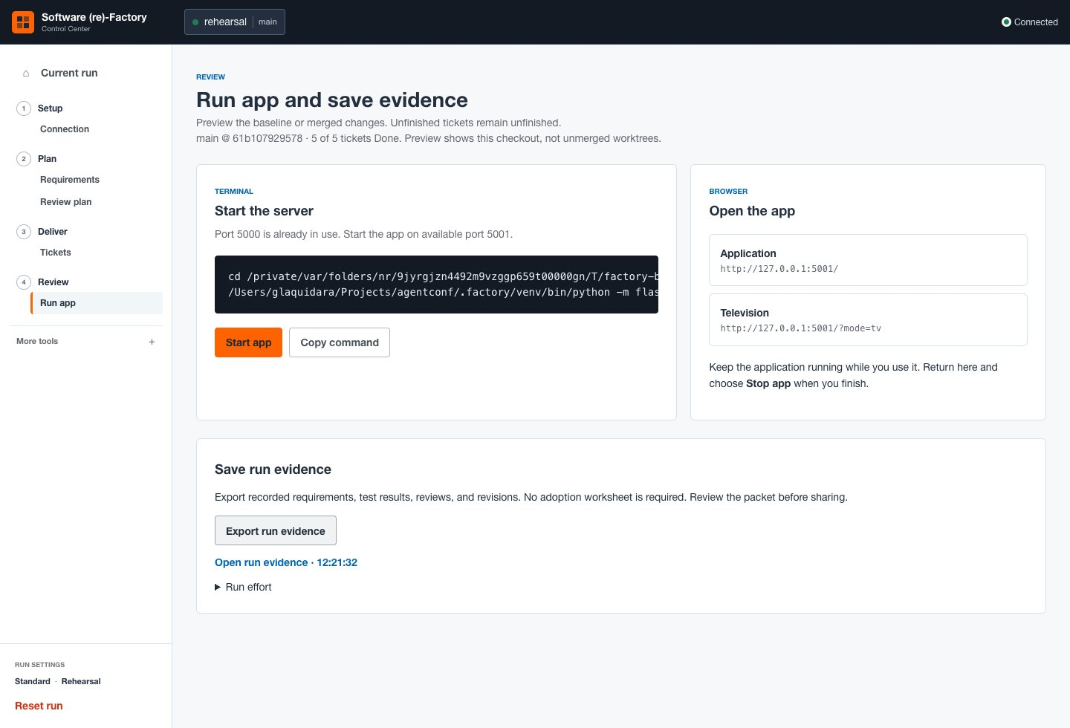
Inspecting a run
In the target repository
.factory/prompts
.factory/logs
.factory/receipts
.factory/reviews
Match the role, attempt,
and candidate revision.
23
Notes:
Open the target repository used by the run. In managed Live mode this is under .factory/repositories and may differ from the control-plane checkout. Prompt and log names identify role and attempt. Planning manifests, revision history and receipts provide provenance. Some filenames are reused on resumed runs. Review private content before sharing.
Reference: Find the full prompt and result for a run.
Image: workshop-guide/public/screenshots/control-center-evidence.jpg.
Source: factory/AGENT_REFERENCE.md (7 September 2026).

Slide 24
Applying the workflow to your team
Choose one change in your own repository.
What observable behavior should it deliver?
Which evidence would justify merging it?
Who can resolve a block and approve progression?
Workshop practice: inspect evidence, request a revision, recover a failure.
24
Notes:
Closing activity, 3 minutes: ask each attendee to name one change they could try in their own repository. Have them state observable behavior, the evidence they would require and who can approve progression. Ask which failure they would deliberately rehearse. This is an application exercise derived from the factory workflow, not a claim that a specific profile fits every organization.
Source: factory/AGENT_REFERENCE.md (7 September 2026).

