Slide 1

Your assignment
A food company needs a recipe app.
You have inherited Pocket Cinema.
Hearth & Harvest Foods wants you to turn it into TableStory.
You lead the transformation. AI agents help you deliver it.
01
Notes:
FACILITATOR CUE: about 40 seconds.
Say: You are the engineering team taking over Pocket Cinema, an existing movie application. Hearth & Harvest Foods wants to reuse it to launch TableStory, a recipe product. You are responsible for delivering that transformation using AI agents. Keep laptops on this briefing for now. Introduce the product problem before naming factory internals. This opening is a separate briefing for use before Setup; the existing three-hour deck is unchanged.
SOURCES
recipe-app-prd.md; factory/WORKSHOP_PLAN_3_HOURS.md; factory/AGENT_REFERENCE.md; factory/CONTROL_CENTER.md.
Workshop guide: https://software-refactory-workshop.vercel.app/
This is the Standard Live workshop. Use each attendee's own disposable GitHub repository. Human QA approval and human merge remain enabled. Prepared product screenshots illustrate the goal, not an attendee's completed run.

Slide 2
The product you will transform
Starting app: Pocket Cinema
Target example: TableStory
Find a movie. Read its details.
Save it for later.
Find a recipe by ingredient.
Read its steps. Save to My Cookbook.
02
Notes:
FACILITATOR CUE: about 45 seconds.
Show the Pocket Cinema starting app and the prepared TableStory reference. Point out that familiar capabilities can be reused, but their meaning changes. Say: Today someone looks for a movie, reads its details and saves it. The new customer wants a home cook to search by ingredient, read cooking instructions and save a recipe. The screenshot is one possible completed design, not a pixel-perfect template or a promise of the exact Live output. Sources for images: workshop-guide/public/screenshots/pocket-cinema-before.webp and tablestory-desktop.webp.
SOURCES
recipe-app-prd.md; factory/WORKSHOP_PLAN_3_HOURS.md; factory/AGENT_REFERENCE.md; factory/CONTROL_CENTER.md.
Workshop guide: https://software-refactory-workshop.vercel.app/
This is the Standard Live workshop. Use each attendee's own disposable GitHub repository. Human QA approval and human merge remain enabled. Prepared product screenshots illustrate the goal, not an attendee's completed run.

Slide 3
The complete transformation
The cooking journey
Search by ingredient, read the cooking steps,
then save the recipe to My Cookbook.
The rest of the product changes too
Recipe data and APIs. A new identity and wording.
Mobile and TV behavior. Removal of movie-specific behavior.
The full recipe PRD defines the scope.
03
Notes:
FACILITATOR CUE: about 40 seconds.
Keep one cooking journey as the teaching thread, while preserving the full PRD scope. Explain recipe data and APIs in plain language as the information and services behind the screens. The app must also work on mobile and with TV keyboard/remote navigation, and remove movie-domain language. A logo swap or one search ticket is insufficient. The provided recipe-app-prd.md contains the detailed requirements. Do not add accounts, cross-device synchronization or persistent storage beyond the PRD.
SOURCES
recipe-app-prd.md; factory/WORKSHOP_PLAN_3_HOURS.md; factory/AGENT_REFERENCE.md; factory/CONTROL_CENTER.md.
Workshop guide: https://software-refactory-workshop.vercel.app/
This is the Standard Live workshop. Use each attendee's own disposable GitHub repository. Human QA approval and human merge remain enabled. Prepared product screenshots illustrate the goal, not an attendee's completed run.

Slide 4
What is an AI software factory?
A repeatable way to deliver software
using AI agents.
It connects requirements to code, checks and review,
with clear rules for accepting a change.
In this workshop, you keep the final merge decision.
04
Notes:
FACILITATOR CUE: about 40 seconds.
Use this working definition: a repeatable software-delivery workflow that uses AI agents to perform development tasks. It connects requirements to implementation, checks and acceptance under explicit operating rules. One agent can participate in a factory. Several agents, cloud deployment and full autonomy are not defining requirements. Our workshop implementation keeps human approval and uses ordinary code to coordinate Standard delivery. The repository contract supplies project rules; the PRD supplies the intended outcome.
SOURCES
Workshop definition and application: factory/WORKSHOP_NARRATIVE.md; factory/WORKSHOP_PLAN_3_HOURS.md; factory/AGENT_REFERENCE.md; recipe-app-prd.md.
Discussion of planning, review and rework: Dex Horthy, Harness Engineering is not Enough: Why Software Factories Fail, https://ai.engineer/talks/Ib5GBkD555M-harness-engineering-is-not-enough-why-software (checked 14 September 2026).
The selection advice is a workshop recommendation, not a measured comparison or universal requirement.

Slide 5
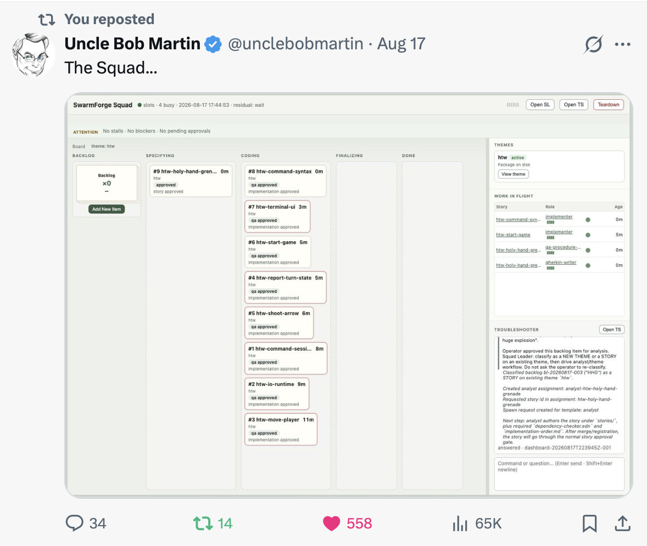
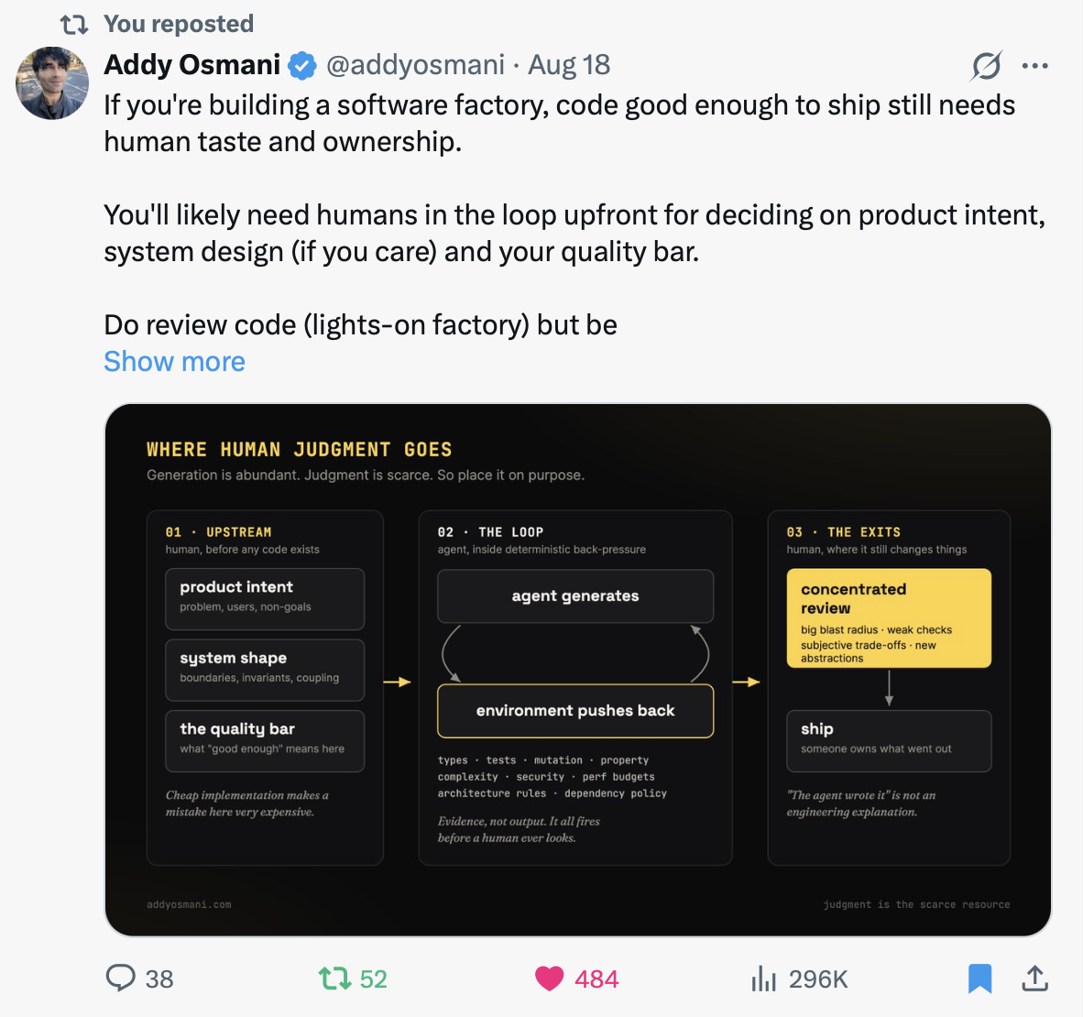
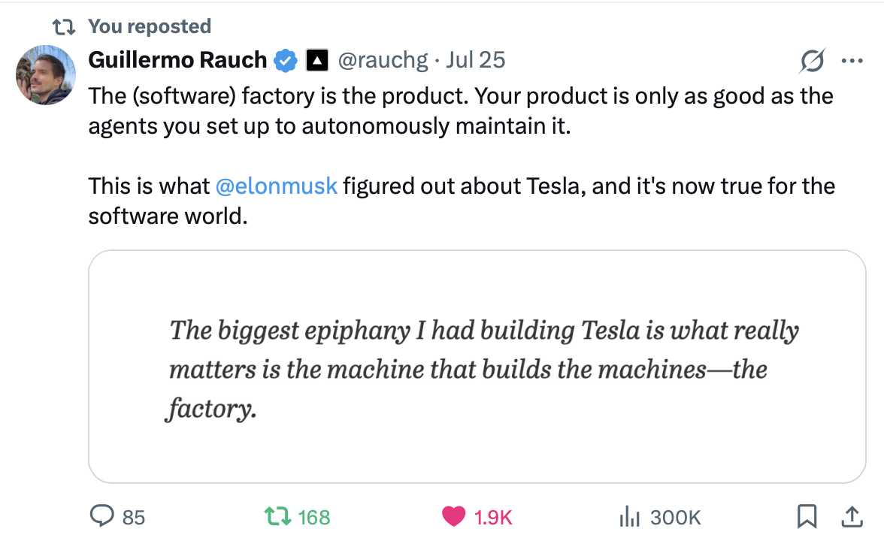
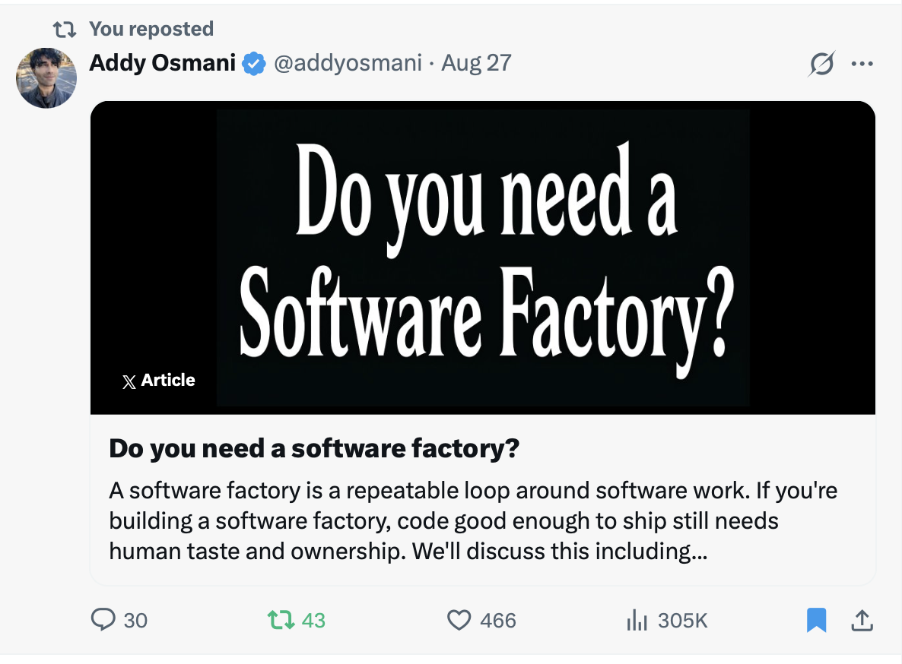
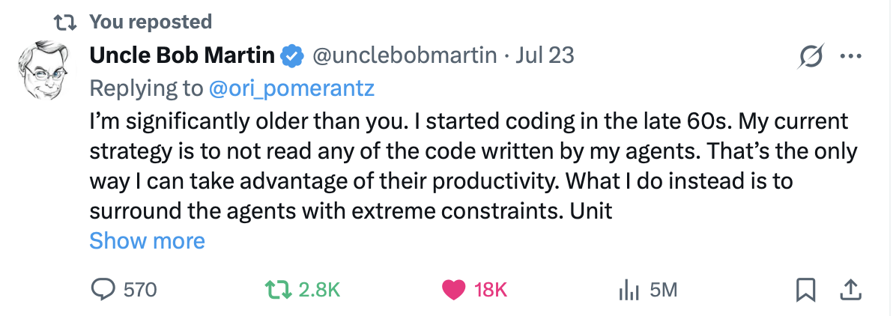
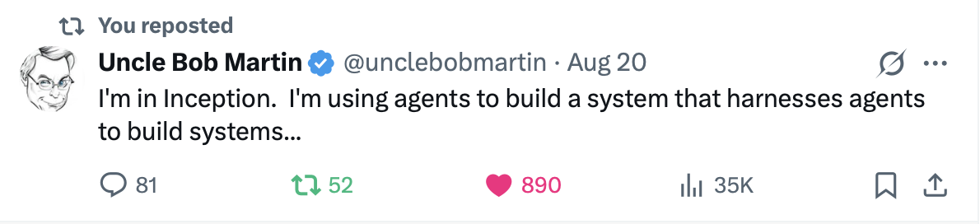
Software factories are an active discussion
Uncle Bob Martin
Addy Osmani
Guillermo Rauch
July–August posts
The discussion includes
autonomy, human judgment
and how to control agents.
05
Notes:
FACILITATOR CUE: about 45 seconds.
These six posts show three practitioners discussing and building software factories. Point to Bob Martin’s working squad, Addy Osmani’s emphasis on human judgment and Guillermo Rauch’s focus on the factory itself. They disagree about how far autonomy should go. This is evidence of active discussion, not proof that the approaches are safe, effective or universally adopted. The workshop gives you a way to inspect those claims through an actual delivery exercise. Keep human review and the final merge decision in our Standard workshop.
The visible posts show July and August dates without a year. The supplied files were captured on 14 September 2026. Do not infer verified publication years or current engagement counts from the filenames. Some screenshots contain truncated posts; no missing text has been reconstructed. Images remain intact and editable as individual pictures.
SOURCES
User-supplied screenshots:
/Users/glaquidara/Desktop/Screenshot 2026-09-14 at 13.00.30.png
/Users/glaquidara/Desktop/Screenshot 2026-09-14 at 13.01.27.png
/Users/glaquidara/Desktop/Screenshot 2026-09-14 at 13.00.06.png
/Users/glaquidara/Desktop/Screenshot 2026-09-14 at 13.00.23.png
/Users/glaquidara/Desktop/Screenshot 2026-09-14 at 12.59.35.png
/Users/glaquidara/Desktop/Screenshot 2026-09-14 at 13.01.14.png

Slide 6
Why use a factory?
Several changes must fit together.
The plan and dependencies coordinate work across the app.
Every change needs evidence.
Checks and review show what supports the merge decision.
Failures need a next action.
Recorded results help you find the cause and resume work.
Its value depends on the review effort and rework it actually saves.
06
Notes:
FACILITATOR CUE: about 40 seconds.
Tie the explanation to TableStory. Recipe data, public APIs and screens must agree, so a plan and ticket prerequisites coordinate the changes. The factory records candidate checks and review so people can inspect what supports acceptance. Failures return to the appropriate work with their evidence rather than requiring someone to reconstruct every handoff. These are intended operational benefits, not a claim of guaranteed speed or correctness. Existing CI and developer tools can provide some of the same controls. The added coordination must earn its cost.
SOURCES
Workshop definition and application: factory/WORKSHOP_NARRATIVE.md; factory/WORKSHOP_PLAN_3_HOURS.md; factory/AGENT_REFERENCE.md; recipe-app-prd.md.
Discussion of planning, review and rework: Dex Horthy, Harness Engineering is not Enough: Why Software Factories Fail, https://ai.engineer/talks/Ib5GBkD555M-harness-engineering-is-not-enough-why-software (checked 14 September 2026).
The selection advice is a workshop recommendation, not a measured comparison or universal requirement.

Slide 7
When is it worth using?
Consider a factory
You repeatedly coordinate several changes or handoffs,
and can define checks and assign a reviewer.
A simpler workflow may be enough
For a small, isolated change, use one coding agent
with your existing tests and human review.
Unclear requirements or missing checks? Establish those first.
07
Notes:
FACILITATOR CUE: about 40 seconds.
Recommend a small pilot when repeatable delivery work, dependencies and approval handoffs create a real coordination burden. Start with outcomes that can be checked and an owner who can review them. Potential examples include bounded migrations or a product transformation such as TableStory. For a small isolated fix, a coding agent with existing tests, CI and human review may be sufficient. If requirements are unclear or meaningful checks do not exist, establish them first; more orchestration cannot substitute for those foundations. Measure accepted outcomes, active review effort, retries and cost before expanding.
SOURCES
Workshop definition and application: factory/WORKSHOP_NARRATIVE.md; factory/WORKSHOP_PLAN_3_HOURS.md; factory/AGENT_REFERENCE.md; recipe-app-prd.md.
Discussion of planning, review and rework: Dex Horthy, Harness Engineering is not Enough: Why Software Factories Fail, https://ai.engineer/talks/Ib5GBkD555M-harness-engineering-is-not-enough-why-software (checked 14 September 2026).
The selection advice is a workshop recommendation, not a measured comparison or universal requirement.

Slide 8
Your engineering decisions
1
Did the agents understand the requested product?
2
Does their proposed plan make sense?
3
Will the tests demonstrate the required behavior?
4
Does the finished change deserve to be merged?
Agents propose the work. You inspect it and accept or request changes.
08
Notes:
FACILITATOR CUE: about 50 seconds.
Say: You are here to make engineering decisions about the agents’ work. The agents prepare requirements, a technical plan, acceptance tests, implementation and code review. Ordinary factory code coordinates the work and runs checks. You review product intent and the plan before tickets, approve valid QA evidence before implementation, and inspect the exact candidate before merging. You can request corrections. Separate agent roles can share blind spots; their output does not replace your judgment. Avoid listing all agent names in this opening.
SOURCES
recipe-app-prd.md; factory/WORKSHOP_PLAN_3_HOURS.md; factory/AGENT_REFERENCE.md; factory/CONTROL_CENTER.md.
Workshop guide: https://software-refactory-workshop.vercel.app/
This is the Standard Live workshop. Use each attendee's own disposable GitHub repository. Human QA approval and human merge remain enabled. Prepared product screenshots illustrate the goal, not an attendee's completed run.

Slide 9
Where you will work
Place | Purpose
Workshop website | Follow the instructions for each step.
Control Center | Start work, inspect results and make decisions.
Your GitHub repository | Keep the product code and pull requests.
GitHub Projects | See the tickets and their status.
09
Notes:
FACILITATOR CUE: about 30 seconds.
Orient the room before asking anyone to navigate. The website gives instructions, the Control Center operates the factory, the personal GitHub repository holds the changed product, and GitHub Projects shows its tickets. These are views and tools for one exercise, not four separate assignments. The factory checkout and product repository are separate. Each attendee uses their own product repository; the facilitator uses a separate one. Detailed installation and authentication remain in the website.
SOURCES
recipe-app-prd.md; factory/WORKSHOP_PLAN_3_HOURS.md; factory/AGENT_REFERENCE.md; factory/CONTROL_CENTER.md.
Workshop guide: https://software-refactory-workshop.vercel.app/
This is the Standard Live workshop. Use each attendee's own disposable GitHub repository. Human QA approval and human merge remain enabled. Prepared product screenshots illustrate the goal, not an attendee's completed run.

Slide 10
What product completion means
You can demonstrate TableStory
from your merged code.
The recipe journeys work.
The complete approved scope passes its acceptance checks.
Save the run evidence and identify the version you verified.
10
Notes:
FACILITATOR CUE: about 30 seconds.
Point back to the customer request. Completion requires the approved transformation to be merged and the integrated application to satisfy acceptance checks. Demonstrate the full find/read/save journey and removal from My Cookbook, plus the rest of the approved scope, including APIs, mobile/TV behavior and domain cleanup. Inspect the merged version rather than only an isolated ticket. Green ticket states alone do not establish product acceptance.
SOURCES
recipe-app-prd.md; factory/WORKSHOP_PLAN_3_HOURS.md; factory/AGENT_REFERENCE.md; factory/CONTROL_CENTER.md.
Workshop guide: https://software-refactory-workshop.vercel.app/
This is the Standard Live workshop. Use each attendee's own disposable GitHub repository. Human QA approval and human merge remain enabled. Prepared product screenshots illustrate the goal, not an attendee's completed run.

Slide 11
What you should leave knowing
What evidence to demand.
How to investigate a failure.
What to try with your own team.
If your Live run is unfinished, record what remains
and the next action needed to resume.
11
Notes:
FACILITATOR CUE: about 25 seconds.
Distinguish the product outcome from the learning outcome. A Live agent run may take longer than the workshop. Healthy agents can keep running. While waiting, inspect the starting app or prepare the acceptance example, and use clearly labeled prepared evidence if the next teaching decision arrives before the Live artifact. Never approve work just to maintain pace. Preserve incomplete work, record the ticket or stage, the next action and its owner, and explain how to resume. Do not describe a prepared example as completing a participant’s Live run.
SOURCES
recipe-app-prd.md; factory/WORKSHOP_PLAN_3_HOURS.md; factory/AGENT_REFERENCE.md; factory/CONTROL_CENTER.md.
Workshop guide: https://software-refactory-workshop.vercel.app/
This is the Standard Live workshop. Use each attendee's own disposable GitHub repository. Human QA approval and human merge remain enabled. Prepared product screenshots illustrate the goal, not an attendee's completed run.

Slide 12
Your understanding of the assignment
What are you delivering?
What are you responsible for checking?
Next: connect your own repository in the Control Center.
12
Notes:
FACILITATOR CUE: about 40 seconds.
Ask before anyone moves to Setup: In your own words, what are you delivering and what are you responsible for checking? Give people a moment, then hear one or two answers. Expected answer: We are transforming a movie app into the complete recipe product, using agents. We remain responsible for whether their understanding, plan, tests and finished changes meet the requirement. If the answer is only launching agents or completing tickets, return to the product and role slides. Once this is clear, proceed to the existing workshop guide Setup or confirm pre-session setup.
SOURCES
recipe-app-prd.md; factory/WORKSHOP_PLAN_3_HOURS.md; factory/AGENT_REFERENCE.md; factory/CONTROL_CENTER.md.
Workshop guide: https://software-refactory-workshop.vercel.app/
This is the Standard Live workshop. Use each attendee's own disposable GitHub repository. Human QA approval and human merge remain enabled. Prepared product screenshots illustrate the goal, not an attendee's completed run.

