Slide 1
Workshop guide
AI software factory
workshop
Workshop format
100 minutes
Hands-on
Pocket Cinema → TableStory
Use Pocket Cinema to learn a controlled path from product intent to verified software.
Plan
Build
Verify
Review
A learning deck for software developers and technical leads
Notes:
Introduce the session as a practical engineering workshop.
Tell participants that Pocket Cinema is a working system, not a blank starter project.
The goal is to learn a repeatable delivery method, not a single tool or prompt pattern.
[Sources]
- /Users/glaquidara/Projects/agentconf/factory/WORKSHOP_OUTLINE.md
- /Users/glaquidara/Projects/agentconf/factory/README.md
- https://developers.google.com/style/
- https://developers.google.com/style/highlights
[/Sources]

Slide 2
AI software factory workshop
Overview
What you will learn
You will complete one delivery loop and inspect the artifacts that make the result trustworthy.
1
Explain the system
Workshop output
Distinguish a coding agent from the factory that governs its work.
An approved plan, five vertical slices, protected acceptance tests, a candidate change, and a documented merge decision.
2
Plan the change
Turn a product requirements document into approved, dependency-aware slices.
3
Run work safely
Use isolated worktrees and explicit ticket ownership.
How to participate
4
Evaluate evidence
Follow the Goal, Do, Check rhythm. Stop when evidence is missing or a human decision is required.
Check protected tests, RED/GREEN proof, and required gates.
5
Make the decision
Review the exact candidate revision and decide whether to merge.
2
Notes:
Read the objectives as capabilities participants will practice, not topics they will only hear about.
Point out that the workshop output includes both software and the evidence required to review it.
[Sources]
- /Users/glaquidara/Projects/agentconf/factory/WORKSHOP_OUTLINE.md
- https://developers.google.com/learn/pathways
- https://developers.google.com/style/accessibility
[/Sources]

Slide 3
AI software factory workshop
Concepts
What an AI software factory controls
A factory coordinates people, agents, repositories, tests, and approvals so a change can reach a reviewable decision.
Coding agent | Software factory
Receives one bounded ticket | Supplies approved intent and dependencies
Edits code in one isolated worktree | Controls concurrency, ownership, and limits
Reports that work is complete | Requires causal tests and gate results
Cannot approve its own output | Preserves human authority over the merge
Key point
The agent performs the work. The factory controls how that work becomes trustworthy.
3
Notes:
Use the comparison to establish a clear boundary of responsibility.
An agent can implement a ticket, but it does not define product intent or grant its own merge authority.
The factory supplies context, isolation, quality gates, traceability, and human decisions.
[Sources]
- /Users/glaquidara/Projects/agentconf/factory/WORKSHOP_OUTLINE.md
- /Users/glaquidara/Projects/agentconf/factory/README.md
[/Sources]

Slide 4
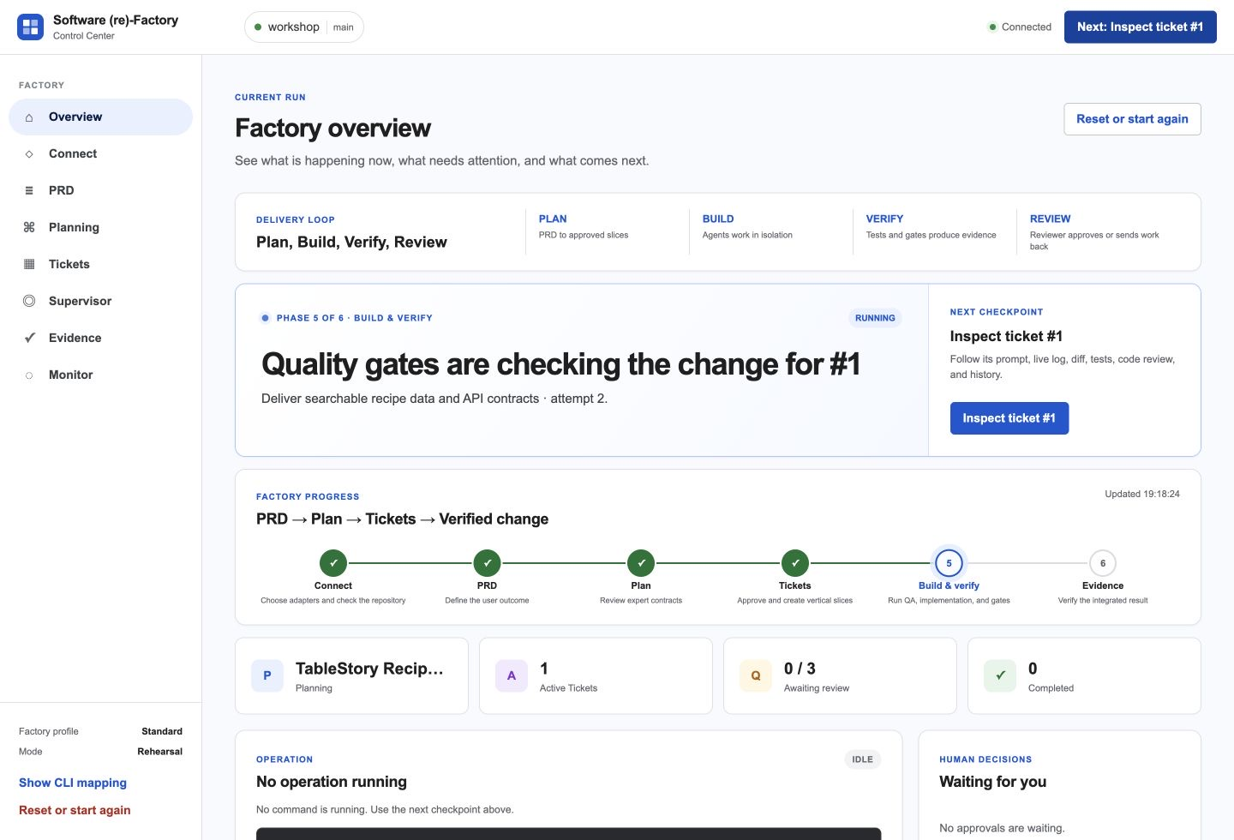
AI software factory workshop
Concepts
The factory turns intent into a decision
Each stage starts with a visible artifact and produces the input required by the next stage.
Stage | Starts with | Work | Produces
Plan | PRD | Approve intent and slices | Ready tickets
Build | Ready ticket | Work in isolation | Candidate revision
Verify | Candidate revision | Run protected tests and gates | Evidence packet
Review | Evidence packet | Inspect the exact revision | Merge or revise
Read the system state
Before continuing, name the current stage, artifact, and next human checkpoint.
4
Notes:
Walk down the table and name the artifact produced by each stage.
Use the Control Center image to show that the same delivery loop is visible during execution.
The loop is complete only when a person reviews the evidence and decides what happens next.
[Sources]
- /Users/glaquidara/Projects/agentconf/factory/WORKSHOP_OUTLINE.md
- /Users/glaquidara/Projects/agentconf/factory/README.md
- /Users/glaquidara/Projects/agentconf/workshop-guide/public/screenshots/control-center-overview.jpg
[/Sources]

Slide 5
AI software factory workshop
Workshop procedure
Use the same learning loop at every stage
Complete one bounded action, then inspect the result before you continue.
1
Goal
2
Do
3
Check
Name the artifact or decision you must produce.
Perform one bounded action in the Control Center or repository.
Inspect state, evidence, and the next checkpoint.
Minutes | Phase | What you will do
0–20 | Understand the system | Set up, inspect Pocket Cinema, and read the supplied PRD.
20–53 | Plan the change | Approve product intent, architecture, and vertical slices.
53–85 | Execute safely | Approve tests, run the factory, and inspect one ticket.
85–100 | Decide and learn | Review evidence, merge the exact revision, and monitor the result.
Choose a mode
Use Rehearsal for deterministic timing. Use Live when model and GitHub integrations are ready.
5
Notes:
Repeat Goal, Do, Check throughout the workshop.
The schedule groups the detailed workshop steps into four learner-facing phases.
Rehearsal and Live use the same workflow. Rehearsal replaces external variability with deterministic behavior.
[Sources]
- /Users/glaquidara/Projects/agentconf/factory/WORKSHOP_OUTLINE.md
- /Users/glaquidara/Projects/agentconf/factory/FACILITATOR.md
- /Users/glaquidara/Projects/agentconf/factory/README.md
[/Sources]

Slide 6
AI software factory workshop
Use case
Inspect Pocket Cinema before you change it
The baseline already contains behavior, data, layouts, and tests. Record them before you plan the rebrand.
Record these observations
Navigation: Browse, Watchlist, and Profile
Data: film collection, search, and detail routes
Layouts: desktop, mobile, and television
Tests: startup path and existing behavior
Stop condition
Do not redesign yet. First identify what works and what must not regress.
6
Notes:
Ask participants to run the baseline and trace one user flow before opening the target PRD.
Record navigation, data flow, responsive behavior, and existing tests.
The current system establishes the non-regression boundary for the change.
[Sources]
- /Users/glaquidara/Projects/agentconf/factory/WORKSHOP_OUTLINE.md
- /Users/glaquidara/Projects/agentconf/workshop-guide/public/screenshots/pocket-cinema-before.webp
[/Sources]

Slide 7
AI software factory workshop
Use case
Define the TableStory change as behavior
The target is a domain conversion with new user journeys, not a visual reskin.
Change
Film domain → recipe domain
Recipe search, details, and cookbook
Remote-first television journey
TableStory terminology and identity
Preserve
Responsive layouts
Keyboard and remote access
Deterministic data and startup
Acceptance outcome
A user can find a recipe, understand it, and save or remove it from My Cookbook.
Testable API and browser flows
7
Notes:
Describe the target in terms of user behavior and system contracts.
The change replaces the film domain with recipe data, routes, search, detail, cookbook, and television navigation.
The preserved qualities become non-regression requirements.
[Sources]
- /Users/glaquidara/Projects/agentconf/factory/README.md
- /Users/glaquidara/Projects/agentconf/factory/scenarios/recipe-rebrand/steps/5/demo-app/README.md
- /Users/glaquidara/Projects/agentconf/workshop-guide/public/screenshots/tablestory-desktop.webp
[/Sources]

Slide 8
AI software factory workshop
Planning
Split the change into five vertical slices
Each slice has acceptance criteria, file ownership, dependencies, and its own QA evidence.
Ticket | Slice | Needs | Observable outcome
T1 | Recipe data and API | — | A client can discover valid recipes through the collection contract.
T2 | Accessible mobile shell | — | A visitor sees a coherent, readable TableStory product shell.
T3 | Recipe and cookbook journey | T1, T2 | A home cook can find, understand, save, and remove a recipe.
T4 | Television recipe journey | T3 | A viewer can complete the journey with remote-equivalent keys.
T5 | Proof and documentation | T4 | A reviewer can reproduce and verify the completed conversion.
Planning check
Publish tickets only after every requirement traces to a slice and every dependency is explicit.
8
Notes:
Use the table to explain why the exercise has five reviewable outcomes instead of one rebrand epic.
T1 and T2 can begin independently. The later user journeys depend on those foundations.
Do not publish the tickets until requirements, contracts, program elements, and slices align.
[Sources]
- /Users/glaquidara/Projects/agentconf/factory/scenarios/recipe-rebrand/planning/04-vertical-slices.json
- /Users/glaquidara/Projects/agentconf/factory/WORKSHOP_OUTLINE.md
[/Sources]

Slide 9
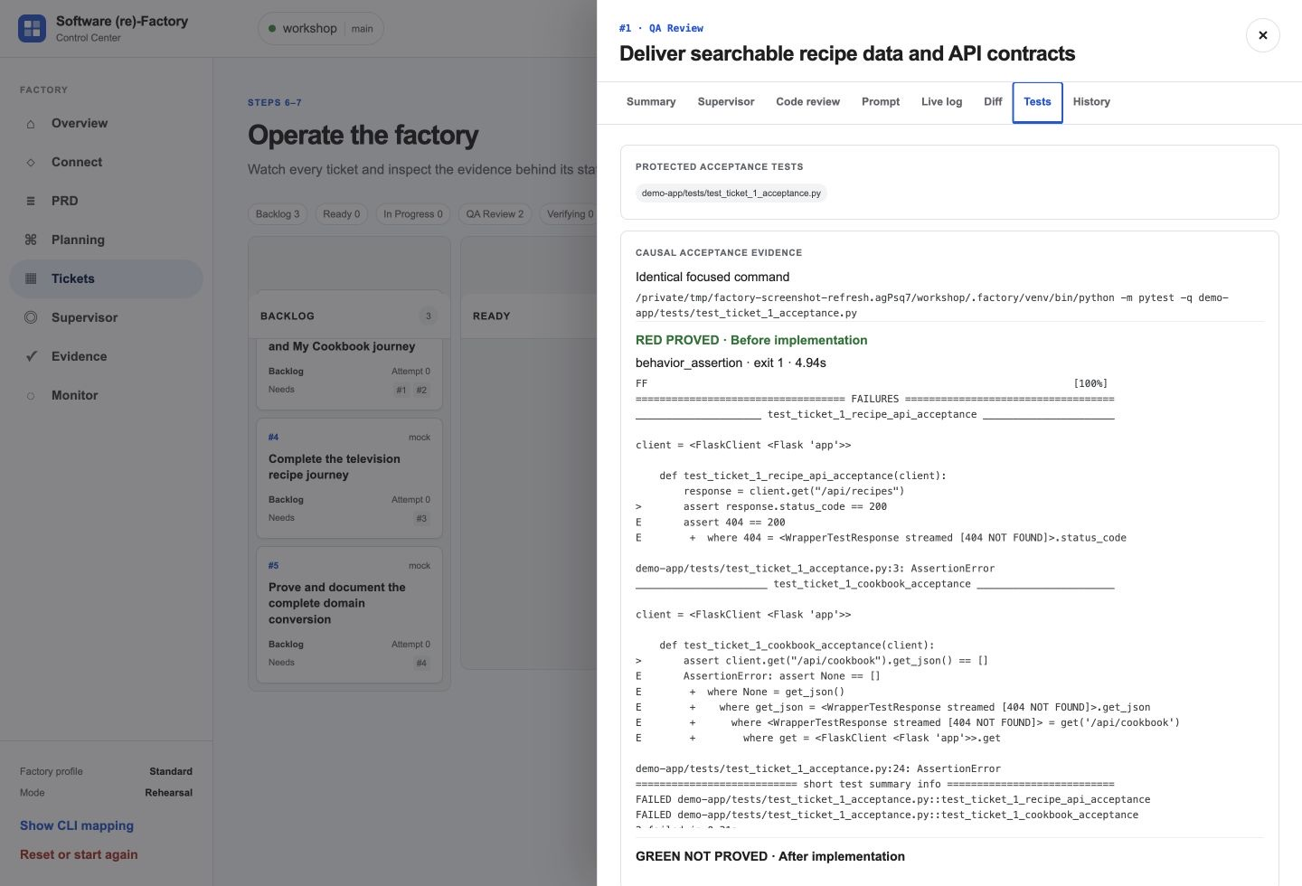
AI software factory workshop
Verification
Approve acceptance tests before implementation
A protected test states the ticket requirement in executable form before the coding agent begins.
1
Create ticket-specific tests
Independent QA converts the approved acceptance criteria into focused checks.
2
Review the test diff
Confirm that the tests check the requirement without assuming the implementation.
3
Prove RED
Run the focused command before implementation. It must fail for the missing behavior.
4
Prove GREEN
Run the same command after implementation. It must pass with the required gates.
Stop condition
If the test cannot prove the requirement, revise the test before any implementation work begins.
9
Notes:
Explain that independent QA authors ticket-specific tests before implementation.
Participants review the test diff and focused command before approving the ticket for implementation.
Causal evidence requires the same focused command to fail before the change and pass after it.
[Sources]
- /Users/glaquidara/Projects/agentconf/factory/WORKSHOP_OUTLINE.md
- /Users/glaquidara/Projects/agentconf/factory/README.md
- /Users/glaquidara/Projects/agentconf/workshop-guide/public/screenshots/control-center-ticket-tests.jpg
[/Sources]

Slide 10
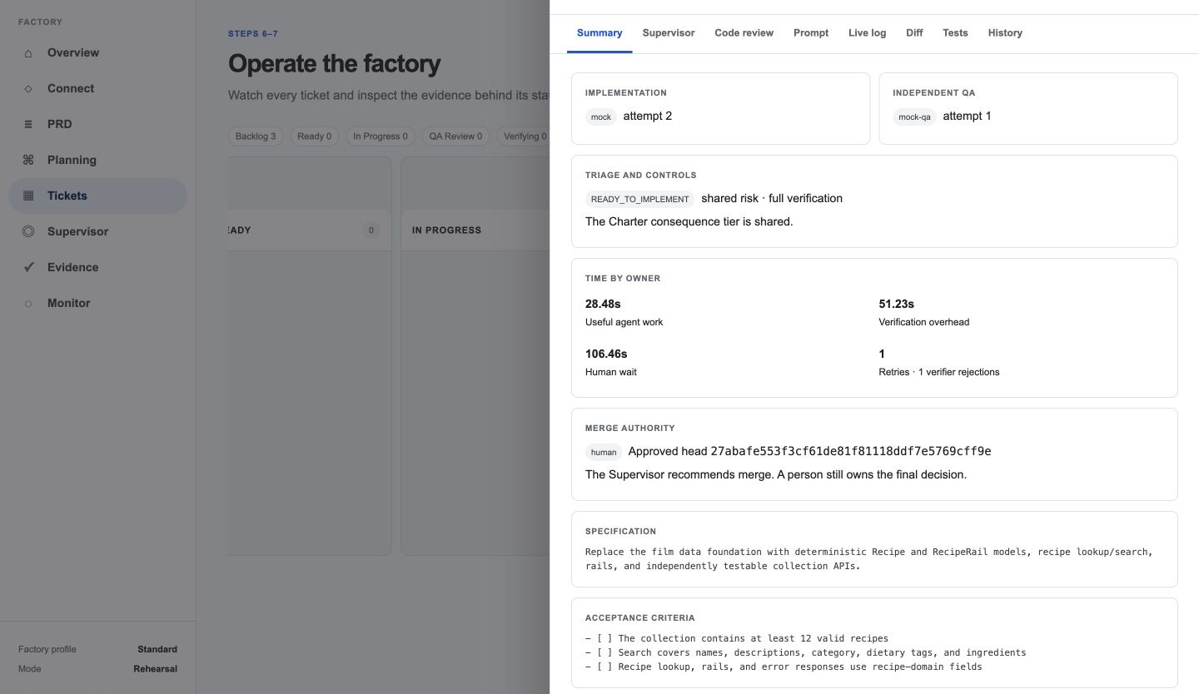
AI software factory workshop
Review
Review the exact candidate revision
The factory can recommend a merge. A person must inspect the evidence and choose what ships.
Review checklist
Acceptance criteria are satisfied
RED/GREEN proof is visible
Required gates pass
The diff matches the ticket
The candidate revision is recorded
The merge decision is attributed to a person
Human authority
Merge the reviewed revision, or return the ticket with a reason.
10
Notes:
Inspect the candidate revision, acceptance criteria, diff, tests, logs, and code review as one evidence chain.
The merge action targets an exact revision so the reviewed artifact cannot change underneath the decision.
If evidence is incomplete, send the ticket back with a precise revision request.
[Sources]
- /Users/glaquidara/Projects/agentconf/factory/WORKSHOP_OUTLINE.md
- /Users/glaquidara/Projects/agentconf/factory/README.md
- /Users/glaquidara/Projects/agentconf/workshop-guide/public/screenshots/control-center-human-merge.jpg
[/Sources]

Slide 11
AI software factory workshop
Exercise
Start with inspection
Open Pocket Cinema. Do not change code yet.
1
Run the baseline
You are ready to continue when
Confirm that the application starts and the current tests pass.
• The baseline runs
• Current behavior is named
• The regression boundary is explicit
• Open questions are recorded
2
Trace one user flow
Follow Browse → search → detail and identify the data involved.
3
Record your observations
Write down what must change, what must remain, and what is unclear.
4
Compare with the PRD
Next section
Product review: agree on the problem, behavior, and boundary before you plan implementation.
Open the TableStory requirements and identify the first disagreement.
11
Notes:
End the introduction by moving participants directly into the inspection exercise.
Do not let participants edit code during this step.
The first useful output is a shared description of current behavior and the non-regression boundary.
[Sources]
- /Users/glaquidara/Projects/agentconf/factory/WORKSHOP_OUTLINE.md
- /Users/glaquidara/Projects/agentconf/factory/FACILITATOR.md
[/Sources]

