Slide 1
Sketch of Global Terorrism Visualization Final Design
GWDA Project 2 Team 6

Slide 2
Project Team 6
Team:
-- Joe Lee
-- Kristen Talbot
-- Joseph Marinelli
-- Francis “Jo Jo” Djamson

Slide 3
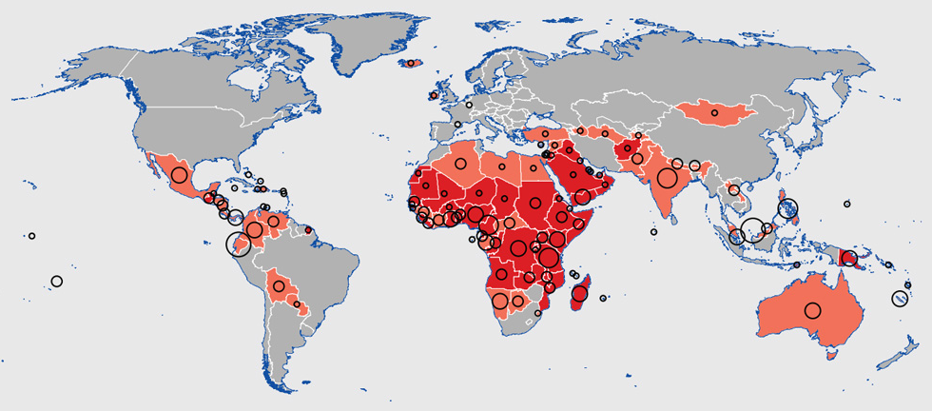
Afghanistan:
Terrorist Groups:
-- ISIL
-- Lashkar Jangvi
-- Terik e-Taliban
(displayed on click)
Start Year
End Year
Submit

Slide 4
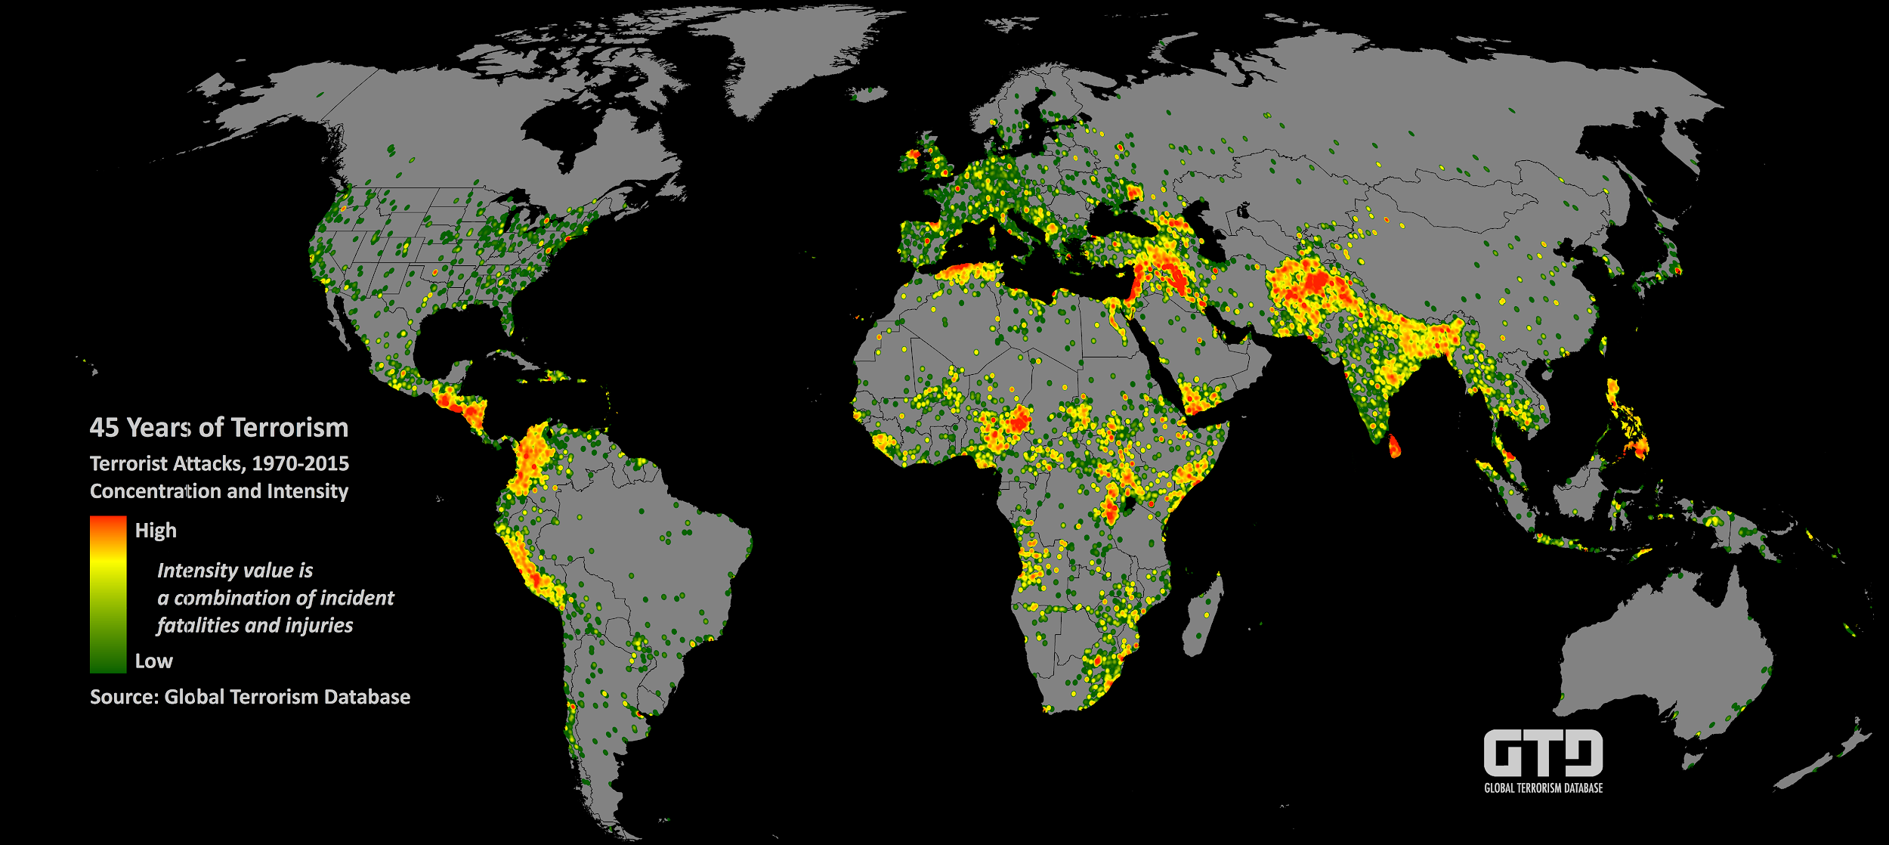
1970
2016

Slide 5
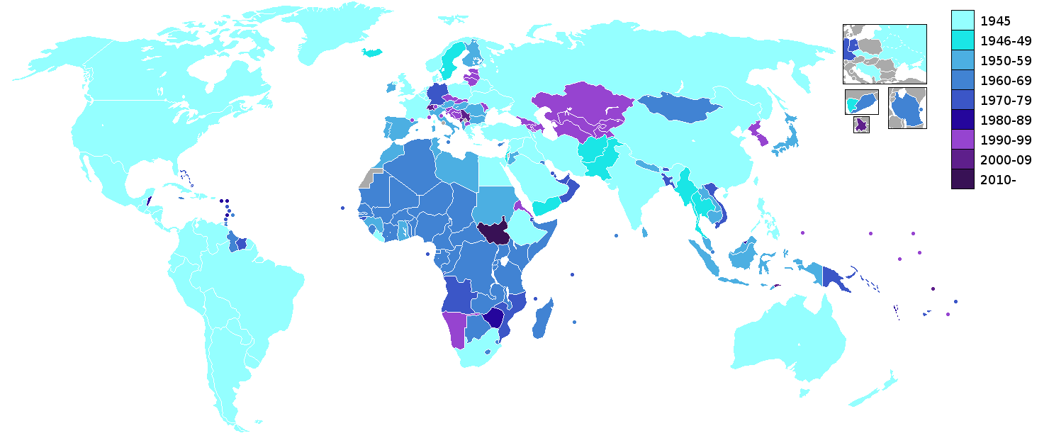
Onclick Response:
Display key incident info:
Who: Where: When: With What:
Damage:
Legend
Dots represent incidents
+
-
Start Year
End Year
Submit

