Slide 1
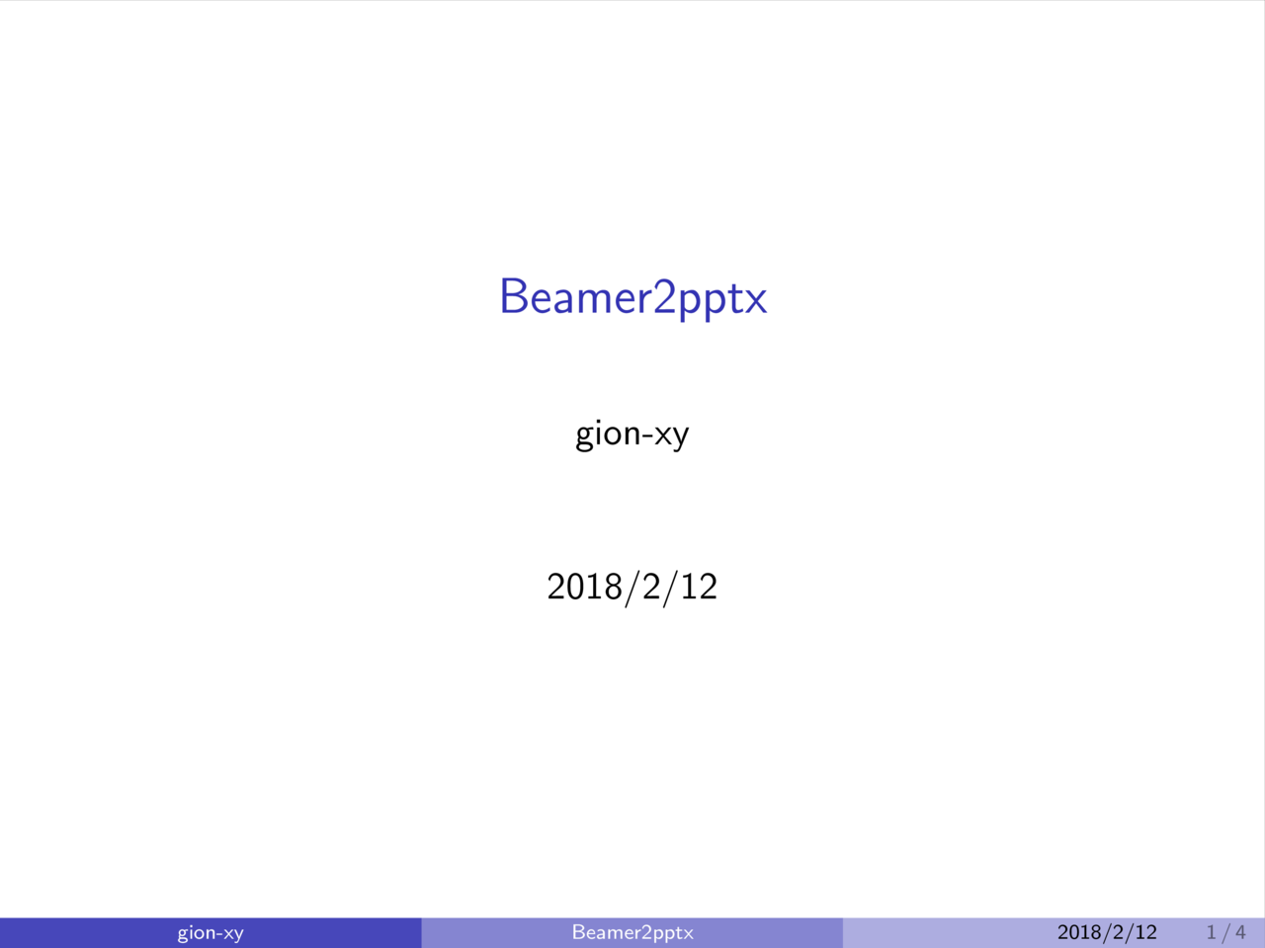

Slide 2
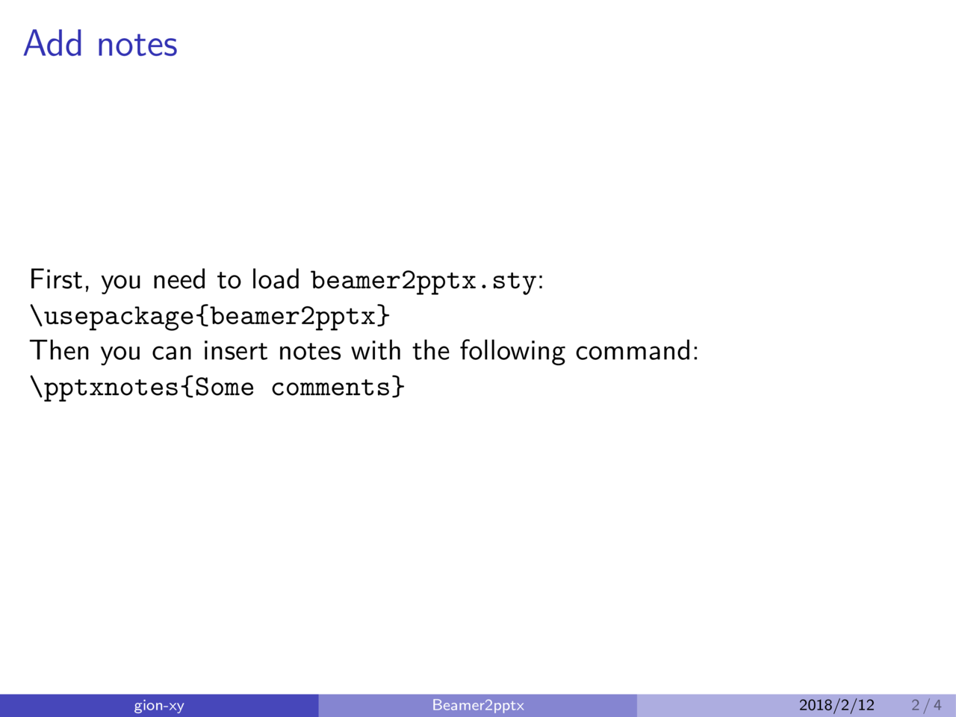
Notes:
Comment

Slide 3
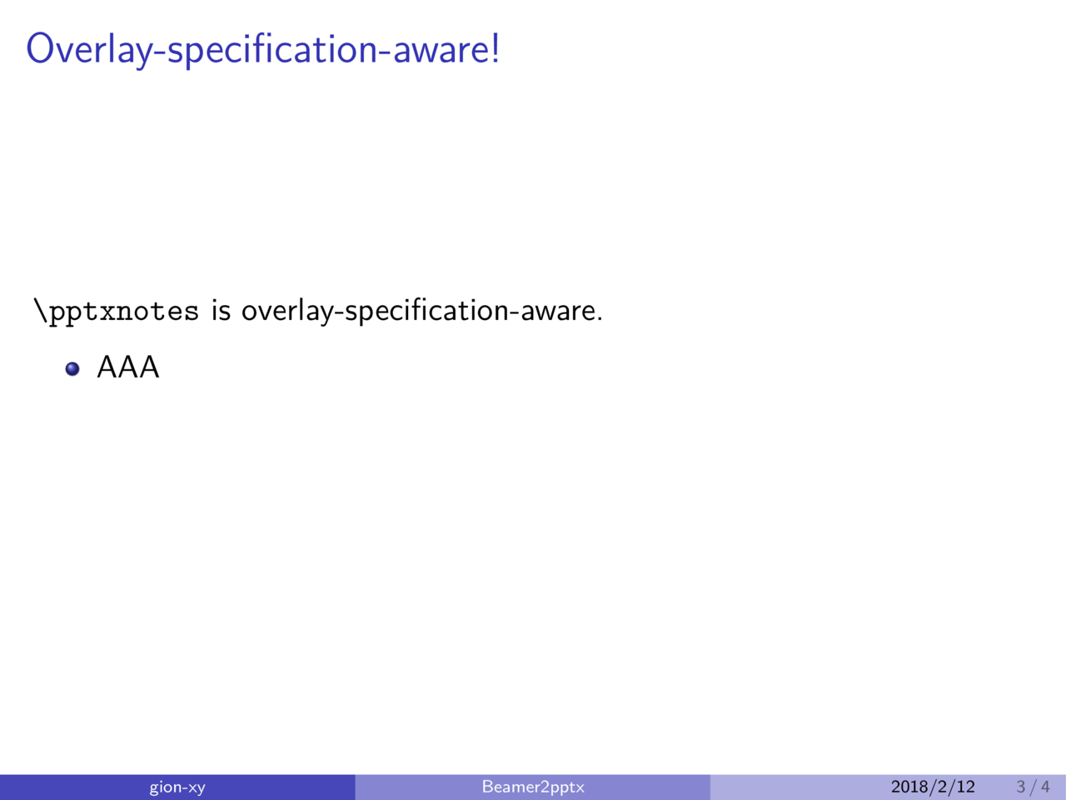
Notes:
You can use non-ascii character in notes.

Slide 4
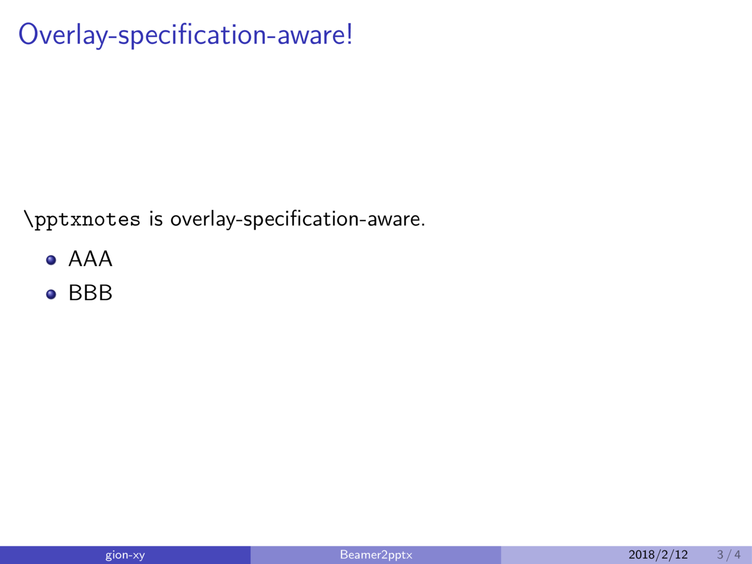
Notes:
非ASCII文字も使える．

Slide 5
