Slide 1
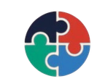



Community Impact Project
WeCare
Empowering Men and Women Through Health, Equality & Technology
From mobile-app concept to a working physical health-monitoring kiosk.
SDG 3 · Good Health
SDG 5 · Gender Equality
SDG 9 · Innovation
Giorgi Pataridze · Avtandili Javrishvili

Slide 2


Community Impact Project
THE PROBLEM
Health access isn't equal — for women or men
70%+
1%
Stigma
Women in rural & peri-urban Cameroon and Zambia lack reliable access to health information and services.
Of global healthcare R&D targets female-specific conditions beyond oncology — driving preventable deaths.
Men face a silent mental-health crisis: stigma and 'be stoic' norms keep them from seeking help.
Cultural taboos, gender-based violence, menstrual school absenteeism and low digital literacy intensify the gap.

Slide 3



Community Impact Project
OUR INITIATIVE
From a concept app to a machine that works
The original concept
What we built
Bridge for Balance — a proposed mobile app & community hub.
Telehealth, education modules, AI-assisted feedback.
Strong vision — but a slide-deck idea, not a tested device.
A fully functional physical health-monitoring kiosk.
Live vitals from real sensors on a Raspberry Pi 5.
A working dashboard — demonstrable, measurable, real.
We turned the team's vision into hardware you can walk up to and use.

Slide 4
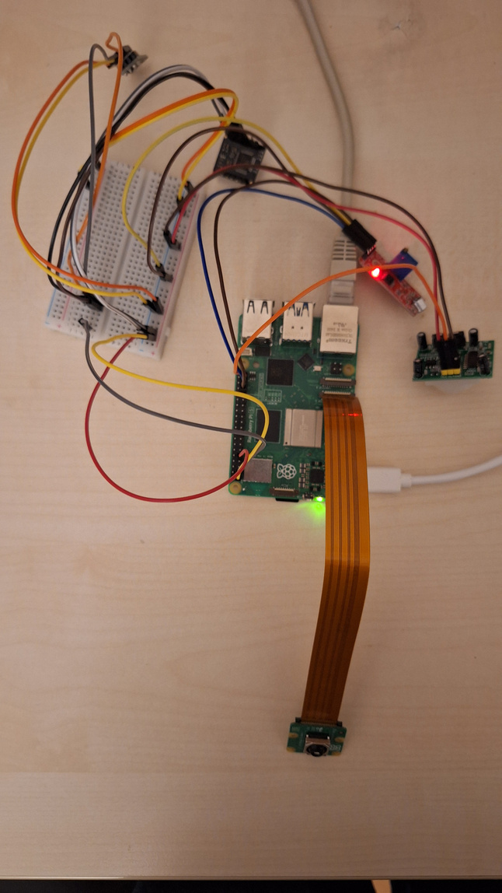


Community Impact Project
THE SOLUTION
A self-service health kiosk
Instant vitals
Heart rate, SpO₂ and body temperature in seconds — no appointment.
Private & judgment-free
Self-service and anonymous — no receptionist to face. Vital for men who avoid seeking help.
Always-on insight
Every reading is logged so trends — not just snapshots — are visible.
Our working prototype — Raspberry Pi 5 + full sensor suite.

Slide 5




Community Impact Project
HOW WE BUILT IT
A pure Raspberry Pi 5 architecture
Sensors
Raspberry Pi 5
Python + Flask
InfluxDB
5 sensors capture vitals & environment
Bookworm OS — the kiosk's brain
Live web dashboard served locally
Time-series store: live + history
One self-contained device. No Arduino, no external microcontrollers — everything runs on the Pi 5.

Slide 6


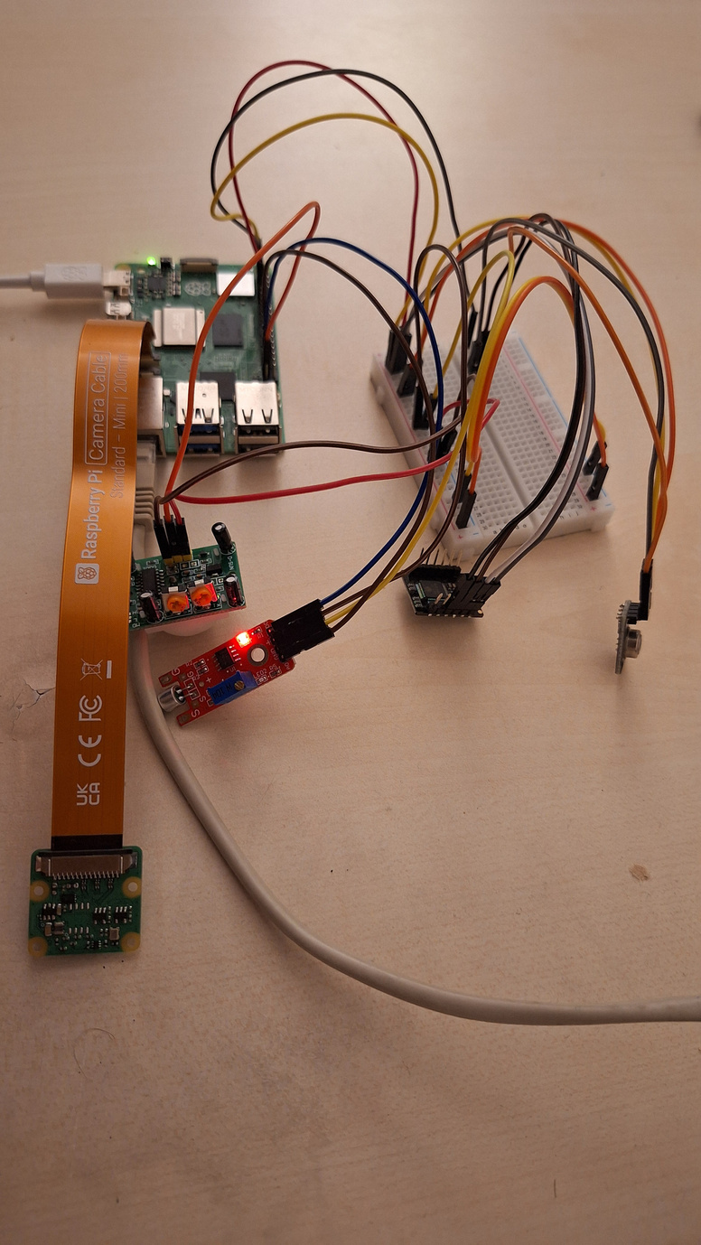


Community Impact Project
THE SENSOR SUITE
Five inputs, one dashboard
MAX30102
MLX90614
PIR motion
Heart rate & SpO₂ via red/IR LED (I²C)
Non-contact infrared body temperature (I²C)
Visitor & footfall counting at the kiosk
Sound sensor
Pi Camera 3
Ambient noise — crowd & distress signal
Live patient vision feed

Slide 7
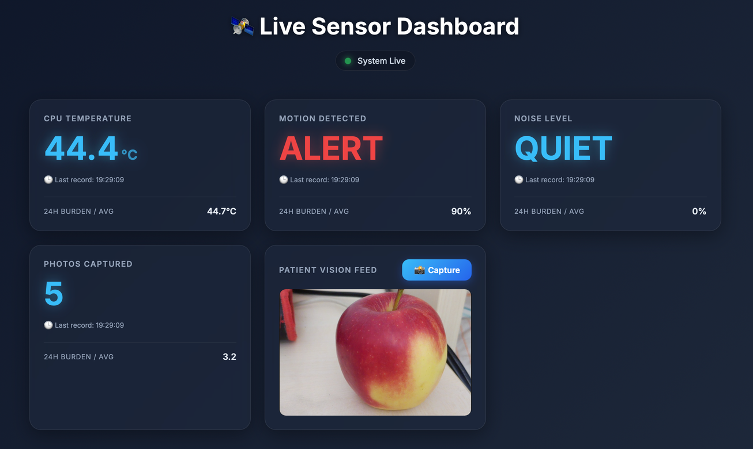
Community Impact Project
THE LIVE DASHBOARD
Everything visible in real time
Live vitals
HR, SpO₂ and temperature update the instant they're measured.
Trends from InfluxDB
Historical charts reveal change over time, not just one reading.
Environment awareness
Footfall and noise levels shown at a glance for the whole space.

Slide 8






Community Impact Project
HOW WE TESTED IT
Validated in the lab and in real use
VALIDATION
ENGINEERING CHALLENGES SOLVED
Accuracy
I²C bus debugging
Readings cross-checked against a commercial pulse oximeter and thermometer.
Got the Pi 5 reading the MAX30102 and MLX90614 simultaneously without crashing.
Stability
Ingestion engine
Extended continuous-run sessions on the Pi 5 — no crashes or drift.
Hardened the Python + Flask server to run seamlessly — no [Errno 121] or memory errors.
Real-use trials
Noise calibration
Multiple users under varied lighting, movement and finger placement.
Tuned the sound sensor's potentiometer to reliably tell “LOUD” from “QUIET” in a real room.

Slide 9



Community Impact Project
FROM PROTOTYPE TO DEPLOYMENT
How WeCare scales into the real world
Phase 1
Phase 2
Phase 3
Harden
Scale
Comply
Sealed, durable, tamper-resistant enclosure built for public spaces.
Cloud sync + a fleet dashboard to monitor many kiosks from one place.
Encrypted health data, clear consent, and health-data regulation compliance.
Cost-effective at scale: a full kiosk — Raspberry Pi 5 + I²C sensors — assembles for under $150, versus the original $15,000 app budget. Deploy dozens for a fraction of the cost.

Slide 10
Community Impact Project
Health made accessible
We didn't just design an app — we built a working machine.
Fast, free, equal access to health monitoring — wherever people are.
Thank you · Questions?
Giorgi Pataridze · Avtandili Javrishvili

