Slide 1
Regularization
An introduction to regularized regression
Giordano Viviani
27th January 2023

Slide 2
Overview
Introduction to Linear Regression
  Ordinary Least Squares
  Generalized Least Squares
Priors in Linear regression
Regularization
  L2 Norm - Ridge
  L1 Norm – Lasso
  Geometrical Interpretation
Examples

Slide 3


Ordinary Least Squares (OLS)
I will introduce regularization in the context of linear regression
Observations
Design matrix
Weights
One models the observations as a linear combination of regressors

Slide 4
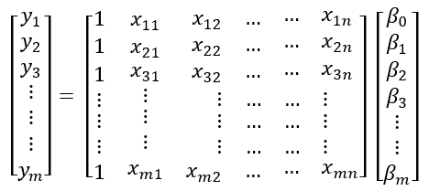

Ordinary Least Squares (OLS)
In order to solve for 𝛽:
n
This is almost never possible
Usually, the design matrix is not invertible!
Regressors
Note that often $m ≠n$

Slide 5

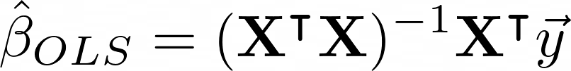
Ordinary Least Squares (OLS)
Square by construction
In the case that it is also invertible, it follows:
OLS estimator

Slide 6
What about the noise?
Let’s consider the case in which we have heteroscedastic errors on our observations:
cannot be ignored
Generalized Least Squares (GLS)
We need to bring in the concept of likelihood in order to inform the result about the different uncertainties in our data

Slide 7
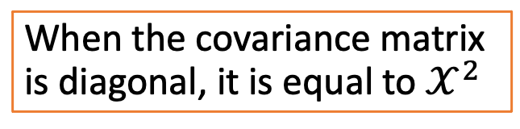
Generalized Least Squares (GLS)
Assuming that the data is generated by an underlying Gaussian process:
Covariance matrix
When the covariance matrix is diagonal, it is equal to $𝒳^{2}$

Slide 8
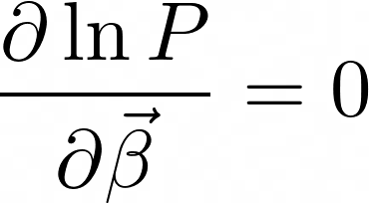
Generalized Least Squares (GLS)
We want to maximize the likelihood:
Linear Model + Gaussian Likelihood = Convex problem
gives a maximum
GLS estimator

Slide 9
OLS vs GLS
All we are doing is weighting the data with the inverse of the covariance matrix

Slide 10
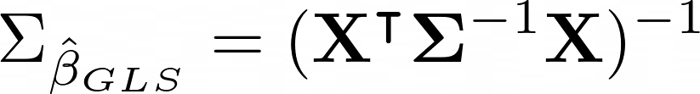
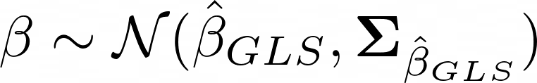
Wait…. what about the priors?
But, for GLS not only the maximum likelihood is analytical, also the covariance.
So, one can conclude that the posterior constraint on $\overset{⃑}{β}$ is:

Slide 11
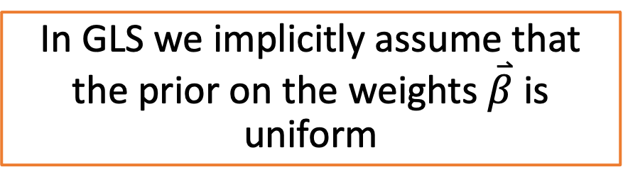
Wait…. what about the priors?
In GLS we implicitly assume that the prior on the weights $\overset{⃑}{β}$ is uniform
Uninformative prior

Slide 12

Why bother about the priors?
Because is not always invertible!
We need informative priors in order to break possible degeneracies
Regularization

Slide 13
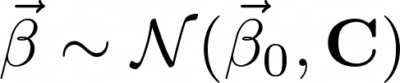
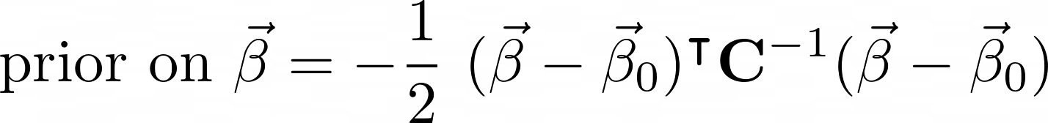
L2 Norm – Ridge Regression
Let’s assume a gaussian prior for $\overset{⃑}{β}$:

Slide 14
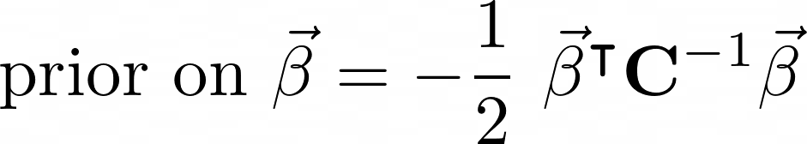
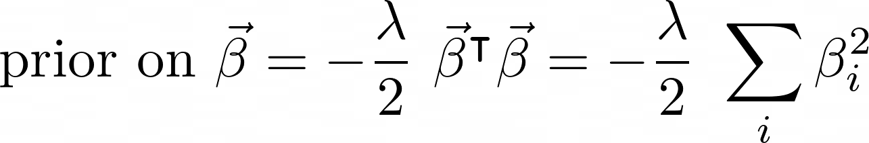
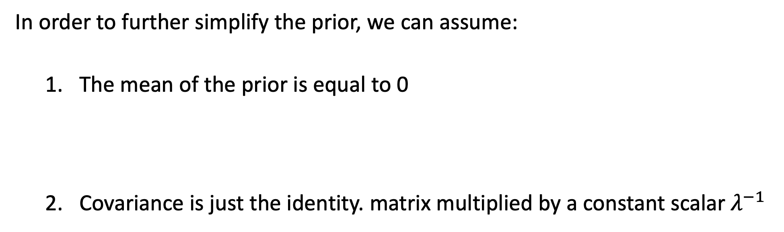
L2 Norm – Ridge Regression
In order to further simplify the prior, we can assume:
  The mean of the prior is equal to 0
  Covariance is just the identity. matrix multiplied by a constant scalar $λ^{−1}$

Slide 15
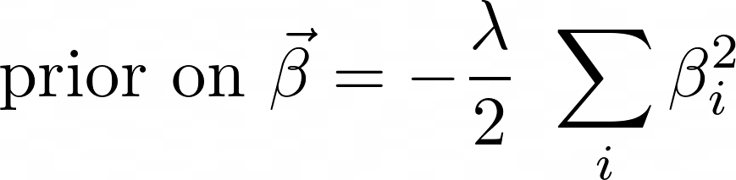
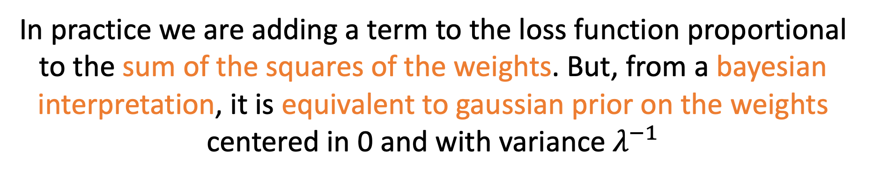
L2 Norm – Ridge Regression
L2 Penalty
In practice we are adding a term to the loss function proportional to the sum of the squares of the weights. But, from a bayesian interpretation, it is equivalent to gaussian prior on the weights centered in 0 and with variance $λ^{−1}$

Slide 16

L2 Norm – Ridge Regression
L2 Norm also has a closed form:
For any square matrix there is always a value of $λ$ that makes it invertible

Slide 17
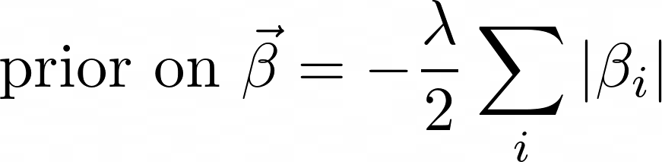
L1 Norm – Lasso
There is no closed form solution for linear regression
There is no equivalence to a prior distribution
Drives parameters to 0 sparsity

Slide 18
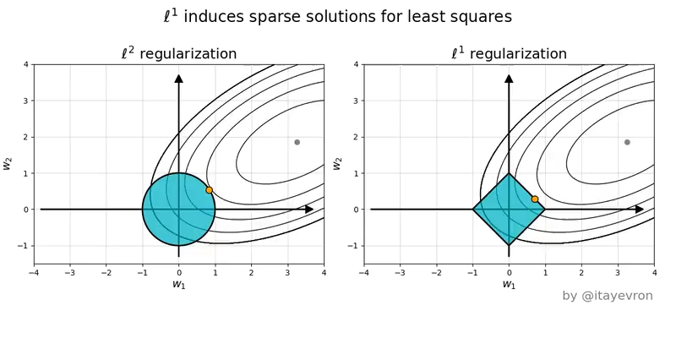
Geometrical interpretation
Credits

Slide 19
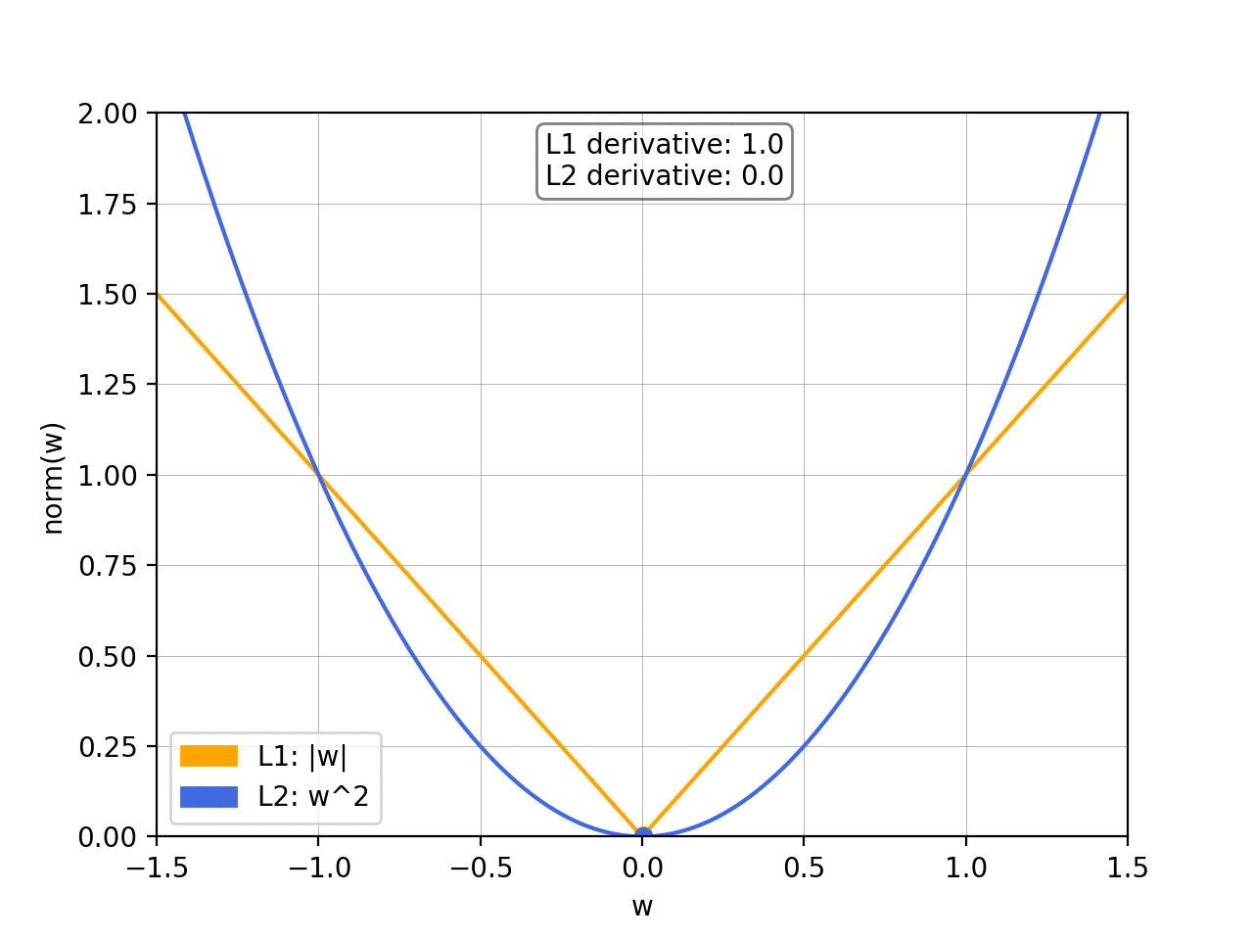
Geometrical interpretation
Diminishing returns
Credits

Slide 20
Ridge vs Lasso
L2 Norm – Ridge
NOT sparse
Unique solution
NO
Issues with outliers
Bayesian interpretation
Closed form solution
L1 Norm – Lasso
Sparse
Not necessarily true
Built-in feature selection
More robust to outliers
NO
NO
VS

