Slide 1
Java Collections Framework (JCF)
Università di Modena e Reggio Emilia
Prof. Nicola Bicocchi (nicola.bicocchi@unimore.it)

Slide 2
Framework
The Java collections framework (JCF) is a set of classes and interfaces that implement commonly reusable collection data structures. The JCF provides both interfaces that define various collections and classes that implement them.
Interfaces (Abstract Data Types)
Implementations (of ADT)
Algorithms
java.util.*

Slide 3
Requisites
Resizable Array
Linked List
Balanced Tree
Hash Table

Slide 4
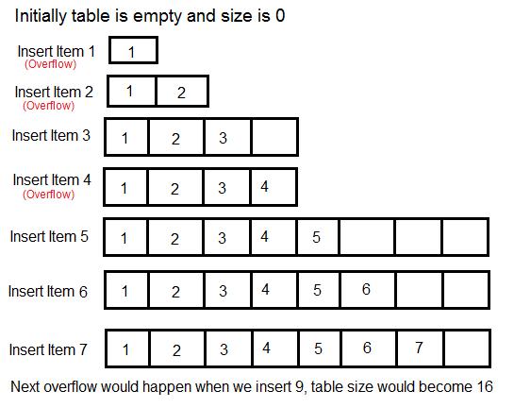
Resizable Array

Slide 5
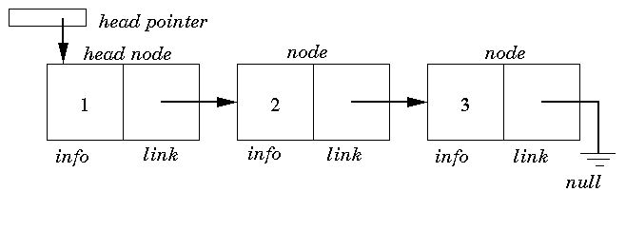
Linked List

Slide 6
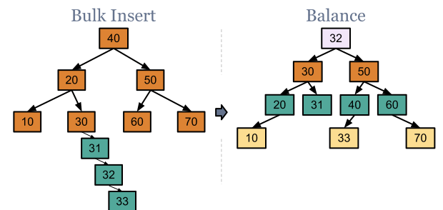
Balanced Tree

Slide 7
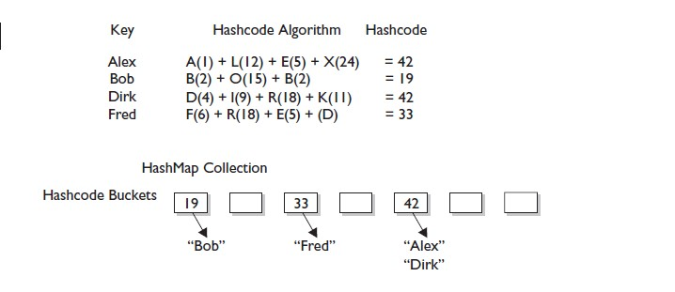
Hash Table

Slide 8
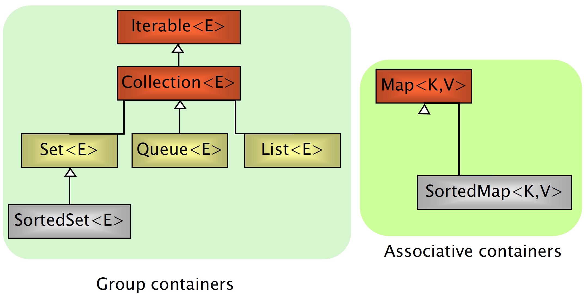
Interfaces

Slide 9
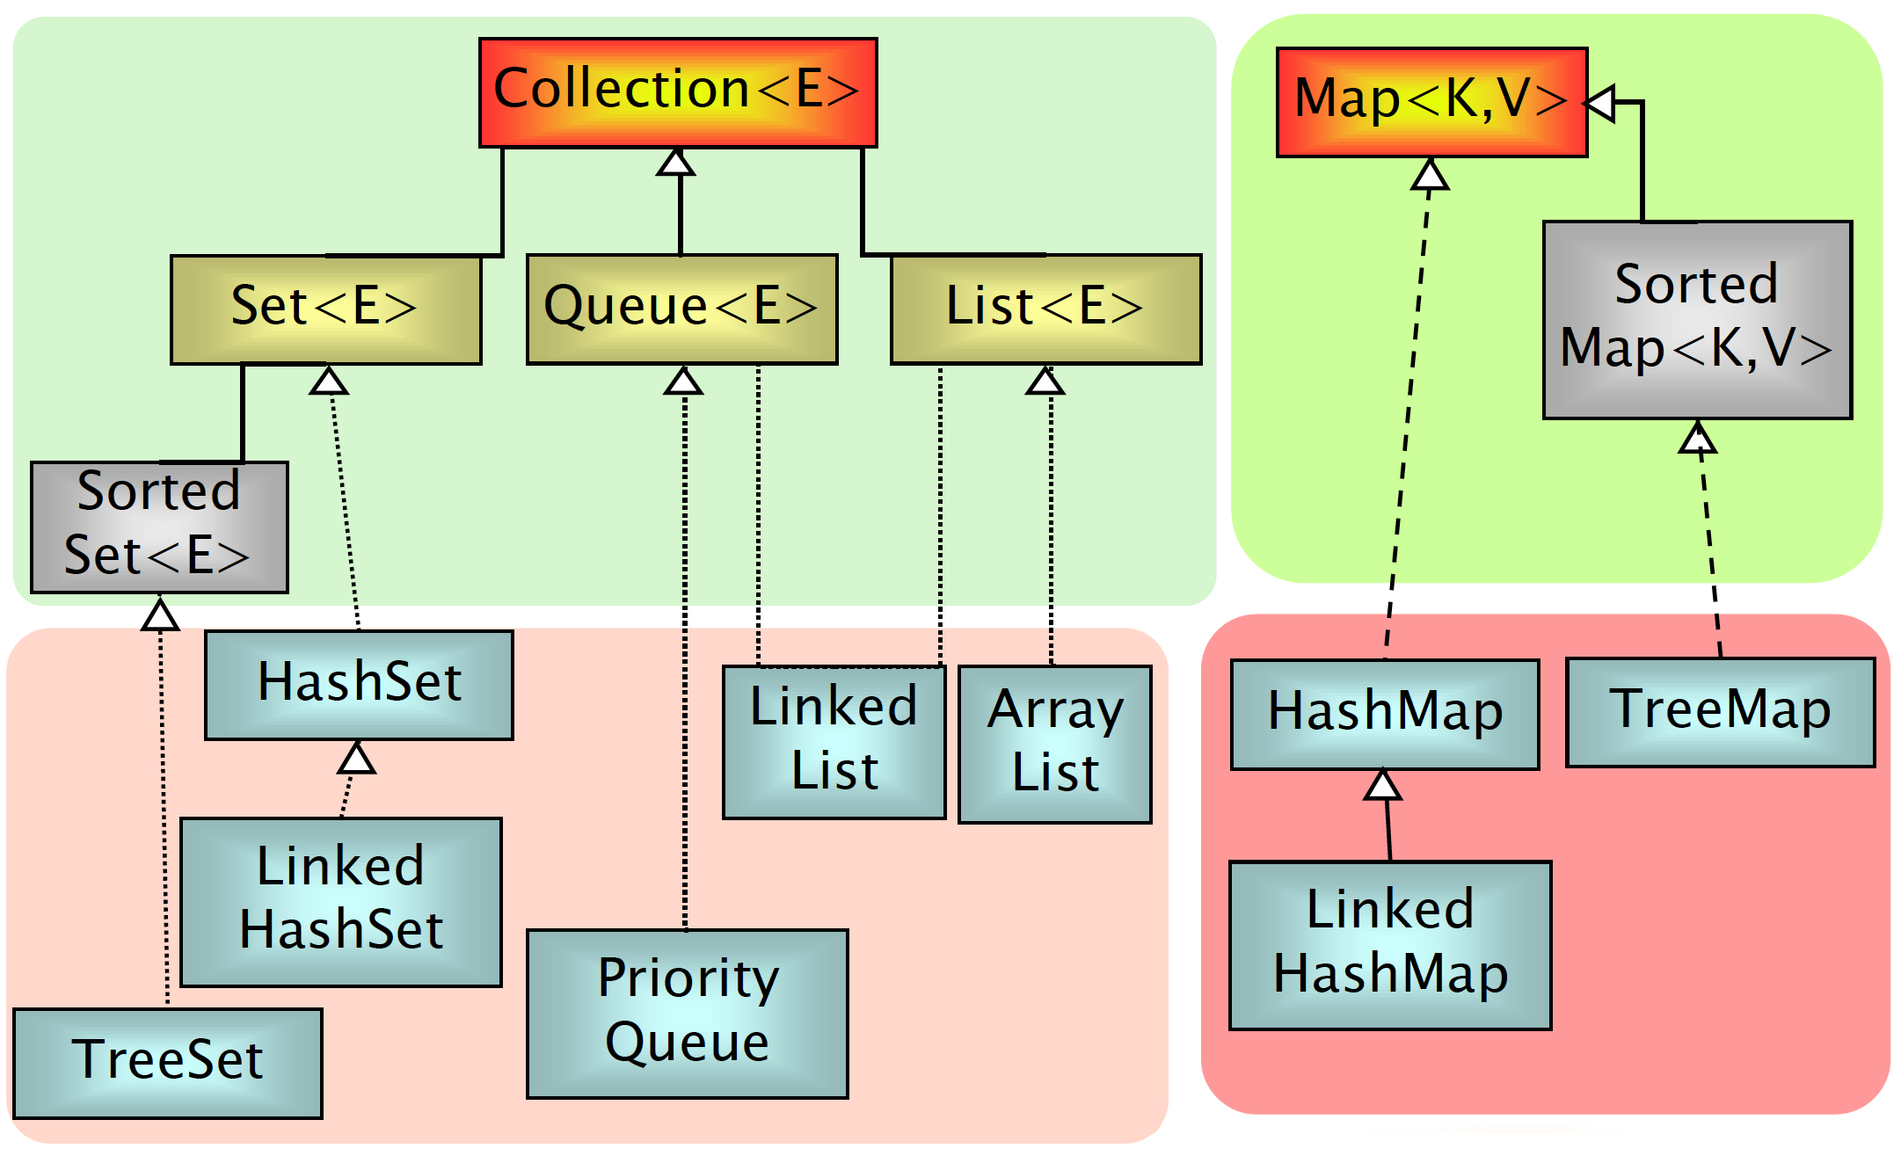
Implementations

Slide 10
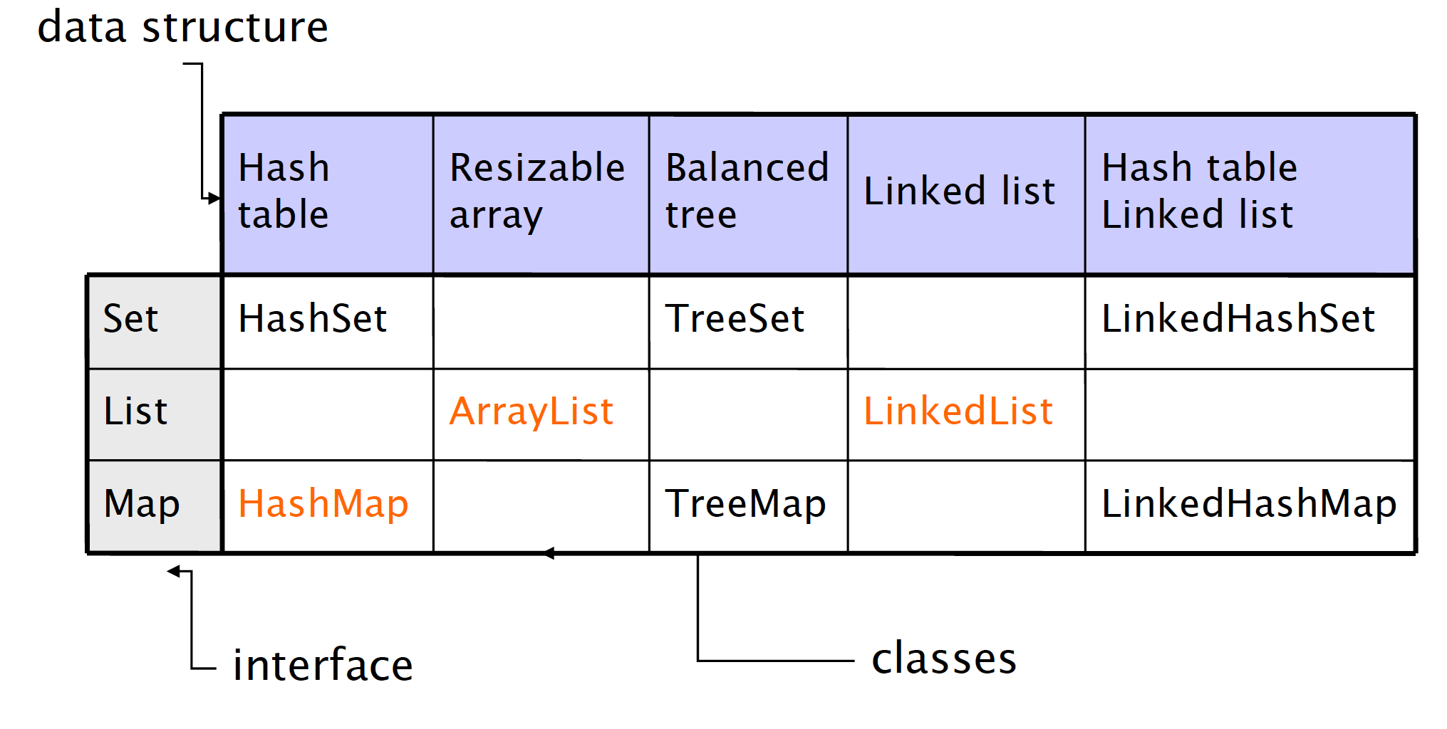
Internals

Slide 11
Iterable Interface
The Iterable interface (java.lang.Iterable) is the root interface of the Java collection framework. The Collection interface extends Iterable, so all subtypes of Collection also implement the Iterable interface.
Iterarable, literally, means that “can be iterated”. From a technical perspective, it means that an Iterator can be returned.
Iterable objects can be used with the new for-loop:
List list = new ArrayList();
for(Object o : list){
//do something;
}
The Iterable interface has only one method:
public interface Iterable<T> {
public Iterator<T> iterator();
}

Slide 12
Iterator Interface
boolean hasNext()
object next()
void remove()

Slide 13
Collection Interface
Group of elements (references to objects)
It is not specified whether they are
Ordered / not ordered
Duplicated / not duplicated
Following constructors are common to all classes implementing Collection
T()
T(Collection c)

Slide 14
Collection Interface
int size()
boolean isEmpty()
boolean contains(Object element)
boolean containsAll(Collection c)
boolean add(Object element)
boolean addAll(Collection c)
boolean remove(Object element)
boolean removeAll(Collection c)
void clear()
Object[] toArray()
Iterator iterator()

Slide 15
Collection Examples
Collection<Person> p = new LinkedList<Person>();
p.add(new Person(“Alice”));
p.add(new Person(“Bob”));
System.out.println(p.size());
Collection<Person> c = new TreeSet<Person>();
c.addAll(p); // new TreeSet(persons)
Person[] array = c.toArray();

Slide 16
Map Interface
An object that associates keys to values (e.g., Person => Phone number)
Keys and values must be objects
Keys must be unique
Following constructors are common to all collection implementers
T()
T(Map m)

Slide 17
Map Interface
Object put(Object key, Object value)
Object get(Object key)
Object remove(Object key)
boolean containsKey(Object key)
boolean containsValue(Object value)
public Set keySet()
public Collection values()
int size()
boolean isEmpty()
void clear()

Slide 18
Map Examples
Map<String,Person> people = new HashMap<String,Person>();
people.put(“3474566867”, new Person(“Alice”, “Smith”));
people.put(“3358987278”, new Person(“Bob”, “Green”));
if people.containsKey(“3358987278”) {
System.out.println(people.get(“3358987278”));
}
System.out.println(people.size());

Slide 19
Generic Collections
From Java 5, all collection interfaces and classes have been redefined as Generics
Use of generics lead to code that is
safer
more compact
easier to understand
equally performing

Slide 20
Generic Collections
List l = new ArrayList<Integer>();
public interface List<E>{
void add(E x);
Iterator<E> iterator();
}
public interface Iterator<E>{
E next();
booleanhasNext();
}

Slide 21
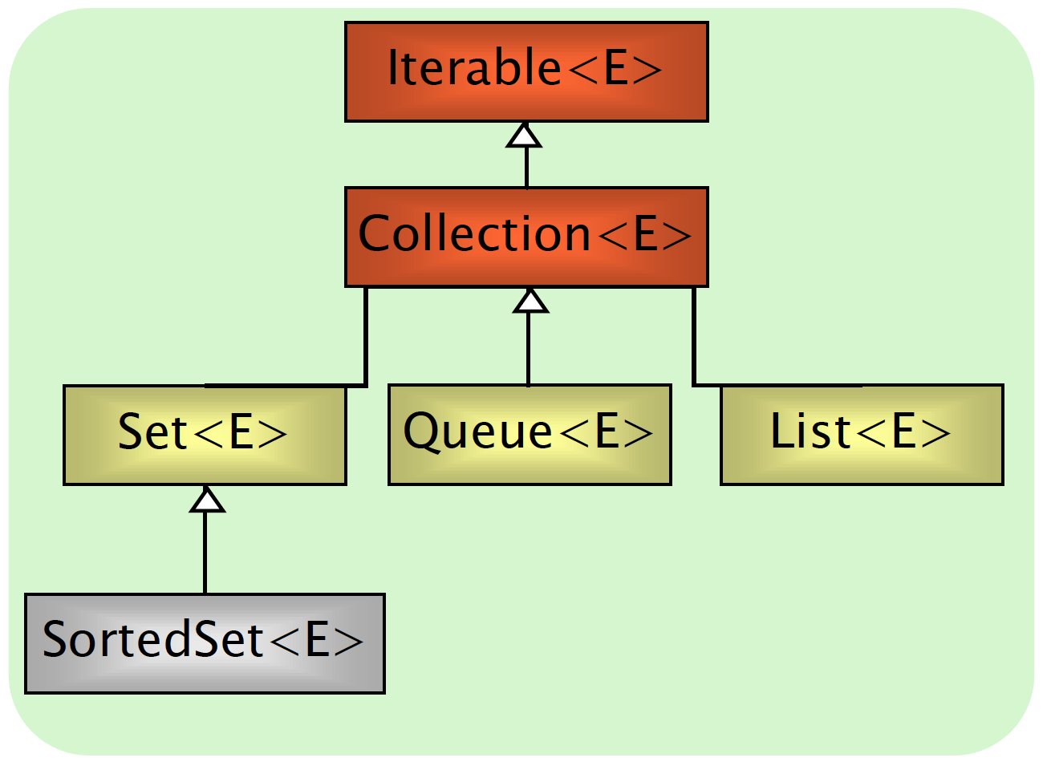
List Interface
Can contain duplicate elements
Insertion order is preserved
User can define insertion point
Elements can be accessed by position

Slide 22
List additional methods
Object get(int index)
Object set(int index, Object element)
void add(int index, Object element)
Object remove(int index)
boolean addAll(int index, Collection c)
int indexOf(Object o)
int lastIndexOf(Object o)
List subList(int fromIndex, int toIndex)

Slide 23
List Implementations
ArrayList
Get(n) -> Constant time
Insert (beginning) -> Linear time
LinkedList
Get(n) -> Linear time
Insert (beginning) -> Constant time

Slide 24
ArrayList Example
List<Car> garage = new ArrayList<Car>(20);
garage.add(new Car());
garage.add(new ElectricCar());
garage.add(new ElectricCar());
garage.add(new Car());
for(int i; i < garage.size(); i++){
Car c = garage.get(i);
c.turnOn();
}

Slide 25
LinkedList Example
List<Car> garage = new LinkedList<Car>();
garage.add(new Car());
garage.add(new ElectricCar());
garage.addFirst(new ElectricCar());
garage.addLast(new ElectricCar());
garage.getfirst();
garage.getLast();
garage.removeFirst();
garage.removeLast();

Slide 26
Queue Interface
Collection whose elements have an order (not and ordered collection though)
Defines a head (first element) and a tail (last element)
peek()
poll()

Slide 27
Queue Implementations
LinkedList
head is the first element of the list
FIFO internal policy: Fist-In-First-Out
PriorityQueue
head is the smallest element

Slide 28
Queue Example
Queue<Integer> fifo = new LinkedList<Integer>();
Queue<Integer> pq = new PriorityQueue<Integer>();
fifo.add(3); pq.add(3);
fifo.add(1); pq.add(1);
fifo.add(2); pq.add(2);
System.out.println(fifo.peek()); // 3
System.out.println(pq.peek()); // 1

Slide 29
Set Interface
Contains no methods other than those inherited from Collection
add() has restriction that no duplicate elements are allowed
Iterator: the elements are traversed in no particular order

Slide 30
SortedSet Interface
No duplicate elements
Iterator
The elements are traversed according to the natural ordering(ascending)
Augments Set interface
Object first()
Object last()
SortedSet headSet(Object toElement)
SortedSet tailSet(Object fromElement)
SortedSet subSet(Object from, Object to)

Slide 31
Set Implementations
HashSet implements Set
Hash tables as internal data structure (fast!)
No order
LinkedHashSet extends HashSet
Insertion order
TreeSet implements SortedSet
R-B trees as internal data structure (slow!)
Natural (ascending) order

Slide 32
Set Implementations
Depending on the constructor used, SortedSet implementations can use different orderings
TreeSet()
Natural ordering (elements must implement the Comparable Interface)
TreeSet(Comparator c)
Ordering is according to the comparator rules, instead of natural ordering

Slide 33
Set Example I
Set setA = new HashSet();
setA.add("element 0");
setA.add("element 1");
setA.add("element 2");
// access via Iterator
Iterator iterator = setA.iterator();
while(iterator.hasNext(){
String element = (String) iterator.next();
}
// access via new for-loop
for(Object object : setA) {
String element = (String) object;
}

Slide 34
Set Example II
ArrayList<String> l = new ArrayList<String>();
ArrayList<String> lHashSet = new ArrayList<String>();
ArrayList<String> lLinkedHashSet = new ArrayList<String>();
ArrayList<String> lTreeSet = new ArrayList<String>();
l.add("Nicola"); l.add("Silvia");
l.add("Marzia"); l.add("Silvia");
lHashSet.addAll(new HashSet<String>(l));
lLinkedHashSet.addAll(new LinkedHashSet<String>(l));
lTreeSet.addAll(new TreeSet<String>(l));
System.out.println(l);
System.out.println(lLinkedHashSet);// [Nicola, Silvia, Marzia] System.out.println(lHashSet); // [Silvia, Marzia, Nicola]
System.out.println(lTreeSet); // [Marzia, Nicola, Silvia]

Slide 35
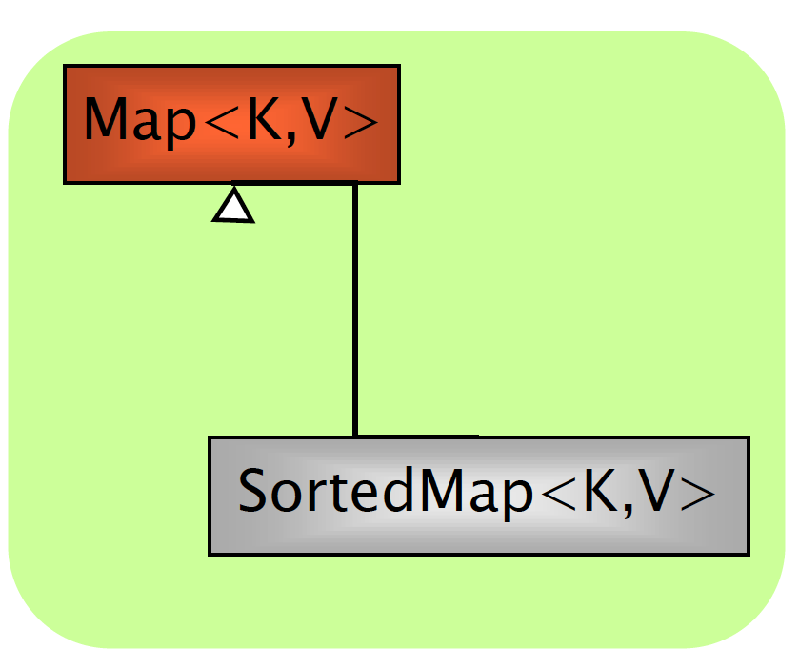
Map Interface
An object that associates keys to values (e.g., Person => Phone number)
Keys and values must be objects
Keys must be unique

Slide 36
SortedMap Interface
…

Slide 37
Map Implementations
Similar to Set
HashMap implements Map
No order
LinkedHashMap extends HashMap
Insertion order
TreeMap implements SortedMap
Natural (ascending) key order

Slide 38
HashMap
Get/set takes constant time(in case of no collisions)
Automatic re-allocation when load factor reached
Constructor optional arguments
load factor(default = .75)
initial capacity(default = 16)

Slide 39
Map Example I
Map<String, Integer> lhm = new LinkedHashMap<String, Integer>();
lhm.put("Silvia", 2);
lhm.put("Marzia", 3);
lhm.put("Silvia", 4);
lhm.put("Nicola", 1);
Map<String, Integer> hm = new HashMap<String, Integer>(lhm);
Map<String, Integer> tm = new TreeMap<String, Integer>(lhm);
System.out.println(lhm); // {Silvia=4, Marzia=3, Nicola=1}
System.out.println(hm); // {Silvia=4, Nicola=1, Marzia=3}
System.out.println(tm); // {Marzia=3, Nicola=1, Silvia=4}

Slide 40
Map Example II
Map<String, Integer> hm = new HashMap<String, Integer>();
…
List<String> keys = hm.keySet();
for(String s : keys) {
System.out.println(s + " -> " + hm.get(s));
}

Slide 41
Iterator
A common operation with collections is to iterate over their elements
Interface Iterator provides a transparent means to cycle through all elements of a Collection
Keeps track of last visited element of the related collection
Each time the current element is queried, it moves on automatically

Slide 42
Iterator Interface
boolean hasNext()
Object next()
void remove()

Slide 43
ListIterator
An iterator for lists that allows the programmer to traverse the list in either direction, modify the list during iteration, and obtain the iterator's current position in the list.
A ListIterator has no current element; its cursor position always lies between the element that would be returned by a call to previous() and the element that would be returned by a call to next().

Slide 44
ListIterator Interface
boolean hasNext()
boolean hasPrevious()
object next()
object previous()
void add()
void set()
void remove()
int nextIndex()
int previousIndex()

Slide 45
Iterator Example
List<Person> pl = new ArrayList<Person>();
/* C style */
for (int i = 0; i < pl.size; i++)
System.out.println(pl.get(i))
/* Java style */
for (Person p : pl)
System.out.println(p);
/* Iterator style */
for(Iterator<Person> i = pl.iterator(); i.hasNext();) {
Person p = i.next();
System.out.println(p);
}
/* While style */
Iterator i = pl.iterator();
while (i.hasNext())
System.out.println((Person)i.next());

Slide 46
Caveat
It is unsafe to iterate over a collection you are modifying (add/del) at the same time!
Unless you are using the iterator methods
Iterator.remove()
ListIterator.add()

Slide 47
Caveat
List<Integer> l = new LinkedList<Integer>();
l.add(new Integer(10));
l.add(new Integer(11));
l.add(new Integer(13));
l.add(new Integer(20));
count = 0
for (Iterator<Integer> i = l.iterator(); itr.hasNext();){
i.next();
if (count++ == 1) l.remove(count);
if (count++ == 2) l.add(new Integer(22));
// Wrong! We modify the list while iterating
}

Slide 48
Caveat
List<Integer> l = new LinkedList<Integer>();
l.add(new Integer(10));
l.add(new Integer(11));
l.add(new Integer(13));
l.add(new Integer(20));
count = 0
for (Iterator<Integer> i = l.iterator(); itr.hasNext();){
i.next();
if (count++ == 1) i.remove();
}

Slide 49
Caveat
List<Integer> l = new LinkedList<Integer>();
l.add(new Integer(10));
l.add(new Integer(11));
l.add(new Integer(13));
l.add(new Integer(20));
count = 0
for (ListIterator<Integer> i = l.listIterator(); itr.hasNext();){
i.next();
if (count++ == 2) i.add(new Integer(22));
}

Slide 50
The Comparable Interface
public interface Comparable<T> {
public int compareTo(T obj);
}
Compares the receiving object with the specified object
Return value must be:
< 0 if this precedes obj
== 0 if this has the same order as obj
> 0 if this follows obj

Slide 51
The Comparable Interface
The interface is implemented by language common types in packages java.lang and java.util
String objects are lexicographically ordered
Date objects are chronologically ordered
Number and sub-classes are ordered numerically

Slide 52
The Comparable Interface
Given the following class:
class Person {
protected String name;
protected String surname;
protected Integer name;
…
}

Slide 53
The Comparable Interface
How to define an ordering upon Person objects according to the “natural alphabetic order”
class Person implements Comparable<Person> {
protected String name;
protected String surname;
protected Integer name;
…
public int compareTo(Student s) {…}
}

Slide 54
The Comparable Interface
public int compareTo(Student s) {
// order by surname
cmp = lastName.compareTo(s.lastName);
if(cmp == 0)
// if equal surnames, order by name
cmp = firstName.compareTo(s.firstName);
return cmp;
}

Slide 55
The Comparator Interface
public interface Comparator<T> {
public int compare(T o1, T o2);
}
java.util
Compares its two arguments
Return value must be
< 0 if o1 precedes o2
== 0 if o1 has the same ordering as o2
> 0 if o1 follows o2

Slide 56
The Comparator Interface
public class StudentComparator implements Comparator<Student> {
public int compare(Student s1, Student s2) {
cmp = s1.lastName.compareTo(s2.lastName);
if(cmp == 0)
cmp = s1.firstName.compareTo(s2.firstName);
return cmp;
}
}

Slide 57
Algorithms
Static methods of java.util.Collections class
Work on lists
sort() - merge sort implementation, n log(n)
binarySearch() - requires ordered sequence
shuffle() - unsort
reverse() - requires ordered sequence
rotate() - of a given distance
min(), max() - in a Collection

