Slide 1
Java Exceptions
Università di Modena e Reggio Emilia
Prof. Nicola Bicocchi (nicola.bicocchi@unimore.it)

Slide 2
The world without exceptions
If errors happen while method is executing, we return a special value
Special values are different from normal return value (e.g., null, -1)
Developer must remember value/meaning of special values for each call to check for errors
What if all values are normal?

Slide 3
The world without exceptions
List<Integer> list = new ArrayList<Integer>();
public int get(int i) {
if (list.size() <= i) {
return -1;
return list.get(i)
}
What does -1 mean?
Is it an error or a negative value from the list?
Need to find documentation!

Slide 4
The world without exceptions
If a non locally remediable error happens while method is executing, call System.exit()
A method causing an unconditional program interruption is not usable in real-world!

Slide 5
The world without exceptions
List<Integer> list = new ArrayList<Integer>();
public int get(int i) {
if (list.size() <= i) {
System.exit(); // Never do this!!
return list.get(i)
}

Slide 6
Real-world problems
Code is messier to write and harder to read
Only the direct caller can intercept errors (no delegation to any upward method)
if ( func() == ERROR)
// handle error
else
// proceed

Slide 7
An example, file to memory copy
Open the file open()
Determine file size size()
Allocate that much memory allocate()
Read the file into memory read()
Close the file close()
All of them can fail!

Slide 8
Correct (but long and obscure)
open the file;
if(operationFailed)
return -1;
determine file size;
if(operationFailed)
return -2;
allocate that much memory;
if(operationFailed) {
close the file;
return -3;
}
read the file into memory;
if (operationFailed) {
close the file;
return -4;
}
close the file;
if (operationFailed)
return -5;
return 0;
}
Lots of error-detection and error-handling code
To detect errors we must check specs of library calls (no homogeneity)

Slide 9
Wrong (but short and readable)
int readFile() {
open the file;
determine file size;
allocate that much memory;
read the file into memory;
close the file;
return 0;
}

Slide 10
Using Exceptions
try {
open the file;
determine file size;
allocate that much memory;
read the file into memory;
close the file;
}
catch (fileOpenFailed)
{ doSomething; }
catch(sizeDeterminationFailed)
{ doSomething; }
catch (memoryAllocationFailed)
{ doSomething; }
catch (readFailed)
{ doSomething; }
catch (fileCloseFailed)
{ doSomething; }

Slide 11
Using Exceptions
Exceptions delegate error handling to higher levels
Callee might not know how to recover from an error
Caller of a method can handle error in a more appropriate way than the callee
Exceptions separate error handling from functional code
Functional code is more readable
Error code is centralized, rather than being scattered

Slide 12
Basic Concepts
The code causing the error will generate an exception
Developers code
Third-party library
At some point up in the hierarchy of method invocations, a caller will intercept and stop the exception
In between, methods can
Ignore the exception (complete delegation)
Intercept without stopping (partial delegation)

Slide 13
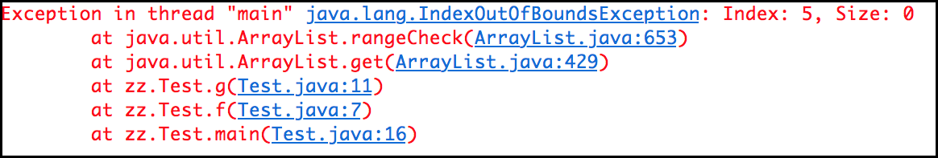
Stack trace
public class Test {
public void f(int i) {
g(i);
}
public void g(int i) {
new ArrayList().get(i);
}
public static void main(String[] args) {
new Test().f(5);
}
}

Slide 14
Syntax
Java provides three keywords
Try
Contains code that may generate exceptions
Catch
Defines the error handler
Throw
Generates an exception
Throws
Mark a method as able to convey exceptions
We also need a new entity
Exception class

Slide 15
Interception
try {
AudioSystem.getAudioInputStream(
new FileInputStream(“music.wav”));
} catch (IOException e) {
// error handling
System.out.println(e);
...
}

Slide 16
Interception
try {
AudioSystem.getAudioInputStream(
new FileInputStream(“music.wav”));
} catch (IOException e01) {
// error handling
System.out.println(e);
...
} catch(UnsupportedAudioFileException e02) {
// error handling
System.out.println(e);
...
}

Slide 17
Interception
try {
f.read();
} catch(EOFException e01) {
//
} catch(IOException e02) {
//
} catch(Exception e03) {
//
}
Only one handler is executed! Handlers must be ordered according to their “generality”. More specific first!

Slide 18
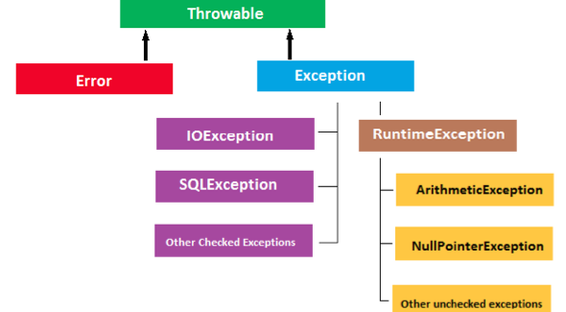
Matching Rules
Generality

Slide 19
A complete example
FileReader f = new FileReader(“foo.txt”);
try {
f.open();
f.read();
f.close();
} catch (IOException e) {
System.out.println(“something went wrong!”);
}

Slide 20
Generation
(Eventually) Declare an exception class
Mark the method generating the exception with throws
Throw upward a new exception object

Slide 21
Generation
public class EmptyStack extends Exception {}
public class Stack {
public Object pop() throws EmptyStack {
if (size == 0) {
throw(new EmptyStack());
}
…
}
}

Slide 22
throw
Execution of current method is interrupted immediately
Catching phase starts

Slide 23
throws
Method interface must declare exception type(s) generated within its implementation (list with commas)
Either generated and thrown
by method, directly
by other methods called within the method and not caught

Slide 24
Nesting
Try/catch blocks can be nested (e.g., error handlers may generate new exceptions)
try { /* Do something */ }
catch (…) {
try { /* log on file */ }
catch (…) { /* Ignore */ }
}

Slide 25
Generate and catch
When calling code which possibly raises an exception, the caller can
Catch
Propagate
Catch and re-throw

Slide 26
Catch
Class Dummy {
public void foo(){
FileReader f;
try {
f = new FileReader(“file.txt”);
catch (FileNotFound e) {
/* do something */
}
}
}

Slide 27
Propagate
Class Dummy {
public void foo() throws FileNotFound {
FileReader f;
f = new FileReader(“file.txt”);
}
}

Slide 28
Propagate
Exception not caught can be propagated till main(). When an exception is not caught in main() execution is halted!
Class Dummy {
public void foo() throws FileNotFound {
FileReader f;
f = new FileReader(“file.txt”);
}
}
Class App {
public static void main (String args[]) throws FileNotFound {
Dummy d = new Dummy();
f.foo();
}
}

Slide 29
Catch and re-throw
Class Dummy {
public void foo()throws FileNotFound {
try {
FileReader f;
f = new FileReader(“file.txt”);
} catch (FileNotFound e) {
/* do something */
throw e;
}
}
}

Slide 30
Custom Exception
It is possible to define new types of exceptions if the ones provided by the system are not enough…
Subclass Throwable or Exception
public class EmptyStack extends Exception {}

Slide 31
Checked and Unchecked
Trowable
Error
Checked
Exception
RuntimeException
Uncheked
Unchecked

Slide 32
Checked and Unchecked
Unchecked exceptions (Generated by JVM)
Their generation is not foreseen (can happen everywhere)
Need not to be declared (not verified by the compiler)
NullPointerException, ArrayIndexOutOfBound, …
Checked exceptions
Exceptions declared and checked
Generated with “throw”
IOException, SQLException, ClassNotFoundException, …
Trowable
Error
Checked
Exception
RuntimeException
Uncheked
Unchecked

Slide 33
Error
An Error is a subclass of Throwable that indicates serious problems that a reasonable application should not try to catch. Most such errors are abnormal conditions.
LinkageError - Subclasses of LinkageError indicate that a class has some dependency on another class; however, the latter class has incompatibly changed after the compilation of the former class.
VirtualMachineError - Thrown to indicate that the Java Virtual Machine is broken or has run out of resources necessary for it to continue operating.
Trowable
Error
Checked
Exception
RuntimeException
Uncheked
Unchecked

Slide 34
Exceptions and loops
For errors affecting a single iteration, the try-catch blocks is nested in the loop. In case of exception the execution goes to the catch block and then proceed with the next iteration.
while(true){
try{
// potential exceptions
}catch(Exception e){
// handle the anomaly
}
}

Slide 35
Exceptions and loops
For serious errors compromising the whole loop, the loop is nested within the try block. In case of exception the execution goes to the catch block, thus exiting the loop.
try{
while(true){
// potential exceptions
}
}catch(AnException e){
// print error message
}

Slide 36
Finally
The runtime system always executes the finally block regardless the outcome of try/catch. Usually it is used for cleanup (e.g., closing files, connections, …).
FileReader f = new FileReader (“foo.txt”);
try {
f.open();
f.read();
f.close();
} catch (IOException e) {
System.out.println(“something went wrong!”);
} finally {
if (out != null) out.close();
}

