Slide 1
Java I/O
Università di Modena e Reggio Emilia
Prof. Nicola Bicocchi (nicola.bicocchi@unimore.it)

Slide 2
Java I/O
Stream
Buffer
File
StringTokenizer, StreamTokenizer
Serialization

Slide 3
Stream
All I/O operations rely on the abstraction of STREAM (“bytes flow”)
A stream can be:
A file on the disk
standard input, output, error
A network connection
A data-flow from/to whichever hardware device
I/O operations work in the same way with ALL kinds of stream

Slide 4
Stream
Reader Writer
stream of chars (Unicode Chars 16 bit)
All characters
InputStream OutputStream
stream of bytes (8 bit)
Binary data, sounds, images
package java.io
All related exceptions are subclasses of IOException

Slide 5
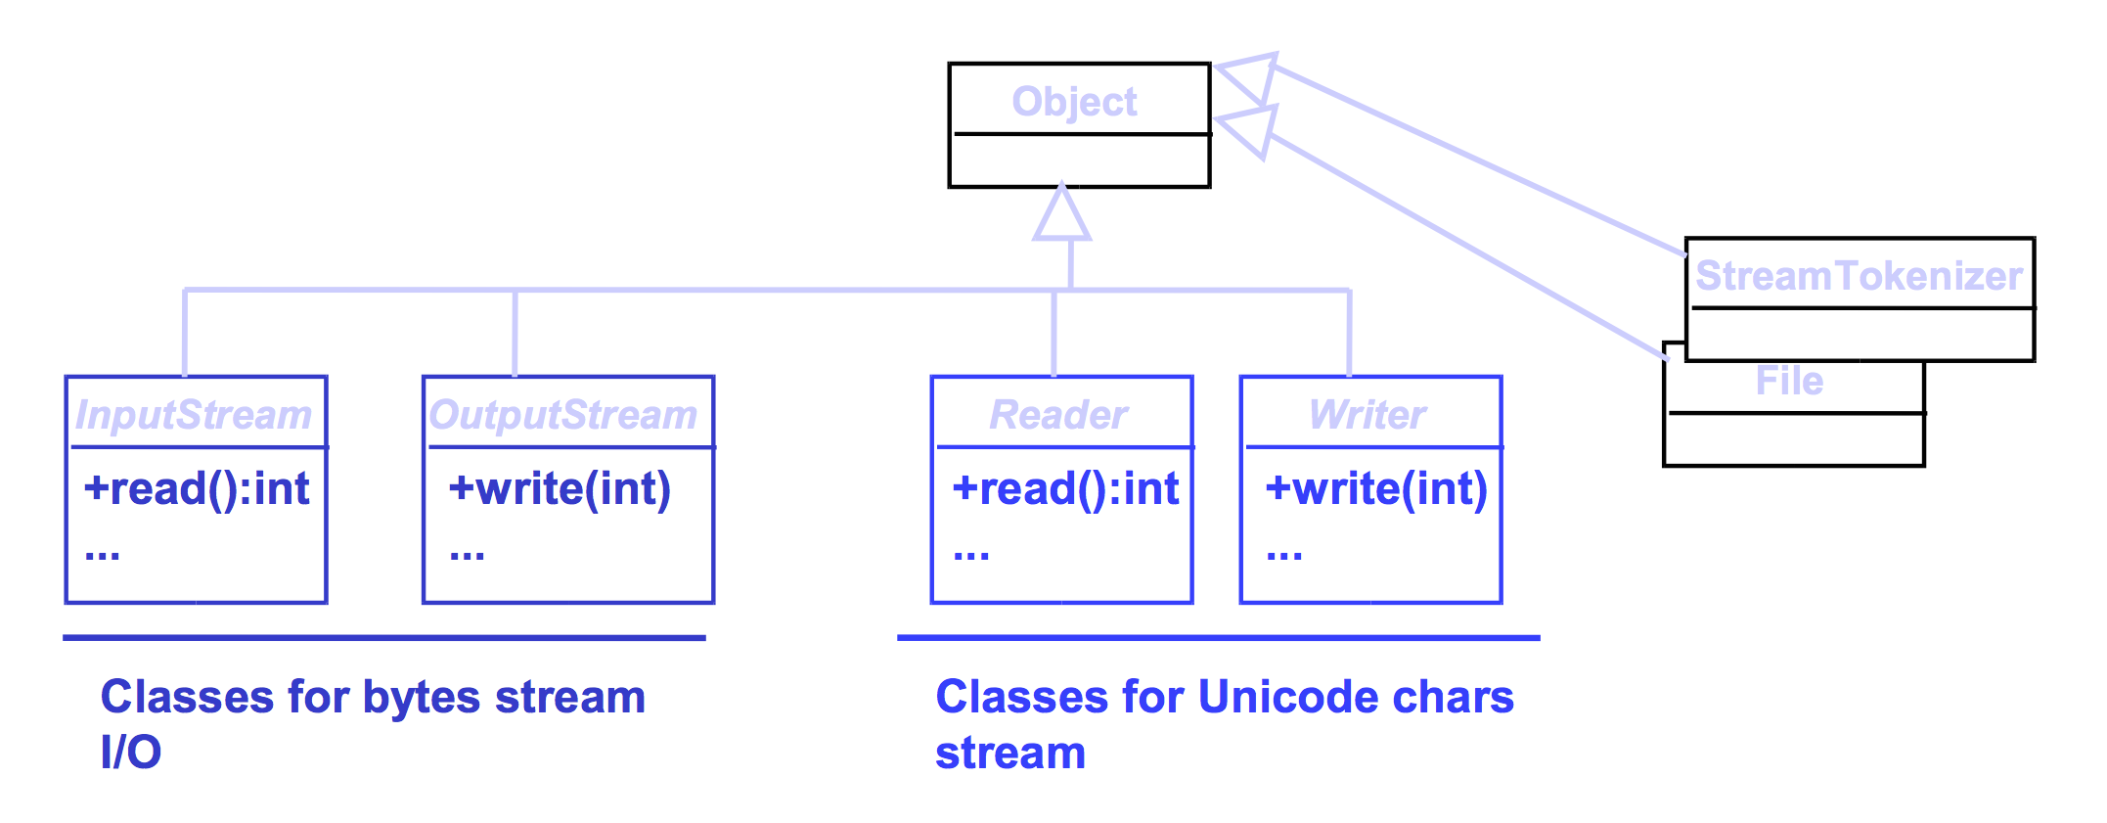
Base classes in java.io

Slide 6
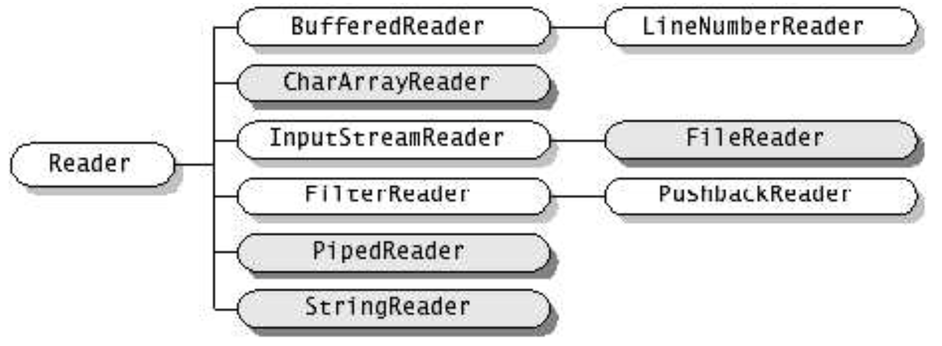
java.io.Reader

Slide 7
java.io.Reader
void close()
Close the stream.
int read()
Read a single character: -1 when end of stream. Block until char is available, I/O error, end of stream.
int read(char[] cbuf)
Read characters into an array.
abstract int read(char[] cbuf, int off, int len)
Read characters into a portion of an array.
boolean ready()
Tell whether this stream is ready to be read.
void reset()
Reset the stream.
long skip(long n)
Skip characters.

Slide 8
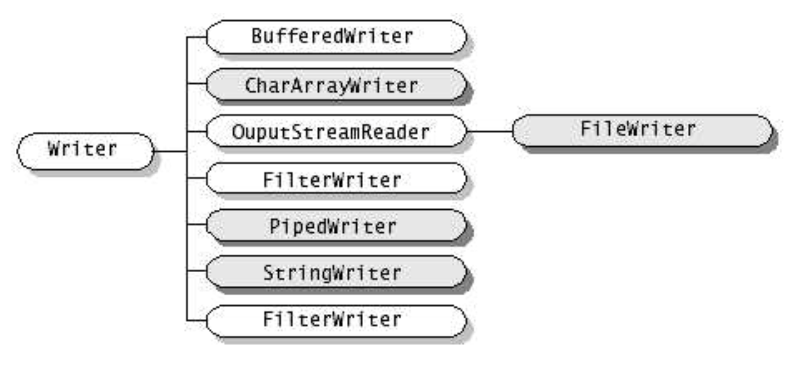
java.io.Writer

Slide 9
java.io.Writer
close()
Close the stream, flushing it first.
abstract void flush()
Flush the stream.
void write(char[] cbuf)
Write an array of characters.
abstract void write(char[] cbuf, int off, int len)
Write a portion of an array of characters.
void write(int c)
Write a single character.
void write(String str)
Write a string.
void write(String str, int off, int len)
Write a portion of a string.

Slide 10
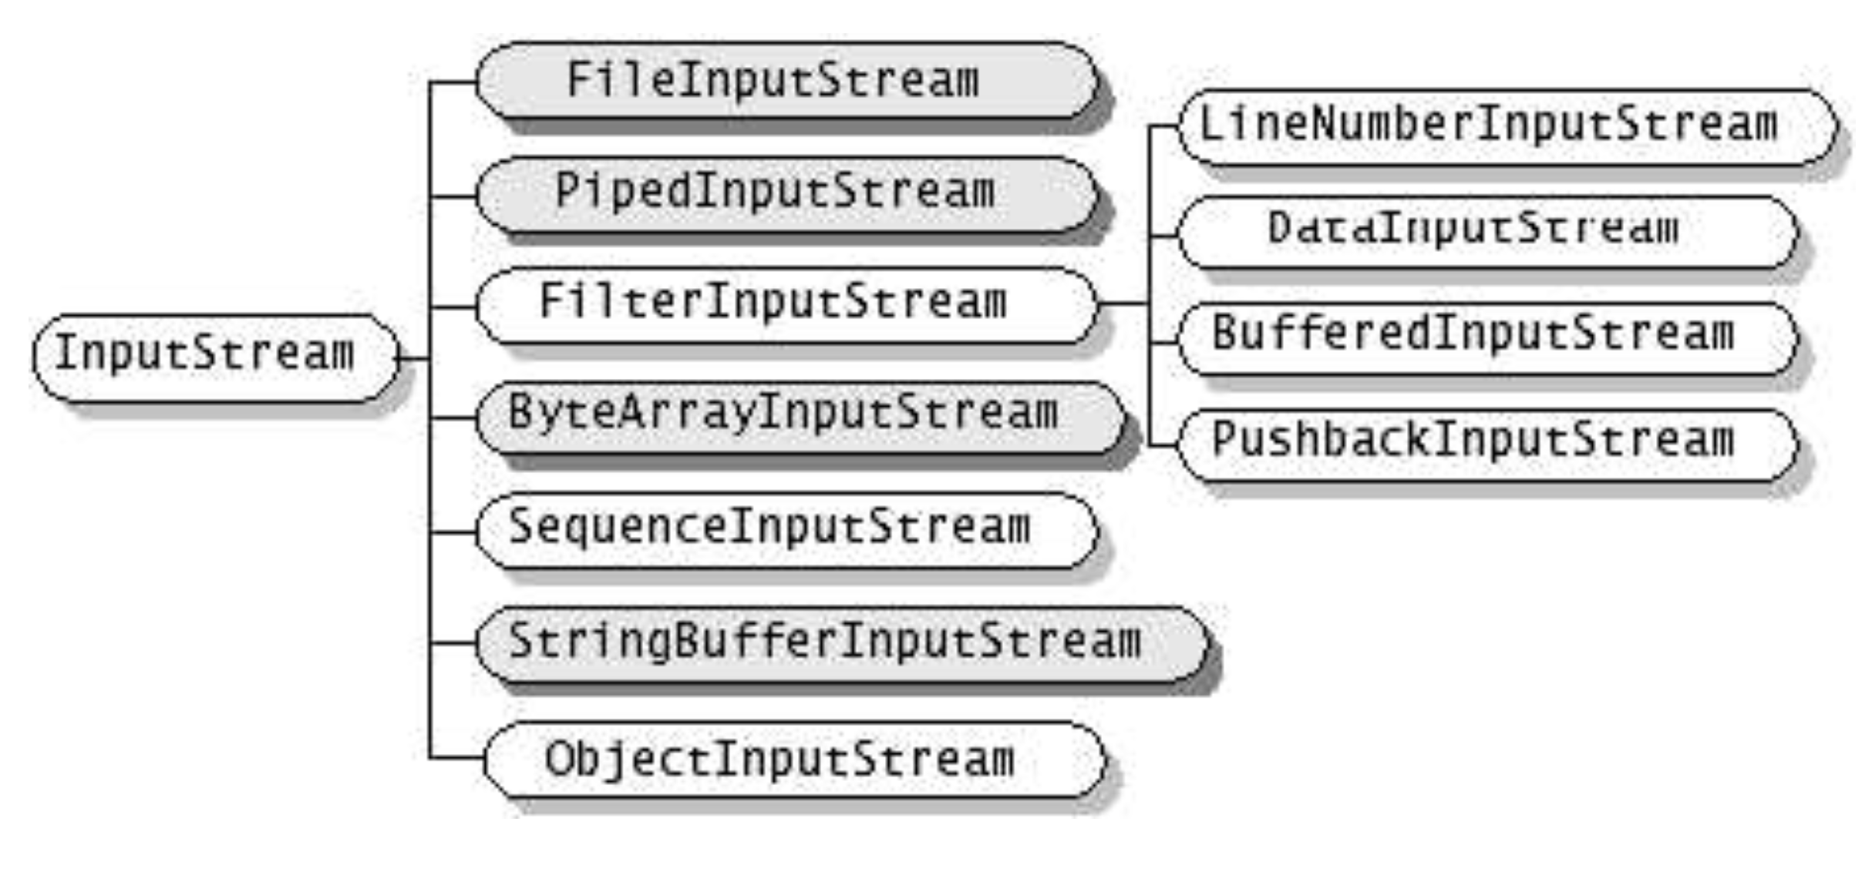
java.io.InputStream

Slide 11
java.io.InputStream
int available()
Returns the number of bytes that can be read (or skipped over) from this input stream without blocking by the next caller of a method for this input stream.
void close()
Closes this input stream and releases any system resources associated with the stream.
abstract int read()
Reads the next byte of data from the input stream.
int read(byte[] b)
Reads some number of bytes from the input stream and stores them into the buffer array b.
int read(byte[] b, int off, int len)
Reads up to len bytes of data from the input stream into an array of bytes.
void reset()
Repositions this stream to the position at the time the mark method was last called on this input stream.
long skip(long n)
Skips over and discards n bytes of data from this input stream.

Slide 12
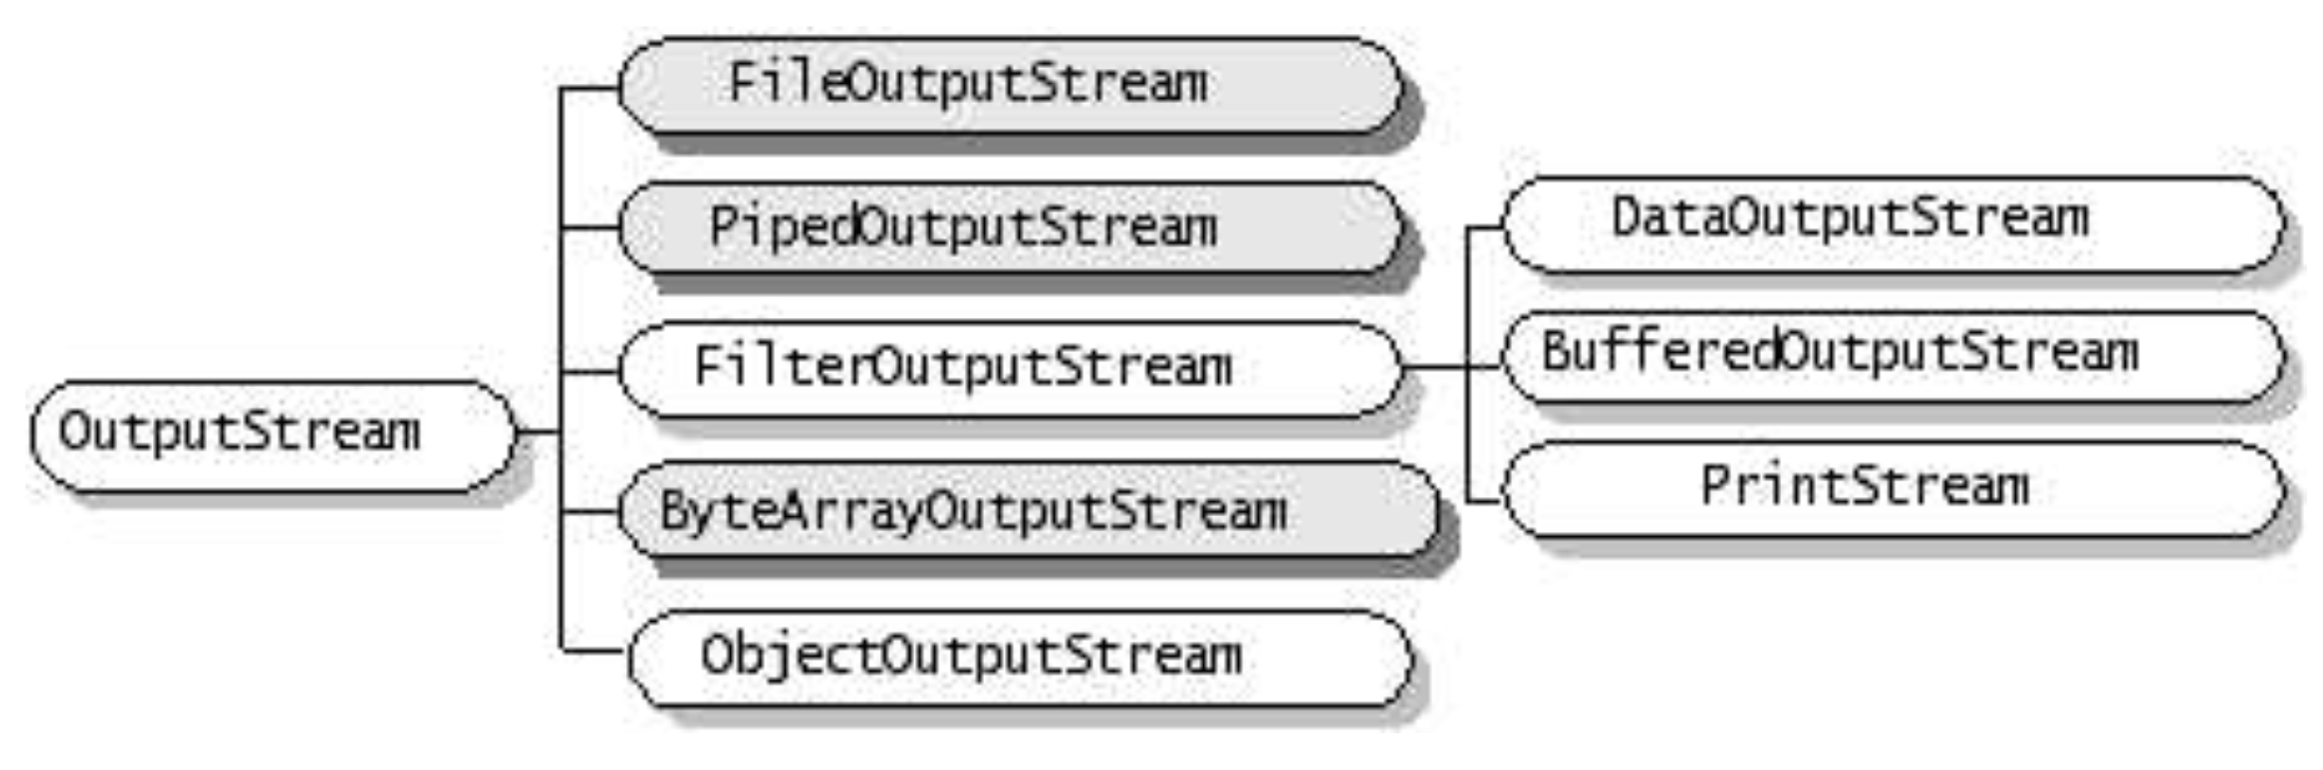
java.io.OutputStream

Slide 13
java.io.OutputStream
void close()
Closes this output stream and releases any system resources associated with this stream.
void flush()
Flushes this output stream and forces any buffered output bytes to be written out.
void write(byte[] b)
Writes b.length bytes from the specified byte array to this output stream.
void write(byte[] b, int off, int len)
Writes len bytes from the specified byte array starting at offset off to this output stream.
abstract void write(int b)
Writes the specified byte to this output stream.

Slide 14
System.in and System.out
System defines default input and output streams
class System {
static InputStream in;
static PrintStream out; // see after
…
}

Slide 15
Stream specializations
Memory (source/destination)
Pipe (source/destination)
File (source/destination)
Buffered (functionality)
Printed (functionality)
Interpreted (functionality)

Slide 16
Read/Write in memory
CharArrayReader
CharArrayWriter
R/W char or byte from/to array in memory
ByteArrayInputStream
ByteArrayOutputStream
R/W char or byte from/to array in memory
StringReader
StringWriter
R/W chars from/to String

Slide 17
Read/Write of pipes
Pipes are used in inter-process communication
PipedReader
PipedWriter
R/W chars from pipe
PipedInputStream
PipedOutputStream
R/W bytes from pipe

Slide 18
Read/Write of files
FileReader
FileWriter
R/W char from file
FileInputStream
FileOutputStream
R/W byte from file
File
handles filename and pathname

Slide 19
Buffered Streams
BufferedInputStream
BufferedOutputStream
BufferedReader
BufferedWriter
Examples:
BufferedInputStream(InputStream i)
BufferedInputStream(InputStream i, int size)

Slide 20
Printed Streams
PrintStream(OutputStream o)
print() println() for primitive types and String
Do not throw IOException, but it sets a bit, to be checked with method checkError()
System defines out and err
class System {
static PrintStream out, err;
…
}

Slide 21
Interpreted Streams
Translates primitive types in standard format (UTF-8) on file
DataInputStream(InputStream i)
readByte(), readChar(), readDouble(), readFloat(), readInt(), readLong(), readShort()
DataOutputStream(OutputStream o)
writeByte(), writeChar(), writeDouble(), writeFloat(), writeInt(), writeLong(), writeShort()

Slide 22
File
abstract pathname
directory, file, file separator
absolute, relative
convert abstract pathname <--> string
methods:
create() delete() exists() , mkdir(), getName() getAbsolutePath(), getPath(), getParent(), isFile(), isDirectory(), isHidden(), length(), listFiles(), renameTo()

Slide 23
Example: text file copy
import java.io.*;
public class Copy {
public static void main(String[] args) throws IOException {
File inputFile = new File("farrago.txt");
File outputFile = new File("outagain.txt");
FileReader in = new FileReader(inputFile);
FileWriter out = new FileWriter(outputFile);
int c;
while ((c = in.read()) != -1)
out.write(c);
in.close();
out.close();
}}

Slide 24
Conversion byte <--> char
InputStreamReader
byte --> char
OutputStreamWriter
char --> byte

Slide 25
Tokenizers
StringTokenizer
Works on String
set of delimiters (blank, “,”, \t, \n, \r, \f )
Blank is the default delimiter
Divides a String in tokens (separated by
delimiters), returning the token
hasMoreTokens(), nextToken()
Does not distinguish identifiers, numbers, comments, quoted strings

Slide 26
Tokenizers
StreamTokenizer
Works on Stream (Reader)
More sophisticated, recognizes identifiers, comments, quoted string, numbers
Use symbol table and flag
nextToken(), TT_EOF if at the end

Slide 27
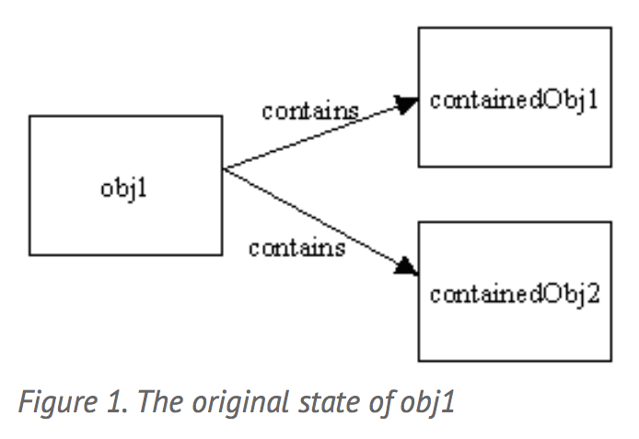
Deep/Shallow Copy

Slide 28
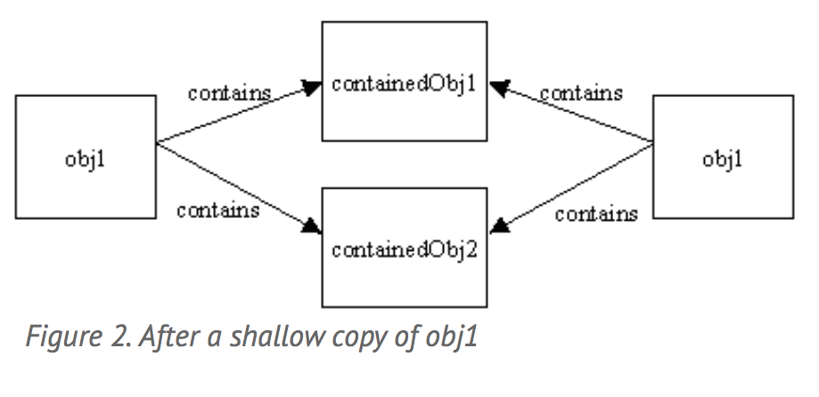
Deep/Shallow Copy

Slide 29
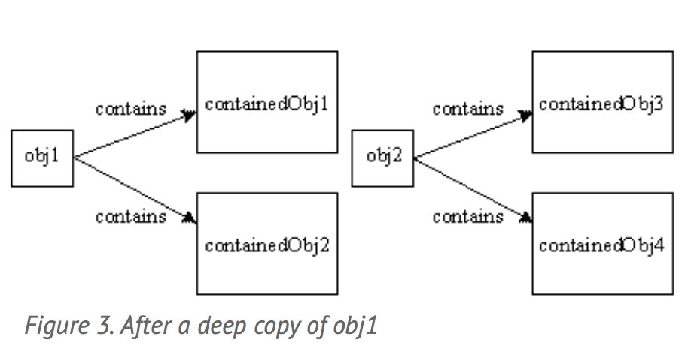
Deep/Shallow Copy

Slide 30
Serialization
Read / write of an object imply:
read/write attributes (and optionally the type) of the object
Correctly separating different elements
When reading, create an object and set all attributes values
These operations (serialization) are automated by
ObjectInputStream
ObjectOutputStream

Slide 31
Serialization
Methods to read/write objects are:
void writeObject(Object)
Object readObject()
ONLY objects implementing interface Serializable can be serialized
This interface is empty. Just used to avoid serialization of objects, without permission of the class developer

Slide 32
Serialization, deep copy
An ObjectOutputStream saves automatically all objects referred by its attributes
objects serialized are numbered in the stream
references are saved like ordering numbers in the stream
If I save 2 objects pointing to a third one, this is saved just once
Before saving an object, ObjectOutputStream checks if it has not been already saved
Otherwise it saves just the reference (as a number)

Slide 33
Serialization, type recovery
When reading, an object is created
... but which is its type?
Down casting to the exact type is useful only to send specific messages
A viable solution could be down casting to a common ancestor

