Slide 1
Java Threads
Università di Modena e Reggio Emilia
Prof. Nicola Bicocchi (nicola.bicocchi@unimore.it)

Slide 2
Process
In operating systems (OS), a process is an instance of a running application
A process has it own private virtual address space, code, data, opened files, etc..
A process also might contain one or more threads that run in the context of the process.

Slide 3
Thread
A thread is the basic entity to which the operating system allocates CPU time. A single process can execute multiple threads.
All threads of a process share address space, global variables, and resources.
A thread can execute any part of application's code, including parts currently being executed by other threads.

Slide 4
Communication
Processes do not share memory (separate address spaces), thus the must communicate through IPC mechanisms offered by the operative systems (i.e., pipes, signals)
Multiple threads belonging to the same process share the same address space. Thus, they do need to explicitly communicate. They can use shared variables. Fast but dangerous!

Slide 5
Multitasking
A multitasking operating system assigns CPU time (slices) to threads
O.S. is preemptive, if a thread is executed until
time slice is over or it ends its execution;
it blocks (synchronization with threads or resources)
another thread acquires more priority execution seems to be parallel
Small time-slices (20ms) provide the illusion of parallelism (on multi-core machines it is a partial illusion)

Slide 6
JVM and Operating System
The JVM gets its turn at the CPU by whatever scheduling mechanism the OS uses
JVM operates like a mini-OS and schedules its own threads
Most JVMs use O.S. scheduler (native threads, a Java thread is actually mapped to a system thread)
Assuming a single processor machine:
Only one thread can actually run at a time.
The order in which runnable threads are chosen to be THE ONE running is NOT guaranteed.

Slide 7
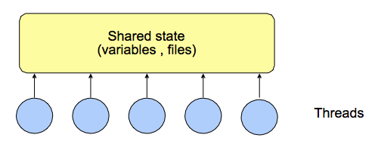
What are threads ?
General-purpose solution for managing concurrency.
Multiple independent execution streams
Shared state

Slide 8
What are threads used for ?
Operating systems: one kernel thread for each user process.
Scientific applications: one thread per CPU (solve problems more quickly).
Distributed systems: process requests concurrently (overlap I/Os).
GUIs:
Threads correspond to user actions; they can help display during long-running computations. Multimedia, animations.

Slide 9
Why threads ?
Imagine a stock-broker application with a lot of complex capabilities:
download last stock option prices
check prices for warnings
analyze historical data for company

Slide 10
Single-threaded scenario
In a single-threaded runtime environment, these actions execute one after another
The next action can happen only when the previous one is finished.
If a historical analysis takes half an hour, and the user selects to perform a download and check afterward…
…the result may come too late to buy or sell the stock

Slide 11
Multi-threaded scenario
In a multi-threated scenario
the download can execute in background (i.e. in another thread).
other processes could execute at the same time e.g. a notification could be fired instantly, while the user is interacting with other parts of the application (remember your phone?)
The analysis, too, can execute in a separate thread, so the user can work in the rest of the application while the results are being calculated.

Slide 12
The good
Enable parallelism
Lighter than processes (i.e., fork(), pipe(), …)

Slide 13
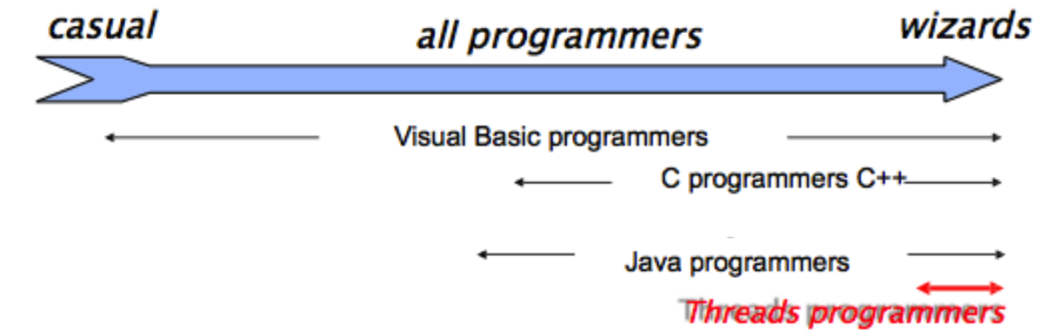
The bad
Hard for most programmers
Even for experts, development is painful
Threads break abstraction: can't design modules independently.

Slide 14
How to create a Thread
Threads can be created by extending Thread and overriding the run() method.
Thread objects can also be created by passing to the Thread class constructor a Runnable object (the target of the thread)
It is legal to create many Thread objects using the same Runnable object as the target.

Slide 15
How to create a Thread
Extending Thread class
Class T extends Thread {}
\\ write code into the run() method (override)
T t = new T();
t.start();
Implementing Runnable interface (better)
Class R implements Runnable {
public void run() {
//code here
}
}
Thread t = new Thread(new R);
t.start();

Slide 16
Example: extends Thread
class Counter extends Thread {
private int n;
String name;
public Counter(String name, int n) {
this.name = name;
this.n = n;
}
public void run() {
for(int i=0; i<num; ++i)
System.out.println(“name :” + i);
}
}
}

Slide 17
Example: implements Runnable
class Counter2 implements Runnable {
private String name;
private int n;
public Counter(String name, int n) {
this.name = name; this.n = n;
}
public void run() {
for(int i=0; i<num; ++i)
System.out.println(“name :” + i);
}
}

Slide 18
Starting a Thread
When a Thread object is created, it does not start executing until its start() method is invoked.
When a Thread object exists but hasn't been started, it is in the new state and is not considered alive.
Method start() can be called on a Thread object only once. If start() is called more than once on same object, it will throw a RuntimeException

Slide 19
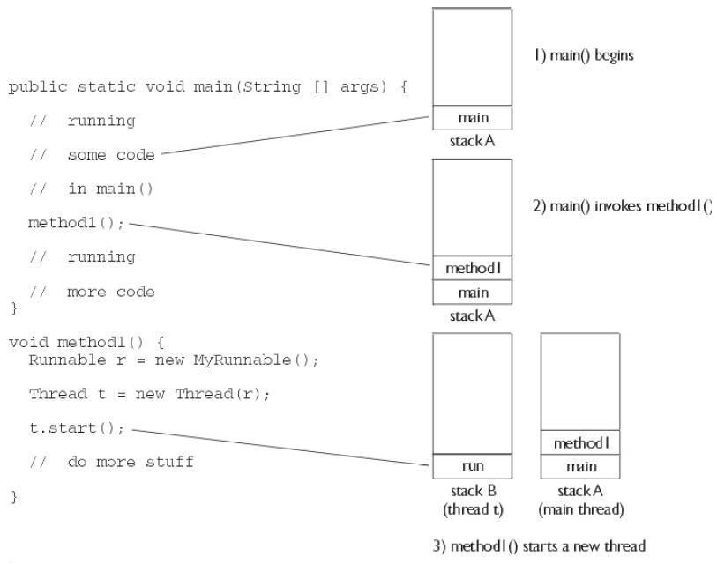
Starting a Thread

Slide 20
Running multiple threads
class Counter implements Runnable {
public void run() {
for(int i=0; i<10; i++)
System.out.println(Thread.currentThread().getName());
}
}
public class Runner{
public static void main(String[] args) {
Thread t1 = new Thread(new Counter());
Thread t2 = new Thread(new Counter());
Thread t2 = new Thread(new Counter());
t1.setName(“Abramo”); t2.setName(“Luisa”); t3.setName(“Elvira”);
t1.start(); t2.start(); t3.start();
}
}

Slide 21
Running multiple threads
It is not guaranteed that threads will start running in the order they were started
It is not guaranteed that a thread keeps executing until it's done (it is not guaranteed that its loop completes before another thread begins)
Nothing is guaranteed except:
Each thread will start, and each thread will run to completion, hopefully.

Slide 22
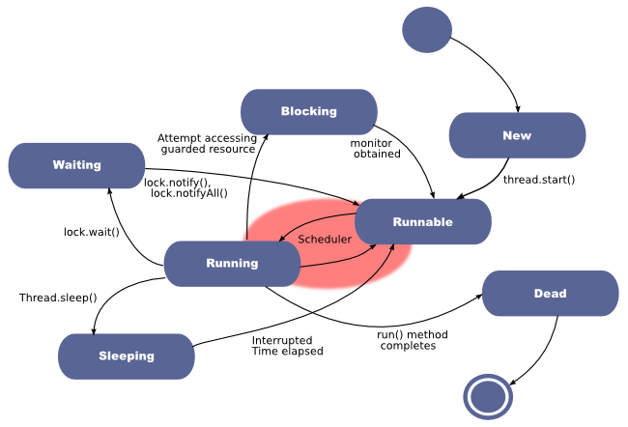
Thread states

Slide 23
Thread state: Running
This is the state a thread is in when the thread scheduler selects it (from the runnable pool) to be the currently executing process.
A thread can transition out of a running state for several reasons, including because “the thread scheduler decided it”
Only one way to get to the running state: the scheduler chooses a thread from the runnable pool.

Slide 24
Thread state: Runnable
A thread is queued & eligible to run, but the scheduler has not selected it to be the running thread
A thread first enters the runnable state when the start() method is invoked
A thread can also return to the runnable state after either running or coming back from a blocked, waiting, or sleeping state
When the thread is in the runnable state, it
is considered alive

Slide 25
Thread state: Blocking
This is the state a thread is in when it is NOT eligible to run.
It might return to a runnable state later if a particular event occurs.
A thread may be blocked waiting for a resource ( I/O or an object's lock) e.g.:
if data comes in through the input stream the thread code is reading from
the object's lock suddenly becomes available.

Slide 26
Thread state: Sleeping
A thread may be sleeping because the thread's run() code tells it to sleep for some period of time,
Back to Runnable state when it wakes up because its sleep time has expired.
try {
Thread.sleep(5*60*1000); // Sleep for 5 min
} catch (InterruptedException ex) { }

Slide 27
Thread state: Waiting
A thread run code causes it to wait
It comes back to Runnable state when another thread sends a notification
Used for synchronization
Note Well: one thread does not tell another thread to block. The OS does!

Slide 28
Thread priority
By default, a thread gets the priority of the thread creating it.
Priority values are defined between 1 and 10
Thread.MIN_PRIORITY (1)
Thread.NORM_PRIORITY (5)
Thread.MAX_PRIORITY (10)
Priority can be directly set
FooRunnable r = new FooRunnable();
Thread t = new Thread(r);
t.setPriority(8);
t.start();

Slide 29
JVM scheduling policy
A thread always runs with a priority number
The scheduler in most JVMs uses time-sliced, preemptive, priority-based scheduling
each thread is allocated a fair amount of time, after that it is sent back to runnable to give another thread a chance
JVM specification does not require a VM to implement a time-slicing scheduler !
some JVM may use a scheduler that lets one thread stay running until it completes its run() method

Slide 30
Checking JVM scheduler
public class Hamlet implements Runnable {
public void run(){
while(true)
System.out.println(Thread.currentThread().getName());
}}
public class TryHamlet {
public static void main(String argv[]) {
Hamlet r = new Hamlet ();
new Thread(r, “To be”).start();
new Thread(r, “Not to be”).start();
}}
If non-preemptive the thread chosen first run forever and it never releases CPU
If preemptive threads randomly alternate on output

Slide 31
Leaving the running state (explicitly)
There are 3 ways for a thread to do it:
sleep(): guaranteed to cause the current thread to stop executing for at least the specified sleep duration
yield(): the currently running thread moves back to runnable, to give room to other threads with same priority
join(): stop executing until the thread it joins with completes

Slide 32
join()
The join() method lets one thread "join onto the end” of another thread.
Thread t = new Thread();
t.start();
t.join( );
Current thread (caller) move to Waiting state and it will be Runnable when thread t is dead. A timeout can be set to wait for a thread’s end
t.join(5000);
// wait t for 5 seconds: if t is not finished
// then current thread is Runnable again

Slide 33
yield()
The method yield() make the currently running thread back to Runnable state
It allows other threads of the same priority to get their turn (e.g., because computation is terminated)
yield() will cause a thread to go from running to runnable, but it might have no effect at all
There's no guarantee the yielding thread won't just be chosen again over all the others!

Slide 34
yield()
Code is less dependent from the scheduler type, because threads release CPU when needed.
Used when computation is not possible in a specific time slice.
public class Hamlet implements Runnable {
public void run() {
while (true){
System.out.println(Thread.currentThread().getName()); Thread.yield(); // allow other thread to run
}
}

Slide 35
sleep()
try {
// Sleep for 5 min
Thread.sleep(5 * 60 * 1000);
} catch (InterruptedException ex) {
//
}

Slide 36
A word of advice
Some methods may look like they tell another thread to block, but they don't.
If t is a thread object reference, you can write something like: t.sleep() or t.yield()
However, they are static methods of the Thread class:
they don't affect the instance t !!!
instead they affect the thread in execution
That’s why it's a bad idea to use an instance variable to access a static method ;)

Slide 37
Leaving the running state (implicitly)
There are 4 cases when JVM scheduler does it:
The thread's run() method completes
The thread scheduler can decide to move the current thread from running to runnable in order to give another thread a chance to run
Thread calls wait() on an object
A thread can't acquire the lock on the object

