Slide 1
Java Swing
Università di Modena e Reggio Emilia
Prof. Nicola Bicocchi (nicola.bicocchi@unimore.it)

Slide 2
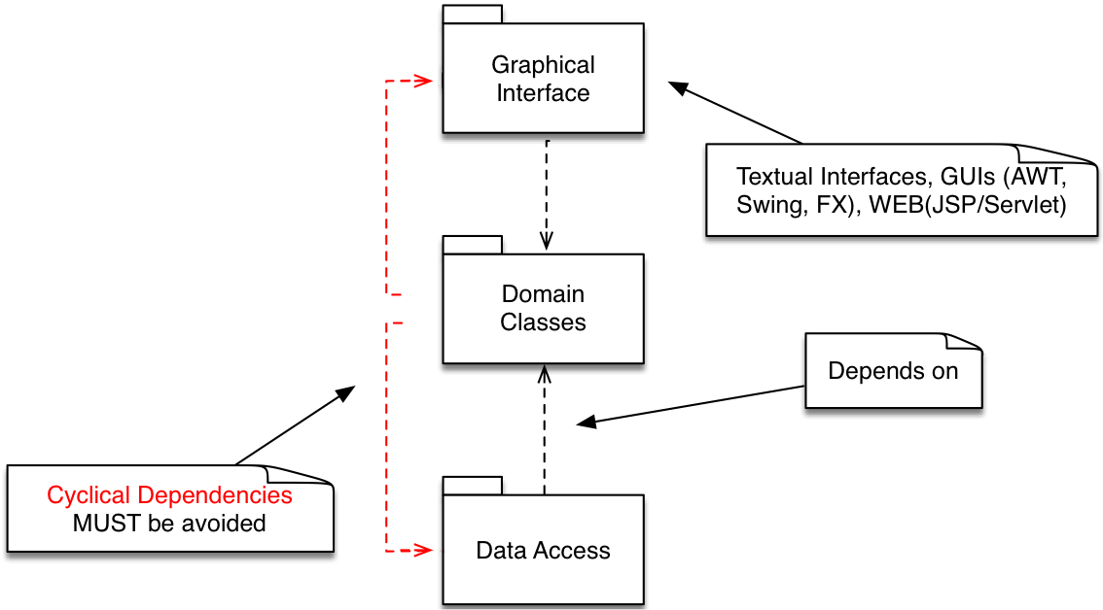
Software Design

Slide 3
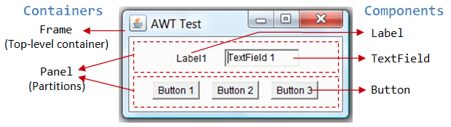
Containers and components

Slide 4
Package java.awt.*
Provides:
Components (button, checkbox, scrollbar, etc.)
Containers (they are still components)
Event management:
System-generated events
UI-generated events
Layout management

Slide 5
Package javax.swing.*
Contains the same components of java.awt, but with different names (JButton, JFrame, etc.)
All these components derive from JComponent
Advantages:
provides a series of components light-weight with the same appearance/behavior on all platforms
look and feel changeable on the flight
Swing it is an extension of AWT. However management of the events in the two packages is different

Slide 6
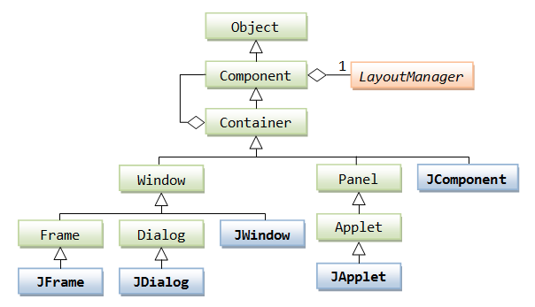
Class hierarchy

Slide 7
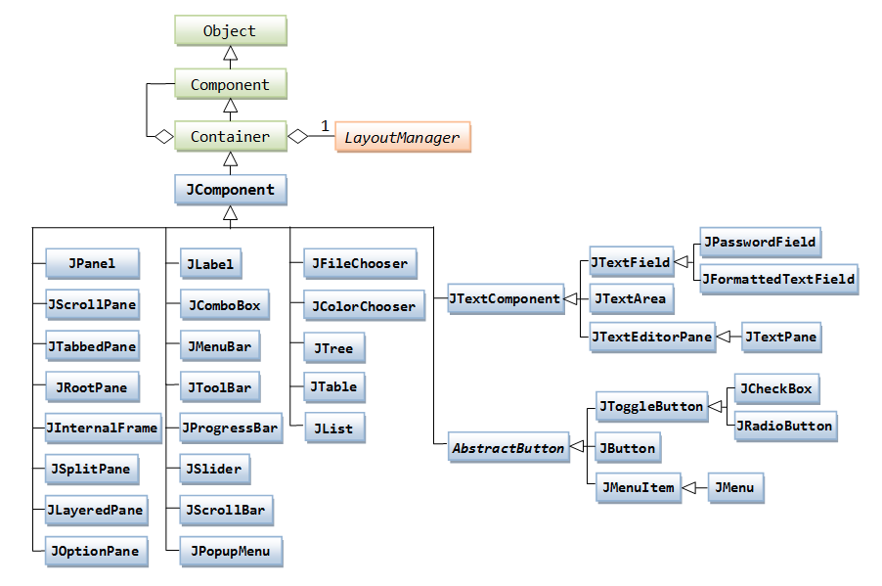
Class hierarchy

Slide 8
Graphical Programming
Set a Look & Feel (= Style)
Microsoft Windows, Mac, Java Metal
Define one (or more) top-level container
JFrame, JDialog, JApplet
Add components to the containers
JButton, JComboBox, JSlider, …
Arrange the components within layouts

Slide 9
Graphical Programming
Set Look & Feel
Define top-level container
Add component
Add secondary container

Slide 10
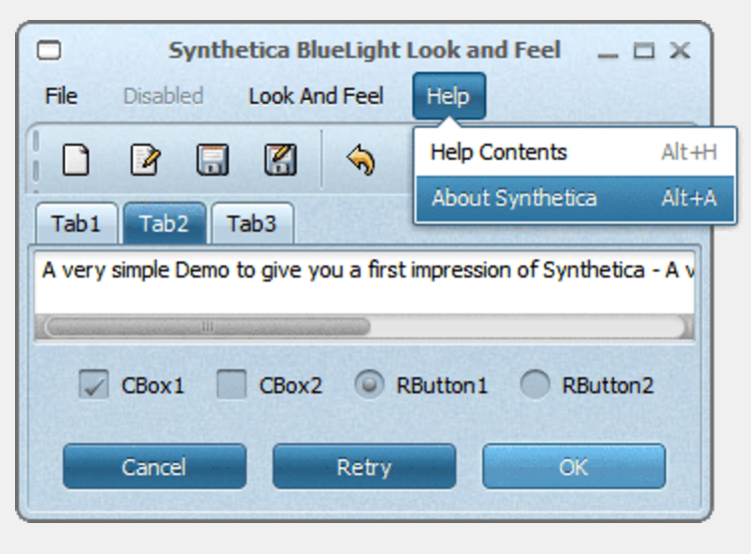
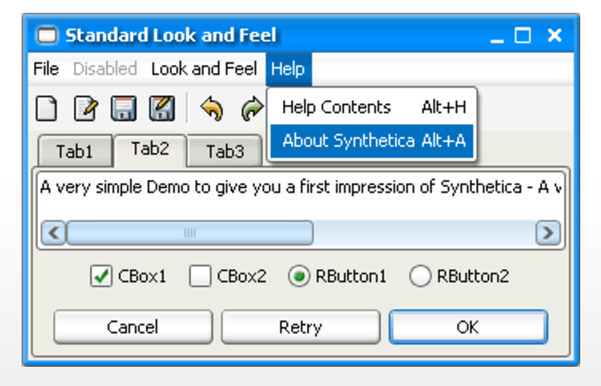
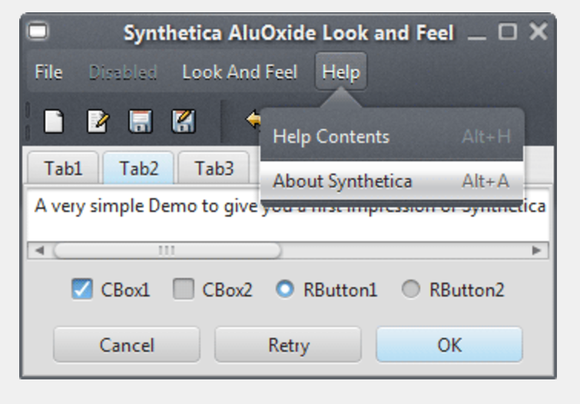
Look & Feel

Slide 11
Look & Feel
UIManager manages the current look and feel!
*http://www.jyloo.com/synthetica/themes/
// Set Metal L&F
UIManager.setLookAndFeel("javax.swing.plaf.metal.MetalLookAndFeel");
// Set Motif L&F UIManager.setLookAndFeel("com.sun.java.swing.plaf.motif.MotifLookAndFeel");
// Set Windows L&F UIManager.setLookAndFeel("com.sun.java.swing.plaf.windows.WIndowsLookAndFeel");

Slide 12

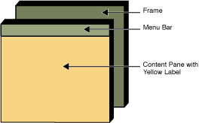
Top-level container: JFrame

Slide 13
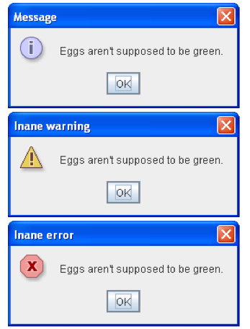
Top-level container: JDialog

Slide 14
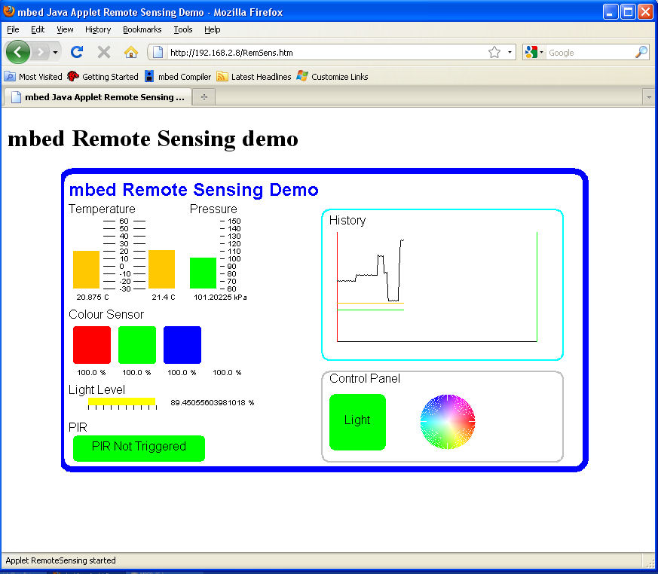
Top-level container: JApplet (deprecated)

Slide 15
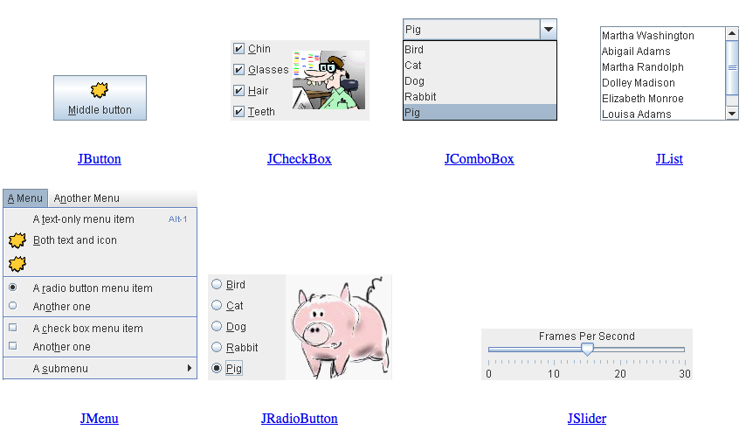
Components, a visual guide
http://web.mit.edu/6.005/www/sp14/psets/ps4/java-6-tutorial/components.html

Slide 16
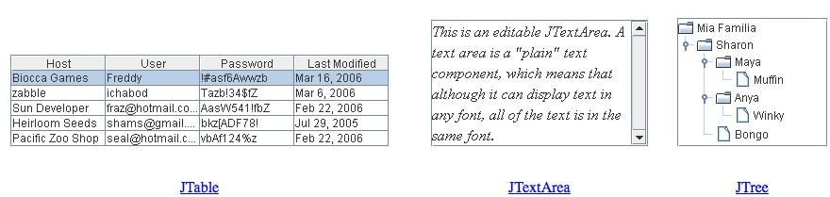

Components, a visual guide
http://web.mit.edu/6.005/www/sp14/psets/ps4/java-6-tutorial/components.html

Slide 17
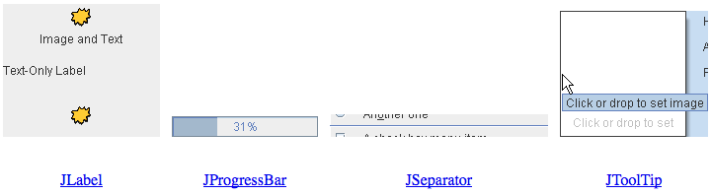
Components, a visual guide
http://web.mit.edu/6.005/www/sp14/psets/ps4/java-6-tutorial/components.html

Slide 18
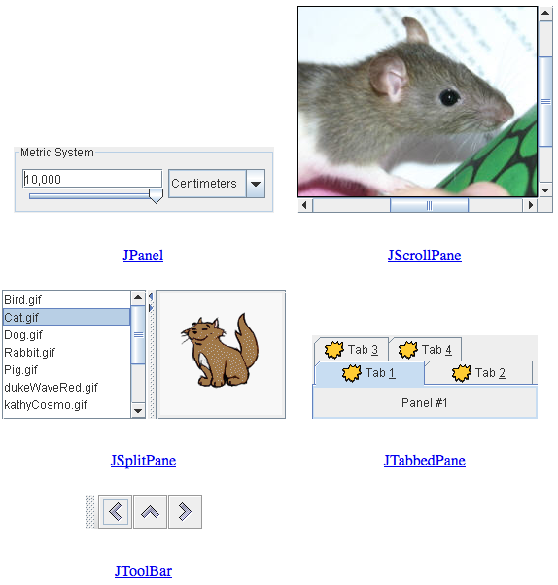
Components, a visual guide
http://web.mit.edu/6.005/www/sp14/psets/ps4/java-6-tutorial/components.html

Slide 19
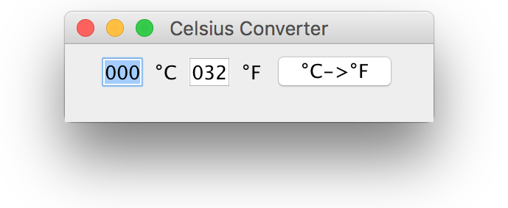
A complete example
public class CelsiusConverterBasic extends JFrame {
private static final long serialVersionUID = 1L;
private JButton CFButton;
private JTextField fahrenheitTF, celsiusTF;
public CelsiusConverterBasic() {
super("Celsius Converter");
celsiusTF = new JTextField("000");
fahrenheitTF = new JTextField("032");
CFButton = new JButton("°C->°F");
JPanel p1 = new JPanel();
p1.add(celsiusTF);
p1.add(new JLabel("°C"));
p1.add(fahrenheitTF);
p1.add(new JLabel("°F"));
p1.add(CFButton);
add(p1);
setDefaultCloseOperation(WindowConstants.EXIT_ON_CLOSE);
setSize(250, 75);
setVisible(true);
}
}

Slide 20
JFrame basic functions
setDefaultCloseOperation(WindowConstants)
EXIT_ON_CLOSE
DO_NOTHING_ON_CLOSE
DISPOSE_ON_CLOSE
HIDE_ON_CLOSE
setSize(int base, int height)
defines the dimensions of the component
setVisible(boolean visibility)
defines the visibility status of the component
primarycontainer.setcontentpane(secondarycontainer)
insert the secondary container in primary

Slide 21
Running it!
// Ok
public static void main(String[] args) {
new CelsiusConverter();
}
// Better
public static void main(String[] args) {
EventQueue.invokeLater(new Runnable() {
@Override
public void run() {
new CelsiusConverter();
}
});
}

Slide 22
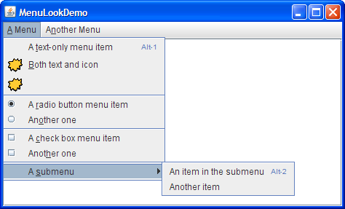
Swing Menus

Slide 23
Swing Menus
Three components are involved in a hierarchical fashion:
JMenuBar, JMenu, JMenuItem
JMenuItem openFile = new JMenuItem("Open");
JMenuItem closeFile = new JMenuItem("Close");
JMenu file = new JMenu("File");
file.add(openFile);
file.add(closeFile);
JMenuBar menuBar = new JMenuBar();
menuBar.add(file)
setJMenuBar(menuBar);

Slide 24
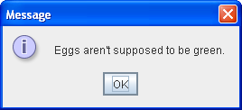
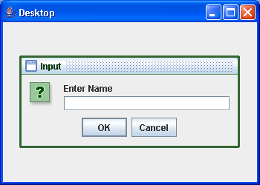
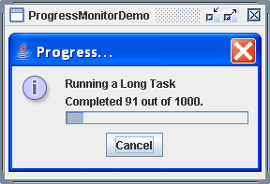
JDialog
Applications need to provide information, advise the user, etc.

Slide 25
JDialog
Dialogs are a better choice than instantiating other JFrames!
Every dialog is dependent on a top-level container.
Dialogs are all instances of JDialog, even though the majority is done using helper classes (e.g., JOptionPane).

Slide 26
How to make Dialogs
Subclassing JDialog (top-level container) and defining your own layouts.
Using JOptionPane. You can quickly create and customize several different kinds of dialogs. JOptionPane provides support for laying out standard dialogs, providing icons, specifying the dialog title and text, and customizing the button text.

Slide 27
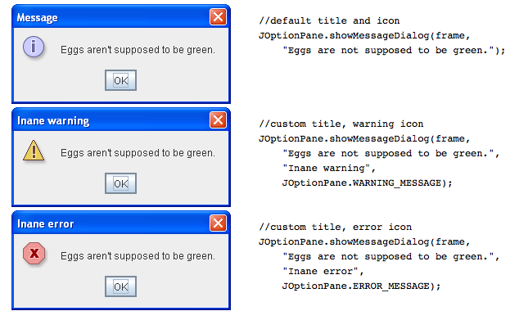
JOptionPane.showMessageDialog()

Slide 28
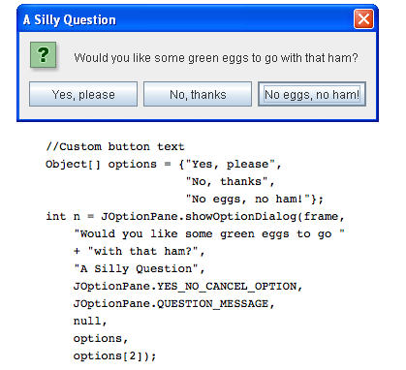
JOptionPane.showOptionDialog()
Displays a modal dialog with the specified buttons, icons, message, title, and so on. With this method, you can change the text that appears on the buttons of standard dialogs. You can also perform many other kinds
of customization.

Slide 29
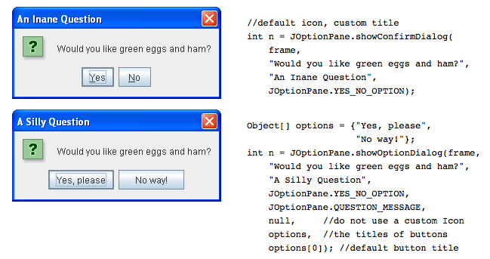
JOptionPane.showConfirmationDialog()

Slide 30
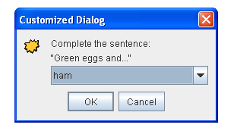
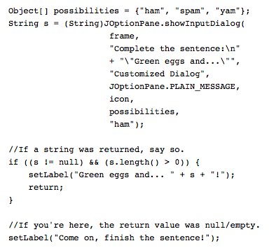
JOptionPane.showInputDialog()

Slide 31
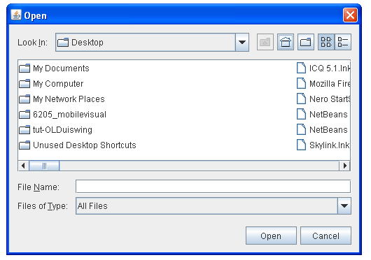
JFileChooser
Provides a GUI for navigating the file system. Could be used as both:
static method (modal)
instance of JFileChooser

Slide 32
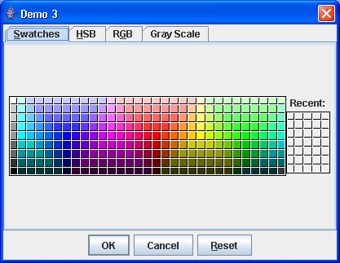
JColorChooser
Provides a GUI for navigating color spaces.

Slide 33
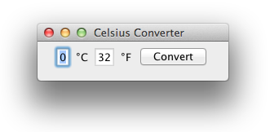
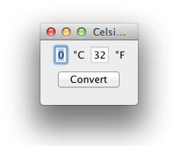
What is a layout?
Default GUIs, when resized, allow the relocation of the components:
this behavior is a necessity: Java adapts to many platforms (display in different ways)

Slide 34
Layout Manager
A layout manager determines the disposal of the components in a container
Flow, Border, Grid, GridBag, Card Layouts
Panels are containers supporting layouts
Different panels can have different layouts
Layouts are passed to constructors
Methodology:
JPanel panel = new JPanel(new GridLayout(2,2));
panel.add(JButton); (…)

Slide 35
Layout Manager - FlowLayout
It is the default layout (e.g., new JPanel())
Disposes components from left to right, starting from the left most corner in the top
Constructors:
FlowLayout f = new FlowLayout();
FlowLayout f = new FlowLayout(int align);
FlowLayout f = new FlowLayout(int align, int hgap, int vgap);
Constructors parameters:
align: Alignment of basis (FlowLayout.LEFT, FlowLayout.RIGHT, FlowLayout.CENTER)
hgap: Horizontal space between components (default: 3 pixel)
vgap: Vertical space between components (default: 3 pixel)

Slide 36
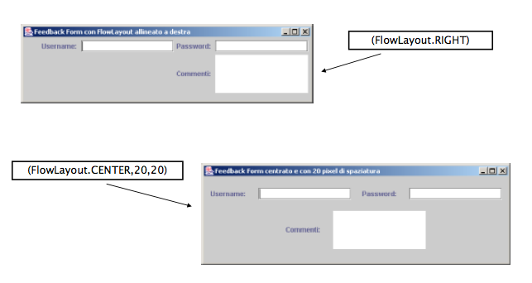
Layout Manager - FlowLayout

Slide 37
Layout Manager - BorderLayout
Splits into five areas (“North”, “South”, “East”, “West”, “Center”).
Constructors:
BorderLayout b = new BorderLayout();
BorderLayout b = new BorderLayout(int1, int2);
int1, int2 are the spaces between the components related horizontal and vertical
The filling is “targeted”:
JPanel panel = new JPanel(new BorderLayout()); panel.add(BorderLayout.PAGE_START”, b1);
panel.add(BoarderLayout.PAGE_END, b2);

Slide 38
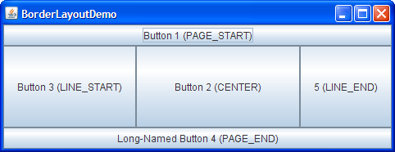
Layout Manager - BorderLayout

Slide 39
Layout Manager - GridLayout
Splits the visual area in a grid of rows and columns
Starts from the box in the top left
Constructors:
GridLayout g = new GridLayout(int rows, int cols);
GridLayout g = new GridLayout(rows, cols, hgap, vgap);
Constructors parameters:
rows: number of row; cols: number of columns;
hgap: Spacing (in pixels) between two horizontal boxes (default: 0 pixel)
vgap: spacing (in pixel) between two vertical boxes (default: 0 pixel)

Slide 40
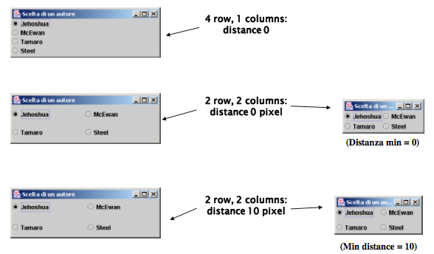
Layout Manager - GridLayout

Slide 41
Layout Manager - GridBagLayout
Extension of GridLayout. Makes it possible to adjust the elements of the grid
Methodology:
JPanel pane = new JPanel(new GridBagLayout());
GridBagConstraints c = new GridBagConstraints();
//For each component to be added to this container:
//...Create the component...
//...Set instance variables in the GridBagConstraints instance...
pane.add(theComponent, c);

Slide 42
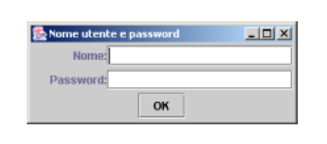
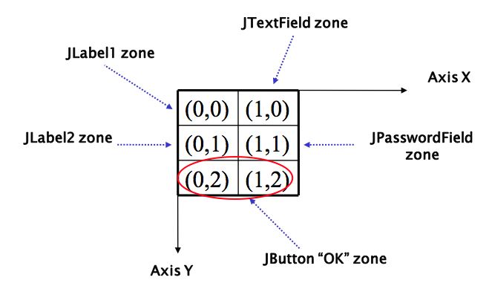
Layout Manager - GridBagLayout

Slide 43
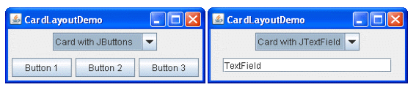
Layout Manager - CardLayout
CardLayout allows to have different panels in the frame, but only one showed at time
￼￼￼￼￼the panels are called cards
Methodology:
JPanel p = new JPanel(new CardLayout());
p.add(“Panel1”, new JPanel());
p.add(“Panel2”, new JPanel());

