Slide 1
Java Swing Events
Università di Modena e Reggio Emilia
Prof. Nicola Bicocchi (nicola.bicocchi@unimore.it)

Slide 2
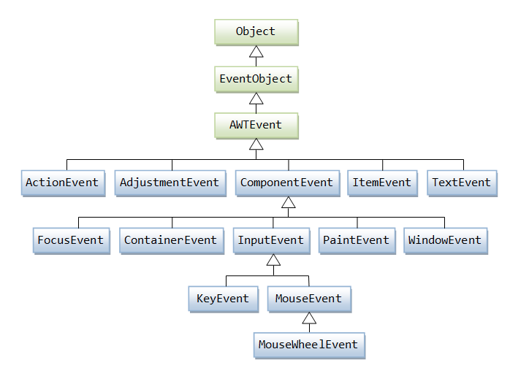
EventObject

Slide 3
Event Delegation Model
Events are classified by type
MouseEvent, KeyEvent, ActionEvent
Events are generated in components (source)
Listeners (target) can be registered to components
Whenever an event occurs, the event thread send a message to all the registered listeners (the event is passed as a parameter)
Listeners must implement appropriate interfaces to make the callback mechanism possible

Slide 4
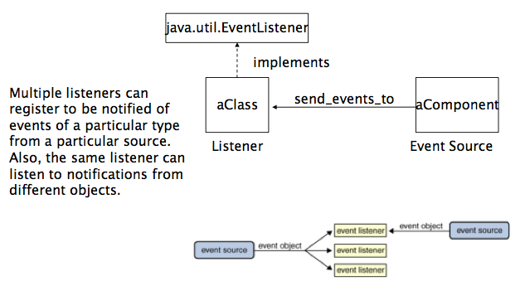
Event Delegation Model

Slide 5
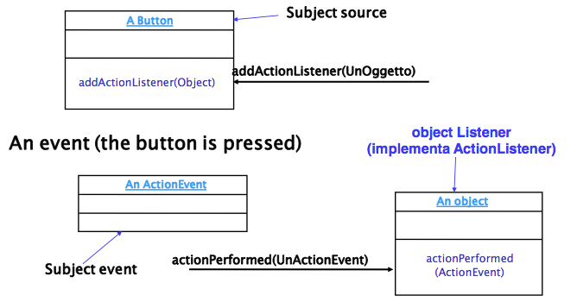
Example

Slide 6
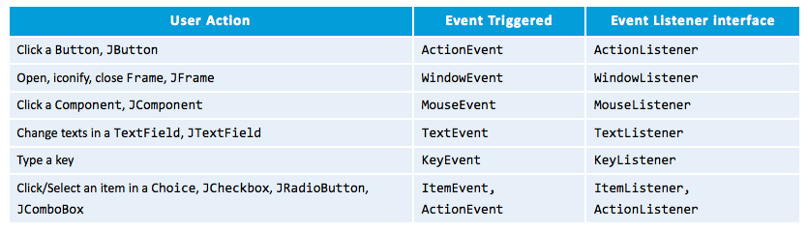
Event Delegation Model
Events are organized by type and need specific listeners

Slide 7
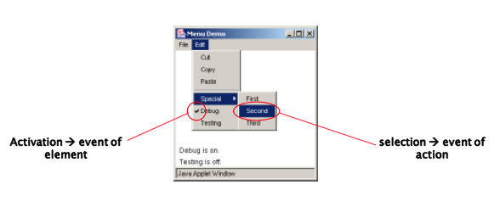
“selection” and “activation”

Slide 8
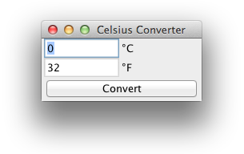
A complete example
import java.awt.*;
import java.awt.event.*;
import javax.swing.*;
public class CelsiusConverter extends JFrame implements ActionListener {
private JButton convertButton;
private JTextField fahrenheitLabel;
private JTextField tempTextField;
public CelsiusConverter() {
super("Celsius Converter");
tempTextField = new JTextField("0");
fahrenheitLabel = new JTextField("32");
fahrenheitLabel.setEditable(false);
convertButton = new JButton("Convert");
convertButton.addActionListener(this);
JPanel p = new JPanel();
p.setLayout(new GridLayout(2, 2));
p.add(tempTextField); p.add(new JLabel("°C"));
p.add(fahrenheitLabel); p.add(new JLabel("°F"));

Slide 9
A complete example
setLayout(new BorderLayout());
add(p, BorderLayout.CENTER);
add(convertButton, BorderLayout.SOUTH);
setDefaultCloseOperation(WindowConstants.EXIT_ON_CLOSE);
setSize(200, 100);
setVisible(true);
}
public void actionPerformed(ActionEvent e) {
int tempFahr = (int)
((Double.parseDouble(tempTextField.getText())) * 1.8 + 32);
fahrenheitLabel.setText(Integer.toString(tempFahr));
}
public static void main(String[] args) {
new CelsiusConverter();
}
}

Slide 10
How to manage events in Java
The principle underlying the events is quite similar to the exceptions :
the class declares which event is able to deal with (one or more) by implementing one or more interfaces
joins a component that are source of events (JButton, JTextField, etc..)
JButton.addActionListener(this)
Pay attention!You're implementing interfaces, so you must overwrite all methods of those interfaces!

Slide 11
How to manage events in Java
Components can:
Handle events on their own
Delegate events to their parent class
Delegate events to external classes

Slide 12
Handle events on their own
class ButtonWithEvents extends JButton implements InterfaceWithEvents {
addListener(this);
void methodOfTheInterfaceWithEvents() {...}
void anotehrMethodOfTheInterfaceWithEvents() {...}
} //end class

Slide 13
Delegate events to their parent class
class FrameWithEvents extends JFrame implements InterfaceWithEvents {
JComponent componentSourceofEvents = new JComponent();
componentSourceOfEvents.addListener(this);
void methodOfTheInterfaceWithEvents() {...}
void anotehrMethodOfTheInterfaceWithEvents() {...}
} //end class

Slide 14
Delegate events to external classes
class MyListener implements InterfaceWithEvents {
void methodOfTheInterfaceWithEvents() {...}
void anotehrMethodOfTheInterfaceWithEvents() {...}
} //end class
class Frame extends JFrame {
MyListener listener = new MyListener();
JComponent componentSourceofEvents = new JComponent();
componentSourceOfEvents.addListener(listener);
} //end class

Slide 15
Dealing with multiple sources
getSource() and object references
if (evt.getSource() == ButtonSelfDestruction ) {}
getActionCommand() and custom strings
If (evt.getActionCommand() == “destroy”) {}
Event classes
If (evt instanceof(KeyEvent)) {}

Slide 16
Extracting information from events
Every function that appears at the interfaces presents a common argument (KeyEvent, MouseEvent, etc.)
Each argument is an object and it provides methods to get information about the event
ActionListener
String getActionCommand(): returns a string identifying the component which generated the command
String paramString(): returns a string describing the event type (common to all event objects)

Slide 17
Event Interfaces
ActionListener
void actionPerformed (ActionEvent evt)
FocusListener
void focusGained (FocusEvent evt)
void focusLost (FocusEvent evt)
ItemListener
void itemStateChanged (ItemEvent evt)

Slide 18
Event Interfaces
MouseListener
void mouseClicked (MouseEvent evt)
void mouseEntered (MouseEvent evt)
void mouseExited (MouseEvent evt)
void mousePressed (MouseEvent evt)
void mouseReleased (MouseEvent evt)
MouseMotionListener
void mouseDragged (MouseEvent evt)
void mouseMoved (MouseEvent evt)

Slide 19
Event Interfaces
KeyListener
void keyPressed (KeyEvent evt)
void keyReleased(KeyEvent evt)
void keyTyped(KeyEvent evt)
WindowListener
void windowActivated(WindowEvent evt)
void windowClosed (WindowEvent evt)
void windowClosing (WindowEvent evt)
void windowDeactivated (WindowEvent evt)
void windowDeiconified (WindowEvent evt)
void windowIconified (WindowEvent evt)
void windowOpened (WindowEvent evt)

