Slide 1
REST (Representational State Transfer)
Università di Modena e Reggio Emilia
Prof. Nicola Bicocchi (nicola.bicocchi@unimore.it)

Slide 2
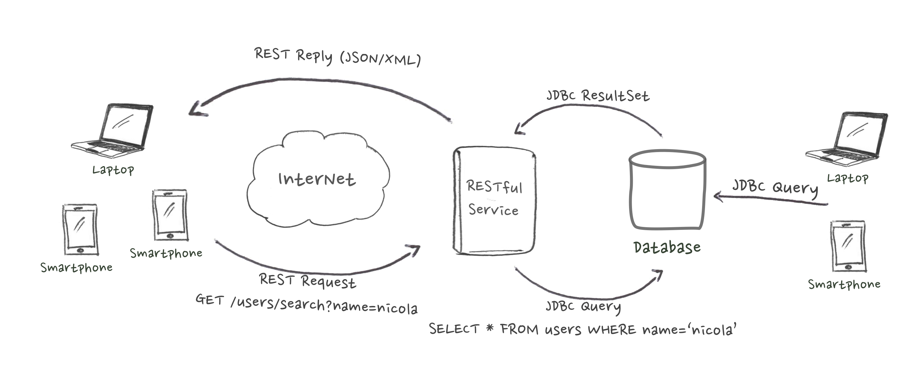
Why Learn REST?
REST is primarily used to build Web services that are lightweight, maintainable, and scalable.
Decouple applications to vendor-specific details (e.g., JDBC) and prevent exposing DMBS to untrusted networks (e.g. Internet)

Slide 3
Why Learn REST?
REST is primarily used to build Web services that are lightweight, maintainable, and scalable.
A number of mobile apps are built upon RESTful services.
Every major development language includes frameworks for building RESTful Web services (e.g., RESTLet for Java).

Slide 4
Major Concepts
Resources
Representations
Messages
URIs
Stateless

Slide 5
Resources
Every system uses resources. Resources can be pictures, videos, users data ecc... The purpose of a service is to provide an access to resources to its clients. Service architects and developers want services to be easy to implement, maintainable, extensible, and scalable.

Slide 6
Resources
Place details
https://api.foursquare.com/v2/venues/VENUE_ID
Photos details
https://api.foursquare.com/v2/photos/PHOTO_ID
Search for a user
https://api.foursquare.com/v2/users/search
Recent checkins by friends
https://api.foursquare.com/v2/checkins/recent

Slide 7
Representations
The focus of a RESTful service is on resources and how to provide access to these resources. A resource can be thought of as an object as in OOP. A resource can consist of other resources.
While designing a system, the first thing to do is identify the resources and determine how they are related to each other.
This is similar to designing a database: Identify entities and relations.

Slide 8
Representations
Once we have identified our resources, the next thing we need is to find a way to represent these resources.
You can use any format for representing the resources, as REST does not put a restriction on the format of a representation. Nevertheless, the most used representations are XML and JSON

Slide 9
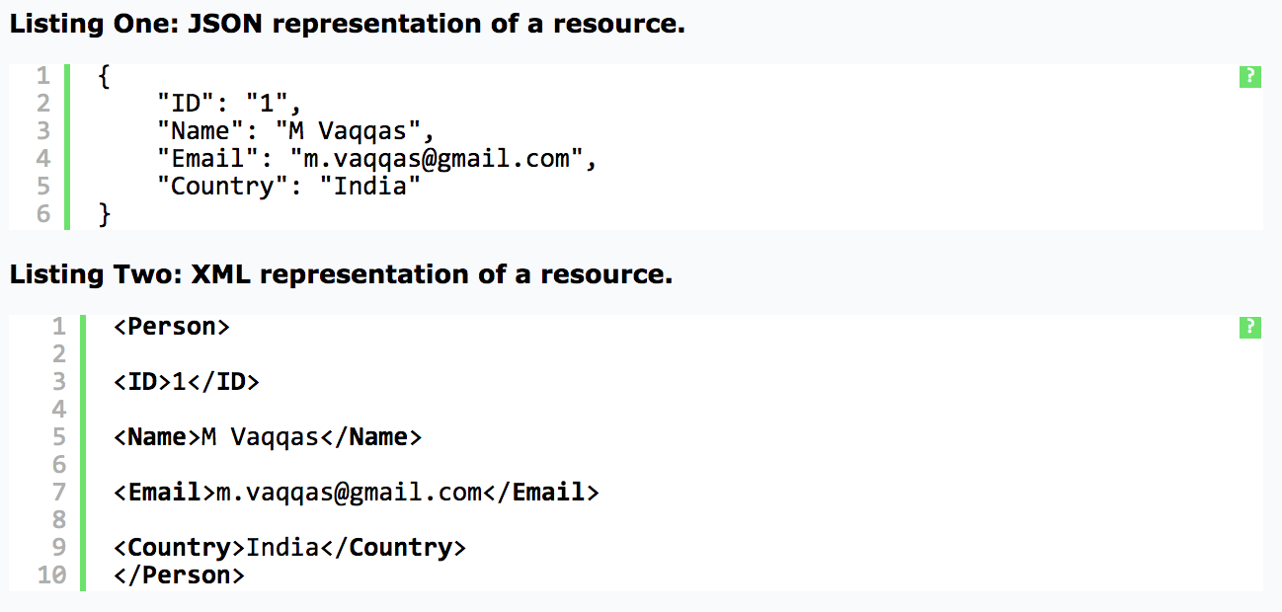
Representations

Slide 10
Messages
The client and service talk to each other via messages. Clients send a request to the server, and the server replies with a response. Apart from the actual data, these messages also contain some metadata about the message.
It is important to have some background about the HTTP 1.1 request and response formats for designing RESTful Web services.

Slide 11
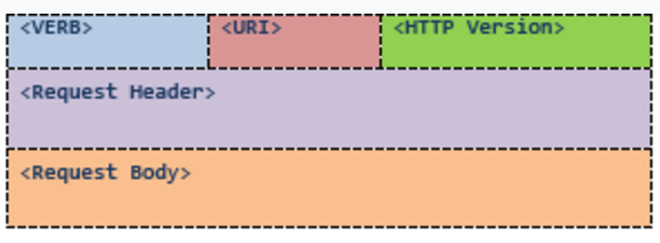
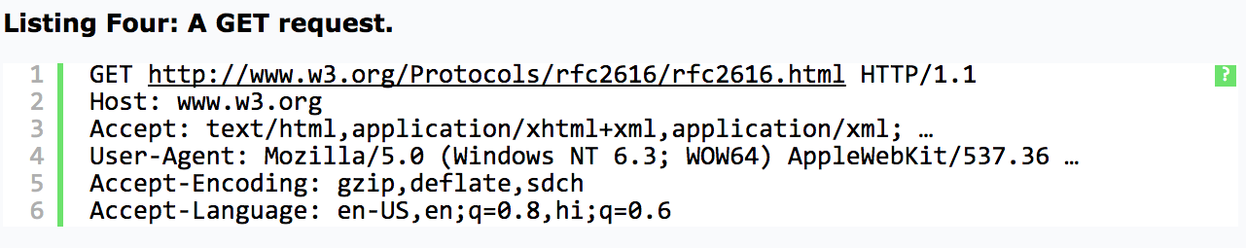
Messages (HTTP Request)
HTTP/1.1 Request

Slide 12
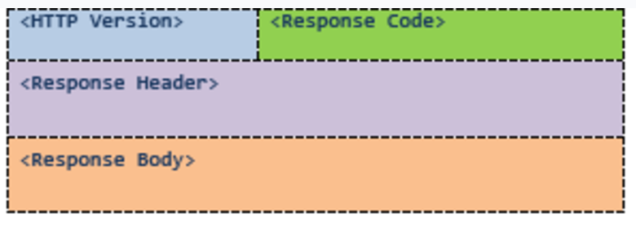
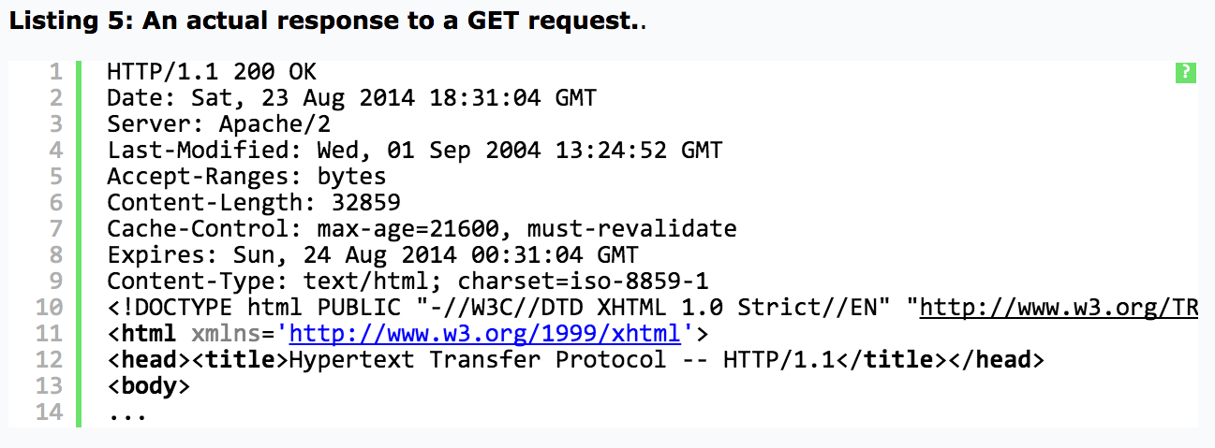
Messages (HTTP Response)
HTTP/1.1 Response

Slide 13
HTTP Verbs (Operations)
HTTP Verbs (see HTTP Request) define operations on specific resources.
GET /users/145 (retrieve user 145)
DELETE /users/145 (delete user 145)
POST /users/ (add a new user)
PUT /users/17 (update user 17)

Slide 14
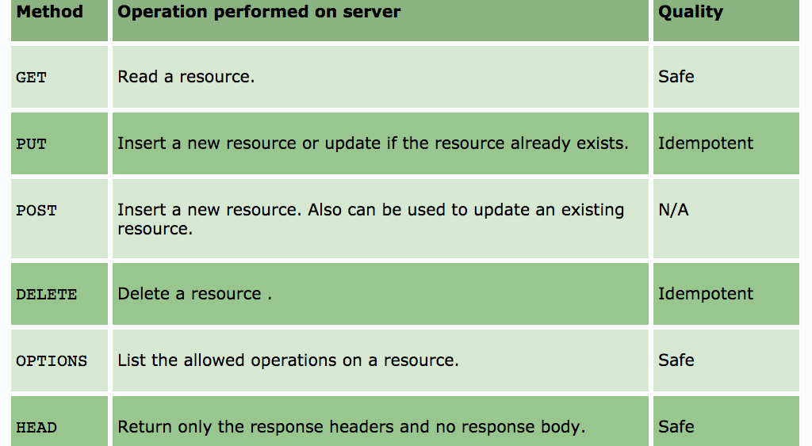
HTTP Verbs (Operations)

Slide 15
Safe and Idempotent
A Safe HTTP method does not make any changes to the resource on the server.
An Idempotent HTTP method has same effect no matter how many times it is performed.
Classifying methods as Safe and Idempotent makes it easy to predict the results in the unreliable environment of the Web where the client may fire the same request again.

Slide 16
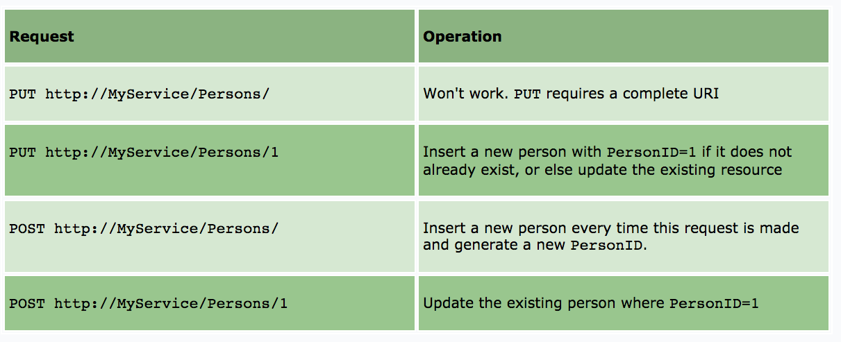
PUT and POST

Slide 17
PUT and POST
There is no difference between PUT and POST if the resource already exists, both update the existing resource.
The third request (POST http://MyService/Persons/) will create a resource each time it is fired.
A lot of developers think that REST does not allow POST to be used for update operation; however, REST imposes no such restrictions.

Slide 18
Addressing resources (URIs)
REST requires each resource to have at least one URI. A RESTful service uses a directory hierarchy like human readable URIs to address its resources. The job of a URI is to identify a resource or a collection of resources. The actual operation is determined by an HTTP verb. The URI should not say anything about the operation or action.
Suppose we have a database of persons and we wish to expose it to the outer world through a service. http://MyService/Persons/1
Protocol://ServiceName/ResourceType/ResourceID

Slide 19
Addressing resources (URIs)
Use plural nouns for naming your resources.
Avoid using spaces as they create confusion. Use an _ (underscore) or – (hyphen) instead.
A URI is case insensitive. I use camel case in my URIs for better clarity. You can use all lower-case URIs.
A cool URI never changes; so give some thought before deciding on the URIs for your service. If you need to change the location of a resource, do not discard the old URI and redirect the client to the new location.
Avoid verbs for your resource names until your resource is actually an operation or a process. Verbs are more suitable for the names of operations.

Slide 20
Query parameters
The basic purpose of query parameters is to provide parameters to an operation that needs the data items.
http://MyService/Persons/1?format=json
http://MyService/Persons/search?name=‘nicola’
Including the parameters format and encoding here in the main URI in a parent-child hierarchy will not be logically correct as they have no such relation:
http://MyService/Persons/1/json/

Slide 21
Statelessness
A RESTful service is stateless and does not maintain the application state for any client.
A request cannot be dependent on a past request and a service treats each request independently.
HTTP is a stateless protocol by design and you need to do something extra to implement a stateful service using HTTP.

Slide 22
Statelessness
Stateless design
Request1: GET http://MyService/Persons/1 HTTP/1.1
Request2: GET http://MyService/Persons/2 HTTP/1.1
Stateful design
Request1: GET http://MyService/Persons/1 HTTP/1.1
Request2: GET http://MyService/NextPerson HTTP/1.1

Slide 23
Documentation
There is no excuse for not documenting your service.
You should document every resource and URI for client developers. You can use any format for structuring your document, but it should contain enough information about resources, URIs, Available Methods, and any other information required for accessing your service.

Slide 24
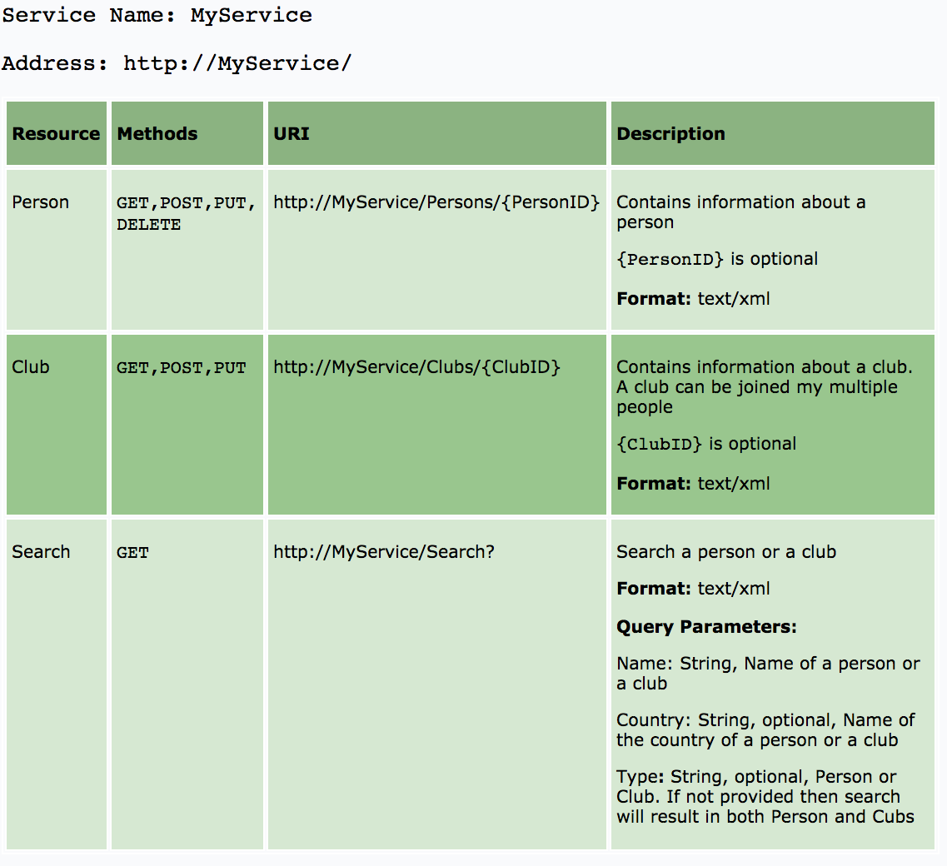
Documentation

Slide 25
Criticism
No transactions support
DBMS (usually behind REST services) support transactions
No publish/subscribe support.
Notification is done by polling.
The client can poll the server. GET is extremely optimized on the web.
No asynchronous interactions
The server can return a URI of a resource which the client can GET to access the/other results.
High bandwidth
HTTP uses a request/response model, so there’s a lot of baggage flying around the network to make it all work.

Slide 26
Advantages
REST is a great way of developing lightweight Web services that are easy to implement, maintain, and discover.
HTTP provides an excellent interface to implement RESTful services with features like a uniform interface and caching. However, it is up to developers to implement and utilize these features correctly.
If we get the basics right, a RESTful service can be easily implemented using any of the existing technologies such as Python, .NET, or Java.

