Slide 1
TestDouble auto injection with Specflow during runtime integration testing

Slide 2
Application Design
SetConfiguration
IFileWriter
FileWriter
FileManagerSimpleStub
FileManagerFunnyStub
Sender
Receiver

Slide 3

Standard app workflow
Sender
Receiver
File System
1) Write a message
2) Send the message
3) Persist the message
4) Check on console

Slide 4

Receiver Integration Test Workflow
Sender
Receiver
File System
0) Inject testDouble
2) Send the message
3) Write on console
4) Check on console

Slide 5
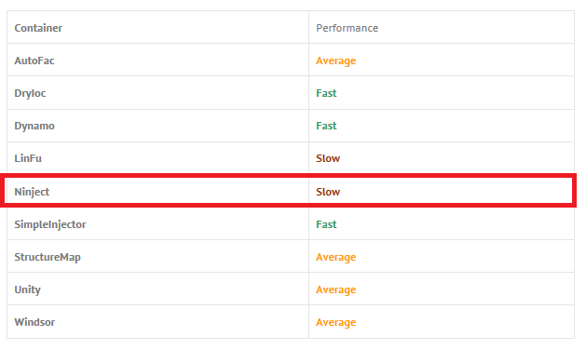
Risks associated
Abstracting everything with interfaces and injecting plugin with an IoC framework at runtime using a configuration file could impact the performance of the application.
-> Solution:
implementing a default mechanism for production that inject via code
Change IoC with a more performant framework

