Slide 1




Manual SQLI
schematics
Tbilisi, 2022

Slide 2

Overview
SQL Injection
How to test on SQLI
sqlmap
Machine: schematics

Slide 3

Web Penetration Testing 2
For Educational Purposes Only
In either case,
hacking without a customer’s explicit permission and direction
is a crime.

Slide 4
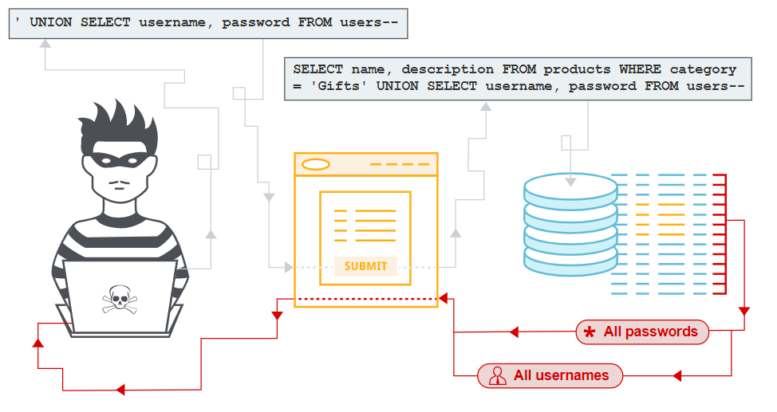
What is SQL injection ?
Let’s see what SQL injection is, and describe some common examples, explain how to find and exploit various kinds of SQL injection vulnerabilities

Slide 5
SQL injection (SQLi) is a web security vulnerability that allows an attacker to interfere with the queries that an application makes to its database. It generally allows an attacker to view data that they are not normally able to retrieve.
This might include data belonging to other users, or any other data that the application itself is able to access. In many cases, an attacker can modify or delete this data, causing persistent changes to the application's content or behavior.

Slide 6

The impact of a successful SQL injection attack
A successful SQL injection attack can result in unauthorized access to sensitive data, such as passwords, credit card details, or personal user information.
Many high-profile data breaches in recent years have been the result of SQL injection attacks, leading to reputational damage and regulatory fines.
In some cases, an attacker can obtain a persistent backdoor into an organization's systems, leading to a long-term compromise that can go unnoticed for an extended period.

Slide 7

SQL injection examples
There are a wide variety of SQL injection vulnerabilities, attacks, and techniques, which arise in different situations. Some common SQL injection examples include:
Retrieving hidden data, where you can modify an SQL query to return additional results.
Subverting application logic, where you can change a query to interfere with the application's logic.
UNION attacks, where you can retrieve data from different database tables.
Examining the database, where you can extract information about the version and structure of the database.
Blind SQL injection, where the results of a query you control are not return

Slide 8
Retrieving hidden data
Consider a shopping application that displays products in different categories. When the user clicks on the Gifts category, their browser requests the URL:
This causes the application to make an SQL query to retrieve details of the relevant products from the database:

Slide 9
Retrieving hidden data
This SQL query asks the database to return:
all details (*)
from the products table
where the category is Gifts
and released is 1.
The restriction released = 1 is being used to hide products that are not released. For unreleased products, presumably released = 0.
The application doesn't implement any defenses against SQL injection attacks, so an attacker can construct an attack like:

Slide 10
Retrieving hidden data
This results in the SQL query:
The key thing here is that the double-dash sequence -- is a comment indicator in SQL, and means that the rest of the query is interpreted as a comment. This effectively removes the remainder of the query, so it no longer includes AND released = 1. This means that all products are displayed, including unreleased products.
Going further, an attacker can cause the application to display all the products in any category, including categories that they don't know about:

Slide 11
Retrieving hidden data
This results in the SQL query:
The modified query will return all items where either the category is Gifts, or 1 is equal to 1. Since 1=1 is always true, the query will return all items.

Slide 12
Subverting application logic
Consider an application that lets users log in with a username and password. If a user submits the username wiener and the password bluecheese, the application checks the credentials by performing the following SQL query:
If the query returns the details of a user, then the login is successful. Otherwise, it is rejected.

Slide 13
Subverting application logic
Here, an attacker can log in as any user without a password simply by using the SQL comment sequence -- to remove the password check from the WHERE clause of the query. For example, submitting the username administrator'-- and a blank password results in the following query:
This query returns the user whose username is administrator and successfully logs the attacker in as that user.

Slide 14
Retrieving data from other database tables
In cases where the results of an SQL query are returned within the application's responses, an attacker can leverage an SQL injection vulnerability to retrieve data from other tables within the database. This is done using the UNION keyword, which lets you execute an additional SELECT query and append the results to the original query.
For example, if an application executes the following query containing the user input "Gifts":

Slide 15
Retrieving data from other database tables
then an attacker can submit the input:
This will cause the application to return all usernames and passwords along with the names and descriptions of products.

Slide 16
Examining the database
Following initial identification of an SQL injection vulnerability, it is generally useful to obtain some information about the database itself. This information can often pave the way for further exploitation.
You can query the version details for the database. The way that this is done depends on the database type, so you can infer the database type from whichever technique works. For example, on Oracle you can execute:

Slide 17
Examining the database
You can also determine what database tables exist, and which columns they contain.
For example, on most databases you can execute the following query to list the tables:

Slide 18
Blind SQL injection vulnerabilities
Many instances of SQL injection are blind vulnerabilities. This means that the application does not return the results of the SQL query or the details of any database errors within its responses.
Blind vulnerabilities can still be exploited to access unauthorized data, but the techniques involved are generally more complicated and difficult to perform.

Slide 19
Blind SQL injection vulnerabilities
Depending on the nature of the vulnerability and the database involved, the following techniques can be used to exploit blind SQL injection vulnerabilities:
You can change the logic of the query to trigger a detectable difference in the application's response depending on the truth of a single condition. This might involve injecting a new condition into some Boolean logic, or conditionally triggering an error such as a divide-by-zero.
You can conditionally trigger a time delay in the processing of the query, allowing you to infer the truth of the condition based on the time that the application takes to respond.
You can trigger an out-of-band network interaction, using OAST techniques. This technique is extremely powerful and works in situations where the other techniques do not. Often, you can directly exfiltrate data via the out-of-band channel, for example by placing the data into a DNS lookup for a domain that you control.

Slide 20
How to detect SQL injection vulnerabilities
SQL injection can be detected manually by using a systematic set of tests against every entry point in the application. This typically involves:
Submitting the single quote character ' and looking for errors or other anomalies.
Submitting some SQL-specific syntax that evaluates to the base (original) value of the entry point, and to a different value, and looking for systematic differences in the resulting application responses.
Submitting Boolean conditions such as OR 1=1 and OR 1=2, and looking for differences in the application's responses.
Submitting payloads designed to trigger time delays when executed within an SQL query, and looking for differences in the time taken to respond.
Submitting OAST payloads designed to trigger an out-of-band network interaction when executed within an SQL query, and monitoring for any resulting interactions.

Slide 21
SQL injection in different parts of the query
SQL injection vulnerabilities can in principle occur at any location within the query, and within different query types. The most common other locations where SQL injection arises are:
In UPDATE statements, within the updated values or the WHERE clause.
In INSERT statements, within the inserted values.
In SELECT statements, within the table or column name.
In SELECT statements, within the ORDER BY clause.

Slide 22
SQL injection in different contexts
In all of the labs so far, you've used the query string to inject your malicious SQL payload. However, it's important to note that you can perform SQL injection attacks using any controllable input that is processed as a SQL query by the application. For example, some websites take input in JSON or XML format and use this to query the database.

Slide 23
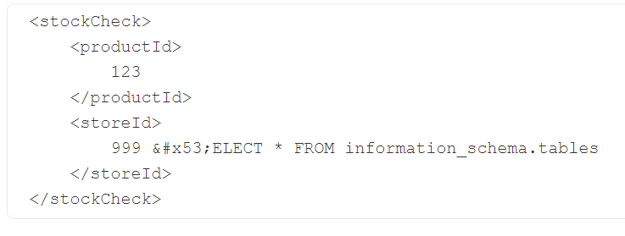
SQL injection in different contexts
Weak implementations often just look for common SQL injection keywords within the request, so you may be able to bypass the filters by simply encoding or escaping characters in the prohibited keywords.
For example, the following XML-based SQL injection uses an XML escape sequence to encode the S character in SELECT - This will be decoded server-side before being passed to the SQL interpreter.

Slide 24
Second-order SQL injection
First-order SQL injection arises where the application takes user input from an HTTP request and, in the course of processing that request, incorporates the input into an SQL query in an unsafe way.
In second-order SQL injection (also known as stored SQL injection), the application takes user input from an HTTP request and stores it for future use.
This is usually done by placing the input into a database, but no vulnerability arises at the point where the data is stored. Later, when handling a different HTTP request, the application retrieves the stored data and incorporates it into an SQL query in an unsafe way.

Slide 25
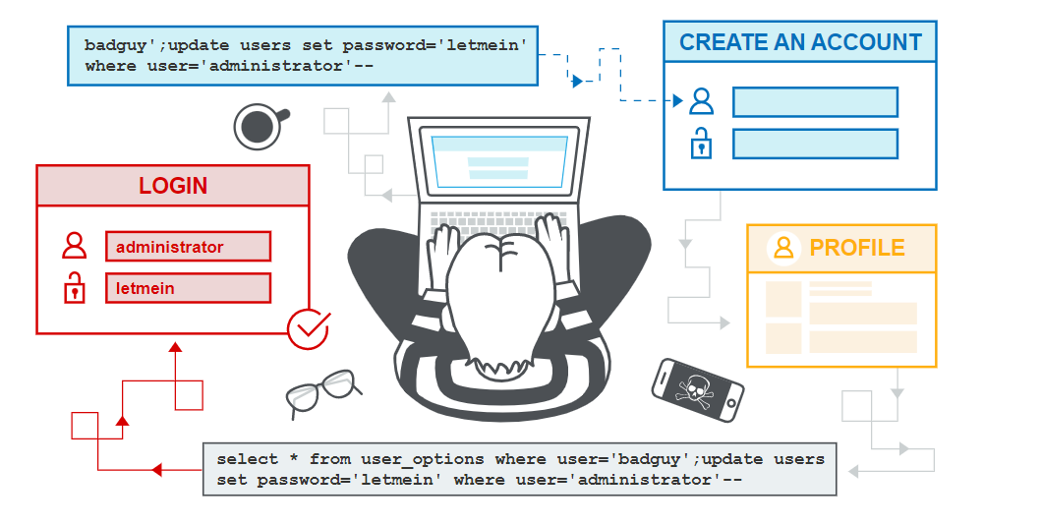
Second-order SQL injection

Slide 26
Second-order SQL injection
Second-order SQL injection often arises in situations where developers are aware of SQL injection vulnerabilities, and so safely handle the initial placement of the input into the database.
When the data is later processed, it is deemed to be safe, since it was previously placed into the database safely. At this point, the data is handled in an unsafe way, because the developer wrongly deems it to be trusted.

Slide 27
Database-specific factors
Some core features of the SQL language are implemented in the same way across popular database platforms, and so many ways of detecting and exploiting SQL injection vulnerabilities work identically on different types of database.
However, there are also many differences between common databases. These mean that some techniques for detecting and exploiting SQL injection work differently on different platforms.

Slide 28
Database-specific factors
Syntax for string concatenation.
Comments.
Batched (or stacked) queries.
Platform-specific APIs.
Error messages.

Slide 29
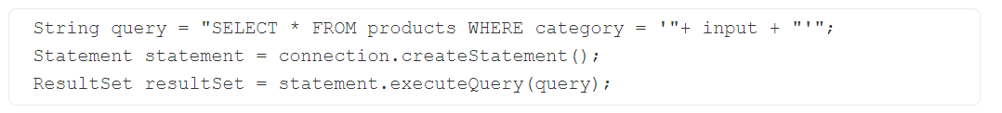
How to prevent SQL injection
Most instances of SQL injection can be prevented by using parameterized queries (also known as prepared statements) instead of string concatenation within the query.
The following code is vulnerable to SQL injection because the user input is concatenated directly into the query:

Slide 30
How to prevent SQL injection
This code can be easily rewritten in a way that prevents the user input from interfering with the query structure:
PreparedStatement statement = connection.prepareStatement("SELECT * FROM products WHERE category = ?");
statement.setString(1, input);
ResultSet resultSet = statement.executeQuery();

Slide 31

How to prevent SQL injection
Parameterized queries can be used for any situation where untrusted input appears as data within the query, including the WHERE clause and values in an INSERT or UPDATE statement.
They can't be used to handle untrusted input in other parts of the query, such as table or column names, or the ORDER BY clause.
Application functionality that places untrusted data into those parts of the query will need to take a different approach, such as white-listing permitted input values, or using different logic to deliver the required behavior.

Slide 32
How to prevent SQL injection
For a parameterized query to be effective in preventing SQL injection, the string that is used in the query must always be a hard-coded constant, and must never contain any variable data from any origin.
Do not be tempted to decide case-by-case whether an item of data is trusted, and continue using string concatenation within the query for cases that are considered safe.
It is all too easy to make mistakes about the possible origin of data, or for changes in other code to violate assumptions about what data is tainted.

Slide 33
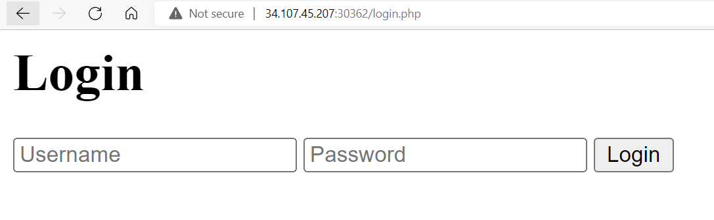
Laboratory: schematics
Description:
Welcome to our technology store.
Flag format: CTF{sha256}
Level: Easy
Server: 34.107.45.207:30362

Slide 34
Laboratory: schematics

Slide 35
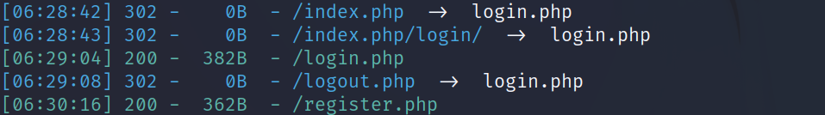
Laboratory: schematics
After a few attempts of web application reconnaissance using dirsearch, we obtain a register endpoint.

Slide 36
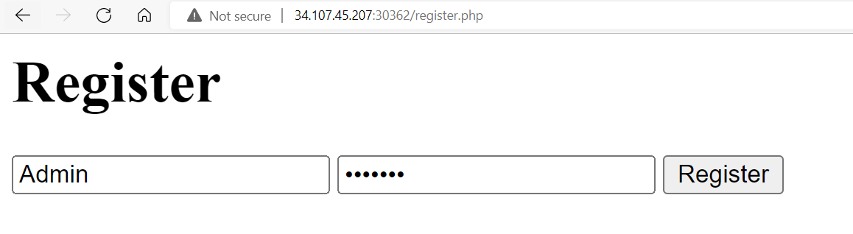
Laboratory: schematics
After accessing the path obtained during the recon process, we need to create an account.
In this example the following credentials were used: admin: mikheil

Slide 37
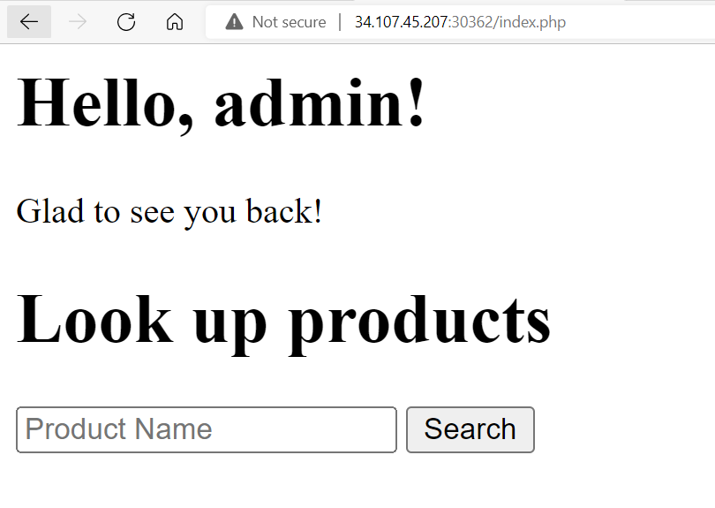
Laboratory: schematics
Once we login using newly created credentials, we can see the page with search field

Slide 38
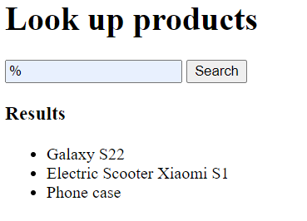
Laboratory: schematics
When we put “%” into the field, the list of all the products is showed

Slide 39
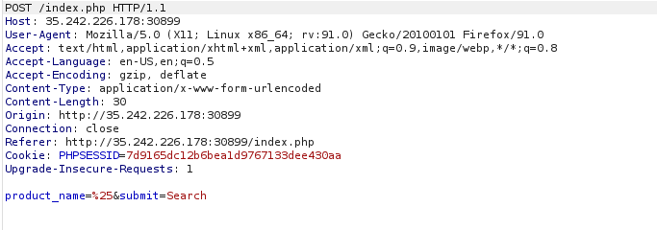
Laboratory: schematics
At this moment, we can conclude that the page with search functionalities implemented is vulnerable to SQLi injection.
To proceed further with the attack, copy the cookie from the POST request obtained with Burp and use SQLmap on it.

Slide 40
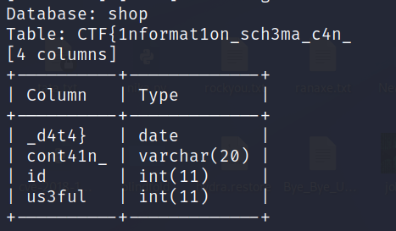
Laboratory: schematics
CTF{1nformat1on_sch3ma_c4n_cont41n_us3ful_d4t4}

Slide 41
Thank you for Attention!

