Slide 1


Markov-state modeling of biomolecular systems pt. 2
Toni Giorgino National Research Council of Italy toni.giorgino@cnr.it
www.giorginolab.it
@giorginolab
Master in Bioinformatics for Health Sciences
Barcelona, 28 Apr 2020
Projects available!
Notes:
1

Slide 2
Part 1. Theory Markov State Models (MSM) provide a statistical framework to analyze ensembles of trajectories and reconstruct equilibrium (free energy) and non-equilibrium (kinetic) properties.
Part II. Practice
We’ll solve a toy (1D) MSM model to illustrate the principles which are applied in more complex cases.

Slide 3
Instructions
Open github.com
GIT clone (or unzip) giorginolab/Markov-Tutorial-BCN-2020
This will copy the exercise files in your machine

Slide 4
Plan of the practice
We compute a MSM of a “toy model”: trajectory in a 1-D potential (R language).
(Advanced) Move to a realistic trajectory set: prothrombin:inhibitor binding
PLUMED projection
build a simple MSM in R like before
(Self-study) Repeat the analysis with a ready-made library, HTMD, following the demo

Slide 5
1. Toy model in 1D
Start the environment
See the “Markov From Scratch” document
Data file needed: data1.csv.gz
data10.csv.gz is also available for experimenting, see comments
$ zless data1.csv.gz
2.300000000000000000e+01
2.300000000000000000e+01
2.400000000000000000e+01
2.500000000000000000e+01
2.600000000000000000e+01
2.600000000000000000e+01
2.600000000000000000e+01

Slide 6
Let’s now follow the notebook

Slide 7
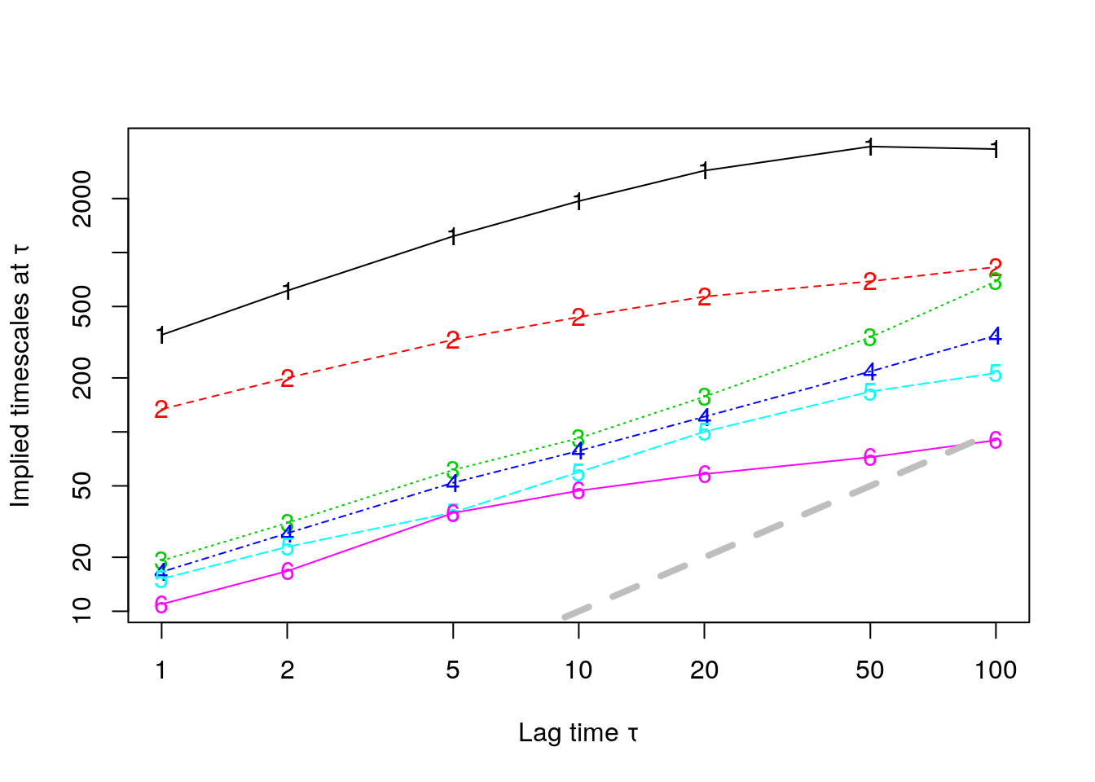
Possible homework (I)
We are starting to see convergence, but not quite. Use the PLUMED syntax to find better metrics that improve Markovianity.
Explore the most stable states
Explore major relaxation modes

Slide 8
Possible homework (II)
Try the other split of the dataset. (1 vs 2 vs 3). Are they independent?
Use all of them together.
Try the other systems in, like villin and cxcl12
Familiarize with the PDB
Devise a reasonable metric

Slide 9
Advanced 1: using PLUMED for projections

Slide 10
Using PLUMED for projections
We need to extract from each frame of each trajectory a limited number of values (projection, or metric)
Must be orientation-independent (align)
PLUMED* may be used for the task
protein-ligand-vector.plumed
project-with-plumed.sh
Results: metric.dat
* http://www.plumed.org

Slide 11
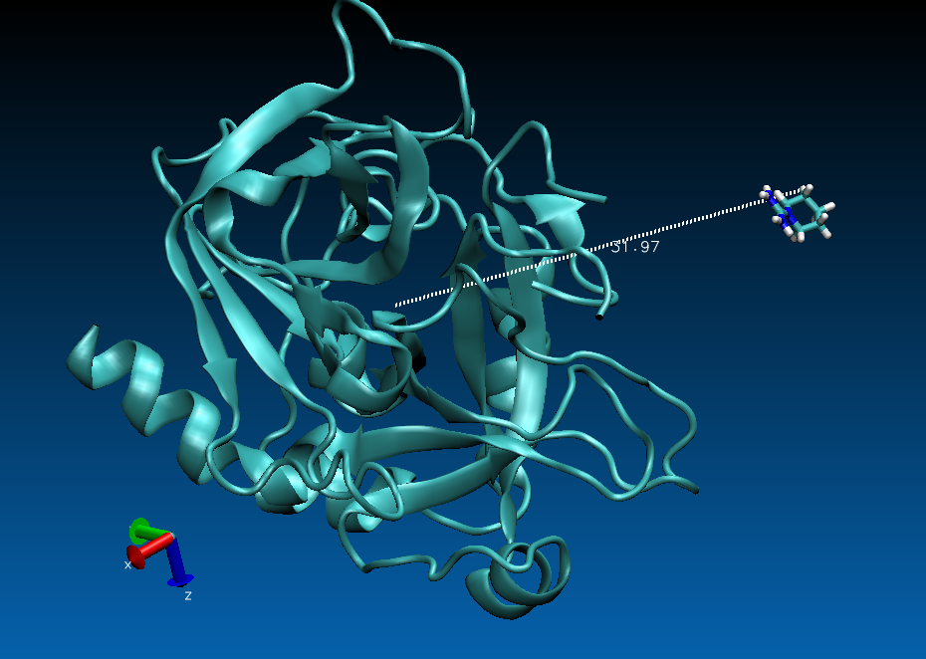

Slide 12
protein-ligand-vector.plumed
UNITS LENGTH=A
FIT_TO_TEMPLATE STRIDE=1 REFERENCE=reference.pdb TYPE=OPTIMAL
# These are the serial numbers of protein CA's
prot: CENTER ...
ATOMS={ 5, 20, 30, 42, 52, 59, 78, 110, 116, 135, 155,
170, 192, 214, 225, 244, 259, 271, 293, 307, 322, 346,
. . .
4229, 4253, 4272, 4294, 4316, 4340, 4359, 4376, 4398, 4414, 4433,
4445, 4462
}
...
# This is "resname MOL and noh" (inhibitors's heavy atoms)
ligand: CENTER ATOMS=4481,4484,4487,4490,4493,4496,4497,4498,4501
pl: DISTANCE ATOMS=prot,ligand COMPONENTS
PRINT ARG=pl.*

Slide 13
project-with-plumed.sh
Computes the metric over all the trajectories
(You don’t actually have to run this. The results are already in metrics.dat)
#!/bin/bash
# This file computes the PLUMED metric indicated in $script
# on all of the trajectory files in $indir. The results
# are printed in stdout.
# You only need to run this file if you change the definition
# of the metric. The current results are in metric.dat
script=protein_ligand_vector.plumed
indir=/mnt/scratch/shared/markov/binding/1/filtered
# Loop over all files ending by .xtc
for tj in `find $indir -name \*.xtc -and -not -name .\*`; do
# Output file name
outname=`basename $tj`
echo Running plumed on $tj >&2
plumed driver --plumed $script \
--pdb $indir/filtered.pdb \
--mf_xtc $tj | \
egrep "^ " | sed "s+^+$outname+"
done
project-with-plumed.sh > newmetric.dat

Slide 14
metric.dat
Results of the projection are in metric.dat.
This will be read in by R.
(htmd) tonigiorgino@monaco:~/practice$ head metrics.dat
e36s5_e27s3f37-....xtc 0.000000 -0.224091 -11.886612 1.973588
e36s5_e27s3f37-....xtc 1.000000 -0.413809 -12.038901 1.644167
e36s5_e27s3f37-....xtc 2.000000 -0.532973 -12.323975 2.144003
e36s5_e27s3f37-....xtc 3.000000 -0.300480 -11.363546 1.903810
e36s5_e27s3f37-....xtc 4.000000 -0.433555 -11.792027 2.057442
. . .
e24s3_e21s4f177-....xtc 196.000000 8.976495 -10.536748 2.060360
e24s3_e21s4f177-....xtc 197.000000 9.262883 -11.399111 2.169123
e24s3_e21s4f177-....xtc 198.000000 8.517335 -12.355884 2.464811
e24s3_e21s4f177-....xtc 199.000000 8.496182 -12.325769 1.489607

Slide 15
Advanced 2: using HTMD for projections and analysis

Slide 16
2. Prothrombin:ligand example
This is a large, realistic simulation set
From htmd.org: Ligand Binding Analysis*
3 GB (don’t download today)
852 trajectories (in 3 groups)
852 x 20 ns ≈ 17 µs
See the 5_ligand-binding-analysis.ipynb document
* http://pub.htmd.org/tutorials/ligand-binding-analysis/datasets.tar.gz

Slide 17
Conclusions and Resources

Slide 18
Conclusions
MSM methods make efficient use of unbiased sampling
Cluster → P_{ij} → eigenvectors → free energies (K_{D}) and kinetics (k_{on}/k_{off})
Still require huge (but not unreachable) amounts of sampling/simulation for biologically interesting systems
Strong mathematical foundation, with good software available

Slide 19
Warning
Still very active field
For serious work, many more details are in…
the theory of Markov state models
the discretization, projection, and estimation of models from trajectories
Suggested further steps: worked out real-world examples distributed with software packages*
* see the last slides

Slide 20
Software + Tutorials
All are Python-based
They include clear walkthroughs (highly recommended) with datasets
HTMD – www.htmd.org
Also analysis + system build + adaptive …
Can aggregate large-scale datasets
PyEMMA – www.emma-project.org
MSMBuilder - msmbuilder.org

Slide 21
Related topics
If you liked this, you may also like…
Estimation of reversible transition matrices
Hidden Markov Models doi:10.1063/1.4828816
TICA
Conformational fluxes
Adaptive sampling
Role of drug residence time in drug discovery

Slide 22
Introduction
Early biological application
More mathematical detail

Slide 23
Literature
Buch et al., 10.1073/pnas.1103547108
Rigid ligand + protein association, simplest case
Swinney, PMID:19152211
Importance of kinetics in drug design
Chodera and Noe, 10.1016/j.sbi.2014.04.002
Excellent overview (1)
Voelz et al., 10.1021/ja9090353
Full reconstruction of a millisecond folding
Pande et al., 10.1016/j.ymeth.2010.06.002
Excellent overview (2)
Paul et al., 10.1038/s41467-017-01163-6
Peptide-peptide association
Doerr et al., 10.1021/ct400919u
Adaptive sampling
Bryan et al., “The $25 B eigenvector”
The original PageRank algorithm; e.g. jdc.math.uwo.ca/M1600b/l/pagerank-1600.pdf

Slide 24
End

