Slide 1


MD projections: PLUMED GUI & MDTraj
Toni Giorgino National Research Council of Italy toni.giorgino@cnr.it
www.giorginolab.it
@giorginolab
Thesis projects available
github.com/giorginolab/ MD-Trajectory-Tutorial-UniPD-2022
University of Padova c/o Prof. Fuxreiter
Apr 28, 2022
Notes:
1
Good morning to everyone. My name is Toni Giorgino, and it is my pleasure to be a guest in your course.
Today I’d like to give you an overview of the use of Markov-state based methods in biomolecular simulations.

Slide 2
Part I – PLUMED & PLUMED-GUI
Part II – Python + MDTraj

Slide 3
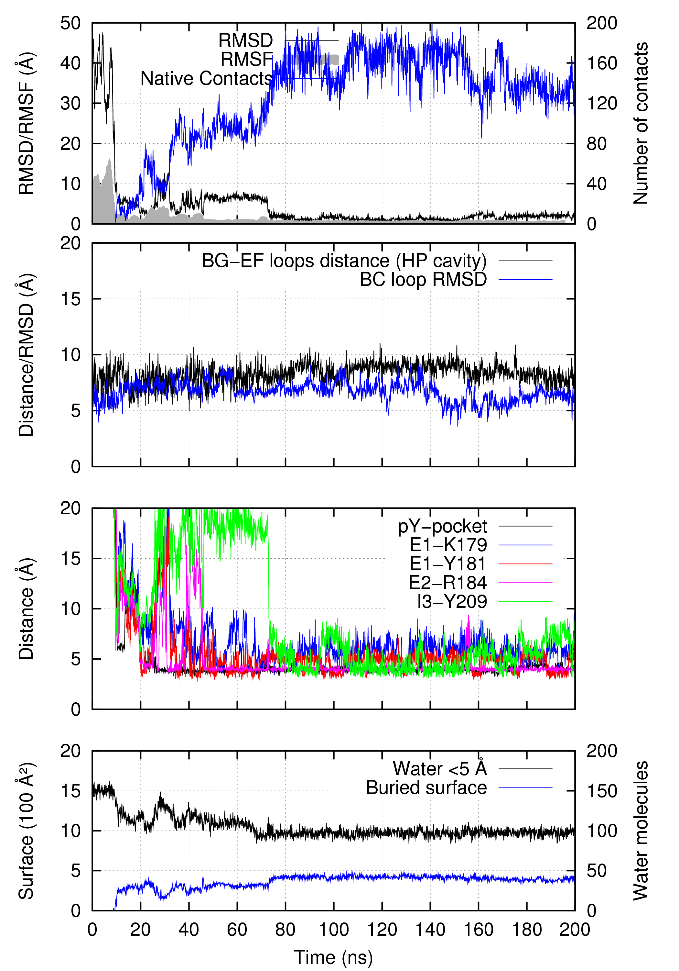
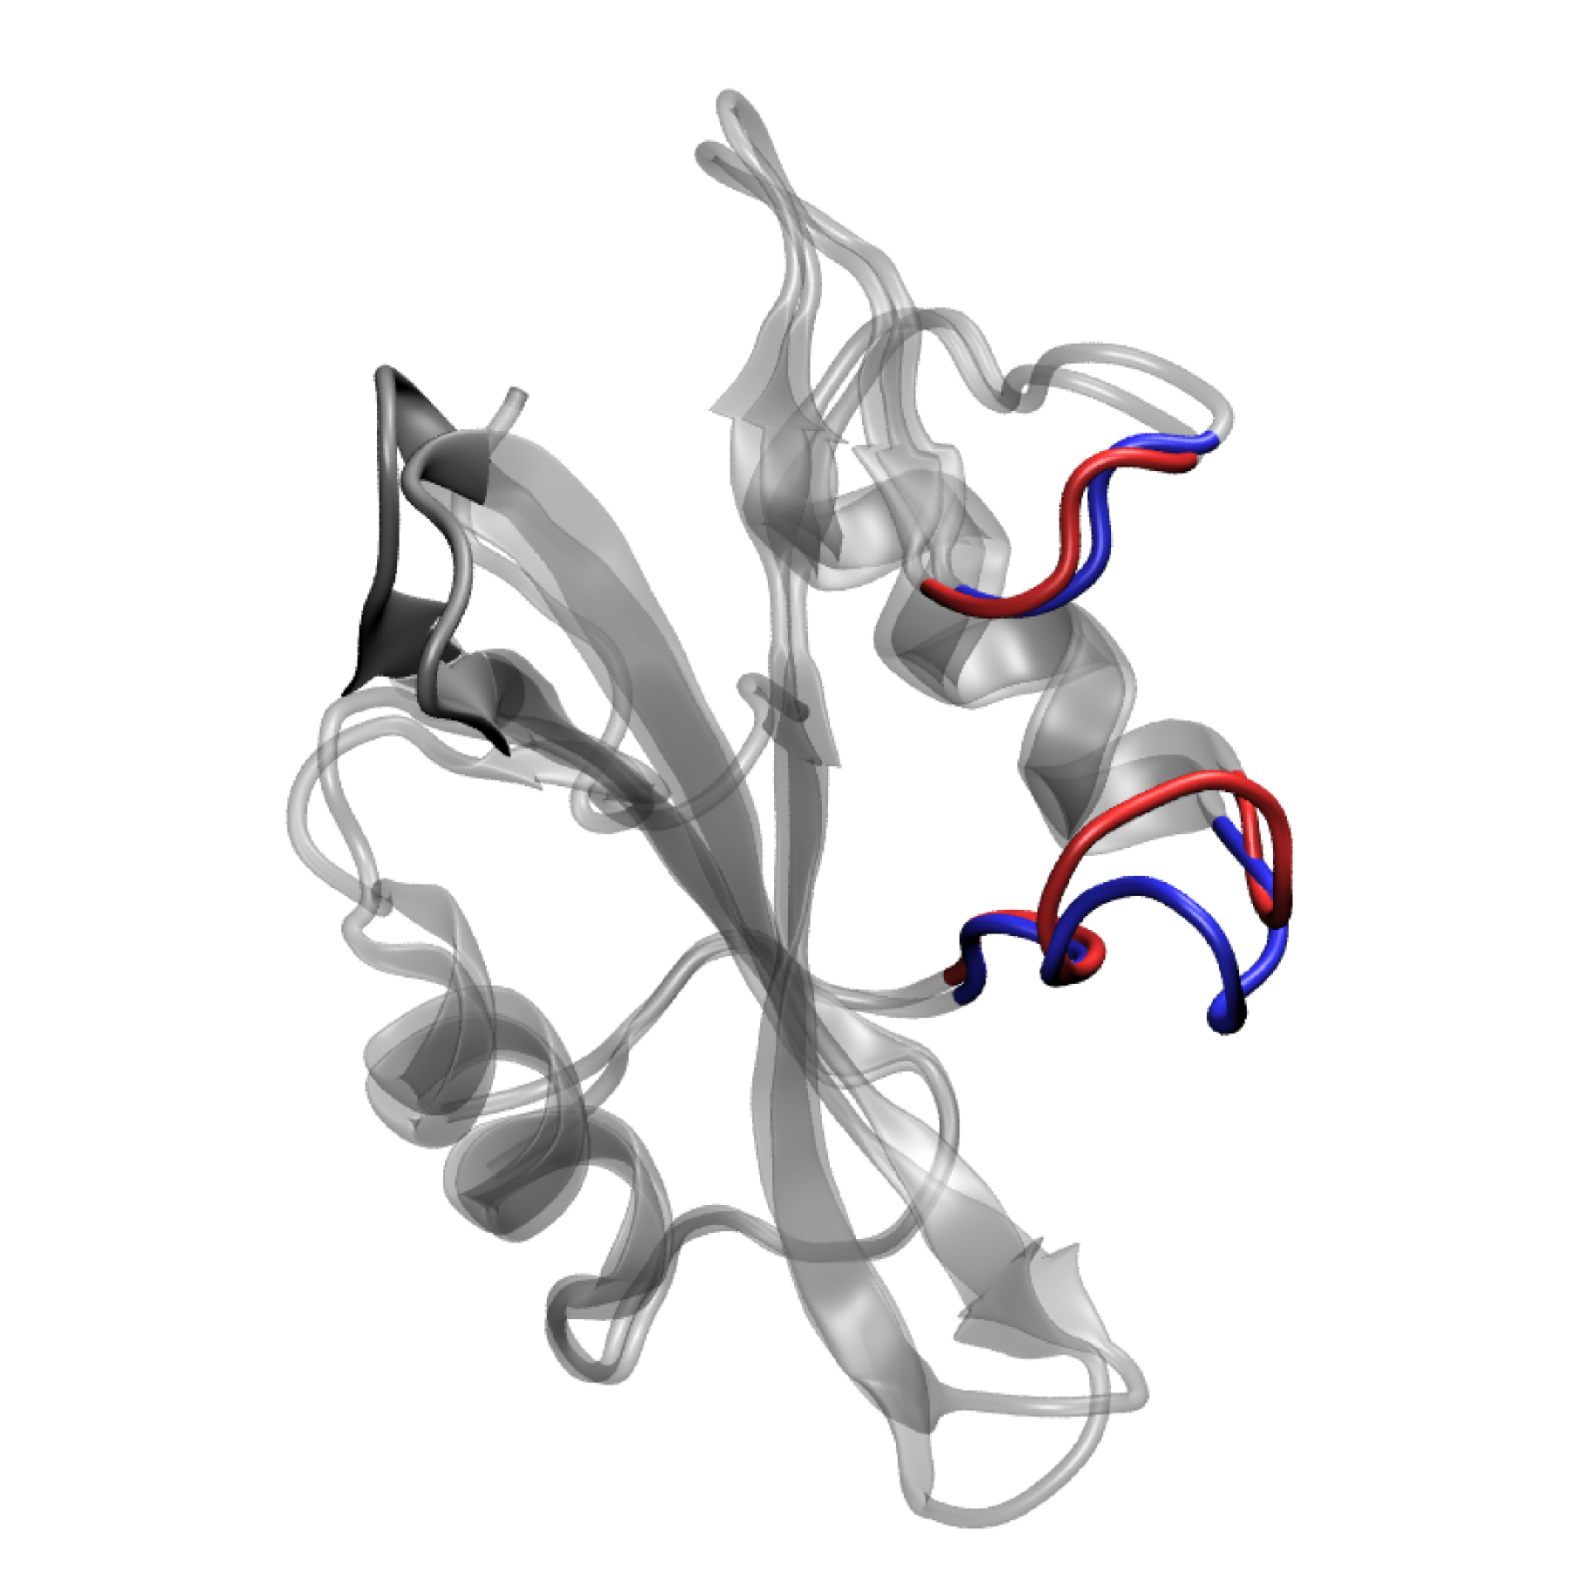
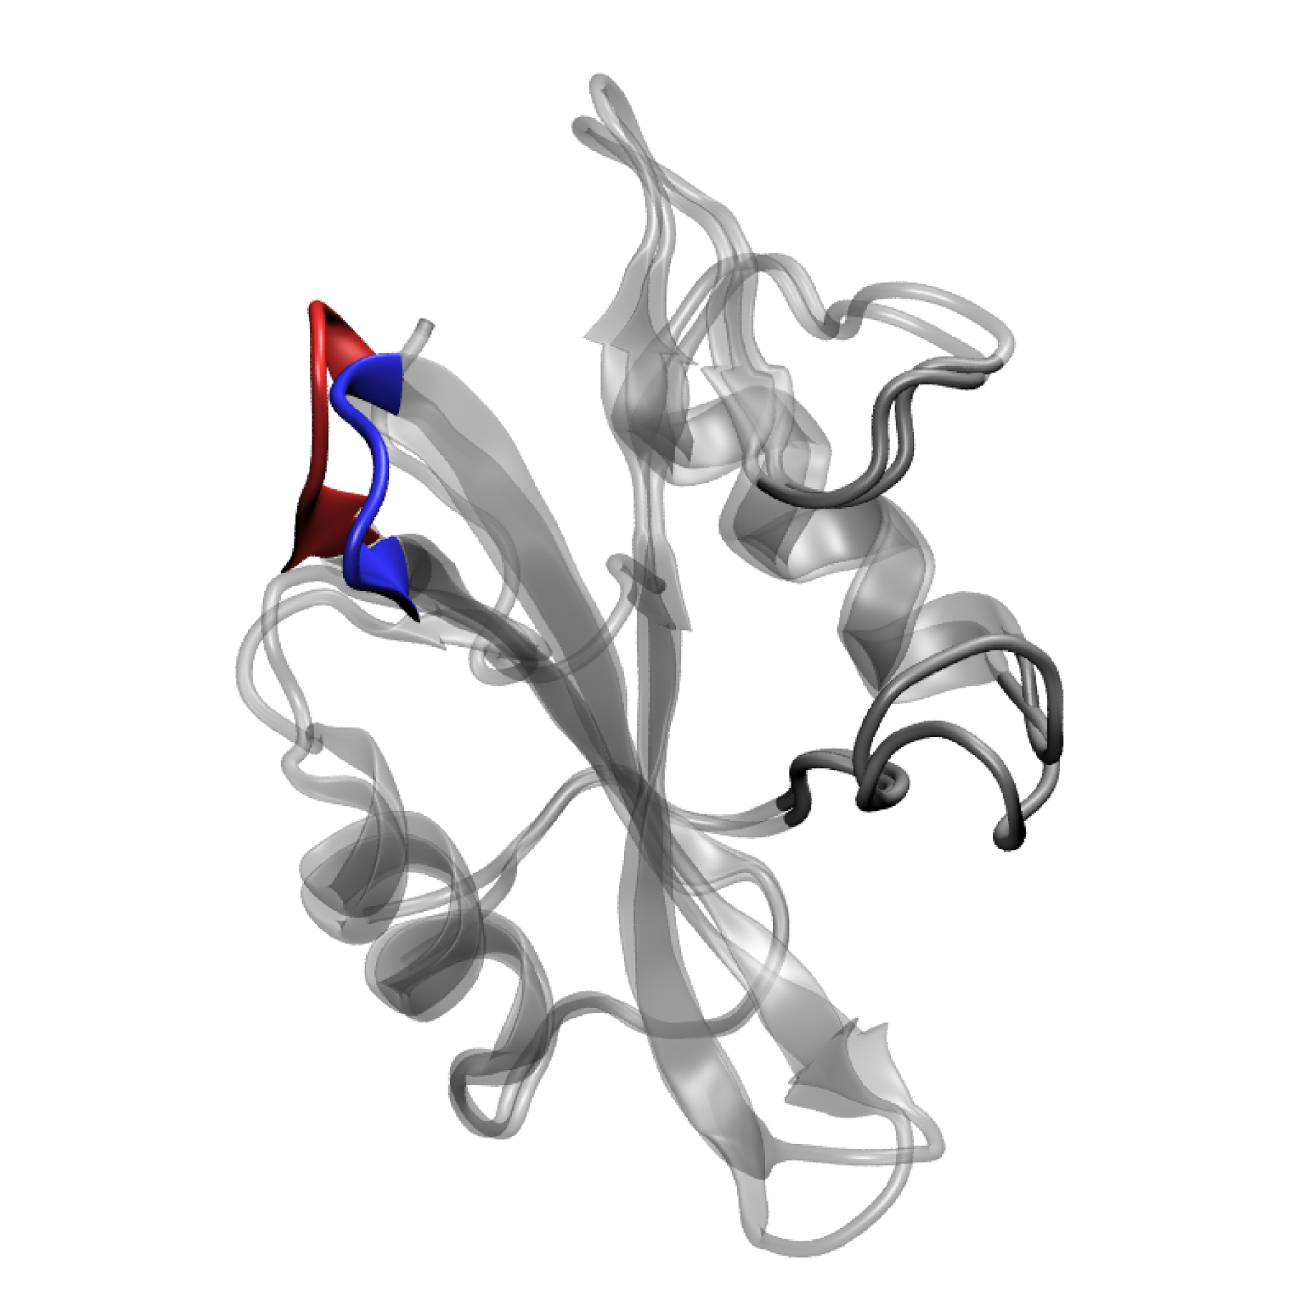
Rationale for a Plumed-GUI
Local RMSD
Contacts
Native contacts
Hydration
…
All of them seem good ideas… until you try them
Giorgino et al., JCTC 2012

Slide 4

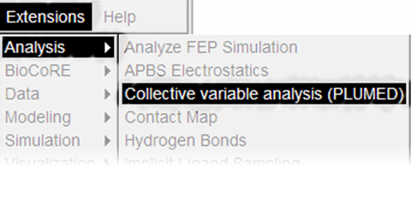
1. A common, concise language to define all observables
Managed if we had…
2. An interface to quickly code, click, and check
Notes:
Enter plumed: I attempted to replace previous scripting to increase the idea-analysis-result turnaround

Slide 5
Generalized forces in biased sampling
A collective variable (CV)
Bias potential depending on x only through CV
Generalized force
CV gradient
Bias force

Slide 6
Assumptions
Mostly dealing with timeseries, x_{i}(t)
Analyze existing trajectories → driver
Enter PLUMED
Replaces scripting with homogeneous one-liners
Speeds up clue-analysis-result
Desiderata
Syntax mnemonics, manual lookup
Symbolic atom selections
Immediate visualization
Notes:
I was struck by the fact that, once for all, we had a simple language to express observables.
Not functions to write, but declarations. One observable, one line. Logically clear and consistent
The syntax covered most of the features I used, even if sometimes not directly

Slide 7
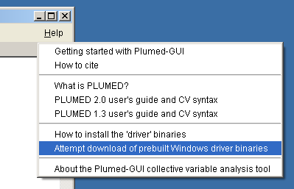
Need driver and/or plumed in path
Linux and OSX: supported by PLUMED 2.x’s configure
Windows: “auto-install” gets both 1.3 & 2.0 (cross-compiling 2.x is also easy)
Notes:
(Windows: Help > Automatic download)

Slide 8
Plumed-GUI objectives
Provide mnemonics for CVs (and options)
“How was it called…?”
Help with the generation of non-trivial CVs
“Oh no, I need to redo that Z_PATH reference…”
Show the results fast
“Show me! Now!”

Slide 9
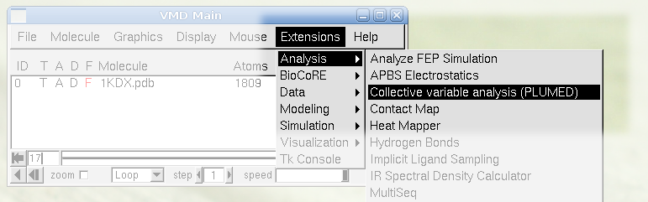

VMD > Extensions > Analysis > CV
tonigi/vmd_plumed

Slide 10
How does it look like?

Slide 11
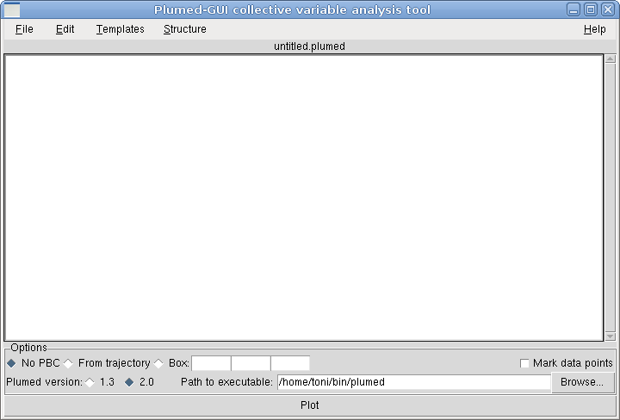
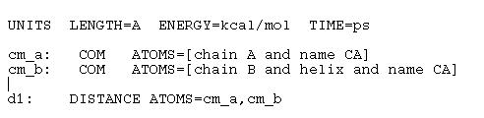
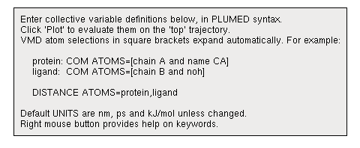

← Tiny tutorial
Enter the PLUMED input file as in a text editor

Slide 12
Basics
File and Edit menus: like a text editor
You write a “.plumed” file (unsubstituted brackets)
Free text: syntax-agnostic
Only square brackets are parsed into atom lists
Custom PLUMED CVs are totally fine
To get the script after substitutions:
File → Export (“META_INP”, with comments)
Notes:
Brackets in the “master script” are internally replaced by (lists of) serials

Slide 13
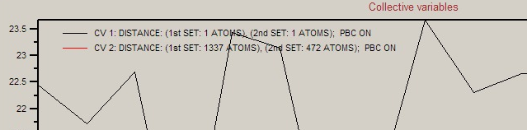
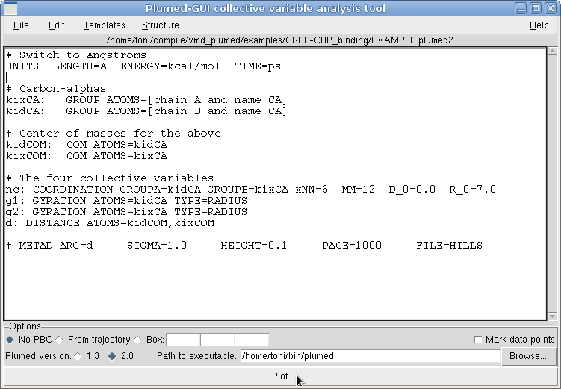
Syntax-agnostic editor
Enter actions as usual…
nc: COORDINATION GROUPA=kidCA GROUPB=kixCA …
…symbolic atom selections allowed in [ · ]
kixCA: GROUP ATOMS=[chain A and name CA]
→ 45,66,78,99,… (Transparently)

Slide 14
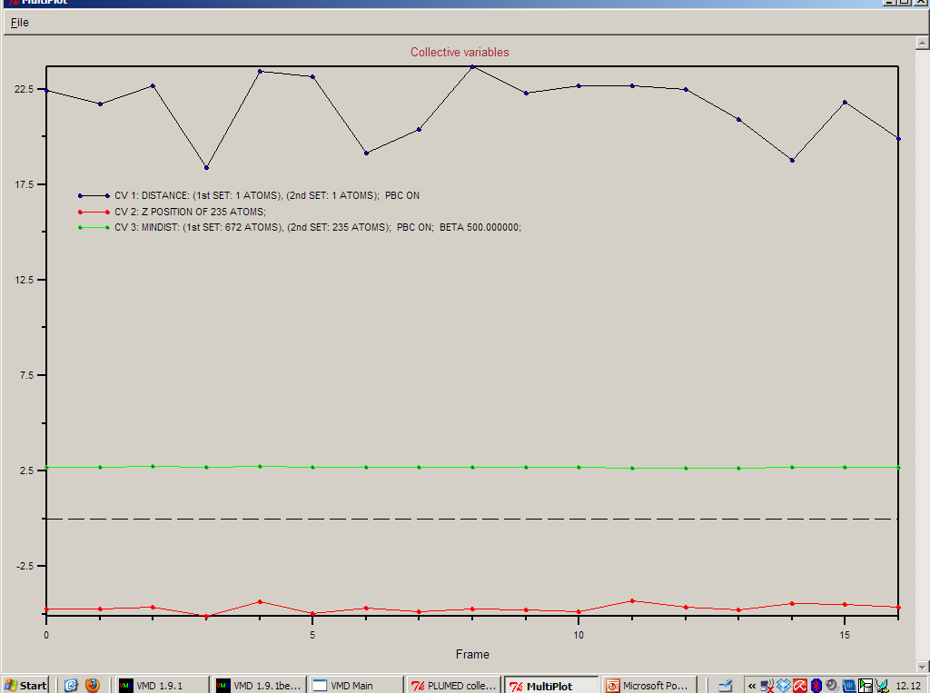
Timeseries for CV_{i}(t) for the top molecule…
…get data files with File > Export

Slide 15
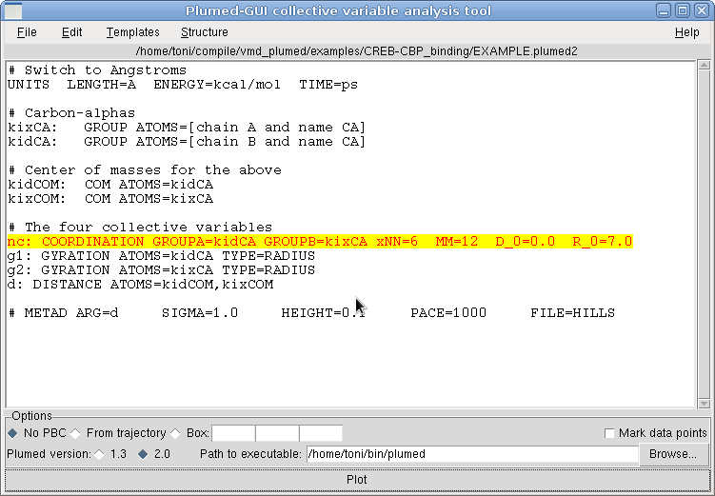
Error highlighting
(…sometimes)

Slide 16
Behind the scenes…
The current trajectory is saved
Bracketed [ … ] atom selections expand according to the top molecule’s topology
Masses and charges → β/occupancy
“plumed driver” is invoked
☹ → Errors appear in console
☺ → COLVAR is parsed and plotted

Slide 17
Assisted editing

Slide 18
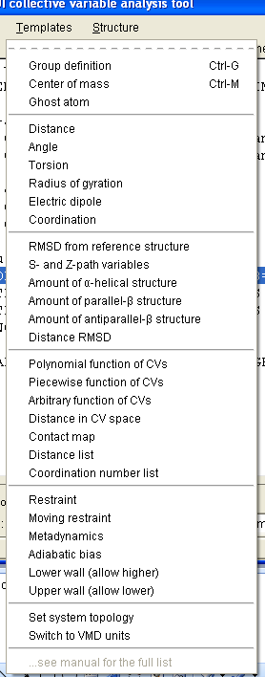
Templates menu
“What was the that CV named again?”
Insert a definition at the cursor
kixCA: GROUP ATOMS=[…]
PARABETARMSD RESIDUES=<…> TYPE=DRMSD R_0= D_0=0.0 NN=8 MM=12 STYLE=all
LOWER_WALLS ARG= AT= KAPPA= OFFSET=0.0 EXP=2.0 EPS=1.0

Slide 19
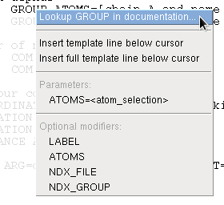
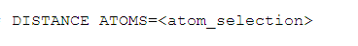
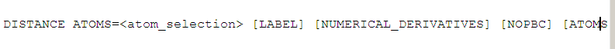
Right-click on action: context-sensitive
Doxygen-generated pages are one click away
If you know the action: insert the template
Mandatory/optional parameters listed
Autogenerated with the gentemplate tool

Slide 20
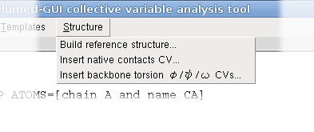
Structure menu
Simplify preparation of non-trivial CVs
More-than-one liners, external files, etc.

Slide 21
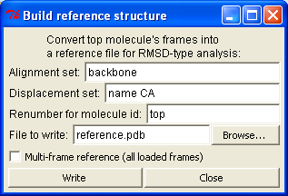

Structure → Build reference structure PDBs for PATHMSD
Source: current frame, top molecule
Target: molecule ID
Plumed 2.x allows multi-frame references
Extracts the current frame of the top molecule (source)
Pseudo-PDB numbered for the molecule in the target box
Deals with PDB subsetting, fields and parsing quirks

Slide 22
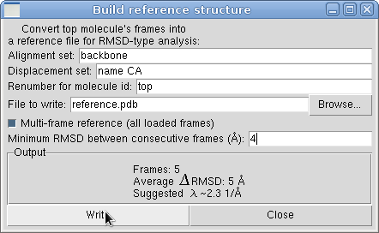
What’s next: λ and subsetting
Subset trajectory so that RMSD(i→i+1) is approximately constant, suggest λ
Contact maps (suggestions welcome)
Notes:
Ie λ ~ 2.3 / <RMSD(i->i+i)>

Slide 23
Number of native contacts
Intramolecular (one atom set)
Intermolecular (two atom sets)
Δ(resid) ≥ N
Cutoff
Cutoff
Notes:
For example, how many of you tried to compute native contacts in VMD? There is no reason why it should not be as easy as RMSD. Computing RMSD is trivial, computing NC is very cumbersome. But they are logically very similar: “distance from a reference”.

Slide 24
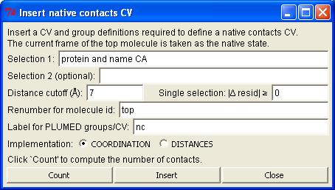
Structure → Insert native contacts CV
Enumerate native pairs in the current frame of the top molecule (source)
Lists are renumbered for the molecule in the target box
co: COORDINATION PAIR GROUPA=nc_a GROUPB=nc_b ... # or
di: DISTANCES LESS_THAN={RATIONAL R_0=0.5 D_0=7} ATOMS1=914,849

Slide 25
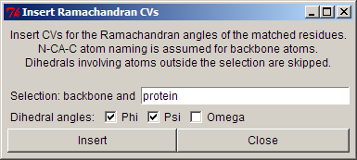
Structure → Insert φ/ψ/ω
TORSION ATOMS=1,2,3,8 LABEL=GLY586_PSI
TORSION ATOMS=3,8,9,10 LABEL=VAL587_PHI
TORSION ATOMS=8,9,10,24 LABEL=VAL587_PSI
…

Slide 26
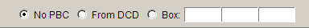
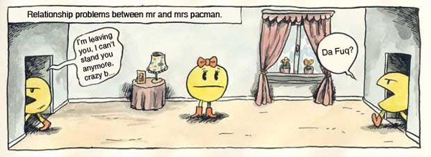
Periodic boundary conditions
Time-varying cell are now allowed
Be mindful of VMD limitation on cell’s orientation

Slide 27
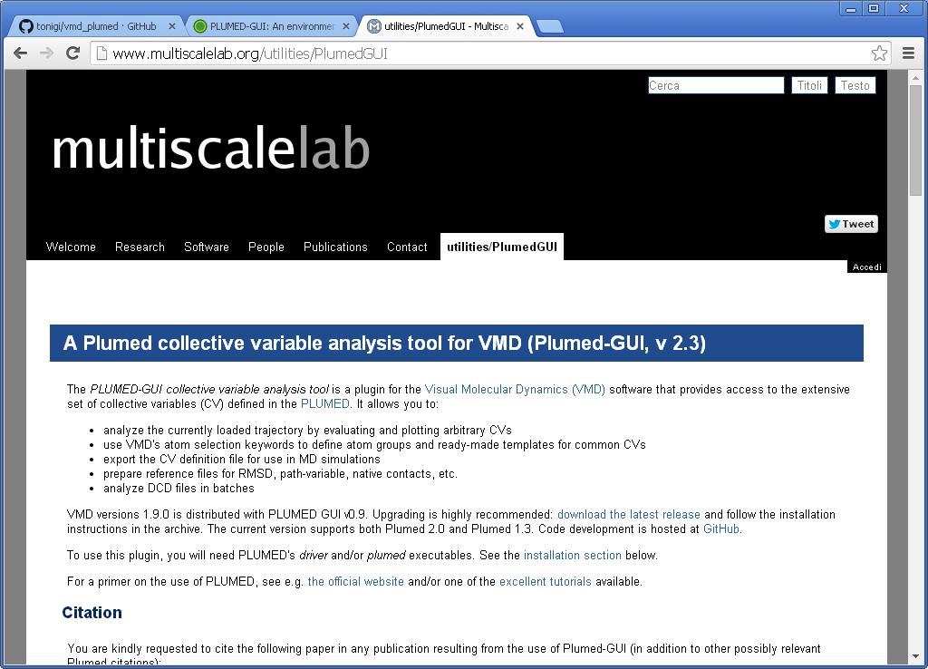
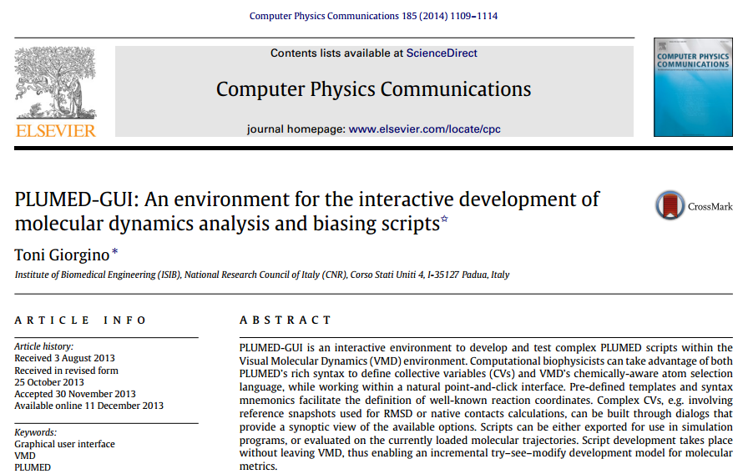
Documentation
Short
www.multiscalelab.org/ /utilities/PlumedGUI
Long →
doi:10.1016/j.cpc.2013.11.019 arxiv:1312.3190

Slide 28
Part II – Python + MDTraj
See the online notebook

