Slide 1


Markov-state modeling of biomolecular systems, II
Toni Giorgino National Research Council of Italy toni.giorgino@cnr.it
www.giorginolab.it
@giorginolab
Thesis projects available
github.com/giorginolab/ Markov-Tutorial-BCN-2022
Master in Bioinformatics for Health Sciences
UPF Barcelona, 3 May 2022
Notes:
1
Good morning to everyone. My name is Toni Giorgino, and it is my pleasure to be a guest in your course.
Today I’d like to give you an overview of the use of Markov-state based methods in biomolecular simulations.

Slide 2
Discrete-time Markov chains

Slide 3
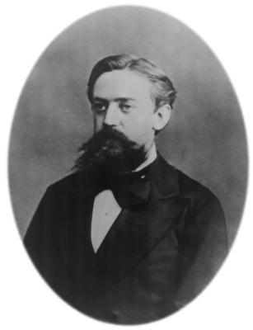
Discrete Time Markov Chains
A random process.
The system’s state is a discrete variable.
It undergoes transitions between states at uniformly-spaced (discrete) time points.
Transition probabilities do not depend on the previous history of states (memorylessness).
Andrei Markov 1856-1922
B
A
Notes:
First of all, we are talking about discrete time markov chains. Read.

Slide 4
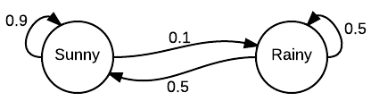

First example
Assume a deterministic initial condition:
X₀ = Sunny with certainty; i.e.,
p(Sunny | t=0)=1 and
p(Rainy | t=0)=0 i.e.
s₀ = [1, 0]
…now, what is s₁?

Slide 5
First example
What is s₁?
p(Sunny | t=1) = 0.9
p(Rain | t=1) = 0.1
s₁
In matrix form…
…now, what is s₂?
s₁ = s₀ P

Slide 6
First example
What is s₂?
s₂
p(Sunny | t=2) = 0.9 p(Sunny | t=1) + 0.5 p(Rainy | t=1) = 0.86
p(Rainy | t=2) = 0.1 p(Sunny | t=1) + 0.5 p(Rainy | t=1) = 0.14
In matrix form…
And in general…
Meaning…
s₂ = s₁ P
s_{t+1} = s_{t} P
s_{t} = s₀ P ^{t}

Slide 7
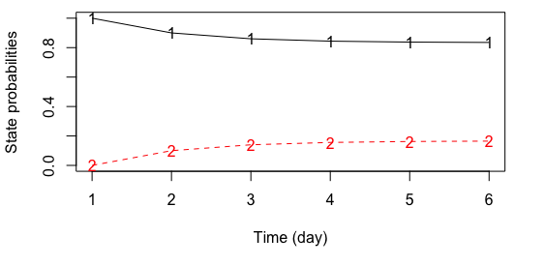
Let’s do a numerical test…

Slide 8
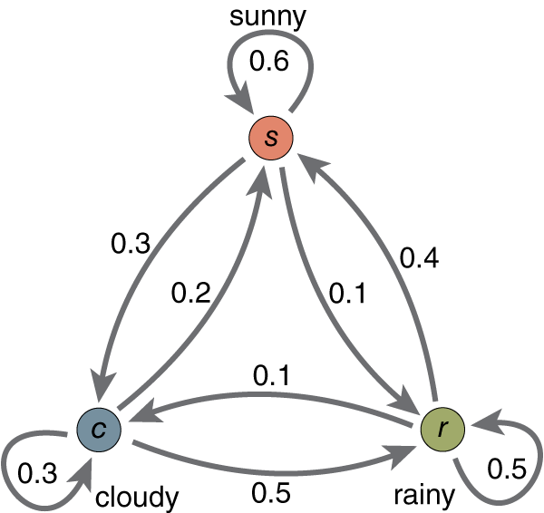
Let’s try with 3 states…
[,1] [,2] [,3]
[1,] 0.6 0.3 0.1
[2,] 0.2 0.3 0.5
[3,] 0.4 0.1 0.5

Slide 9
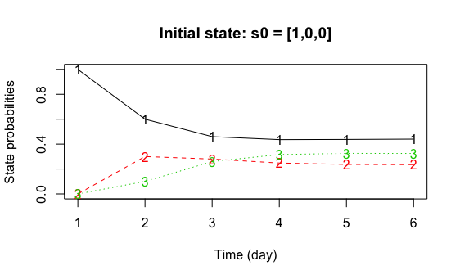
Starting from Sunny…
[,1] [,2] [,3]
[1,] 0.6 0.3 0.1
[2,] 0.2 0.3 0.5
[3,] 0.4 0.1 0.5

Slide 10
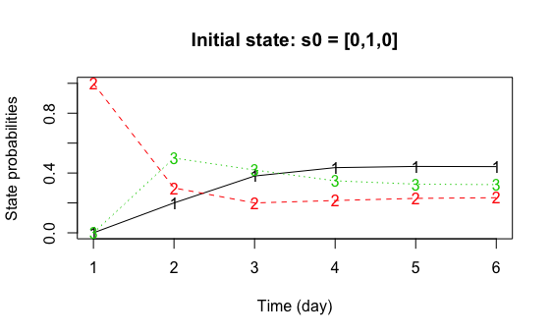
Starting from Cloudy…
[,1] [,2] [,3]
[1,] 0.6 0.3 0.1
[2,] 0.2 0.3 0.5
[3,] 0.4 0.1 0.5
Take-home message: under conditions usually met, state populations go exponentially towards equilibrium.
We can compute the time constants.

Slide 11
Homogeneity
If the transition probabilities do not change with time, we have an homogeneous Markov chain
Example of non-homogeneous MC: weather transition probabilities Markovian, but dependent on the season.

Slide 12
Important quantities we can compute
Stationary distribution (→ eq. probabilities)
Relaxation times
Mean-first passage times (→ kinetic rates)
And others we won’t discuss:
Committor probabilities
Fluxes
…

Slide 13
Learning matrices from trajectories
(of discrete states)

Slide 14
Markov models
Total sampled time (e.g. 100 μs)
Define the discrete state of the system in discrete time (e.g. via reaction coordinates)
. . .
Lag time τ (here: 4 time units)
Compute the transition probability matrix sliding a window of lag time τ
To
To
0 | 0 | 0
0 | 0 | 0
0 | 0 | 0
0 | 0 | 1
0 | 0 | 0
0 | 0 | 0
From
From

Slide 15
Markov models
Total sampled time (e.g. 100 μs)
Define the discrete state of the system in discrete time (e.g. via reaction coordinates)
. . .
Lag time τ (here: 4 time units)
Compute the transition probability matrix sliding a window of lag time τ
To
To
0 | 0 | 1
0 | 0 | 0
0 | 0 | 0
0 | 0 | 1
0 | 1 | 0
0 | 0 | 0
From
From

Slide 16
Markov models
Total sampled time (e.g. 100 μs)
Define the discrete state of the system in discrete time (e.g. via reaction coordinates)
. . .
Lag time τ (here: 4 time units)
Compute the transition probability matrix sliding a window of lag time τ
To
To
0 | 0 | 1
0 | 1 | 0
0 | 0 | 0
0 | 0 | 1
0 | 1 | 0
1 | 0 | 0
From
From

Slide 17
Markov models
Total sampled time (e.g. 100 μs)
Define the discrete state of the system in discrete time (e.g. via reaction coordinates)
. . .
Lag time τ (here: 4 time units)
Compute the transition probability matrix sliding a window of lag time τ
To
3 | 0 | 2
1 | 3 | 0
1 | 2 | 1
From

Slide 18
Transition counts
Transition probabilities
To
To
Σ_{j}
3 | 0 | 2
1 | 3 | 0
1 | 2 | 1
3/5 | 0 | 2/5 | 1
¼ | ¾ | 0 | 1
¼ | 2/4 | ¼ | 1
From
From
Normalize by rows
P_{ij}
Probability vector
Evolved (after τ) state
3/5 | 0 | 2/5
¼ | ¾ | 0
¼ | 2/4 | ¼
1 | 0 | 0
x
=
3/5 | 0 | 2/5
s_{i}
P_{ij}
s’_{j}

Slide 19
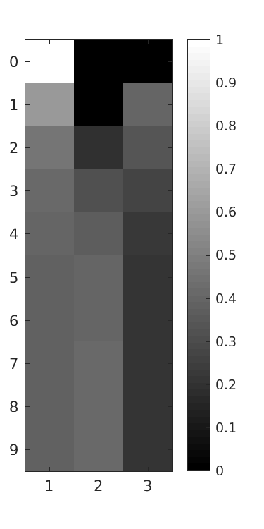
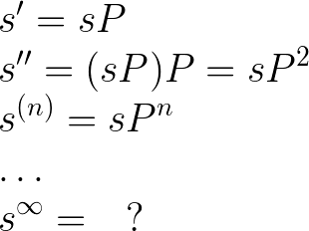
Probability vector
Evolved state
3/5 | 0 | 2/5
¼ | ¾ | 0
¼ | 2/4 | ¼
1 | 0 | 0
x
=
3/5 | 0 | 2/5
s_{i}
P_{ij}
s’_{j}
1 | 0 | 0
.60 | 0 | .40
.46 | .20 | .34
.41 | .32 | .27
.39 | .37 | .23
.39 | .40 | .22
… | … | …
time
Notes:
P=[3/5 0 2/5; .25 .75 0; .25 .5 .25]
s=[1 0 0]
for r=1:10; R(r,:)=s*P^r; end
imagesc(R)
set(gcf,'PaperPosition',[0 0 2.5 5])

Slide 20
Probability vector
Evolved state (after tau)
3/5 | 0 | 2/5
¼ | ¾ | 0
¼ | 2/4 | ¼
1 | 0 | 0
x
=
3/5 | 0 | 2/5
s_{i}
P_{ij}
s’_{j}
Left eigenvector of P (eigenvalue 1)
Is the stationary state = equilibrium probabilities = the free energy surface
[a,b]=eig(P')
a(:,3)/sum(a(:,3)) = 0.385 0.410 0.205 = [5/13 16/39 8/39]
Notes:
https://latex.codecogs.com/png.latex?%5Cdpi%7B200%7D%20%5Clarge%20%5C%5C%20s%27%3DsP%20%5C%5C%20s%27%27%3D%28sP%29P%3DsP%5E2%20%5C%5C%20s%5E%7B%28n%29%7D%3DsP%5En%20%5C%5C%20%5Cdots%20%5C%5C%20s%5E%7B%5Cinfty%7D%3D%20%5Cquad%20%3F%20%5C%5C

Slide 21
Relaxation towards equilibrium
Equilibrium is reached within typical relaxation times*.
Do an eigen-decomposition…
time
*
Current Opinion in Structural Biology 2014, 25:135–144
Notes:
\\
\mathbf x V P = \Lambda \mathbf x V \\
\mbox{\dots with } \Lambda = \mbox{diag}(\mu_i) \\
\mathbf y \equiv \mathbf x V \\
\mathbf y(t+1) = \Lambda \mathbf y(t) \\
y_i(t)=y_i(0) \mu_i^t = y_i(0) e^{t \log \mu_i}\\

Slide 22
Relaxation towards equilibrium
Equilibrium is reached within typical relaxation times T_{k}.
called implied timescales
computed from the eigenvalues μ_{k} < 1
depend on τ
time
(Stationary state: T₁=∞ → μ₁ = 1.0)
Current Opinion in Structural Biology 2014, 25:135–144

Slide 23
Markov modeling a 1D trajectory
(Please find the extended version online, “Markov state models of a 1D trajectory”, with R code at github.com/giorginolab/Markov-Tutorial-Data)

Slide 24
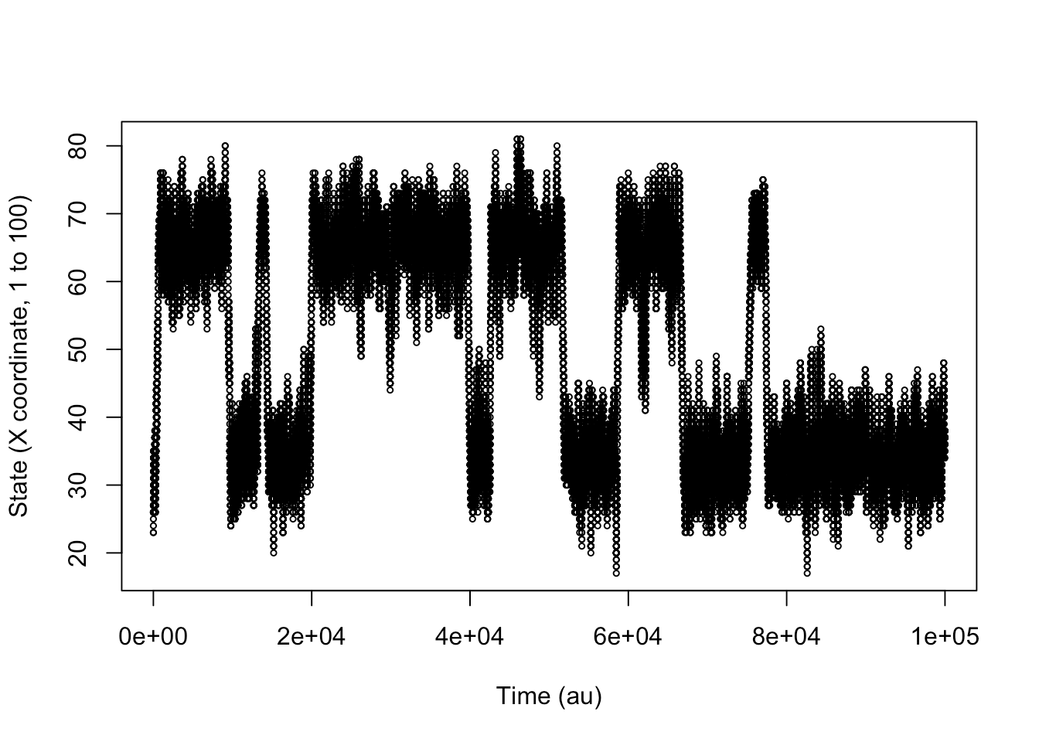
Start with a 1-D trajectory
Already discretized in 100 bins

Slide 25
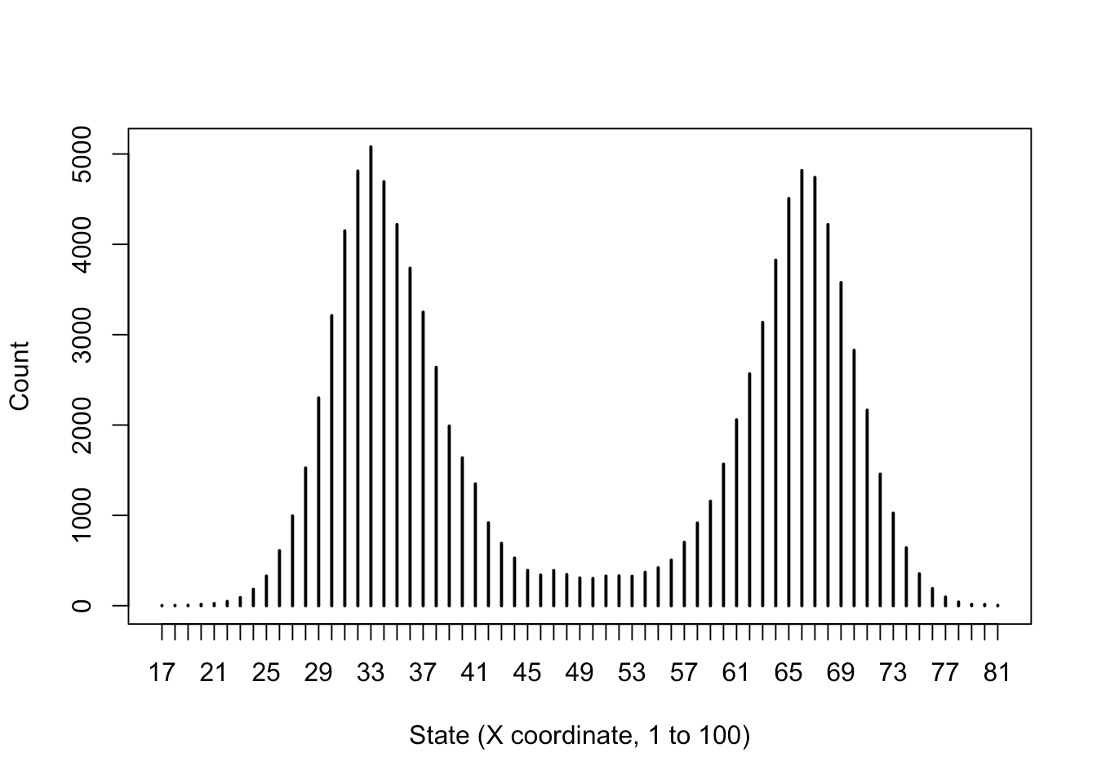
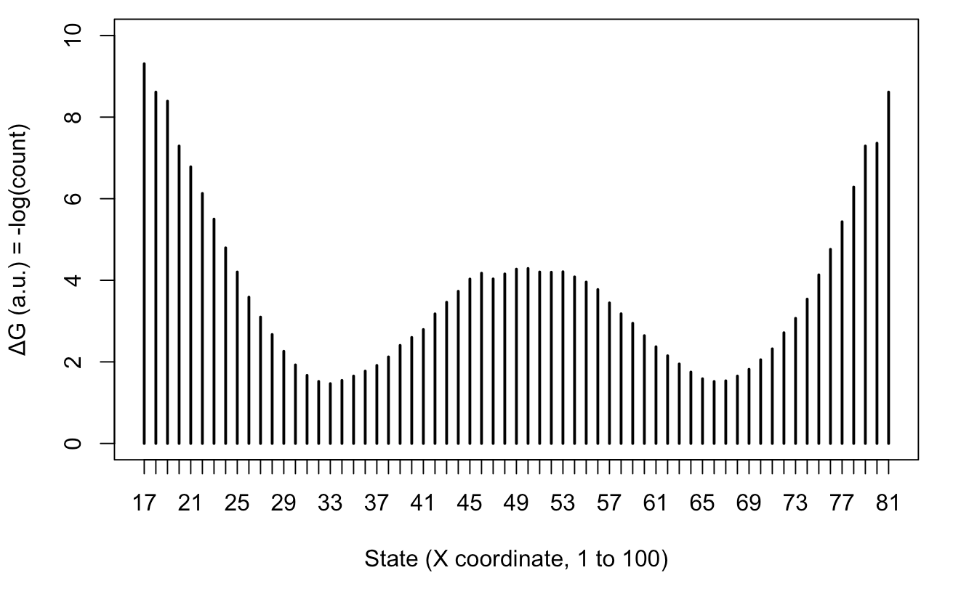
Histogram
Boltzmann inversion -log(count)

Slide 26
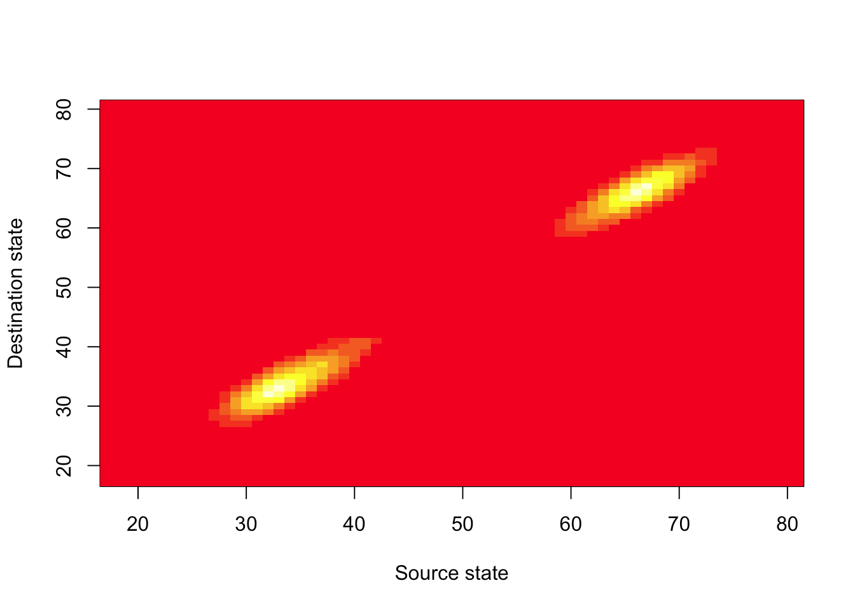
The transition count matrix*
How many times we have seen state i going to j after τ=10 time units
* shown as an image for compactness

Slide 27
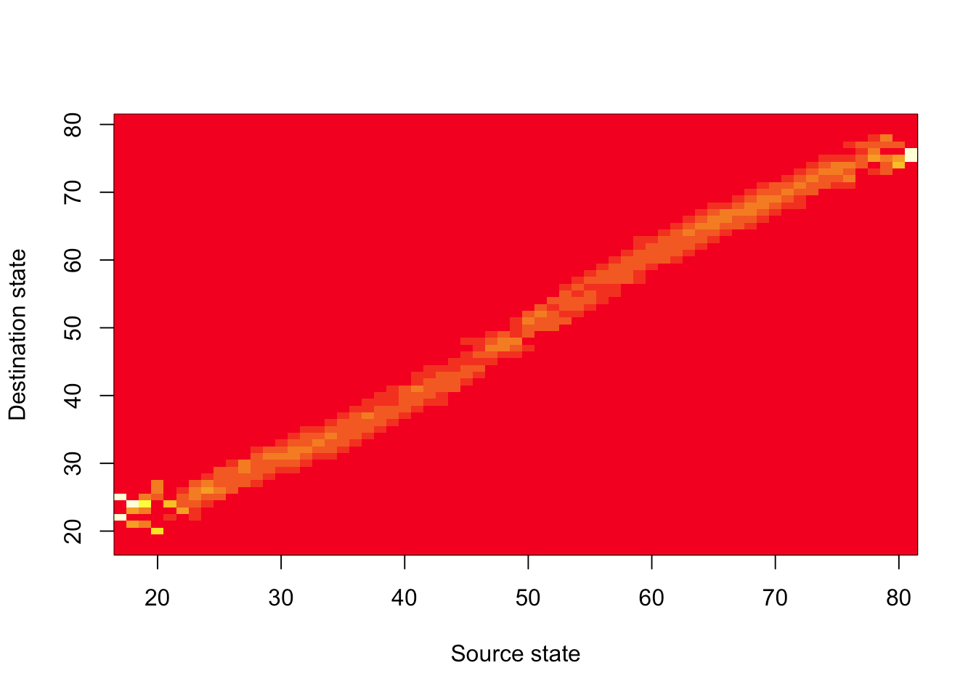
The transition probability matrix
Rows normalized to sum to 1

Slide 28
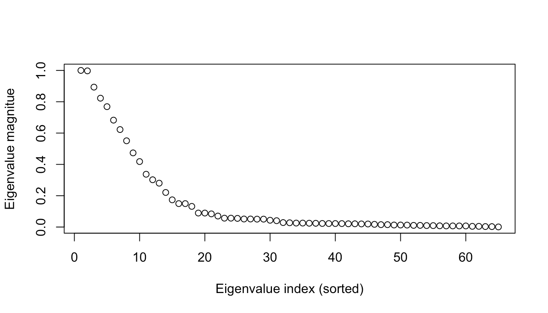
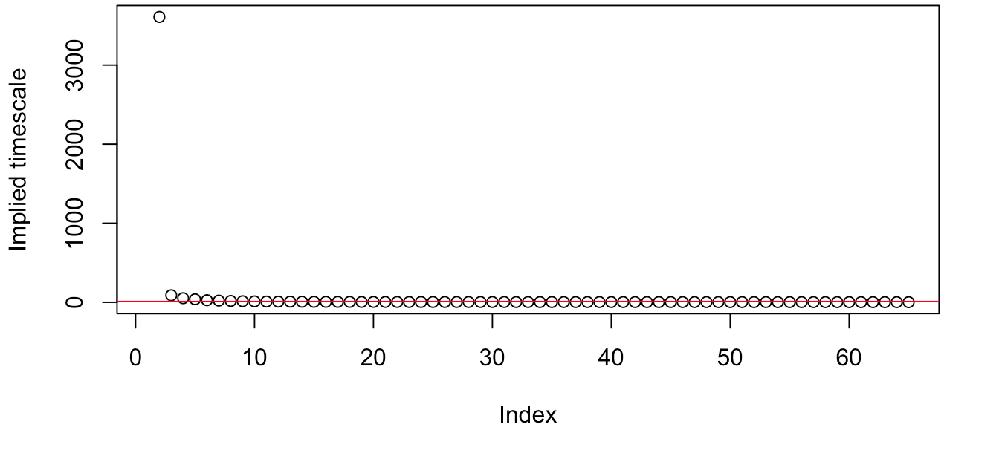
Eigenvalues (at τ=10)
Eigenvalues μ_{i}
Implied timescales
-τ/log(μ_{i})

Slide 29
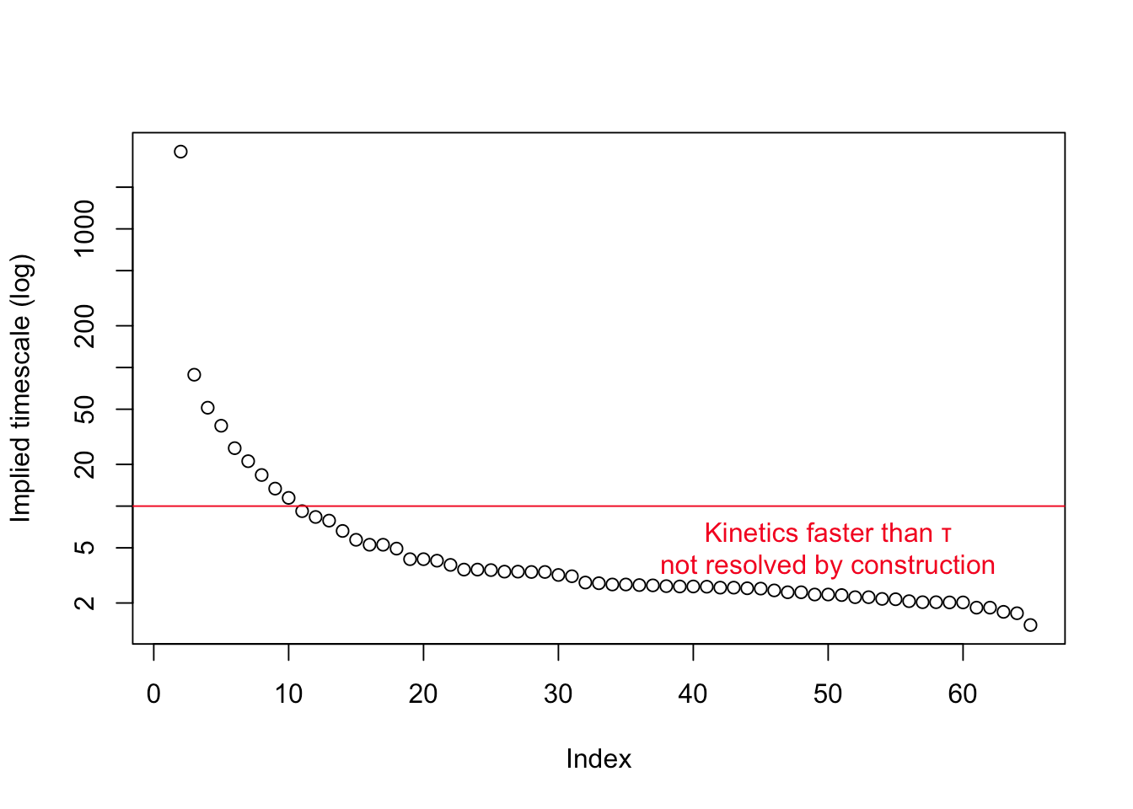
Eigenvalues (at τ=10)
Eigenvalues μ_{i}
Implied timescales
-τ/log(μ_{i})
Now in log scale!

Slide 30
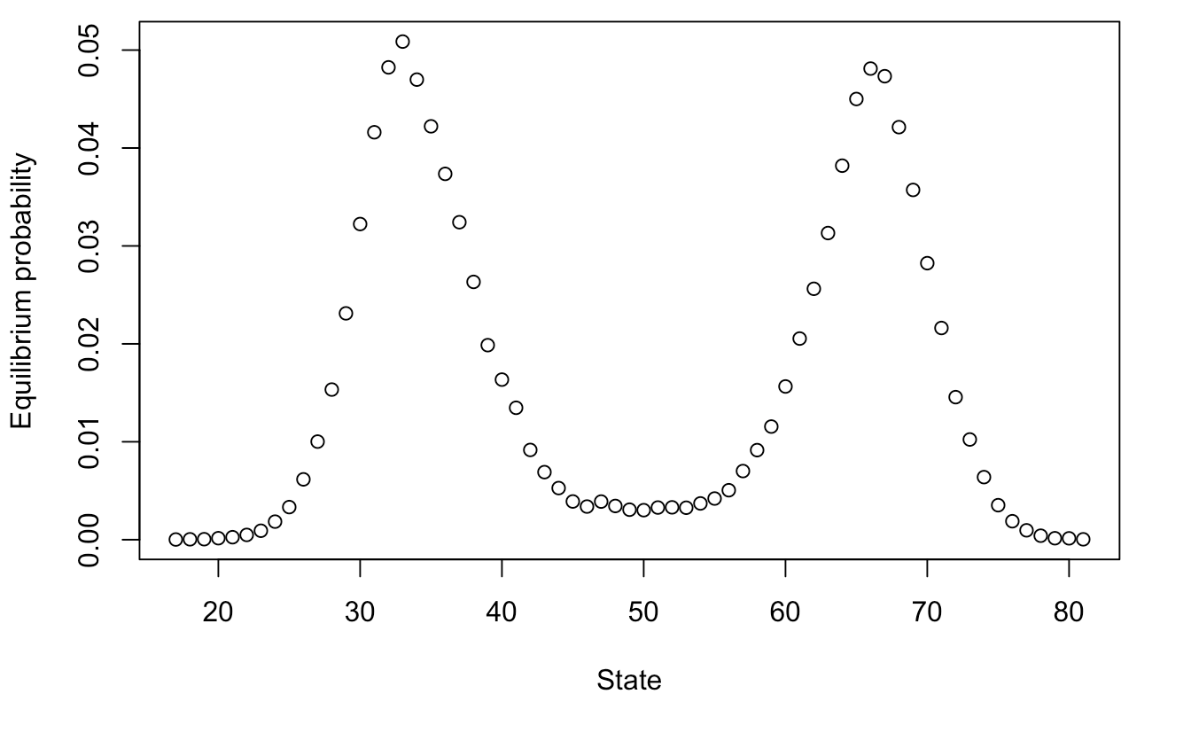
First eigenvector (μ₁=1)
This is the stationary state (normalize so it sums to 1)

Slide 31
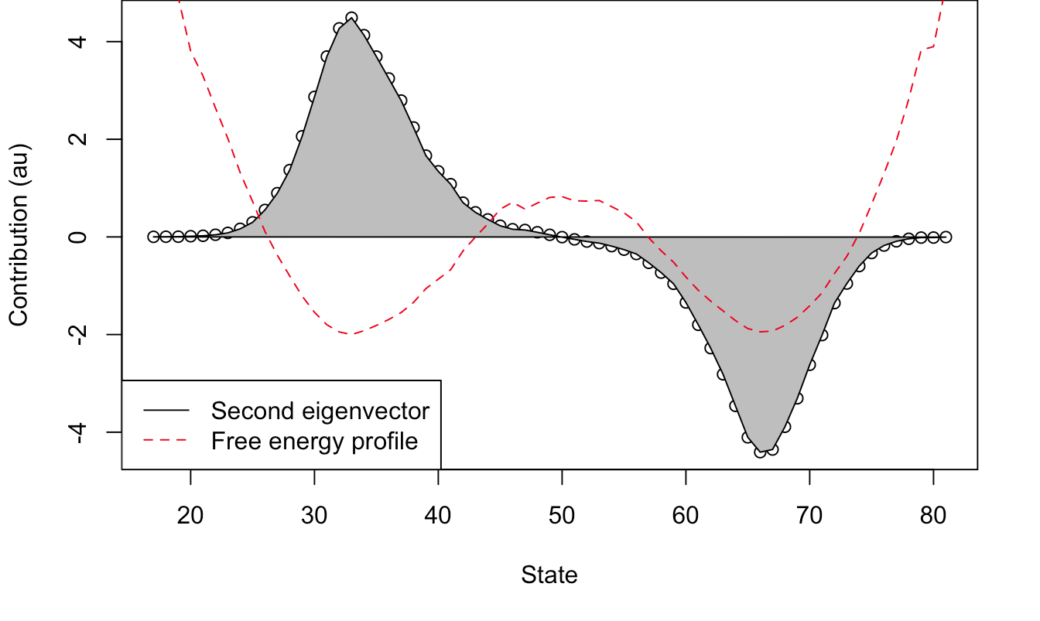
Second eigenvector (μ₂=0.997)
This is the slowest relaxation mode: ITS τ₂ = 3610 time units
*
* Probability mass is exchanged between the + and - basins

Slide 32
Take-home message
Define states.
Use trajectories to count transitions ➔ P_{ij}
Eigenvalues: 1.0, µ₁, µ₂, …
These are the time-scales (after –log)
Eigenvectors: s∞, s₁, s₂, …
These are the equilibrium configuration, i.e. ΔG; and faster “oscillations” (kinetics)
All are a function of τ: convergence

Slide 33
Markovianity
The state transition probabilities only depend on the current state.
Examples
Today’s weather, not yesterday’s
Where the ligand is, not how did it got there
The property may be false at short timescales but true at longer ones (system’s memory)
It does depend on the chosen states

Slide 34
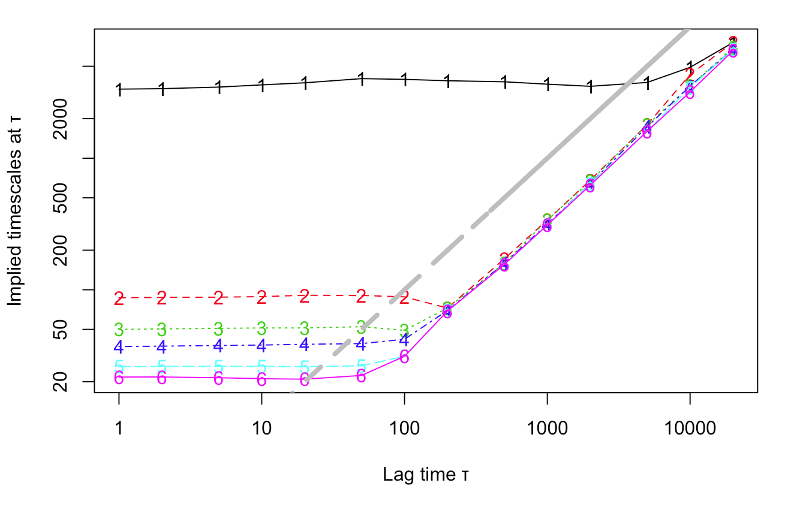
Implied timescales plot
Repeat the eigenvalues determination for several lags. Check convergence.
Here, convergence is achieved very early.
Reasons:
true two-state dynamics;
absence of orthogonal degrees of freedom;
fine space discretization
…and so on

Slide 35
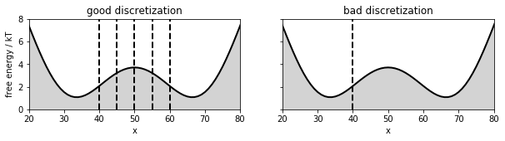
Macrostates
A bad choice of the discretization breaks the Markovianity assumption
In the “bad discretization” case, the barrier is embedded in one of the states. This generates a “long term memory” effect: the rightmost state could actually be short-lived (if we are on the left of the barrier) or long-lived (if we are on its right). These two cases are convoluted into the same, so that the present state information itself is not sufficient to predict the “future” of the system any more.
Based on http://www.emma-project.org/v2.0.4/generated/model_selection_validation.html

Slide 36
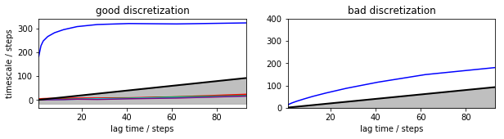
Macrostates
A bad choice of the discretization breaks the Markovianity assumption
Based on http://www.emma-project.org/v2.0.4/generated/model_selection_validation.html

Slide 37
Now let’s head to files
DeepTime_Markov.ipynb
R_Markov.ipynb
The Analysis for HTMD page contains tutorials using actual large-scale simulation data and the HTMD library (note that it takes 30'-1h to install, download data, and run the analysis).

