Slide 1


Molecular dynamics analysis libraries, part 2 with an example based on the dynamics in the physiopathology of gelsolin
Toni Giorgino toni.giorgino@cnr.it
www.giorginolab.it
@giorginolab
github.com/giorginolab/GSN-Tutorial-BCN-2023
Master projects available!
MSI - Master in Bioinformatics for Health Sciences @ UPF 27/4/2023
Notes:
1

Slide 2

Part 1. Motivation Finnish-type amyloidogenic gelsolin variant -
an example of protein dynamics playing a role in proteotoxicity and drug design discovered by MD.
Part II. Practice
MD analysis libraries: intro and reproduction of the analysis* shown in the paper.
* Marked with this symbol →

Slide 3
Part II.
MD analysis libraries
(Practice)

Slide 4
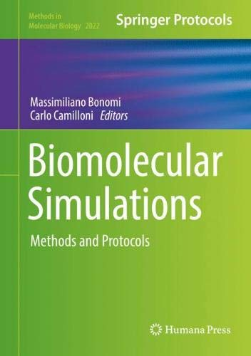
Springer, ISBN 978-1-4939-9608-7 Preprint here.

Slide 5
Analysis of MD trajectories
Interactive: VMD, Chimera, PyMol…
Intuitive
Suitable for one-off tasks
Scripted: for…
repeated analysis (e.g. ensembles)
custom tasks (your own ideas)
automated analysis, e.g. machine learning
Analysis libraries are needed

Slide 6
MD analysis libraries
Library | Language
VMD | TCL
Bio3D | R
MDAnalysis | Python
MDTraj | Python
HTMD/MoleculeKit | Python
We’ll show examples for MDTraj, but there are direct equivalents in the others.
In fact, converting is a useful exercise.
See the Chapter.

Slide 7

Please clone or download…
which contains the papers and data files.
2. Open the Colaboratory link
It is a “live” Python notebook to run your code on Google’s servers. (Account needed)
Alternatively, work locally on your PC.

Slide 8
Loading a trajectory
First, import (activate) the library
Then, load the topology and trajectory*
* Atom names, types, bonds, etc. Usually a PDB or PSF file.
Several formats are supported. Here we use PDB+XTC.

Slide 9
Access molecular data

Slide 10
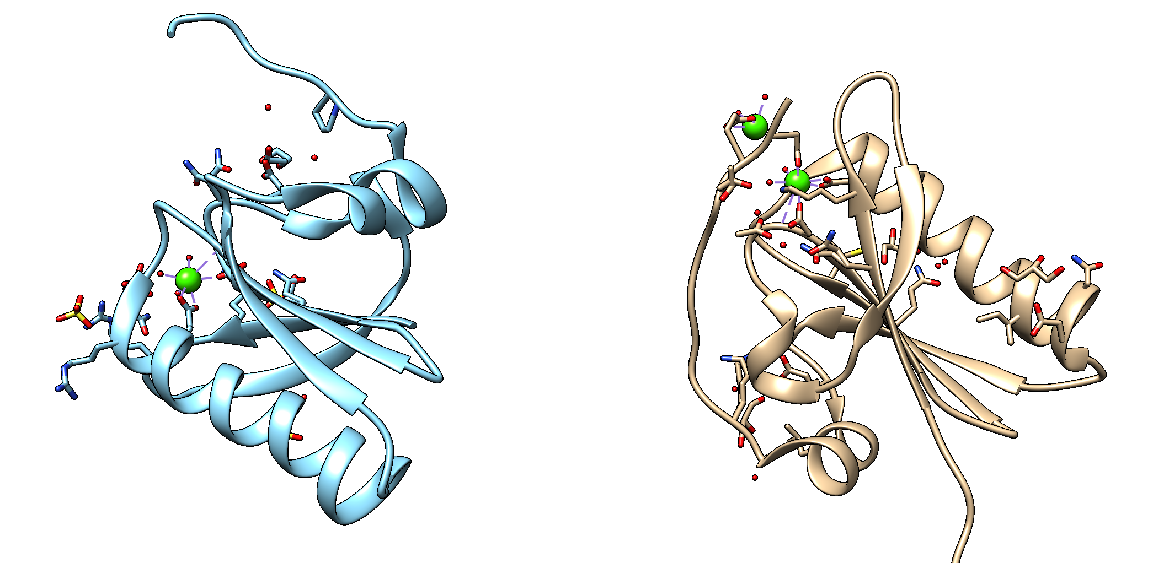
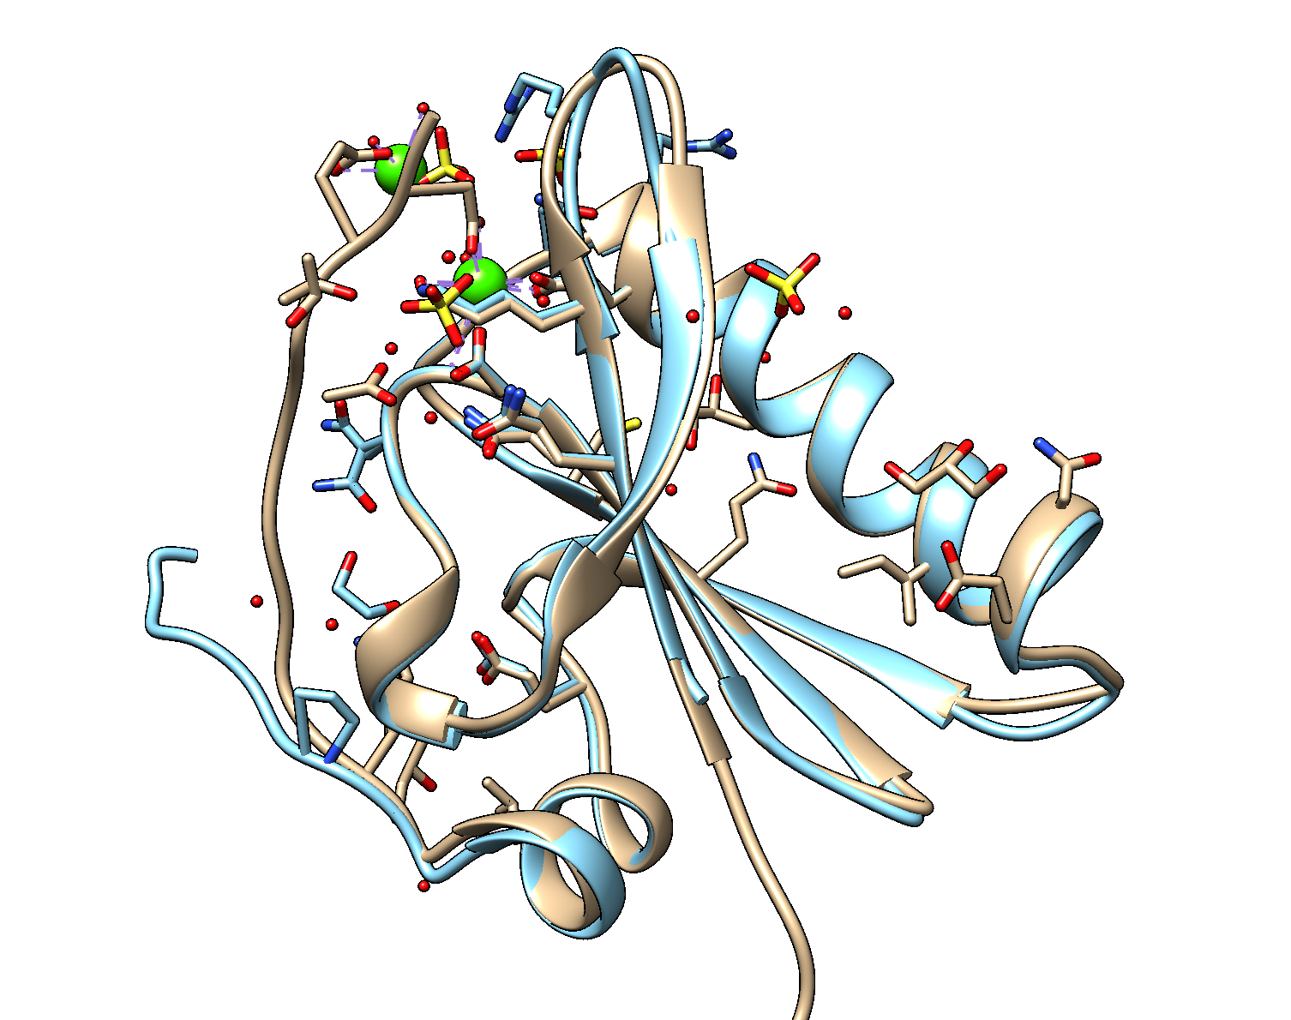
Alignment
Calculations are often performed after a rigid transformation which optimally superimposes two structures (or two frames). It removes diffusion.
Minimize RMSD
Before
After

Slide 11
RMSD
Is the mean squared displacement between two sets of atoms

Slide 12

RMSD
Coordinates array: coords[ atom_index , axis , frame ]
δ₀
c[0,:,t]
Atom 0
c[0,:,0]
δ_{i} = c[:,:,t]-c[:,:,0] (vectors)
δ₁
c[1,:,t]
Atom 1
| δ_{i} | = $\sqrt{δ_{ix}^{2}+δ_{iy}^{2}+δ_{iz}^{2}}$
c[1,:,0]
Atom 2
δ₂
c[2,:,0]
c[2,:,t]
= Time 0
= Time t

Slide 13
Data files (directory data)
 | Apo form | In complex with nanobody Nb11
Wild type | WT | WT+Nb
D187N mutant | D187N | D187N+Nb
For each combination you will find:
a PDB file
a PSF file
an unwrapped trajectory in XTC format (10 ns/frame)
IF present, Nb was held restrained

Slide 14
Now we open the Colaboratory Notebook and try to solve the exercises. ☺
Advanced: rewrite it to use a different library.
Notes:
https://colab.research.google.com/drive/1Pt9gGqiGtrA9_5VRr4J7h3D_WLrBK4k8#scrollTo=SBPzAT4qCrW1

