Slide 1
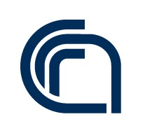

MD Simulations with OpenMM
Toni Giorgino National Research Council of Italy toni.giorgino@cnr.it
www.giorginolab.it
@giorginolab
Thesis projects available
https://github.com/giorginolab/ OpenMM-Tutorial-UniPD-2023
University of Padova c/o Prof. Fuxreiter
Mar 16, 2023
Notes:
1
Good morning to everyone. My name is Toni Giorgino, and it is my pleasure to be a guest in your course.
Today I’d like to give you an overview of the use of Markov-state based methods in biomolecular simulations.

Slide 2
This class
Molecular dynamics is a powerful tool for studying molecular systems
OpenMM is a software library that allows for efficient and customizable MD simulations
It’s exemplary of a modern well-maintained open-source library:
CI infrastructure, developed on GitHub
C++ w/ Python bindings
We’ll use the latter, testing live on Google Colab.

Slide 3
Molecular Dynamics
Notes:
Let me try to convey you the general idea of how MSM stands with respect to other methods.

Slide 4
What is MD?
Attempt the most detailed description of a system which is
atomistic
classical
Model the internal forces…
…in order to integrate the motion
Hope in convergent sampling

Slide 5
Assumptions
In this tutorial we shall deal with unbiased sampling approaches with explicit solvent, i.e.
no added forces except the "physical" ones in your system;
all of the system (including water molecules) have atomic resolution.
Also, current classical MD does not address, by design, the following:
Chemical reactions, e.g. catalysis, phosphorylation, ubiquitination etc.
Protonation changes
Finally, small molecules pose distinct challenges and need a separate, expensive parameterization step.

Slide 6
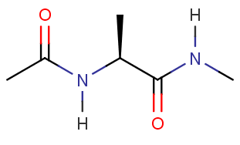
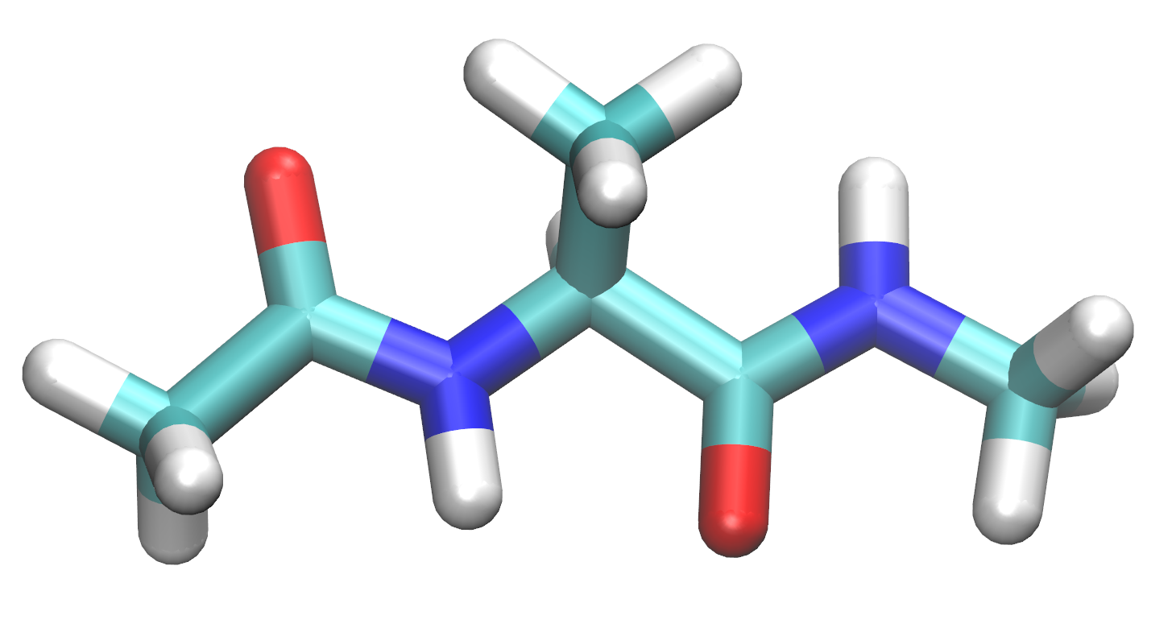
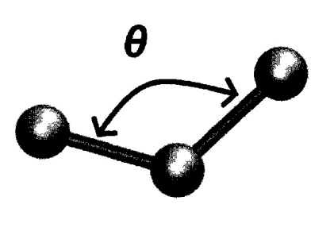
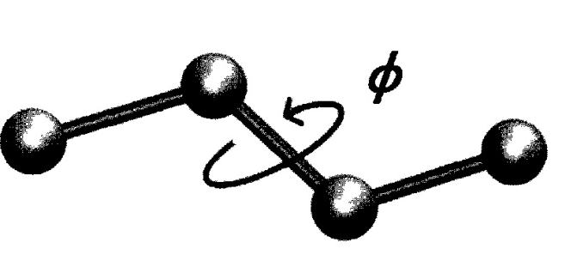
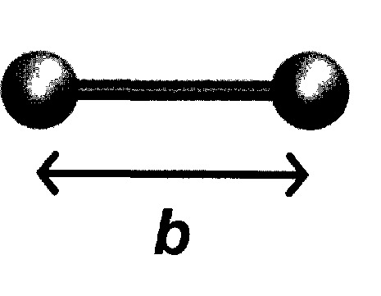
Alanine “dipeptide”
ACE
Ala
NME
Bonded energy terms
+ Electrostatics
+ VdW
The forcefield is a database of interatomic parameters

Slide 7
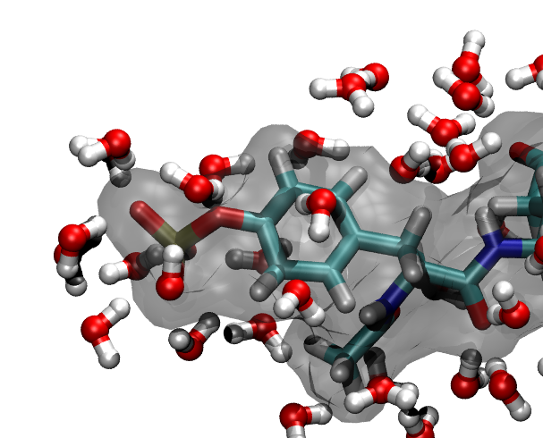
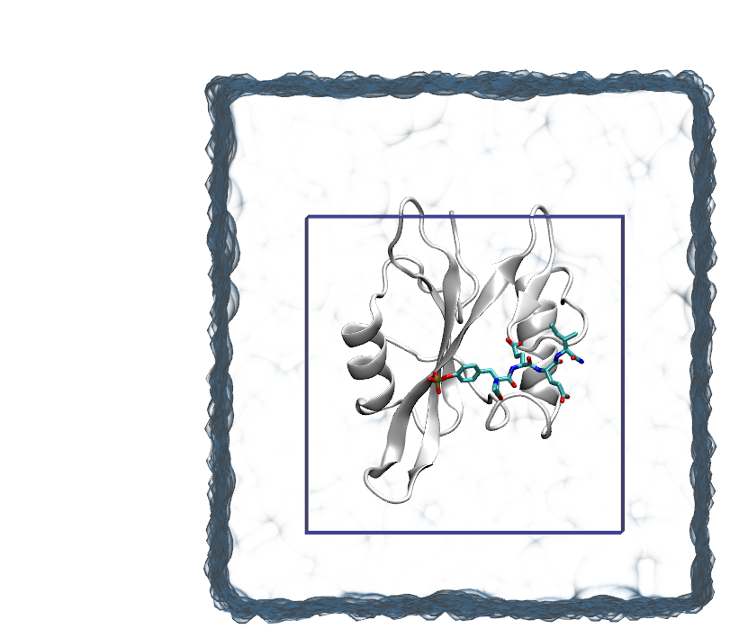
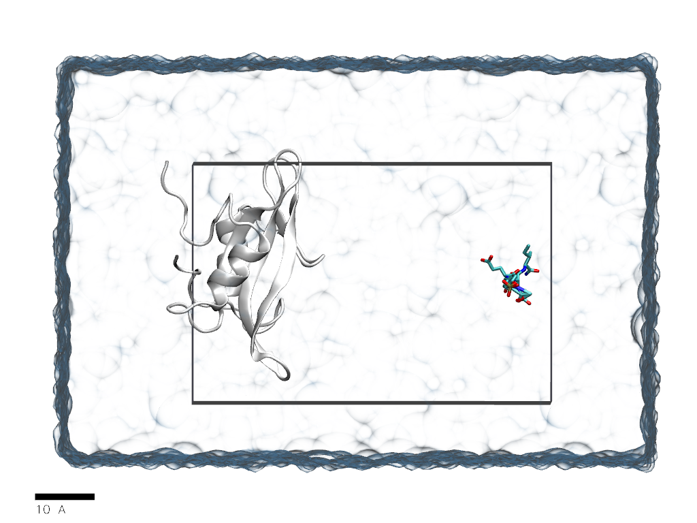
Explicit solvation
→ O(10⁵) atoms
Unbiased dynamics
Update every 10⁻¹⁵ s (1 fs)
7 nm
7 nm
10 nm

Slide 8
Event ≡ Binding / Unbinding / Folding / Unfolding / …
* 1/t_{on} = association rate of SH2-pYEEI × [pYEEI]
Ability to “play” biomolecular processes at all-atom resolution in silico
Molecular bases of folding, binding, selectivity, gating…
Large gain
E.g.*: t_{on} ~ 30 µs → → 10¹⁰ integration timesteps → → 15 years single-CPU compute time
Large cost
Notes:
while I can not have 100s of supercomputers, I can have 100s of gpus. what do I need? enthusiastic volunteers
(or 1 cluster: 128-cores cluster, 50k €)

Slide 9
MD is entirely about timescales
Your ability to obtain quantitative results is severely limited by the sampling ability you have. You will only be able to reach phenomena occurring on the sampled timescales, or shorter.
Sidechain rearrangements, diffusion-limited processes: usually possible *
Local flexibility: usually possible *
Membrane environments: ok-ish
Binding: hard but not impossible
Folding: very hard but not impossible
[*] Unless there are significant barriers.

Slide 10
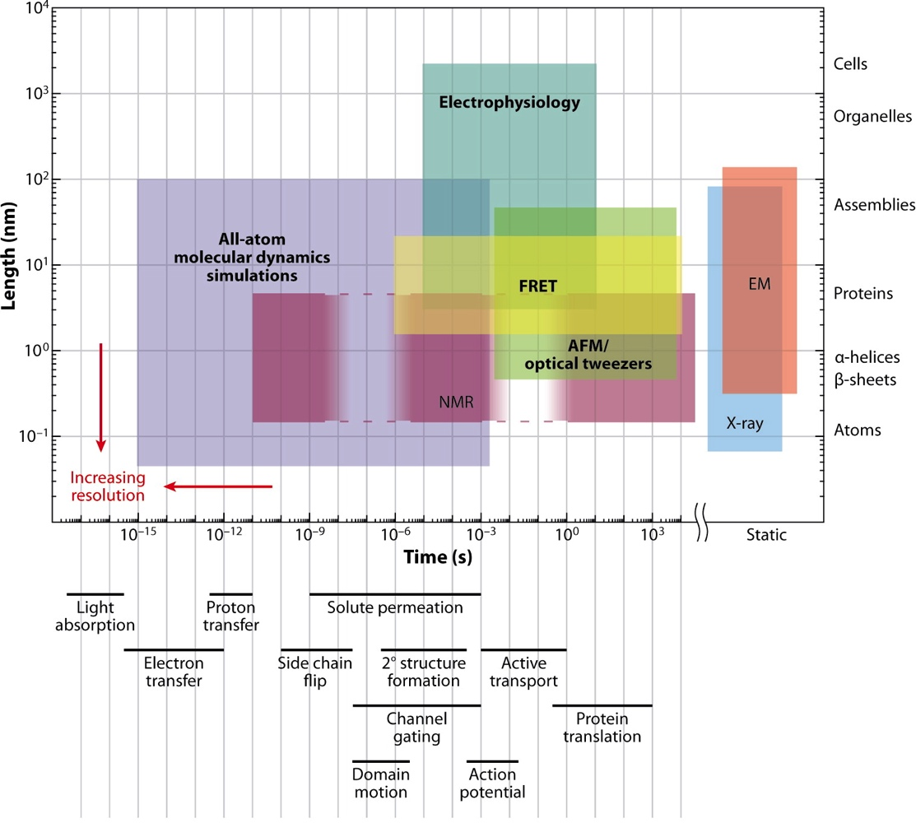
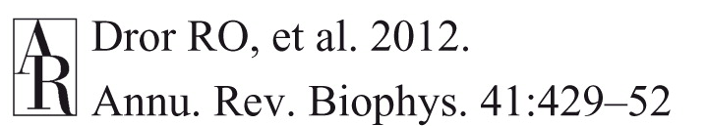
Timescales overview

Slide 11
Patience and limits
The following factors affect the running speed (usually expressed in ns per simulation day, ns/day)
System size. Reasonable is 100 AA ~ 30,000 atoms.
Computer speed. Forget laptops.
Definitely use GPUs.
Software.

Slide 12
OpenMM
Notes:
Let me try to convey you the general idea of how MSM stands with respect to other methods.

Slide 13
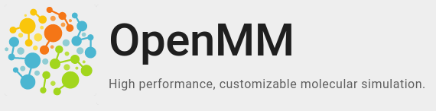
.org
OpenMM is a molecular dynamics simulation toolkit that allows for high-performance simulations of biomolecules.
Allows for simulation of a variety of molecular systems, including proteins, nucleic acids, and small molecules
OpenMM supports a wide range of force fields and integrators and can run on CPUs and GPUs.
Open source, written in C++ with Python and other language bindings available

Slide 14
Basic Workflow (object-oriented)
Download, complete and edit the structure:
Topology (i.e. the identity of atoms, bonds, etc)
Positions (i.e. the starting coordinates)
Create the system object.
Create the integrator object.
Create and add custom forces to system if needed.
Define the simulation object.
Set the initial positions and velocities.
Minimize.
Run the simulation.
(Analyze the results.)

Slide 15
Integrators
…are algorithms that solve the equations of motion for a system
OpenMM includes several integrators, e.g. Langevin dynamics, Verlet integrator, and Monte Carlo barostat
Different integrators are appropriate for different types of simulations and conditions (e.g.: NPT vs NVT)

Slide 16
Simulating a system
Once a system has been defined and the force field and integrator selected, it can be simulated
The simulation (run) involves running a series of steps, where each step involves calculating the forces on each atom, integrating the equations of motion, and updating the system's coordinates
After the simulation, data analysis can be performed to obtain information about the system's behavior and properties

Slide 17
Let’s pick a test system
Notes:
Let me try to convey you the general idea of how MSM stands with respect to other methods.

Slide 18

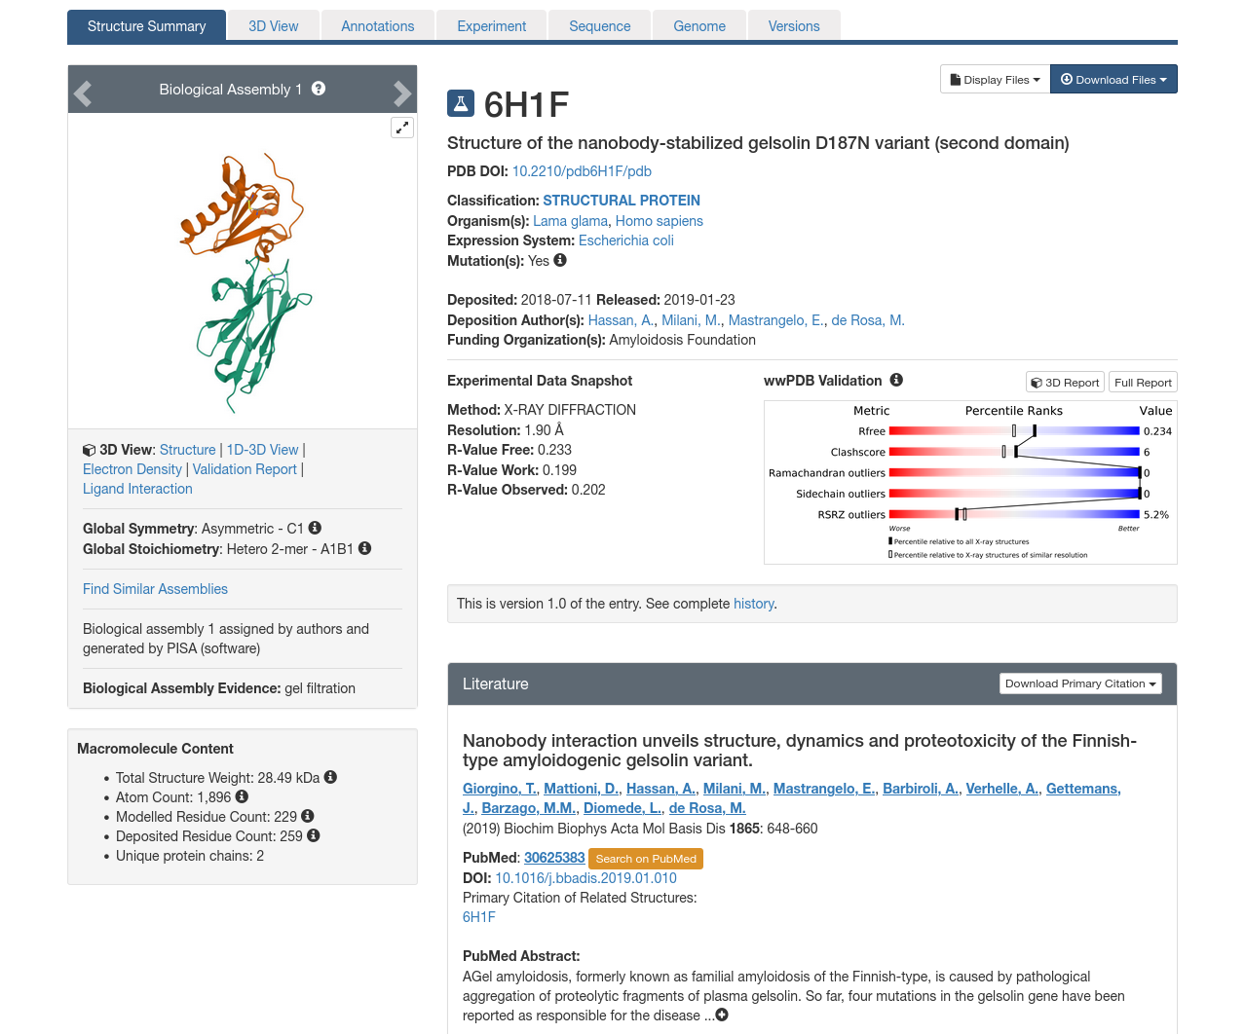
6H1F: Gelsolin G2+nanobody

Slide 19
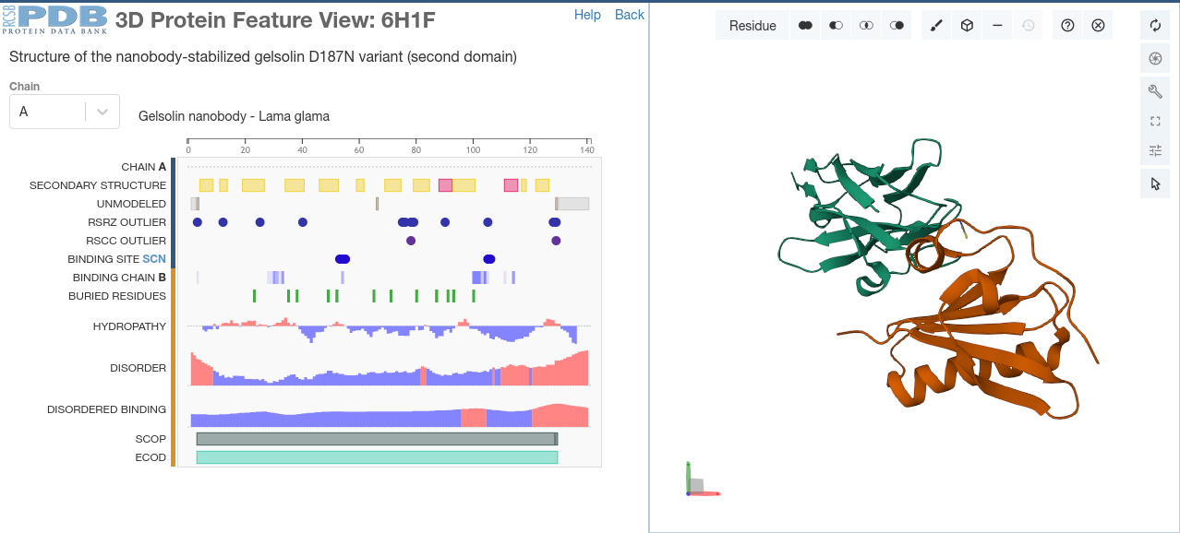

Slide 20
In practice
Notes:
Let me try to convey you the general idea of how MSM stands with respect to other methods.

Slide 21
Using OpenMM on Google Colab
We’ll test OpenMM on Google Colab to run molecular dynamics simulations without the need for installing any software on your local machine.
Google Colab is a free Jupyter environment that allows you to run Python code in the cloud. GPUs runtimes are available.
To use OpenMM on Google Colab or locally, open the provided notebook (read the comments)

Slide 22
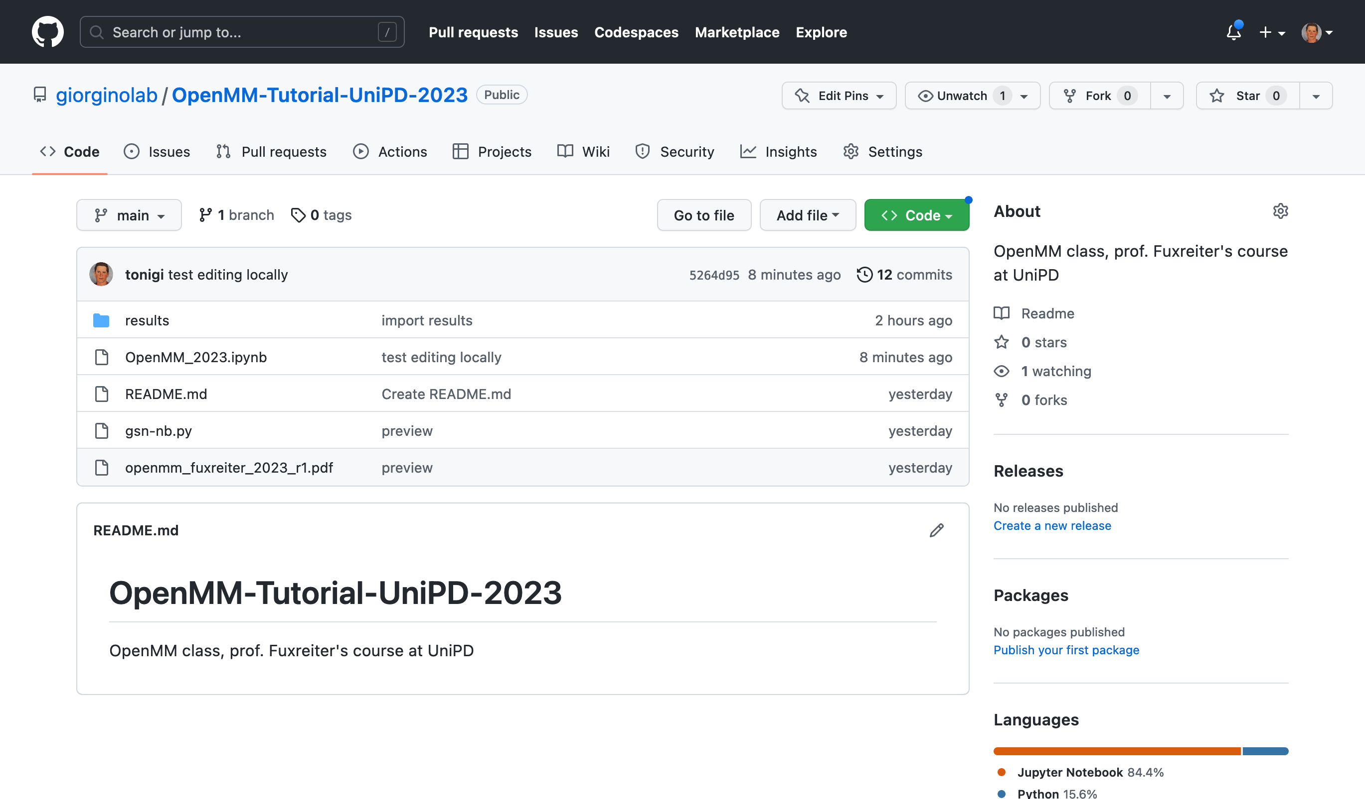

Slide 23
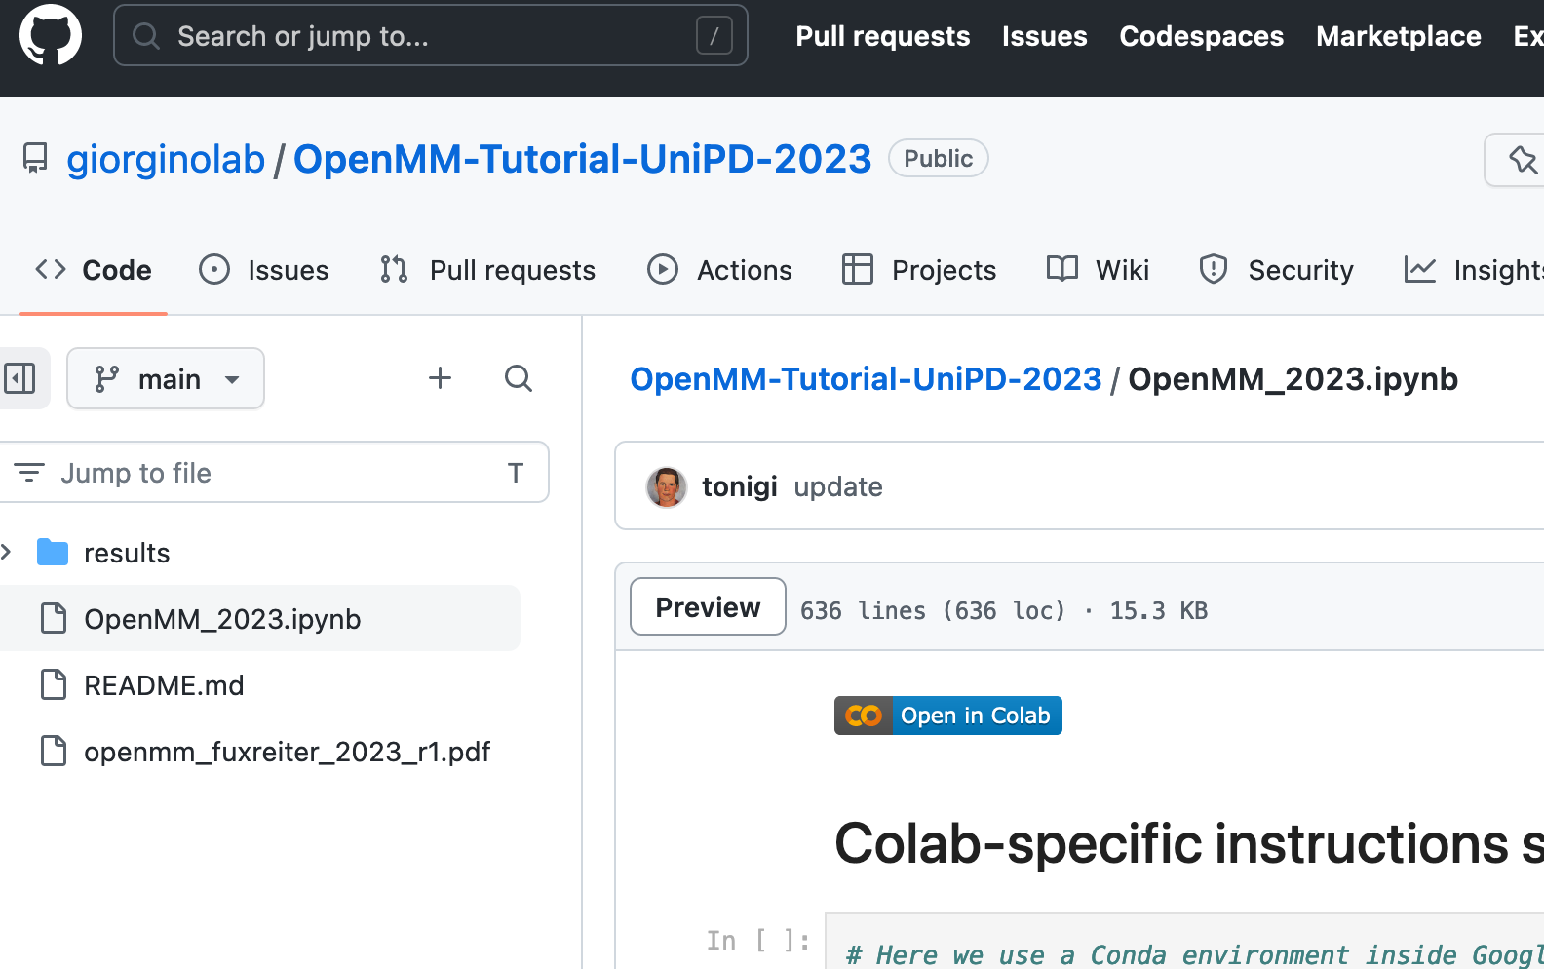
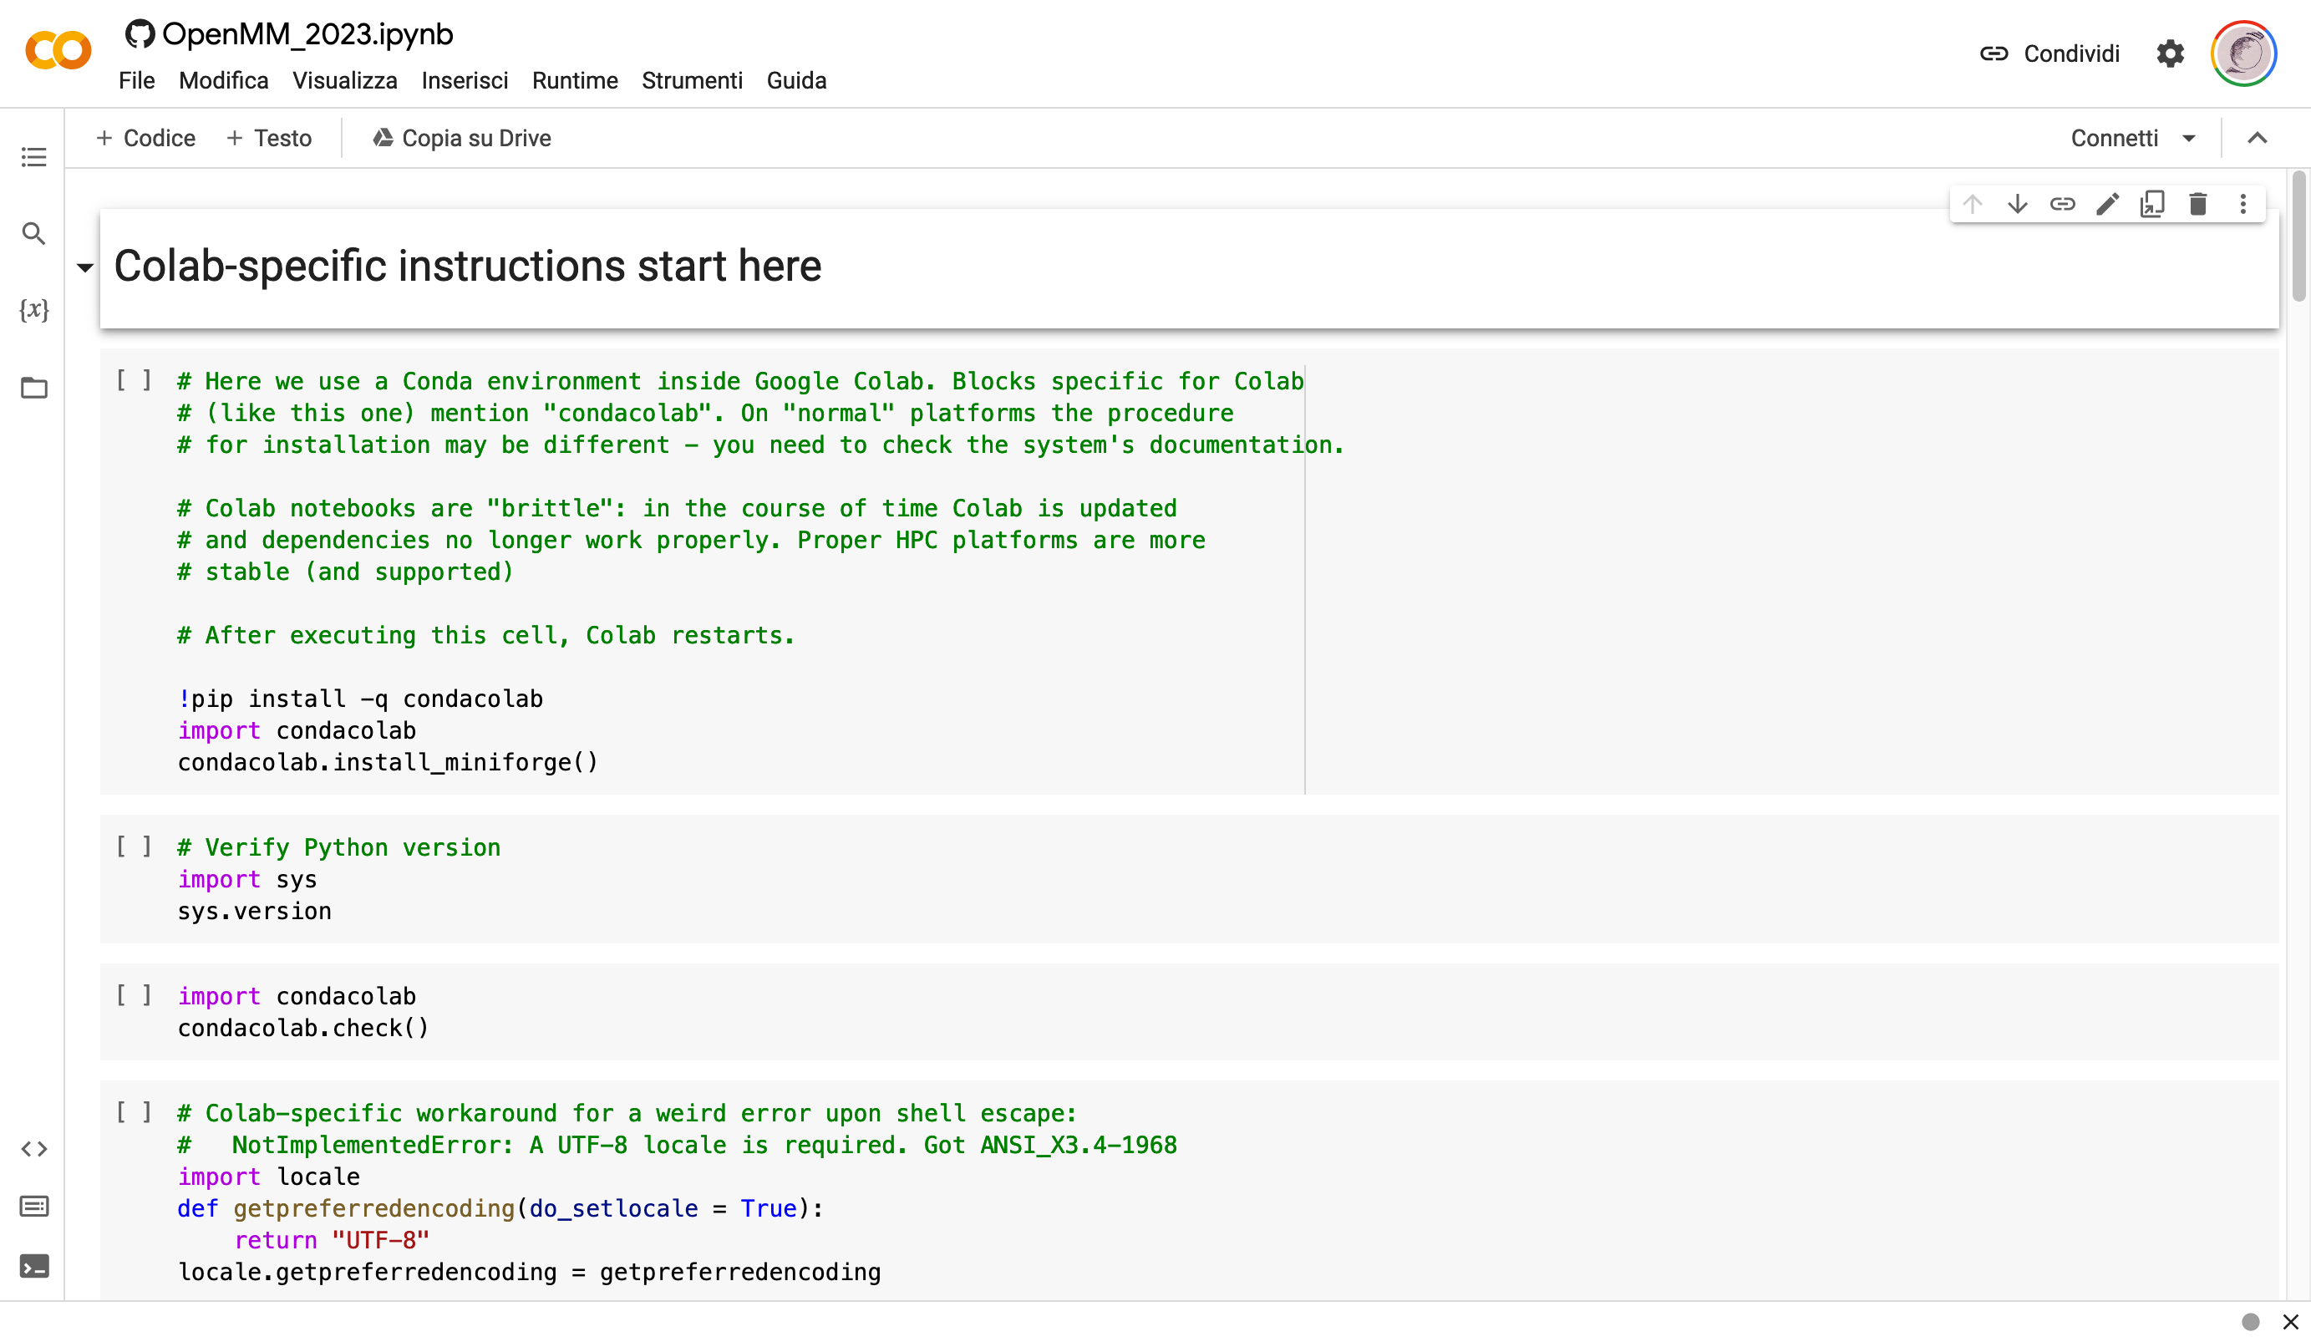

Slide 24
…when done…
Notes:
Let me try to convey you the general idea of how MSM stands with respect to other methods.

Slide 25

Visualize
After you have done the simulation, load the minimized PDB and output.dcd in PyMOL
What about PBCs? Fix with: pbc_unwrap …

Slide 26
Questions
How many atoms?
How many residues?
Disulfide bridges?
How many trajectory frames?
Simulation length in actual time?

Slide 27
More questions
Does density change? Should it?
What is the box size? Is it appropriate?
Relaxation time?
Plot the log file

Slide 28
Conclusion
Notes:
Let me try to convey you the general idea of how MSM stands with respect to other methods.

Slide 29
Conclusion
OpenMM is a powerful tool for molecular dynamics simulations
Good, if fragmented, documentation
With its customizable force fields and integrators, it can be used to study a wide range of atomistic systems, e.g.
“toy” polymers
all-atom MD with major FFs
ANN potentials

Slide 30
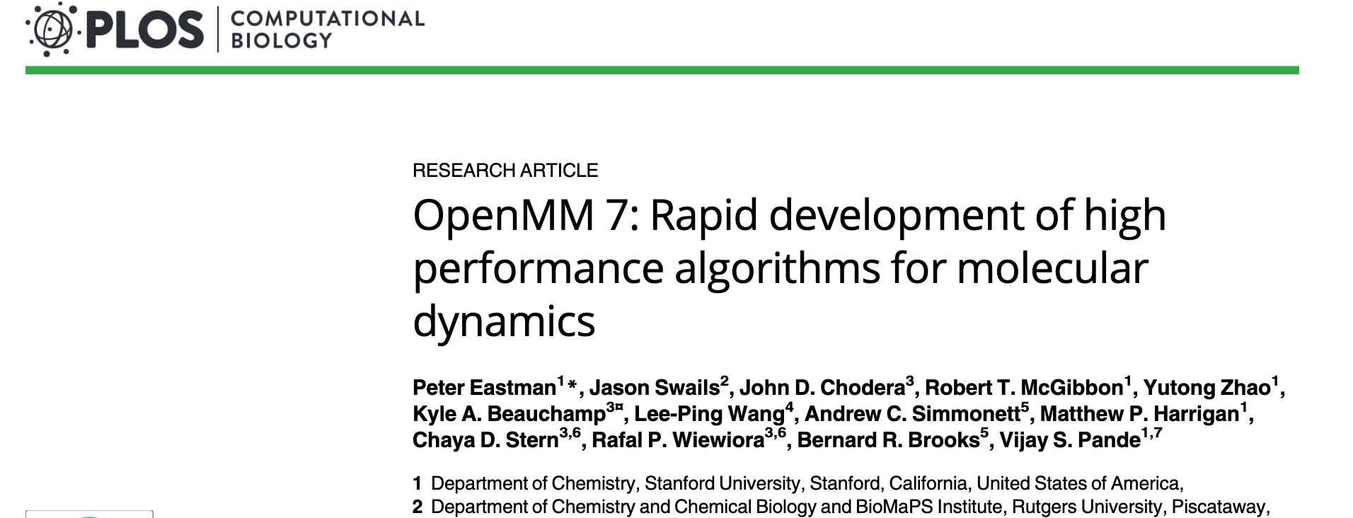
Resources for learning OpenMM
OpenMM.org website and documentation
GitHub repository with examples and tutorials
Community forums and mailing lists for support and discussion
See also
OpenMMtools
https://openforcefield.org/
HTMD, ACEMD
https://github.com/openmm/pdbfixer
Charmm-GUI

Slide 31
End

