Slide 1
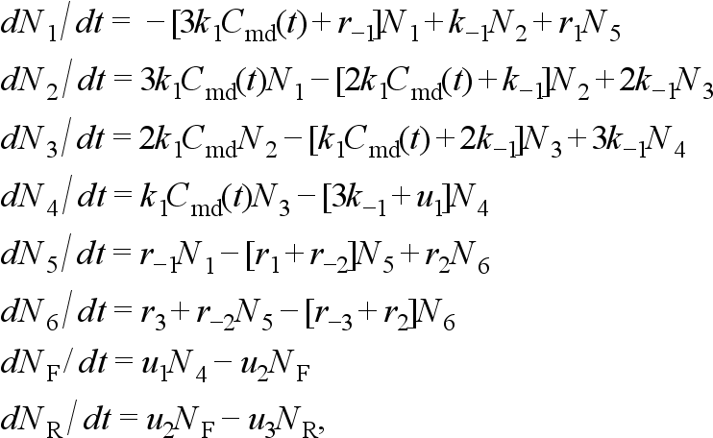



Chain of
granules
Calcium dynamics
Ca⁺⁺ inward
currents

Slide 2




Ca⁺⁺ leak
currents
Effect of Ca⁺⁺ on granule dynamics

Slide 3
Micro-domain
Cytosol
J_{L}
B(C_{md}-C_{i})
L(C_{i})
J_{R}

