Slide 1

Using Machine Learning Classification Algorithms for video quality prediction in DAZN video streamings
Giorgio Daniele Luppina
16 December, 2024

Slide 2
Abstract
DAZN, a global sports streaming service, delivers live and on-demand sports content via a subscription-based model. Since its launch in 2016, it has gained significant traction, particularly among users seeking to avoid traditional cable or satellite TV. This study aims to investigate the application of machine learning techniques to classify video streaming quality based on Layer-4 network measurements. These measurements, including both volumetric and temporal features, are extracted from Tstat log files. By analyzing these features, the objective is to predict the overall streaming quality during a defined playback period, offering insights for network optimization and quality assessment in streaming services.

Slide 3
Streaming Period Sampling
A streaming period is the time interval [ts, te] meanwhile a user watches a video streaming content offered by a Content Provider.
Specifically for DAZN, since the provider adopts DASH as application protol for managing the streaming runtime, each streaming period corresponds to a DASH (Dynamic Adaptive Streaming HTTP) session
DAZN has been observed to use HTTP 1.0 to envelope DASH messages when using TCP, while UDP when using HTTP 3.0 (QUIC over UDP), so there are TCP-based and UDP-based streaming periods. Classification in TCP-based versus UDP-based is data driven:
  Given a streaming period [ts; te], after selecting any flow associate to DASH session, if the 90% or more of all Tstat bins are in TCP, the streaming period is classified as TCP-based; if the 90% or more of all Tstat bins fall in UDP, the streaming period is classified as UDP-based;
  Streaming periods TCP-based are usually made of many TCP flows, since HTTP 1.0 does not support data multiplexing, leading the client to a potential head-of-blocking
  Streaming periods UDP-based are based on QUID, and since HTTP 3.0 supports by design data multiplexing, there is only a flow at layer 4.

Slide 4
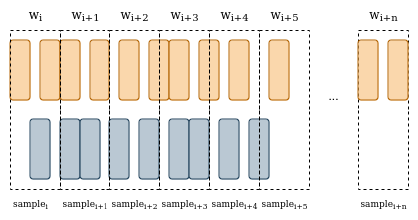
Streaming Period Sampling (cont)
The sampling procedure involves segmenting the time horizon into regular windows, and including all overlapping Tstat bins within each window.
At each window, cumulative sums of bytes, packet are computed, across 1 to N different flows. Since Tstat bins may be not totally included, a uniform distribution is hypothesized for bytes and packets in each bin.
At each window, statistical measures are computed on the bin duration and the idle time, which results in how many milliseconds in the window is not busy by Tstat bins.
The sampling procedure is performed with 1-second step and 10-seconds step
The ground-truth for each window is then defined as the average video quality requested by the client during that step, based on the HTTP requests recorded in the .har trace. It only takes account about 10-seconds step observation (see next slide).
Because of 10-seconds-based ground-truth, any ML model is likely to predict the average video quality each 10 seconds.

Slide 5
Data acquisition
Varying network bandwidth during DASH sessions allows for the evaluation of the streaming protocol's performance under diverse real-world conditions, which is crucial for understanding how adaptive streaming behaves in practical environments.
The client is a simple browser, automated by Streambot, a JS utility which is in charge of conducting supervised experiments, i.e., streaming periods collecting Wireshark traces, HAR archives, and eventually recording streaming periods [ŧs; te].
Network environment is a domestic Wi-Fi LAN, effectively reproducing a customer use-case
Network bandwidth conditions have been emulated with Linux network utility TC, which is in charge to squeeze the bandwidth at client side:
  Network conditions tested: 1.5 Mbps, 3 Mbps, 4.5 Mbps, 6 Mbps, 7.5 Mbps, 8 Mbps, 50 Mbps

Slide 6
Dataset decomposition
Bandwidth | Streaming Periods | TCP | UDP
1.5 Mbps | 76 | 41 | 35
3.0 Mbps | 95 | 41 | 54
4.5 Mbps | 91 | 36 | 55
6.0 Mbps | 94 | 34 | 60
7.5 Mbps | 68 | 29 | 39
50 Mbps | 56 | 26 | 30
Total | 480 | 207 | 273

Slide 7
Dataset format
s_bytes_all | c_bytes_all | ... | s_bytes_all_#1 | c_bytes_all_#1 | ... | s_bytes_all_#2 | c_bytes_all_#2 | ... | video_rate
12134223 | 24343 |  | 2323 | 232 |  | 254 | 343 |  | 1500
3453343 | 24343 |  | 1734 | 23 |  | 254 | 343 |  | 800
164534 | 53343 |  | 2343 | 55 |  | 254 | 343 |  | 1345
3535454 | 23245 |  | 2334 | 35 |  | 254 | 343 |  | 1761
... | ... | ... | ... | ... | ... | ... | ... | ... | ...
After sampling a streaming period, the samples are arranged in a SQL-like table, where each row collects 10-seconds samples metrics alongside all 1-second metrics computed with 1-second step sampling procedure.
The ground-truth has the granularity of 10-seconds

Slide 8
Machine Learning Models
Decision Tree
Random Forest

Slide 9
Jupyter Cluster
Linux Image 22.04.3 LTS (Jammy Jellyfish)
CPU Intel x86_64 Little Endian
72 cores

Slide 10
Preprocessing
Classification algorithm are meant to predict a class, not a real number
The ground-truth variable video_rate has to be binned into discrete classes.
  The binning process requires to set N as number of class
    Low, Medium, High classes are frequently used and useful when assessing quality of a phenomenal,
  The binning process requires also to choose how large each class is. On doing so, we can rely both on unsupervised methods and supervised methods:
    Supervised method: manually definition using MPD DAZN
    Unsupervised methods:
      Using a cluster algoritm, such as Kmeans
      Using a built-in library for equal frequency binning solution, like pandas.qcut

Slide 11
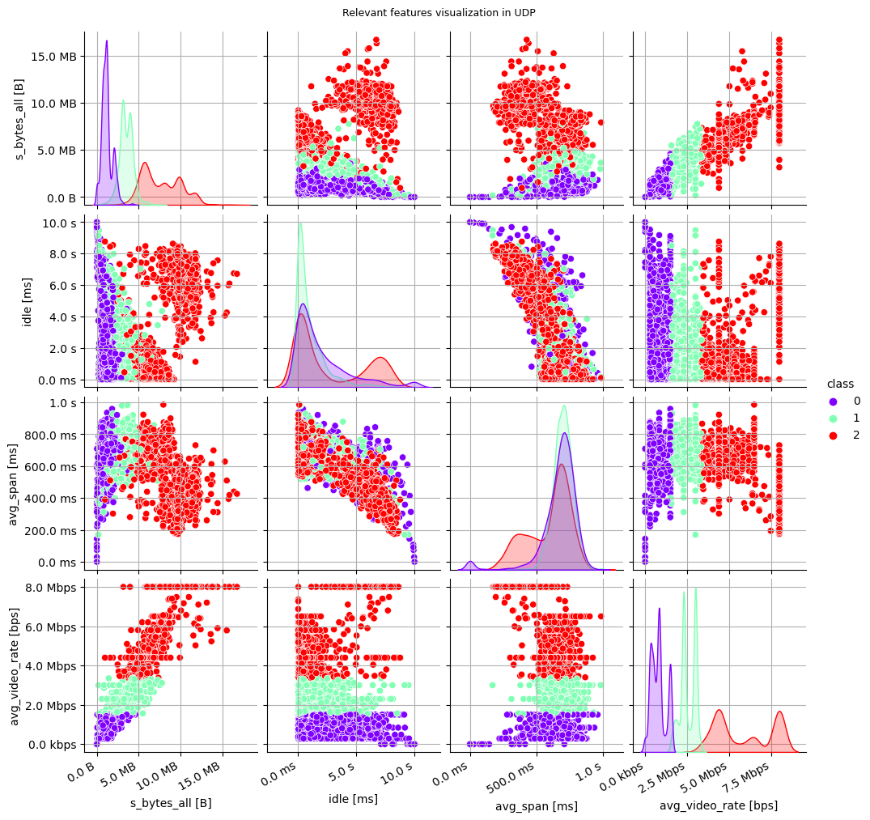
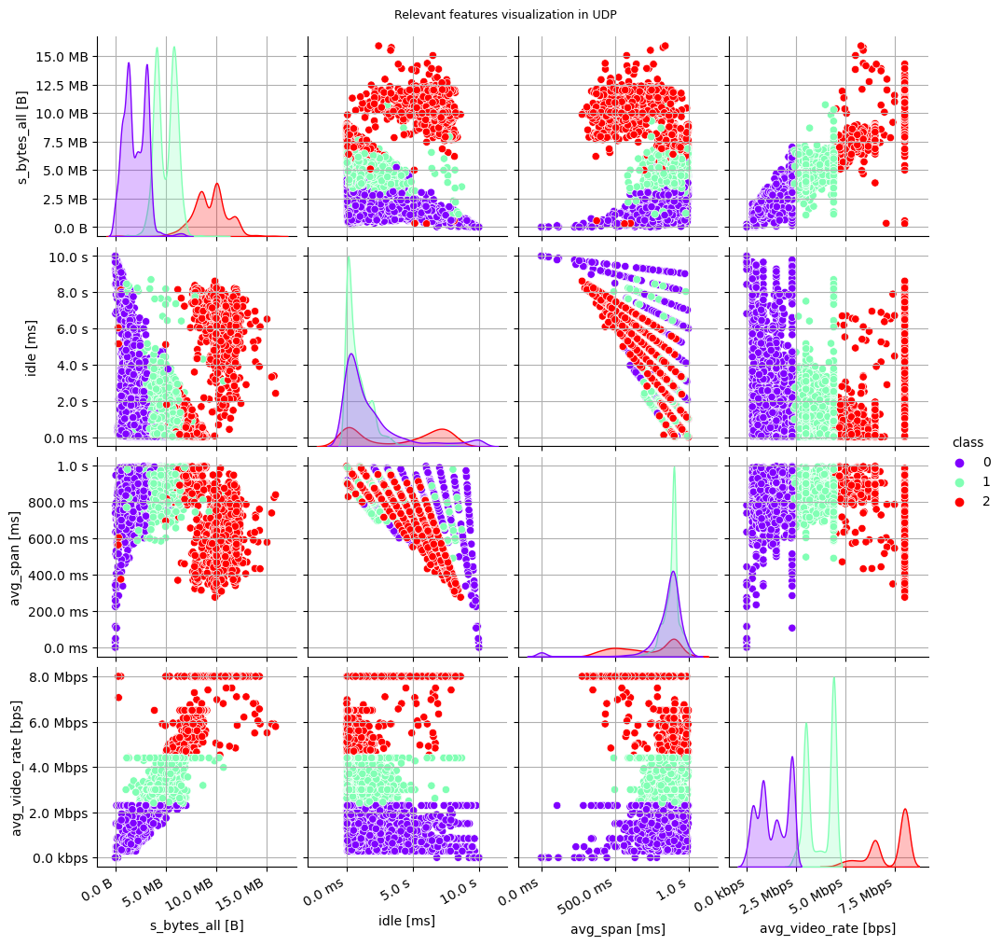
Features Space
(pandas.qcut – based strategy)

Slide 12
TCP/UDP-based Testing Set and Training Set
We created separate classification models, each is meant to classify only streaming periods based either on TCP or UDP
Once having partitioned the streaming periods, each dataset is split in training set and testing set
The ratio between training set and testing at each tested bandwidth is therefore: 75% streaming periods in training set and 15% streaming periods in testing set.
Cross-Validation in LOO has performed for limiting over-fitting, alongside Grid-Search to discover the model that scores the best average macro-f1 across all K folds.
Bandwidth | Training | Testing
1.5 Mbps | 20 | 5
3.0 Mbps | 20 | 5
4.5 Mbps | 20 | 5
6.0 Mbps | 20 | 5
7.5 Mbps | 20 | 5
50 Mbps | 20 | 5

Slide 13
Decision Tree CrossValidation&GridSearch Results
Many instances of sklearn Decision Tree Classifier has been created, focusing primarily on the number of levels the tree should have at most, avoiding to have leaves with few samples.
The best model that has been found in TCP has only 4 levels, 30 samples at minimum in the leaves, using pandas.qcut strategy
The best model that has been found in TCP has only 4 levels, 60 samples at minimum in the leaves, using pandas.qcut strategy.
Hyper-parameter | Values
Minium Samples Leaf | 20 to 210
Tree Depth | 1 to 11
Criterion | entropy, gini

Slide 14
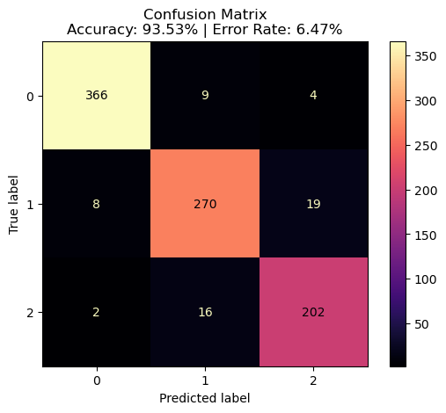
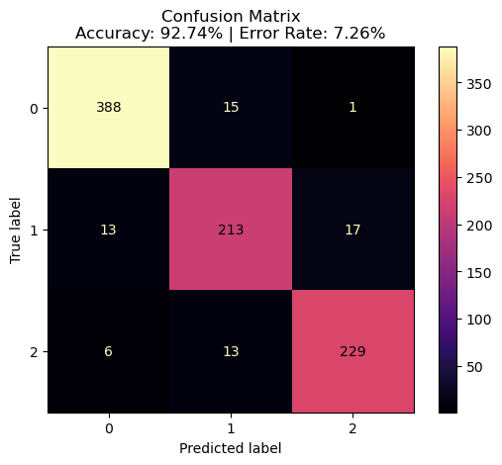
Decision Tree Experimental Results: accuracy
TCP-based DASH streaming
periods
UDP-based DASH streaming
periods

Slide 15
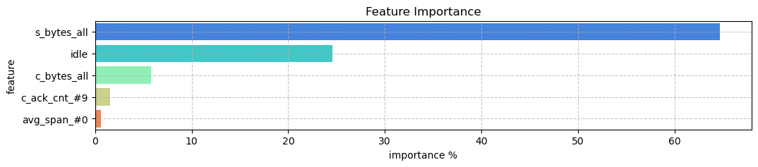
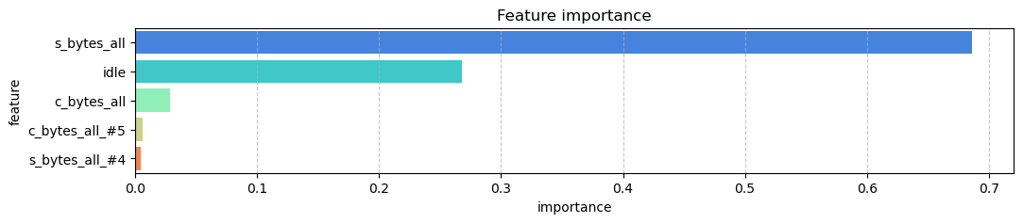
Decision Tree Experimental Results: feature importance
Feature Importance
TCP-based DASH streaming periods
UDP-based DASH streaming periods

Slide 16
Random Forest CrossValidation&GridSearch Results
Many instances of sklearn Random Forest Classifier has been created, focusing primarily on the number of levels the tree should have and the diameter.
The best model that has been found in TCP has only 4 levels, 60 samples at minimum in the leaves, and a diameter of 100 estimators using pandas.qcut strategy
The best model that has been found in UDP has only 4 levels, 160 samples at minimum in the leaves, and a diameter of 100 estimators using pandas.qcut strategy
Hyper-parameter | Values
Minum Samples Leaf | 20 to 210
Tree Depth | 1 to 5
Criterion | entropy, gini
Number Estimators | 50 to 200

Slide 17
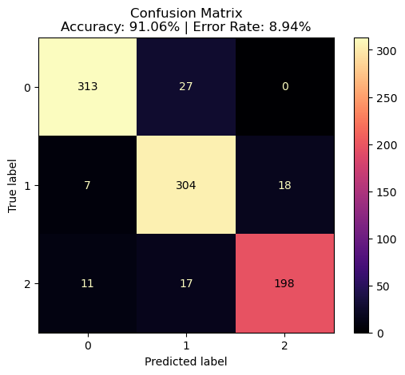
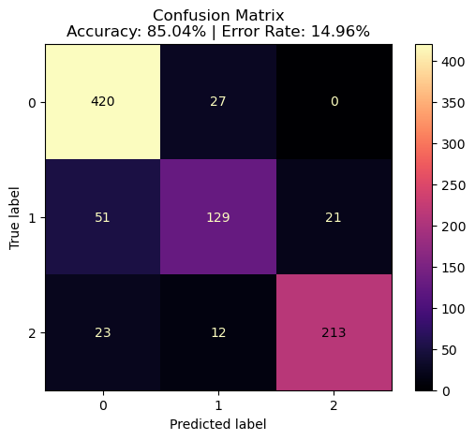
Random Forest Experimental Results: accuracy
TCP-based DASH streaming
periods
UDP-based DASH streaming
periods

Slide 18
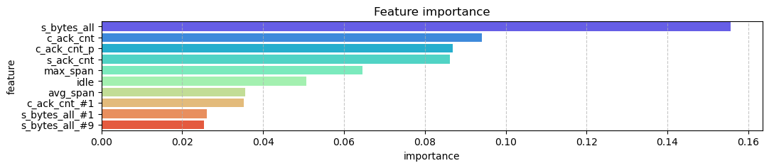
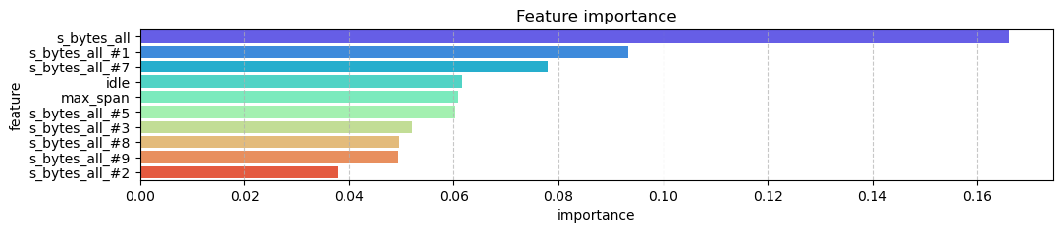
Random Forest Experimental Results: feature importance
TCP-based DASH streaming periods
UDP-based DASH streaming periods

Slide 19
Toward a hybrid model
Experimental results show that s_bytes_all and idle are the most relevant features, and the experimental result holds true for both TCP-based and UDP-based streaming periods classification task
Using a universal model may reduce significantly the classification task, since TCP-based streaming periods and UDP-based streaming periods may be processed and mixed at free will
Incidentally, a universal model would simply the analysis of DAZN flows, aligning Tstat documents to a unique document as mixture of TCP and UDP logs. Thus, this potentially reduces the complexity on designing a system that extract streaming periods from a not supervised Tstat trace.
To have a univeral model, removing the separation between TCP-based and UDP-based streaming periods, only taking the subset of features the two transportation protocol share is mandatory. Having did so, the two protocols can be analyzed as they were identical
Training a unique ML algorithm (Decision Tree, Random Forest) with a mixture of TCP-based streaming periods and UDP-based streamings is what we call a hybrid model.

Slide 20
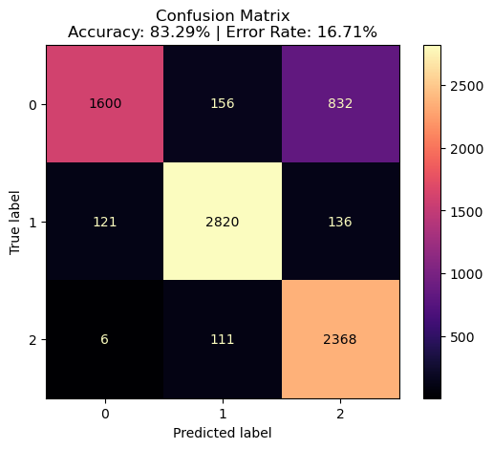
Toward a hybrid model (cont)
When classifying all streaming periods that use the UDP as transportion with a Decision Tree Classifier model trained on streaming periods that use the TCP transport protocol, the result is significant, notably high, and promising. The input was the whole collection of streaming periods we collected, therefore 273 300-seconds long DAZN streaming periods over UDP. Missing features have been zeroed (i.e., the number of ACKs from client to server, and viceversa)

Slide 21
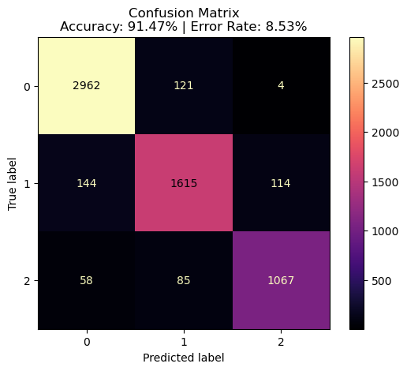
Toward a hybrid model (cont)
Yet, classifying all streaming periods that use the TCP transport protocol with a Decision Tree Classifier model trained on streaming periods that use the UDP transport protocol, reveals significant, notably high, and promising accuracy. The input was the whole collection of streaming periods we collected, therefore 207 300-seconds long DAZN streaming periods over TCP.

Slide 22
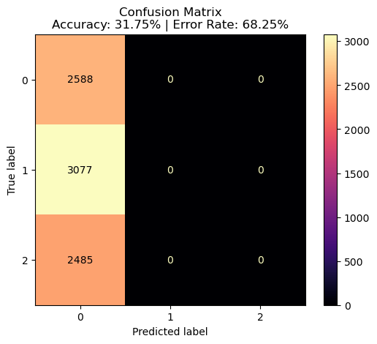
Toward a hybrid model (cont)
Yet, classifying all streaming periods that use the TCP transport protocol with a Random Forest Classifier model trained on streaming periods that use the TCP transport protocol, reveals a poor accuracy. The input was the whole collection of streaming periods we collected, therefore 273 300-seconds long DAZN streaming periods over UDP. Missing features have been zeroed (i.e., the number of ACKs from client to server, and viceversa)

Slide 23
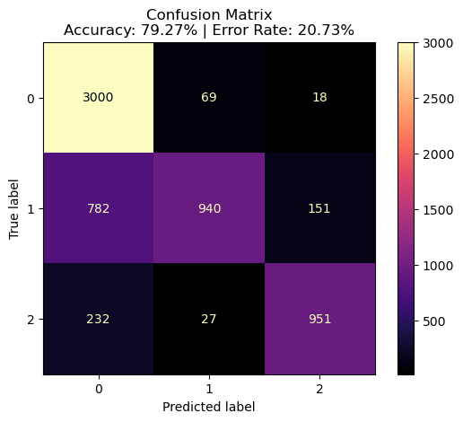
Toward a hybrid model (cont)
Yet, classifying all streaming periods that use the TCP transport protocol with a Random Forest Classifier model trained on streaming periods that use the UDP transport protocol, reveals a discrete accuracy. The input was the whole collection of streaming periods we collected, therefore 207 300-seconds long DAZN streaming periods over TCP.

Slide 24
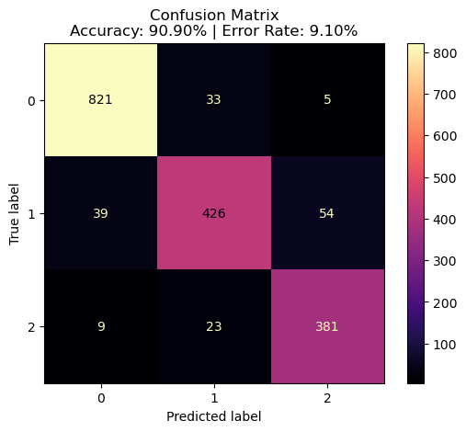
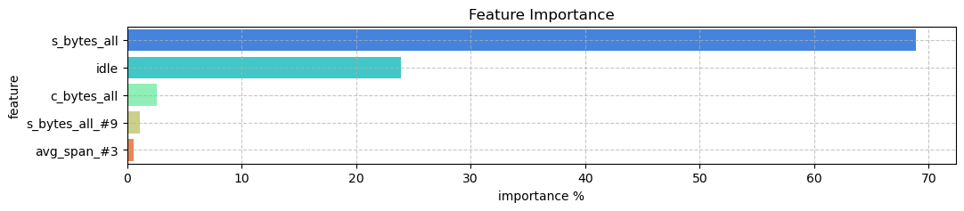
Hybrid Decision Tree Experimental Results
Bandwidth | Training | Testing
1.5 Mbps | 20 | 5
3.0 Mbps | 20 | 5
4.5 Mbps | 20 | 5
6.0 Mbps | 20 | 5
7.5 Mbps | 20 | 5
50 Mbps | 20 | 5
Bandwidth | Training | Testing
1.5 Mbps | 20 | 5
3.0 Mbps | 20 | 5
4.5 Mbps | 20 | 5
6.0 Mbps | 20 | 5
7.5 Mbps | 20 | 5
50 Mbps | 20 | 5
TCP-based streaming periods dataset
UDP-based streaming periods dataset

Slide 25
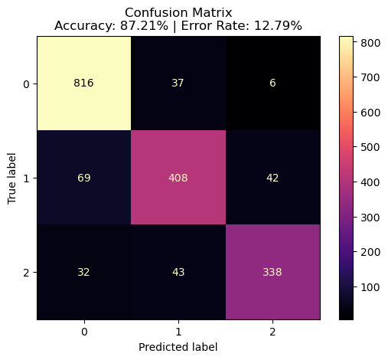
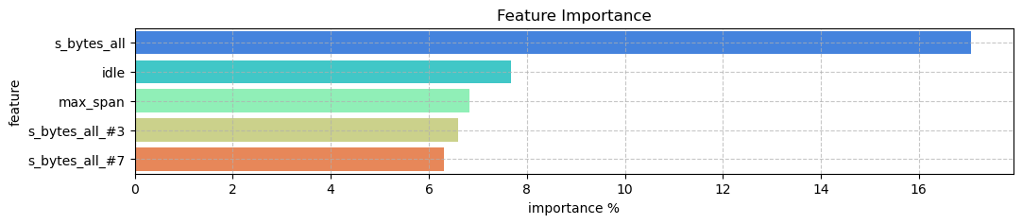
Hybrid Random Forest Experimental Results
Bandwidth | Training | Testing
1.5 Mbps | 20 | 5
3.0 Mbps | 20 | 5
4.5 Mbps | 20 | 5
6.0 Mbps | 20 | 5
7.5 Mbps | 20 | 5
50 Mbps | 20 | 5
Bandwidth | Training | Testing
1.5 Mbps | 20 | 5
3.0 Mbps | 20 | 5
4.5 Mbps | 20 | 5
6.0 Mbps | 20 | 5
7.5 Mbps | 20 | 5
50 Mbps | 20 | 5
TCP-based streaming periods dataset
UDP-based streaming periods dataset

