Slide 1

Introduction to Data Science
Lesson 2
Prof. Hugo Hernandez
Prof. Giorgio Cunto

Slide 2


Module I
Introduction to R
Explore R work environment
Understand what packages are and how to install them
Data types in R
Data structures in R
Order elements in R

Slide 3
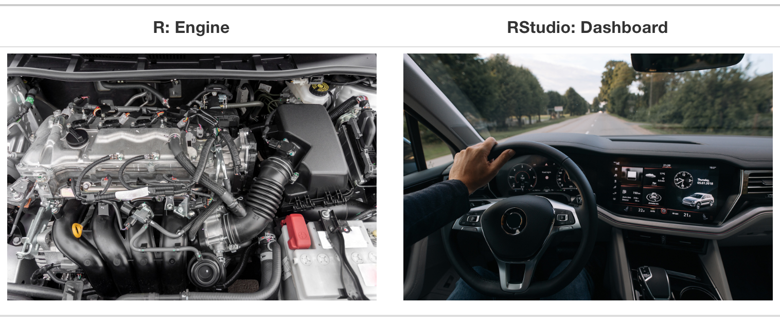
What is R?
R is a free software ecosystem for statistical analysis and data visualization. R is a programming language and environment for statistical and graphical analysis.
RStudio is an Integrated Development Environment (IDE) that helps R users to program comfortably.
The R user interface is not very friendly, so the most common way to use R is through RStudio. RStudio is a program that makes it easier to work with R.
Think of R as the engine running your analysis,
and RStudio as the control cabin.

Slide 4
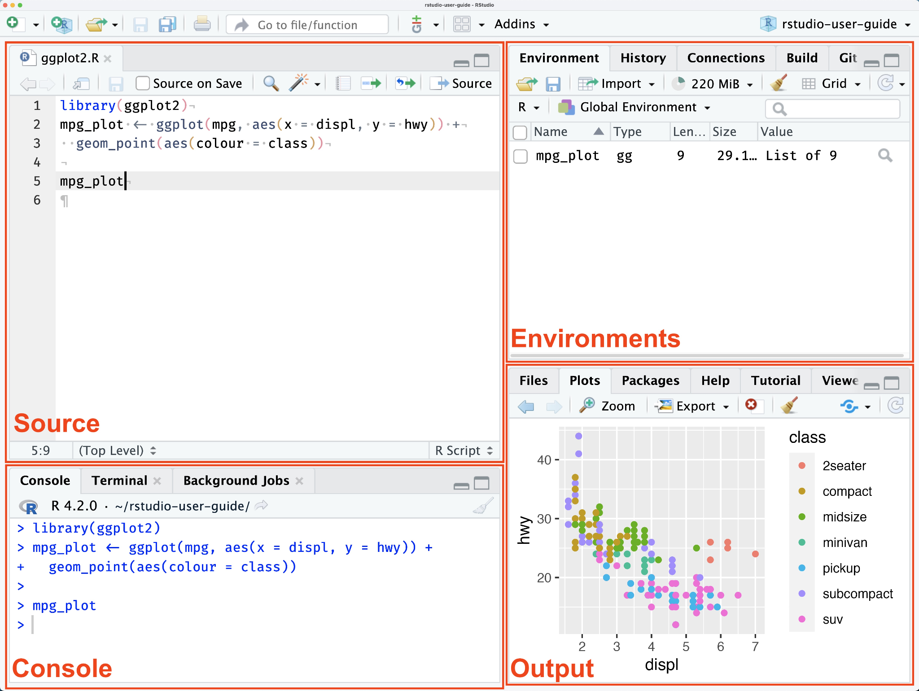
Let’s explore RStudio: pane layout
Shows the name of all objects (vectors, lists, matrices and dataframes) that were defined in the current session in R.
This is where we create and edit R scripts (text files with extension “.R” that store our code).
It is the heart of R. This is where R evaluates and executes the code. Code can be written directly in the console to receive an immediate response. Try writing 1 + 1 in the console
Allows access to files within the designated directory on the computer and displays plots, list of installed packages and R help section.
Fuente: Montané

Slide 5
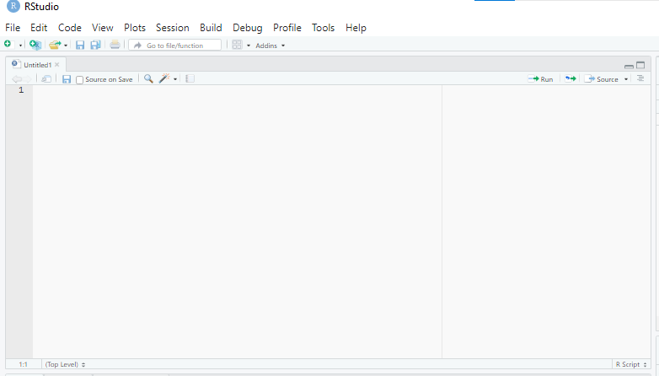
Source pane - Notepad
Menu bar
We highlight the code we want to evaluate and press the “Run” button
Script
R does not evaluate the code immediately while we write in the script. Therefore, we must “send” the code to the console.
PRO TIP:
Write your code in scripts in the file editing panel and save your scripts (to avoid losing your progress). Use the console only for quick analysis.
We highlight the code we want to evaluate and press the CTRL + ENTER keys. If we want to run the entire script: CTRL + SHIFT + ENTER

Slide 6
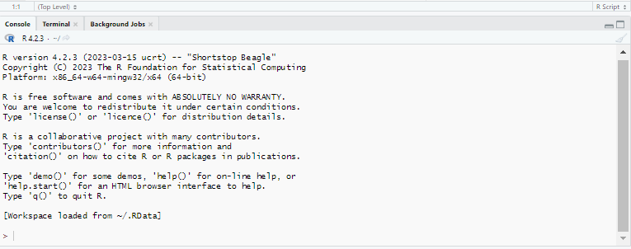
Console - Interprets our code
Working directory: It is the path on the computer that gives a default location of any file that needs to be imported or exported in R.
Prompt
The console DOES NOT store the code you run, that is why it is important to rely on the scripts in the file editing panel when working with elaborate code chunks.

Slide 7
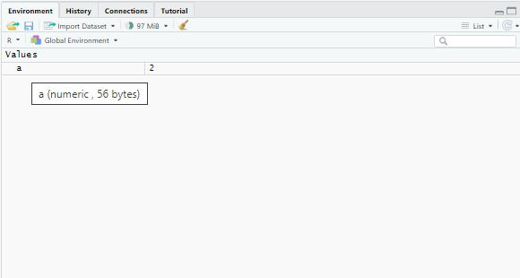
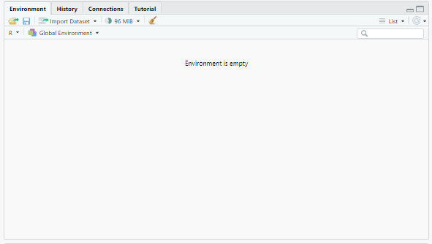

Environment - Almacena los objetos
It is currently empty…
But if we assign the value of 2 to an object that we will call “a”…
Let’s evaluate in the console
a <- 2
It shows us a history of all the code that has been evaluated in the console.
It allows us to access and see all the data objects that we define in the current R session.
Tenemos el objeto a, correspondiente a un vector unitario con el valor de 2

Slide 8
Let's get to work
Scripts 01_the_basics.R y 02_install_packages.R

Slide 9
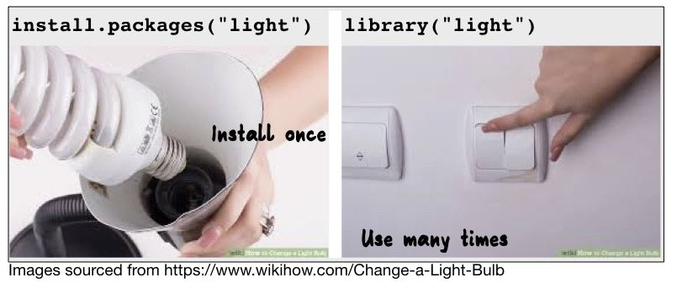
Brief review of scripts 01 and 02
Basic shortcuts to facilitate the use of R:
CTRL + ENTER → Allows you to run the line or chunk of code from the script
CTRL + SHIFT + ENTER → Allows you to run our complete script
CTRL + SHIFT + C → Allows you to insert a comment (It is also valid to use #)
CTRL + SHIFT + R → Allows you to insert a section in the code
ALT + O → Collapse all sections
?function → To search in the help panel for descriptions and arguments of functions
We can do basic numerical operations (addition, subtraction, divisions, powers, etc.)
We assign values to objects using the operator '<-', in which the variable is to the left of the operator and the value to the right (Example: x <- 5)
We can create vectors of numerical values and perform operations with them
We can create vectors of text values or strings and perform transformations with functions like paste()
We install packages with the function install.packages(“package”) and we know that to access and use functions of a package, we MUST ALWAYS execute the library(package) command

Slide 10
Any questions so far?

Slide 11
BREAK TIME
See you in 15 minutes

Slide 12
Main data types in R
Character: data representing string values such as words or multiple words.
Numeric (real or decimal): numeric data that allows continuous values (can contain decimals)
Integer: integer numeric data that allows only discrete values (does not allow decimals)
Logical: Takes values such as TRUE and FALSE or NA (missing values)
TIP: o identify the data type or class of an object, we can use the class() function

Slide 13
Data structures in R
Vectors: contains one (scalar) or more elements of various types, but ALL must be of the same class → Does not allow grouping elements of different classes except for 'NA' (special element of logical type that denotes missing values).
Matrices: vector with dimensions that must contain elements of the same class, like vectors
Lists: unlike vectors and matrices, lists allow us to store different objects or elements with different data classes and different structures. We can generate a list that contains vectors, matrices and even other lists.
Data frames: most common structure for handling and storing data. It is a two-dimensional object that has rows and columns that looks like a matrix, but that can contain different types or classes of data per column.

Slide 14
Let's continue practicing
Script 03_data_types.R

Slide 15
Task for next week
Form work groups for the semester assignments (3 people)
Send via M7 the members of your groups (1 member per team in charge of sending)

