Slide 1

Introduction to Data Science
Lesson 4
Prof. Hugo Hernandez
Prof. Giorgio Cunto

Slide 2
Module II
Research Questions
Importance of research questions in the data science cycle and in research
How to formulate a research question
Data sources for answering our questions

Slide 3
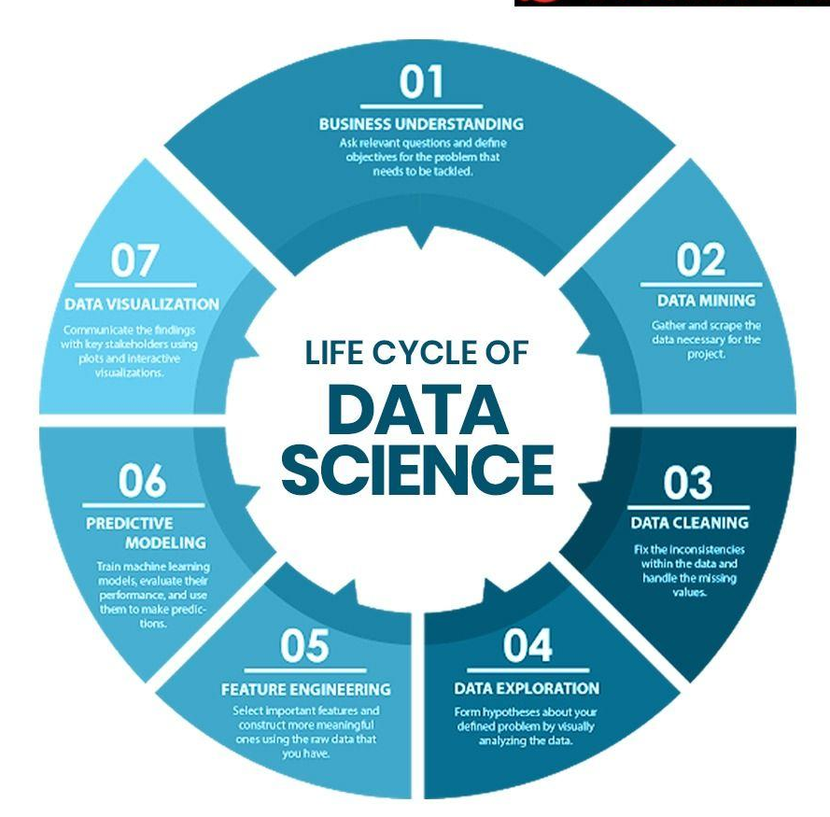
Data Cycle
Understand the problem
Every research project begins with a question
It addresses a topic or a problem that, through the analysis and interpretation of data, is sought to be answered.
Data visualization and communication
Collect data
Analytical tools
Clean data
Transform data
Explore data

Slide 4
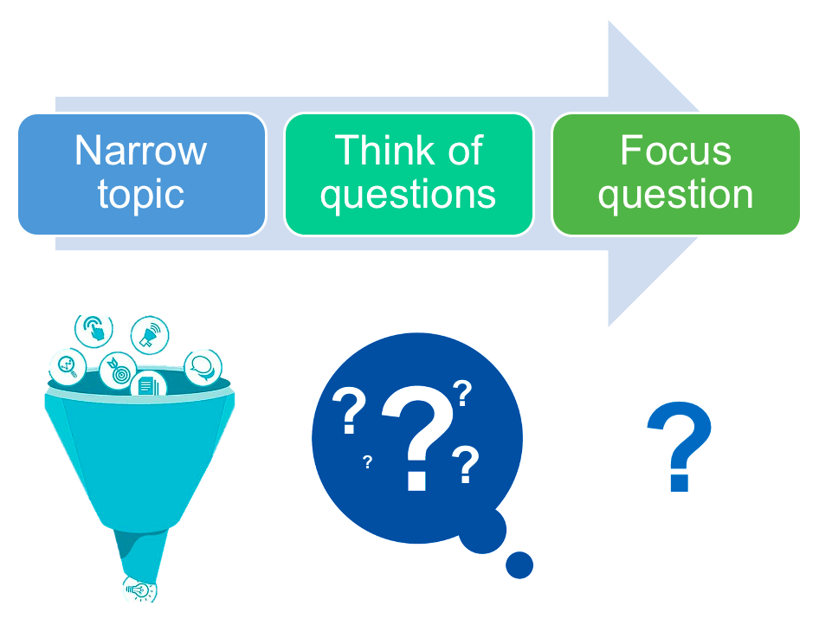
Why is it important?
It allows for clearly establishing the problem to be solved, keeping it focused and with a purpose. It provides the framework within which the topic is intended to be addressed.
It sets boundaries, so that when gathering resources, you focus only on the information that helps answer your question.
Notes:
Describir el presente: procesos, ventas, clientes, poblaciones, problemas. En general ver que esta pasando actualmente, poner diferentes lentes, evaluar según diferentes criterios, características, filtrar los análisis, explorar relaciones intuitivas, etc. Esto ayuda a aliviar el tiempo que necesitas para hacer reportes rutinarios
Buscar patrones y detectar anomalías: bueno por supuesto si podemos establecer como se comporta algo, podemos detectar cuando ese comportamiento esta fuera de la norma. Buscar sesgos, etc.
Diagnosticar eventos, comportamientos, estudiando correlaciones mas complejas.
Hacer predicciones, estimaciones

Slide 5
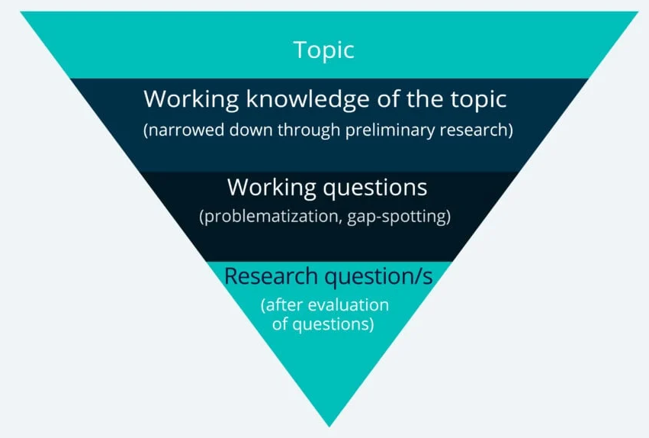
Steps to develop a good research question
Selecting a wide research topic with study branches for potential questions
Preliminary research stage and resource selection
Selecting a narrow or specific study area to narrow down the research question
Formulate questions and evaluate their soundness, specificity, and relevance
Notes:
Describir el presente: procesos, ventas, clientes, poblaciones, problemas. En general ver que esta pasando actualmente, poner diferentes lentes, evaluar según diferentes criterios, características, filtrar los análisis, explorar relaciones intuitivas, etc. Esto ayuda a aliviar el tiempo que necesitas para hacer reportes rutinarios
Buscar patrones y detectar anomalías: bueno por supuesto si podemos establecer como se comporta algo, podemos detectar cuando ese comportamiento esta fuera de la norma. Buscar sesgos, etc.
Diagnosticar eventos, comportamientos, estudiando correlaciones mas complejas.
Hacer predicciones, estimaciones

Slide 6
Steps to develop a good research question
Research topic
Identifying the branches of interest facilitates the process of formulating a research question.
There are no rigid guidelines on how to arrive at a broad topic, but it helps to keep in mind what problems or situations we are curious about. For example:
Approach A: We can choose a broad branch (e.g., Development and Public Policy, Political Economy, Finance, Behavioral Economics, etc.) to investigate and delimit a related problem.
Approach B: We can choose a problem or situation that interests us (based on daily observation or review of previous studies) and work from it. Case studies
Notes:
Describir el presente: procesos, ventas, clientes, poblaciones, problemas. En general ver que esta pasando actualmente, poner diferentes lentes, evaluar según diferentes criterios, características, filtrar los análisis, explorar relaciones intuitivas, etc. Esto ayuda a aliviar el tiempo que necesitas para hacer reportes rutinarios
Buscar patrones y detectar anomalías: bueno por supuesto si podemos establecer como se comporta algo, podemos detectar cuando ese comportamiento esta fuera de la norma. Buscar sesgos, etc.
Diagnosticar eventos, comportamientos, estudiando correlaciones mas complejas.
Hacer predicciones, estimaciones

Slide 7
Steps to develop a good research question
Narrow research topic
Once we have one or more broad topics of interest, we should begin to narrow it down. First, we should read published material related to the topics in order to familiarize ourselves with key debates or events on the topic.
We should focus our attention on a specific topic or debate within the broad topic in order to develop our question.
When delimiting the topic, after preliminary research, we should focus on the key points and arguments we want to convey, as well as the subtopics, deadlines or annotations that will allow us to expose these points.
Notes:
Describir el presente: procesos, ventas, clientes, poblaciones, problemas. En general ver que esta pasando actualmente, poner diferentes lentes, evaluar según diferentes criterios, características, filtrar los análisis, explorar relaciones intuitivas, etc. Esto ayuda a aliviar el tiempo que necesitas para hacer reportes rutinarios
Buscar patrones y detectar anomalías: bueno por supuesto si podemos establecer como se comporta algo, podemos detectar cuando ese comportamiento esta fuera de la norma. Buscar sesgos, etc.
Diagnosticar eventos, comportamientos, estudiando correlaciones mas complejas.
Hacer predicciones, estimaciones

Slide 8
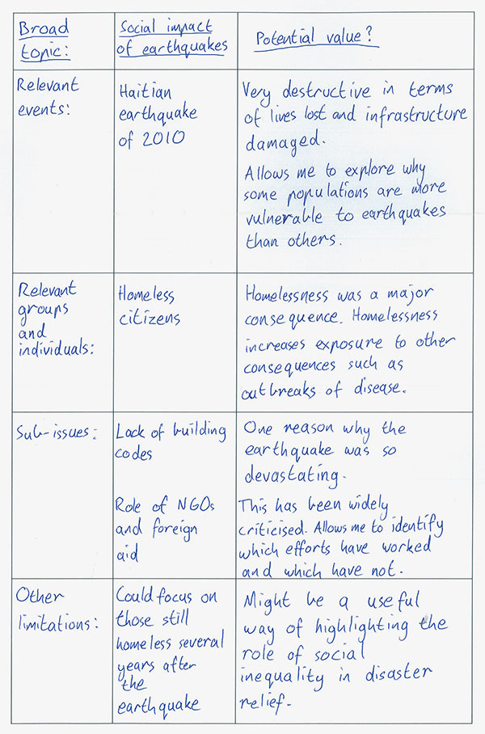
Steps to develop a good research question
Narrow research topic
Example: I am interested in studying the impact of earthquakes on society, in particular the case of Haiti in 2010.
Identifying the main elements is a good start:
General topic
Relevant events (often an important part of the motivation for the study)
Interest groups of the event (we study possible heterogeneities)
Sub-topics
Other annotations or branches that we can explore
Potential value of each of the previous elements.
It allows us to order our ideas and give a simple explanation of why these elements are relevant.
Notes:
Describir el presente: procesos, ventas, clientes, poblaciones, problemas. En general ver que esta pasando actualmente, poner diferentes lentes, evaluar según diferentes criterios, características, filtrar los análisis, explorar relaciones intuitivas, etc. Esto ayuda a aliviar el tiempo que necesitas para hacer reportes rutinarios
Buscar patrones y detectar anomalías: bueno por supuesto si podemos establecer como se comporta algo, podemos detectar cuando ese comportamiento esta fuera de la norma. Buscar sesgos, etc.
Diagnosticar eventos, comportamientos, estudiando correlaciones mas complejas.
Hacer predicciones, estimaciones

Slide 9
Characteristics of a good research question
Written in the form of a question
Relevant → The question is relevant to the research framework, enhancing our understanding of the topic. Seeks to provide answers to a previously studied or new problem
Focused and precise → The question specifies a research objective and the variables to be investigated
Complex → Cannot be answered with a simple “Yes” or “No”; requires synthesis and analysis of ideas to develop an answer
Debatable → The question is open to theoretical debate with more than one possible answer; however, research is required to provide answers to the question. Leads us from a theory to a hypothesis
Feasible → The research needed to answer the question is available and accessible. Data can be collected and analyzed within the time frame of the project
Notes:
Describir el presente: procesos, ventas, clientes, poblaciones, problemas. En general ver que esta pasando actualmente, poner diferentes lentes, evaluar según diferentes criterios, características, filtrar los análisis, explorar relaciones intuitivas, etc. Esto ayuda a aliviar el tiempo que necesitas para hacer reportes rutinarios
Buscar patrones y detectar anomalías: bueno por supuesto si podemos establecer como se comporta algo, podemos detectar cuando ese comportamiento esta fuera de la norma. Buscar sesgos, etc.
Diagnosticar eventos, comportamientos, estudiando correlaciones mas complejas.
Hacer predicciones, estimaciones

Slide 10
Steps to develop a good research question
Research questions
Browse questions
What / Why / How / Which one?
Why is it important?
We must ask questions relevant to our research
Evaluate research questions
Is the question clear?
Is it focused on a defined aspect?
Is it complex enough?
Is it feasible?
Generate hypotheses
Routes we can use to answer the question.
What is my argument going to be and how can I defend it?
What tools can help me answer it?
What data will I need?
Notes:
Describir el presente: procesos, ventas, clientes, poblaciones, problemas. En general ver que esta pasando actualmente, poner diferentes lentes, evaluar según diferentes criterios, características, filtrar los análisis, explorar relaciones intuitivas, etc. Esto ayuda a aliviar el tiempo que necesitas para hacer reportes rutinarios
Buscar patrones y detectar anomalías: bueno por supuesto si podemos establecer como se comporta algo, podemos detectar cuando ese comportamiento esta fuera de la norma. Buscar sesgos, etc.
Diagnosticar eventos, comportamientos, estudiando correlaciones mas complejas.
Hacer predicciones, estimaciones

Slide 11
Good vs. not so good questions
Not a very good question... | Problems with the question | Improved proposal
Why do social inequalities exist? | It is not clearly focused. It is too broad | What is the relationship between women's educational level and fertility rate in developing countries?
Is the use of social networks harmful to the self-esteem of children between 10 and 15 years old? | Not complex enough: we can answer with a yes or no. Not clear enough | How is the amount of time 10-15 year olds spend on TikTok related to their levels of body satisfaction and self-esteem?
How do social, economic, cultural and political factors influence young people's career choices in a globalized and changing context? | Too complex: it tries to cover many relationships between variables. It is better to focus on one of the many options. | What is the relationship between socioeconomic status and STEM career choice among high school students in Mexico City?
How should social networking sites address the harm they cause? | Not clear and specific enough | What measures should social networking sites such as Instagram and Facebook take to protect users' personal information and privacy?

Slide 12
Exercise: Good or bad? Why?
How has the earthquake affected the lives of Haitians living in informal settlements?
Example: I am interested in studying the impact of earthquakes on society, in particular the case of Haiti in 2010.
Notes:
Describir el presente: procesos, ventas, clientes, poblaciones, problemas. En general ver que esta pasando actualmente, poner diferentes lentes, evaluar según diferentes criterios, características, filtrar los análisis, explorar relaciones intuitivas, etc. Esto ayuda a aliviar el tiempo que necesitas para hacer reportes rutinarios
Buscar patrones y detectar anomalías: bueno por supuesto si podemos establecer como se comporta algo, podemos detectar cuando ese comportamiento esta fuera de la norma. Buscar sesgos, etc.
Diagnosticar eventos, comportamientos, estudiando correlaciones mas complejas.
Hacer predicciones, estimaciones

Slide 13
Exercise: Good or bad? Why?
How has the earthquake affected the lives of Haitians living in informal settlements?
How did the distribution of humanitarian aid provided by NGOs affect the persistence of homelessness in rural communities in Haiti between 2011 and 2014, following the 2010 earthquake?
Example: I am interested in studying the impact of earthquakes on society, in particular the case of Haiti in 2010.
Notes:
Describir el presente: procesos, ventas, clientes, poblaciones, problemas. En general ver que esta pasando actualmente, poner diferentes lentes, evaluar según diferentes criterios, características, filtrar los análisis, explorar relaciones intuitivas, etc. Esto ayuda a aliviar el tiempo que necesitas para hacer reportes rutinarios
Buscar patrones y detectar anomalías: bueno por supuesto si podemos establecer como se comporta algo, podemos detectar cuando ese comportamiento esta fuera de la norma. Buscar sesgos, etc.
Diagnosticar eventos, comportamientos, estudiando correlaciones mas complejas.
Hacer predicciones, estimaciones

Slide 14
Exercise: Good or bad? Why?
How has the earthquake affected the lives of Haitians living in informal settlements?
How did the distribution of humanitarian aid provided by NGOs affect the persistence of homelessness in rural communities in Haiti between 2011 and 2014, following the 2010 earthquake?
Did the rate of homelessness have any impact after the earthquake in Haiti?
Example: I am interested in studying the impact of earthquakes on society, in particular the case of Haiti in 2010.
Notes:
Describir el presente: procesos, ventas, clientes, poblaciones, problemas. En general ver que esta pasando actualmente, poner diferentes lentes, evaluar según diferentes criterios, características, filtrar los análisis, explorar relaciones intuitivas, etc. Esto ayuda a aliviar el tiempo que necesitas para hacer reportes rutinarios
Buscar patrones y detectar anomalías: bueno por supuesto si podemos establecer como se comporta algo, podemos detectar cuando ese comportamiento esta fuera de la norma. Buscar sesgos, etc.
Diagnosticar eventos, comportamientos, estudiando correlaciones mas complejas.
Hacer predicciones, estimaciones

Slide 15
Exercise: Good or bad? Why?
How has the earthquake affected the lives of Haitians living in informal settlements?
How did the distribution of humanitarian aid provided by NGOs affect the persistence of homelessness in rural communities in Haiti between 2011 and 2014, following the 2010 earthquake?
Did the rate of homelessness have any impact after the earthquake in Haiti?
Can you think of any way to improve the not-so-good questions or any other questions?
Example: I am interested in studying the impact of earthquakes on society, in particular the case of Haiti in 2010.
Notes:
Describir el presente: procesos, ventas, clientes, poblaciones, problemas. En general ver que esta pasando actualmente, poner diferentes lentes, evaluar según diferentes criterios, características, filtrar los análisis, explorar relaciones intuitivas, etc. Esto ayuda a aliviar el tiempo que necesitas para hacer reportes rutinarios
Buscar patrones y detectar anomalías: bueno por supuesto si podemos establecer como se comporta algo, podemos detectar cuando ese comportamiento esta fuera de la norma. Buscar sesgos, etc.
Diagnosticar eventos, comportamientos, estudiando correlaciones mas complejas.
Hacer predicciones, estimaciones

Slide 16
BREAK TIME
See you in 15 minutes

Slide 17
Now... How to answer the question?
We must consider two aspects:
What arguments should I use to explore and answer the question?
Pose hypotheses → Different ways that I think could explain the phenomenon I want to describe.
Example: Perhaps the distribution of humanitarian aid was more immediate to urban centers than to rural centers with informal settlements.
What analytical strategies allow us to answer the question?
It depends on the type of question we want to answer:
Explanatory (causal) questions: more sophisticated methods such as difference-in-differences, synthetic controls, regression in discontinuities
Descriptive questions: OLS regressions to assess correlations, calculations and basic visualizations
The research question is not written in stone. The process of defining and evaluating questions and hypotheses often brings modifications to our original design.

Slide 18
Analytical Strategies: Design
Surveys: online, by phone, by mail, in person
Experiments: classic, pre-experiments, quasi-experiments
Focus groups: face-to-face or by videoconference
Analysis of existing data
Program evaluation
Depending on what our question or problem is, there are multiple methodological designs that can help us to develop it.

Slide 19
Let's look at a case study
To put into practice the steps we have just seen in the session, let's look at the following case study:
Evolution of youth unemployment in Mexico for 2020-2023
A government agency in Mexico wants to understand how the unemployment rate among 18-25 year olds has changed between 2020 and 2023. They are interested in identifying the relationship of the unemployment rate to factors that may have contributed to these changes, such as level of education, industry of employment, and household poverty level.
Let's think about the following points in relation to the case:
Research Question
What data will we need to answer the question?
What relationships between variables can we hypothesize? For example: unemployment rate and education levels.
Are there any subgroups of interest that we can study (Heterogeneity)?

Slide 20
Available data sources
Micradata
Encuestas de hogares de países (transversales o longitudinales),
Encuestas de caracterización de migrantes
World Bank. https://data.worldbank.org/
Eurostat. https://ec.europa.eu/eurostat
International Monetary Fund. https://data.imf.org/
Armed Conflict Location & Event Data (ACLED). https://acleddata.com/data-export-tool/
The Humanitarian Data Exchange. https://data.humdata.org/dataset/
Google Dataset Search. https://datasetsearch.research.google.com/
Nightlights.
DMSP: https://eogdata.mines.edu/products/dmsp/
VIIRS: https://eogdata.mines.edu/products/vnl/

Slide 21
Additional resources on research questions
Narrow a Topic. https://uwaterloo.ca/writing-and-communication-centre/develop-and-narrow-topic
Develop a research question. https://uwaterloo.ca/writing-and-communication-centre/develop-research-question
Developing research questions. https://www.monash.edu/library/help/assignments-research/developing-research-questions
Writing your research question. https://pressbooks.library.vcu.edu/mswresearch/chapter/9-writing-your-research-question/
Write a research question. https://research.com/research/how-to-write-a-research-question

Slide 22
Assignment 1
For Assignment 1, each of the working groups should choose a research topic for the development of the activity.
You need to select one of the case studies we propose to you.

Slide 23
Task for next week:
Assignment 1 (M7)
Choose research topic for project and develop in a document basic aspects of initial exploration and research questions.
Group deliverable (one member of the group sends the document in M7)
Weighting: 6% of final grade
Due: Sunday, Oct 12th

