Slide 1

Introduction to Data Science
Lesson 5
Prof. Hugo Hernandez
Prof. Giorgio Cunto

Slide 2
Module III
Data handling in R
Introduction to the tidyverse
Tidy vs. not tidy data
Basic functions of the dplyr package

Slide 3
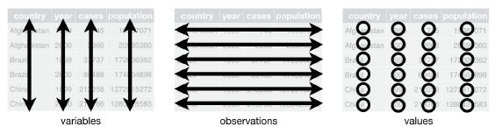
Introduction to the tidyverse
(Tidy ~ Ordered) + (verse ~ universe)
The tidyverse is a collection of libraries in R based on the same philosophy.
It has its own syntax and was designed to be more intuitive than the "base" R functions.
It promotes using data in Tidy format:
Each variable has its own column.
Each observation has its own row.
Each value has its own cell.
What is gained from this?
Order. There are a thousand ways to have messy data, but only one way to have tidy data.
Fuente: Carlos Daboín

Slide 4
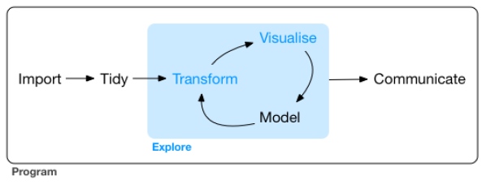
Introduction to the tidyverse
Provides solutions for each stage of data analysis
It has at least 8 libraries that we will use throughout the course. In this session, we will be exploring the dplyr() library.
Fuente: Carlos Daboín

Slide 5
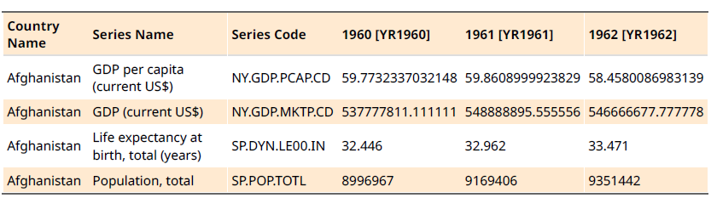
Tidy or not?
World development indicators (World Bank database)
Opinions: Is it tidy? Why?
Source: Carlos Daboín

Slide 6
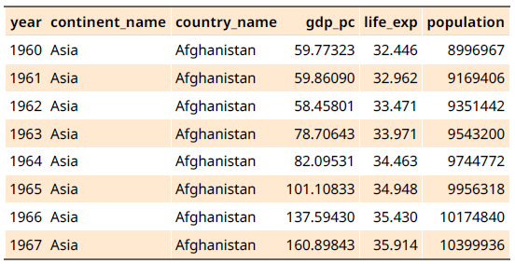
Tidy or not?
World development indicators (World Bank database), tidy version
Source: Carlos Daboín

Slide 7
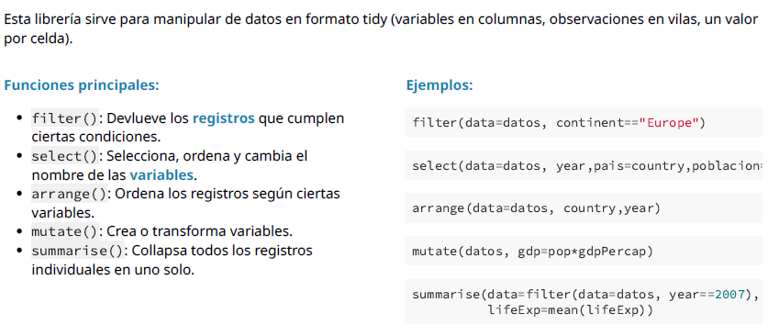
Package dplyr
Fuente: Carlos Daboín

Slide 8
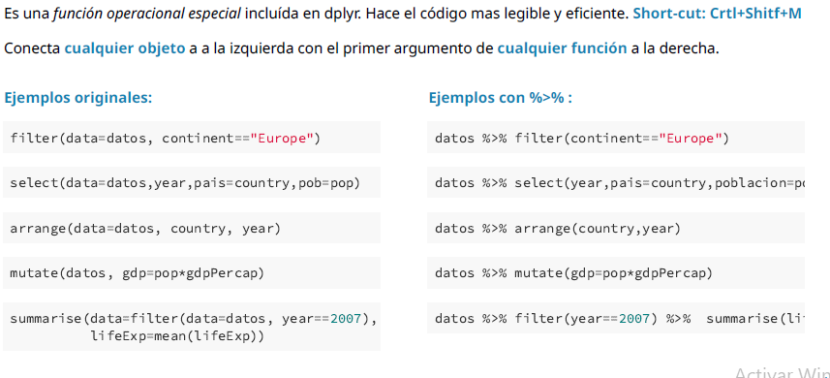
Pipe operator %>%
Fuente: Carlos Daboín

Slide 9
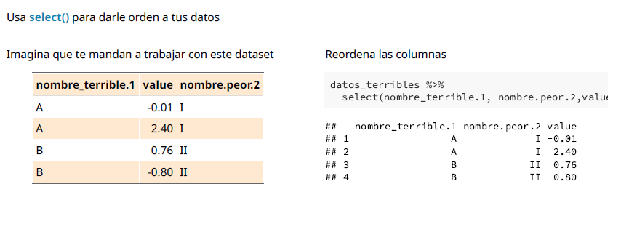
Dplyr in action: select()
Fuente: Carlos Daboín

Slide 10
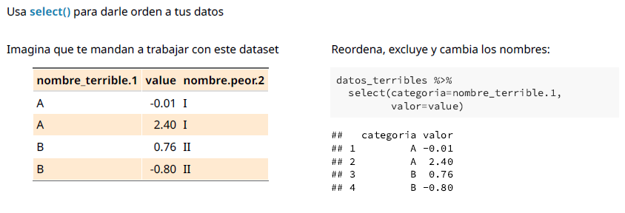
Dplyr in action: select()
Fuente: Carlos Daboín

Slide 11
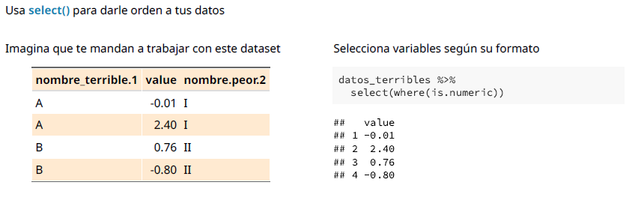
Dplyr in action: select()
Fuente: Carlos Daboín

Slide 12
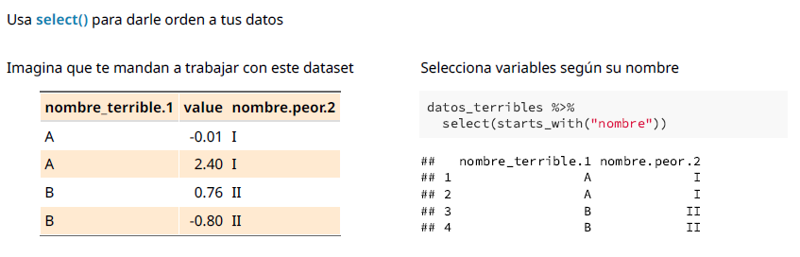
Dplyr in action: select()
Fuente: Carlos Daboín

Slide 13
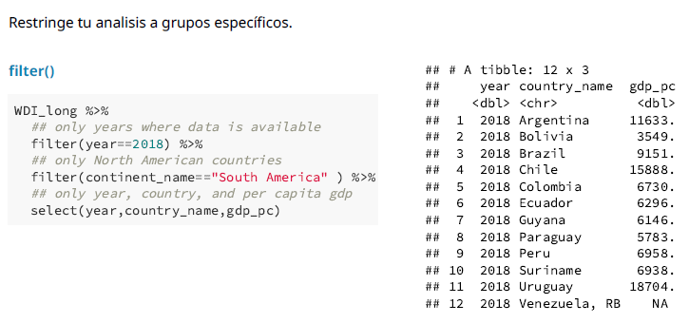
Dplyr in action: filter()
Fuente: Carlos Daboín

Slide 14
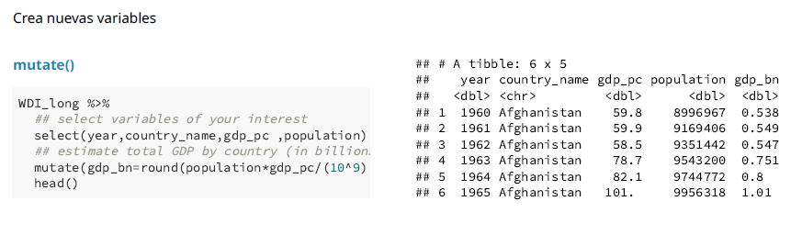
Dplyr in action: mutate()
Fuente: Carlos Daboín

Slide 15
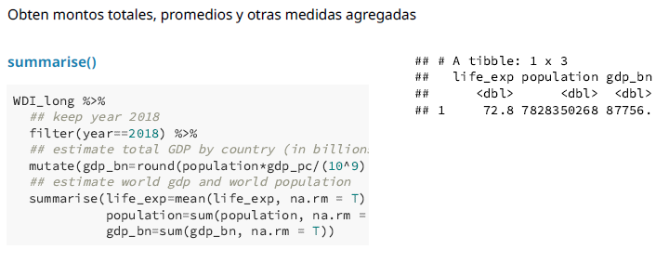
Dplyr in action: summarise() or reframe()
Fuente: Carlos Daboín

Slide 16
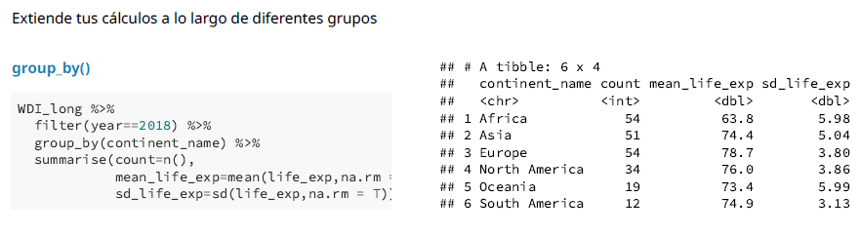
Dplyr in action: group_by()
Fuente: Carlos Daboín

Slide 17
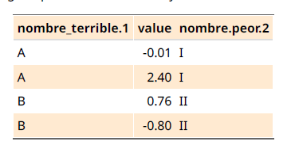
Dplyr in action: rename()
Allows us to change the name of one or more variables within a dataframe using the syntax "new_name" = old_name so that:
We have an object called df
To rename columns 1 and 3:
df %>%
rename(“categoria” = nombre_terrible.1 ,
“nivel” = nombre.peor.2)

Slide 18
Let’s practice
Script 07_basic-functions-dplyr.R

Slide 19
Brief review of script 07
We know how to identify the concepts of tidy databases and use functions from the dplyr package.
filter() Allows us to subset a dataframe or table at the observation level (rows). We filter the base based on certain conditions.
select() Allows us to subset a dataframe at the variable level (columns). It also allows us to reorder the columns of a dataframe and rename them.
mutate() Allows us to create new columns in a dataframe based on other columns or alphanumeric values that are assigned.
group_by() Allows us to group the data of a dataframe based on one or more columns that will be considered as factors or categorical. Remember that group_by() must always be closed with the ungroup() function.
summarise() Allows us to generate measures of an entire dataset. It is usually used with the group_by() function to generate calculations or measures at the subgroup level within the dataset.

Slide 20
BREAK TIME
See you in 15 minutes

Slide 21
A not tidy dataset
World development indicators (World Bank database)
Fuente: Carlos Daboín

Slide 22
A tidy dataset
World development indicators (World Bank database), versión tidy
Fuente: Carlos Daboín

Slide 23
Long vs wide data
A dataset can be written in two formats:
Wide → Format in which one or more columns are the levels of a factor (correspond to different categories of the same variable).
Long → Format in which each column corresponds to a variable and the observations in the column are the different values (can be factors). Tidy format.
Although the long format is considered the most efficient for data analysis, the wide format can be used to present tables for easier reading by people reviewing the data.

Slide 24
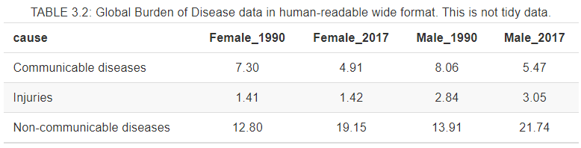
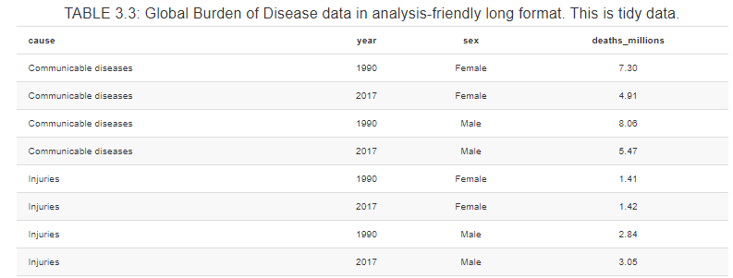
Long vs wide data
Wide
(not tidy)
Long
(tidy)

Slide 25
What to do if we want to transform the format from wide to long or vice versa?
R has the answer!
If we want to change a dataset from wide to long (columns → rows)
we use the function
pivot_longer(c(columns_we_want_to_transform),
names_to = new_column_name_for_names,
values_to = new_column_name_for_values)
If we want to change a dataset from long to wide (rows → columns) we use the function
pivot_wider(c(columns_we_want_to_transform),
values_from = column_with_values,
names_from = column_with_names)

Slide 26
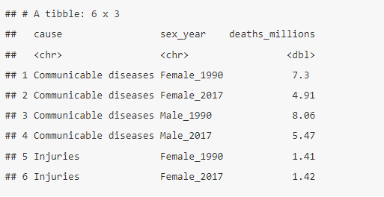
Manipulate columns: separate() and unite() functions
Now, if we want to separate or unite column values, we can use the separate() and unite() functions.
If we want to separate the sex and year
variables into two columns,
we use the separate() function.
separate(variable_to_sep,
into = c(‘var_1’,
‘var_2’),
sep = ‘_’ o separator)
separate(sex_year, into = c(“sex”, “year”), sep = “_”)

Slide 27
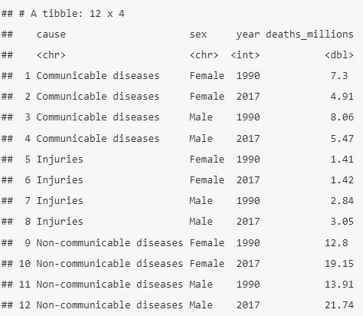
Manipulate columns: separate() and unite() functions
If we want to unite the sex and year
variables into two columns,
we use the unite() function.
unite(var_1, var_2, var_n,
col = “name_new_var”,
sep = ‘_’ o separator)
unite(sex, year, col = “sex_year”, sep = “_”)

Slide 28
Let's continue practicing
Script 08_reshape-data.R

Slide 29
Task para la próxima semana:
Asignación 2 (Sección de tareas, M7)
Actividades sencillas para ser realizadas de forma grupal para comprobar los conocimientos que tenemos hasta el momento
Habrá distintas secciones y actividades, suficientes para poder repartir el trabajo en el equipo
Pequeño apartado para adjuntar el dataset crudo a emplear en el Proyecto, así como una descripción de las variables relevantes que piensan que pueden ser útiles en el desarrollo del mismo
Ponderación: 6% de nota definitiva
Entrega: Lunes 21 octubre

