Slide 1

Introduction to Data Science
Lesson 6
Prof. Hugo Hernandez
Prof. Giorgio Cunto

Slide 2
Module III
Data handling in R
Reshaping data: pivot_longer(), pivot_wider(), separate(), unite()
Combining data.frames using joins and binds

Slide 3
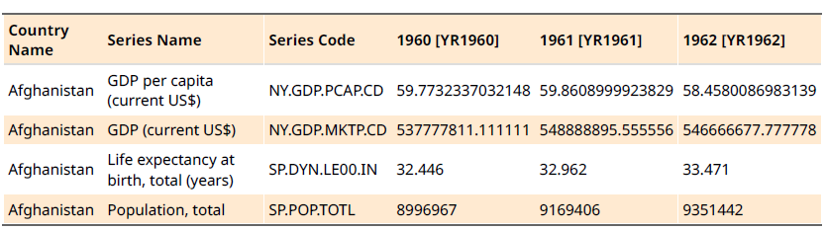
A not tidy dataset
World development indicators (World Bank database)
Fuente: Carlos Daboín

Slide 4
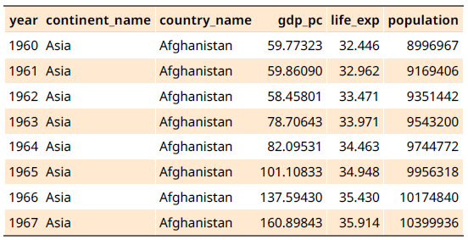
A tidy dataset
World development indicators (World Bank database), versión tidy
Fuente: Carlos Daboín

Slide 5
Long vs wide data
A dataset can be written in two formats:
Wide → Format in which one or more columns are the levels of a factor (correspond to different categories of the same variable).
Long → Format in which each column corresponds to a variable and the observations in the column are the different values (can be factors). Tidy format.
Although the long format is considered the most efficient for data analysis, the wide format can be used to present tables for easier reading by people reviewing the data.

Slide 6
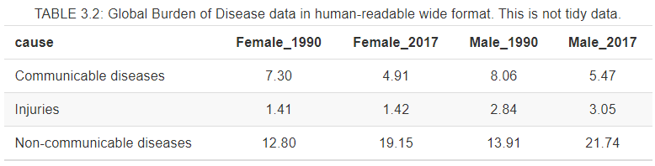
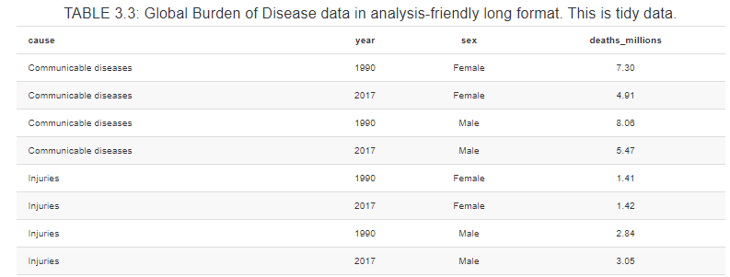
Long vs wide data
Wide
(not tidy)
Long
(tidy)

Slide 7
What to do if we want to transform the format from wide to long or vice versa?
R has the answer!
If we want to change a dataset from wide to long (columns → rows)
we use the function
pivot_longer(c(columns_we_want_to_transform),
names_to = new_column_name_for_names,
values_to = new_column_name_for_values)
If we want to change a dataset from long to wide (rows → columns) we use the function
pivot_wider(c(columns_we_want_to_transform),
values_from = column_with_values,
names_from = column_with_names)

Slide 8
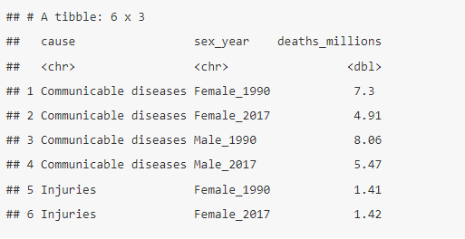
Manipulate columns: separate() and unite() functions
Now, if we want to separate or unite column values, we can use the separate() and unite() functions.
If we want to separate the sex and year
variables into two columns,
we use the separate() function.
separate(variable_to_sep,
into = c(‘var_1’,
‘var_2’),
sep = ‘_’ o separator)
separate(sex_year, into = c(“sex”, “year”), sep = “_”)

Slide 9
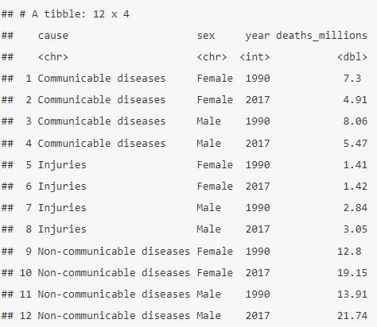
Manipulate columns: separate() and unite() functions
If we want to unite the sex and year
variables into two columns,
we use the unite() function.
unite(var_1, var_2, var_n,
col = “name_new_var”,
sep = ‘_’ o separator)
unite(sex, year, col = “sex_year”, sep = “_”)

Slide 10
Let's practice
Script 08_reshape-data.R

Slide 11
BREAK TIME
See you in 15 minutes

Slide 12
Join tables in R using tidyverse joins
Sometimes we have two or more datasets that have a column in common (or common values in a column) and we want to combine them.
We will call this common variable the “key” variable, since it is the variable in common in both datasets that we are interested in combining them.
The tidyverse package offers us six main functions to combine databases that have a common variable
IMPORTANT: The common variable between both datasets must have the same column name and at least some values in common at the column row level for the joins to be generated

Slide 13
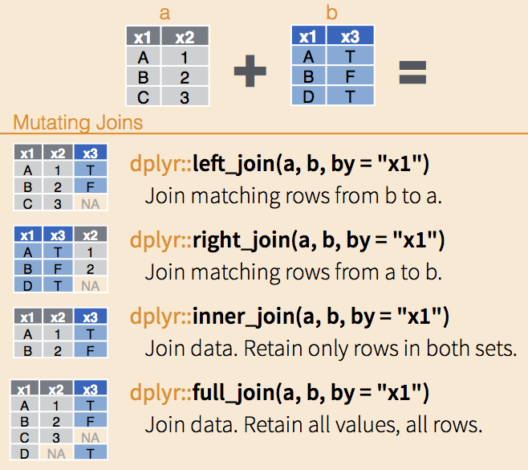
Types of tidyverse joins - Mutating joins
left_join() Keeps all the columns and observations of the first object, adding those of the second object that match.
right_join() Keeps all the columns and observations of the second object, adding those of the first object that match.
inner_join() Keeps only the observations that are in both objects
full_join() Keeps all columns and observations of both objects
Depending on the order in which we specify the join objects in the functions, we will have a left_join or a right_join to the first or second object.

Slide 14
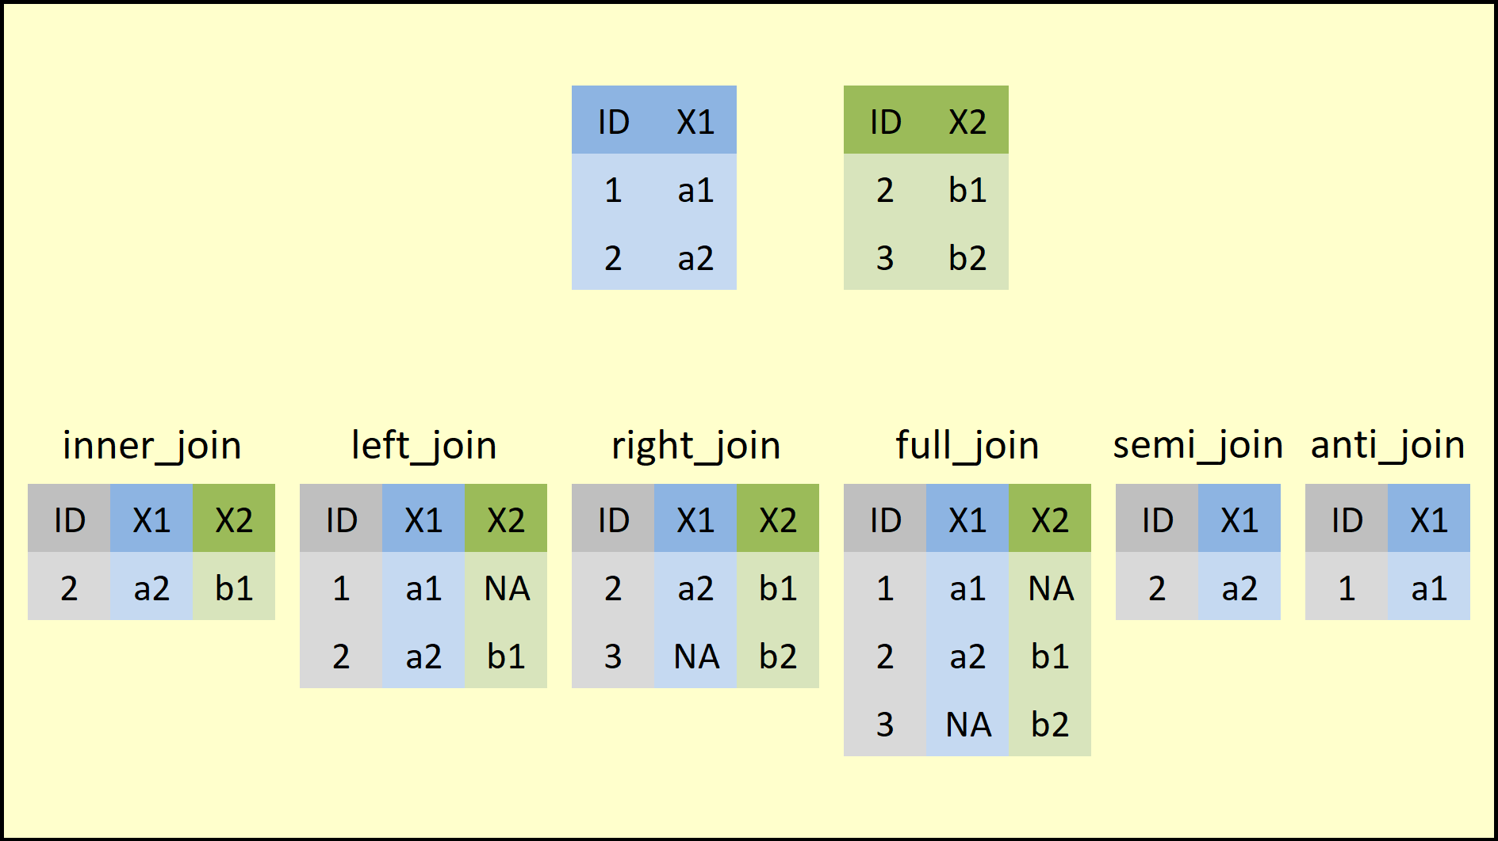
Types of tidyverse joins - Filtering joins
anti_join() Returns all rows or observations of the first object that are NOT present in the second object.
semi_join() Returns all rows or observations of the first element that ARE present in the second object.
The difference between Mutating joins and Filtering joins is that mutating joins add columns from one object to another based on the key variable and filtering joins filter rows or observations from one object based on the presence or absence of matches in another object using the key variable.

Slide 15
Joining tables in R using binds
Another way to join databases is to use binds at the column or row level. These functions allow us to “glue” observations (rows) or variables (columns) from one dataset to another without requiring a common variable between them.
It is important to know that when using binds, it is required that the dimensions between both objects be the same in terms of number of rows or columns depending on the type of bind we make.

Slide 16
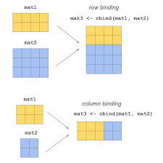
Types of binds
At a column level:
bind_cols()
cbind()
At a row level:
bind_rows()
rbind()

Slide 17
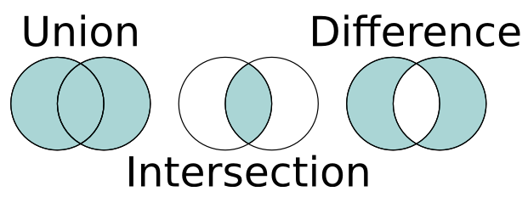
Set operations in R
We already know about the different types of joins and binds that we can use to combine or filter databases or dataframes. Now we are going to see other functions that allow us to generate similar results at set level, through intersection, union and difference.
intersect(a, b) Allows us to identify the intersection or common elements between two vectors or elements ‘a’ and ‘b’.
union(a, b) It allows us to join all the elements between two vectors or elements ‘a’ and ‘b’, counting only once the common elements between them.
setdiff(a, b) It allows us to identify the difference of the elements of the vector ‘a’ and the vector ‘b’. It is important to know that its output is all the elements of a which are not in b, so that:
setdiff(a,b) != setdiff(b, a)

Slide 18
Let’s keep practicing
Script 09_joins_binds_df.R

Slide 19
Let’s keep practicing
Script 10_import_data.R

Slide 20
Let’s keep practicing
Script 11_strings.R

Slide 21
Task for next week:
Asignación 3 (Sección de tareas, M7)
Actividades sencillas para ser realizadas de forma grupal para comprobar los conocimientos que tenemos hasta el momento
Habrá distintas secciones y actividades, suficientes para poder repartir el trabajo en el equipo
Pequeño apartado para adjuntar el dataset crudo a emplear en el Proyecto, así como una descripción de las variables relevantes que piensan que pueden ser útiles en el desarrollo del mismo

