Slide 1

Introduction to Data Science
Lesson 9
Prof. Hugo Hernandez
Prof. Giorgio Cunto

Slide 2
Module IV
Data Visualization
Introduction to ggplot
Basic plots in ggplot
Gapminder and ggplot
Basic functions in ggplot and types of graphs
Functions facet_grid() and facet_wrap()

Slide 3
Principles of data visualization
Visually convey information to extract insights that might not be apparently obvious from summary statistics.
Can be deployed both as exploratory visualization or for publication. Exploratory visualization is to get a notion of data structure, spot outliers, find rough trends. It’s an iterative process of trial and error. Publication visualization is for definitive deployments and must be suited for clarity, following adequate design principles on how data is encoded. The most important thing is legibility!

Slide 4
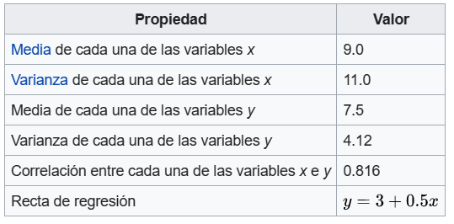
The Anscobe quartet
I |  | II |  | III |  | IV
x | y | x | y | x | y | x | y
10.0 | 8.04 | 10.0 | 9.14 | 10.0 | 7.46 | 8.0 | 6.58
8.0 | 6.95 | 8.0 | 8.14 | 8.0 | 6.77 | 8.0 | 5.76
13.0 | 7.58 | 13.0 | 8.74 | 13.0 | 12.74 | 8.0 | 7.71
9.0 | 8.81 | 9.0 | 8.77 | 9.0 | 7.11 | 8.0 | 8.84
11.0 | 8.33 | 11.0 | 9.26 | 11.0 | 7.81 | 8.0 | 8.47
14.0 | 9.96 | 14.0 | 8.10 | 14.0 | 8.84 | 8.0 | 7.04
6.0 | 7.24 | 6.0 | 6.13 | 6.0 | 6.08 | 8.0 | 5.25
4.0 | 4.26 | 4.0 | 3.10 | 4.0 | 5.39 | 19.0 | 12.50
12.0 | 10.84 | 12.0 | 9.13 | 12.0 | 8.15 | 8.0 | 5.56
7.0 | 4.82 | 7.0 | 7.26 | 7.0 | 6.42 | 8.0 | 7.91
5.0 | 5.68 | 5.0 | 4.74 | 5.0 | 5.73 | 8.0 | 6.89

Slide 5
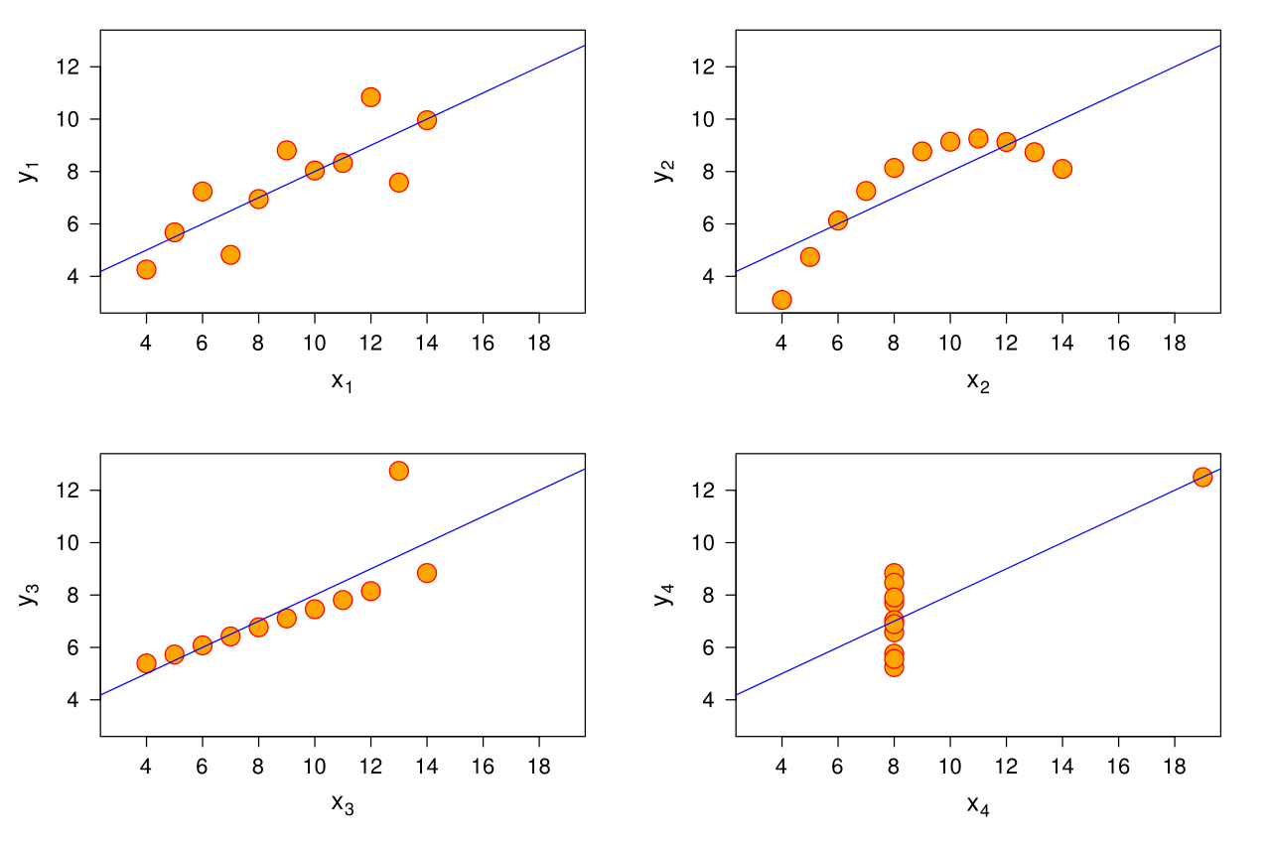
The Anscobe quartet

Slide 6
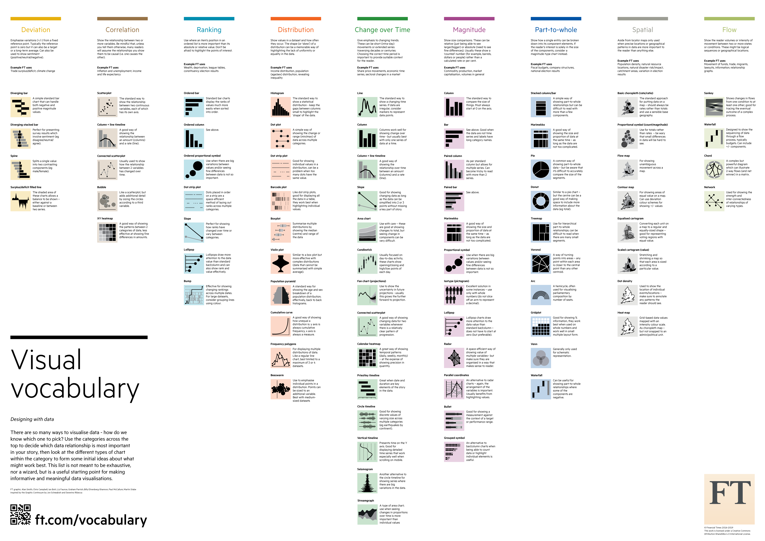
The right viz for the right message

Slide 7
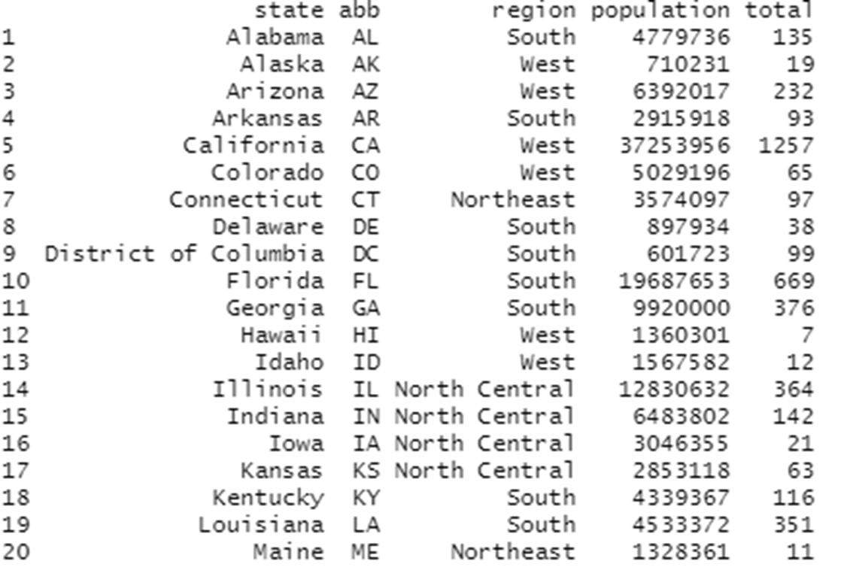

Slide 8
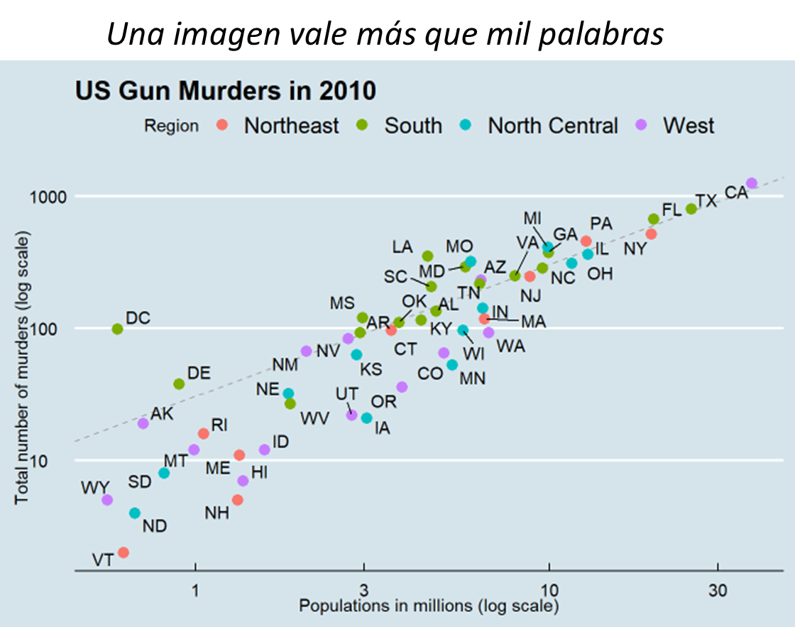
A picture is worth a thousand words

Slide 9
Data visualization in R: ggplot2
ggplot2 is an R package that allows us to produce data visualizations or plots
It is based on a particular grammar or structure based on Grammar of Graphics, which allows us to generate visualizations by combining independent components. This allows us to create graphics that fit our requirements. Grammar of Graphics allows us to build different types of visual elements using a particular “grammar” or syntax for each element within a graph or plot.

Slide 10
Graph syntax : ggplot2
A plot is composed of:
Data to be plotted
Geometric objects that appear in the plot (circles, lines, bars, histograms)
A set of aesthetic mappings or specifications of variables in the data for the aesthetics or appearance of the geometric objects
In order to create a plot we must follow the basic steps 1. Call the function ggplot() that creates a blank canvas 2. Specify the aesthetic mappings, which specify how you want to map variables in the aesthetic aspect (the basic thing is to specify which variables correspond to the X and Y axis) 3. Then you must add the layers that are geometric elements that will appear in the plot.

Slide 11
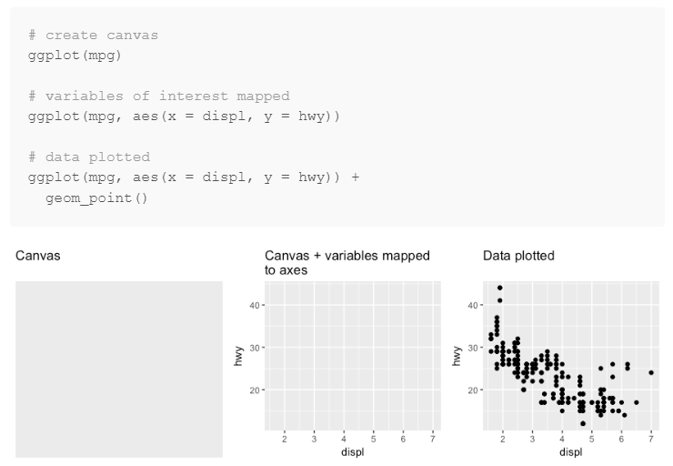
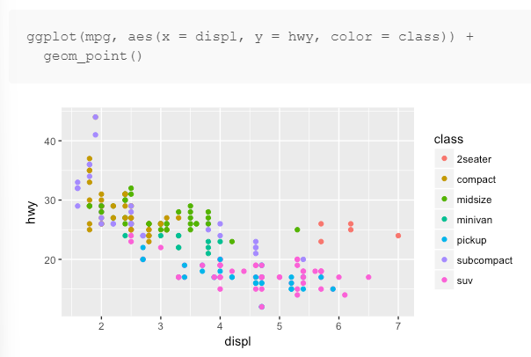
The basics - ggplot
AESTHETIC MAPPINGS
How to create a basic graph in ggplot2 following the 3 steps:
1. Call ggplot
2. Specify aesthetic mapping
3. Add layer with geometric object
It takes properties of the data and uses them to influence visual characteristics, such as position, color, size, shape or transparency. They are specified using the aes() function
NOTE: Remember that to join the different layers of ggplot2 elements, we must use the + symbol (it is the pipe of ggplot2, of its grammar).

Slide 12
Types of basic geometrical objects - ggplot
geom_point() for plotting individual points (scatter plot)
geom_line() for plotting lines
geom_vline() Vertical line
geom_hline() Horizontal line
geom_smooth() for plotting smoothed lines (for simple trends or approximations)
geom_bar() for bar charts
geom_histogram() for histograms (bars grouped by values)

Slide 13
Aesthetic Mappings
Aesthetic mappings that describe how we want the data to look on the plot. These features are introduced with the aes() function as an argument of the ggplot() function or geometric object functions and refer to:
Position (on the axes) Exterior color (color = ) Fill color (fill = ) Point shape (shape = ) Linetype (linetype = ) Size (size = )
We can specify more than one aesthetic mapping for a plot, within the ggplot() function and its other layers composed by the geometric objects geom_xxx() depending on the specifications we want. Therefore, to construct a graph with ggplot2 we start with the following code structure, using + as a nexus between arguments: ggplot(data, aes() ) + geom_type() We must always specify the type of geometric object we are going to plot!

Slide 14
Labels and text on plots - ggplot
R sets as default that the titles of the axes of its plots are the names of the variables that we assign in the corresponding aesthetic mapping. However, we can easily modify the axis titles and even the plot title:
… +
labs(title= 'Notas de 2010 en función de notas de 2009', # General plot title
x= 'Nota de 2009', # Title X Axis
y= 'Nota de 2010') # Title Y Axis

Slide 15
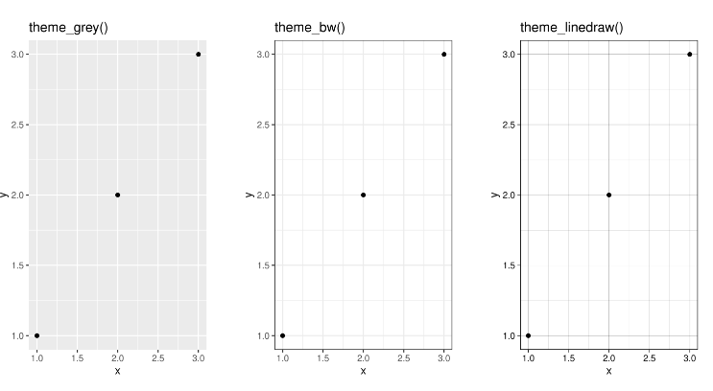
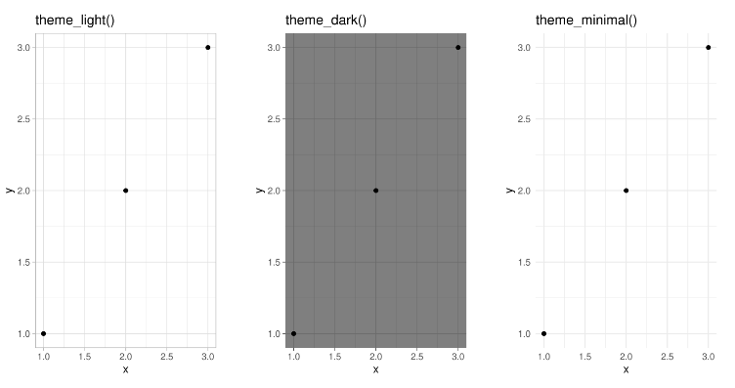
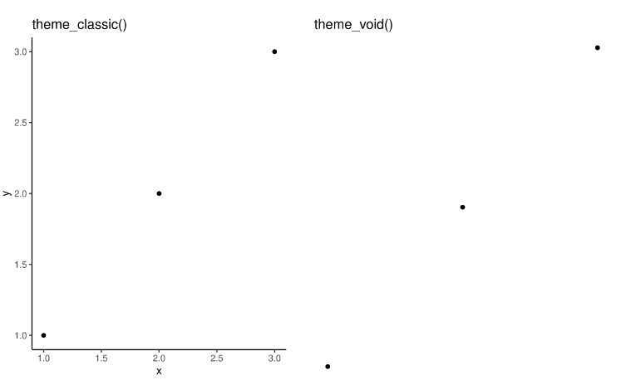
Plot themes- ggplot
To give our graphics the aesthetics we want, we can specify themes in our R plots that set up a sort of formatting template. There are certain predesigned themes in R:
We specify them using
… +
theme_xxx()
Check this link for more themes in R: https://ggplot2-book.org/themes

Slide 16
Now let’s practice
Script 14_intro_ggplot2.R

Slide 17
BREAK TIME
Nos vemos en 15 minutos

Slide 18
PARTE II
REVISEMOS SUS FORMULARIOS DE PROYECTOS
Aprender a importar archivos en R

Slide 19
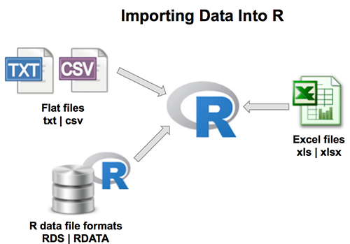
Importar datos en R
Usar bases de datos existentes de paquetes o de R base es útil, pero el mecanismo más común es manejar bases de datos que se importan en R a partir de archivos externos.
¿Tienen algún ejemplo?
R nos permite importar datos de diversos formatos
(siendo los más comunes .xlsx, .xls, .csv, .txt, .sav)
para poder manipularlos y procesarlos.

Slide 20
Importar datos en R: Working directory
Working directory: Directorio de trabajo. Es la ruta o path en la computadora que le da una localización default de cualquier archivo que requiera ser importado o exportado en R.
getwd() Nos permite saber cuál es el directorio actual en la sesión de R
setwd() Nos permite modificar el directorio actual en la sesión de R
list.files() Nos permite listar todos los archivos o carpetas disponibles en
nuestro directorio

Slide 21
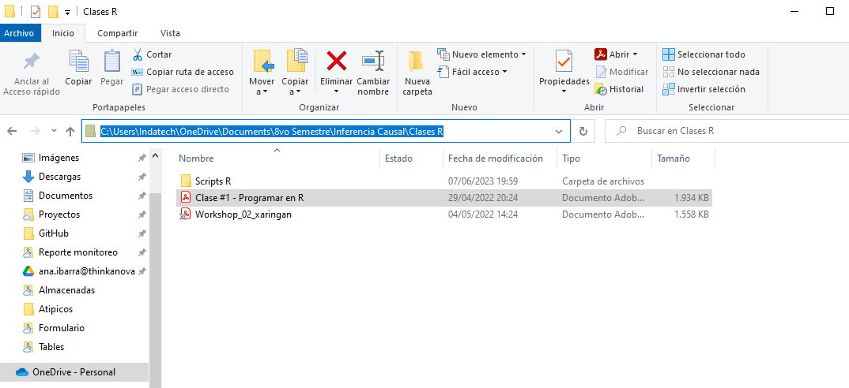

Importar datos en R: Working directory
PRO TIP:
Para especificar una ruta de nuestra computadora a la que queremos acceder, podemos tomarla directamente desde nuestra computadora en el Explorador de Archivos cambiando los backslash \ por forward slash /. Es importante especificar esta ruta entre comillas para funciones como setwd() o funciones para importar archivos

Slide 22
Importar datos en R: Funciones principales
R nos permite importar archivos de múltiples formatos, pero los más comunes corresponden a libros de Excel (.xlsx, .xls), Archivos de valores separados (.csv) e inclusive archivos de texto (.txt).
Para importar cada uno de estos tipos de archivos, existe una función específica dependiendo de su formato.
readxl::read_excel() Lee archivos de terminal .xls y .xlsx
utils::read.csv() Lee archivos de terminal .csv
data.table::fread() Lee archivos de valores separados (.csv)

Slide 23
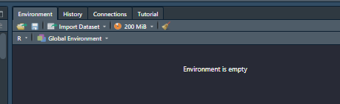
Importar datos en R: Import button
Es una manera más sencilla que ofrece la interfaz gráfica RStudio, que ejecuta el comando para importar un dataset.
Pero… No guarda directamente la ruta o el comando en nuestro script, solo ejecuta el importe de nuestros datos.
Recomendamos emplear funciones directamente, dejando . Eso nos permite que nuestros scripts sean replicables.

