Slide 1

Introduction to Data Science
Session 10
Prof. Hugo Hernandez
Prof. Giorgio Cunto

Slide 2
Module IV
Data Visualization
Continuation of ggplot. Gapminder and visualizations in ggplot. Basic ggplot functions for different types of visualizations: Functions facet_grid() and facet_wrap() Visualization principles.

Slide 3
Quick recap of session 9
We know we can use survey data or data we create ourselves to generate insights based on our own research questions → We can generate our own datasets to answer research questions and perform quantitative analysis.
We know how to identify the basic functions of the ggplot2 package to produce different types of charts:
geom_histogram()
geom_density() → A smooth version of the histogram, usefult for continous data.
geom_vline()
geom_hline()
We know ggplot is compatible with pipe workflows (dplyr) to generate plots directly from processed data.
Remember that ggplot2 functions are combined using the + symbol, unlike dplyr functions, which use the pipe %>%.
We understand that aesthetic mapping allows us to define graphical attributes using aes(), which we specify either in ggplot() or in a geom_xxx() layer.
We learned to change titles and axis labels with the labs() function.
We learned to modify the visual format of graphs with predefined themes from the ggplot2 package.

Slide 4
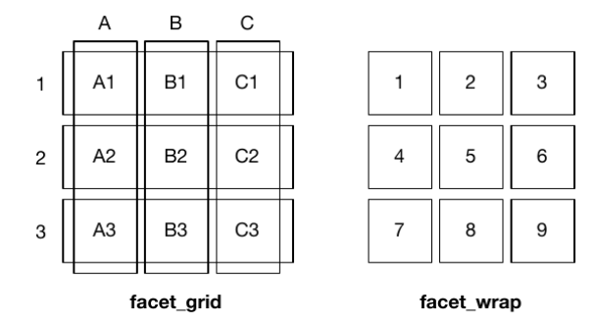
facet_wrap and facet_grid
Faceting allows us to display separate plots for subsets of the original data. With this functionality we can create different plots for different subsets, which makes comparison easier. It allows us to split a plot into multiple panels according to one or more categorical variables.
ggplot2 provides two main faceting functions:
facet_wrap(): defines subsets as the levels of a single grouped variable.
facet_grid(): defines subsets as the combination (crossing) of two grouped variables.
Think of faceting functions as a kind of graphical version of group_by() in ggplot2 — they let us create grouped plots based on variables. We specify groups like this:
facet_xxx( ~ a) , facet_xxx(b~), facet_xxx(b ~ a)
Notes:
facet_grid y facet_wrap son dos funciones en el paquete ggplot2 de R que permiten dividir un gráfico en múltiples paneles según las variables de una o varias variables categóricas. Estas funciones son especialmente útiles cuando se desea explorar la relación entre variables en diferentes subconjuntos de datos.

Slide 5
Let’s practice
Script 16_viz-gapminder-e..R

Slide 6
Quick recap of the script
We learned to:
Use faceting functions to create grouped plots by one or more variables
facet_wrap()
facet_grid()
Use the aesthetic mapping arguments to define plot colors, axis positions, and other specifications.
Use reorder() function inside ggplot() aesthetics to reorder how a variable is plotted based on another variable or a transformation.
Add text labels to our plots using the geom_text() function.

Slide 7
BREAK TIME
See you in 15 minutes!

Slide 8
We Know How to Visualize Data in R!
We already understand how plots work and how to create various kinds of plots using ggplot2.
Now, we’ll focus on general principles for effective data visualization — how people detect patterns and make visual comparisons.
Therefore, we prefer approaches that align with how our brains process visual information.

Slide 9
Defining objective + visualization type
When choosing visualization tools, it’s important to keep our objective in mind.
We might be: Comparing a small number of values, describing the distribution of categorical or numerical data, comparing data between two groups, or describing the relationship between two variables.
All of this affects the type of visualization we should choose.
https://rafalab.dfci.harvard.edu/dslibro/principios-de-visualizaci%C3%B3n-de-datos.html

Slide 10
Let’s Practice
Script 17_principios-dataviz-e.R

Slide 11
Project Discussion

Slide 12
Tasks para la próxima semana:
Asignación 7: Hasta el momento hemos trabajado en nuestras preguntas de investigación, metodología propuesta e hipótesis de los proyectos de investigación.
Ahora empezaremos a trabajar en las entregas del proyecto final. Básicamente se trata de entrega de un informe final en RMarkdown (que sigue la estructura de un informe formal) y de una presentación presencial (requiere de material de apoyo).
La asignación 7 se enfocará en empezar a desarrollar la introducción, preguntas y metodología.

