Slide 1

Introduction to Data Science
Session 13
Prof. Hugo Hernandez
Prof. Giorgio Cunto Morales

Slide 2
Module V
Analysis tools
RMarkdown: the basics

Slide 3
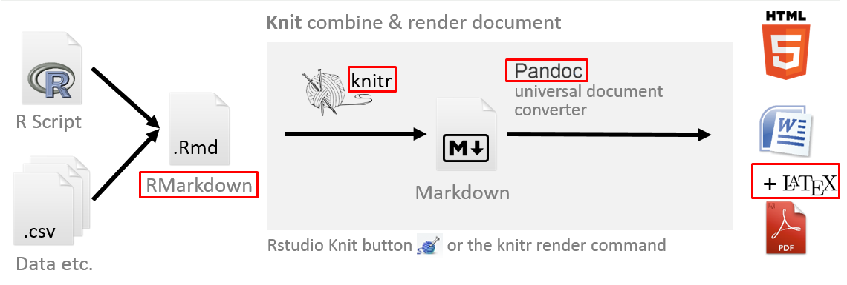
RMarkdown: What is it?
RMarkdown is a text processor that also allows the inclusion of chunks of code from R (or other formats).
The main benefit of this tool is that it makes it possible to work in a single document both the writing of the narrative content of research reports and the construction and formal presentation of statistical analysis results.
Link to a guide on RMarkdown

Slide 4
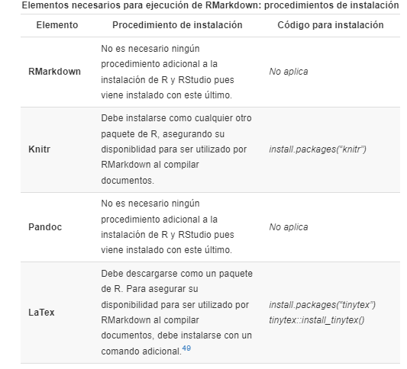
In summary: before compiling an RMarkdown document, we must ensure that these components are installed on our computers.

Slide 5
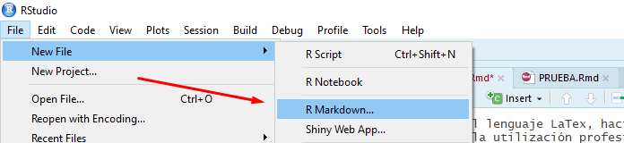
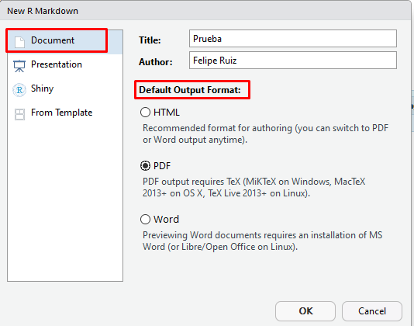
RMarkdown: How to Use It?
You can create a new RMarkdown document using the top toolbar in RStudio. As shown below: go to File → New File → RMarkdown.
Once you follow that procedure, a new configuration window will appear. Here you set the basic settings of the report, such as the document title, author name, and the format of the output (in this example, PDF).
RMarkdown Guide

Slide 6
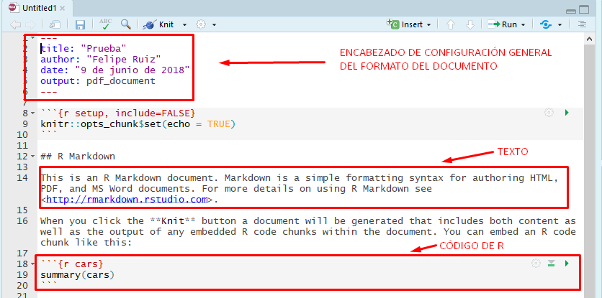
RMarkdown: How to Use It?
After entering your specifications, you will get the template of your file in a new R tab (with the extension .Rmd), which contains the RMarkdown syntax in which the research report will be edited. As shown in the image, RStudio provides a preconfigured RMarkdown template.
Los archivos Rmd que generamos contienen 3 elementos primordiales:
General format header: where we specify basic document information such as title, subtitle, author, date, bibliography, and output settings.
Text
R code chunks

Slide 7
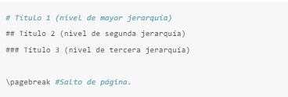
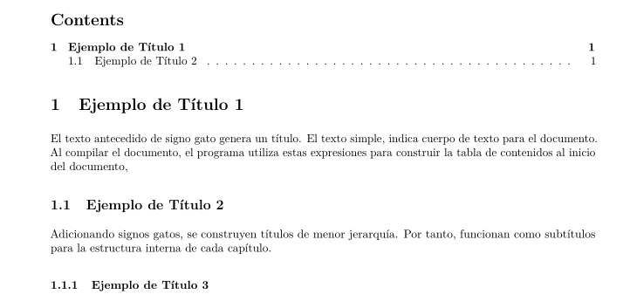
Basic RMarkdown Functionalities
Adding Titles and Subtitles
In RMarkdown, the “hash” signs (#) indicate a section title or subtitle.The more hash symbols used, the lower the hierarchy of the heading. Additionally, you can insert page breaks with the command \pagebreak. This is useful, for example, to start each section of the document on a new page.

Slide 8
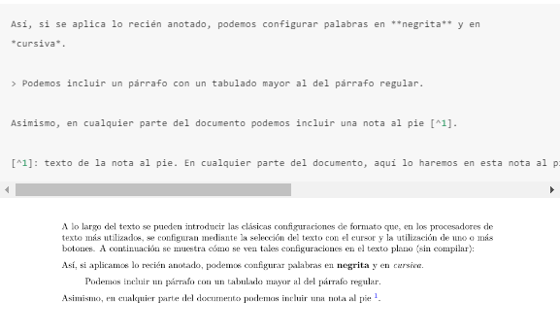
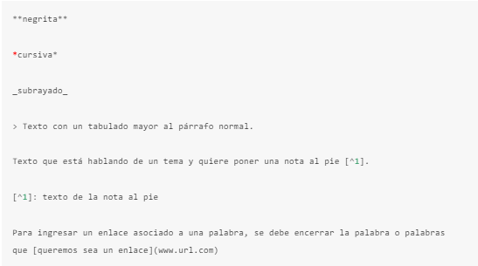
Basic RMarkdown Functionalities
2. Emphasizing Text

Slide 9

Basic RMarkdown Functionalities
3. Configuring Code Chunks
You can use R code chunks to generate outputs such as tables, visualizations, and more.Chunk options allow you to modify how the chunk behaves. For example:
Showing only the results of the code
Hiding execution messages
Hiding warnings
Showing only the code without running it
For that we can use Rmarkdowwn arguments!
{r, echo = FALSE, results = 'asis', message= FALSE}

Slide 10
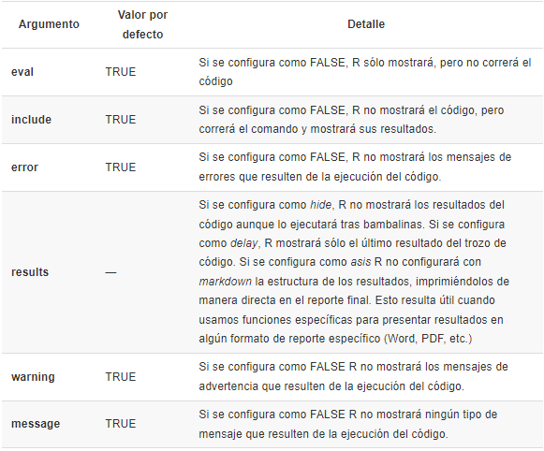
{r, echo = FALSE, results = 'asis', message= FALSE}

Slide 11
Let’S practice
Script 22_intro_rmarkdown.R

Slide 12
Important with RMarkdown
RMarkdown does not work like the RStudio Console, which executes operations using objects already loaded in the environment.
RMarkdown requires that all packages and datasets be loaded inside the file, so that when it is compiled (“Knit”), it can generate the intended outputs.
If you do not load a package or dataset inside the RMarkdown file, when compiling it will throw an error.
We must install all necessary packages based on the type of compilation we want to perform:
LaTex → tinytex
PDF → knitr
Debemos hacer uso de los argumentos en los chunks de código, que nos permitirán modificar el output una vez compilemos nuestro reporte RMarkdown
RMarkdown works for many things!

Slide 13
Let’s talk projects

