Slide 1

Introduction to Data Science
Lesson 13
Prof. Hugo Hernandez
Prof. Giorgio Cunto

Slide 2
Module V
Analysis tools
RMarkdown: The Basics

Slide 3
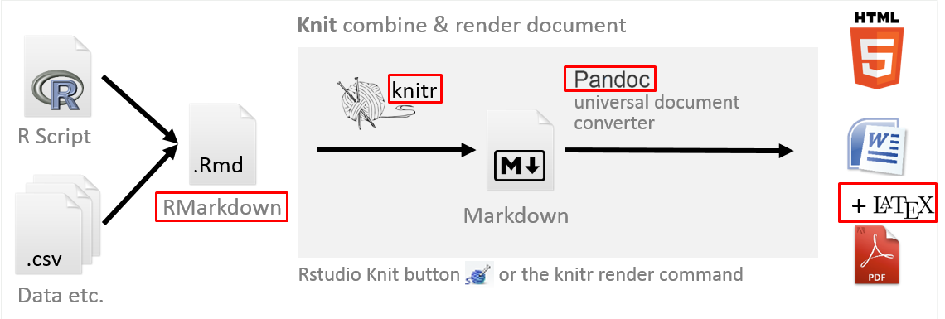
RMarkdown: What is it?
RMarkdown is a text processor that also offers the possibility of including pieces of code from R (or other formats).
The main benefit of this tool is that it allows you to work on a single document both the writing of the narrative content of research reports, as well as the construction and formal presentation of statistical analysis results.
Guide link for Using RMarkdown

Slide 4
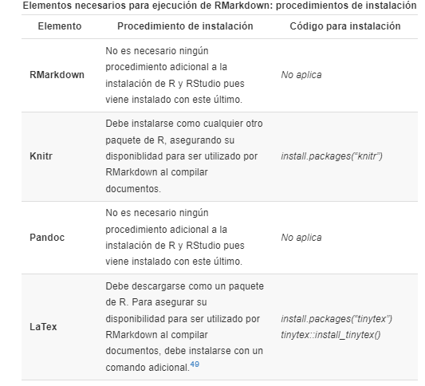
In summary: before proceeding to the compilation of an RMarkdown document, we must ensure the installation of these components in R.

Slide 5
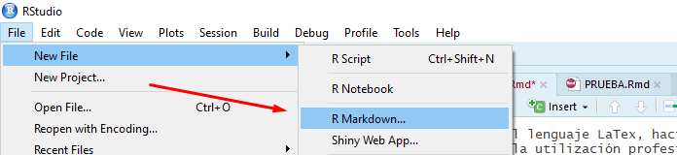
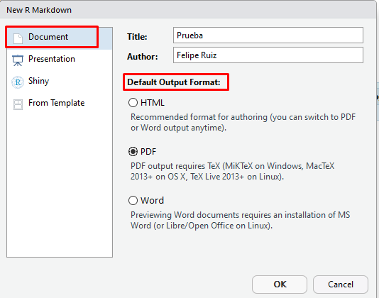
RMarkdown: How to use it?
It is possible to create a new RMarkdown document using the RStudio top button. As seen below, in File, New File and selecting the RMarkdown option.
Once this procedure is done, a new general settings screen will appear. Here the basic configuration of the results report is established, indicating a title for the document, the name of the author, as well as the format of the report to be built (in this example the PDF format is selected).
Guide link for Using RMarkdown

Slide 6
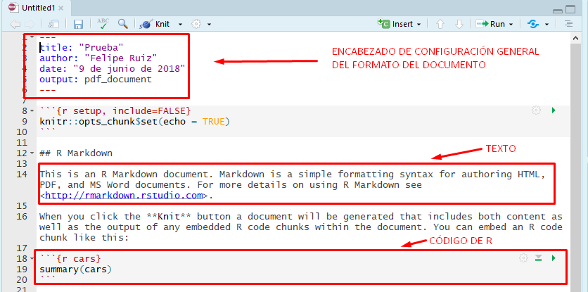
RMarkdown: How to use it?
After registering our specifications, we will have the template of our file in a new tab in R (with . Rmd) which will be the RMarkdown syntax in which the research report will be edited. As seen in the image below, RStudio offers a pre-configured RMarkdown syntax.
The Rmd files we generate contain 3 main elements:
General format header: we can specify basic data of the document such as titles, subtitles, author, date, bibliography and output specifications
Text
R Code chunks

Slide 7
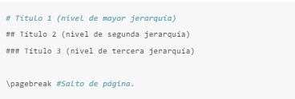
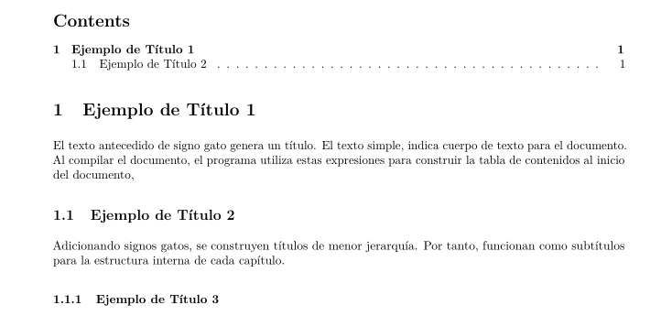
Basic functionalities of RMarkdown
Add titles and subtitles
In the case of RMarkdown, the “hashtag" symbols (#) indicate that a section title or subtitle is being indicated. The more hashtags you add, the more you will be indicating that it is a title of lower hierarchy. On the other hand, the \pagebreak command can indicate page breaks. The latter serves, for example, to start each section of the document on a new page.

Slide 8
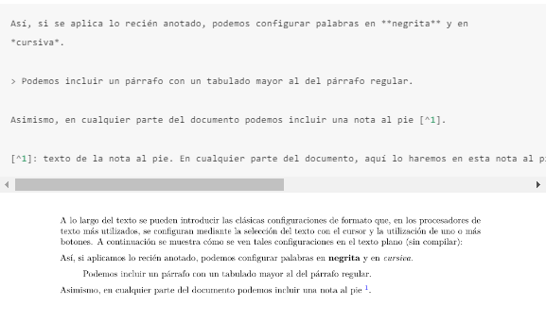
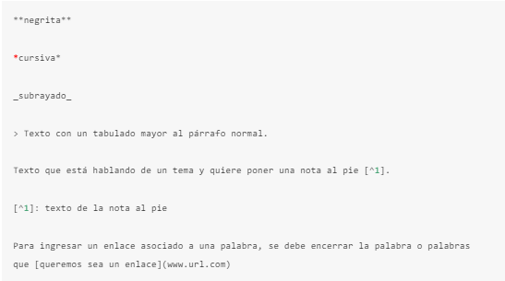
Basic functionalities of RMarkdown
2. Emphasize Text

Slide 9

Basic functionalities of RMarkdown
3. Configure code chunks
We can use R code chunks to be able to generate different outputs like the ones we have used so far: tables, visualizations, etc. We can use arguments in code chunks so that we can modify the appearance of those code chunks.
Sometimes we want you to only see the output that the code generates
No execution messages
No warnings
Or sometimes we want to only see the chunk code we make, without evaluating it
That's what we can use the arguments in RMarkdown chunks for!
{r, echo = FALSE, results = 'asis', message= FALSE}

Slide 10
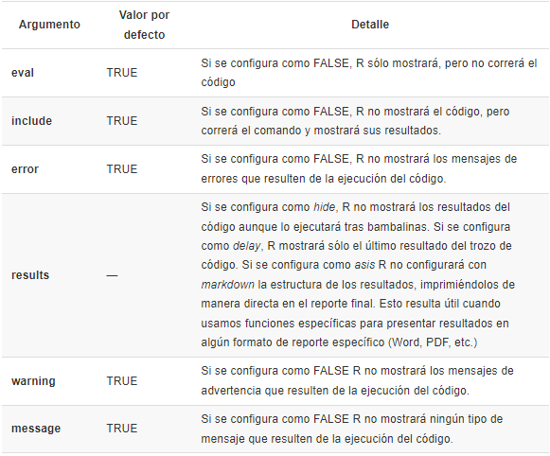
{r, echo = FALSE, results = 'asis', message= FALSE}

Slide 11
Now let’s practice
Script 22_intro_rmarkdown. R

Slide 12
Important in RMarkdown
RMarkdown does not work like the RStudio console, which performs operations with elements or objects that are previously loaded in our environment. Markdown requires that all packages and databases be loaded into the file so that when compiled, it can generate the desired outputs
If I do not load any of the packages or datasets that I use within the RMarkdown, at the time of compiling or pressing 'Knit', it will return an error
We need to install the necessary packages according to the type of build we want to do
LaTex → tinytex
PDF → knitr
We must make use of the arguments in the code chunks, which will allow us to modify the output once we compile our RMarkdown report
RMarkdown helps us to do a lot of things!

Slide 13
Let's talk about the projects

