Slide 1
Machine Learning
Custom hardware architectures and High Performance Computing
A brief introduction
Author: Giorgio Garziano
Last update: July, 13th 2016, 09:36am

Slide 2
Abstract
Machine learning algorithms may be very CPU and data storage demanding
High Performance Computing (HPC) may take advantage of custom hardware platforms and specialized software libraries
Starting from Google TPU platform, this presentation introduces the main aspects of Machine Learning custom hardware platforms, focusing on CPU processing capabilities (it does not encompass big data infrastructures)
Further, wearable devices represent a new area of machine learning algorithms application

Slide 3
TensorFlow running on TPUs
TensorFlow™ is an open source software library for numerical computation using data flow graphs. Nodes in the graph represent mathematical operations, while the graph edges represent the multidimensional data arrays (tensors) communicated between them. The flexible architecture allows you to deploy computation to one or more CPUs or GPUs in a desktop, server, or mobile device with a single API.
TensorFlow 0.8 with distributed computing support allows to train distributed models on your own infrastructure. Distributed TensorFlow is powered by the high-performance gRPC library, which supports training on hundreds of machines in parallel.
References:
https://www.tensorflow.org/
http://www.grpc.io/

Slide 4
TensorFlow running on TPUs (2)
Google shared that they have been using an internally-developed processor, called a Tensor Processing Unit (TPU), for over a year to accelerate Deep Learning applications, from Google Street View to their win at the game of Go. Rumours have swirled for years that Google may develop their own processors, potentially based on ARM Holdings V8 and / or IBM OpenPOWER, to displace Intel Xeon server processors
TPU is tailored to machine learning applications, allowing the chip to be more tolerant of reduced computational precision, which means it requires fewer transistors per operation
References:
http://www.wired.com/2016/05/google-tpu-custom-chips/
https://cloudplatform.googleblog.com/2016/05/Google-supercharges-machine-learning-tasks-with-custom-chip.html
http://www.forbes.com/sites/moorinsights/2016/05/26/googles-tpu-chip-creates-more-questions-than-answers/#3621fe07ed96

Slide 5
Deep Learning with Limited Numerical Precision
IBM presented a work (outlined in the paper at bottom specified) that owes its inception to the thinking that it may be possible to leverage algorithm-level noise-tolerance to relax certain constraints on the underlying hardware, leading to a hardware-software co-optimized system that achieves significant improvement in computational performance and energy efficiency
Training of large-scale deep neural networks is often constrained by the available computational resources. IBM studied the effect of limited precision data representation and computation on neural network training. Within the context of low-precision fixed-point computations, we observe the rounding scheme to play a crucial role in determining the network’s behavior during training. IBM results show that deep networks can be trained using only 16-bit wide fixed-point number representation when using stochastic rounding, and incur little to no degradation in the classification accuracy. We also demonstrate an energy-efficient hardware accelerator that implements low-precision fixed-point arithmetic with stochastic rounding
References:
https://arxiv.org/pdf/1502.02551v1.pdf

Slide 6
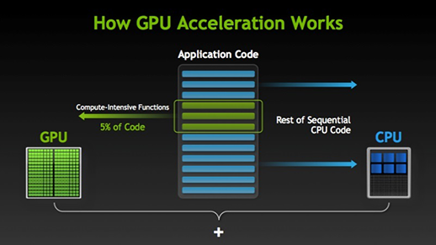
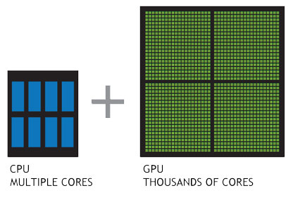
GPU and High Performance Computing
GPU-accelerated computing is the use of a graphics processing unit (GPU) together with a CPU to accelerate scientific, analytics, engineering, consumer, and enterprise applications. Pioneered in 2007 by NVIDIA®.
References:
https://developer.nvidia.com

Slide 7
GPU and High Performance Computing (2)
Kepler GK110/210 GPU Computing Architecture
Comprising 7.1 billion transistors, the Kepler GK110/210 architecture incorporates many new innovative features focused on compute performance
Designed to be a parallel processing powerhouses for Tesla® and the HPC market
Both Kepler GK110 and 210 provide over 1 TFlop of double precision throughput with greater than 80% DGEMM efficiency versus 60-65% on the prior Fermi architecture.
References:
http://images.nvidia.com/content/pdf/tesla/NVIDIA-Kepler-GK110-GK210-Architecture-Whitepaper.pdf
http://dame.dsf.unina.it/documents/TESI_GAROFALO_FINALE.pdf

Slide 8
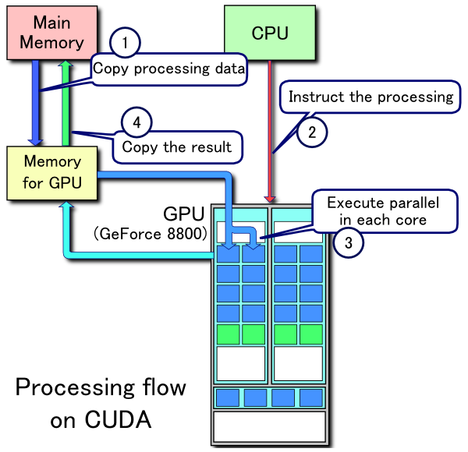
GPU-based software frameworks - CUDA
CUDA is a parallel computing platform and programming model invented by NVIDIA, hence it is vendor specific. It allows software developers to use a CUDA-enabled graphics processing unit (GPU) for general purpose processing – an approach known as GPGPU
CUDA platform is a software layer that gives direct access to the GPU's virtual instruction set and parallel computational elements, for the execution of compute kernels
Designed to work with programming languages such as C, C++ and Fortran.
References:
https://en.wikipedia.org/wiki/General-purpose_computing_on_graphics_processing
https://developer.nvidia.com/cuda-zone
https://en.wikipedia.org/wiki/CUDA_units

Slide 9
GPU-based software frameworks - OpenCL
Open Computing Language (OpenCL) is a framework for writing programs that execute across heterogeneous platforms consisting of central processing units (CPUs), graphics processing units (GPUs), digital signal processors (DSPs), field-programmable gate arrays (FPGAs) and other processors or hardware accelerators
OpenCL specifies a programming language (based on C99) for programming these devices and application programming interfaces (APIs) to control the platform and execute programs on the compute devices
OpenCL provides a standard interface for parallel computing using task-based and data-based parallelism.
OpenCL is an open standard maintained by the non-profit technology consortium Khronos Group
References:
https://en.wikipedia.org/wiki/OpenCL
https://developer.nvidia.com/opencl

Slide 10
Parallelization by multi-threading- OpenMP
OpenMP (Open Multi-Processing) is an application programming interface (API) that supports multi-platform shared memory multiprocessing programming in C, C++, and Fortran,[3] on most platforms, processor architectures and operating systems, including Solaris, AIX, HP-UX, Linux, OS X, and Windows. It consists of a set of compiler directives, library routines, and environment variables that influence run-time behavior
OpenMP is managed by the nonprofit technology consortium OpenMP Architecture Review Board (or OpenMP ARB), jointly defined by a group of major computer hardware and software vendors, including AMD, IBM, Intel, Cray, HP, Fujitsu, Nvidia, NEC, Red Hat, Texas Instruments, Oracle Corporation, and more
OpenMP uses a portable, scalable model that gives programmers a simple and flexible interface for developing parallel applications for platforms ranging from the standard desktop computer to the supercomputer
An application built with the hybrid model of parallel programming can run on a computer cluster using both OpenMP and Message Passing Interface (MPI), or more transparently through the use of OpenMP extensions for non-shared memory systems
OpenMP is an implementation of multithreading, a method of parallelizing whereby a master thread (a series of instructions executed consecutively) forks a specified number of slave threads and the system divides a task among them. The threads then run concurrently, with the runtime environment allocating threads to different processors
Reference:
https://en.wikipedia.org/wiki/OpenMP

Slide 11
GPU based software languages and libraries
C++, (library: GPUMlib)
R, (packages: OpenCL, RViennaCL, rpud, gpuR, gpuRcuda, gmatrix, gputools)
Python, (library: PyCuda)
Java, (library: JCuda)
References:
http://gpumlib.sourceforge.net/
http://www.parallelr.com/
http://devblogs.nvidia.com/parallelforall/accelerate-r-applications-cuda/
https://cran.r-project.org/web/views/HighPerformanceComputing.html
https://developer.nvidia.com/how-to-cuda-python
http://www.jcuda.org/

Slide 12
FPGA-based architectures
http://www.embedded-vision.com/platinum-members/auvizsystems/embedded-vision-training/documents/pages/fpgasneuralnetworks
https://etd.ohiolink.edu/!etd.send_file?accession=dayton1449417091&disposition=inline
http://arxiv.org/pdf/1602.04283.pdf
http://www.doc.ic.ac.uk/~oskar/pubs/fpt05.pdf
http://arsenalfc.stanford.edu/papers/fccm10_dbn.pdf

Slide 13
High Performance Computing (HPC)
Just-in-time compiling
Multi-core
Multi-threading
Software frameworks (CUDA, OpenCL, OpenMP)
GPU based architectures
FPGA based architectures
Custom hardware architectures (TPU, Nvidia Tesla P100)
Clouds (Microsoft, Amazon, Google), HPC as-a-service
References:
https://www.hpcwire.com/2015/12/07/intels-next-generation-of-high-performance-computing-architecture/
http://www.shodor.org/media/content/petascale/materials/UPModules/beginnersGuideHPC/moduleDocument_pdf.pdf
http://www.nvidia.com/object/tesla-p100.html
https://azure.microsoft.com/en-us/documentation/scenarios/high-performance-computing/
https://aws.amazon.com/it/hpc/
https://cloud.google.com/solutions/architecture/highperformancecomputing

Slide 14
Teraproc: R Analytics cluster and GPU as-a-service
A complete R environment
No infrastructure required
Cost effective by leveraging AWS Spot Instances
Cloud-friendly auto-scaling
General-purpose GPU support for R model acceleration
BatchJobs enhancements to mix distributed Rmpi and serial jobs
Multi-user clusters
References:
http://www.teraproc.com/front-page-posts/r-on-demand/
http://devblogs.nvidia.com/parallelforall/gpu-accelerated-r-cloud-teraproc-cluster-service/

Slide 15
Machine Learning and Wearable Devices
http://www.wareable.com/wearable-tech/machine-learning-wearable-data-sensors-2015
http://www.wired.com/insights/2014/12/wearing-your-intelligence/
http://insidebigdata.com/2014/06/13/big-data-opportunity-wearables/
http://focusmotion.io/
https://www.atlaswearables.com/
http://dms.ife.ee.ethz.ch/index.php/attachments/single/687
http://www.algorithms.io/
http://www.mdpi.com/1424-8220/14/6/10691/pdf
https://www.youtube.com/watch?v=u5oTz1e5qqE
http://www.marketing-farmaceutico.com/mobile-pharma/2015/wearable-device-big-data/

Slide 16
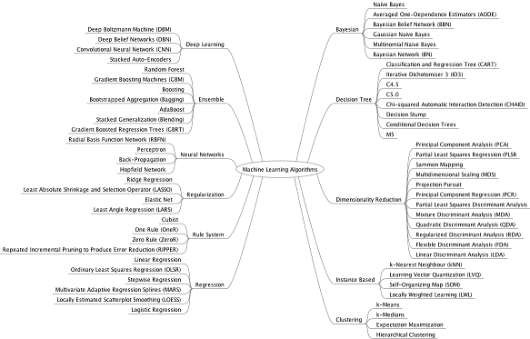
Machine Learning Eco-system
http://www.datasciencecentral.com/profiles/blogs/a-tour-of-machine-learning-algorithms-1

Slide 17
Machine Learning Eco-system (2)
As shown in the previous slide, the machine learning eco-system is remarkably large and diversified
The diagram shown in previous slide is anyway incomplete, as it is missing of Time Series Analysis and Survival Analysis for example
Generally speaking, the data analysis workflow encompasses also complex data collection, data clean-up and data storage technique algorithms, frameworks and infrastructures

Slide 18
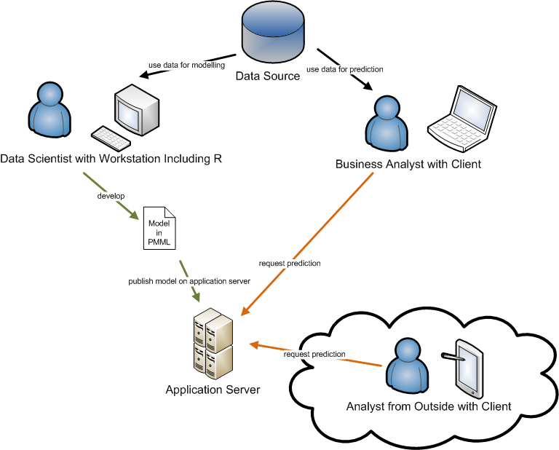
Machine Learning Model Generation and Scoring
The separation of model generation and scoring allows for diversified requirements on the
platforms where such two operations (model generation and scoring) run
On the other hand, if complex models need to be (re)-generated on
embedded hardware platforms (such as wearable devices), specific
optimizations have to be implemented, as previously outlined
If a specific wearable/embedded device can take advantage of
any cloud based infrastructure to offload any processing/storage
depends on:
network connectivity availability,
network bandwith requirements
overall system reliability requirements
risks factors as a consequence of the network connectivity unavailability
(ex. self-driving cars, http://www.nvidia.com/object/drive-px.html)

