Slide 1
Whole Tissue Analysis Pipeline
03/04/19
Carmen Li

Slide 2
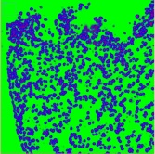

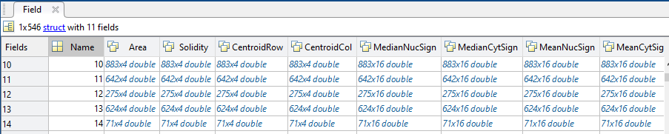
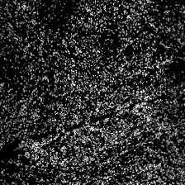
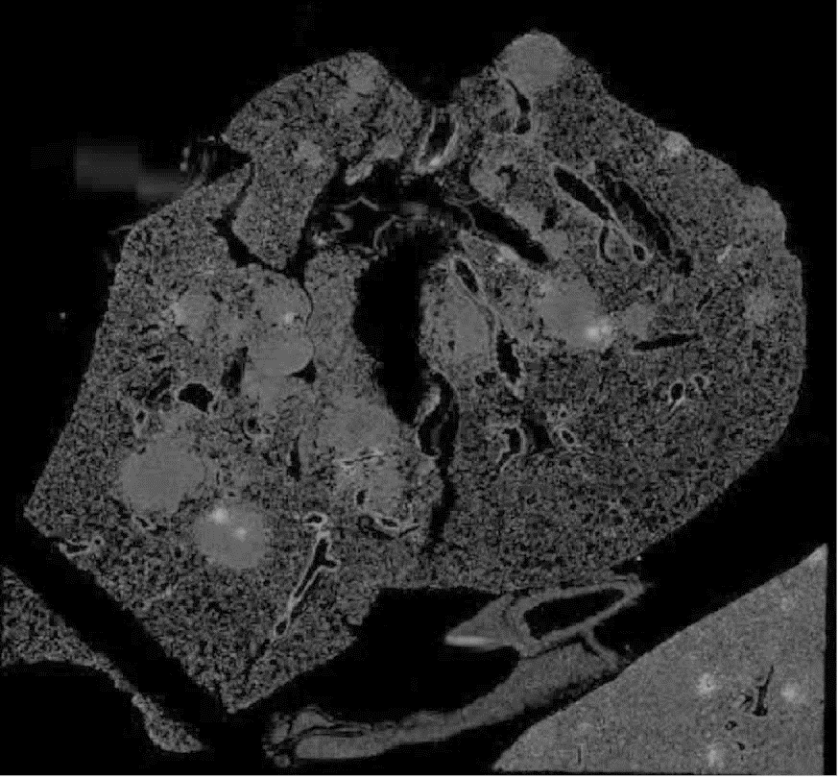
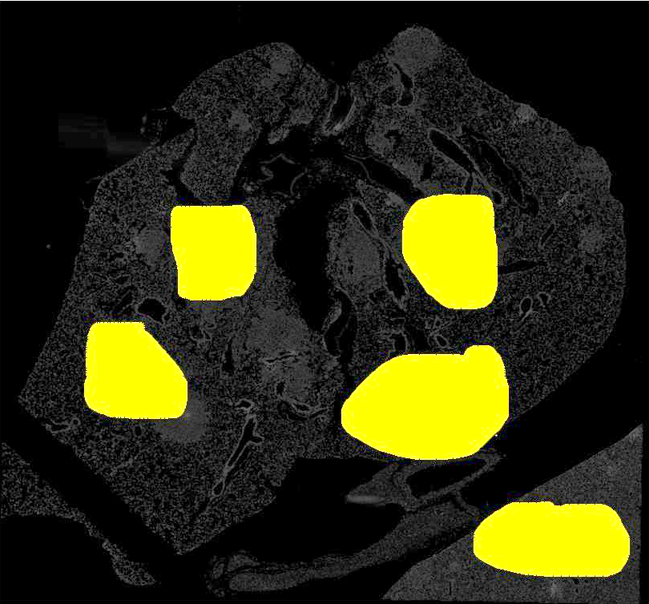
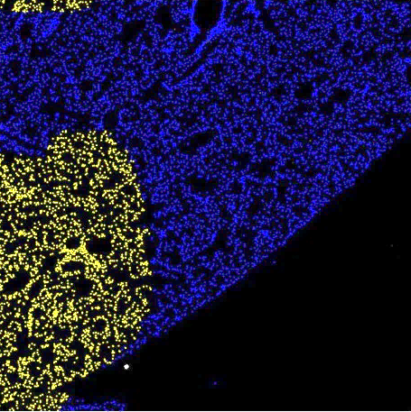

Analysis Pipeline
Ilastik
Segmentation
Measurements
Raw Images
BaSiC Correction
ASHLAR
Full Stacks
ROI
Filtering by ROI
Raw Images: Images taken by the Incell on a field by field and channel by channel basis.
BaSic Correction: Background and shading correction
ASHLAR: Stitches and registers each field into a whole image.
Full Stacks: Cuts the stitched and registered image into fields of a size specified by user and creates a stack of all cycle images. Cuts smaller images in each field for training Ilastik. Saves a small montage of DAPI first cycle for ROIs.
Ilastik: User trains Ilastik using a subset of the data. Ilastik produces segmentation probabilities.
Segmentation: Segments the nuclei based on the segmentation probabilities produced by Ilastik.
Measurements: Various measurements are taken for each antibody signal.
ROI: User draws ROI on montage in ImageJ
Filtering by ROI: Gets indexes of cells within the ROI. Measurement data can be filtered based on ROI.
Github repository: https://github.com/giorgiogaglia/CycIF-Pipelines/tree/master/WholeTissueAshlaredPipeline
Notes:
Include changing channel script
Change cut ashlar image to make sense
Add in colore image of ilastik
Change take measurement image to data table

Slide 3
Codes:
Basic Correction and ASHLAR (run_ashlar_batch_csv_incell.py; Command Line): Background and shading correction and stitching and registering each field into a whole image
Script to run Step 3, 5 and 6 (RUN_All.m; MATLAB): Script to run all the MATLAB scripts
Preprocessing before Ilastik:
Full Stacks and Cropped Stacks (RUN_Step1_new_fields_preilastik_crops.m; MATLAB ): Cuts fields to a size specified by the user and cuts out smaller cropped images in each field for training in Ilastik. Saves a small montage of the DAPI of the first cycle for ROIs.
Processing stacks for Ilastik (changetifffromZtoXhannel_nocrops.ijm; ImageJ): Changes properties of the stack from Z to channels. Required for Ilastik.
Ilastik (GUI or headless on O2): User trains Ilastik using cropped stacks. Ilastik produces segmentation probabilities.
Segmentation(RUN_Step3_segmentfromilastik.m; MATLAB): Segments the nuclei based on segmentation probabilities produced by Ilastik
Measurements (RUN_Step4_CycIF_measurements_ilastik.m; MATLAB): Takes various measurements for each antibody signal.
ROI (RUN_Step5_ROI.m; MATLAB): User draws ROIs on ImageJ. Indexes of each pixel in the ROI are found. Indexes of centroils in the ROI are also found.

Slide 4
How to run ASHLAR
Requirements:
“run_ashlar_batch_csv_incell.py” file created by YuAn
https://gist.github.com/Yu-AnChen/f9030c9d6425cb293846a729d1b224ed
CSV file:
First column: Directory (location of folder that holds all the raw data for the slide)
Second column: Correction (y/n; Basic Correction)
Third column: Pyramid (y/n)
Open command prompt:
D: (directory that the script is in)
cd D:\path\ (folder that the script is in)
Command line: python run_ashlar_batch_csv_incell.py Nameofcsv.csv

Slide 5
RUN_ALL.m
What it does:
Runs step 1,3 and 4 after ASHLAR: Fullstacks, Segmentation and measuring
User input:
Location of ASHLARed image
Name of ome.tif w/o “ome.tif” ending
Size of field desired (field will be a square)
Number of crops desired
Number of cycles
Location of folder that contains Ilastik probabilities and Full stacks
Channels corresponding to Ilastik probabilities
Foci segmentation parameters

Slide 6
RUN_Step1_new_fields_preilastik_crops.m
What it does:
Cuts ASHLARed image into fields of the size specified by user
Creates stack of all channels for fields that contain cells
Cuts cropped images of 250X250 pixels from the field, for Ilastik training
Creates stack of all channels for the cropped image
Inputs:
Location of ASHLARed image
Name of ome.tif w/o “ome.tif” ending
Size of field desired (field will be a square)
Number of crops desired
Number of cycles
Outputs:
NameofOmetif_Field_row_column.tif: stack of all channels
Coordinates_Fullstacks\NameofOmetif.mat:
Matrix of [if field is kept(1/0), x0,x1,y0,y1]
NameofOmetif_Field_row_column_crop#.tif: stack of all channels for cropped image
NameofOmetif_montage.tif

Slide 7
changetifffromZtoXhannel_nocrops.ijm
What it does:
Changes the slices from Z to X for Ilastik processing
User Input:
Number of channels
Location of full stacks and cropped images
Output:
Full stack and cropped image tiff with Z changed to X

Slide 8
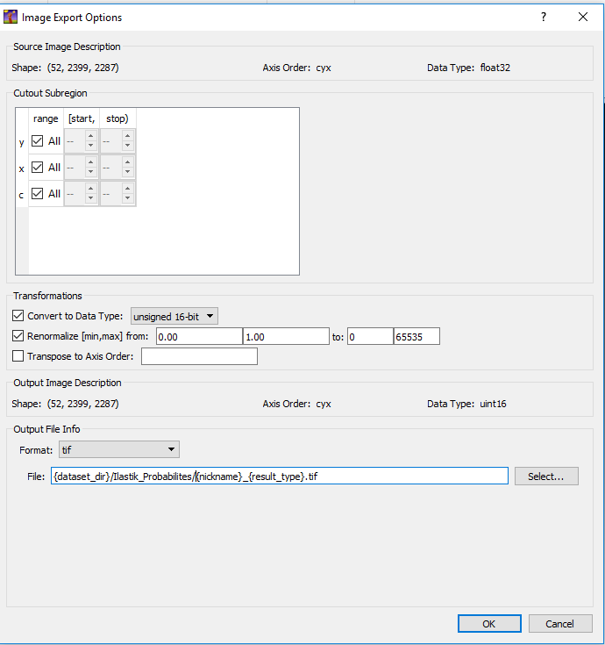
Ilastik
Create project
Input cropped images for training
Train using three qualifications: nucleus, cytoplasm, background
Input fields
IMPORTANT: Export settings should be:
Export Source: Probabilities
Cover to Data Type: unsigned 16-bit
Renormalize [min,max] from: 0.0-1 .0 to 0:65535
Filename_format: {dataset_dir}/Ilastik_Probabilities/{nickname}_Probabilities.tif
File_format: tiff
Use batch processing to create segmentation probabilities

Slide 9
RUN_Step3_segmentfromilastik.m
What it does:
Takes in Ilastik probabilities and produces segmentation
User input:
Ilastik probabilities
FullStacks
Output:
Segmented image
Check segmented image

Slide 10
RUN_Step4_CycIF_measurements_ilastik.m
What it does:
Takes measurements of the signal of the antibody
User Input:
Segmented Image
FullStacks
Output:
NameofOmeTif_Results_date.mat: matrix of measurements
Nucleus and cytoplasm segmented image
Foci segmented image

Slide 11
RUN_Step5_ROI.m
What it does:
Finds the pixels in the ROI area
User Input:
ROI drawn on ImageJ
Montage that ROI was drawn on (Created in RUN_Step1…)
Coordinates of each field
Output:
ROI_pixels.mat: matrix of pixel locations (x,y) of ROIs, vector of row indexes of Centroids that are within the ROI

Slide 12
Other Scripts
Might be useful, might not be useful. All on Github

Slide 13
RUN_Step6_PlottingResults.m
Example of how you would use indexes to filter measurements in mat file created in RUN_Step4

Slide 14
renamefiles_v2.m
Renames multiple files
In Other Scripts folder of Github

Slide 15
Ilastik on O2

Slide 16
Need to Download and Install
Filezilla: to upload to O2
https://filezilla-project.org/download.php
Mobaxterm: to access O2 on Windows
https://mobaxterm.mobatek.net/download.html

Slide 17
Installing Linux version of O2
mfk8@login02:~$ srun --pty -p interactive -t 0-12:00 /bin/bash (Interactive node)
mfk8@compute-a-01-01:~$ wget http://files.ilastik.org/ilastik-1.3.2rc2-Linux.tar.bz2
mfk8@compute-a-01-01:~$ tar –vxjf ilastik-1.3.2rc2-Linux.tar.bz2
IMPORTANT: Make sure you are downloading the version you need
http://files.ilastik.org/

Slide 18
Example script to run 1 Field
IMPORTANT: Must have training set of data in same folder format for Ilastik to work
SH Script:
#!/bin/bash
#SBATCH -p short (Type of Partition)
#SBATCH -t 0-03:00 (Time requested)
#SBATCH --mem=100G (Memory Requested)
#SBATCH -o %j.out (Out file naming: JobID..out)
./ilastik-1.3.2rc2-Linux/run_ilastik.sh \ (Calling Ilastik)
--headless \ (Non GUI mode)
--project=/n/scratch2/cl401/MouseLung/2019-01-03_MouseLungTumors_training_headless.ilp \ (Project)
--export_source="Probabilities“ \ (Export type)
--export_dtype=uint16 \ (Data type)
--pipeline_result_drange="(0.0,1.0)" \ (Import data range)
--export_drange="(0,65535)" \ (Export Data range)
--output_format=tif \ (Output file type)
--output_filename_format={dataset_dir}/Ilastik_Probabilities/{nickname}_Probabilities.tif \ (output filename format: location)
/n/scratch2/cl401/MouseLung/AJ0176_P2_Field_02_01.tif (File to be run through ilastik)
Notes:
\ : new line
#: comment

Slide 19
How to create a script
vim scriptname.sh
Type i for insert mode
Start typing
When finished, press ESC key
To save, type :wq, then press Enter key
To run the script: sbatch Scriptname.sh

Slide 20
How to check on the job you are running:
squeue -u UserName (Shows Job id and information)
watch squeue –u UserName (updates the squeue every 2 seconds)
sacct (Shows list of jobs you are running/ have run for the day)
tail –f JobID.out (Shows last ten lines of “out” file)
less JobID.out (shows entire “out” file)
O2sacct JobID (returns information about the job after completion)

Slide 21
Example script to run Ilastik on multiple files
To create script: vim NameofScript.sh
To save and exit out of writing script: Shift + Z + Z
for f in {Folder w/ all files}/*.tif; do
cmd="./ilastik-1.3.2-Linux/run_ilastik.sh \
--headless \
--project=./ilastik-1.3.2-Linux/2019-01-03_MouseLungTumors_training_headless.ilp \ (Project)
--export_source=Probabilities \ (Export type)
--export_dtype=uint16 \ (Data type)
--pipeline_result_drange=‘(0.0,1.0)’
--export_drange=‘(0, 65535)’ \ (Data range)
--output_format=tif \ (Output file type)
--output_filename_format={dataset_dir}/Ilastik_Probabilities/{nickname}_Probabilities.tif\ (Output file format: location)
$f“ (File that is run in Ilastik)
sbatch -p short -t 0-01:00 --mem=100G -o %j.out --wrap="$cmd"
done

Slide 22
Completed ilastik 1 field (6000X6000 pixels)
Time = 01:3:03
Memory used = 72.01G
35756800.ba+ COMPLETED compute-e-16-245 2019-03-05T15:37:10 01:03:30 01:03:30 01:02:46 cpu=1,mem=100G,node=1 72.01G

Slide 23
O2 Tips and tricks
CTRL + L (clear screen)
CTRL + A (jumps to beginning of line)
rsync –a (command to upload data; -a: uploads metadata)
/n/scratch2/= 10TB size
Home= 100GB size

Slide 24
Helpful Links
https://wiki.rc.hms.harvard.edu/display/O2/Local+Software+Installs
https://www.ilastik.org/documentation/basics/headless

Slide 25
Old slides + extra stuff

Slide 26
Headless on windows
.\run-ilastik.bat --headless --project=Z:\sorger\data\IN_Cell_Analyzer_6000\Giorgio\2019-01-03_Mouse_Lung_Tumors_Round2\Analysis\2019-01-03_MouseLungTumors_training.ilp --export_source="Probabilities" --export_dtype=uint16 --pipeline_result_drange="(0.0,1.0)" --export_drange="(0,65535)" --output_format=tif --output_filename_format={dataset_dir}/Ilastik_Probabilities/{nickname}_Probabilities.tif Z:\sorger\data\IN_Cell_Analyzer_6000\Carmen\O2test\Field_01_03_17.tif

Slide 27
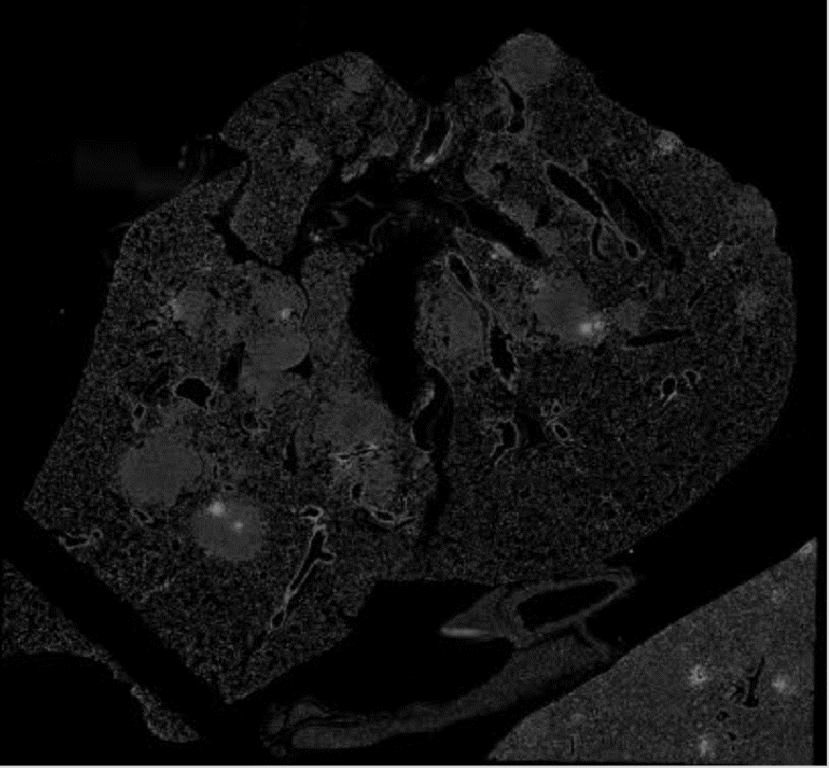

Analysis Pipeline
Raw Images
BaSiC Correction
Segmentation probabilities by Ilastik
Segments based on Ilastik Probabilties
Takes Measurements
ASHLAR
Cut ASHLAR image into fields of a size specified by user and into stack of all channels
run_ashlar_batch_csv_incell.py
Ilastik
Run 3
Run 4
Run 1
Github repository: https://github.com/giorgiogaglia/CycIF-Pipelines/tree/master/WholeTissueAshlaredPipeline
Notes:
Include changing channel script
Change cut ashlar image to make sense
Add in colore image of ilastik
Change take measurement image to data table

Slide 28
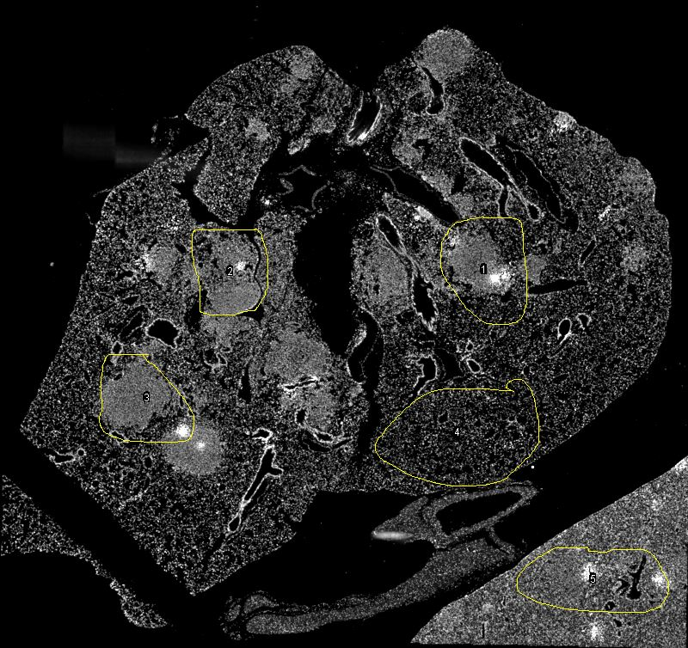
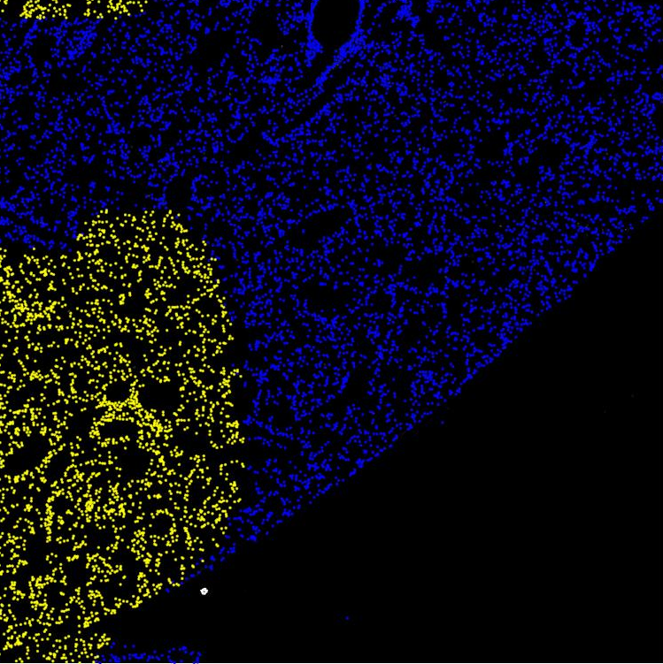
Analysis Pipeline
Raw Images
BaSiC Correction
Ilastik
Segmentation
Measurements
ASHLAR
Full Stacks
Raw Images: Images taken by the Incell on a field by field and channel by channel basis.
BaSic Correction: Background and shading correction
ASHLAR: Stitches and registers each field into a whole image.
Full Stacks: Cuts the stitched and registered image into fields of a size specified by user and creates a stack of all cycle images. Cuts smaller images in each field for training Ilastik. Saves a small montage of DAPI first cycle for ROIs.
Ilastik: User trains Ilastik using a subset of the data. Ilastik produces segmentation probabilities.
Segmentation: Segments the nuclei based on the segmentation probabilities produced by Ilastik.
Measurements: Various measurements are taken for each antibody signal.
Github repository: https://github.com/giorgiogaglia/CycIF-Pipelines/tree/master/WholeTissueAshlaredPipeline
Notes:
Include changing channel script
Change cut ashlar image to make sense
Add in colore image of ilastik
Change take measurement image to data table

