Slide 1


AI-based PV Detection from Electricity Consumption Profiles
NEURAL WAVE HACKATHON 2026 · AIL CHALLENGE
81.8
validation points
(baseline 54.6)
From one 15-minute grid-consumption curve, and nothing else: is there a PV plant, when was it switched on, and how big is it?
Figure 1
inference.py pipeline: test CSV → tolerant reader → daily UTC bands → Task 1 → Task 2 → Task 3 → extensions → 2 CSV files
Insert picture from the report
Team AI-uto!: Giorgio Ripani · Leonardo Lodolini · Andrea Gallo · Flavio Davide Borriello · Francesco Tassi
Notes:
AIL asked how much we can learn about a PV plant from the grid-consumption curve alone: 15-minute readings, no weather, no location. Three questions per customer: is there PV, when was it switched on, how many kWp. Our whole solution rests on one effect: once panels are on the roof, the customer takes less from the grid around noon, and more so on sunny days. Pipeline (Figure 1): a tolerant reader, daily figures in fixed UTC hours, then one simple model per task. Result: 81.8 points in leave-one-customer-out validation, against 54.6 for a trivial baseline.

Slide 2
Task 1 · Is there PV?
A solar dip comes and goes with the clouds; a lunch break does not
1
Last 2 years only
Better performance compared to using the whole 4 year set, so old habit changes stay out
detect.py · features_from_daily (simplified)
d = d[d["date"] > end - pd.Timedelta(days=730)]
dip = log_ratio(d["midday"],
(d["morning"] + d["afternoon"]) / 2)
dip_s = dip[summer].dropna()
f["dip_spread"] = (dip_s.quantile(0.9)
- dip_s.quantile(0.1))
f["rec_drop"] = (dip[prev].median()
- dip[rec].median())
# rule saved in artifacts/detect_params.json
pv = dip_spread > 0.85 or rec_drop > 0.12
2
dip_spread > 0.85
Spread (q90 − q10) of the summer midday dip vs morning and afternoon
3
rec_drop > 0.12
Second look for recent plants: last 90 days vs the same days a year earlier
20 / 22
0
0.952
PV plants found
false alarms among 18 without PV
F1, leave-one-customer-out
Notes:
Panels lower midday consumption only when the sun is out, so with PV the midday dip changes from day to day with the clouds; a dip caused by habits is the same every day. dip_spread measures exactly that over summer days. Customers the first rule rejects get a second look with rec_drop, which catches plants installed in the last months. Both features use only the last two years, like the training windows. We tried a dozen features plus 22 variants, trees, logistic regression and pseudo-labels: none beat this two-step rule. 20 of 22 plants found, no false alarm.

Slide 3
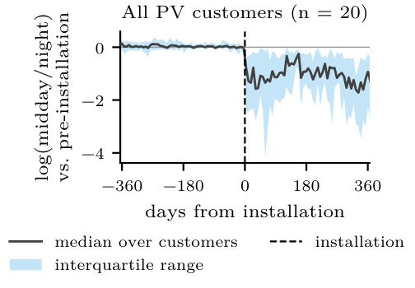
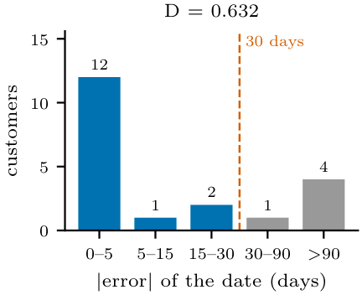
Task 2 · When was it switched on?
The installation is a lasting step in the midday-to-night ratio
y_{t} = a + b·sin(ωt) + c·cos(ωt) + s·𝟙[t ≥ τ] + ε_{t}
y_{t} = log(midday / night) · ω = 2π / 365.25 · step s at day τ
date.py · _step_regression
Figure 2a: Midday-to-night ratio of the 20 PV customers, aligned on the installation day
for k in range(MIN_SEGMENT_DAYS, n - MIN_SEGMENT_DAYS + 1):
post = (np.arange(n) >= k).astype(float)
s = sse(np.column_stack([base, post]))
if s < best_sse:
best_k, best_sse = k, s
if (sse0 - best_sse) / sse0 < MIN_SSE_GAIN: # 5 %
return first # PV already there at the start
Median error 1 day · 13 of 20 within a week · D = 0.632
No parameter trained on labels
Figure 2c: Absolute date error: 12 within 5 days, 5 beyond 30 days
Notes:
Once panels are installed, midday consumption drops for good compared with the night, which never sees the sun. So we fit the daily log midday/night ratio with a constant, a yearly sine and cosine for the seasons, and one step. We try every candidate day and keep the one with the smallest squared error. If no step reduces the error by at least 5%, the panels were already there and we return the first day. Nothing is trained on labels. Median error: 1 day; 13 of 20 dates within a week; 5 are more than 30 days off.

Slide 4
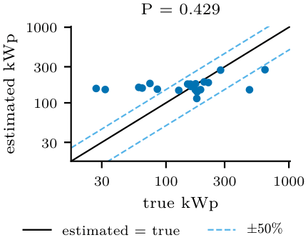
Task 3 · How many kWp?
Capacity from the midday power that goes missing after installation
1
2
3
Before
r = midday / night
usual ratio, no PV yet
Summer, after
deficit =
r·night − midday
kW the panels cover
kWp
linear(mean deficit Δ)
then √(kWp × 169.5)
capacity_common.py · capacity_blend.py (simplified)
def deficit(days, ratio):
return ratio * days["night_kw"] - days["mid_kw"]
def combine(base_kwp, median, mode):
if mode == "geo":
return math.sqrt(base_kwp * median)
Figure 2b: Estimated vs true capacity for the 20 detected PV customers (dashed lines: ±50%)
P = 0.429 · median error 22% · 9 of 20 within 20% · the median alone gives 0.415
Notes:
We never see what the panels produce, only what the customer takes from the grid. Before installation we learn the customer's usual midday-to-night ratio. After installation, that ratio times each summer night predicts midday demand without PV; the gap to the real withdrawal is the power the panels cover. A linear regression turns the average gap into kWp, and a geometric mean with the median plant (169.5 kWp) limits large errors on unusual customers. Capacity is our weakest task: P 0.429 against 0.415 for the median alone.
Mention extra task??

Slide 5
Challenges
What made it hard, and how we handled it
1
2
inference.py · main (simplified)
try:
df, all_ids = read_test(path)
rows = predict_all(df, used, all_ids)
ext_rows = predict_extensions_all(
df, rows, used)
except Exception as e:
# safety net: predictions.csv
# is written in any case
rows = fallback_rows(ids) # all TRUE
ext_rows = []
write_outputs(rows, ext_rows)
Big, dirty data
7.9 GB file: DuckDB capped at 4 GB, sorted per customer. Non-POD ids removed, negative kWh → 0, gaps kept as NaN.
Midday saturation
The meter stops at zero, so large plants look smaller than they are: capacity stays hard.
3
4
1,147 unlabelled customers
34% flagged as PV. Otsu cut at 1.08 vs our 0.85: about 7% false alarms possible. Pseudo-labels: not one decision changed.
Malformed test rows
One bad timestamp crashed the script. Now a tolerant reader and fallbacks always write one row per customer.
214 tests
automated, on synthetic data only
Notes:
Data: the unlabelled file is 7.9 GB, so we read it with DuckDB with memory capped at 4 GB. Midday saturation: the meter cannot go below zero, so big plants look smaller, which is why capacity stays hard. On the 1,147 unlabelled customers 34% come out as PV; an unsupervised cut lands at 1.08 against our 0.85, so a few false alarms are possible on new customers. Pseudo-labels from three agreeing models changed nothing. Finally robustness: one malformed row used to crash everything; now every module has a fallback and the output always has one row per customer.

Slide 6
Results
Leave-one-customer-out on the 40 labelled customers, full 2022–2025 series
81.82
Official score
F1 × (70 + 15·D + 15·P) · baseline 54.58
0.952
0.632
0.429
F1 · detection
D · date
P · capacity
20 of 22 plants found, 0 false alarms. Dates are the strong part (median error 1 day); capacity the weak part (median error 22%).
2-year windows: robustness check, 77.93 ± 2.42 over 5 rounds
Notes:
Every customer is predicted by models whose thresholds and coefficients were fitted on the other 39. Final score 81.82 with F1 0.952, D 0.632, P 0.429, against 54.58 for the baseline. Moving detection to the last two years took us from 78.49 to 81.82. Cut to 2-year windows, the pipeline still scores 77.93 plus or minus 2.42. Honest caveat: features and methods were chosen looking at all 40 customers, so 81.8 is probably slightly optimistic; one customer is worth about 2 points.

Slide 7
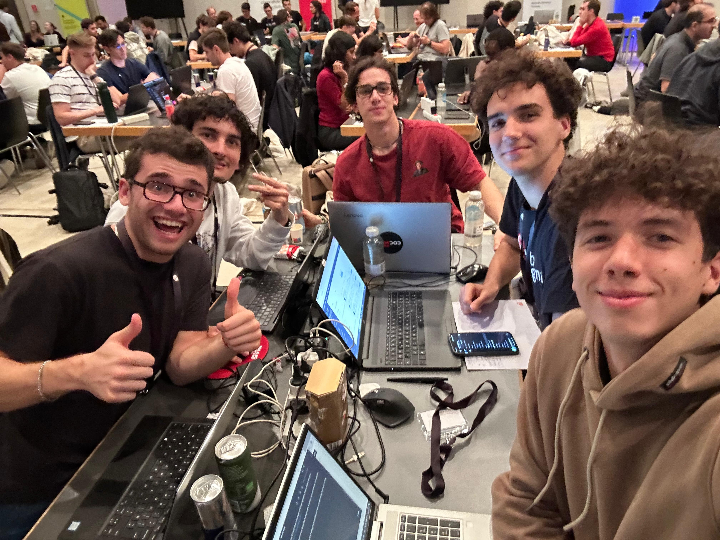
Thank you for your attention!

