Slide 1
Marketing Case - ELVT

Slide 2
Data Set Summary
7414 records x 21 features + 1 target
Variables (custAge, day_of_week, schooling) have missing values
There are 11 numerical and 10 categorical
Dataset has 26 duplicate rows
Variables (pastEmail & previous) have high percentage of Zeros
Data set clean but with imbalanced predictors ex. (schooling have only 1 illiterate record)

Slide 3
Data Set first 4 rows
custAge | profession | marital | schooling | default | housing | loan | contact | month | day_of_week | campaign
55.0 | admin. | single | university.degree | unknown | no | no | cellular | nov | mon | 1
NaN | blue-collar | married | NaN | no | no | no | cellular | jul | mon | 1
42.0 | technician | married | high.school | no | no | no | telephone | may | mon | 1
55.0 | management | divorced | NaN | unknown | yes | yes | cellular | jul | wed | 2
pdays | previous | poutcome | emp.var.rat | cons.price.idx | cons.conf.idx | euribor3m | nr.employed | pmonths | pastEmail | responded
999 | 0 | nonexistent | -0.1 | 93.200 | -42.0 | 4.191 | 5195.8 | 999.0 | 0 | no
999 | 0 | nonexistent | 1.4 | 93.918 | -42.7 | 4.960 | 5228.1 | 999.0 | 0 | no
999 | 0 | nonexistent | 1.1 | 93.994 | -36.4 | 4.857 | 5191.0 | 999.0 | 0 | no
999 | 0 | nonexistent | 1.4 | 93.918 | -42.7 | 4.962 | 5228.1 | 999.0 | 0 | no

Slide 4
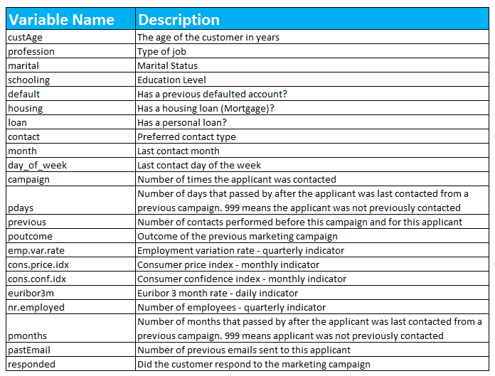
Data dictionary

Slide 6
Future improvements
Collect more data.
Create more features to extract more info.
Parameter tuning to the models.
Create more models and ensemble

