Slide 1
Chansonnier
Web application for multimedia search on song videos
  Giorgio Sironi, A.A. 2009/10

Slide 2
Agenda
Introduction
Case study
Working example
Methodology

Slide 3
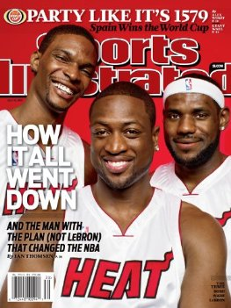
Problem
Multimedia search is an hard problem to solve
Requires analysis of binary audio and video (semantic gap)

Slide 4
Contribution
First-hand experience with a problem from multimedia search
Case study: Chansonnier
  Search application for song videos available online
Features
  Full text search
  Faceted search
  On manual and automatically extracted metadata

Slide 5
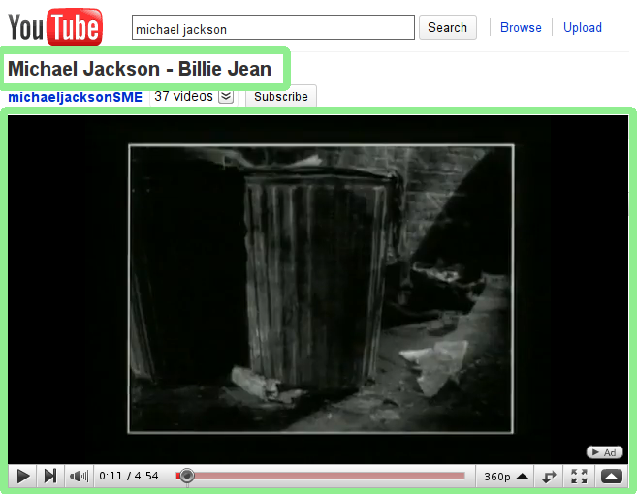
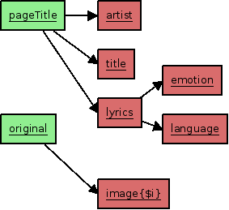
Analysis

Slide 6
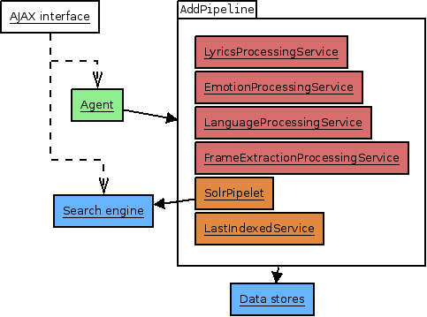

Analysis process

Slide 7
Chansonnier in action
Let's see a video...
  http://github.com/giorgiosironi/Chansonnier/blob/master/chansonnier.subs.avi

Slide 8
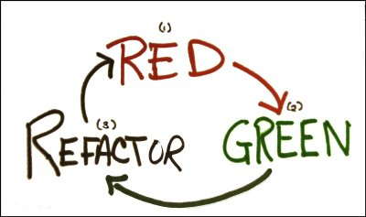
Methodology
Agile development process
Test-Driven Development

Slide 9
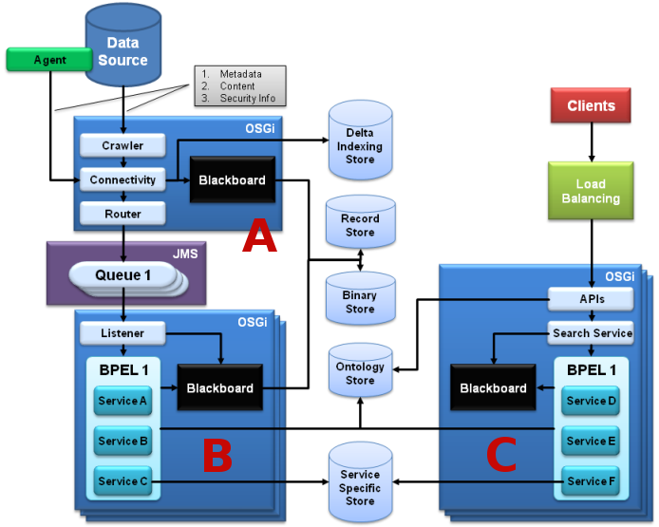
Tools (1/3)
SMILA
  Framework
Solr
  Search engine

Slide 10
Tools (2/3)
LyricWiki
  Song lyrics research
Google Translate
  Language identification
Synesketch
  Emotion recognition
FFmpeg
  Extraction of frames from videos

Slide 11
Tools (3/3)
Test harnesses (JUnit, HttpUnit, Selenium)
Distributed source control (git)
Published to an open source repository
  http://github.com/giorgiosironi/Chansonnier
Build automation (Ant)

Slide 12
Conclusions
Design and development of a running multimedia search application
Adoption of state-of-the-art Agile development methodologies and tools
Future work
  New annotators
  Content-based search
  Cloud distribution

Slide 13
Q/A

Slide 14
Acknowledgements
  TDD image: http://agileinaflash.blogspot.com/2009/02/red-green-refactor.html

