Slide 1

Pursuing
practices of
Domain-Driven
Design
in PHP

Slide 2


Who am I
Giorgio Sironi
Bachelor in Computer Engineering
Advisor @ Allbus
Zone Leader @ DZone

Slide 3
The long title
Pursuing
practices of
Domain-Driven
Design
in PHP

Slide 4
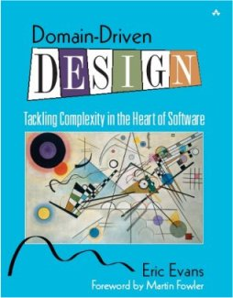
The DDD box of goods
Knowledge crunching
Ubiquitous Language
Domain Model
Refactoring towards deeper insight...
Collaboration patterns (Anti-corruption layer, Separate ways, ...)

Slide 5
Why? (the most important slide)
Close to business, to follow its changes
  aids iterative development
The code is the design
  supported by blackboards and UML
Test and develop with in-memory objects
  no instantiation of Oracle connections
It's also fun!
  exercise creativity and learning skills

Slide 6
Domain Model
Reflects knowledge of the domain more than technology
  While there is value in the item on the right, we value the item on the left more
  Persistence-agnostic (UnitOfWork)
  In general, no outward dependencies

Slide 7
Step 1: from relational...
user
id
username
password
active
group
id
name
logo
user_group
id_user
id_group

Slide 8

Step 1: ...to object-oriented
class User
{
}
class Group
{
}

Slide 9
Step 2: from Active Record...
class Group extends Doctrine_Record
{
}
Hard dependency towards ORM
Inherits pollution from Doctrine_Record

Slide 10
Step 2: … to Data Mapper
/**
* @Entity
*/
class User
{
}

Slide 11
Building blocks
Entity
Value Object
Aggregate
Repository
Factory
Service
Other transient objects (Specification, Parameter Objects, ...)

Slide 12
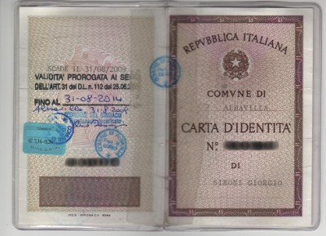
Entity
More than a row
Equality is based on identity
  e.g. Post #42, user 'giorgiosironi', …
The bread and butter of your Domain Model

Slide 13

Value Object
Previously known in the world as value
  e.g. the number 42, Zip code 22031, #FF0000
Equality based on values
Immutable in certain implementations

Slide 14
Aggregate
Subgraph of Entities and Value Objects
  with a single entry: the root
  possible multiple exits, mostly to follow during reading
Unit of consistency: loose correspondency to database transactions
Partitions the state of the application

Slide 15
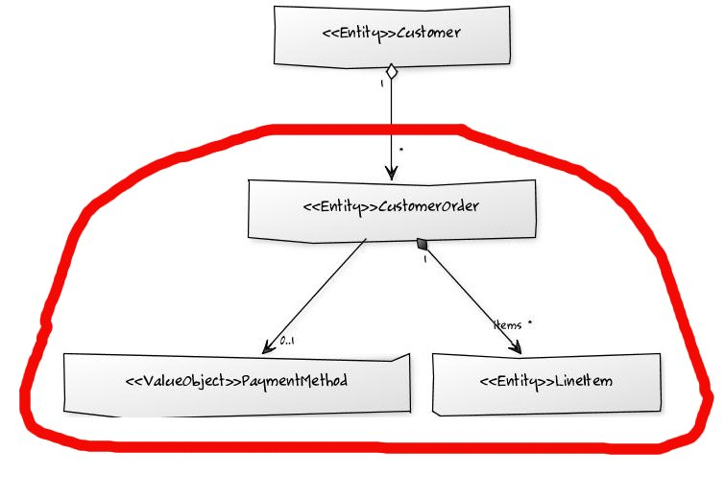
Checkpoint: data modeling

Slide 16
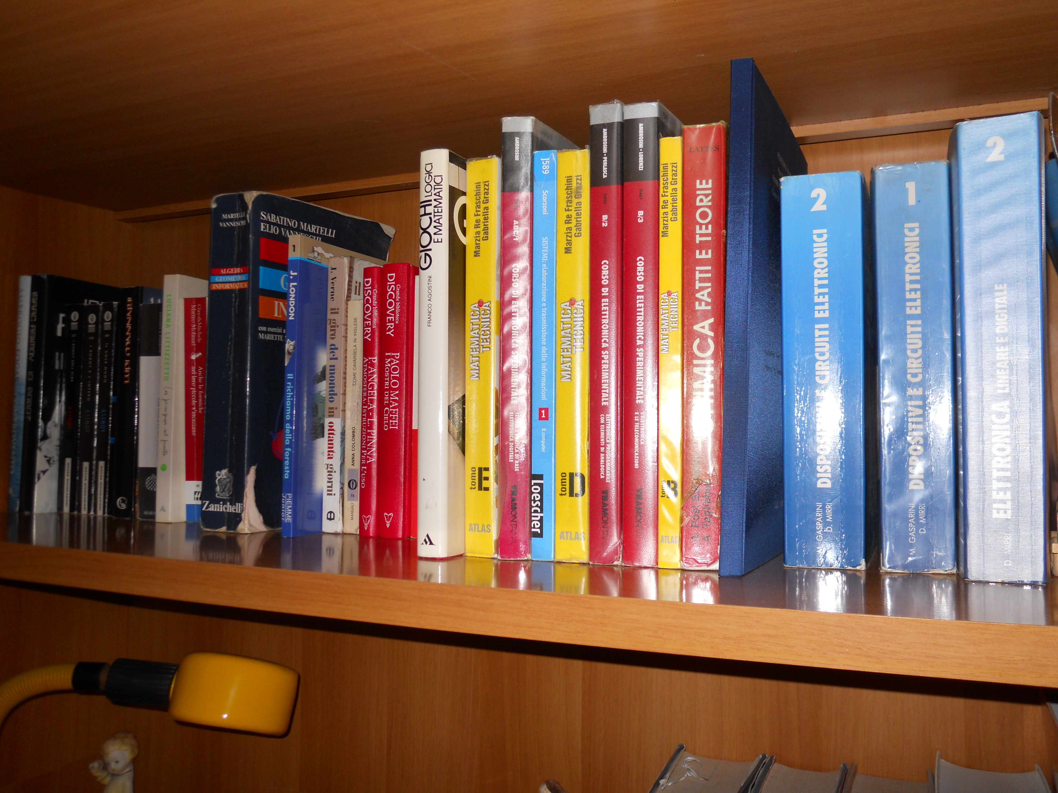
Repository
The gate to the database
  One aggregate at the time
The illusion of an in-memory collection of Entities
  Fowler's definition
  Here's a BookRepository

Slide 17
Factory
Encapsulate creation of complex Aggregates
  a new() is often all you need

Slide 18
Service
At the domain level
To help Entities and Value Objects
  to avoid mutual dependencies
  or field references to strangers
    optimal for isolation from libraries

Slide 19
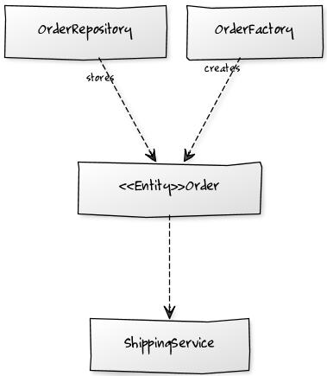
Checkpoint: lifecycle classes

Slide 20
Meanwhile, in PHP...

Slide 21
On frameworks
Only one suggestion: build your Domain Model like if the framework didn't exist

Slide 22
Active Record vs. Data Mapper
Doctrine 2 for persistence (see tutorial by @juokaz)
By default for Doctrine 2 object === row
All the tricks are at http://github.com/giorgiosironi/ddd-talk

Slide 23
Entity
@Entity annotation
  no extends
@Column for fields
  private fields
  types are PHP types: string, not varchar

Slide 24
Value Objects
Do you want an (id, date) table?
  Serialization of the whole object
  Conversion into a custom string/numerical format via a custom DBAL data type
  Deconstruction/reconstruction with lifecycle hooks
  Combined approaches: serialization and mirror fields

Slide 25
Aggregate
Relationships: @OneToMany, @ManyToMany, @OneToOne, …
@OneToMany(..., cascade={“persist”, “remove”})
@OneToMany(..., orphanRemoval=true)
@ManyToMany(targetEntity="Phonenumber") @JoinTable(..., inverseJoinColumns={name=”phonenumber_id", referencedColumnName="id", unique=true)

Slide 26
Repository
Plain Old PHP Object
Composing EntityManager
  It's possible to define EntityManager custom repositories: quick and dirty
Encapsulates queries
Typical methods: add($root), remove($root), find($id), findByStrangeCriteria()
  It's a collection!

Slide 27
Factory, Service
POPO
  Sometimes composing services or infrastructure objects (e.g. generating new progressive number for invoices, calculate current taxes, sending mails...)
Often decoupled with an interface

Slide 28
References
The code shown in this talk
  http://github.com/giorgiosironi/ddd-talk
Four books
  http://domaindrivendesign.org/books
Domain-Driven Design mailing list
  Google that :)

Slide 29
Q/A

Slide 30
Feedback
Testing in isolation tutorial: http://joind.in/3216
DDD talk: http://joind.in/3224

Slide 31
Thanks for your attention

