Slide 1
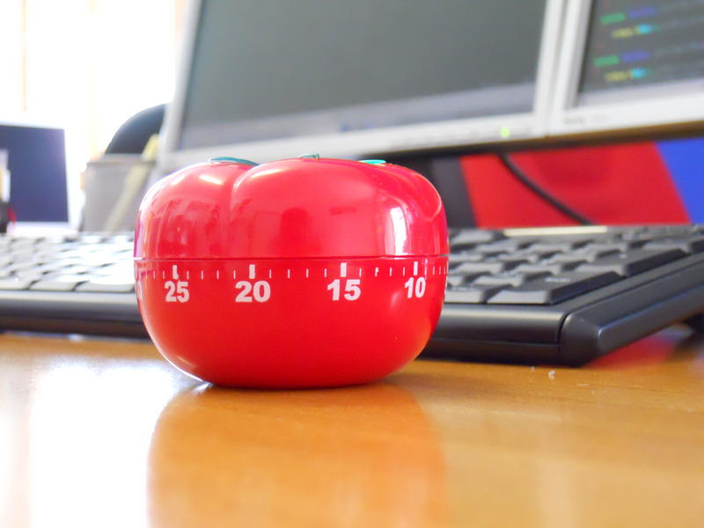
An year of Pomodoros

Slide 2


Who am I
Giorgio Sironi
Bachelor in Computer Engineering
Advisor @ Allbus
Zone Leader @ DZone

Slide 3
Agenda
How it works
2 Whys
3 Faqs
4 Tricks

Slide 4
The Pomodoro Technique
25' of uninterrupted, focused work
Estimate your tasks in Pomodoros
3 to 5 cycles, 5' (short) -15' (long) breaks (image)

Slide 5
Why 1: interruptions
External
Your colleagues
Your boss
Telephone
Internal
How is totally unrelated component going?
I have to buy milk after work
I must check that website later

Slide 6
Why 2: timeboxing
Defines goals
Fight Parkinson's law
Improves motivation
Forces breaks
Risk only a Pomodoro: iterations of 25'
Benchmark interruptions and productivity

Slide 7
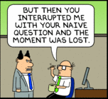
Faq 1
What if I am interrupted by someone?
Generally, the Pomodoro is void
Courtesy of dilbert.com

Slide 8

Faq2
What if I interrupt myself? You'll notice.

Slide 9
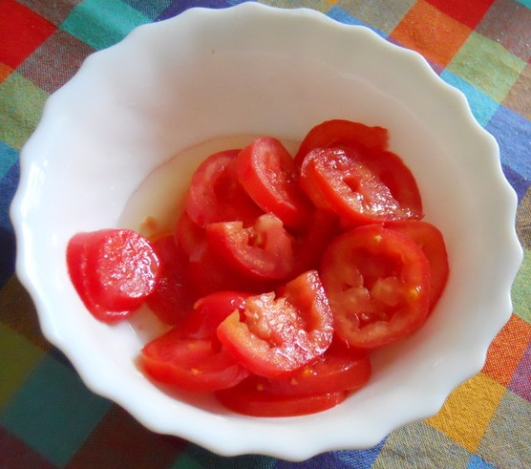
Faq3
What do 0.5 or 3.5 Pomodoros mean?
Nothing: false sense of precision in estimation
  I will arrive at Verona at 09:57:42 AM...

Slide 10
Some tricks
Add new tasks that come up at the end of the list
  (from the original book and worksheet)

Slide 11
Some tricks 2
Rotate a member of the team to shield from interruptions
  (but it's difficult to obtain the same commitment from the whole team)

Slide 12
Some tricks 3
Leave a failing test at the end of Pomodoro
  (but a passing one before pushing)
  In general, TDD at the acceptance and unit level helps maintaining the flow

Slide 13
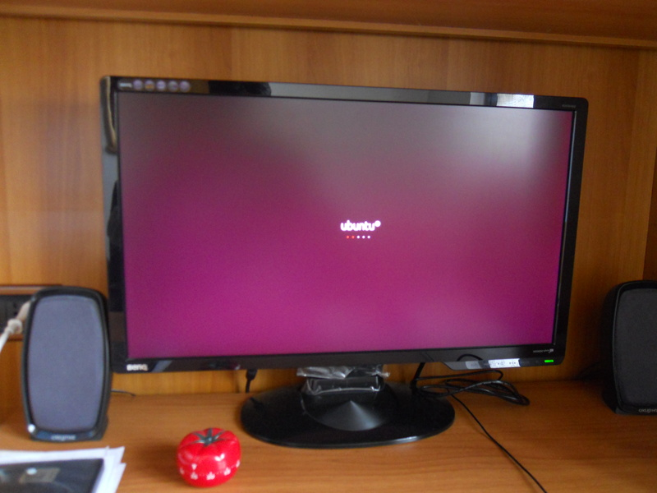
Some tricks 4
Include your setup time in Pomodoros
  (or you won't optimize it)

Slide 14
Resources
Free Pomodoro technique book
  http://www.pomodorotechnique.com/products.html#pomodoropdf
Pomodoro World
  http://www.pomodoroworld.com/experiences.html
Experience it

Slide 15
Thank you for your attention

