Slide 1
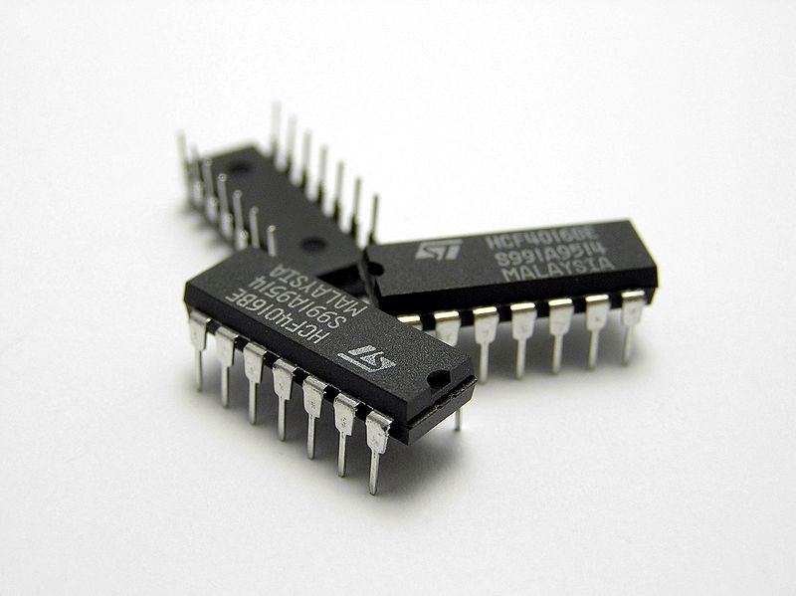
Testing in isolation

Slide 2


Who am I
Giorgio Sironi
Bachelor in Computer Engineering
Advisor @ Allbus
Zone Leader @ DZone

Slide 3
The format
A little bit of theory;
for ($i = 1; $i <= 3; $i++) {
  code in development;
  problem arises;
  refactoring of the code;
}

Slide 4
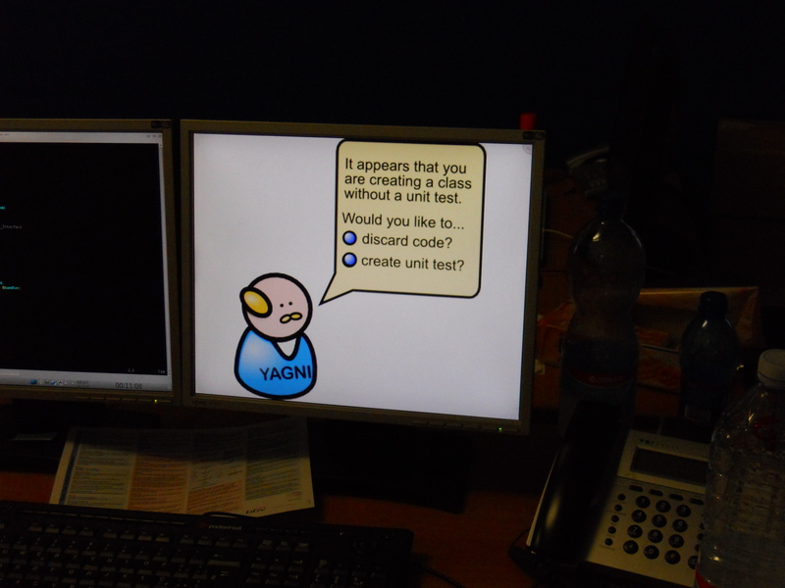
Requirement: TDD

Slide 5
Isolation
Unit tests > functional, end-to-end ones
  simpler tests
  less paths to test
  faster
  localize defects

Slide 6

Test Doubles in one phrase
Dummy
  only passed around
Stub
  returns canned results
Mock
  expects some particular calls
Fake
  implements the collaborator without hassles

Slide 7
Let's begin... I told you there was little theory
Follow at https://github.com/giorgiosironi/testing-in-isolation

Slide 8
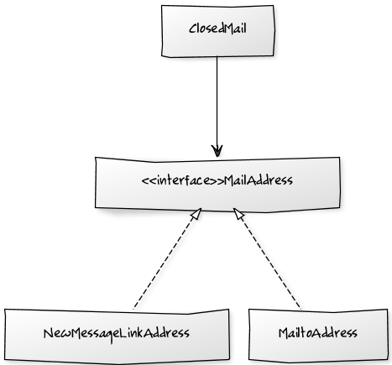
The solution for ClosedMail

Slide 9
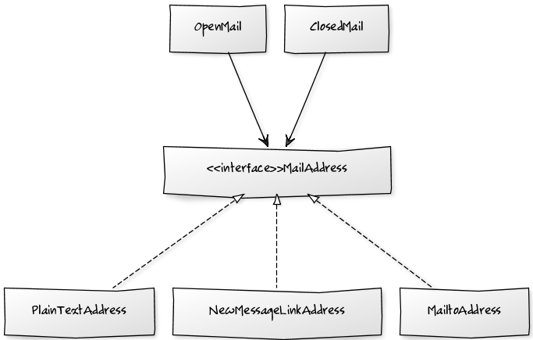
If we extend it...

Slide 10
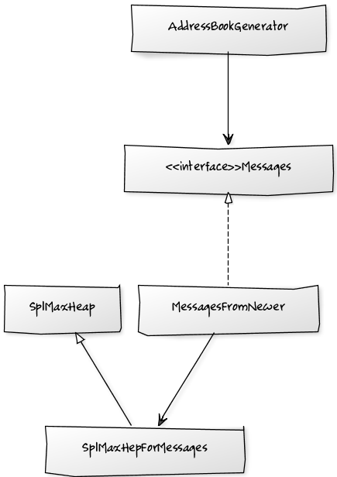
The solution for AddressBookGenerator

Slide 11

The solution for OrderRepository

Slide 12
References
All the code seen today
  http://github.com/giorgiosironi/testing-in-isolation
Integration tests are a scam
  http://www.infoq.com/presentations/integration-tests-scam
Growing object-oriented software, guided by tests
  http://www.growing-object-oriented-software.com/
Pattern of Enterprise Application Architecture by Fowler
  http://martinfowler.com/eaaCatalog/
Hexagonal architecture
  http://alistair.cockburn.us/Hexagonal+architecture

Slide 13
Thanks for your attention

