Slide 1
Some Results
Yash Lal

Slide 2
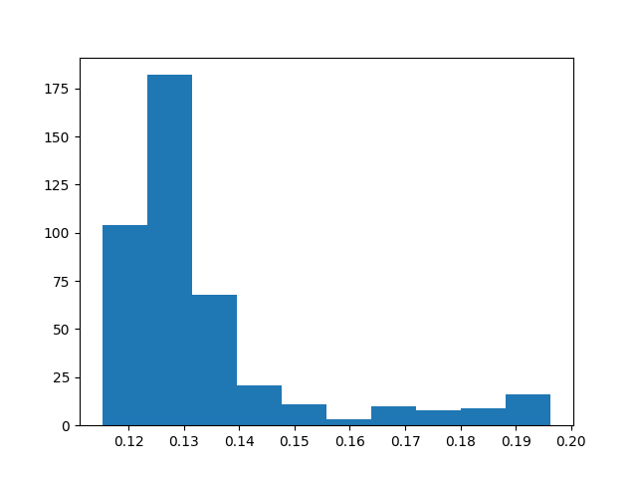
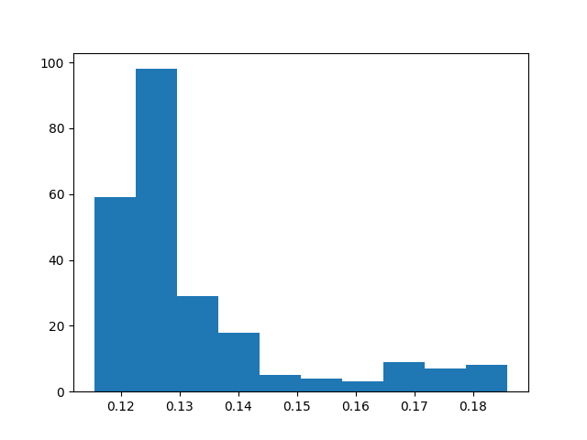
GRU vs LSTM Hist

Slide 3
HP Optimization (grid search)
Best HP (LSTM)
HL Size: 20
N_layers: 1
LR: 0.01
Best Hp (GRU)
HL Size: 10
N_layers: 1
LR: 0.001

Slide 4
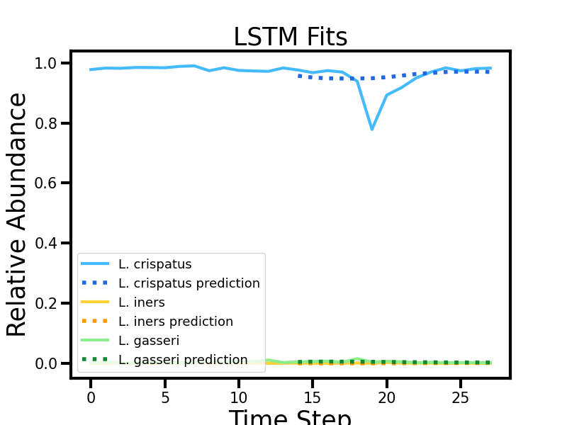
Easy Trajectory

Slide 5
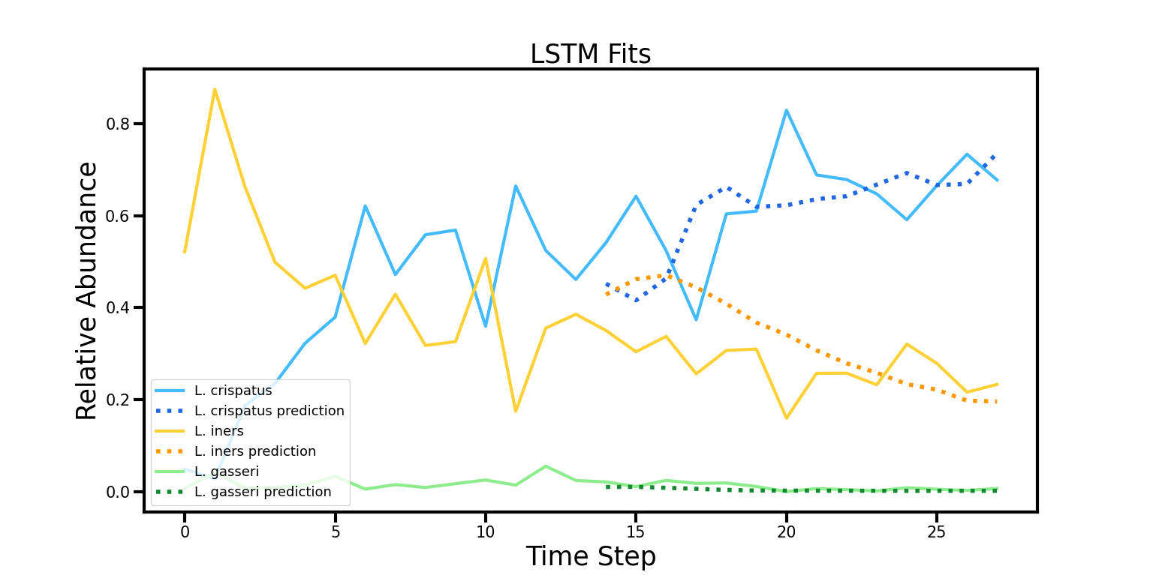
Medium Trajectory

Slide 6
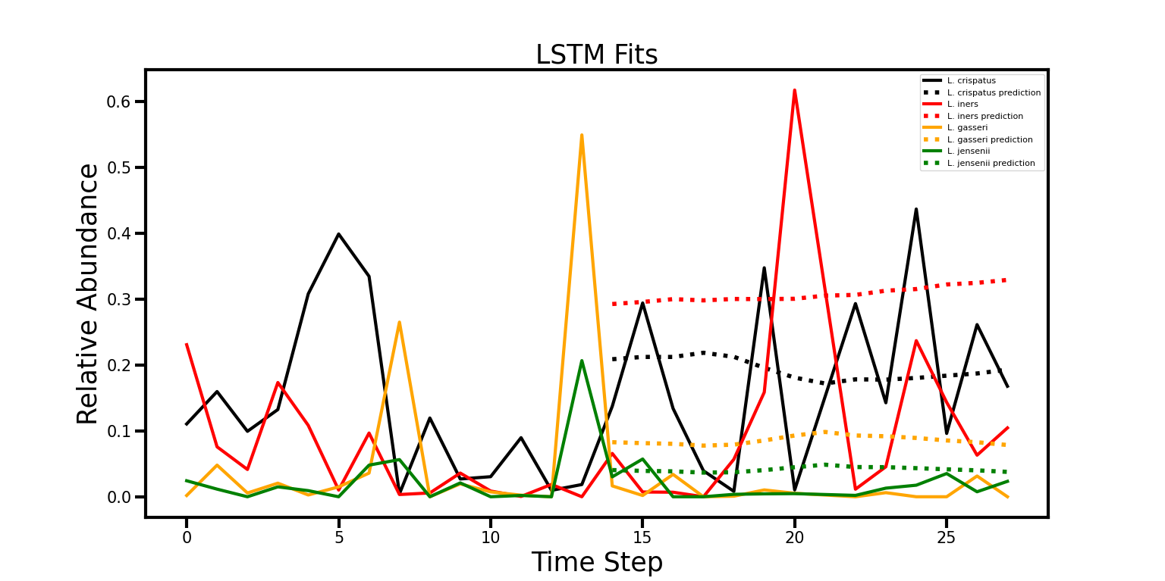
Difficult Trajectory (p1)

Slide 7
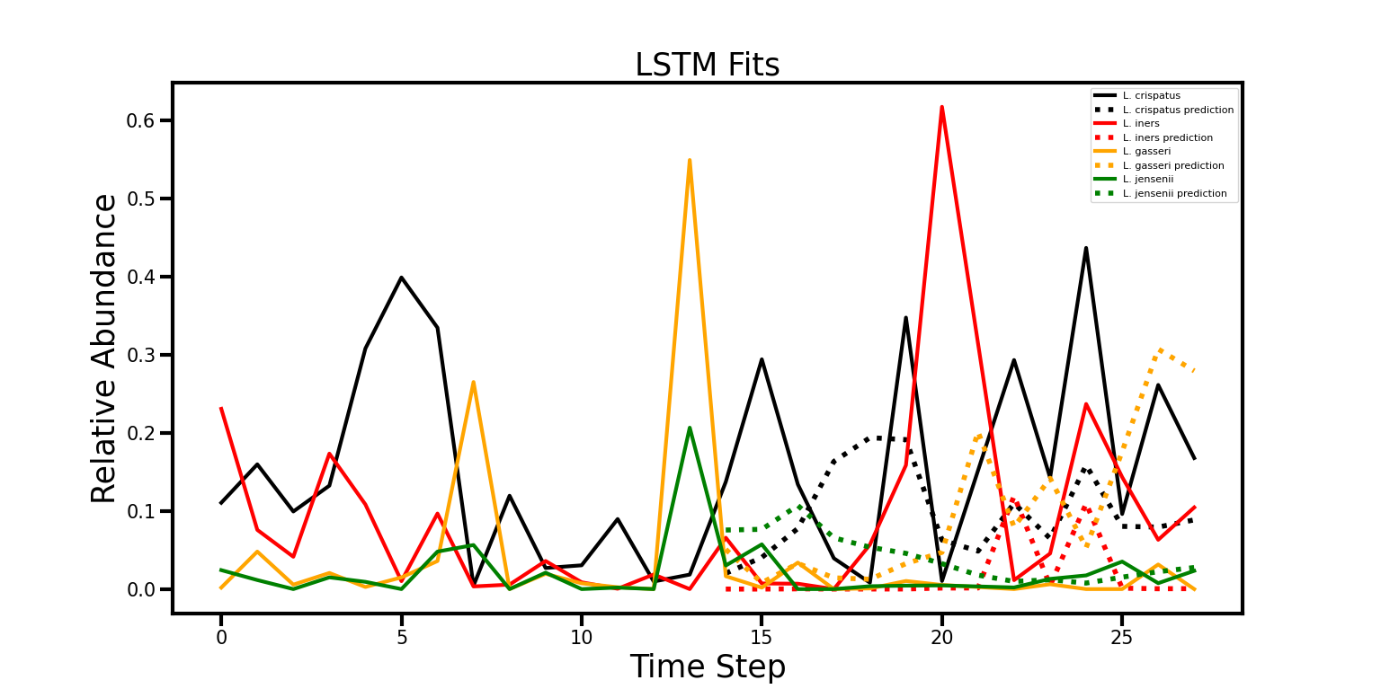
Difficult Trajectory (p2)

Slide 8
Data Augmentation
MSDA Strategy | Ensemble Loss
Normal | 0.118748107
NM+CutMix(custom) | 0.121912762
NM+CutMix(rect) | 0.122646285
NM+Mixup | 0.124753848

Slide 9
Explain MSDA Process

