Slide 1

FAIRIFICATION OF PREMIER LEAGUE DATA
PLAYER STATISTICS FOR 2024-2025 SEASON
Group 9:
Giorgos Oratis & Nefeli Kantouna
Notes:
Good morning everyone. We are Giorgos and Nefeli, and today we will present our project on the FAIRification of Premier League player statistics for the 2024–2025 season.
We will explain how we selected and prepared the data, transformed it into RDF, created metadata, and improved its potential for reuse and interoperability.

Slide 2
Dataset Overview
Name: Premier League Data from 2016 to 2025
Source: Kaggle
Original coverage: Multiple seasons (2016–2025)
Original content: Club performance, club statistics, player profiles, player performance metrics and home/away statistics.
Original format: Multiple CSV files
Selected season: 2024–2025
Selected scope: Player information and performance statistics
Selected Files: Two CSV files
Notes:
Our project is based on a dataset from Kaggle called “Premier League Data from 2016 to 2025.”
The original dataset contains information from multiple seasons, including club statistics, player profiles, and performance metrics. We decided to focus on the 2024–2025 season and specifically on player information and performance statistics.
We selected two CSV files containing complementary information, which we later combined into a single dataset for our FAIRification process.

Slide 3
FAIRification Goals & Planning
1. Data Integration:
Combine two CSV files into one dataset.
2. Semantic Enrichment:
Link relevant attributes to external entities.
3. RDF Transformation:
Convert the dataset into a machine-readable semantic format.
4. Findability:
Provide descriptive metadata and persistent identifiers.
5. Accessibility:
Publish the original and FAIRified resources on GitHub.
6. Metadata Description:
Describe the datasets and how to access them.
Notes:
Before starting, we defined the main goals of our FAIRification process.
First, we wanted to integrate the two CSV files into one dataset. Second, we aimed to enrich the data semantically by linking relevant entities to external resources.
We then planned to transform the data into RDF, create descriptive metadata, assign persistent identifiers, and publish the resources on GitHub.
These steps were intended to improve the findability, accessibility, interoperability, and reusability of our dataset.

Slide 4

Reuse Stakeholders
Football Analysts & Sports Statisticians:
Compare player performance statistics for the 2024/2025 season.
Researchers & University Students:
Use the dataset for research and educational activities.
Football Clubs & Scouting Analysts:
Explore player statistics to support player comparisons.
Data Scientists & Developers:
Integrate the dataset into analytical workflows and combine it with other football datasets.
Notes:
We identified several groups that could benefit from our dataset.
Football analysts and statisticians could use it to compare player performance. Researchers and students could use it for academic projects, while football clubs and scouting analysts could explore player statistics.
Also, data scientists and developers could reuse the structured data in analytical applications or potentially combine it with other football datasets.

Slide 5
Data Selection & Preparation
Selected two CSV files containing player
information and performance statistics from 2024/2025 season
Two original CSV files
1
Player information + performance statistics
(2024/2025 season)
2
Removed columns to focus on 10 relevant properties, following the course recommendation to select a manageable dataset for FAIRification.
Select columns and merge
Remove some columns
Combine the selected data
3
Merged the selected data into one CSV file.
Prepare and reconcile data
4
Clean and prepare the dataset
Use OpenRefine to link entities with Wikidata
Cleaned and prepared the resulting dataset.
5
Used OpenRefine to reconcile relevant
entities with Wikidata.
One prepared CSV file
10 relevant columns for the project
Notes:
We started with two CSV files: one containing player information and another containing performance statistics for the 2024–2025 season.
To keep the project manageable, we selected ten relevant properties, we merged the selected columns into one CSV file and cleaned and prepared the resulting data.
We also used OpenRefine to reconcile relevant entities with Wikidata. This allowed us to connect selected values to external identifiers instead of representing everything only as plain text.

Slide 6
Semantic Data Model
Main Class: Football Player, defined for the project.
External Classes: Country, Sports Club, Football Position and Laterality, reused from external vocabularies.
Reused Properties: Country for sport, Member of, Position played on team, Footedness, name and date of birth.
Project-Specific Properties: goals, assists given, expected Goals (xG) and expected Assists (xA).
Implementation: The ontology was developed in Protégé and visualised using WebVOWL.
Notes:
After preparing the data, we designed our semantic data model.
The main class is Football Player, which we defined specifically for our project. We also reused existing concepts for Country, Sports Club, Football Position, and Laterality from external vocabularies.
Where appropriate, we reused existing properties to describe information such as a player's name, date of birth, nationality, club membership, position, and preferred foot.
For performance statistics, we created project-specific properties for goals, assists, expected goals, and expected assists, using Protégé,. This model defines how the different concepts and properties are represented and related in our RDF dataset.

Slide 7
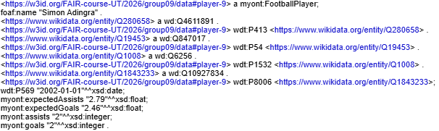
RDF Transformation & Linking
RDF Transformation: Converted the prepared CSV dataset into RDF triples using OpenRefine.
Entity Linking: Reconciled relevant values with Wikidata and linked them to corresponding external entities.
Ontology Reuse: Used existing Wikidata properties and identifiers where appropriate to represent player information.
Custom Properties: Defined project-specific properties for player statistics, including goals, assists, expectedGoals and expectedAssists.
RDF Output: Exported the resulting FAIRified dataset in Turtle (.ttl) format.
Notes:
Next, we transformed the prepared CSV file into RDF using the RDF extension in OpenRefine.
As we know RDF represents data as triples: a subject, a predicate, and an object. For our dataset, the subject of all triples is the Football Player entity.
We used our semantic model and existing vocabulary terms to describe player information. We also linked selected entities to their corresponding Wikidata identifiers.
For statistics we used our own project specific properties.
Finally, we exported the resulting dataset in Turtle format.

Slide 8
Metadata Schemas
Custom SHACL Schemas:
Defined separate schemas for dataset and distribution metadata.
Dataset Schema:
Specifies metadata fields such as title, description, creators, dates, license and coverage.
Distribution Schema:
Defines fields for format, media type, access and download URLs, file size and conformance.
Validation Constraints:
Specifies required and optional fields, expected datatypes and cardinality constraints.
Notes:
Besides the player data, we also needed structured metadata to describe our resources.
We created two custom SHACL schemas: one for dataset metadata and one for distribution metadata.
The dataset schema defines fields such as the title, description, creators, dates, licence, and coverage.
The distribution schema describes details such as the file format, media type, access and download URLs, file size, and conformance.
We also defined validation constraints for required fields, datatypes, and cardinality. These schemas help us check whether our metadata records follow the structure we intended.

Slide 9
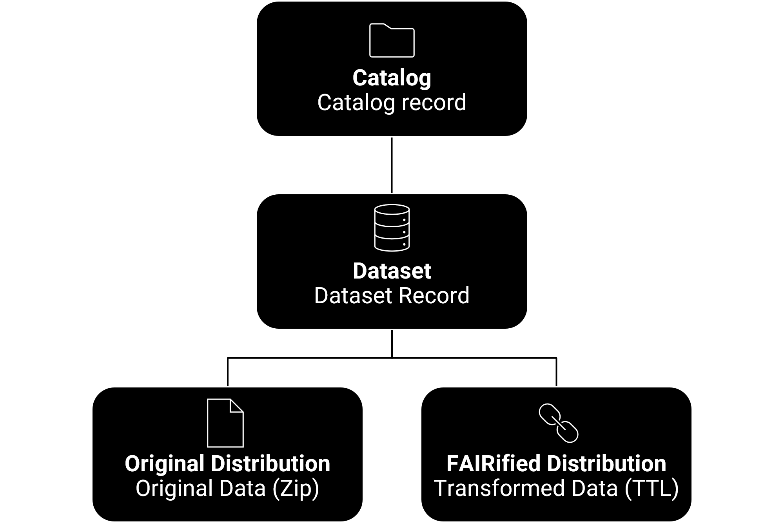
Metadata Records
Catalog Record
Dataset Record
Describes the catalog containing the project dataset
Provides descriptive metadata about the Premier League player statistics dataset.
Distribution Records
Original:
Describes the two original CSV files, packaged together in a single ZIP archive.
FAIRified:
Describes the transformed dataset, provided in RDF/Turtle (.ttl) format.
Notes:
Using our metadata schemas, we created records, through FDP, at three levels: the catalog, the dataset, and its distributions.
The dataset record provides descriptive information about the Premier League player statistics.
We also described two distributions. The original distribution contains the two CSV files packaged together as a ZIP archive. The FAIRified distribution contains the transformed data in RDF/Turtle format.
This structure makes it clearer what the dataset contains and which versions of the data are available for use.

Slide 10

Publication & Persistent Identifiers
Publication:
Published the project resources in a GitHub repository.
Included the original data, FAIRified dataset, ontology and metadata files.
Persistent Identifiers
Assigned W3ID identifiers to the ontology and both data distributions.
Linked the identifiers to the corresponding resources.
Access
https://w3id.org/FAIR-course-UT/2026/group09/ont
https://w3id.org/FAIR-course-UT/2026/group09/data
https://w3id.org/FAIR-course-UT/2026/group09/data-original
Notes:
We published the project resources in a GitHub repository. These resources include the original data, the FAIRified RDF dataset, the ontology, and the metadata files.
We also assigned W3ID identifiers to the ontology and both data distributions, linking those identifiers to the corresponding resources.
Persistent identifiers help other people refer to the resources consistently, while publishing the files and metadata makes them easier to discover and access.
The repository therefore acts as the main location for sharing the outputs of our project.

Slide 11
FAIRness Improvements
FINDABLE
ACCESSIBLE
• Assigned W3ID identifiers to the ontology and data distributions.
• Created descriptive metadata for the catalog, dataset and distributions.
• Published project resources in a GitHub repository.
• Provided original data as a ZIP archive and FAIRified data as RDF/Turtle.
INTEROPERABLE
REUSABLE
• Represented the prepared data as RDF using a project-specific ontology.
• Linked selected entities to external Wikidata identifiers.
• Documented the data preparation and transformation process.
• Included metadata about provenance and licensing, while preserving the original source files.
11
Notes:
We can now summarise our work in terms of the four FAIR principles.
For Findability, we created descriptive metadata and assigned W3ID identifiers to the ontology and data distributions.
For Accessibility, we published the resources on GitHub and provided both the original data and the FAIRified Turtle file.
For Interoperability, we represented the data in RDF, used a project-specific ontology, and linked selected entities to Wikidata.
Finally, for Reusability, we documented the preparation and transformation process and included metadata about provenance and licensing.

Slide 12
Integration Opportunities
Further Data Linking
Enrich player profiles with additional information from external sources.
Connect the dataset with other football-related datasets.
Player Performance Analysis
Compare players using goals, assists, expected goals (xG) and expected assists (xA).
Support statistical analysis of player performance during the 2024/2025 season.
Data Reuse & Integration
Reuse the RDF dataset in data analysis applications.
Combine the dataset with other compatible datasets for broader analysis.
Notes:
Our work also creates opportunities for future use.
The player statistics can support comparisons based on goals, assists, expected goals, and expected assists. Because the data is represented in RDF and selected entities are linked to external entities, it may also be easier to connect the dataset to additional resources in the future.
However, full integration with other football datasets would require further work, including identifying compatible data, establishing the relevant links, and incorporating additional information.
We therefore consider broader data linking and integration as future opportunities.

Slide 13
Challenges, Conclusion & Future Work
Challenges
Entity Linking: Reconciling selected entities with Wikidata using OpenRefine.
Semantic Modelling: Defining a project-specific ontology and creating RDF data.
Conclusion
Transformed Premier League player statistics for the 2024/2025 season into RDF/Turtle.
Linked selected entities to external Wikidata resources.
Created structured metadata for the catalog, dataset and distributions.
Improved the dataset’s potential for findability, interoperability and reuse.
Future Work
Link the dataset with additional football-related datasets.
Extend the dataset with additional seasons and player statistics.
Notes:
During this project, we faced two main challenges.
The first was entity linking: using OpenRefine to reconcile selected values and connect them to external entities.The most difficult part of this process was finding the proper entities to match our data. The second was semantic modelling, which required us to define an ontology and represent our data correctly in RDF.
As future work, we could link the dataset to more football-related resources, include additional seasons, and extend the available player statistics.
Overall, this project showed us how FAIRification involves more than changing a file format: it also requires semantic modelling, metadata, identifiers, and a plan for making data reusable.

Slide 14
THANK YOU!
FAIRification of Premier League Player Statistics
Group 9 · Giorgos Oratis & Nefeli Kantouna
Questions?

