Slide 1

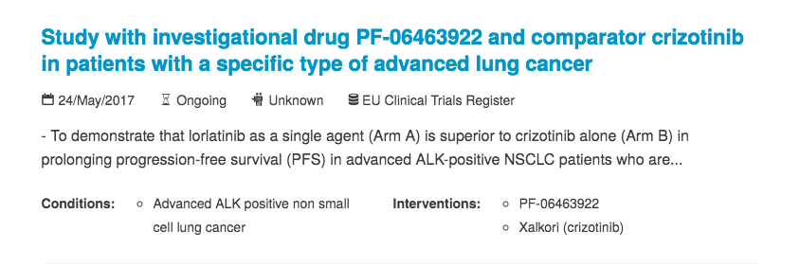
Cancer Clinical Trials
2.1GB SQL dump
350,000 trials
Intervention
Trial
Intervention
Condition
Trial
Notes:
In Academia, I’ve been developing biosensors for cancer diagnostics but the clinical trial work was done by our MD collaborators. So, I decided to look into Open trials, that’s a huge database of clinical trials from which I selected cancer related entries. They look like this one, you have a title, a summary, one or more conditions and interventions. Different trials share condition and intervention forming the network that you see down right. Now, there are a lot of duplicates, small spelling differences, similar sentences, that makes using condition and intervention difficult to use.

Slide 2
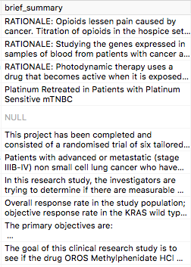
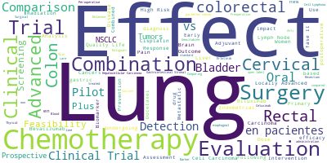
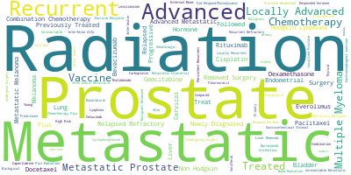
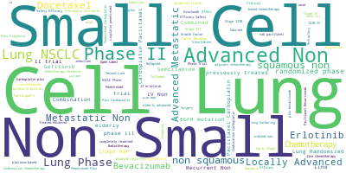
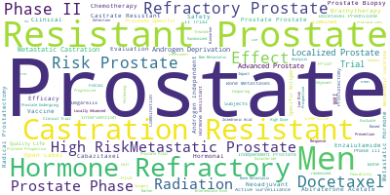
Summary Analysis
24,000 cancer trials entries
TF-IDF vectorizer
Top 1000 words
Kmean
Clustering
15 centers
Notes:
A better approach is to do some Natural language processing work on the summary. From the cancer trials, I vectorized the summaries and used k means clustering to define 15 groups of trials

Slide 3
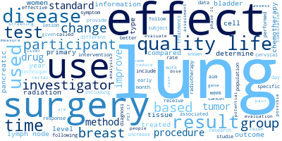
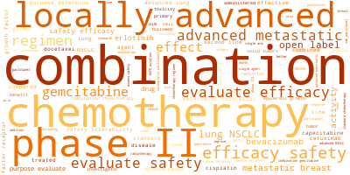
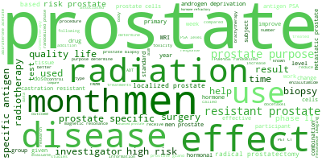
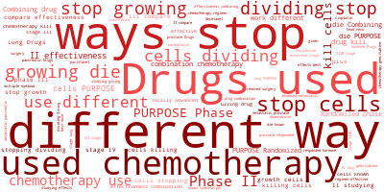
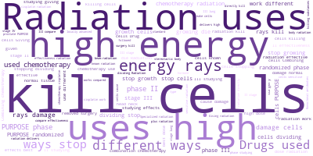
Summary Clusters
Notes:
We can look at the results for the 5 most represented clusters. On the right you see the main terms used in each cluster. In the graph we see how many new trials started each year, belonging to each of these clusters. We can clearly see trends of which topics lose or gain interest, and how some , like prostate cancer (cluster number 3) mantain similar interest

Slide 4
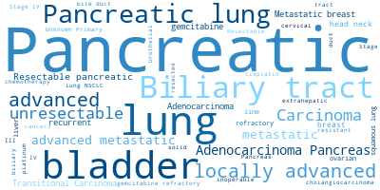
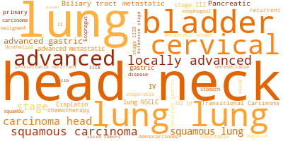
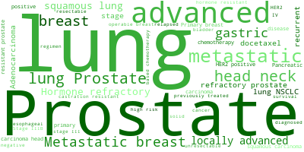
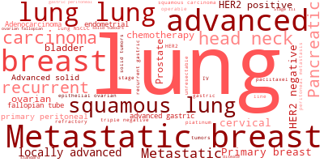
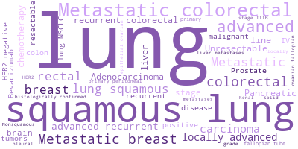
Drug and Condition
Drug list and description: cancerresearchuk.org
Notes:
I then did something similar to analyze condition and drugs associated to them. I prepared a list of cancer drugs and see how often they occur in trials in the different years. Here are the 5 most common, with their corresponding terms from the conditions of the trials. We can also see a trend here, the first 3 drugs, that are chemiotherapy, are well established and loosing momentum. And we can see the last drug, bevacizumab, that is a modern monoclonal antibody, a really targeted drug gaining traction

Slide 5
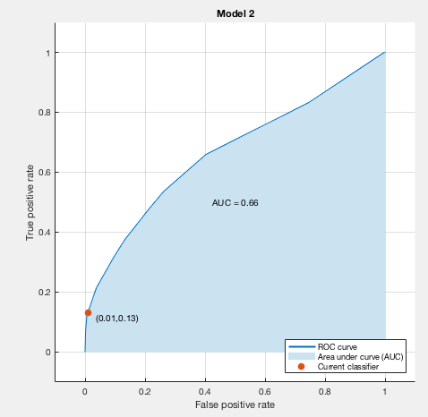
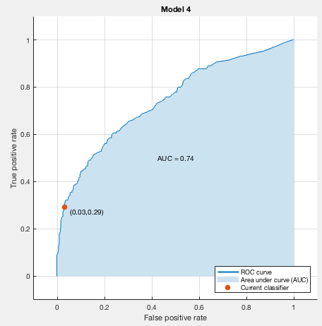
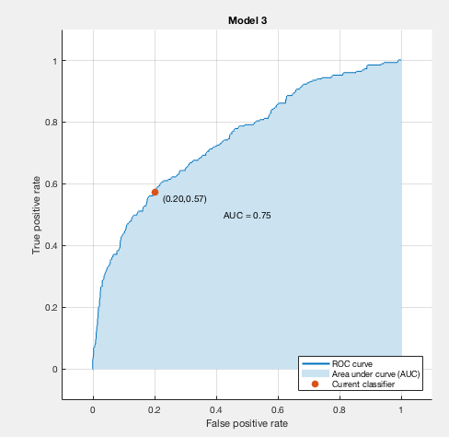
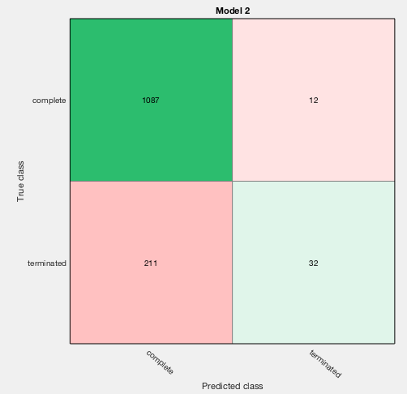
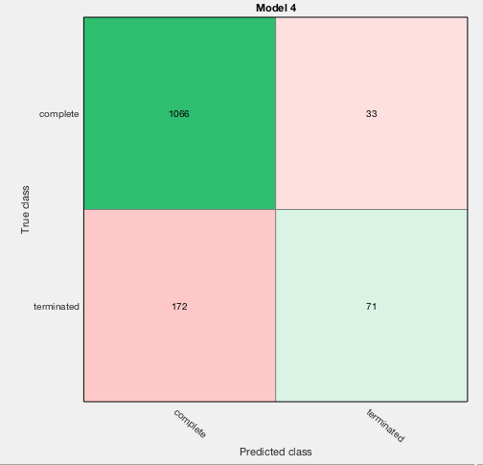
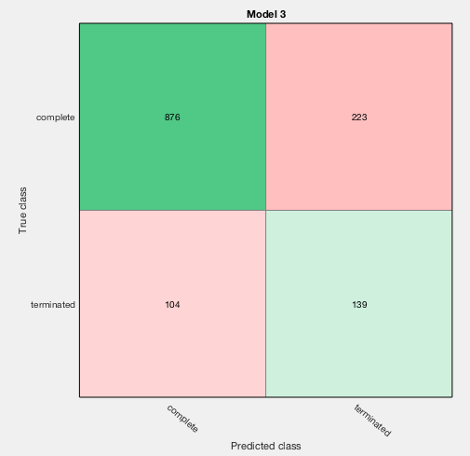
Predicting trial failure
KNN (K=10)
Boosted trees
RUSboosted trees

Slide 6
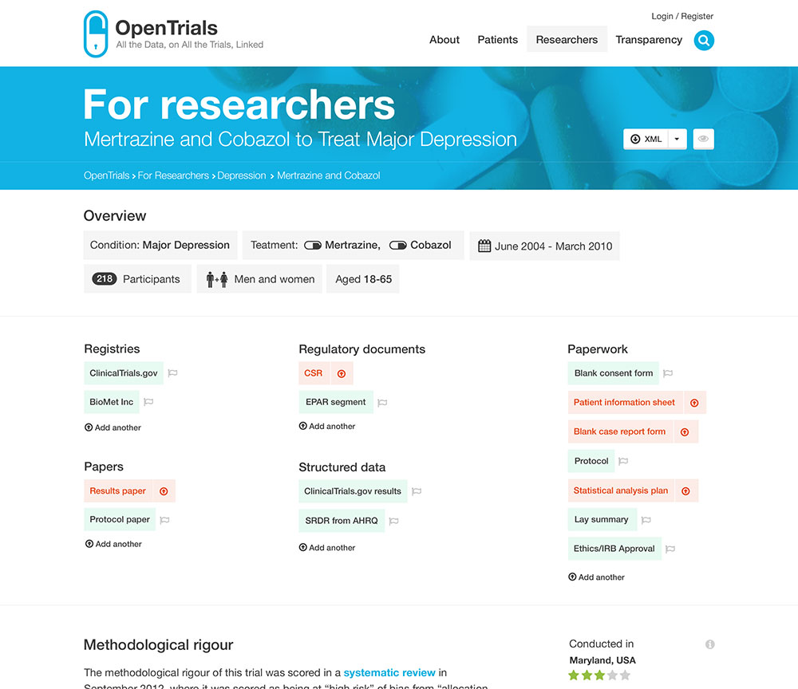

Slide 7
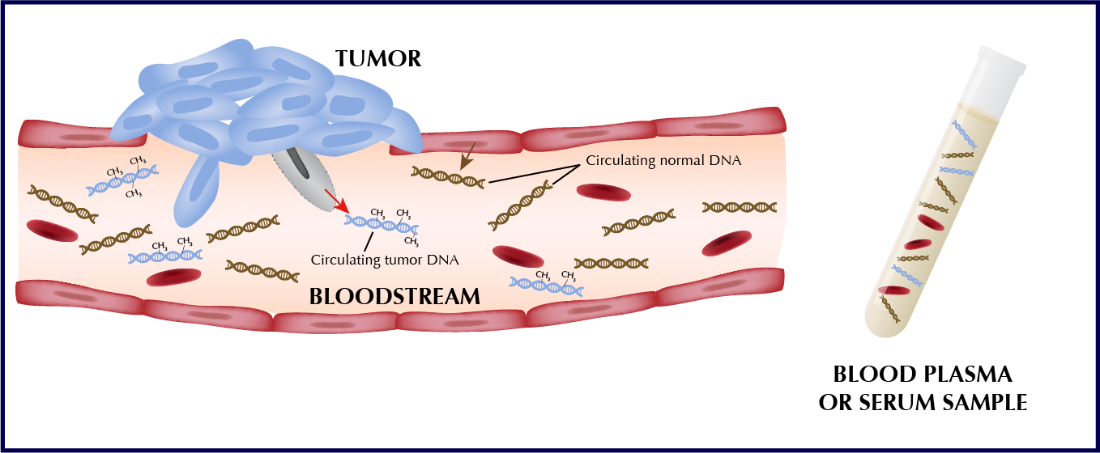
Colorectal Cancer
3rd most common cancer in men and women in US
2nd leading cause of cancer death for men and women combined
5 year relative survival rate at time of diagnosis
90% survival when diagnosed at stage I
11% survival when diagnosed at stage IV (metastatic)
Only 40% of patients are diagnosed at stage I
Enhanced screening efforts (guaiac-based fecal occult blood test – gFOBT – and colonoscopies) have led to decreased overall mortality rates in CRC, but 45% of population is not compliant with current screening guidelines
More user friendly screening platforms are required to enhance patient compliance with screening guidelines
Liquid Biopsies

Slide 8
OpenTrials API

Slide 9
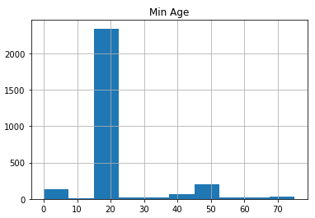
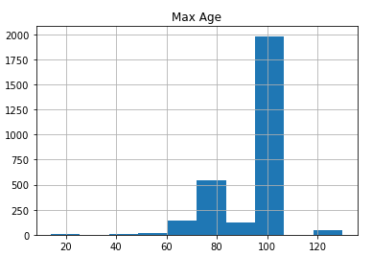
Initial Data Exploration

Slide 10
Title analysis
24,000 trials entries
TF-IDF vectorize
Top 1000 words
Kmean
Clustering
15 centers

Slide 11
Colorectal AND Bevacizumab

