Slide 1





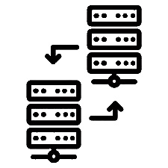










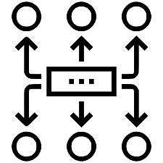
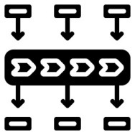





Layers
Presentation &
User models
Identity and Access Management
CMS
Portal
Mobile
Verticals
Purpose Oriented
Infrastructure
Disaster Recovery
Microservices
API Manager
Algorithms
Infrastructure
High Availability
Data Systems
Data
Metadata
Cartography
DWH
Scaling
Ingestion
Security
ESB
Stream Processing
ETL
Sources
Federated
infrastructure
IOT - Sensors
User Data

